Slide 1

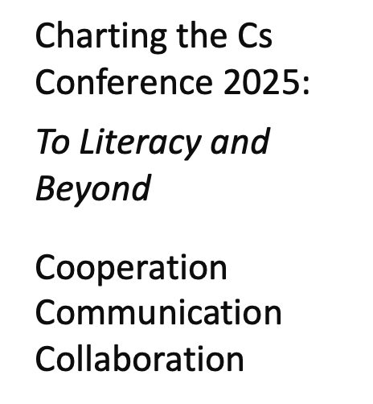
Refusal to Grade Level: My Story of Unlocking a Successful Braille Reader
April 30, 2025
Kim Wilke
Teacher: Blind/Visually Impaired
Saint Paul School District

Slide 2

Hello, There!
“Confidence is the willingness to TRY. It is the willingness to take action, even if it’s not perfect. It’s the secret to everything.”
- Mel Robbins

Slide 3

Flip Flop
Special Education
General Education
Me
Teaching reading skills & strategies through print.
Concepts of print.
Teaching reading skills & strategies through braille.
Concepts of braille.

Slide 4

Warm-Up Print Versus Braille:
“Progression from the basic mechanics of decoding letters to actively using reading to acquire new knowledge and information.”
- American Printing House for the Blind

Slide 5
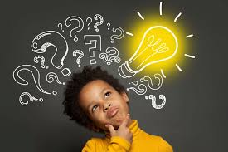
Braille Reading Simulation
Ready, Set…

Slide 6
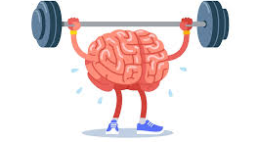
How did you do?
When Jim saw what was under the rock, he gasped.
Reading braille is very different. The memory itself gets a workout!

Slide 7
Reading is complex
…braille readers must rely more on memory to decode and understand words.
-Rex, Koenig, Wormsley, & Baker, 1994

Slide 8

Morphology Matters Word: REREADING
Print
rereading
Braille
r(er)(ea)d(ing)
prefix: re
base word: read
suffix: ing

Slide 9
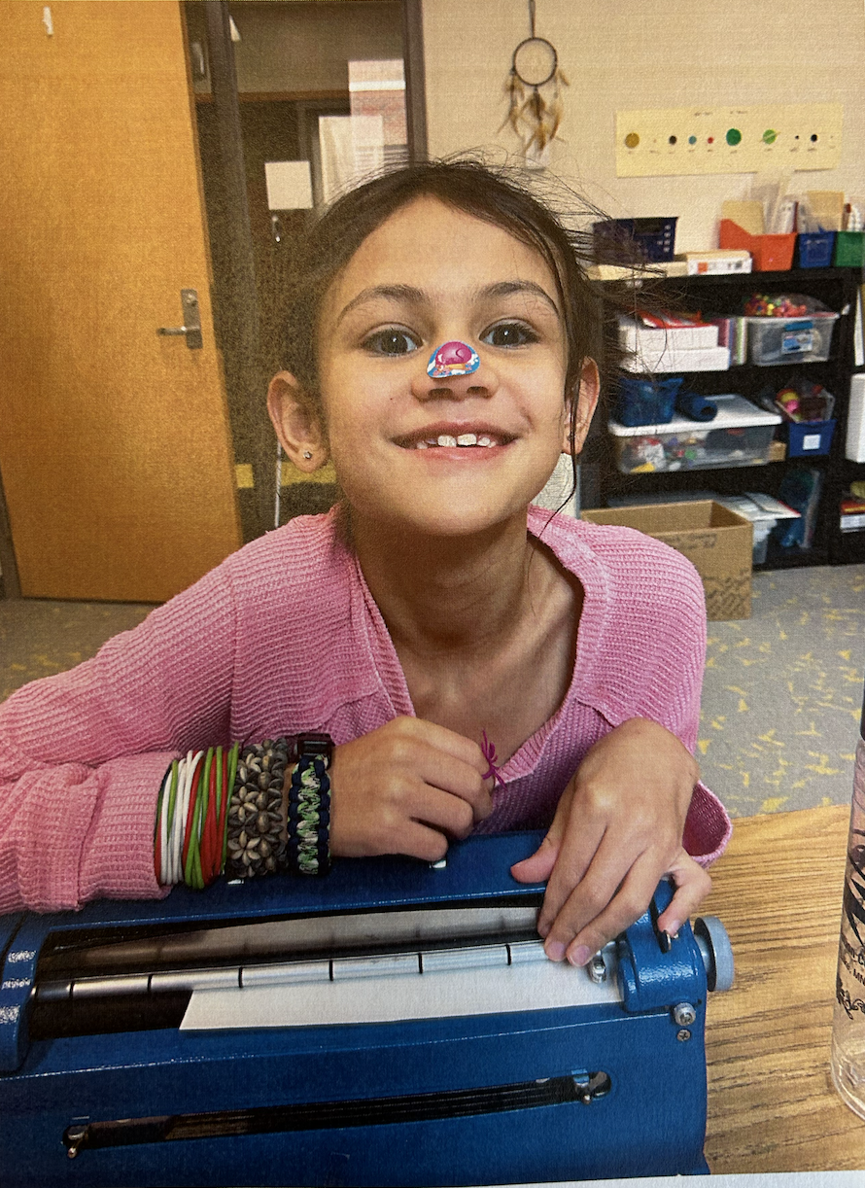
Meet Doob!
Curious fifth grade student.
🩷’s music, baking, yogurt covered raisins and her Ojibwe culture.
Visual diagnosis of Optic Nerve Hypoplasia-no light perception.

Slide 10
Meet Doob! (2)
IEP Team: Orientation & Mobility, Occupational Therapy, Developmental Adapted Physical Education, & Social Work. -Therapy expected

Slide 11
The Starting Line (then)
2nd grade
Pre-reader, isolated skills
Number system (10)
1 year after starting to build rapport with Doob, her family, and her Individualized Education Plan Team.
(Video play on next slide…)

Slide 12
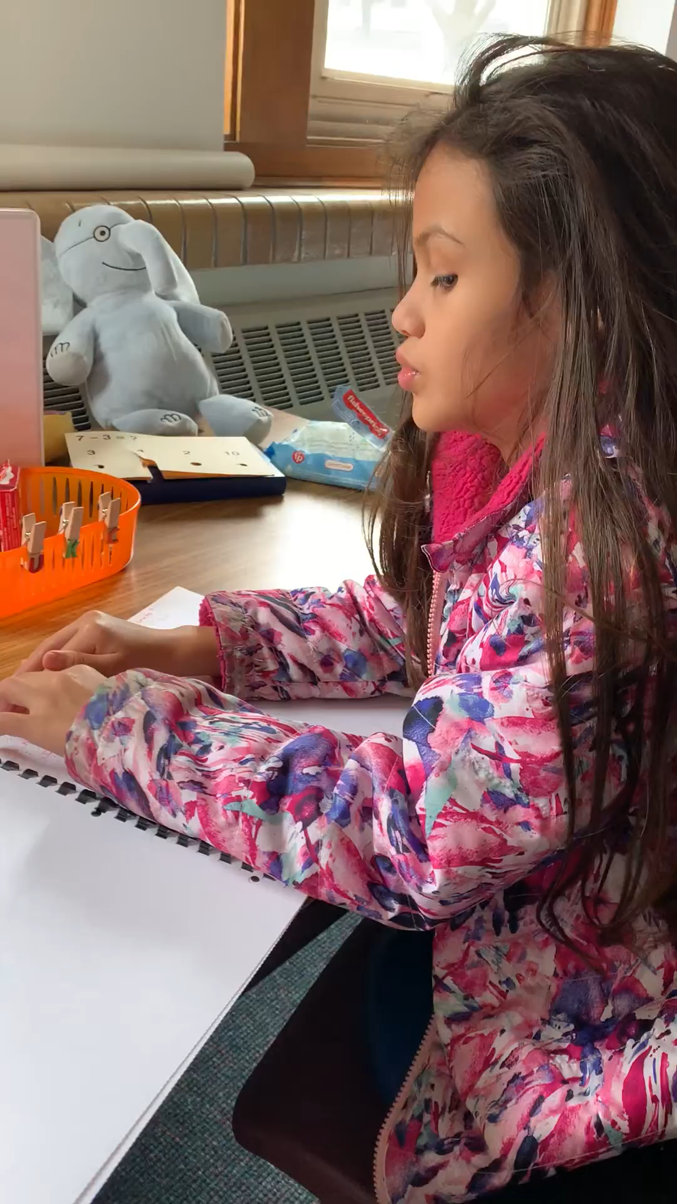
The Starting Line (then) - video

Slide 13
The Finish Line (now)
Beginning of 5th grade
Guided Reading Level: R-S
Emotional Regulation is showing growth.
Respect and Approachability has reached a new level.
(Video play on next slide…)

Slide 14
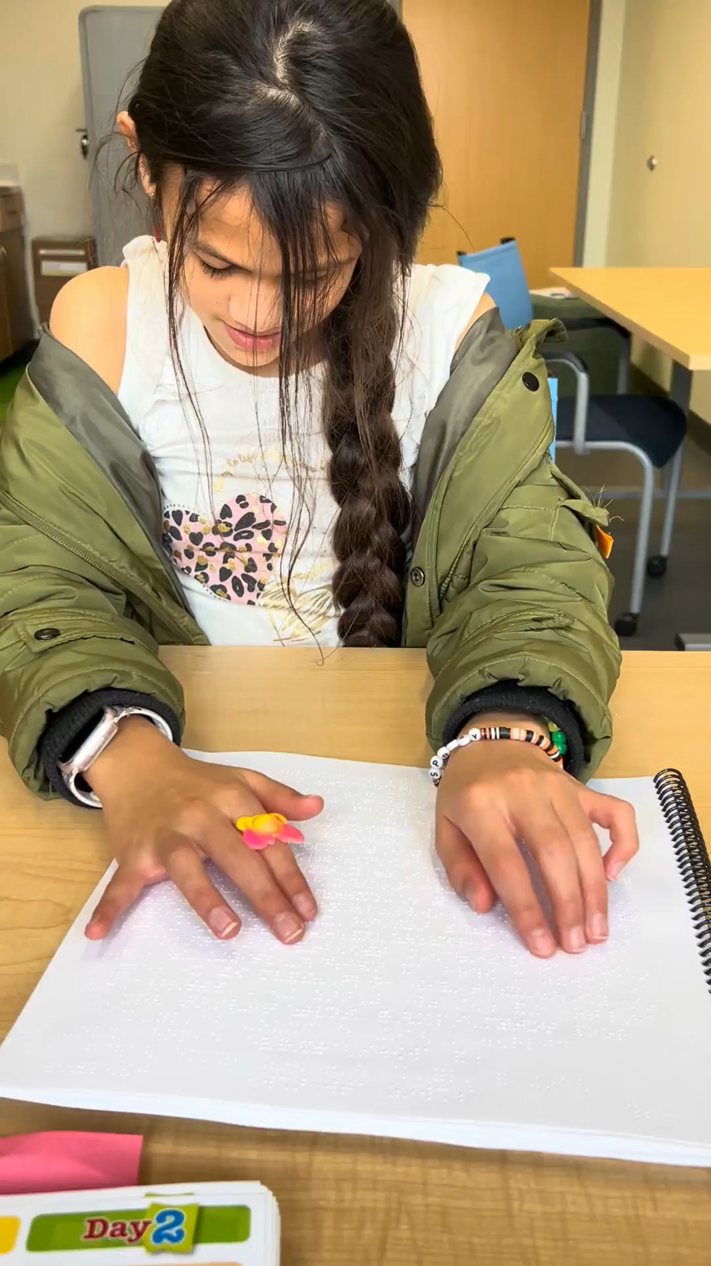
The Finish Line (now) - video

Slide 15
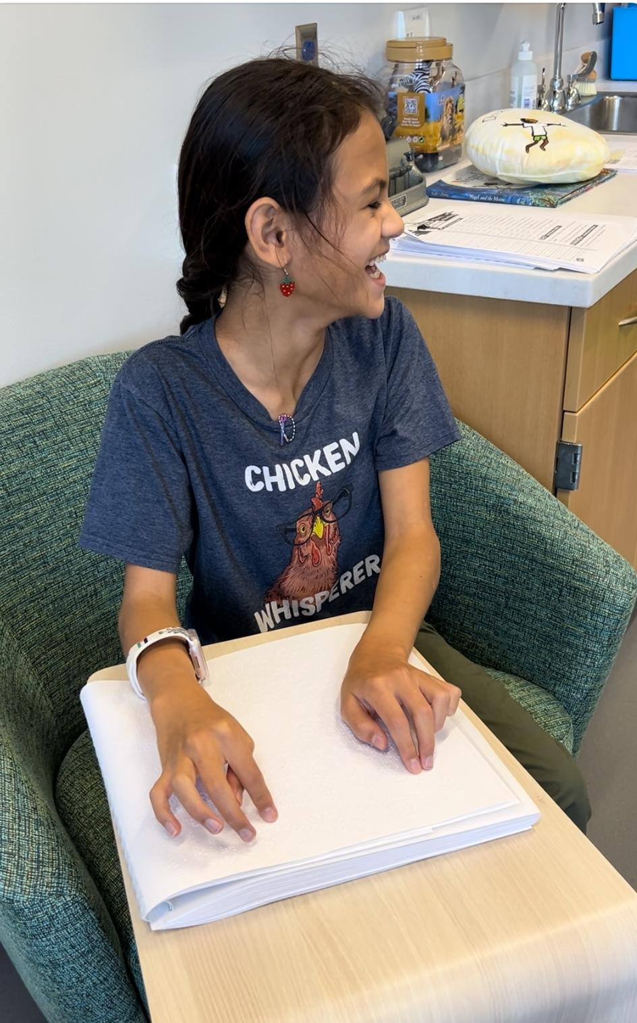
The Messy Middle How Did We Get Here?
Building Relationships & Integrating Culture
Repetition and Routine
Let’s Make This Fun!

Slide 16

Building Relationships & Integrating Culture
“One’s content knowledge & cultural knowledge in one’s family & community, affects
one’s reading comprehension.”
-Duke, Ward & Pearson, 2021
Book Reading Connections

Slide 17
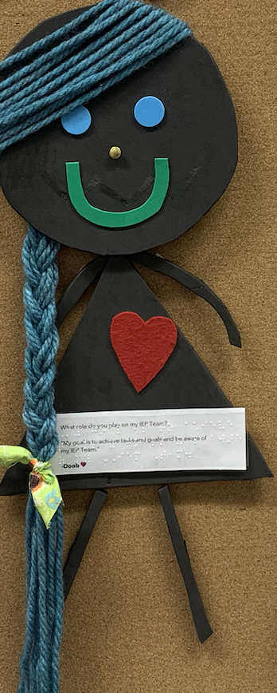
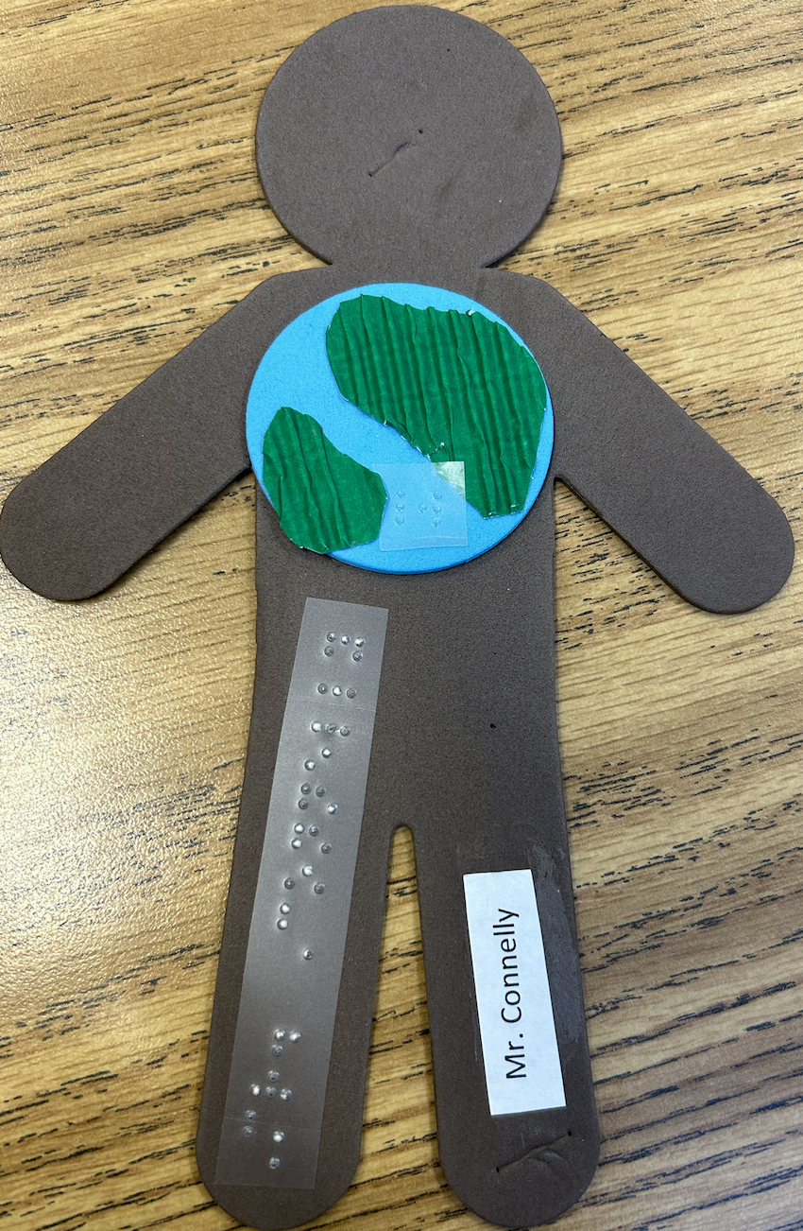
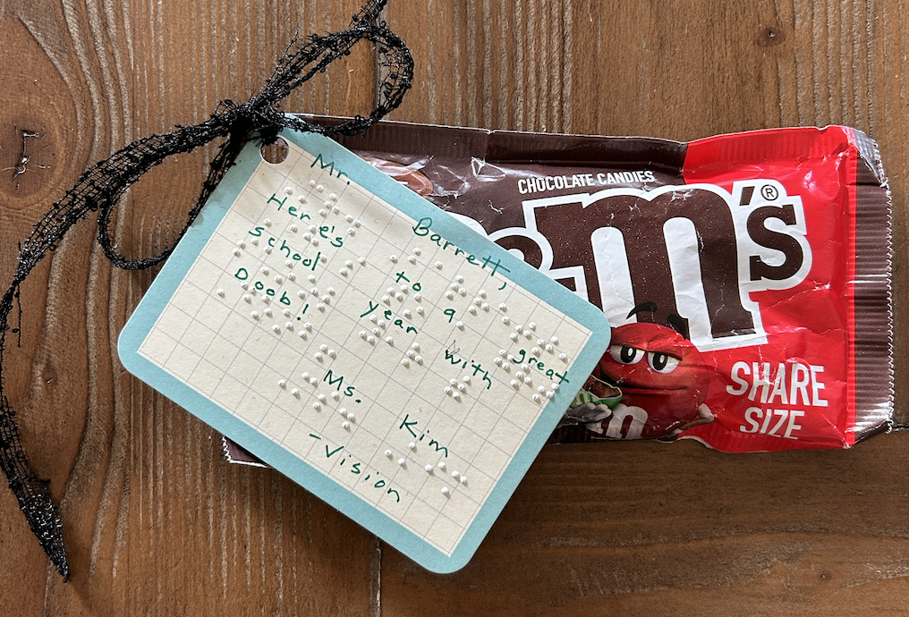
Relationships & Culture

Slide 18
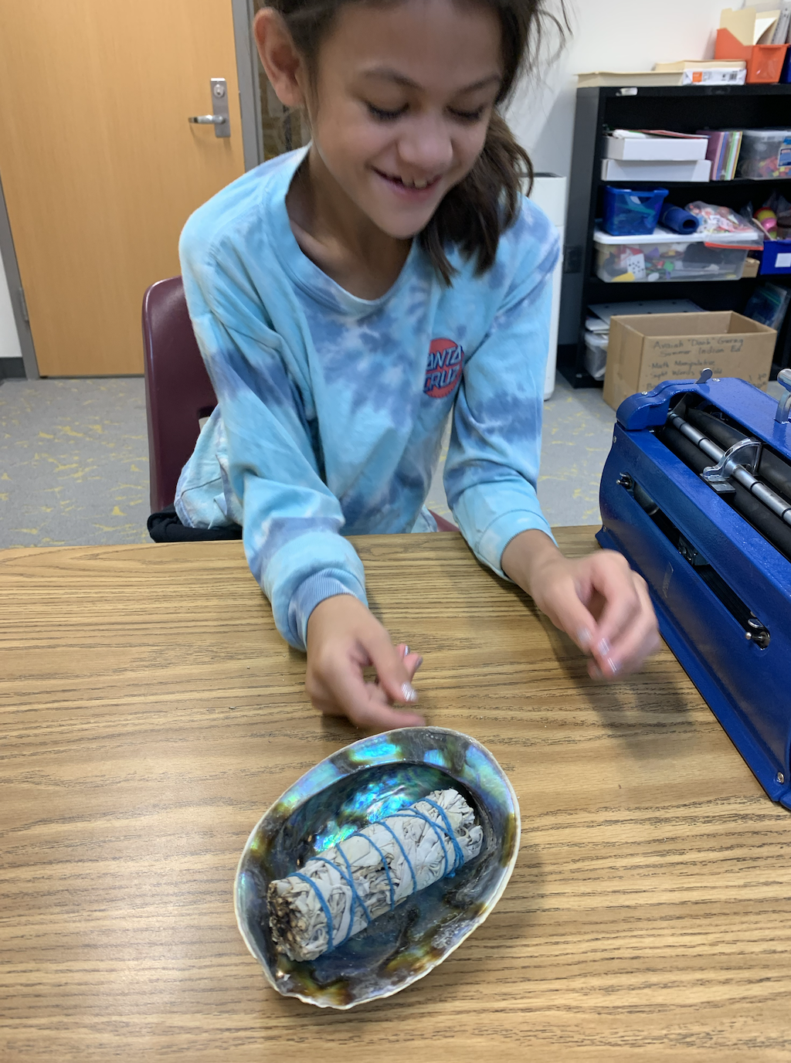
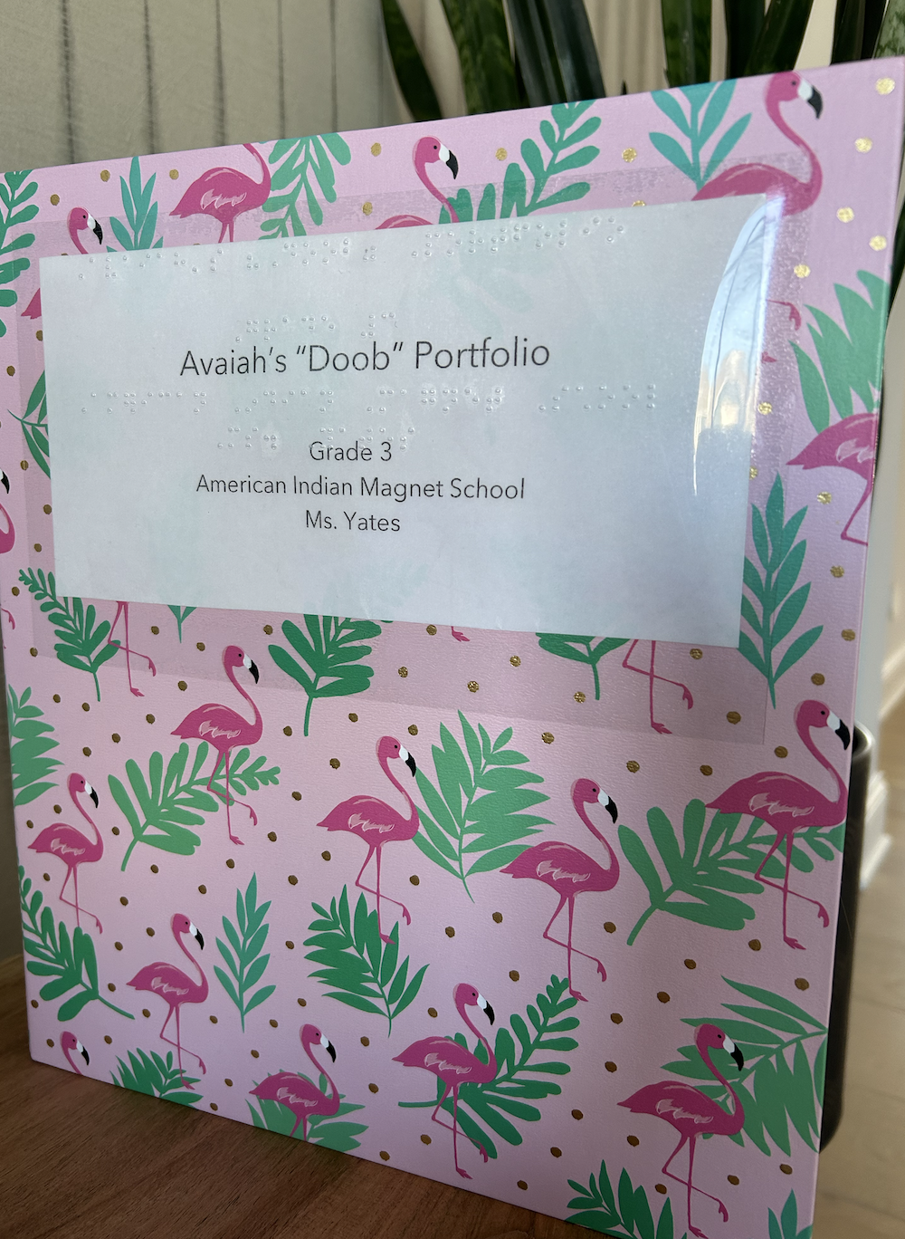
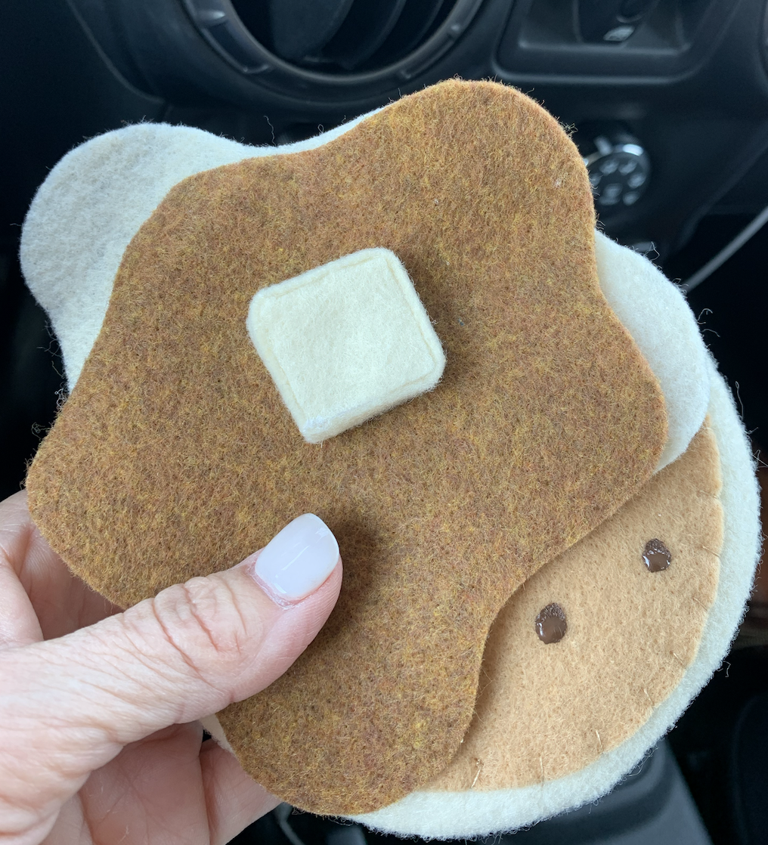
Relationships & Culture (2)

Slide 19
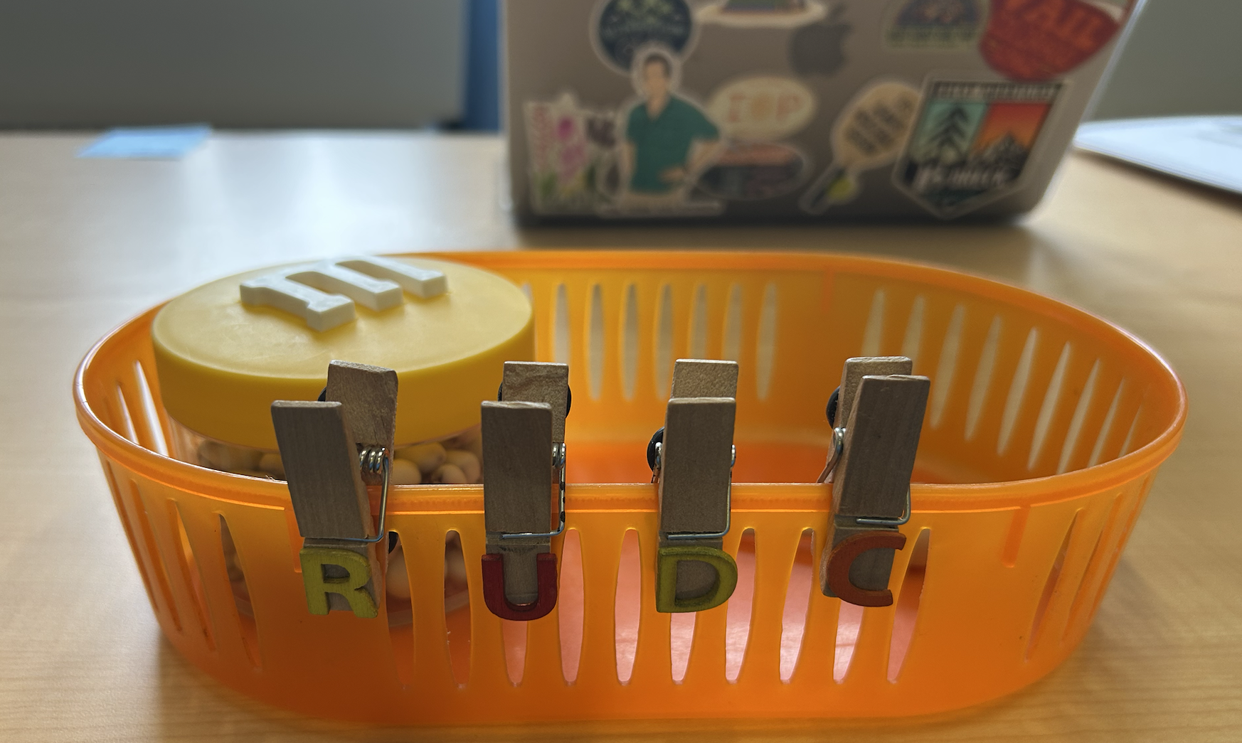
Daily Repetition and Routine

Slide 20
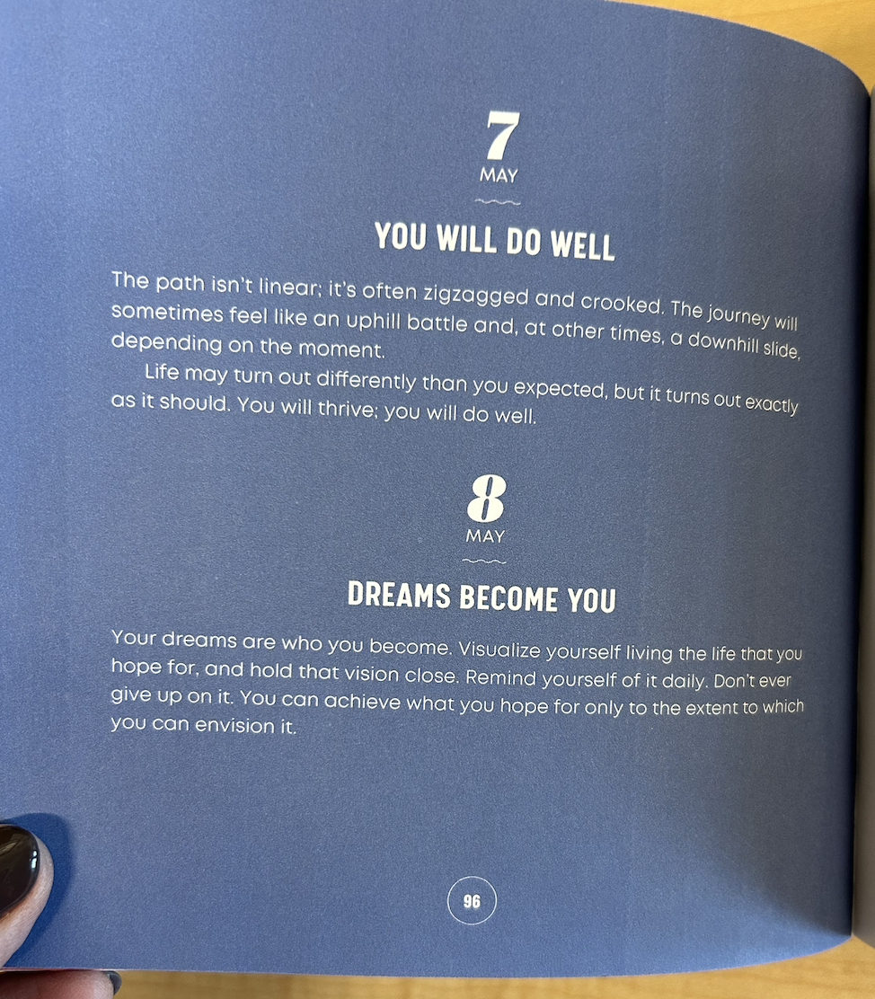
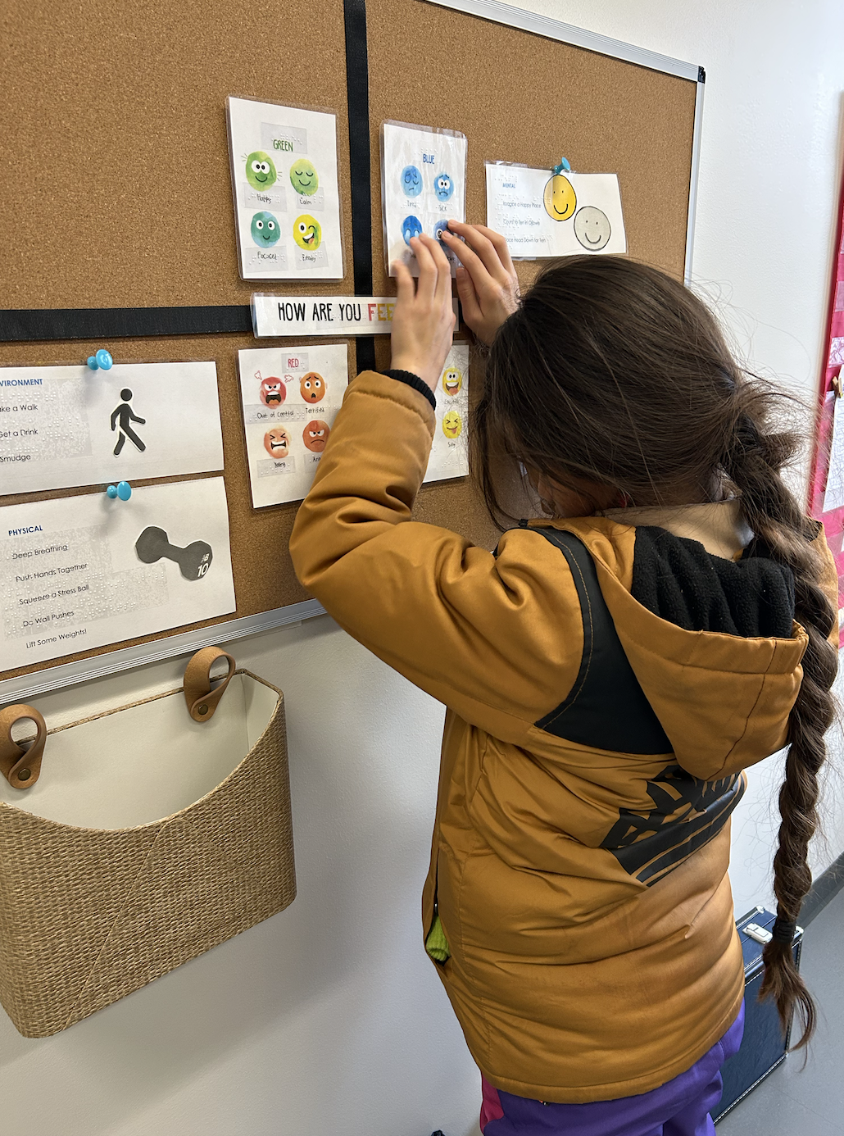
Repetition and Routine

Slide 21
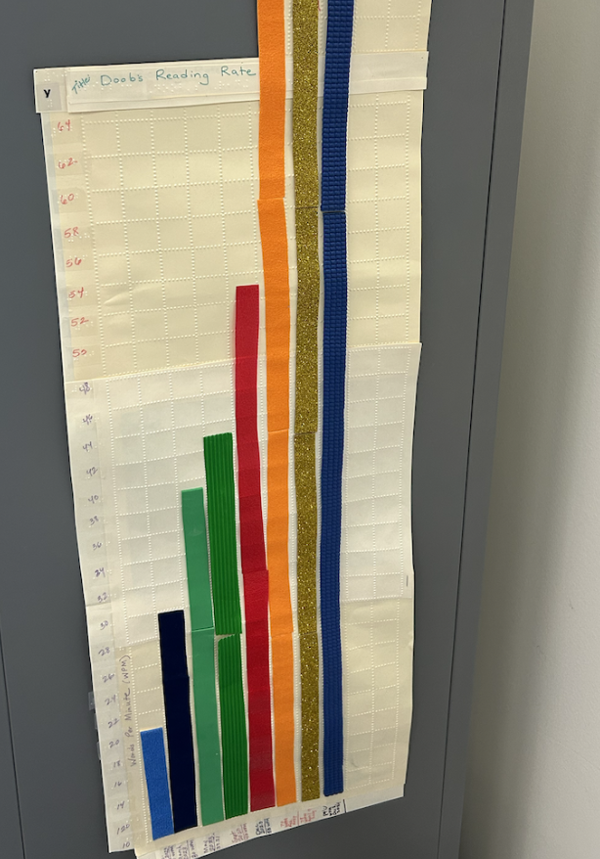
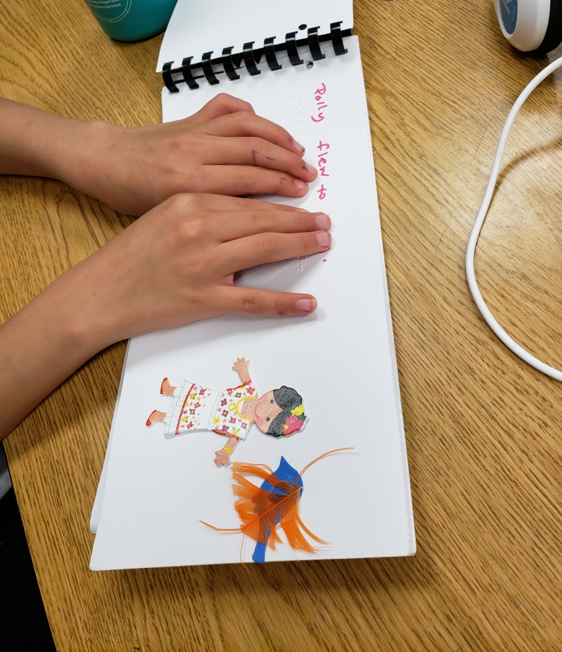
Repetition and Routine …in Literacy!

Slide 22
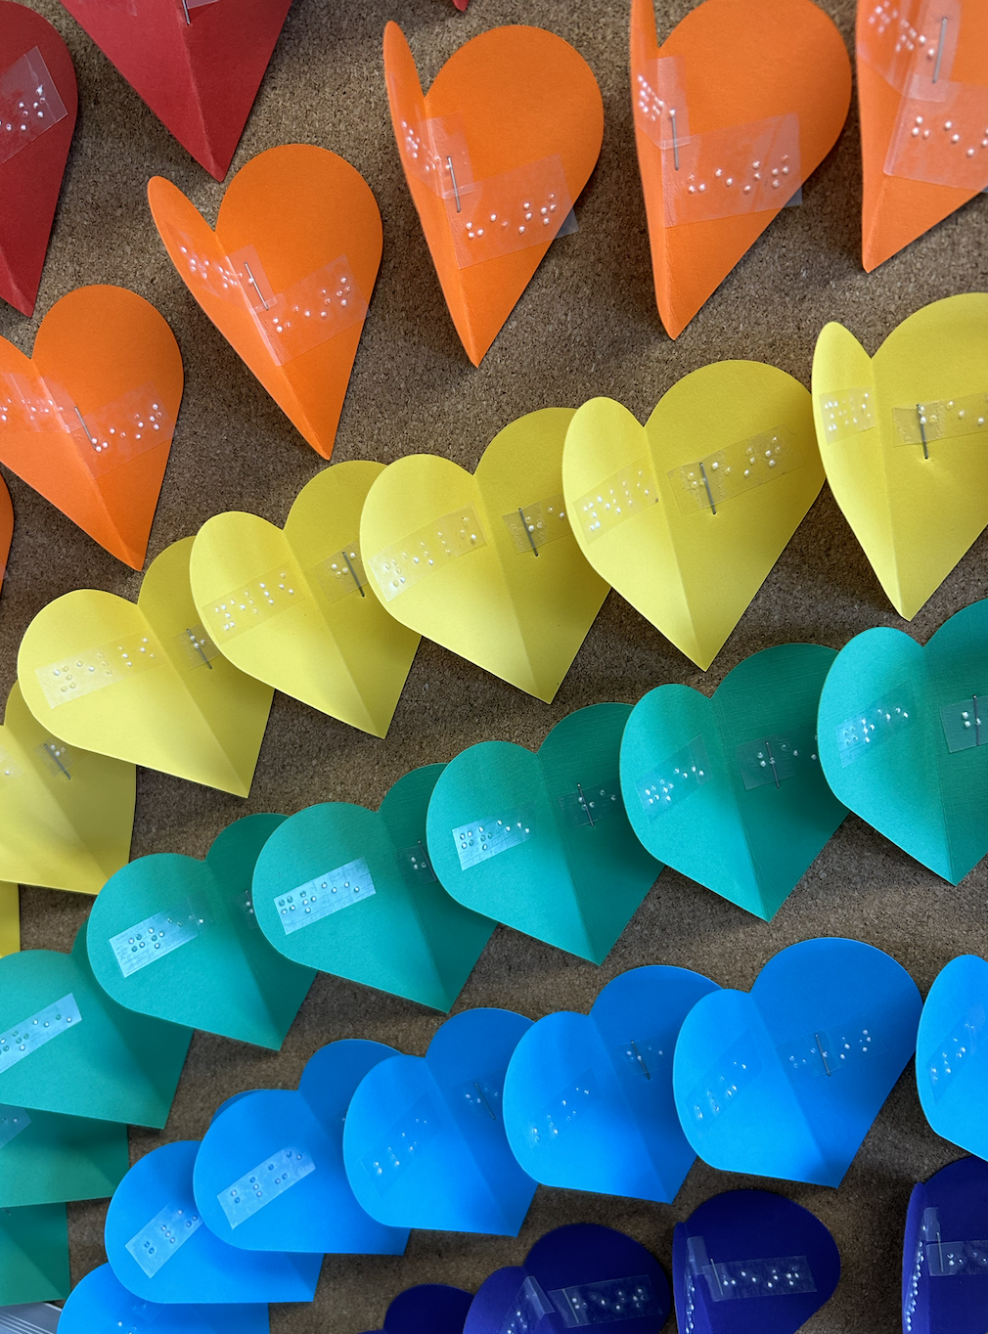
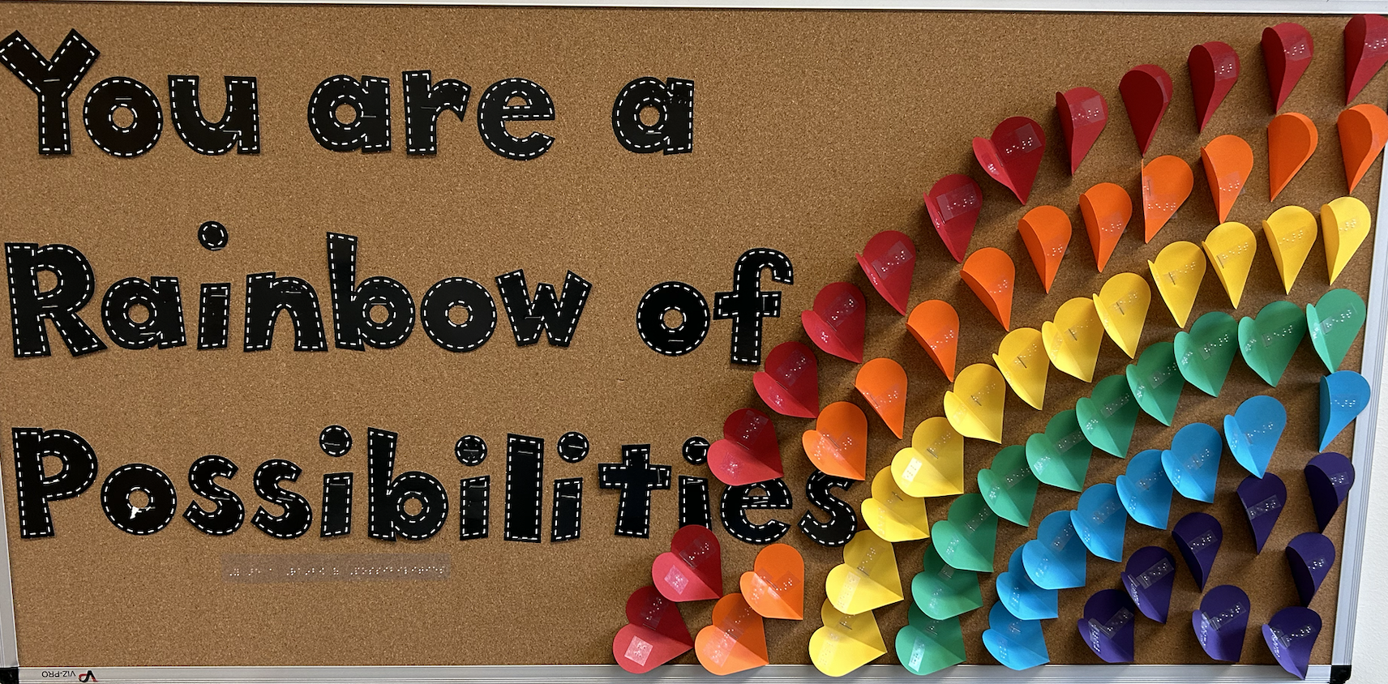
Let’s Make This Fun!
Adapted Bulletin Board

Slide 23
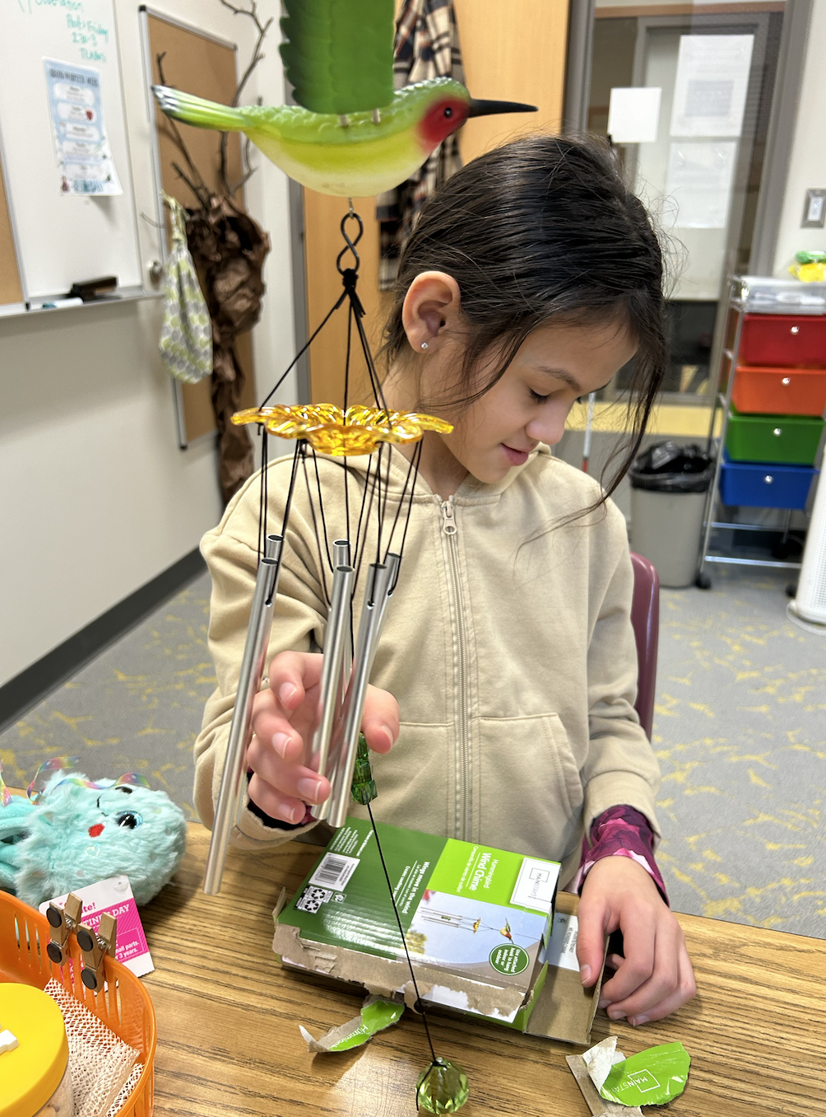
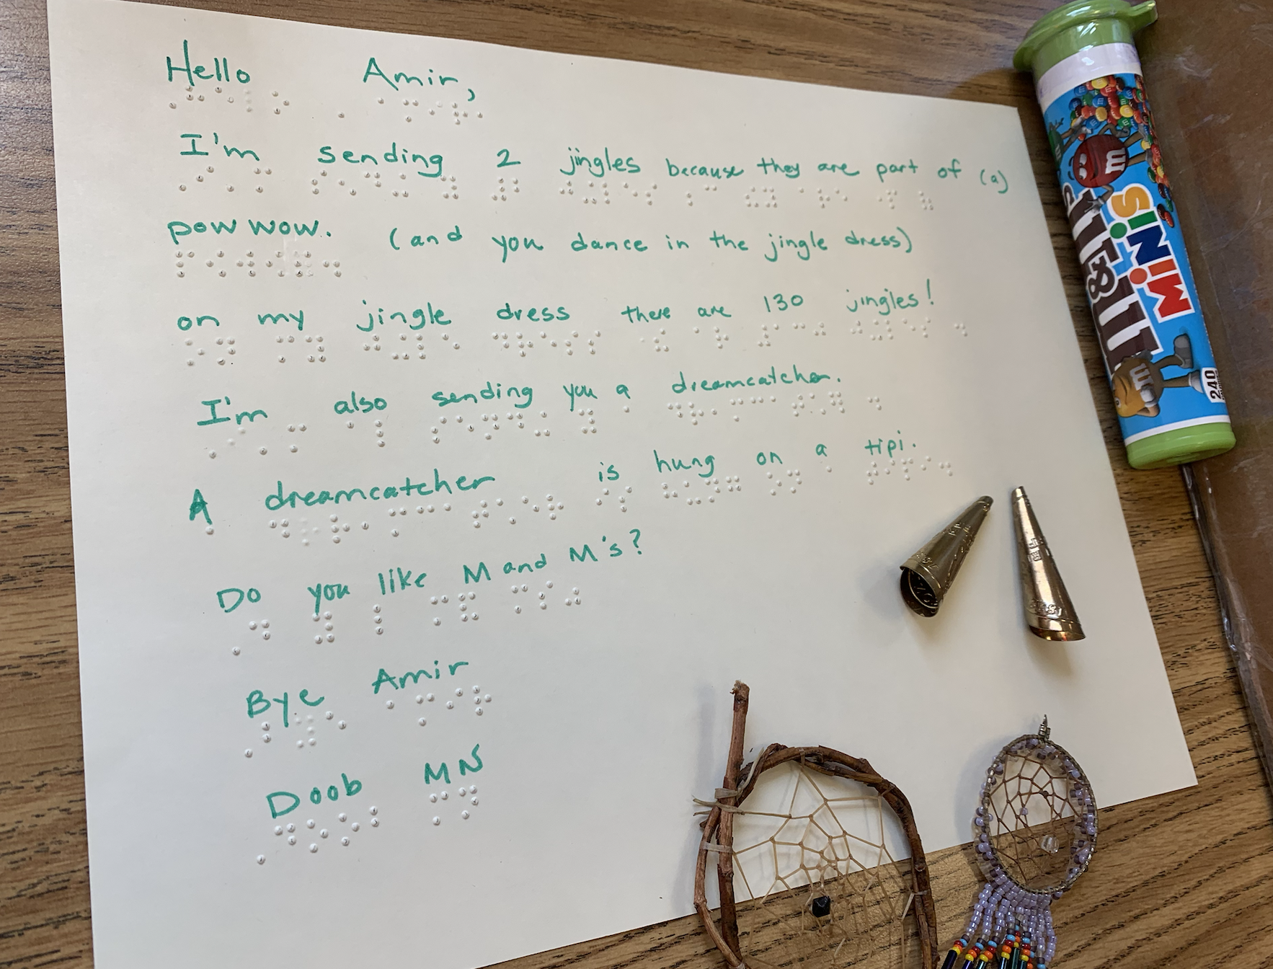
Let’s Make This Fun! (2)
Pen Pal Letters From California

Slide 24
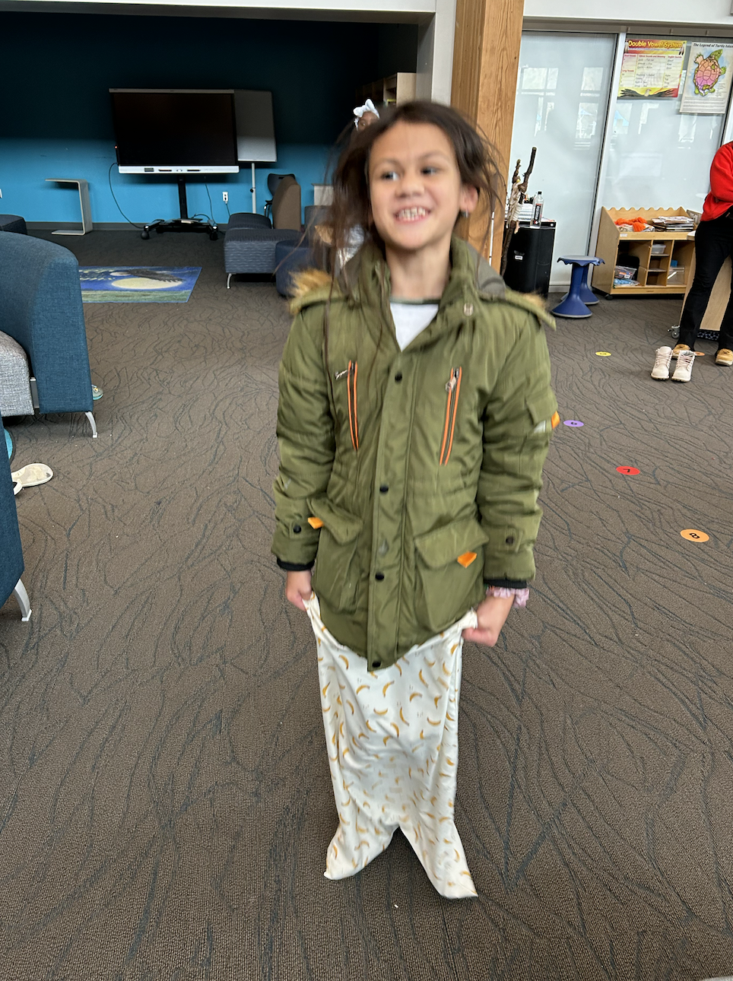
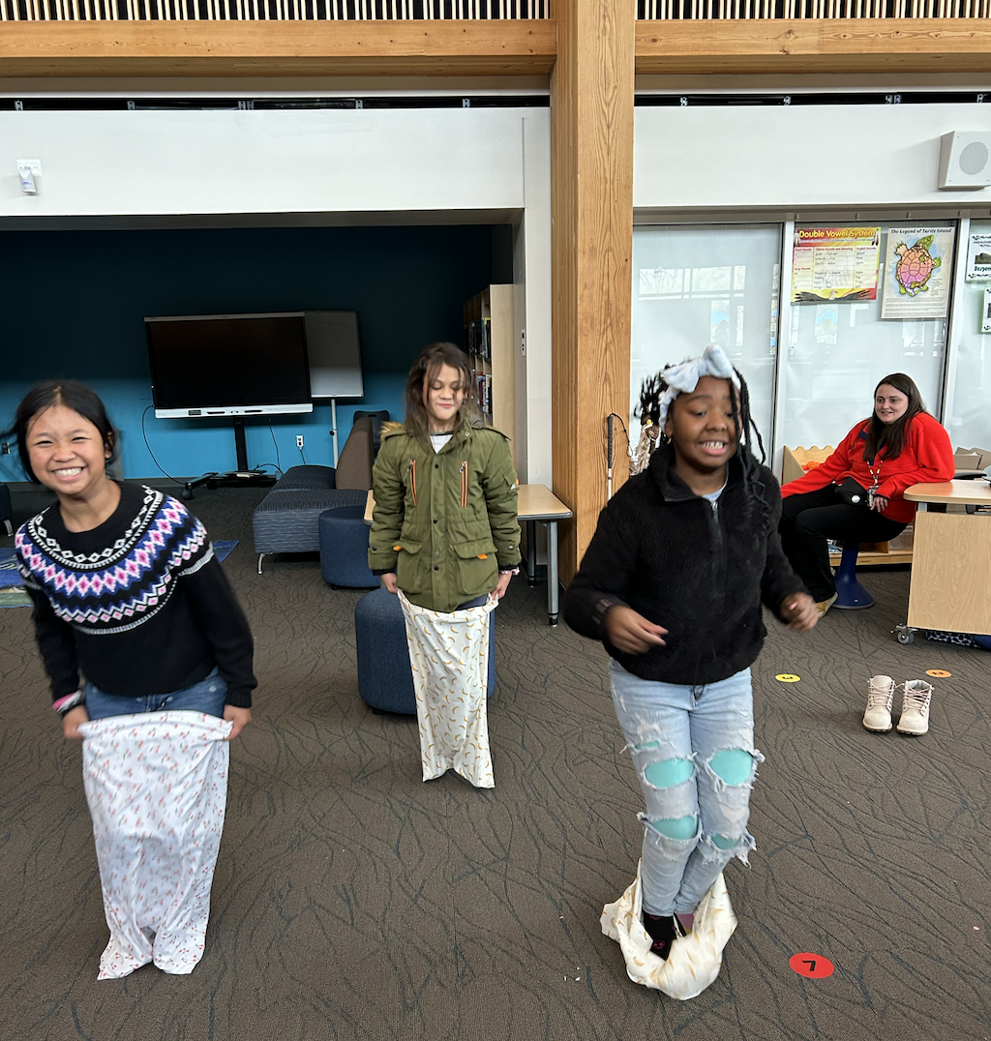
Let’s Make This Fun! (3)
What’s a Potato Sack Race?

Slide 25
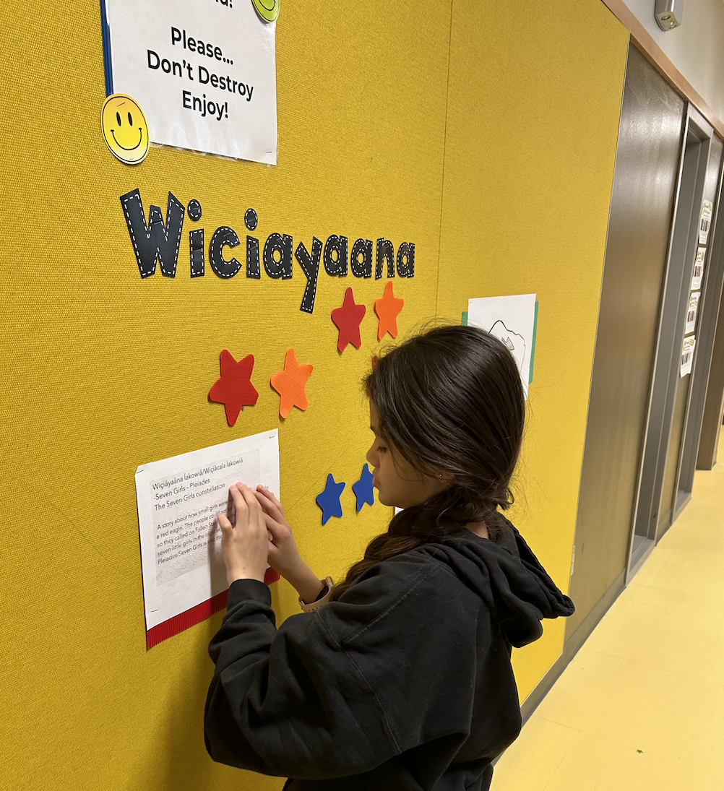
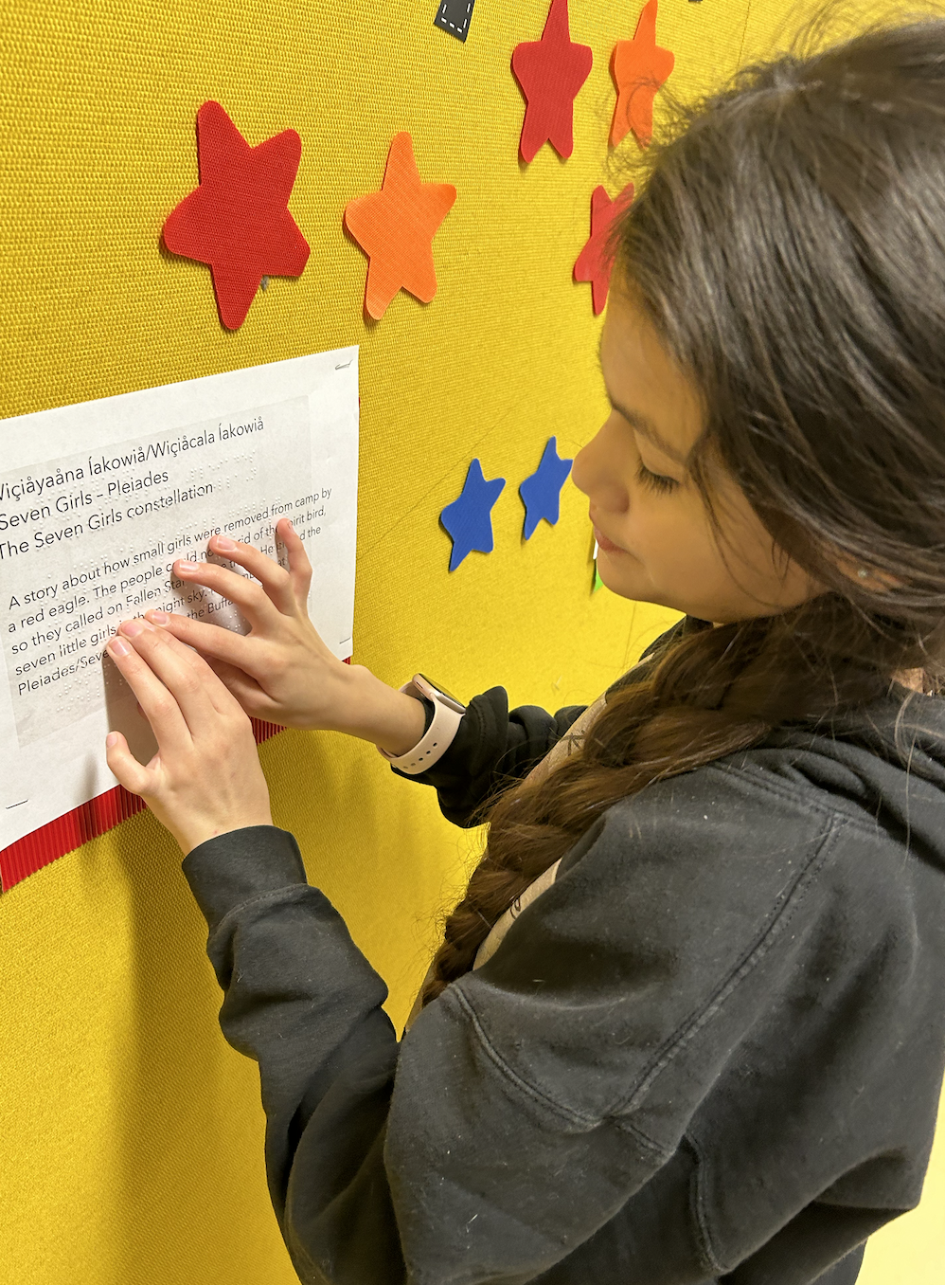
Let’s Make This Fun! (4)
Lifesize Ojibwe Constellations

Slide 26

THANK YOU!
Kim Wilke, kim.wilke@spps.org
Cell: 651-783-2120

Slide 27
Resources
APH Hive Online Course: Unlocking the Foundations of Reading for Students with a Visual Impairment (Science of Reading.) https://aphhive.org/#/home
Building on Patterns. https://aphbop.org/
Paths to Literacy, https://www.pathstoliteracy.org/ resource/braille-mechanics-guidance/

Slide 28
Resources (2)
Project Life Craft Cards https://www.shopbeckyhiggins.com/collections/project-life-card-collections
Reading Connections:
Reading Connections: Strategies for Teaching Students with Visual Impairments

