Slide 1
Reading Beyond Boundaries:
Adapted Literacy for All Ages and Learners
Charting the Cs Conference 2025:
To Literacy and Beyond
Cooperation
Communication
Collaboration
April 29, 2025
Amy Neils, Teacher of the Visually Impaired
Holly Beckmann, Teacher of the Visually Impaired
Kristi Portugue, Teacher of the Visually Impaired

Slide 2
Learning Objectives:
At the end of the session, learners will be able to:
Understand the WHY behind book kits
Understand the concept of book kits
Learn to assemble book kits including supplementary materials
Tailor kits for different age groups and abilities
Explore and interact with digital tools

Slide 3
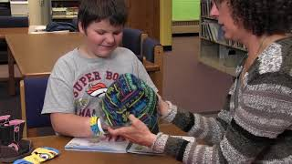
What Are Book Kits?

Slide 4
Why Use Book Kits?
Hands-on
Adapted for different learning styles and preferences
A multi-faceted learning tool instead of a just a hard copy book
Increased engagement
Creates a deeper understanding of the story

Slide 5
Guidelines for Choosing Objects
Use all 5 senses, including forgotten senses of taste and smell
Found around the home or in a classroom
Realistic as possible
Can be cleaned
Large enough for tactile discrimination
Materials that provide a variety of tactile feedback
Purchased again if they disappear from the box

Slide 6
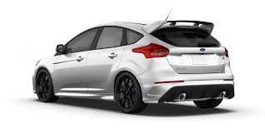
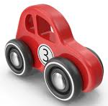
Keep in mind…
Use real objects, not miniatures
Tactual exploration of an object takes longer than using vision
Explore parts of the object that make a whole (car wheels, doors, etc.)
Be selective in object choices
Not all objects must be experienced during each reading
Include objects that will engage all 5 senses

Slide 7
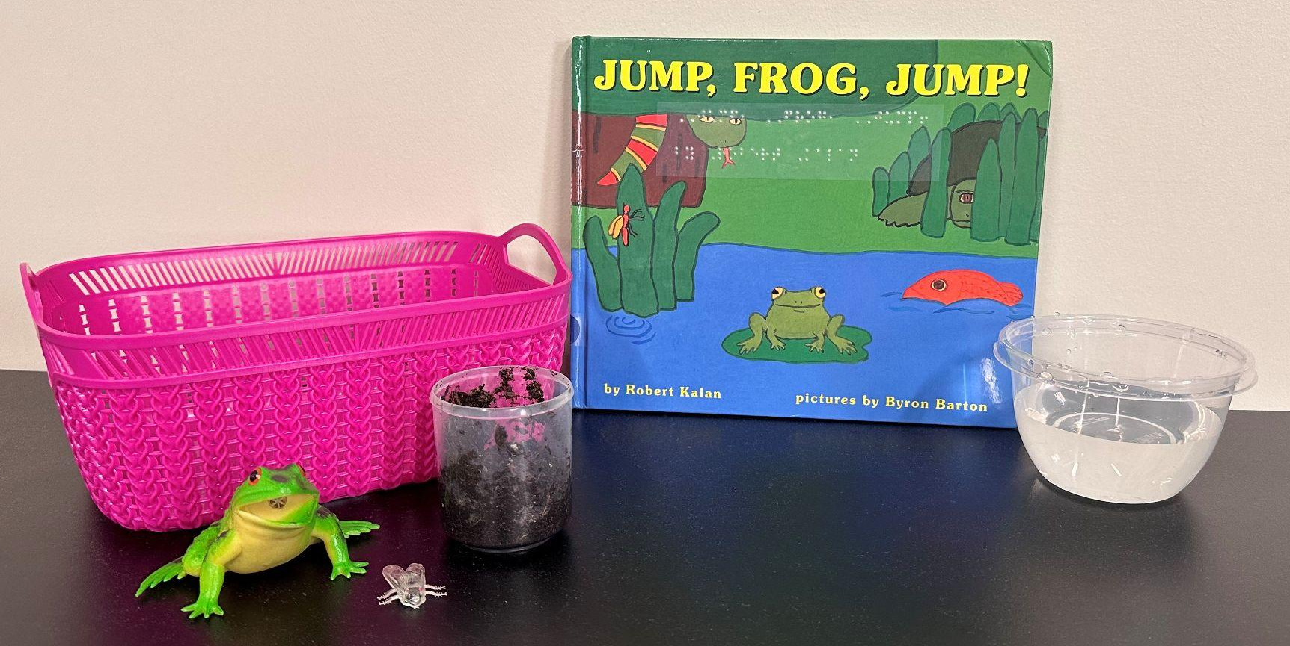
Steps for Creating a Book Kit for Younger Students
Select a book
Choose key items involving all 5 senses
Develop questions from the book

Slide 8
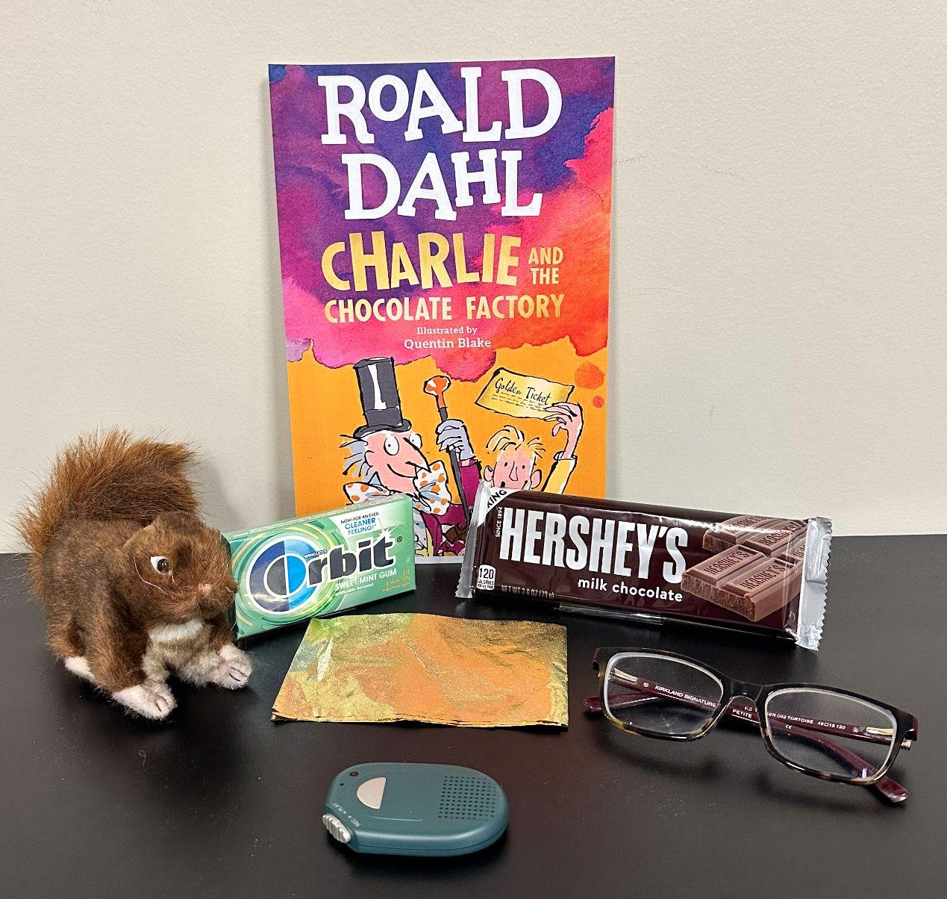
Steps for Creating a Book Kit for Older Students
Select a book
Choose key items involving all 5 senses
Create a chapter summary; print, images, or braille
Develop questions

Slide 9
Practice Using AI
Chat GPT
Choose a book
Create a prompt-refine/expand the prompt as needed
Create a list of 5+ objects, utilizing all 5 senses, from the book
Create a chapter summary at a specific grade level
Create comprehension questions and answers from each chapter

Slide 10
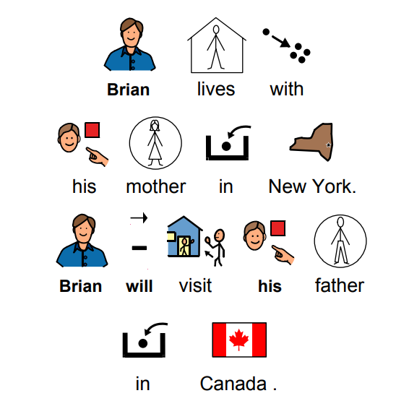
Adapted Chapter Books
Sherlock Center
Chapel Hill Snippets
Hatchet by Gary Paulsen

Slide 11
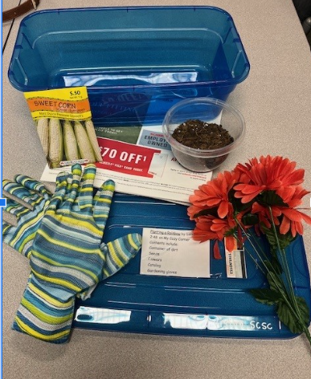
Audio Book Kits
YouTube-Planting a Rainbow
Monarch Reader
Bookshare

Slide 12
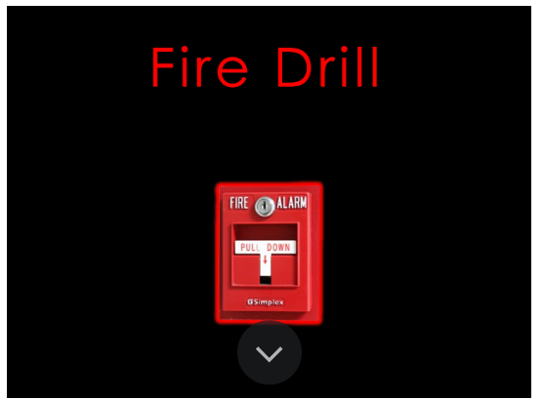
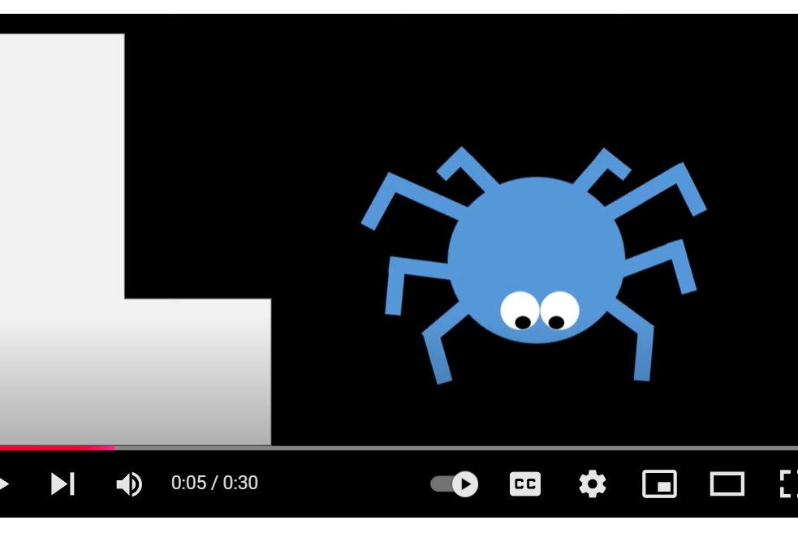
Cortical Vision Impairment Adapted Books
CVI Book Nook
YouTube-example
Sherlock Center
Monarch Reader

Slide 13

Cortical Vision Impairment Adapted Books, video

Slide 14


Switch Adapted Books
Monarch Reader example
Tarheel Gameplay
Bookshare
  Help Kidz Learn
Epic Books
  StoryOnline

Slide 15
Switch Adapted Books Cont.
Book Creator
Roy the zebra
Tarheel Reader
Other options
  Story Place

Slide 16
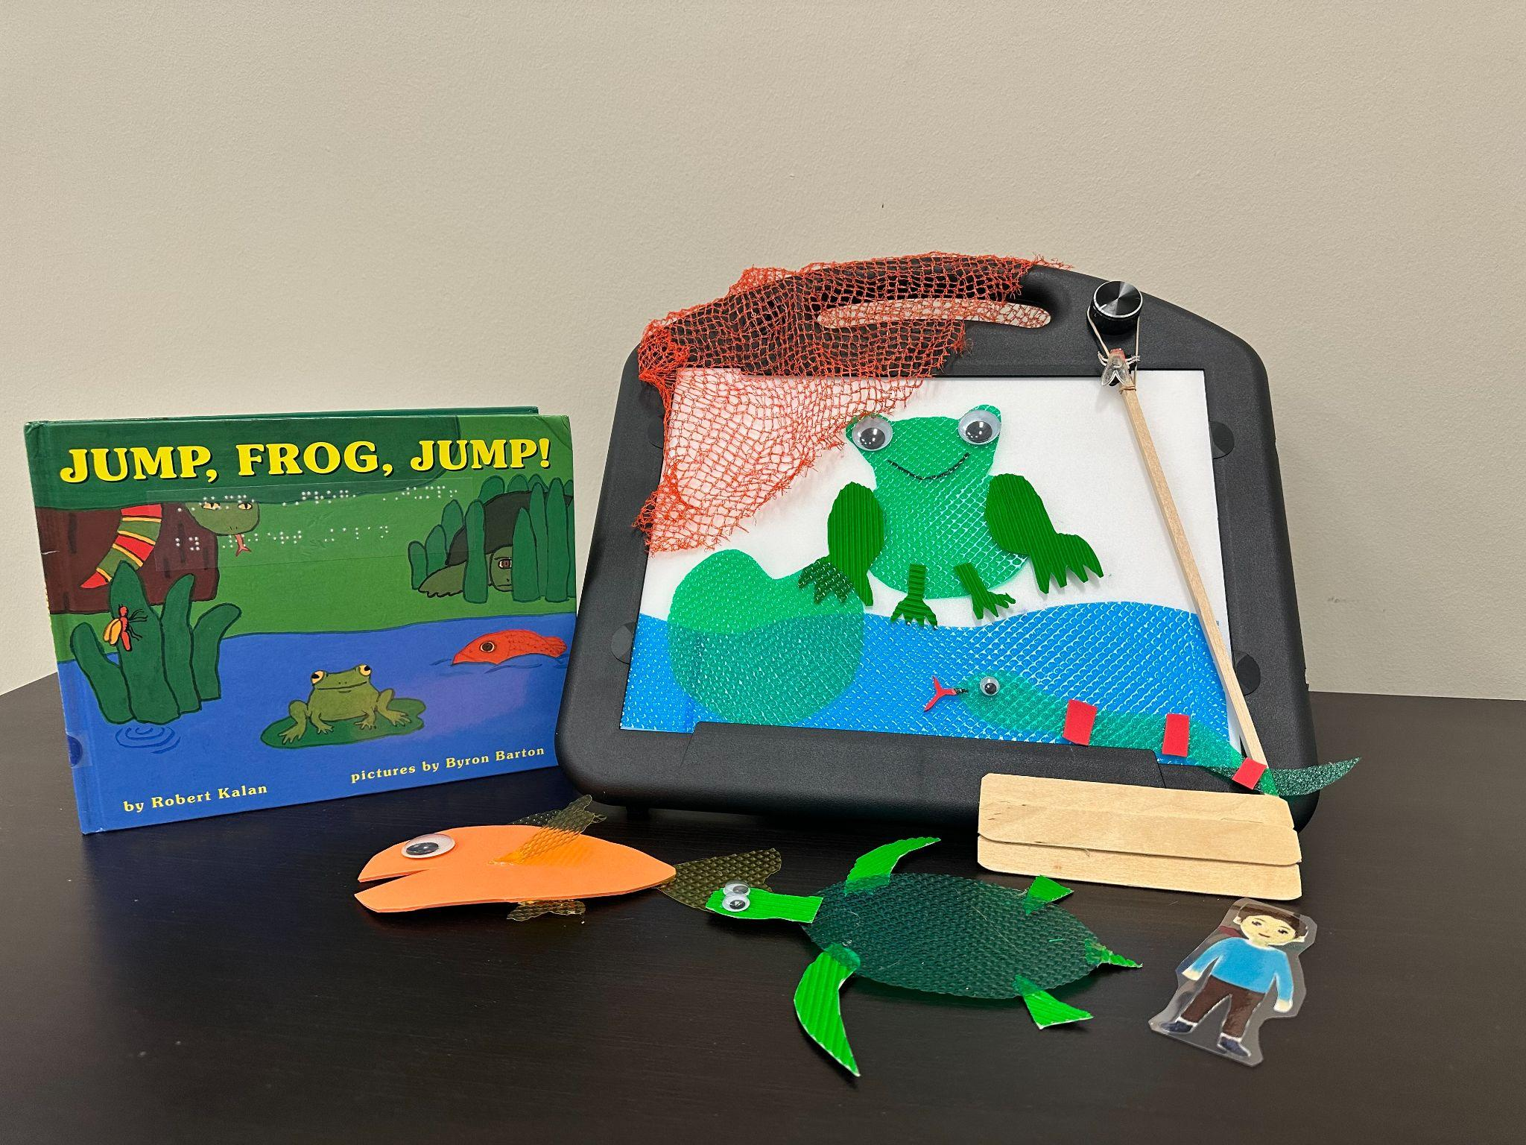
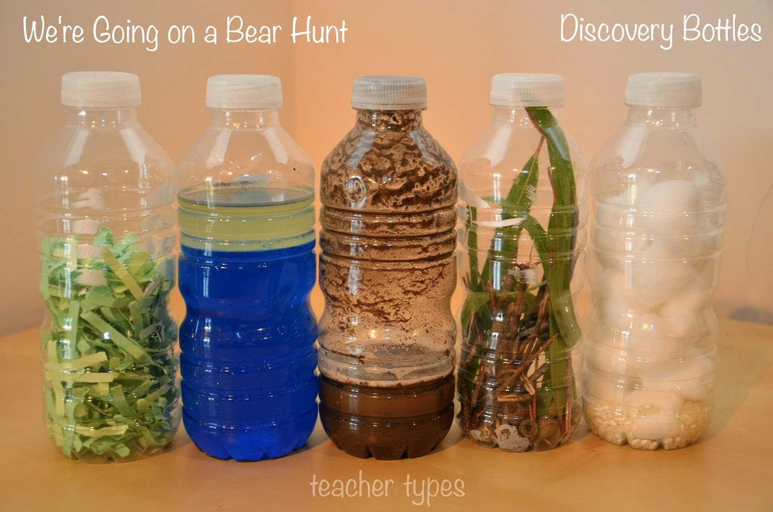
Lightbox Books
Lightbox Stories from Paths to Literacy
APH Lightbox Story Hour video

Slide 17
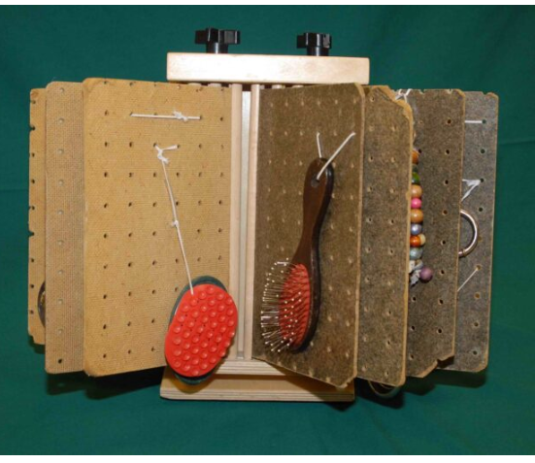
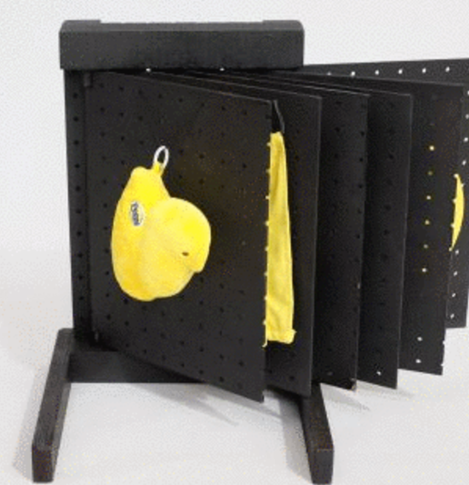
Active Learning Books

Slide 18
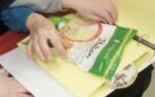
Experience Book Kits
Collection of real objects that are part of an experience
Part of a conversation or interaction with a parent or partner

Slide 19
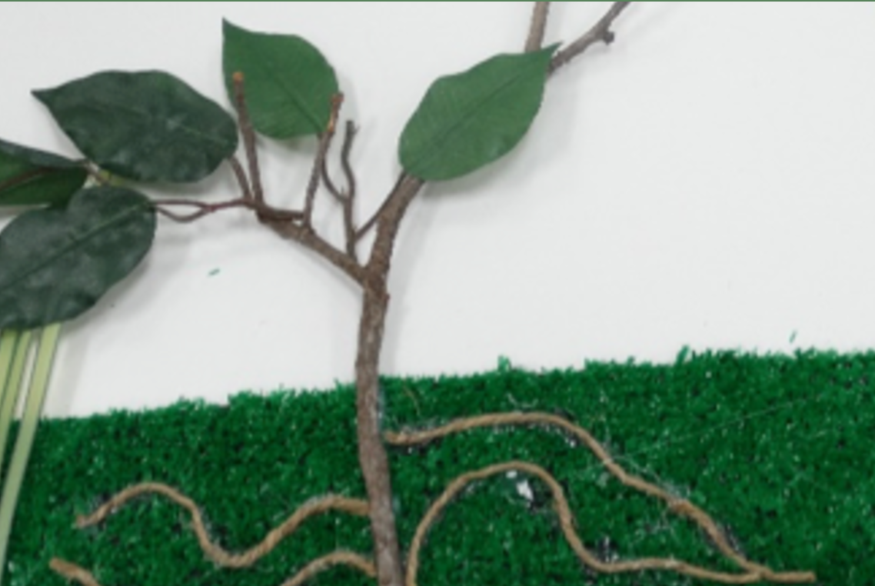
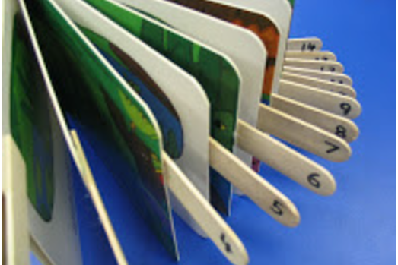
Creating Tactile Access to Books
Literacy For All
Paths to Literacy

Slide 20
Adapting Print and Images
Image Search What's better JPEG or PNG?
Adapted print https://roman-word-bubbling.appspot.com/
Movement and Attention slide animation (video on next slides)
Removing background
  iPhone stickers (video on next slides)
  Powerpoint (video on next slides)
  Pic Collage app

Slide 21
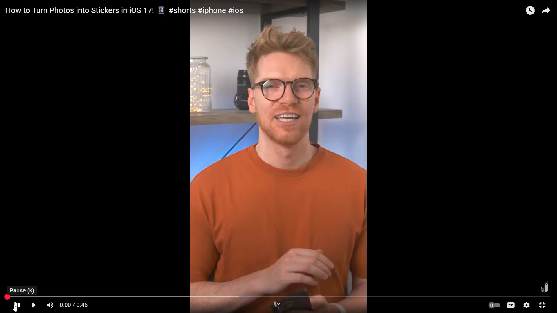
iPhone stickers, video

Slide 22
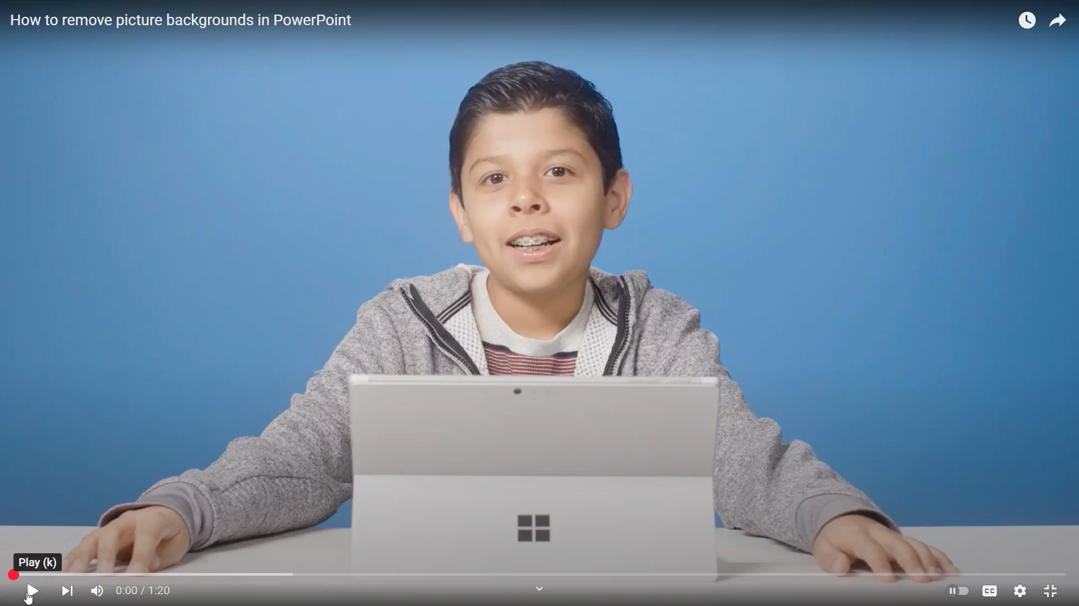
Remove Picture with PowerPoint, video

Slide 23

Slide Animation, video

Slide 24
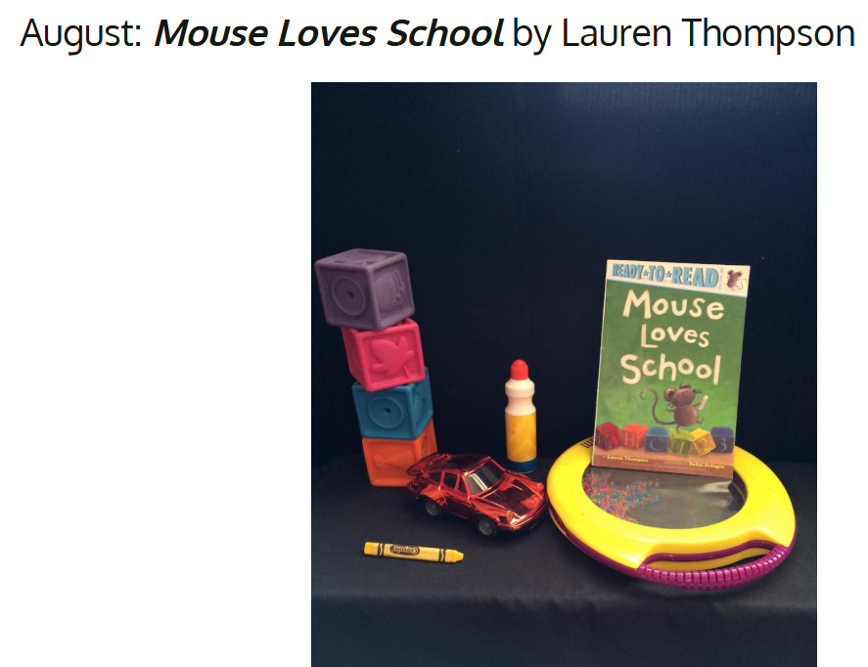
A Year of Book Kits
Easy Create Story Boxes

Slide 25
Now it’s Your Turn to Create!
Your Google Slide should contain:
1 png image
2 Roman bubbled words or numbers
1 animation
Bonus points:
1 image that has the background removed with powerpoint or other program

Slide 26
Remember…
To use real objects, not miniatures
That tactual exploration of an object takes longer than using vision
To explore parts of the object that make a whole (car wheels, doors, etc.)
To be selective in object choices
That not all objects must be experienced during each reading
To include objects that will engage all 5 senses

Slide 27
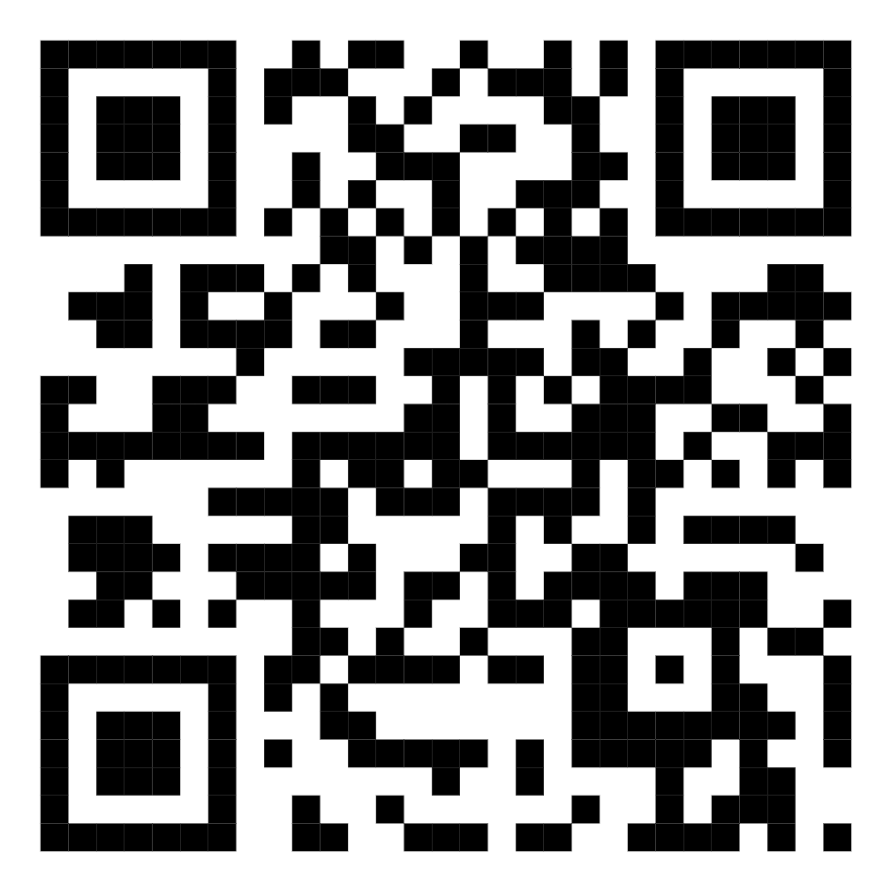
Sources and Resources

Slide 28

Thank you!
Amy Neils, aneils@mnscsc.org
Holly Beckman, hbeckmann@mnscsc.org
Kristi Portugue, kportugue@mnscsc.org

