Slide 1
Assistive Technology Meets Minnesota Statewide Assessments
April 29, 2025, 1:30-2:30 pm
Stacie Stensrud, MDE Alternate Assessment Specialist
Lauren Walker, MDE Alternate Assessment Specialist

Slide 2
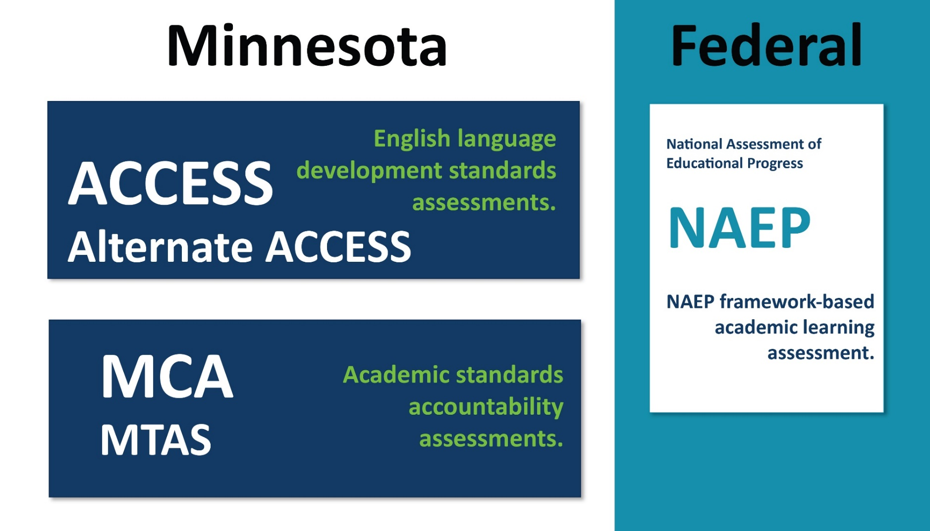
Minnesota Statewide Assessments

Slide 3
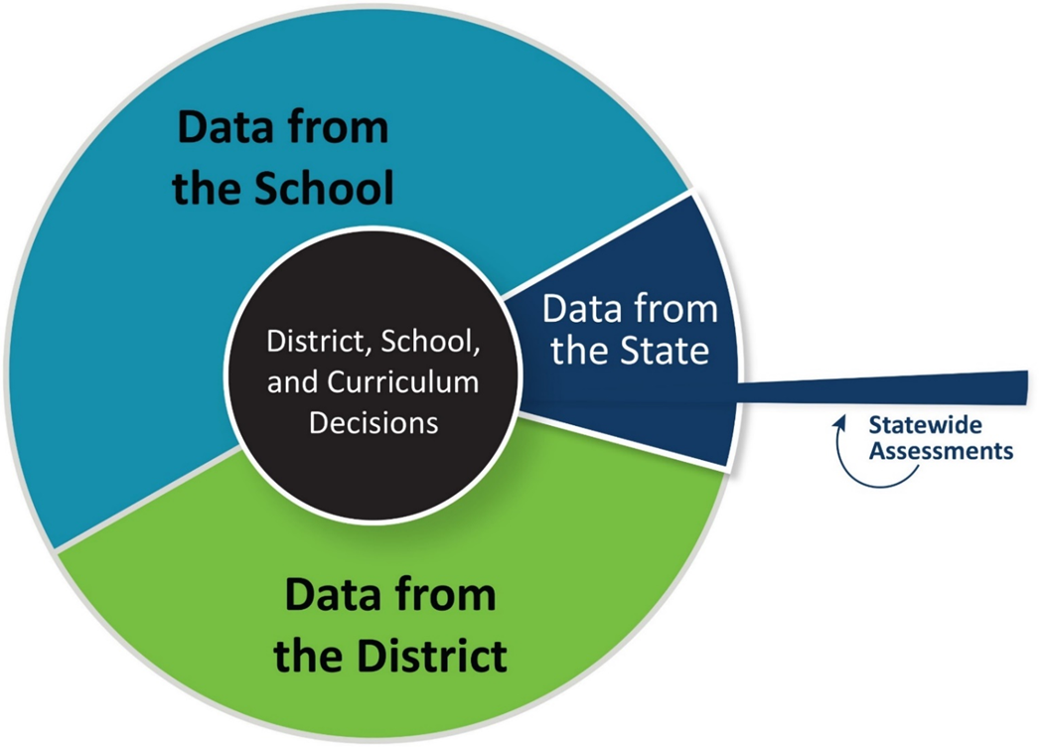
Assessment Data Sources

Slide 4
Alternate MCA Redesign Timelines
Date | Science | Reading | Math | Administration Mode
Spring 25 | * Alternate MCA | MTAS | MTAS | MTAS – paper only Alternate MCA – Online, paper or hybrid available
Spring 26 | * Alternate MCA | * Alternate MCA | MTAS | MTAS – paper only Alternate MCA - Online, paper or hybrid available
Spring 27 | * Alternate MCA | *Alternate MCA | MTAS | MTAS – paper only Alternate MCA - Online, paper or hybrid available
Spring 28 | * Alternate MCA | * Alternate MCA | * Anticipated Alternate MCA | Online, paper or hybrid available

Slide 5
Assistive Technology Definition
The term assistive technology device means “any item, piece of
equipment, or product system, whether acquired commercially off the shelf, modified, or customized, that is used to increase, maintain, or improve the functional capabilities of a child with a disability. The term does not include a medical device that is surgically implanted, or the replacement of such device.
IDEA 2004 for Part B—now requires student planning teams (e.g., IEP, ITP) to consider whether AT devices and services are needed for each student who qualifies for special education services (34 C.F.R. §300.324(a)(2)(v)).

Slide 6
Assistive Technology Test Forms
Separate TestNav forms allow AT devices to interact directly with the test in order to maintain, increase or improve the functional capabilities of a student with disabilities:
Screen reader AT form
Non-screen reader AT Form

Slide 7
Assistive Technology Screen Reader Form
Details of the Screen reader AT From
Limits item types and online tools to those that are keyboard operable and supported by screen readers
Designed to be used with Screen readers and Braille Devices
Need to verify that the AT device will work with TestNav by using the AT Checker
Can include AT devices or software/tools that interact with the TestNav form
Braille materials are designed to be used with the AT Form
Script can be used

Slide 8
Assistive Technology Non-screen Reader Form
Details of the Non-screen reader AT From
For use with AT devices other than Screen Readers and Braille Devices
Need to verify that the AT device will work with TestNav by using the AT Checker
Can include AT devices or software/tools that interact with the TestNav form
Braille materials are designed to be used with the AT Form
Script can be used
Common devices include switches, head mouse, screen magnification tool

Slide 9
Science Alt MCA Assistive Technology
Examples of AT available for the Science Alt MCA
Assistive Technology Forms
Screen Reader and Non-screen reader forms
Augmentative and Alternative Communication Devices
Eye Gaze Technology Devices
Switches
Head Mouse

Slide 10
Science MCA Assistive Technology Devices and Software
Examples of AT available for the Science MCA
Assistive Technology Forms
Screen Reader and Non-screen reader forms
Switches
Head Mouse
Electronic Calculators
CoWriter / Read&Write for short response items
Augmentative and Alternative Communication Devices
Eye Gaze Technology Devices

Slide 11
Considerations for Using Assistive Technology Devices and Software for the Science MCA
Guidelines to consider for using AT devices on the Science MCA
Individual setting is needed due to test security
Check memory-enabled devices before testing and disable any stored programs and applications
Record use of device and the person deleting the test content on the Test Administration Report (TAR)
Student owned devices require MDE approval
Bluetooth is allowed for AT use

Slide 12
When Does an AT Device need approval for the Science MCA?
These are the approved uses of AT devices for the MCA:
Used for scratch paper
Used as a calculator
Electronic notetaker for braille
Used with an AT form
All other uses of AT devices and student owned devices need to have MDE approval. Email mde.testing@state.mn.us to request approval or ask questions.

Slide 13
Guidelines for Using Assistive Technology Online Forms
Student AT devices need to be checked with TestNav to ensure the device is compatible and functions as expected
Students should practice using their device with TestNav to be familiar with how the device functions
District Assessment Coordinators need to create test tickets for TestNav
Access the Guidelines for Using Assistive Technology Online Forms and PearsonAccess Next Training Center
https://minnesota.pearsonaccessnext.com/assistive-technology/

Slide 14
2026 Reading MCA-IV Updates
The Reading MCA-IV will include new accommodations for students:
Screen Reader Assistive Technology version will be an approved accommodation for a small number of students with documented blindness or vision impairments that severely limits or prevents them from accessing printed text and have not yet learned braille.

Slide 15
2026 Reading MCA-IV Updates, continued
The Reading MCA-IV will include new accommodations for students:
Read aloud accommodations (human script, Text to Speech) will be an approved accommodation for a small number of students:
with documented blindness or vision impairments that severely limits or prevents them from accessing printed text and have not yet learned braille that do not use screen readers.
with deafness or a hearing impairment whose print disability is due to a documented history of early and prolonged language deprivation.

Slide 16
New Reading MCA-IV Accommodations in 2026
New accommodation for all students who use assistive technology that interacts with the test form:
A Non-Screen Reader version for use with other AT devices (ex. using switches or a head mouse)

Slide 17
2026 Alt MCA Updates
Reading Alt MCA will have Assistive Technology Forms
Screen Reader version
Non-Screen Reader version for use with other AT devices

Slide 18
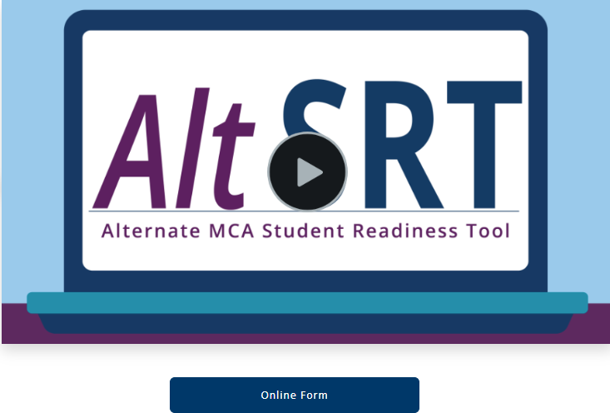
Student Readiness Tools (SRT)

Slide 19
Accessing the Student Readiness Tools (SRT)
Access the Science Alt MCA SRT Video and Online Test Form
https://minnesota.pearsonaccessnext.com/readiness-tools/
Scroll down to the Online Alternate MCA Student Readiness Tools (SRTs) button and select, then select the play arrow on the SRT Image. Select the “Online Form” button below the video to access the Online test form.

Slide 20

Thank you!
Stacie Stensrud & Lauren Walker
Alt.assessment.mde@state.mn.us
651-582-8384

Slide 21
Charting the Cs Conference 2025
Statewide Professional Development to Support the Workforce and Low Incidence Disability Areas in the State of Minnesota.
This presentation is partially funded with a grant from the Minnesota Department of Education using federal funding, CFDA 84.027A, Special Education – Grants to States.

