Slide 1

ASL Activities – How?
Charting the Cs Conference 2025:
To Literacy and Beyond
Cooperation
Communication
Collaboration
April 27, 2025
Lance Gonzalez – MSAD ASL Specialist
Chelsea Paulson – MSAD DHH Outreach Specialist

Slide 2
Workshop Description
Have you ever developed an ASL goal on an IEP, and are stumped with how to provide year-long services with measurable objectives for your student who uses ASL receptively and expressively, at various communication levels? This is the workshop for you to create language lessons with activity ideas on a variety of levels. This session will provide many activities, and you will be inspired with ideas about how to promote ASL development with your student(s).

Slide 3
Topics in ASL for Classroom
Expressive ASL skills
Receptive ASL Skills
ASL Vocabulary Expansion
ASL Grammar and Syntax
ASL Conversational Skills
ASL Reading Skills (Viewing)
ASL Writing Skills (Expressive)
ASL Cultural Competence
Functional ASL Skills
ASL Advocacy and Self-Advocacy

Slide 4
Expressive ASL Skills
This refers to the student's ability to effectively communicate using American Sign Language (ASL) by accurately producing a predetermined number of signs and sentences in daily interactions. This may involve practicing and refining their signing abilities to convey messages clearly and fluently.

Slide 5
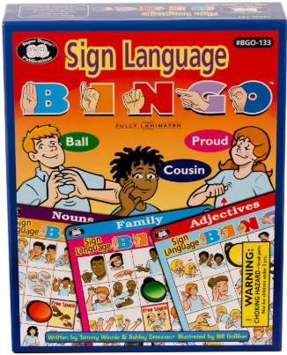

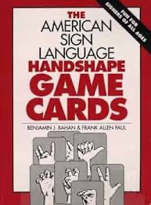
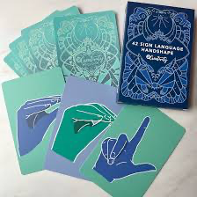
Expressive ASL Skills Activities
Rory’s Story Cubes (https://www.storycubes.com/en/)
Pick a picture based on student’s prior knowledge.
Description an object in the classroom and guess what object.
ASL Handshape Game Cards for multi-purpose
Sign language Bingo
Name story
Creating a machine
A story about a word C-A-T
Describe water cycle through body movement/NMS

Slide 6
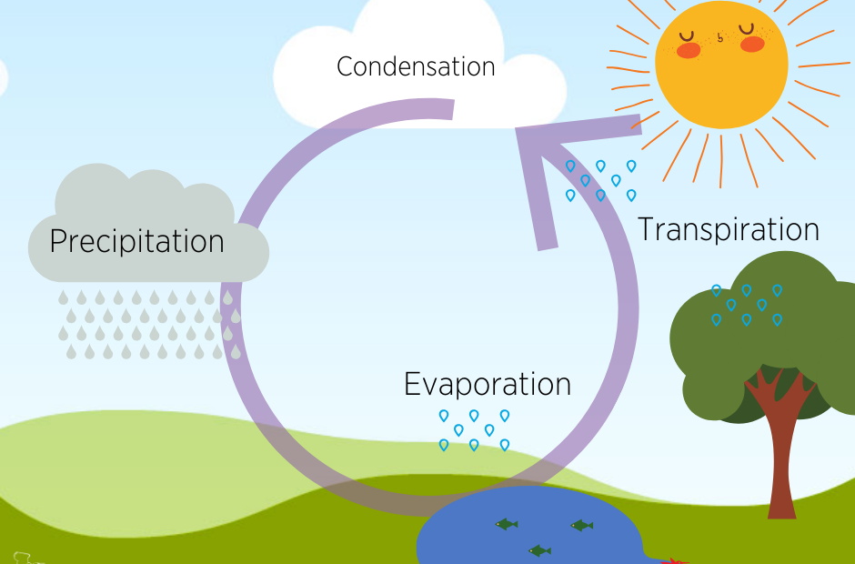
Expressive ASL Skills Activities (Water cycle)

Slide 7
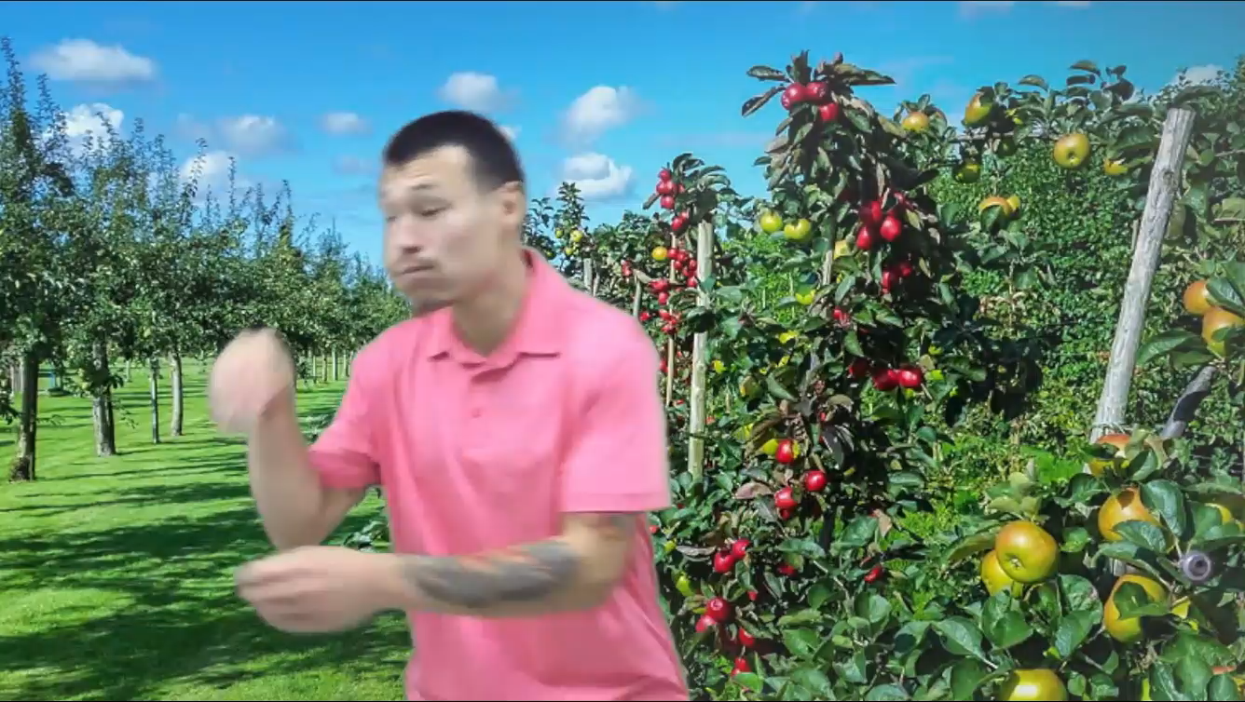
Expressive ASL Rhythm Skills (Apple life cycle)

Slide 8
Receptive ASL Skills
This focuses on the student's ability to understand and comprehend ASL signs and sentences presented by others, such as teachers or peers, during classroom activities. The goal is for the student to accurately identify and interpret ASL communication in various contexts.

Slide 9
Receptive ASL Skills Activities
Read aloud a book**
ASL short story video** (YouTube and in-house ASL videos)
Train ASL short story (pair or small group)
Description an object or cartoon appearance and draw the picture match the description.
Retell their own story with some changes from the short story ("The Three Little Pigs")
Sign Language Bingo (create a sentence)
**Ask questions to check if students are following the video or story.

Slide 10
ASL Vocabulary Expansion
This involves actively learning new signs related to classroom content or everyday life and incorporating them into their communication. It's important for the student to continuously expand their ASL vocabulary to express a wider range of ideas and concepts effectively.

Slide 11
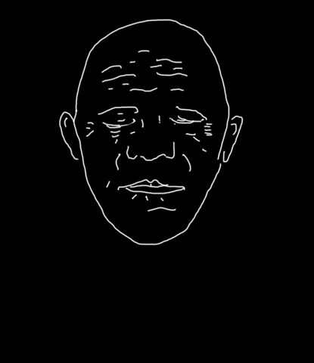
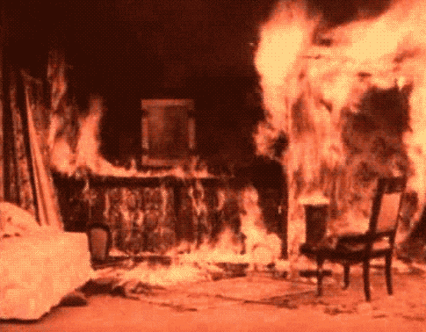

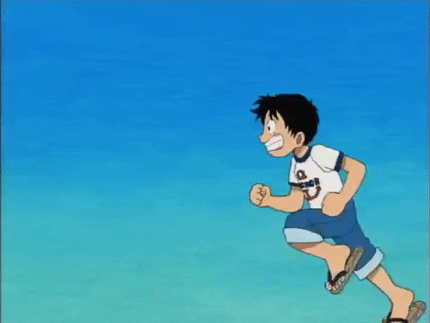

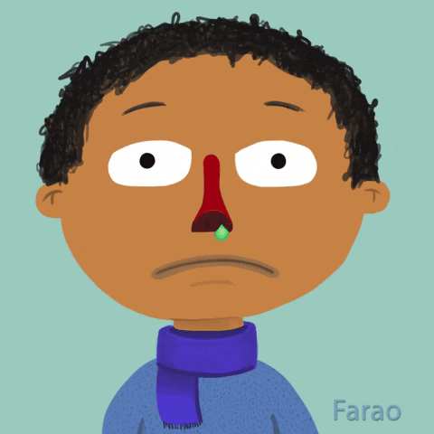
ASL Vocabulary Expansion Activities
Homonym (same word different sign)
Example- “GROW”
Example- “RUN”

Slide 12









ASL Vocabulary Expansion Activities, continued
Compound words

Slide 13
ASL Grammar and Syntax
This pertains to the student's understanding and application of the grammatical rules and sentence structure specific to ASL. Mastery of ASL grammar enables the student to construct sentences correctly and convey meaning accurately in their signed communication.

Slide 14
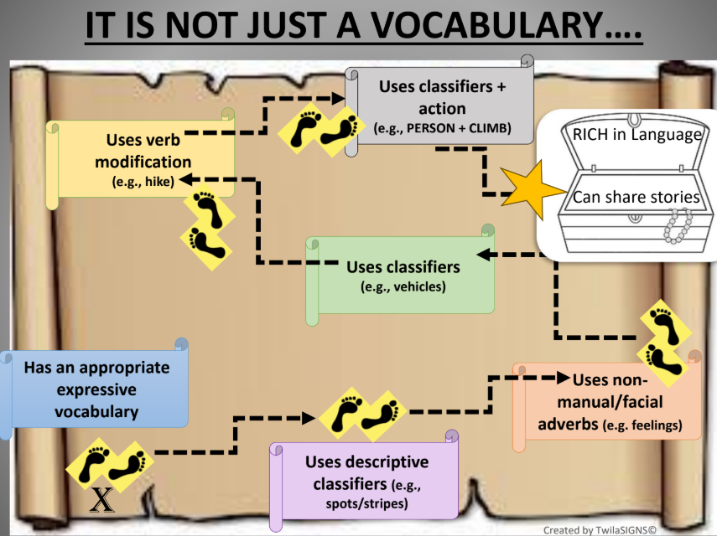
ASL Grammar and Syntax, continued

Slide 15
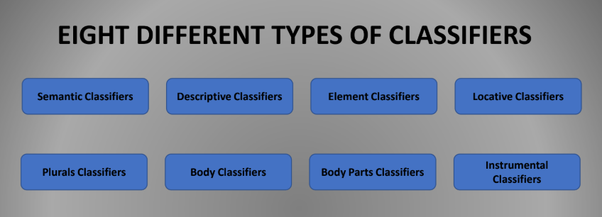
ASL Grammar Activities
5 parameters
ASL grammar/Syntax
8 different types of classifiers
Handshape
Palm Orientation
Location
Movement
Non-manual signals
Role shifting
Classifiers
Directional Verbs
Questions Structure
Ordinal numbers
Semantic
Descriptive
Element
Locative
Plurals
Body
Body Parts
Instrumental

Slide 16
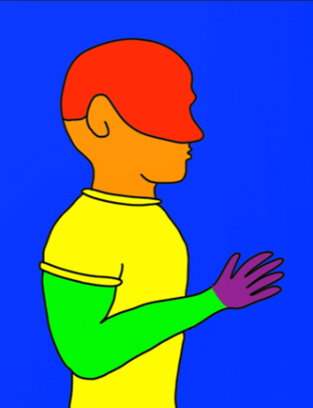
ASL Grammar Activities, continued
Graphmes
Red-Signs are made on the forehead.
Orange-Signs are made at the chin, mouth, or nose.
Yellow- Signs are made at the chest
Green- Signs are made at the forearms and hands.
Blue- Signs are used to designate neutral parts of the body, not touching any body part.
Purple- Lexicalized fingerspelling

Slide 17
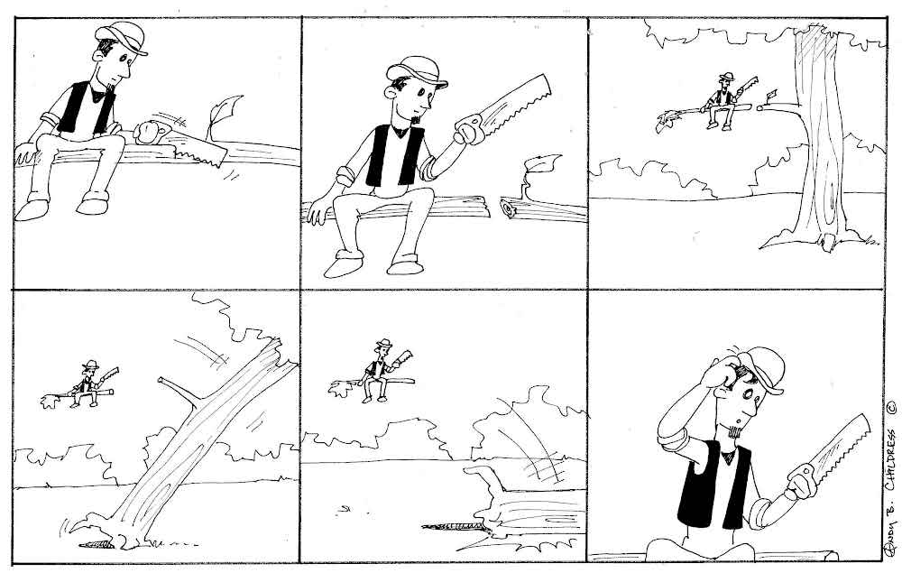
ASL Grammar Activities, continued 2
Comic strip (wordless)

Slide 18
ASL Conversational Skills
This involves the student's ability to engage in meaningful exchanges using ASL, including initiating conversations, maintaining interaction, and appropriately responding to others. Developing conversational skills is crucial for effective communication and social interaction in various settings.

Slide 19
ASL Conversational Skills Activities
Generate a topic for students to engage in a conversation about.
Create an opportunity for students to initiate the conversation in order to gather data for their bar graph. (For example: "Which option would you prefer: pizza or chicken tenders?")
Create a video conversation between two characters, students viewing each other’s videos.

Slide 20
ASL Conversational Skills Activities, continued
ARE
HAVE
CAN

Slide 21

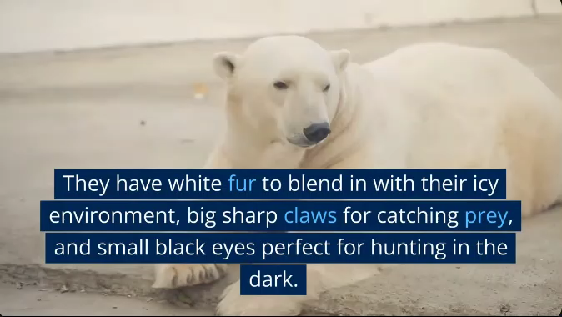
ASL Conversational Skills Activities, continued 2

Slide 22
ASL Viewing Skills (reading)
This includes watching ASL videos, attending signed presentations or lectures, reading ASL literature, and interpreting visual texts presented in ASL. Strengthening ASL viewing skills involves improving one's ability to understand and interpret the language accurately, recognize different signing styles, comprehend linguistic nuances, and understand the cultural context of Deaf communication. These skills are essential for individuals learning ASL to effectively engage with the Deaf community, participate in ASL-based activities, and develop fluency in sign language.

Slide 23
ASL Viewing Skills (reading) Activities
Create several videos and/or find ASL videos on YouTube:
Plot hole/ missing important information
Identify incorrect animals, objects, or other elements in the video.
Identify emotions in the video
Compare two same videos and look for the missing details.

Slide 24
ASL Viewing Skills (reading) Activities, continued
Questions:
Who is the main character of the video?
What is the setting of the video?
Can you describe the climax of the video?
What happens at the end of the video?
Can add other questions to match students’ IEP objectives/goals

Slide 25
Deaf Cultural Awareness
This focuses on the student's understanding and appreciation of Deaf culture, history, traditions, and current events. Participating in discussions, presentations, or projects related to Deaf culture helps the student develop cultural competence and a deeper connection to the Deaf community.

Slide 26
Deaf Cultural Awareness Activities
Deaf Culture Workshops
Students could learn about famous deaf individuals, watch deaf cinema, or explore deaf literature.
Simulation Activities
Students can try communicating with each other using only ASL and/or gestures or by wearing earplugs to simulate hearing loss. This can help Deaf students’ peers gain empathy and understanding of the challenges faced by deaf individuals.

Slide 27
Deaf Cultural Awareness Activities, continued
Deaf History Projects
Assign projects where students research and present on different aspects of deaf history, including key events, figures, and milestones in the deaf community's struggle for recognition and rights.
ASL Slangs
KISSFIST, OH I SEE, BAD/BAI, VEE, TRU-BIZ, FINISH, FOR-FOR, PEI PEI, PAH, WHOA, EYEPOP, BOMP, TRAIN ZOOM, EYE GARAGE DOOR (OPEN/CLOSE), AND DRY DISCUSS.

Slide 28
ASL (Deaf) Advocacy and Self-Advocacy
This involves empowering the student to advocate for their needs, preferences, and rights within the ASL community. It includes effectively communicating with peers, teachers, and other stakeholders about their ASL learning journey and accessibility requirements, fostering self-advocacy skills and promoting inclusivity.

Slide 29
ASL (Deaf) Advocacy and Self-Advocacy Activities
Learn how to effectively request accommodations to meet their needs in appointments, the workplace, and other settings to ensure accessibility.
Learn how to utilize communication tools such as VideoPhone, CapTel, relay services, and enable closed captions.
Call a specific movie theatre or event organizer to request an interpreter for the Deaf community.
Interview Deaf adults for their advice on navigating the hearing world to become better self-advocates as Deaf individuals
Share your voice to get your needs related to accessing information at home or school.
We have MSAD Online Academy – Self-Advocacy Class available for Fall 2025

Slide 30

Thank you!
Lance Gonzalez – MSAD ASL Specialist
Chelsea Paulson – MSAD DHH Outreach Specialist
Lance.Gonzalez@msa.state.mn.us
Chelsea.Paulson@msa.state.mn.us

Slide 31
Charting the Cs Conference 2025
Statewide Professional Development to Support the Workforce and Low Incidence Disability Areas in the State of Minnesota.
This presentation is partially funded with a grant from the Minnesota Department of Education using federal funding, CFDA 84.027A, Special Education – Grants to States.

