Slide 1



Teach Special Education MN Updates
Tuesday, April 30, 2025, 10 AM – 11 AM
Paul Dols, MDE, Special Education Workforce Specialist
Katie Roby, MDE, Low Incidence Disabilities Specialist for Equity and Licensure
www.teachspedmn.org
Charting the Cs Conference 2025:
To Literacy and Beyond
Cooperation
Communication
Collaboration

Slide 2

Teach Special Education Minnesota website

Slide 3
Teach Special Education Minnesota (TeachSpEdMN.org)
TeachSpEdMN.org is a project in collaboration with our Regional Low Incidence Facilitators, BrightWorks, and Minnesota Institutes of Higher Education
TeachSpEdMN.org will serve as a resource for prospective and current special education teachers to explore, become, grow, and thrive in the teaching profession
The vision of this project is to recruit, support and retain excellent special educators and to help shift the public narrative about teaching special education

Slide 4
Explore
  What is special education?
  Why teach special education in Minnesota?
  What are low incidence disabilities?
  Current links to MDE disability category webpages, IDEA, PELSB Supply and Demand Report
  Future links to MDE Disability Category Quick Cards

Slide 5
Become
  Information about becoming a special education teacher in Minnesota
  Licensure information including links to PELSB resources
  Link to Minnesota School Jobs
  Links to our Special Education Preparation Programs in Minnesota
  We are working to include video introduction connecting candidates to colleges and universities with a personal connection

Slide 6
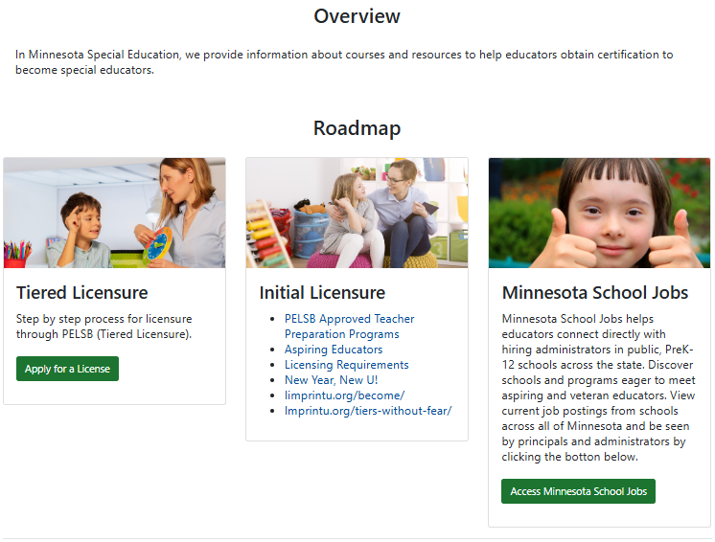
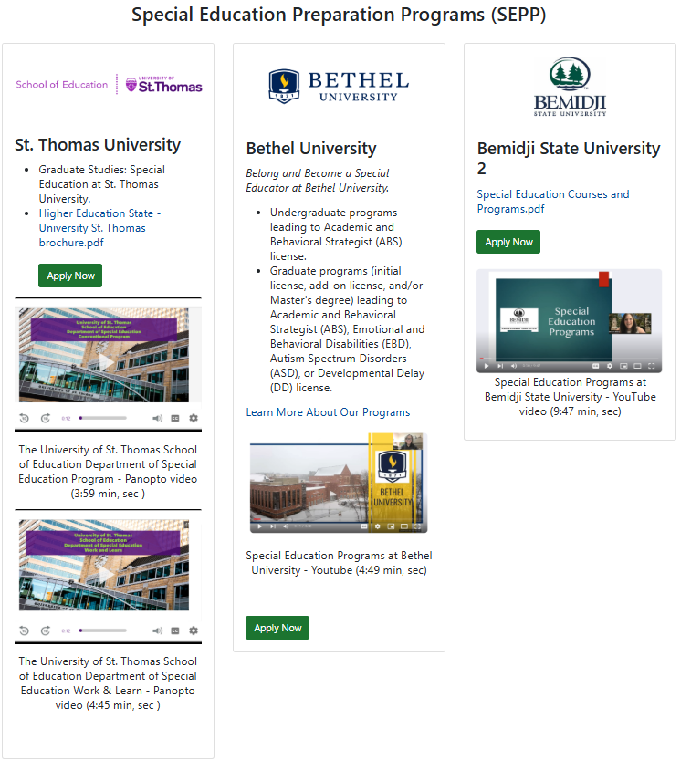
Become Overview

Slide 7
Teach Special Education MN Teacher Recruiting Events
  Two recruiting events annually, with the possibility of adding a third
  Audience:
    Current teachers adding licenses
    Paraprofessionals
    High school seniors

Slide 8
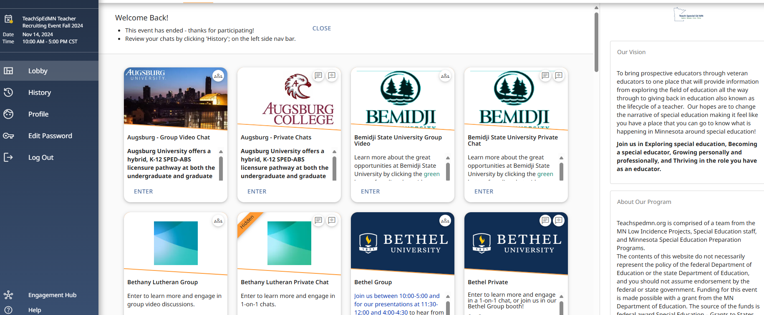
Virtual Event Platform Teacher Recruiting Event Fall 2024

Slide 9
Grow
  Mentoring programs (Minnesota Mentor Program, New Teacher Center, National Center on Intensive Intervention)
  Professional development opportunities including Charting the C’s, MN CEC, HLPs, IRIS Center, etc.
  Connections to regional supports

Slide 10




Mentoring programs

Slide 11

TeachSpEdMN and the Minnesota Council for Exceptional Children
Professional Development for New Special Education Teachers in MN
Quarter 1: Foundations and Getting Started
Week 1-2: Orientation and Introduction to Sp. Ed. in MN
Week 3-4: IEP Fundamentals
Week 5-6: Classroom Management and Behavior Support
Week 7-8: Curriculum and Instructional Strategies

Slide 12
TeachSpEdMN and the Minnesota Council for Exceptional Children, cont.
Professional Development for New Special Education Teachers in MN
Quarter 2: Instructional Practices and Collaboration
Week 9-10: Evidence-Based Instructional Practices
Week 11-12: Data Collection and Progress Monitoring
Week 13-14: Collaboration and Co-Teaching
Week 15-16: Communication and Team Meetings

Slide 13
TeachSpEdMN and the Minnesota Council for Exceptional Children, cont. 2
Professional Development for New Special Education Teachers in MN
Quarter 3: Advanced Practices and Legal Compliance
Week 17-18: Transition Planning
Week 19-20: Legal Compliance and Ethical Practices
Week 21-22: Supporting Diverse Learners
Week 23-34: Self-Assessment and Professional Growth

Slide 14
TeachSpEdMN and the Minnesota Council for Exceptional Children, cont. 4
Professional Development for New Special Education Teachers in MN
Quarter 4: Review, Reflect, and Plan for Next Year
Week 25-26: Reviewing Student Progress and IEP Goals
Week 27-28: Professional Collaboration and Community Building
Week 29-30: Reflection and Planning for Next Year

Slide 15
Thrive
The purpose of the "Thrive" page of this site is to provide resources to enhance the leadership capacity of special education teachers in Minnesota by fostering professional growth and providing opportunities for teachers to thrive and advance in their careers. We are particularly interested in your feedback and suggestions for this portion of the site. We currently share:
Leadership opportunities
Professional memberships

Slide 16
Tuition Supports
New 2025!
Offers information about financial assistance options for educators pursuing special education credentials.​
Federal supports, state supports, and (coming soon) regional supports

Slide 17
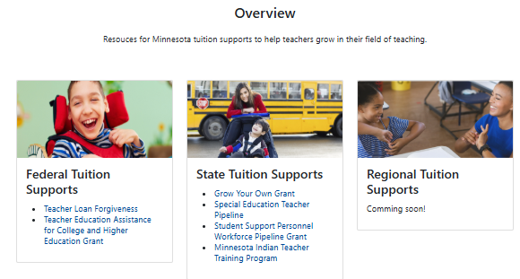
Teacher Journey

Slide 18
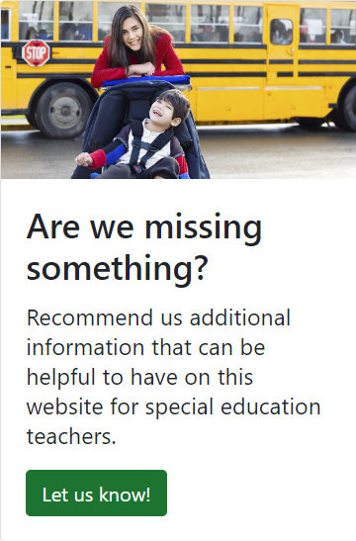
Are we missing something?

Slide 19

Feedback
How did you find the content presented? Any areas you found particularly helpful or areas needing improvement?
What are your thoughts on the usability and accessibility of our website?
Do you have any suggestions for additional resources or features that could enhance our website's support for special education teachers in Minnesota?
Are there any specific topics or tools you would like to see added or expanded upon on our website?
Thank you for taking the time to provide your feedback!

Slide 20
Thank you for your dedication to students with disabilities in Minnesota!
Contact Information:
Paul Dols, paul.dols@state.mn.us
Katie Roby, catherine.roby@state.mn.us

