Slide 1

I completed the READ ACT Training: Now What?
Charting the Cs Conference 2025:
To Literacy and Beyond
Cooperation Communication Collaboration
Supporting Early Literacy Development in Young Learners
Sarah Larson, Rochester Public Schools

Slide 2
Agenda- What to Expect
Key Principles of LETRS
Effective Classroom Practices for Early Literacy
Predictors of Literacy Achievement
Moving beyond “The Letter of the Week”
The Power of Play- Literacy Examples
“Real Life” Examples of Literacy Strategies
Incidental Literacy- “Literacy on the Fly”
Print Rich Environment

Slide 3
What is LETRS?
LETRS stands for Language Essentials for Teachers of Reading and Spelling.
It provides evidence-based strategies for teaching reading, writing, and spelling in early childhood.
The program emphasizes understanding the structure of language, its impact on literacy, and how teachers can support young learners.

Slide 4
Key Principles of LETRS
Phonemic Awareness: Understanding that words are made up of individual sounds.
Phonics: Teaching the relationship between sounds and letters.
Vocabulary Development: Expanding children's word knowledge.
Fluency: Helping children read smoothly and with expression.
Comprehension: Ensuring children understand what they read.

Slide 5
Key Principles of LETRS, cont.
Phonemic Awareness: Understanding that words are made up of individual sounds.
Phonics: Teaching the relationship between sounds and letters.
Vocabulary Development: Expanding children's word knowledge.
Fluency: Helping children read smoothly and with expression.
Comprehension: Ensuring children understand what they read.

Slide 6
Phonemic Awareness
What is Phonemic Awareness?
The ability to hear, identify, and manipulate individual sounds (phonemes) in spoken words.
Key Strategies:
Rhyming games
Segmenting and blending sounds
Sound matching activities
Why is it Important?
A strong predictor of future reading success.
Helps children decode words when they learn to read.

Slide 7
Phonics Instruction
What is Phonics?
Phonics is the understanding that letters and groups of letters represent sounds in spoken words.
Key Strategies:
Systematic and explicit instruction of letter-sound correspondences.
Letter recognition and blending sounds into words.
Practice with decodable texts.
Why is it Important?
Helps children decode and spell words.
Provides the foundation for fluent reading.

Slide 8
Vocabulary Development
What is Vocabulary Development?
The process of teaching children the meaning of words and how to use them in context.
Key Strategies:
Read aloud to children regularly.
Use rich and varied language in conversations.
Teach the meanings of new words in context.
Why is it Important?
A robust vocabulary is linked to better reading comprehension and writing skills.
Supports cognitive development and communication.

Slide 9
Fluency
What is Fluency?
The ability to read text smoothly and with expression, which helps with comprehension.
Key Strategies:
Practice reading aloud regularly.
Focus on expression, intonation, and punctuation.
Use repeated reading of familiar texts.
Why is it Important?
Fluency allows children to focus on understanding the text rather than decoding individual words.
Builds confidence in young readers.

Slide 10
Comprehension
What is Comprehension?
Comprehension is the ability to understand and interpret what is being read.
Key Strategies:
Ask questions before, during, and after reading.
Use graphic organizers to visualize key concepts.
Encourage children to retell stories in their own words.
Why is it Important?
Reading comprehension is the ultimate goal of literacy instruction.
Helps children make connections between what they read and their own experiences.

Slide 11
Effective Classroom Practices for Early Literacy
Structured Literacy Approach:
Provide explicit, systematic, and sequential instruction in language components.
Interactive and Engaging Activities:
Use songs, games, and hands-on learning experiences to support literacy skills.
Differentiation:
Tailor instruction to meet the individual needs of learners.

Slide 12
Predictors of Literacy Achievement
The TWO best predictors of literacy achievement from early kindergarten to 2nd grade are:
Phoneme awareness (sound isolation)
Letter-name knowledge
- (National Reading Panel, 2000; Whitehurst & Lonigan, 2002; National Early Literacy Panel, 2008)

Slide 13
Predictors of Literacy Achievement, cont.
Optimal Benchmark at Pre-K to Kindergarten is:
18 Uppercase Letter Names
15 Lowercase letter names

Slide 14
Moving beyond “The Letter of the Week”
Provide a variety of writing surfaces, such as clipboards and personal dry-erase boards, that children can take anywhere, even outside. Model writing for authentic purposes every day.
Help children create monthly class books about topics that interest them—from their families to their favorite foods, animals, or toys. They can also create books about letters, numbers, and their favorite words.

Slide 15
Moving beyond “The Letter of the Week”, cont.
Remember that literacy is everywhere.
Children love writing with interesting-colored pens and markers, so provide writing utensils in many different colors, sizes, and even scents or shapes. Not only are they fun to use, but the smooth, fluid feeling of using pens and markers encourages writing.

Slide 16
The Power of Play
“Playful learning” helps children make important connections, deepening their background knowledge.
A key point is that adult intentionality and interaction makes an important difference in young children’s learning
An important consideration:
How can I include literacy in play-based learning?
How can I support literacy development through play props, materials, or activities?

Slide 17
Literacy Strategies
Picture Story/Word Story
Read-a-Louds
Phonemic and Letter Awareness
Writing
Literacy during Routines

Slide 18
Picture Story/Word Story
*Helps children feel comfortable writing at their own level and reinforces that they are not expected to write like grown ups. Think about how many opportunities children have to write within your classroom/day. Intentionally guide in the process of what to write, how to get it on paper, identifying letters to sounds, letter formation, and pencil grip. Model/scaffold. (Two phases above)
There are other ways you can present this strategy that doesn’t involve whole group instruction. Ex: Small group and teacher/child activity.
Journals are a great way to implement this strategy.
Provide writing opportunities (art/literacy, dramatic play; Grocery list)
Large chart for question of the day and discussion.

Slide 19
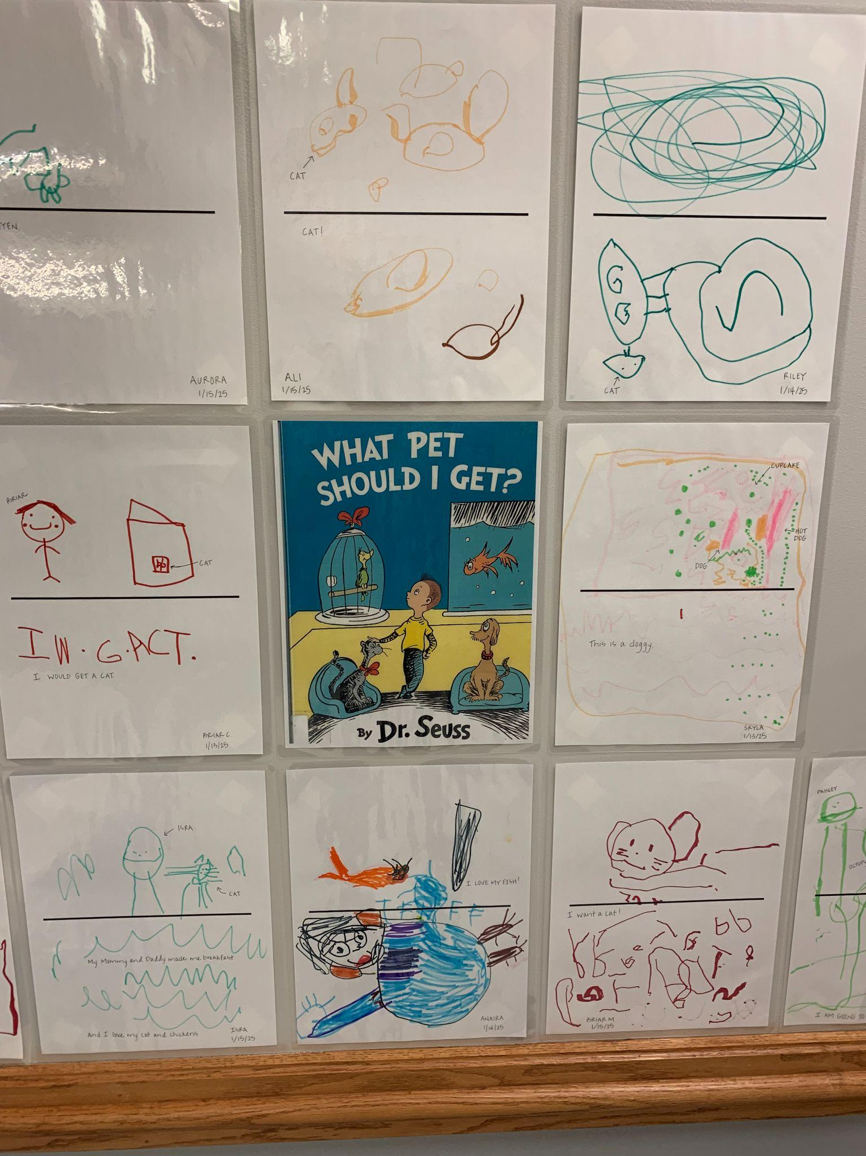
Picture Story/Word Story, cont.

Slide 20
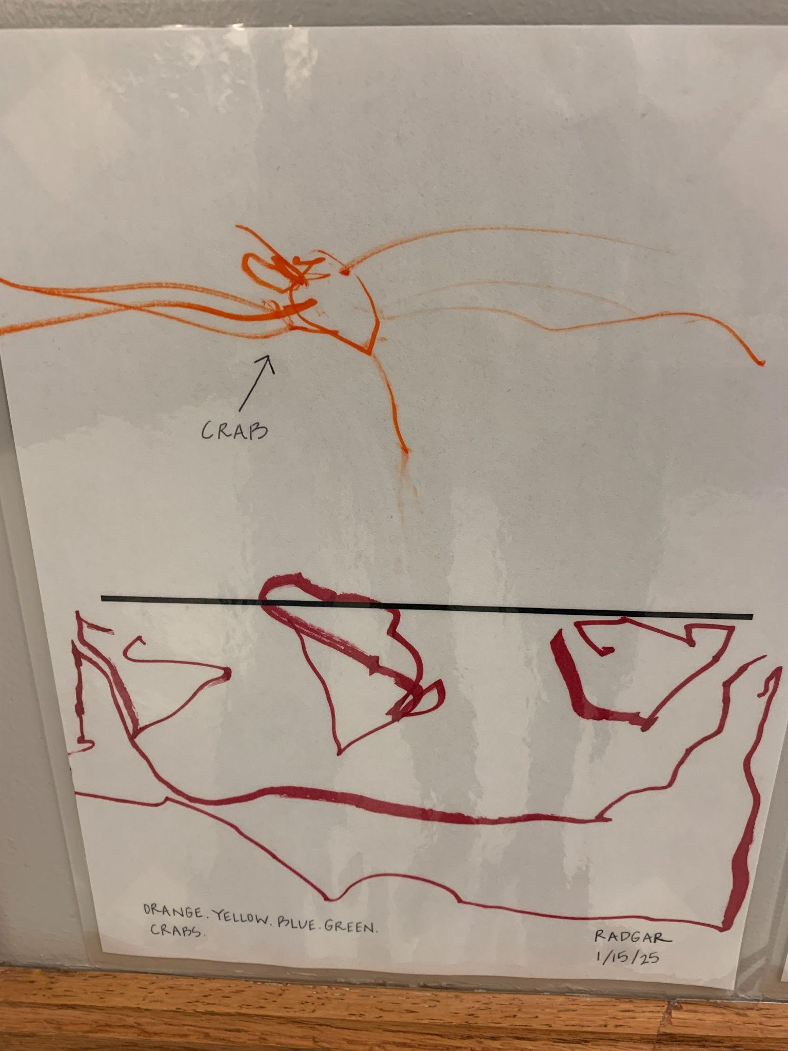
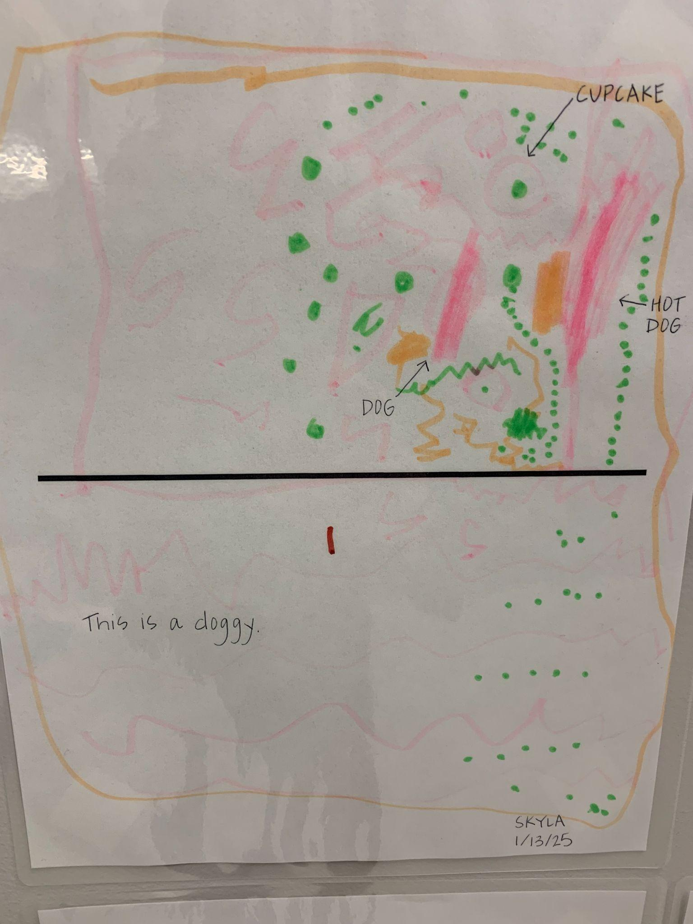
Student Example

Slide 21
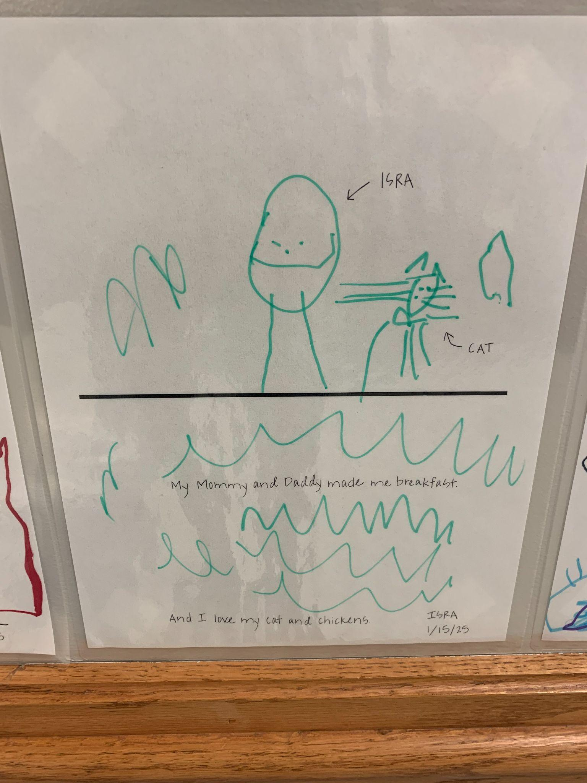
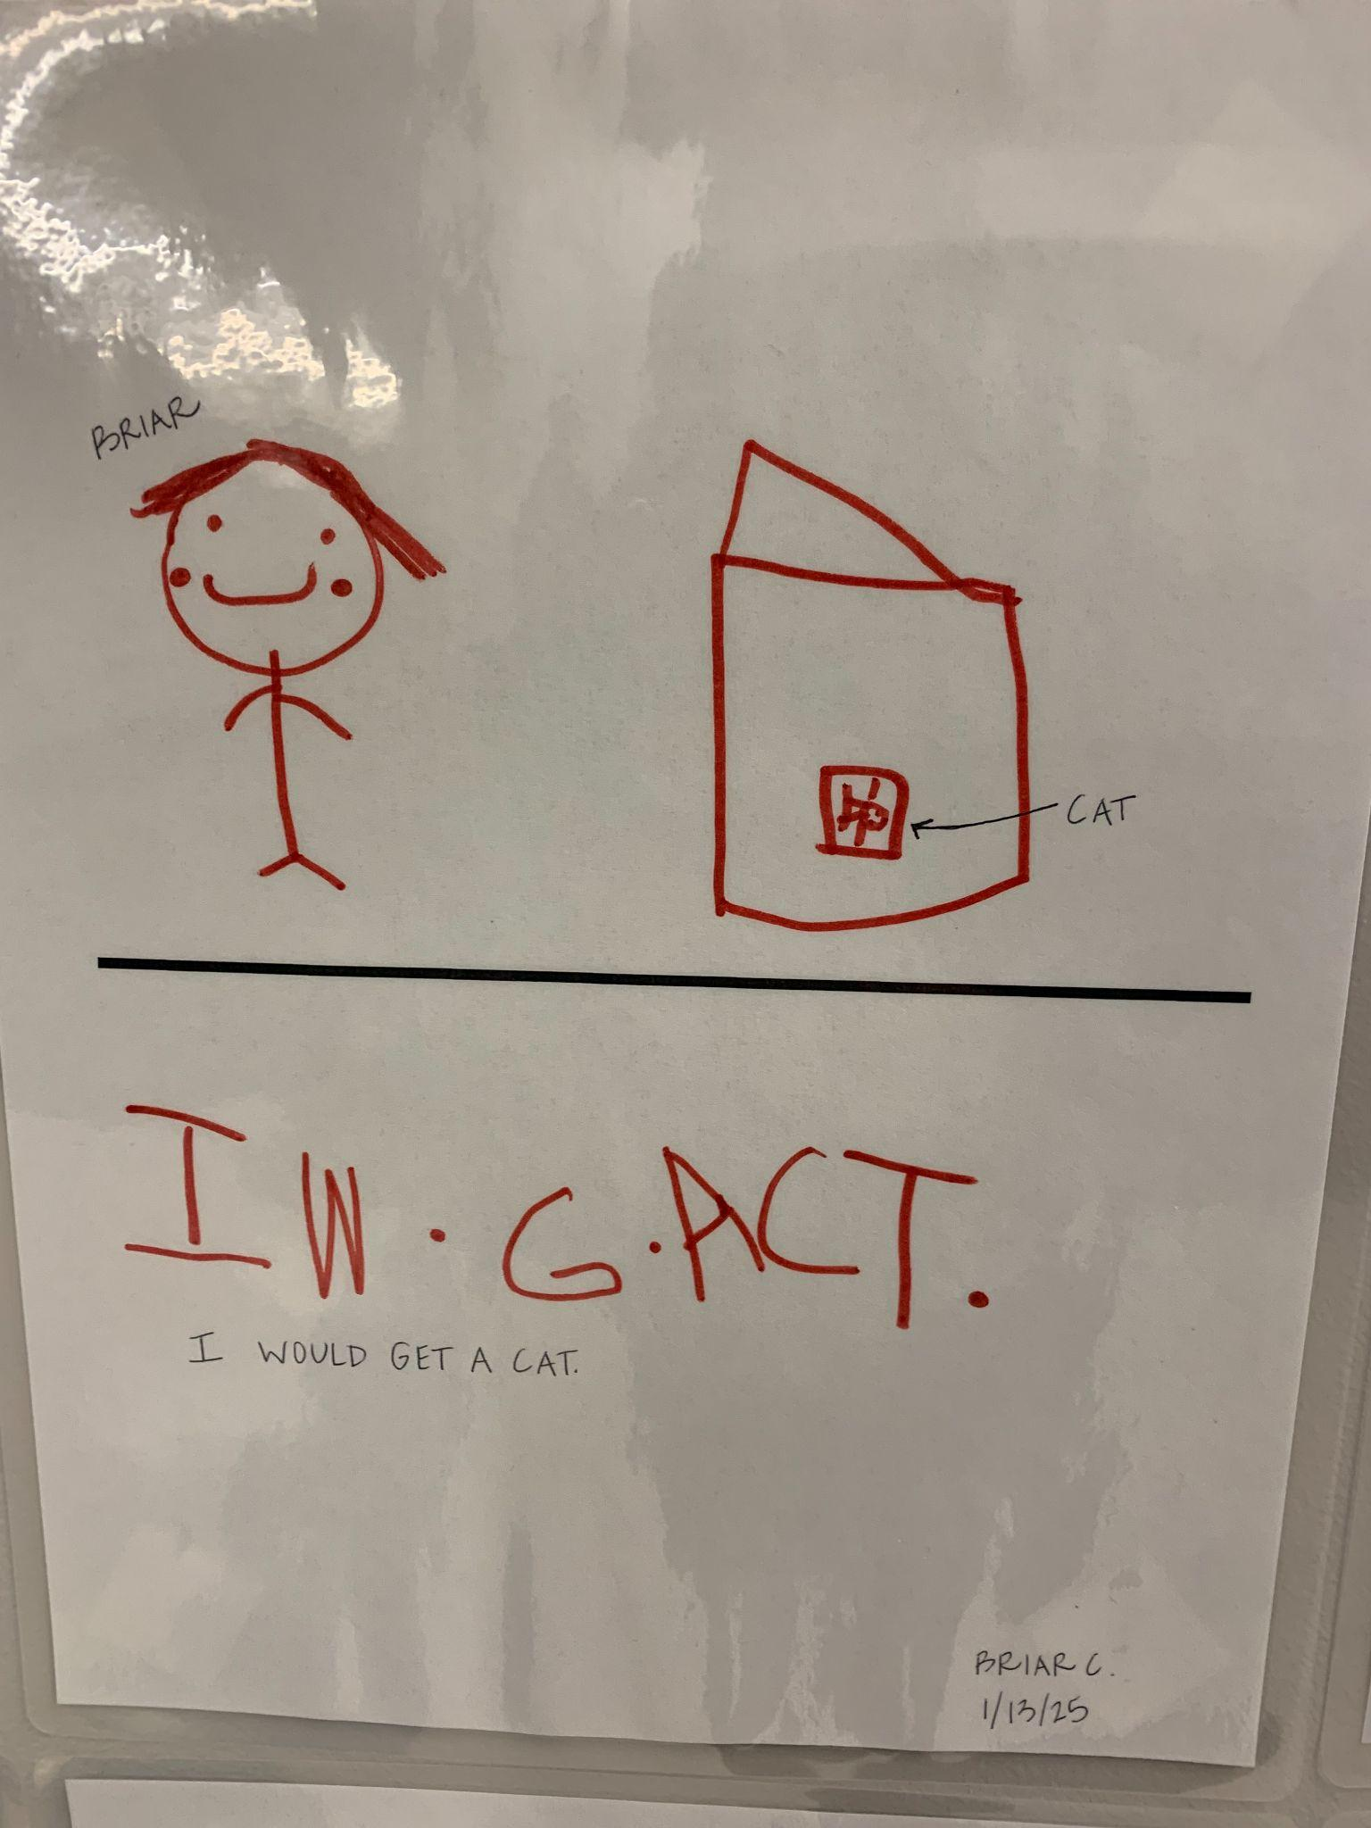
Student Example, cont.

Slide 22
Read-A- Louds
Read A Loud:
Repeated Reading Plan- How to implement- Pg. 80* -84
Intentional plan for repeated reading
Fun ways to do read alouds: Wear fun reading glasses! There is value in creating excitement about read aloud!
Interactive Story book routines
Extension activity: Story Walk
Book Discussion Cards for Creative Curriculum

Slide 23
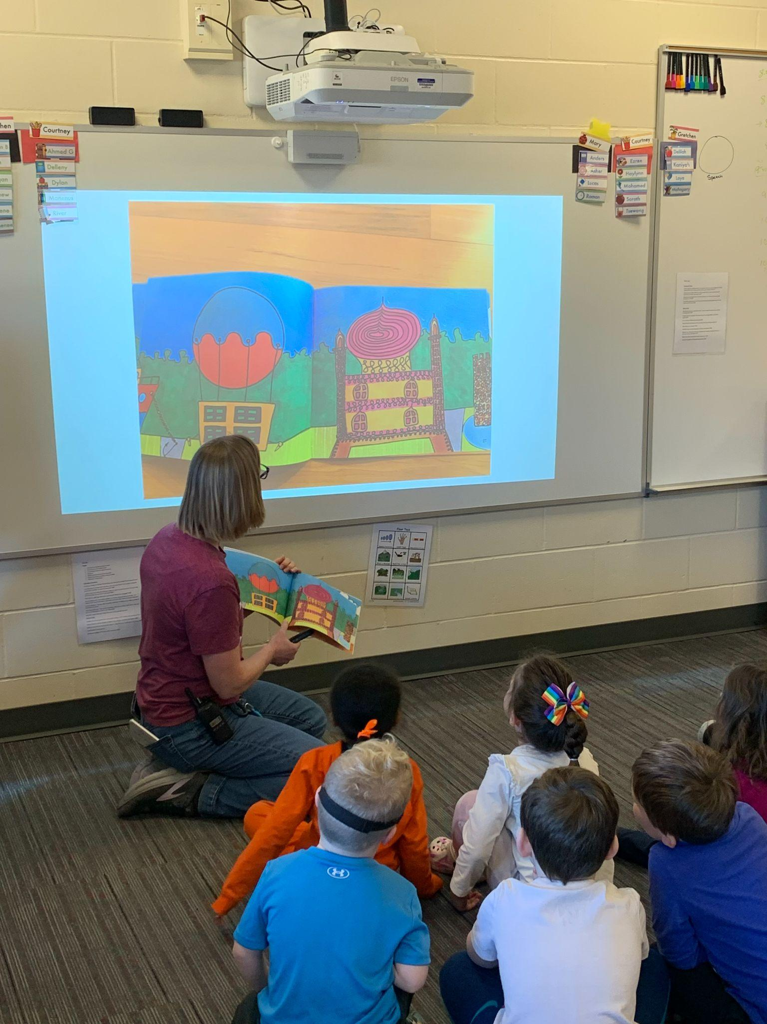
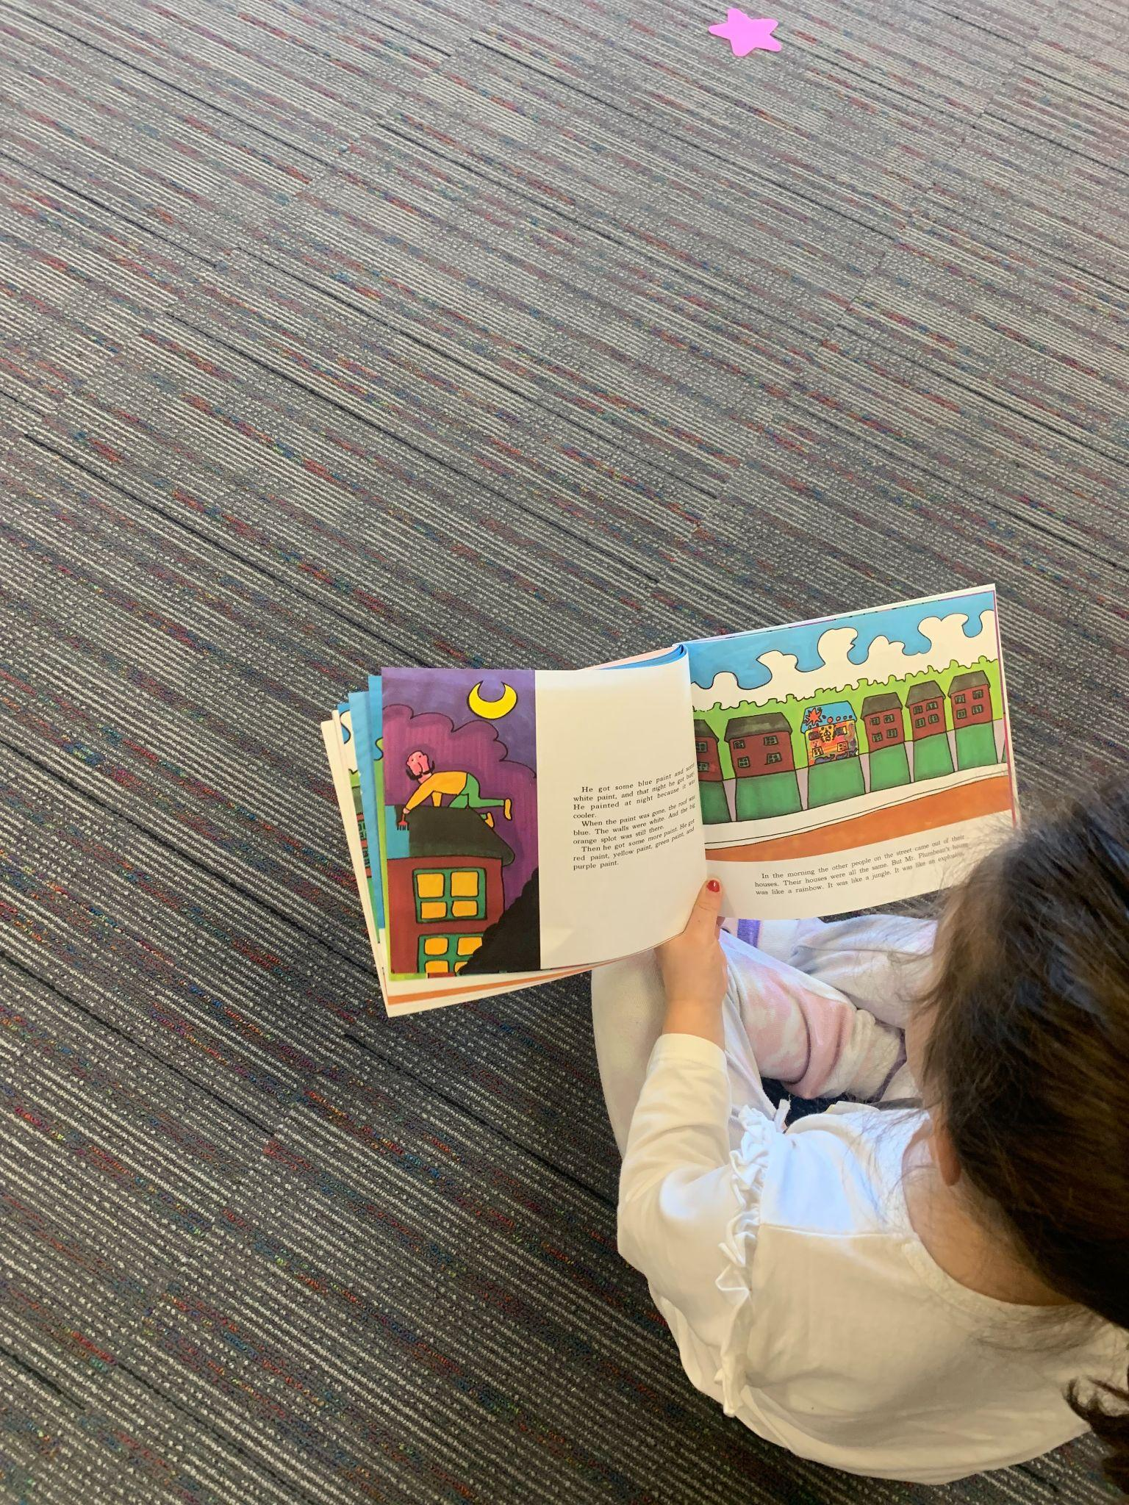
Read-A-Loud Modifications and Accessibility

Slide 24
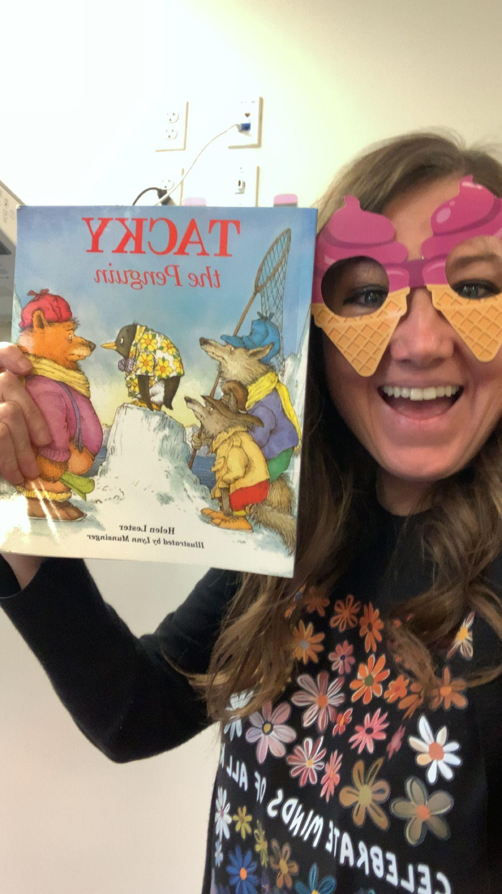
Using Props to Boost Engagement

Slide 25
Phonemic Awareness

Slide 26
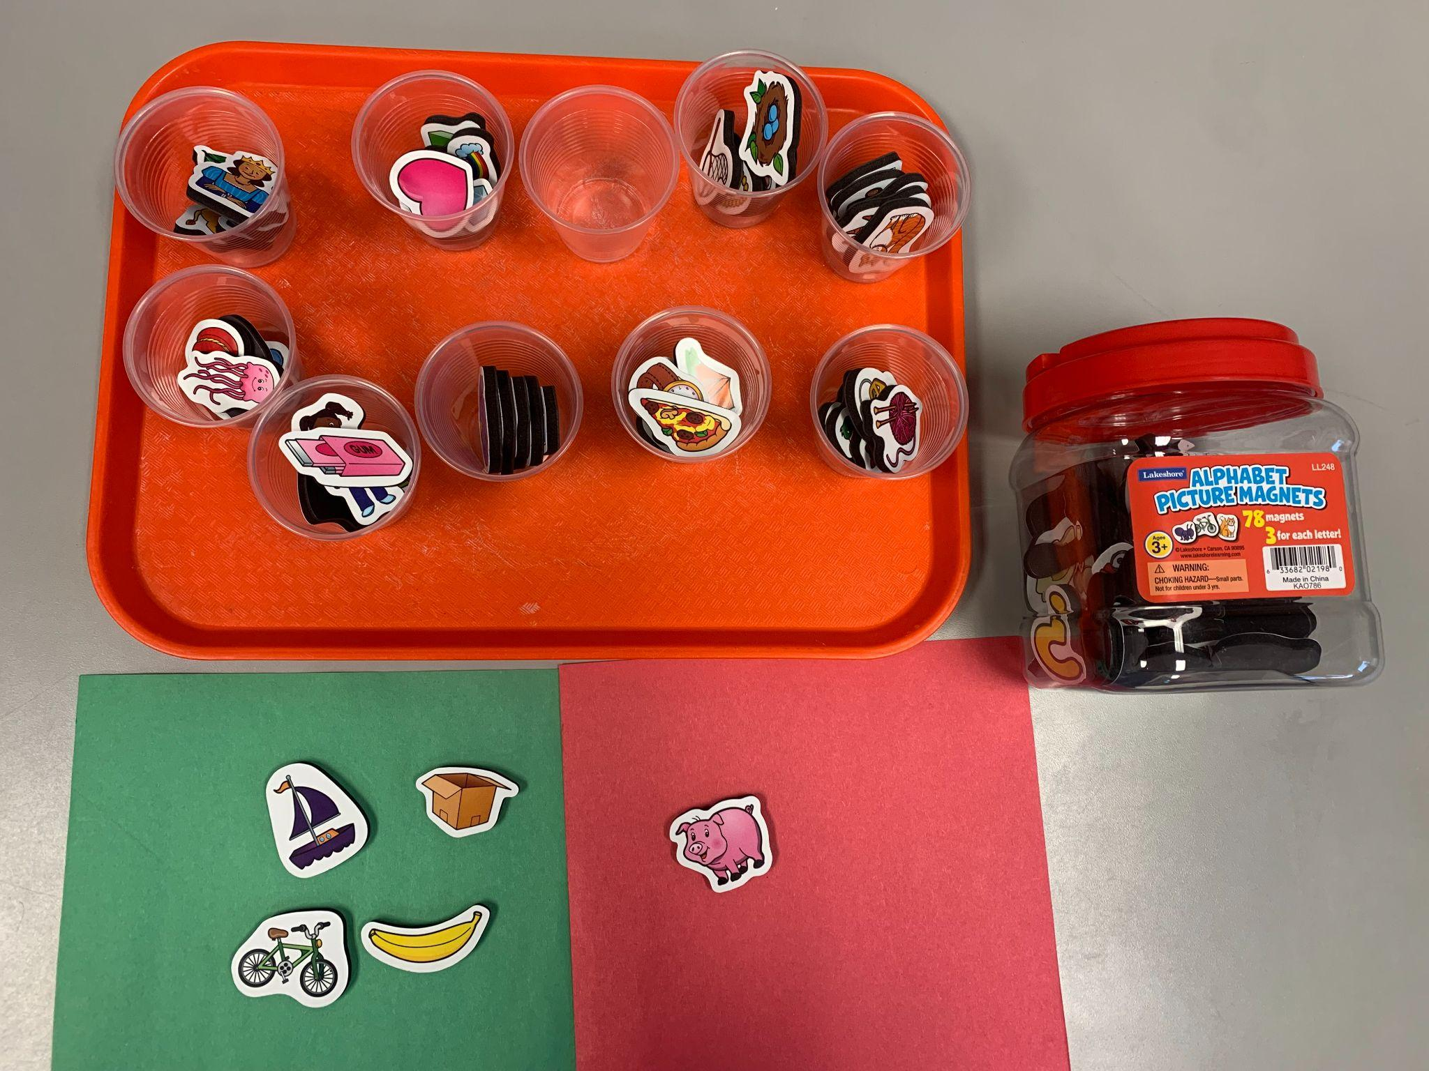
Initial Sound Activity

Slide 27
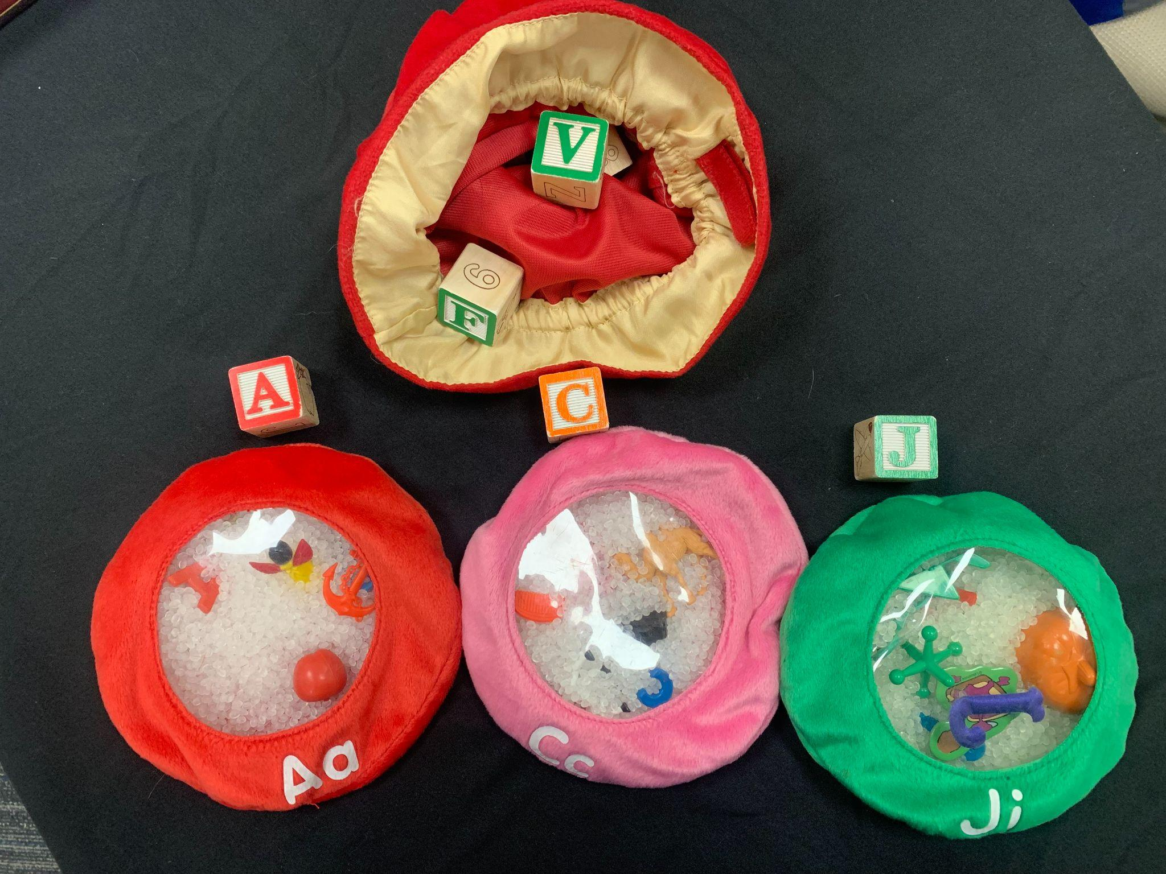
Mystery bag: Letter Matching

Slide 28
Letter Awareness

Slide 29
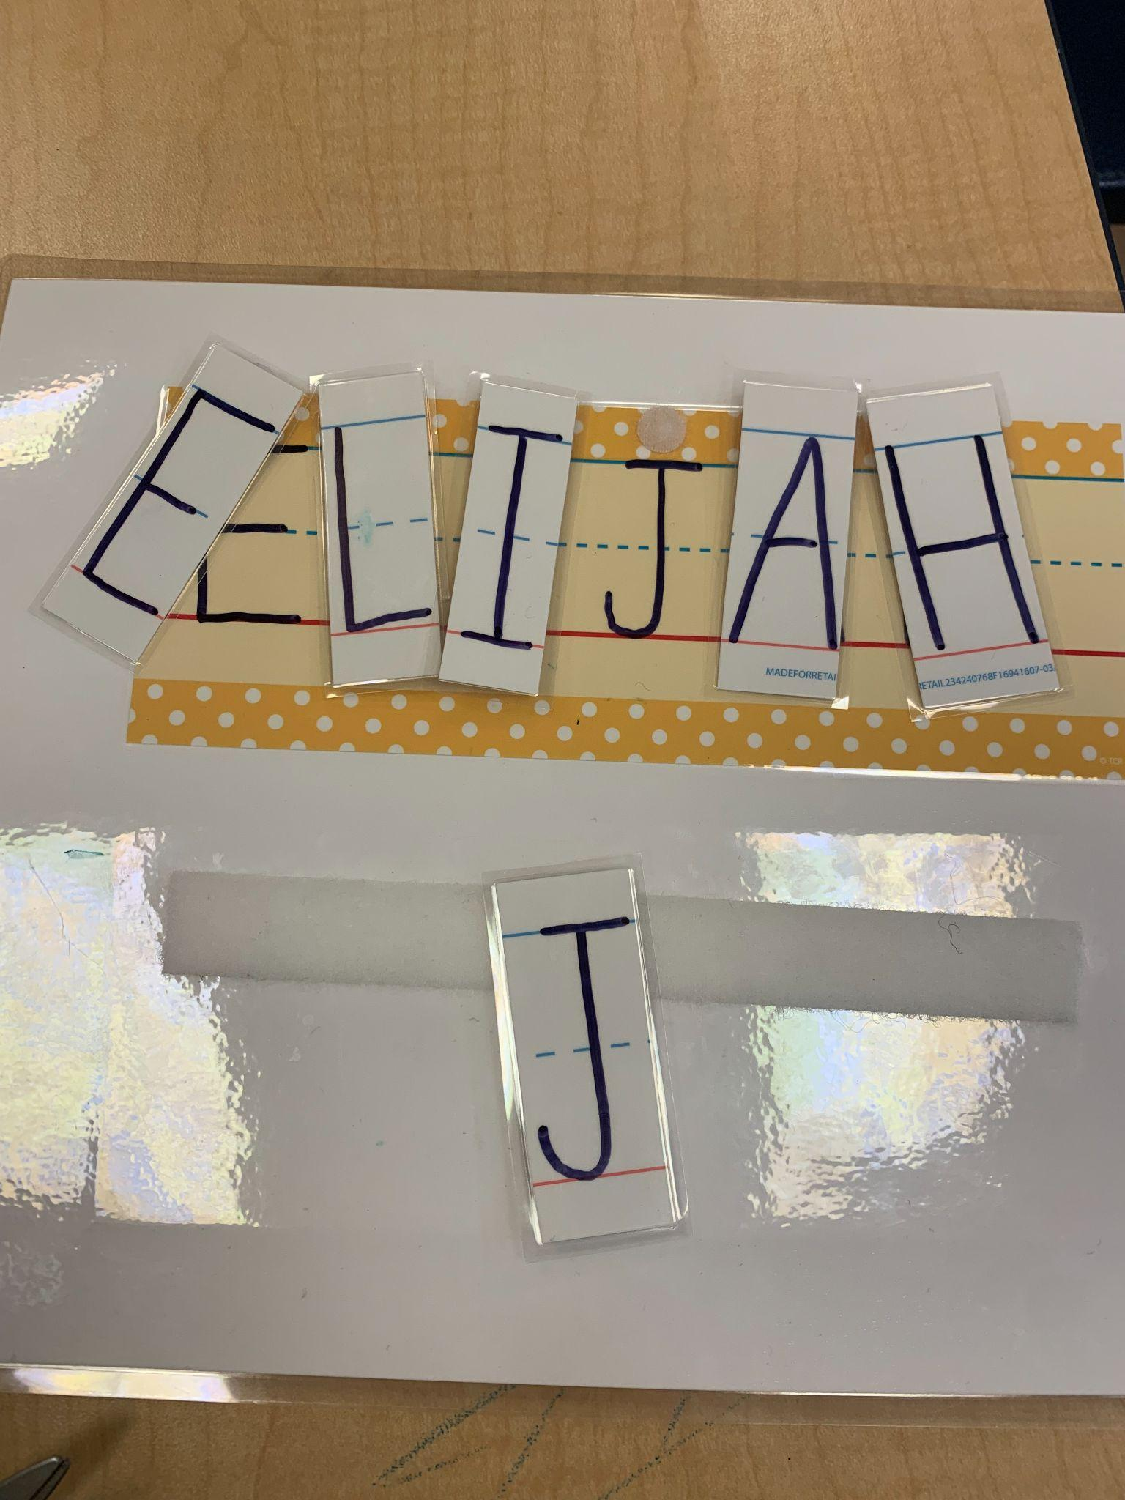
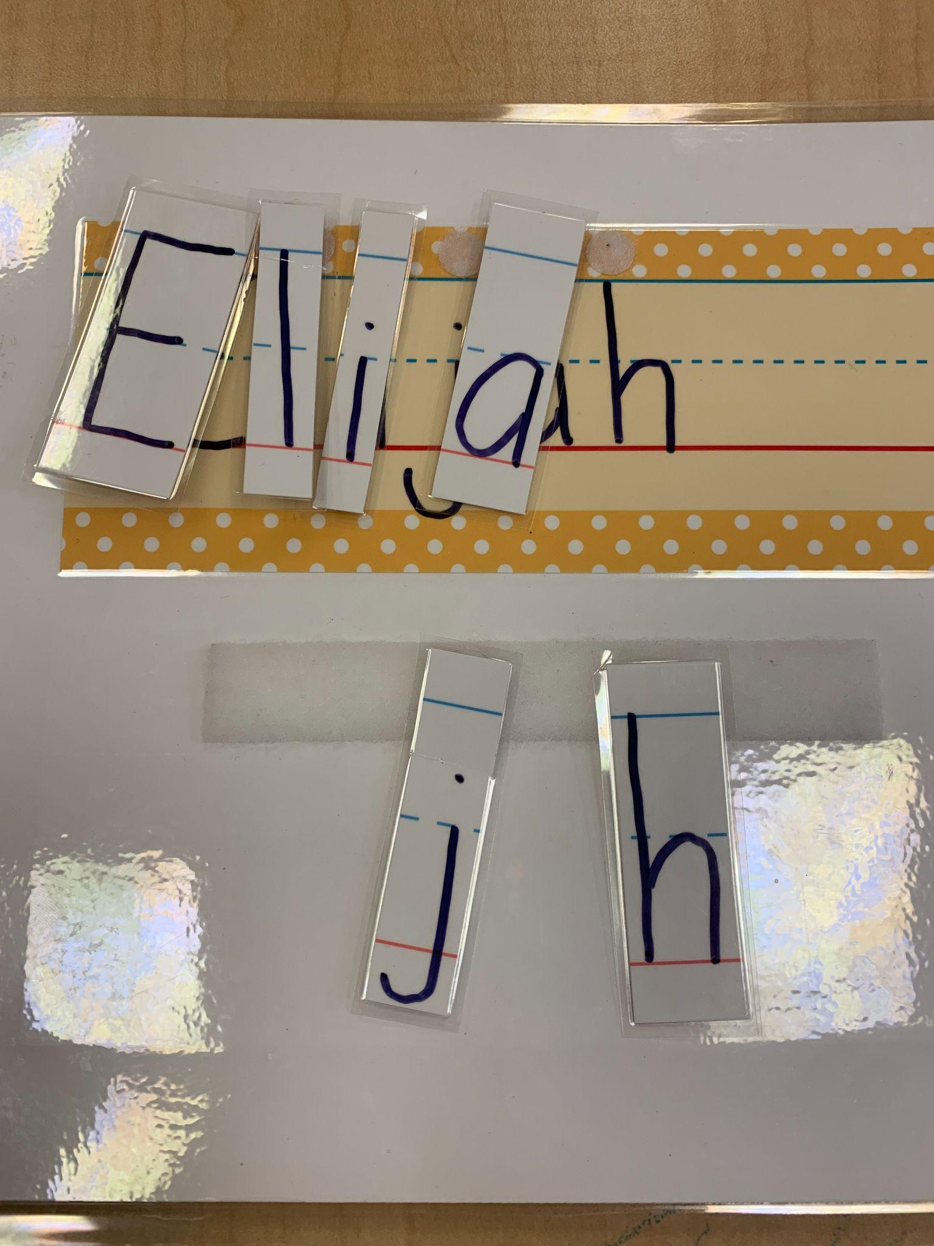
Independent Work: Letter Matching

Slide 30
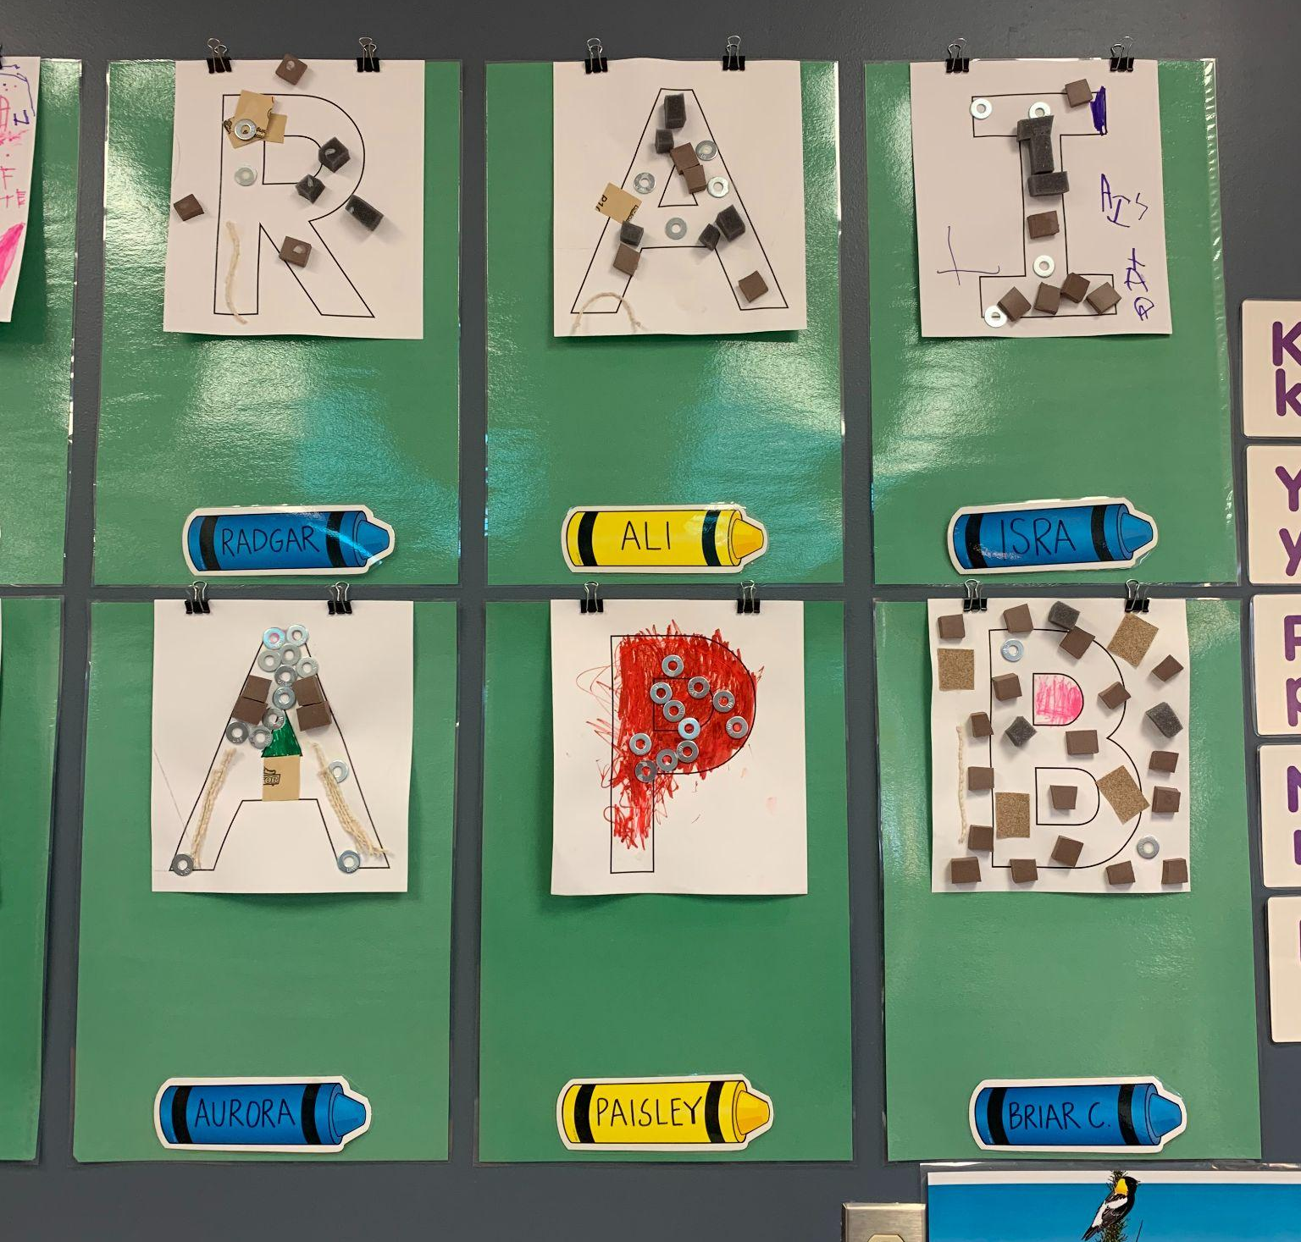
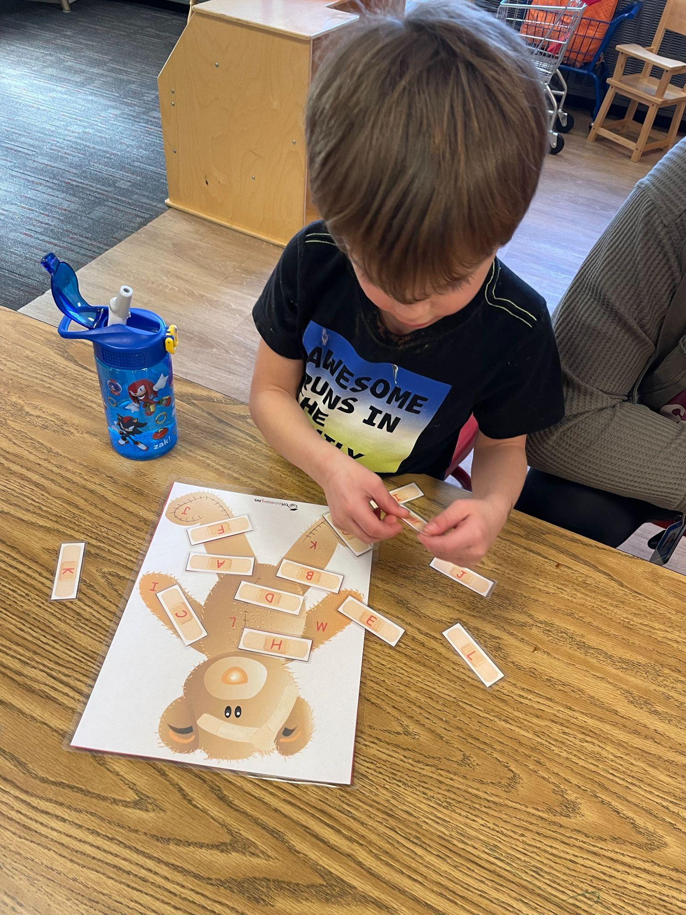
Letter in First Name Activity: Corresponds to Creative Curriculum

Slide 31
Writing

Slide 32
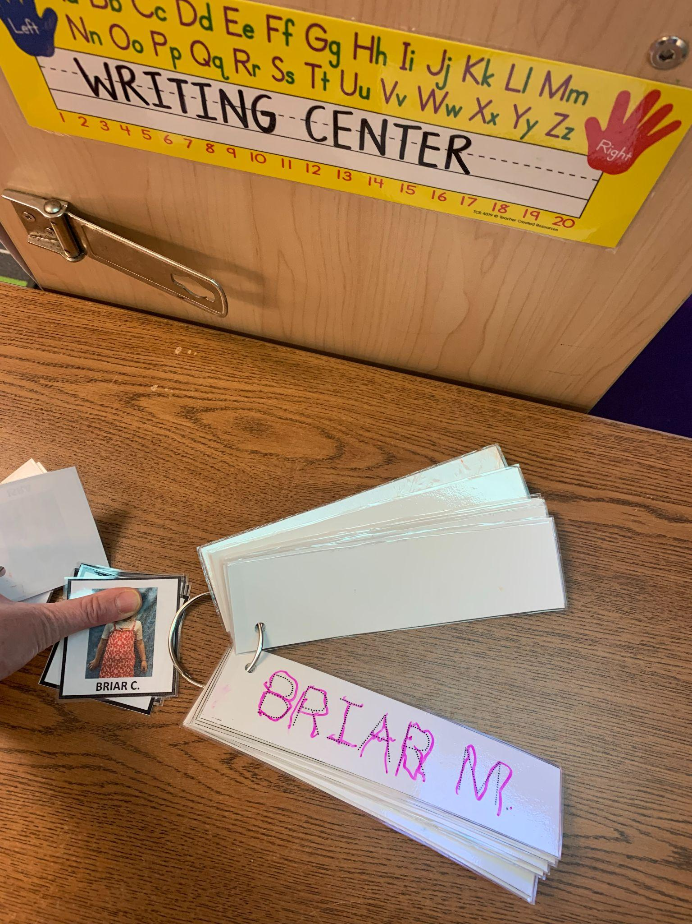
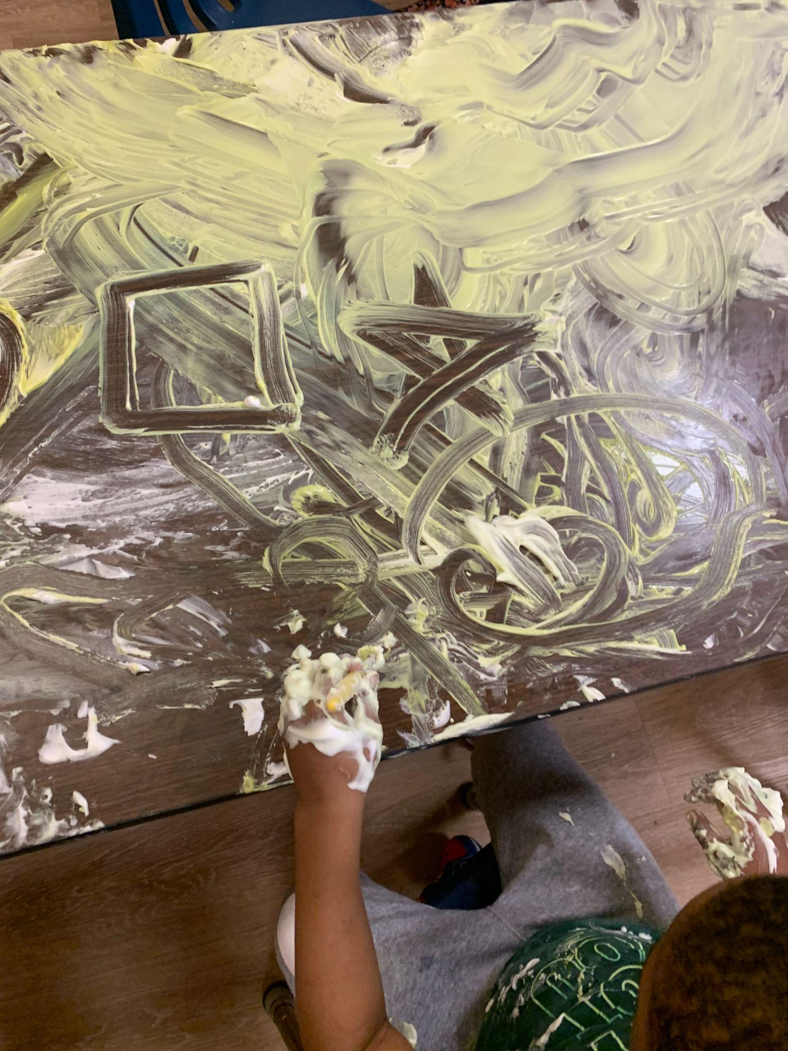
Letter Writing: Symbols, Identifying Shapes

Slide 33
Rhyming Activities

Slide 34
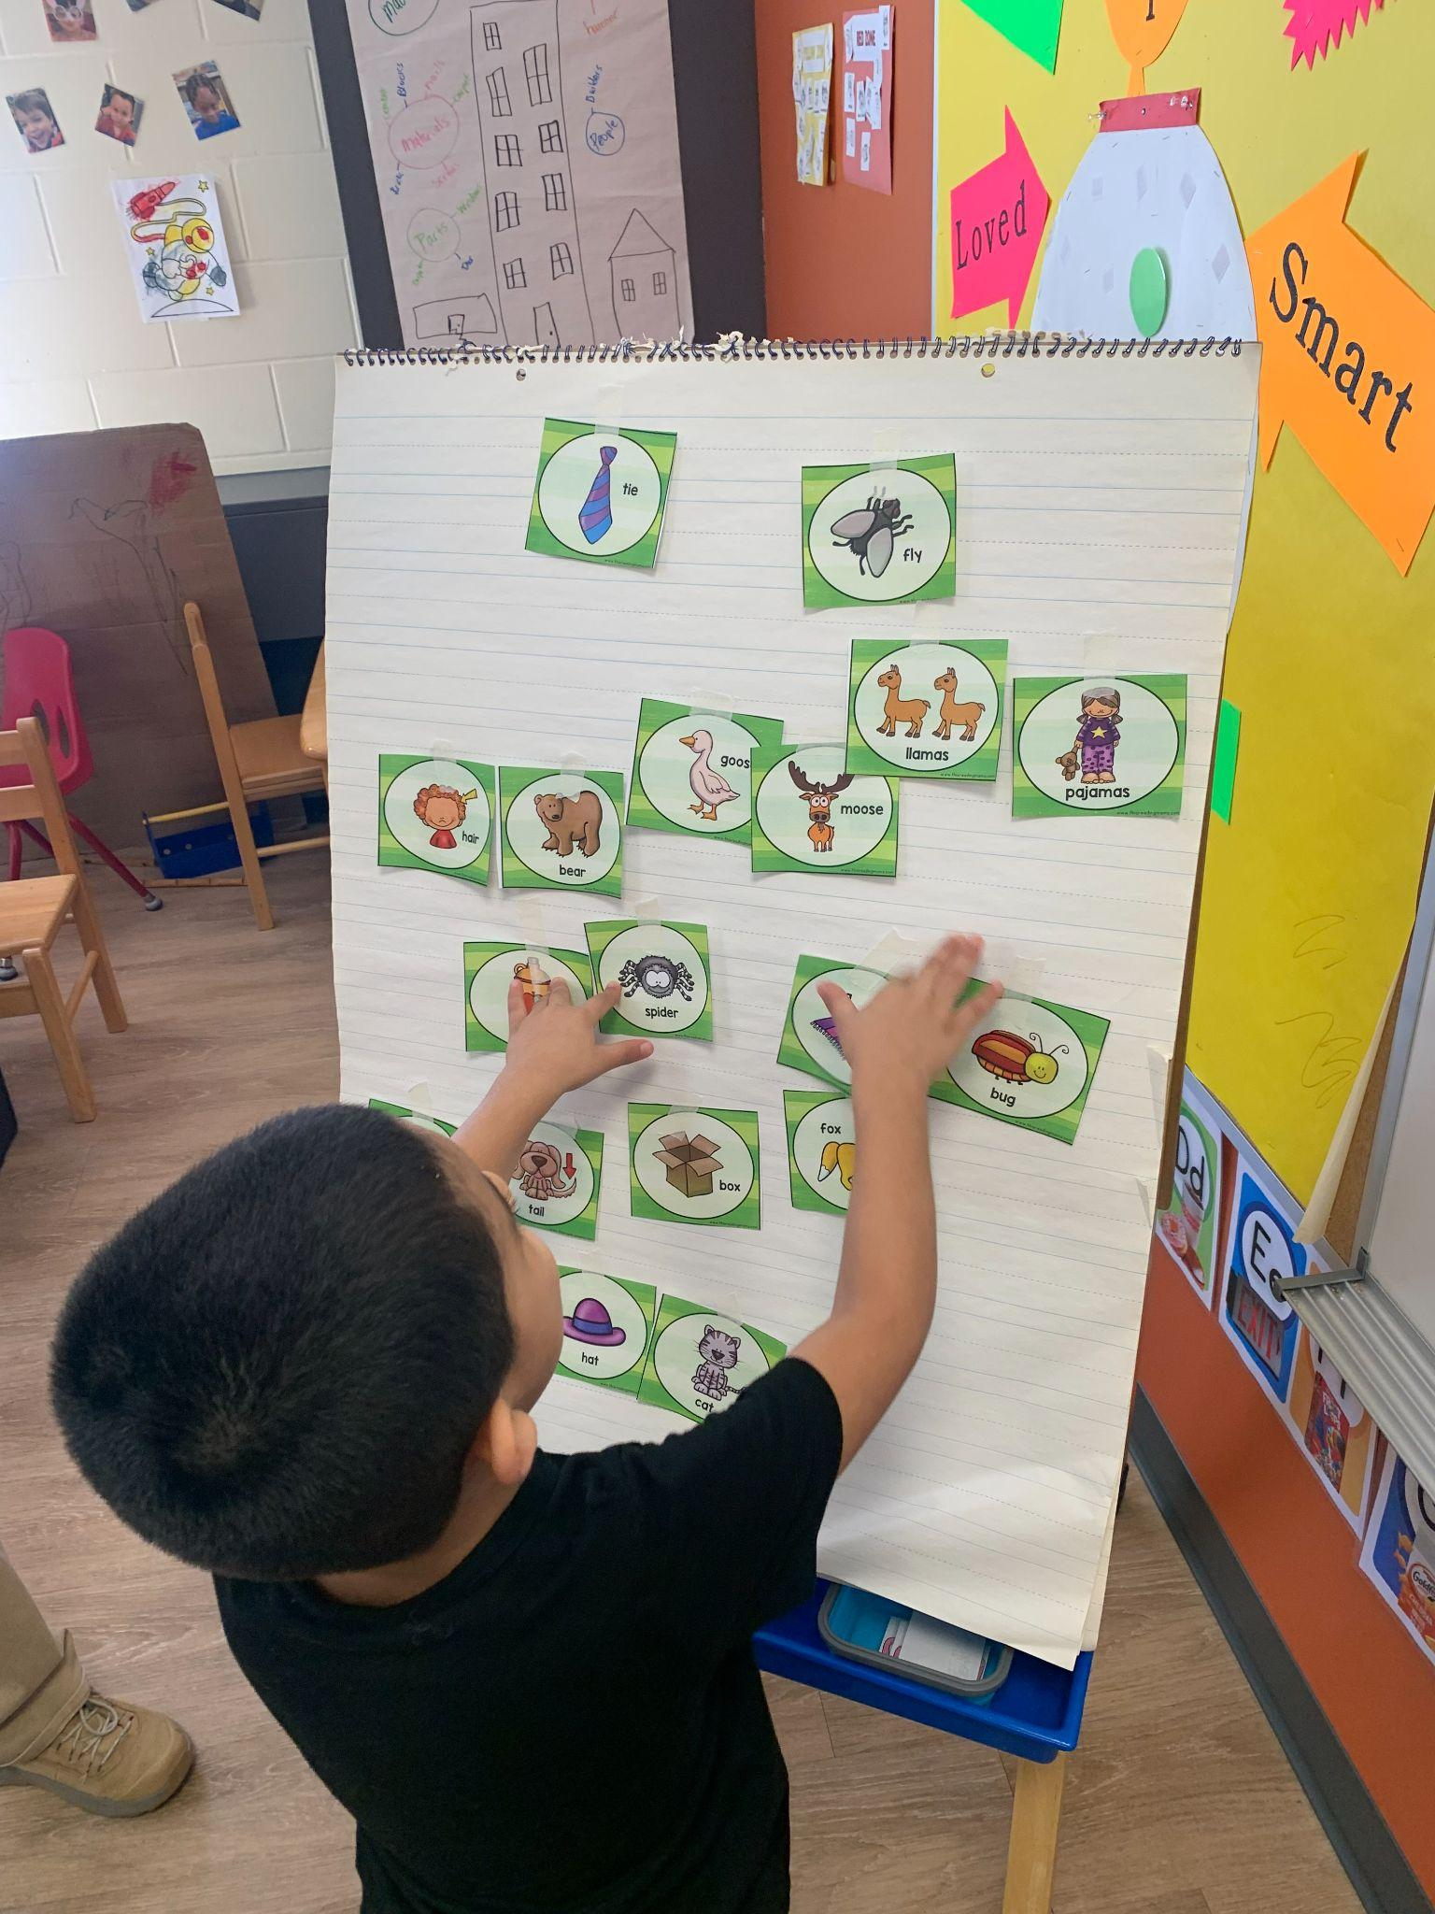
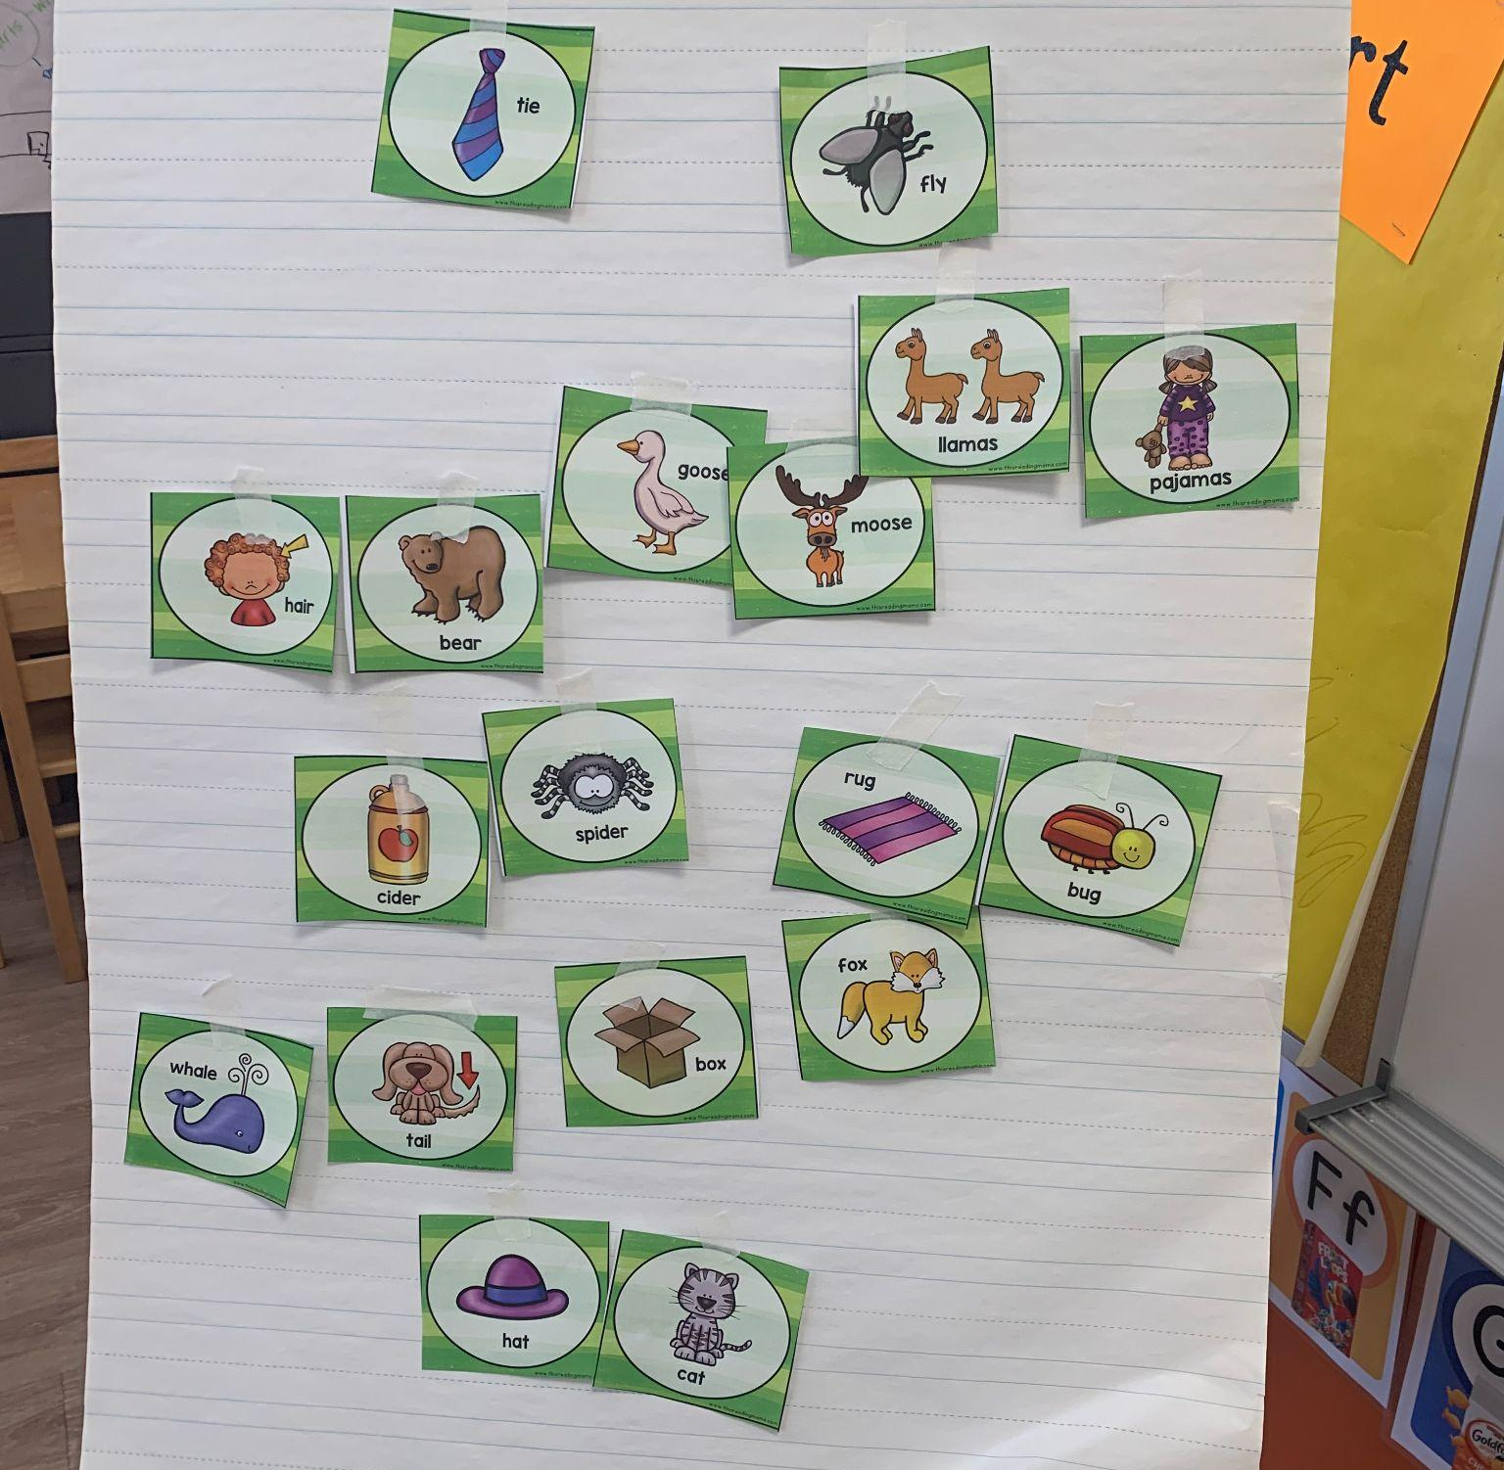
Rhyming Words/Picture Match

Slide 35
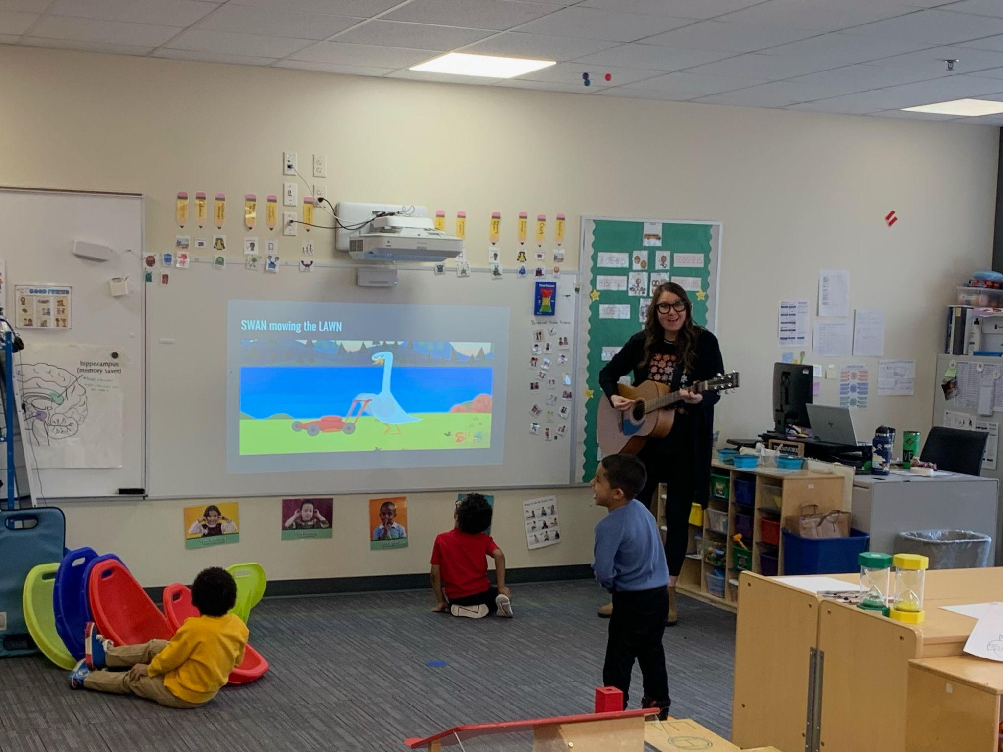
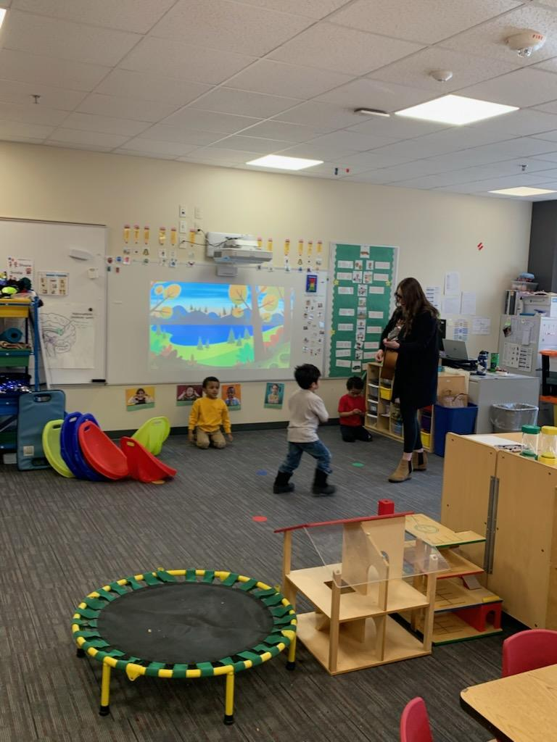
Down by the Bay: Rhyming Song

Slide 36
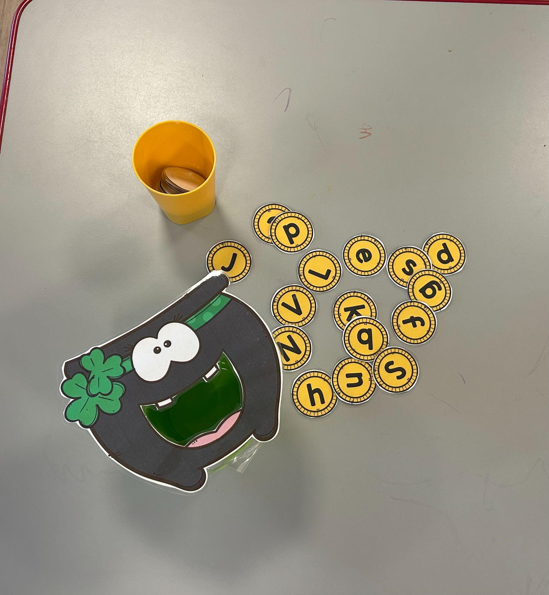
Literacy During Routines
Letter sound transition activity

Slide 37
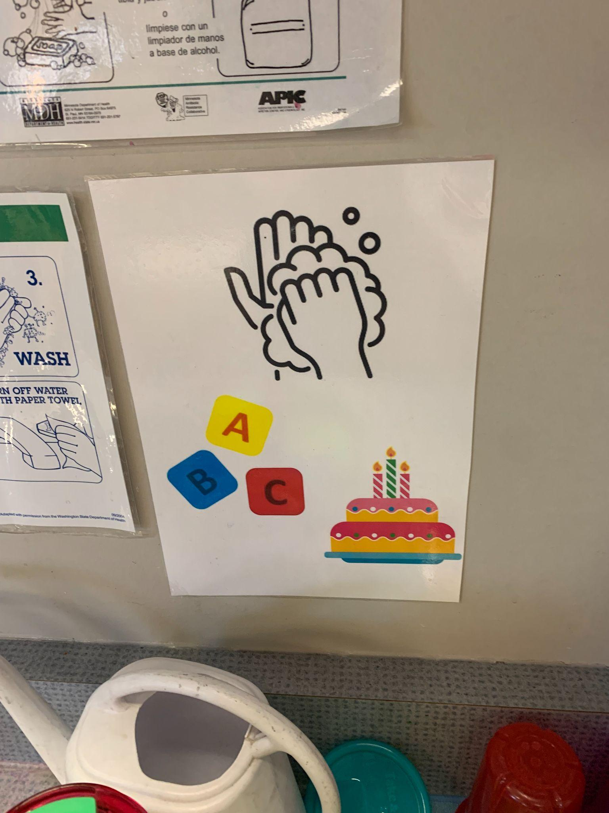
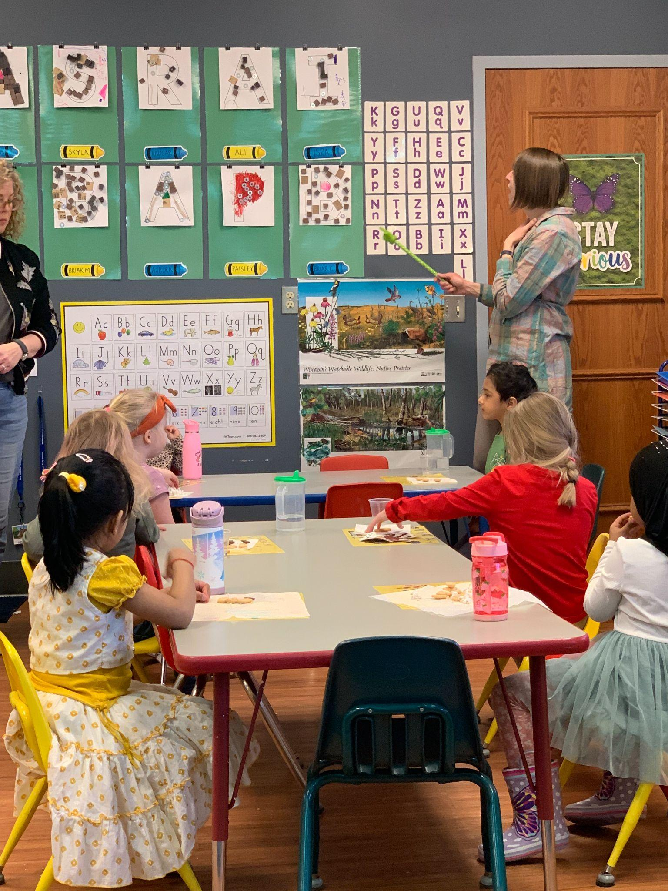
Literacy during routines and snack

Slide 38
Incidental Literacy Teaching
How can you increase incidental learning opportunities?
Songs- letter and letter sound songs
Interactive Stories during non-traditional times

Slide 39
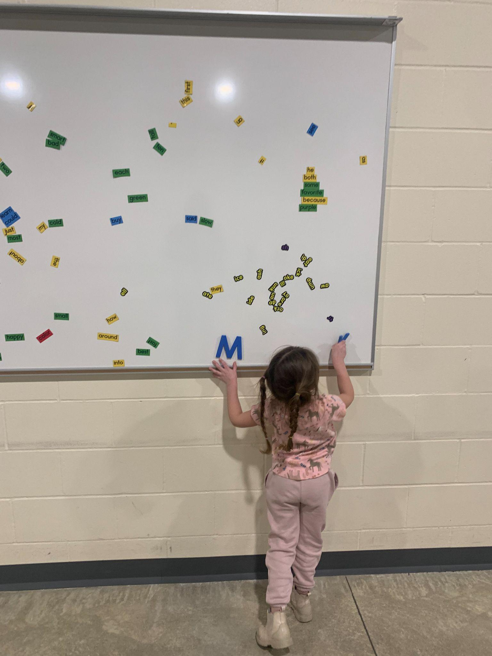
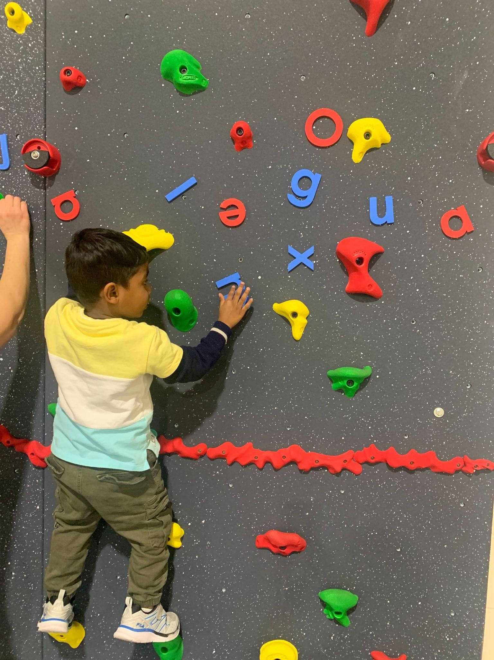
Using Literacy in Non Traditional Spaces

Slide 40
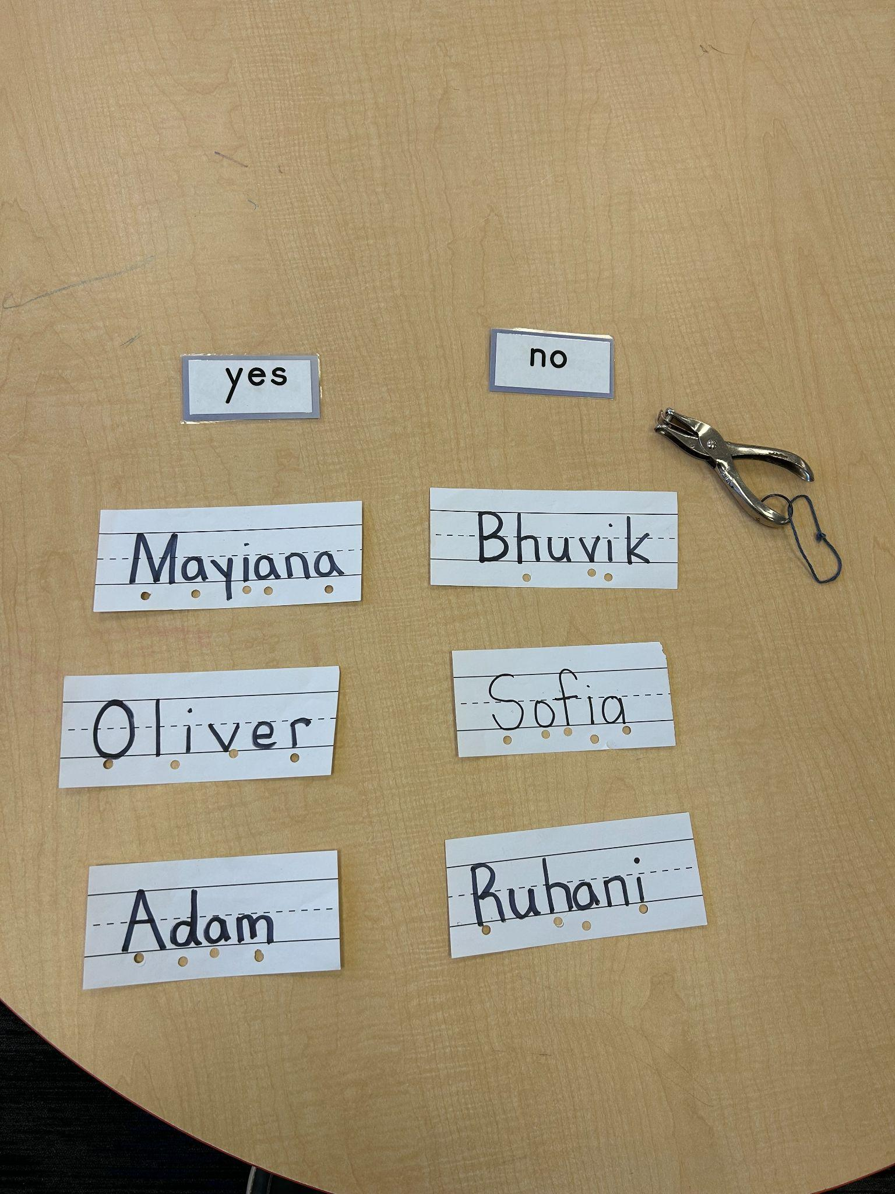
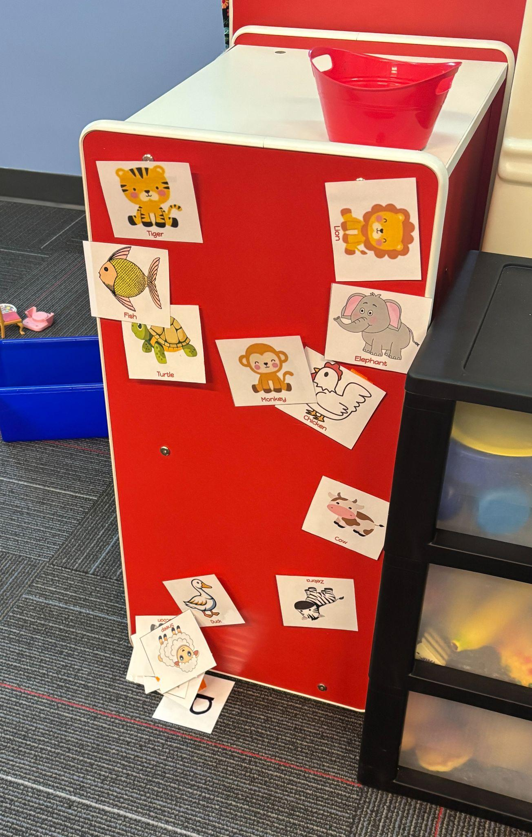
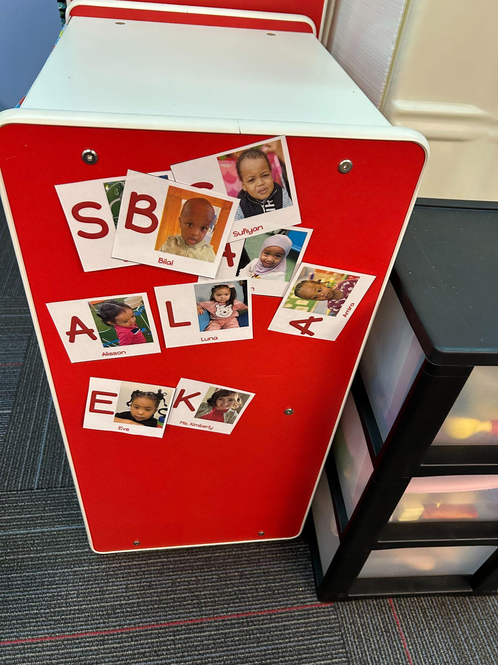
Name-Letter Recognition
Name letter recognition/intentional letter instruction
Alphabet animal vocabulary
First letter name recognition

Slide 41
Print Rich Environment Examples
Story Walks
Dramatic Play Props
Menus
Phone books
Cookbooks
Other
Literacy/Reading during Transitions
iPad storys/songs/rhymes
Checklists for pictures/letter searches in hallway
Playground Print
Scavenger hunts
Picture/Letter Search Games

Slide 42
Share out
Link- to Google Folder with shared ideas
How are you implementing LETRS or Literacy Strategies?
What barriers are you experiencing?
What is the most challenging routine to incorporate literacy?
What Ah-Ha take away will you try to implement this year?

Slide 43

ECSE Literacy Ideas
Please share your email address and I will give you access to this drive!
ECSE Literacy

Slide 44

Thank you!
Sarah Larson
SALARSON@rochesterschools.org

Slide 45
Charting the Cs Conference 2025
Statewide Professional Development to Support the Workforce and Low Incidence Disability Areas in the State of Minnesota.
This presentation is partially funded with a grant from the Minnesota Department of Education using federal funding, CFDA 84.027A, Special Education – Grants to States.

