Slide 1


STAR Autism Support: Launching Every Learner to Reading Success!
Charting the Cs Conference 2025:
To Literacy and Beyond
Cooperation
Communication
Collaboration
April 29th at 2 PM
Kaleen Schultz

Slide 2

Introductions
Kaleen Schultz, M.Ed
Former Special Education Teacher
Parent to a child with autism
STAR Training Specialist
Minnesota

Slide 3

Handouts
Our handouts include resources!
Anytime you see this icon on the bottom, left corner – that resource is included!

Slide 4
Who is STAR Autism Support?
Evidence-based curricula and resources
Training and support for educational staff and caregivers
Building school- and district-wide capacity to serve students with autism and other developmental disabilities
Comprehensive approach across all grade levels
Student growth and achievement in all learning environments

Slide 5
Getting to Know You: Raise Your Hand!
What age-level do you currently teach?
  Preschool
  Elementary
  Middle School
  High School
  Post-Secondary
  Other

Slide 6
Getting to Know You: Raise Your Hand!
What brings you to this presentation? I am a/an . . .
  Student in the field of education
  Educator
  Administrator
  Parent

Slide 7
Getting to Know You: Use Your Fingers!
How familiar are you with our products? The STAR Program, Links Curriculum or SOLER
  Show 1 – I haven’t heard if any of these tools!
  Show 2 – I have some experience, but it’s been a while!
  Show 3 – I use STAR, Links or SOLER in my district, and I am looking for more in-depth info!

Slide 8
Goals for Today
Discuss the benefits of using a comprehensive curriculum to teach acquisition of reading skills to students with significant learning challenges.
Review tools for aligning reading lessons to IEPs and state standards.
Provide examples of digital and printable reading tools that aligned to state standards and can be used with a variety of learners!

Slide 9

Challenges Teaching Reading or Pre-Reading Skills
Diverse learner needs in one classroom
Language and communication deficits affect instruction
Attention to task and behavior issues disrupt learning small group learning
Lack of resources for reading or pre-reading skills
Foundational gaps in early literacy skills
What else do you experience?

Slide 10
Using a Comprehensive Curriculum

Slide 11
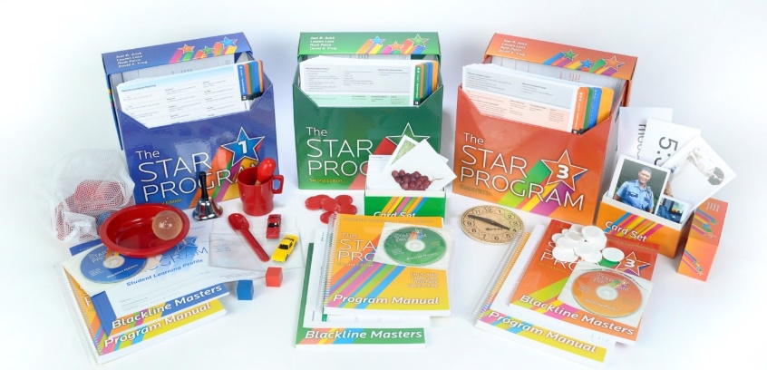
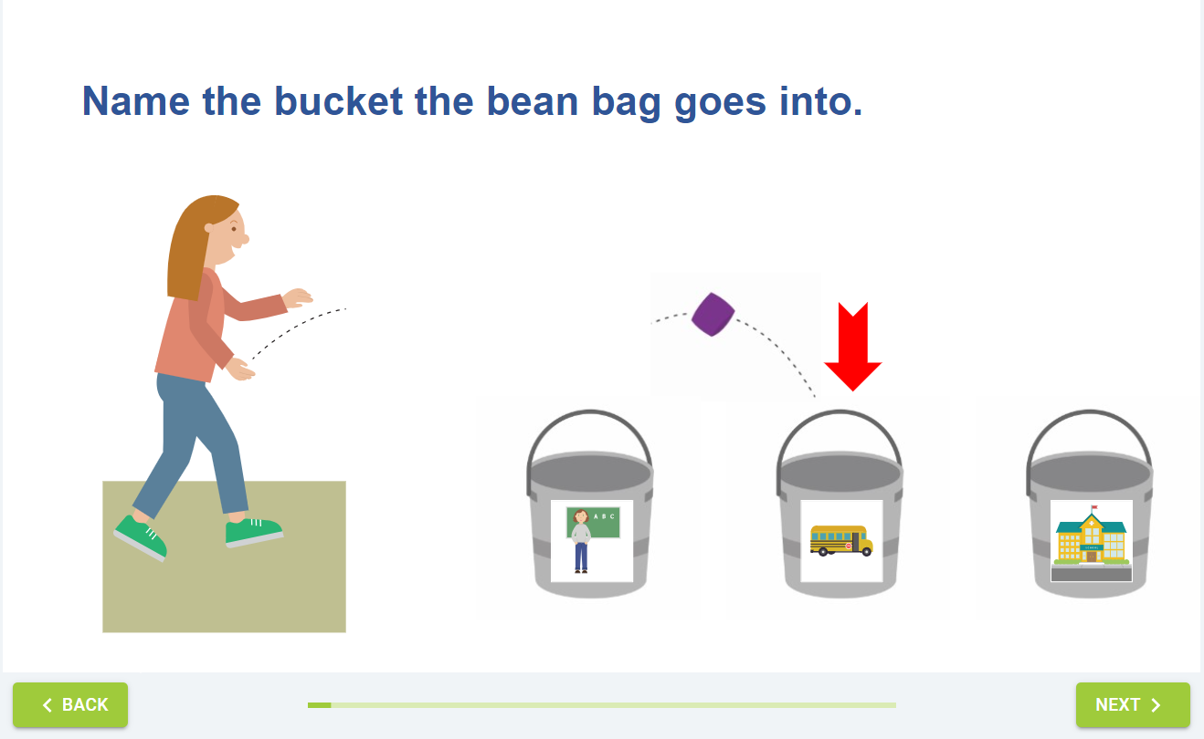
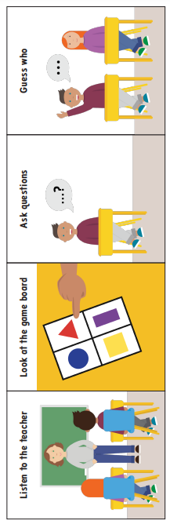

Comprehensive Systems to Teach Foundational Skills
Assessment and progress monitoring
Data collection
Detailed lesson plans in core curricular areas
Differentiated learning for 1:1 and group instruction
Digital tools
Strengths-based
Preschool and Elementary: STAR Program
Themes First!
Academic Teaching Units
Secondary: Links

Slide 12


Instructional Strategies for Students with Autism
Behavioral Interventions (ABA methods)
Pivotal Response Training
Visual Schedules/Visual Supports
Language Training
Self-Management
Task Analysis Instruction
Alternative Communication Devices
Modeling
Naturalistic Teaching Strategies
Peer Mediated Instruction
Parent Training
(The National Professional Development Center, 2015)

Slide 13
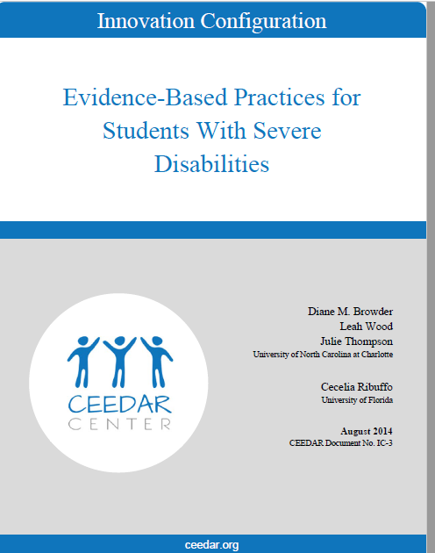

Instructional Strategies for Students with High Support Needs
Systematic Instruction Based on the Principles of ABA
Task Analysis
Data Collection
Prompting and Fading Procedures
Reinforcement
Generalization
Self-Directed Learning
(Ceedar Center, 2014)

Slide 14

Five Pillars of Reading Instruction
Phonemic Awareness: individual sounds
Phonics: letters have sounds to form letter-sound relationships and are put together to form/spell words
Fluency: ability to read correctly with speed and expression
Vocabulary: knowing what words mean
Comprehension: understanding what is being read
(Teaching Strategies, 2025)

Slide 15




Levels of Instruction for Learning
Routine Instruction
One-to-one Instruction
Students apply learned skills during classroom routines and activities
Students engage with individualized learning with educator
Student Skill Acquisition
Independent Instruction
Small Group Instruction
Students work independently and work on reinforcing learned skills through practice
Educators are focused on providing reteaching learning skills

Slide 16
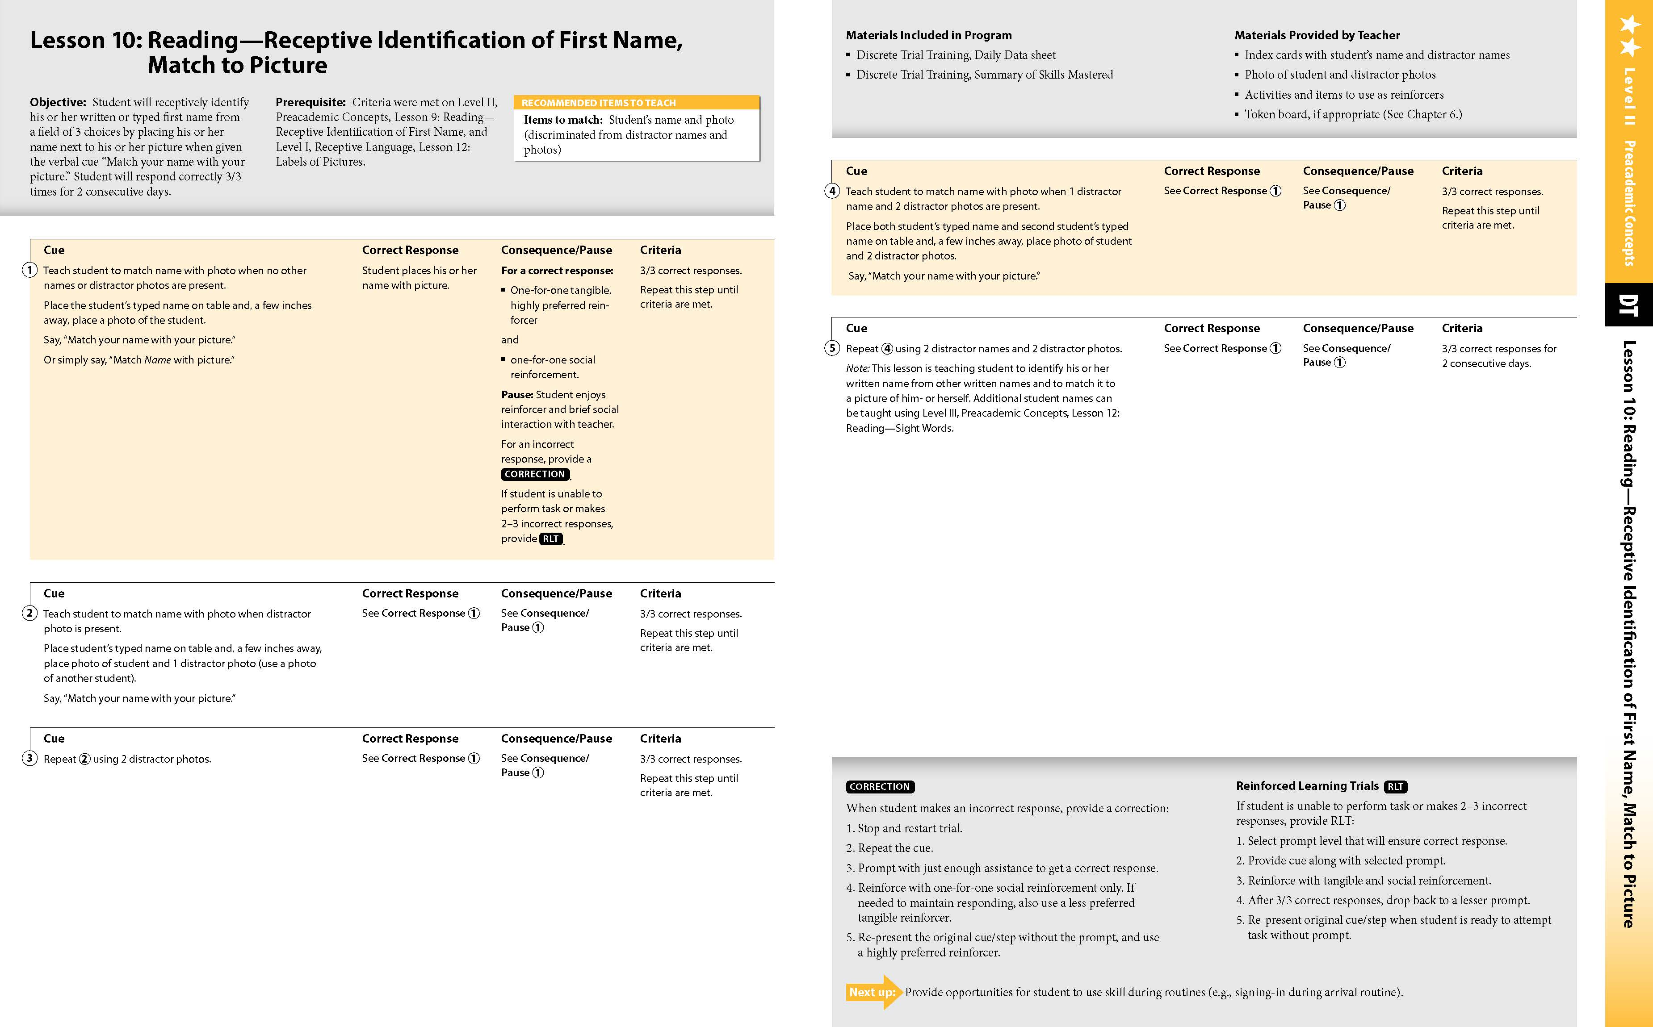
Foundational Academic Lessons in STAR
Letter identification
Name identification
Letter sounds
Matching words to pictures
Sight word identification
Reading a simple book
Writing from dictation
And more!

Slide 17
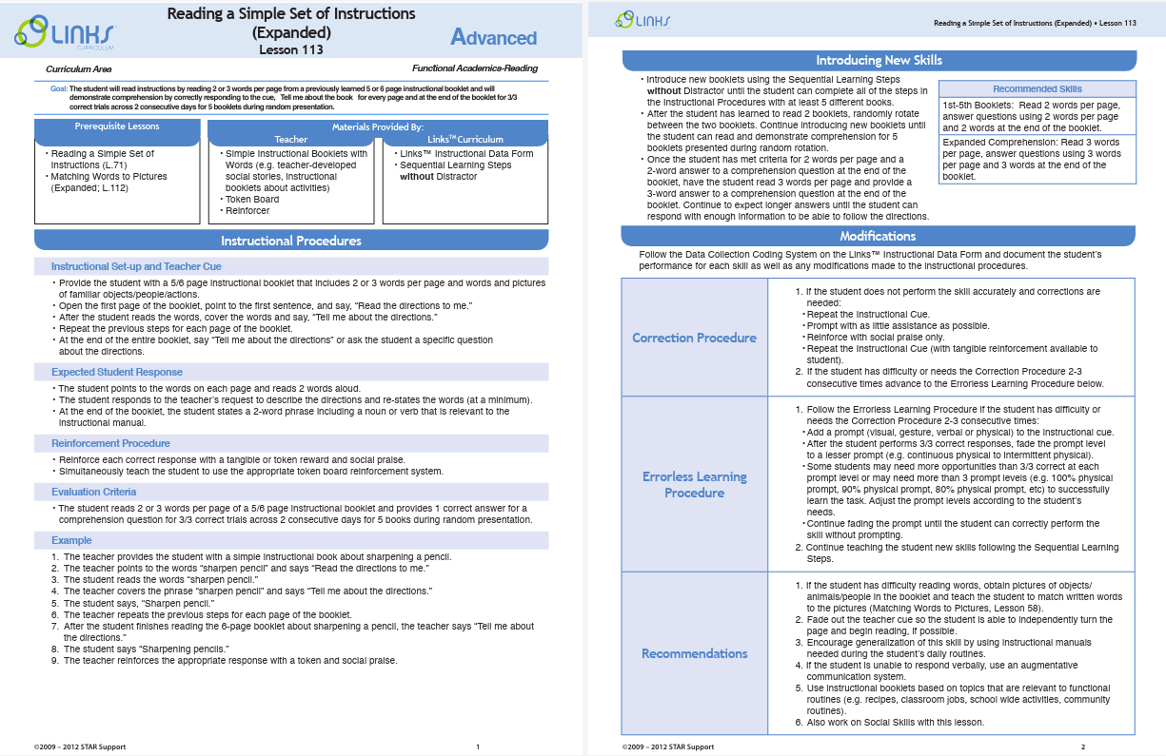

Foundational Academic Lessons in Links
Matching letters
Reading a simple set of instructions
Matching phrases to pictures
Typing words
Using a sight word daily schedule
Social scripts
Writing academic content
And more!

Slide 18
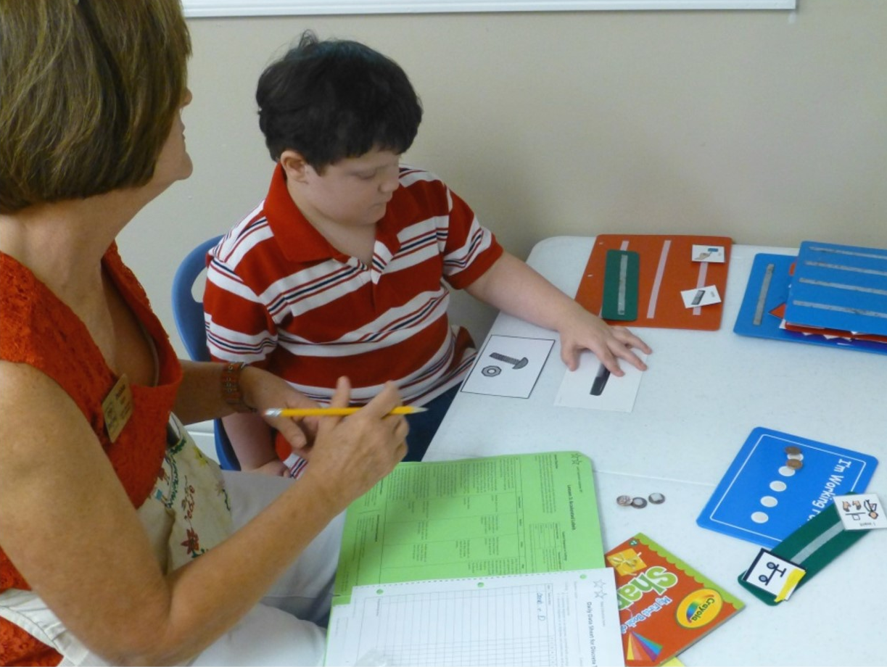
What is Discrete Trial (DT)?
DT is an evidence-based teaching strategy where skills are taught in a logical sequence building on previously learned skills
Concepts taught are identified, then broken down into specific steps for instruction

Slide 19
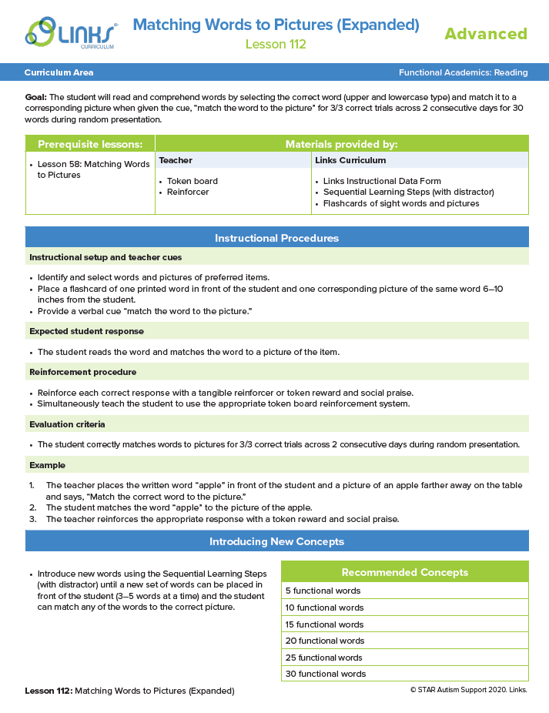
Sample Lesson Plan
Lesson objective
Evidence-based practices embedded in the lesson
Prerequisites
Procedures for Teaching
Recommended Concepts to Teach/Targets

Slide 20
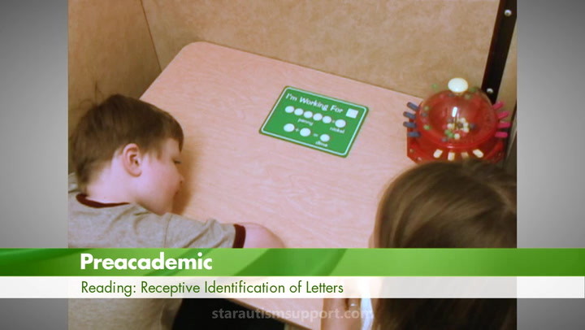
Elementary ELA Example
Notes:
https://cdn.jwplayer.com/previews/oR6Rkpap-CeEBvWnE

Slide 21
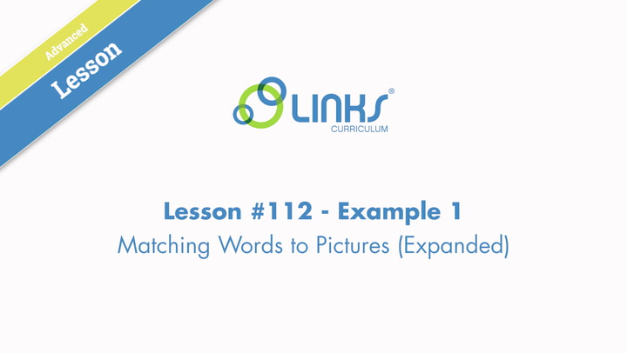
Secondary ELA Example
Notes:
https://cdn.jwplayer.com/previews/YzSLQ7nD-CeEBvWnE

Slide 22
Reading Lessons

Slide 23

What Guides Our Content Development
Evidence-based strategies rooted in education research
Structured literacy methods aligned with the science of reading
Need for easy-to-access lesson plans and supports for differentiation
Built for real-world success—various digital and printable lessons for all students!

Slide 24

Understanding Scarborough’s Reading Rope
Scarborough's Reading Rope, developed by Hollis Scarborough in 2001, explains how various language skills intertwine to develop proficient reading abilities. ​
A weakness in any strand can impact reading development, emphasizing the need for a balanced approach to instruction.

Slide 25
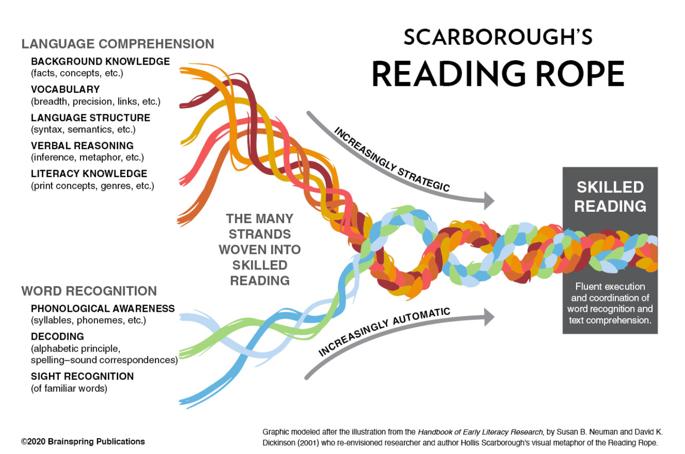
Scarborough’s Reading Rope

Slide 26

ELA Lesson Alignment for Both Strands
Each month, four lessons align with the monthly unit themes, thereby enhancing student engagement with the content.
Two word-recognition lessons include a focus on sight words.
Two language comprehension lessons support diverse learning needs.
Lessons utilize gradual release to increase effective teaching for a variety of learners.

Slide 27
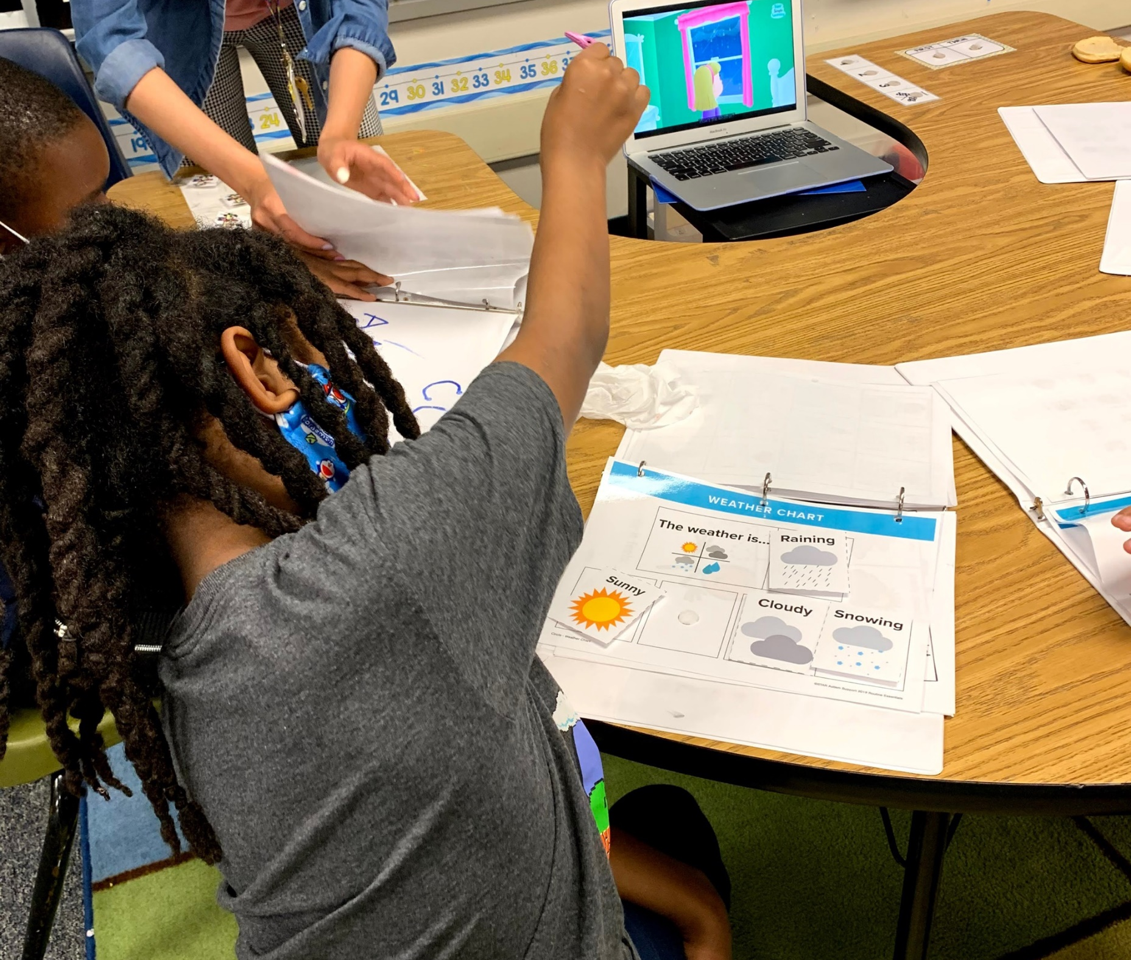
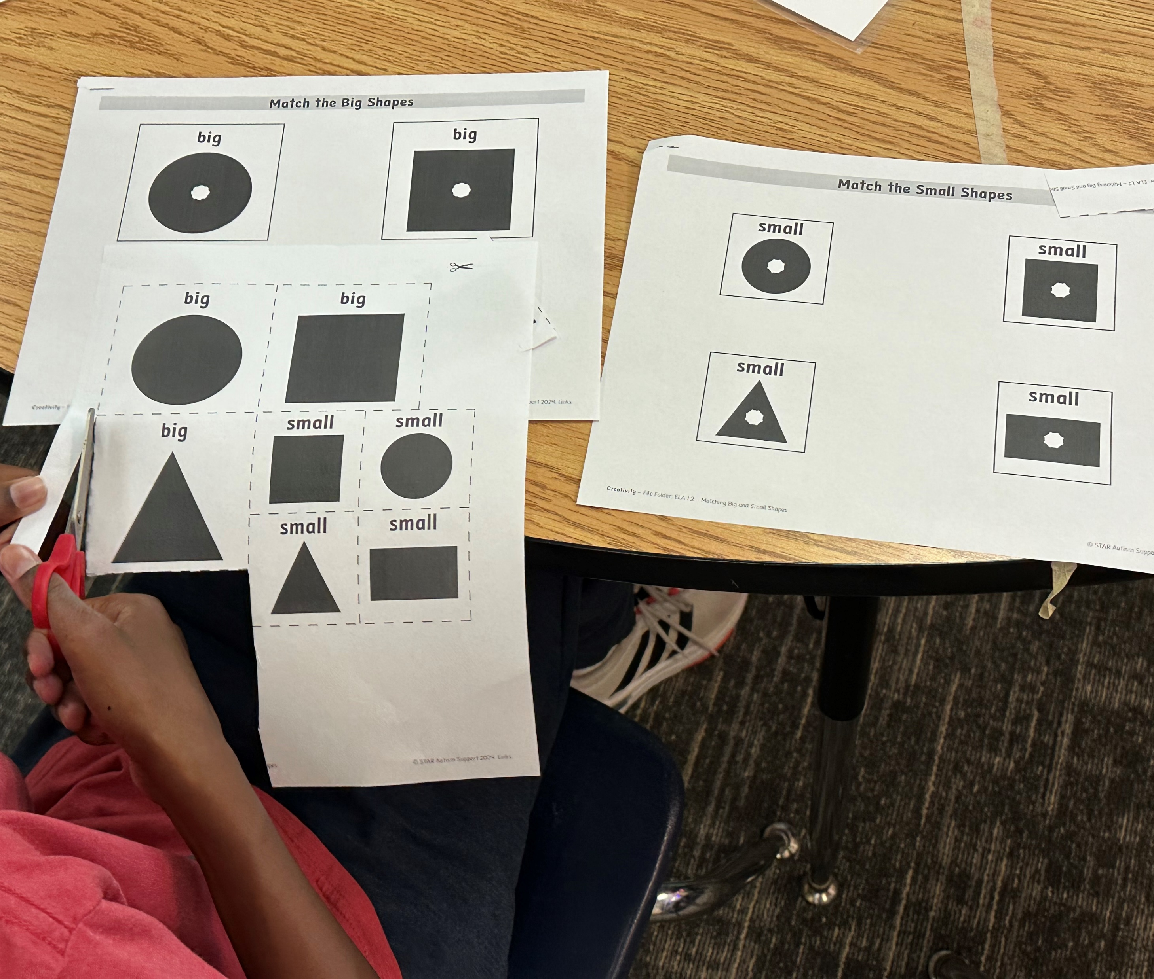
Monthly Thematic Content
Primary: Themes First!
Secondary: Academic Teaching Units

Slide 28
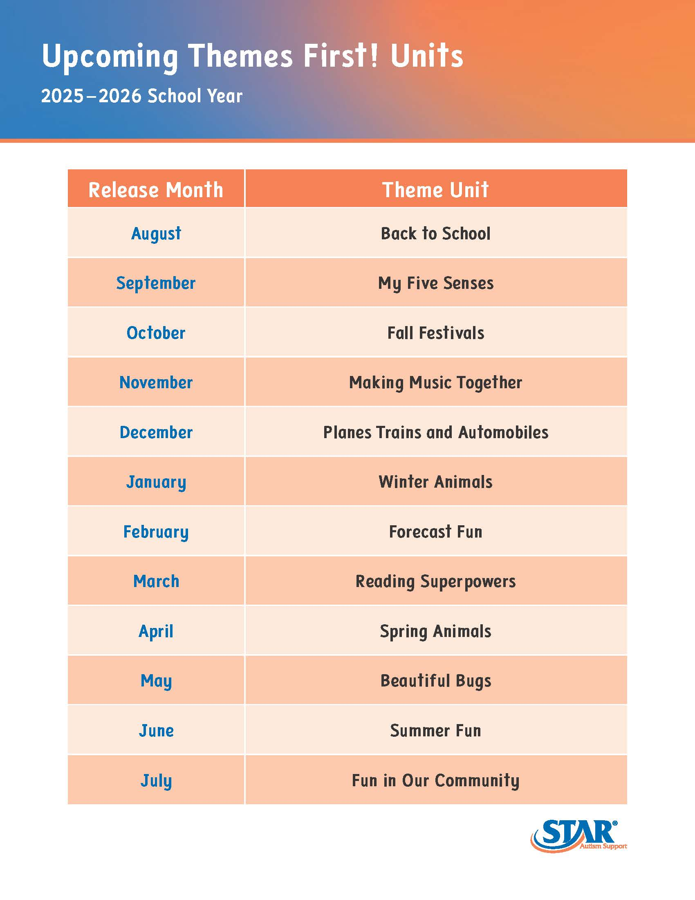
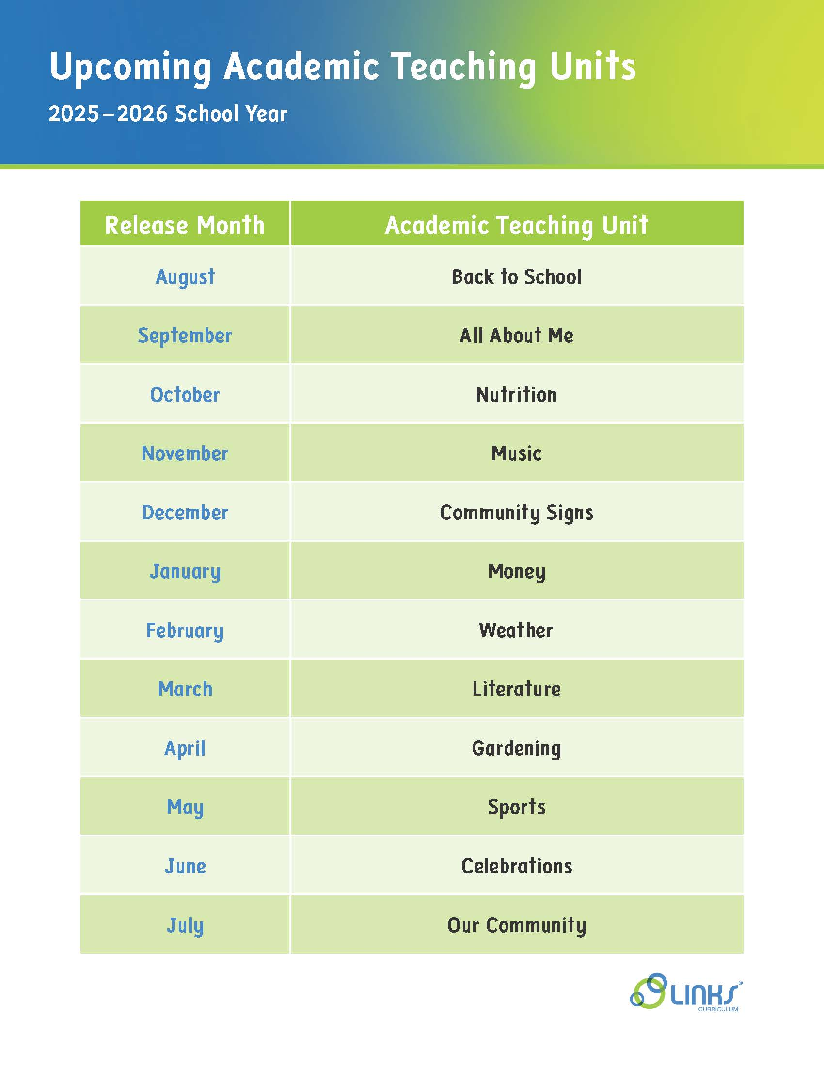

2025-2026 Themes

Slide 29
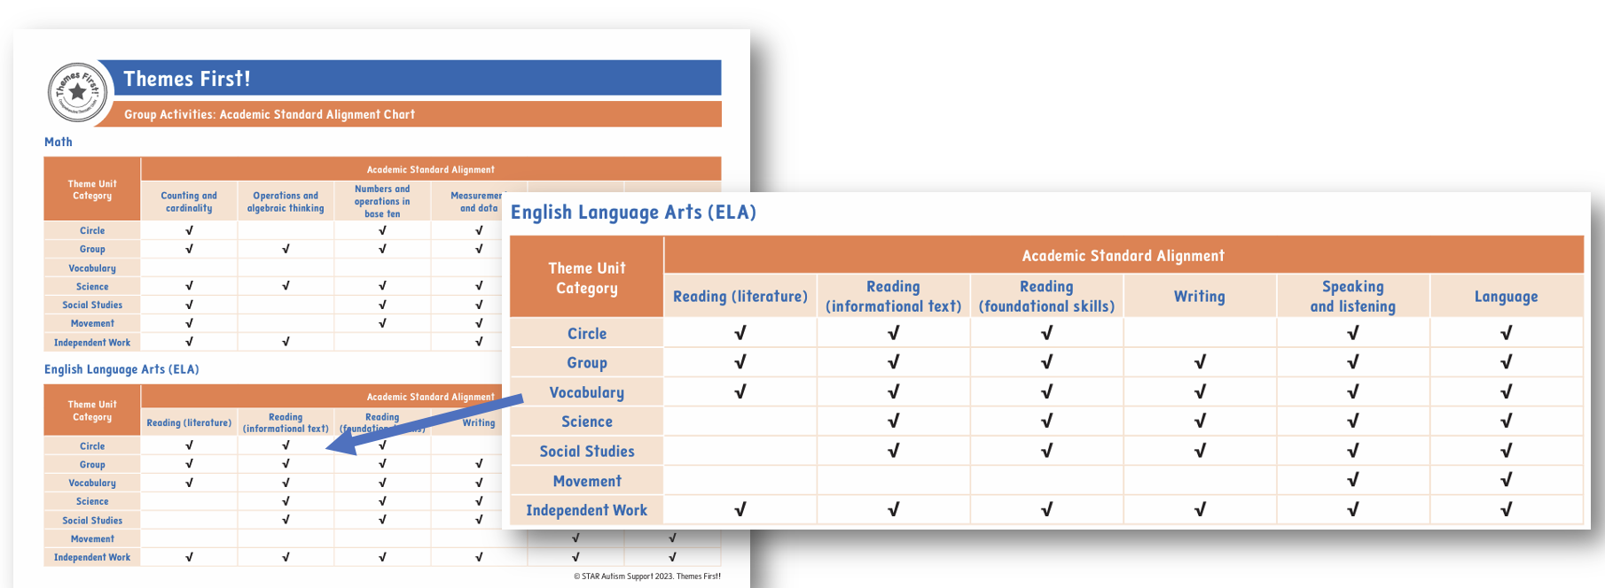
ELA Alignment in STAR Themes First!

Slide 30
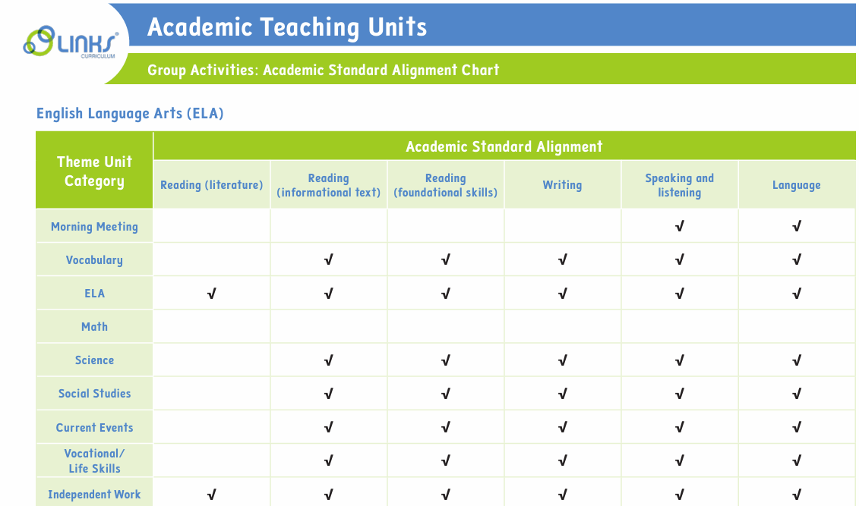
ELA Alignment in Links Academic Teaching Units

Slide 31


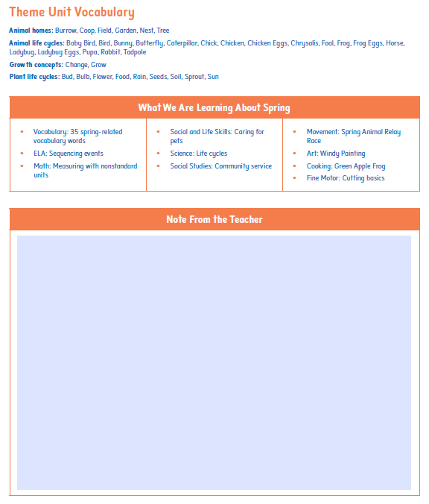


Newsletter to Include Caregivers

Slide 32
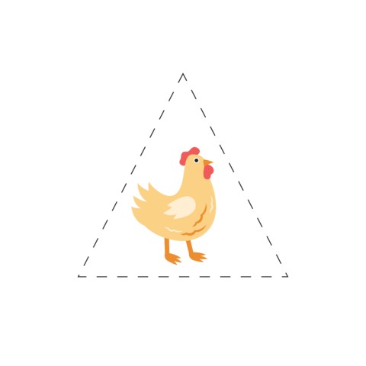
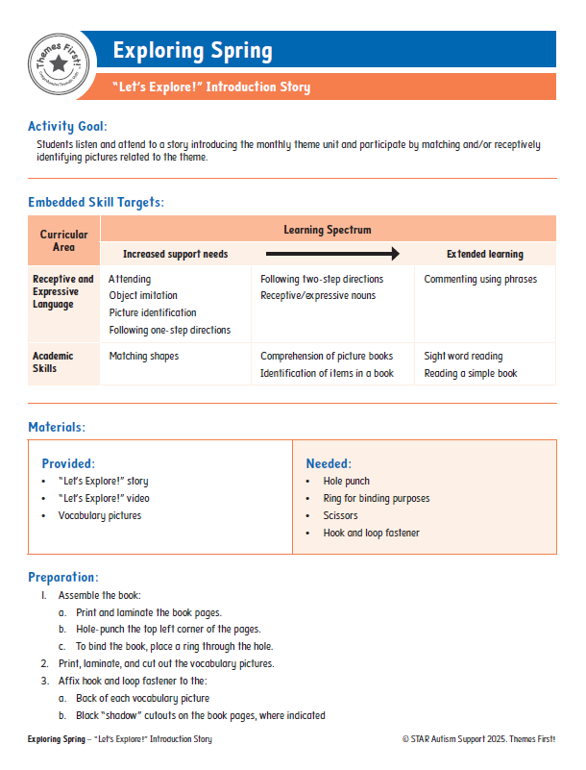



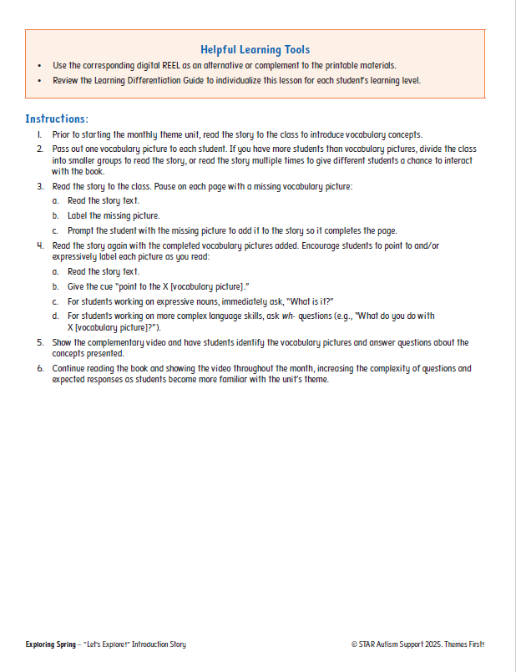
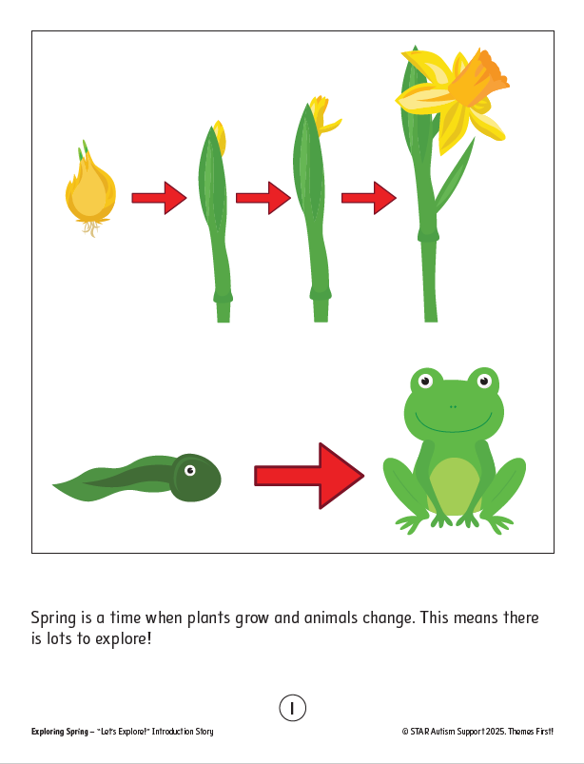
Circle (TF): Introduction Stories

Slide 33
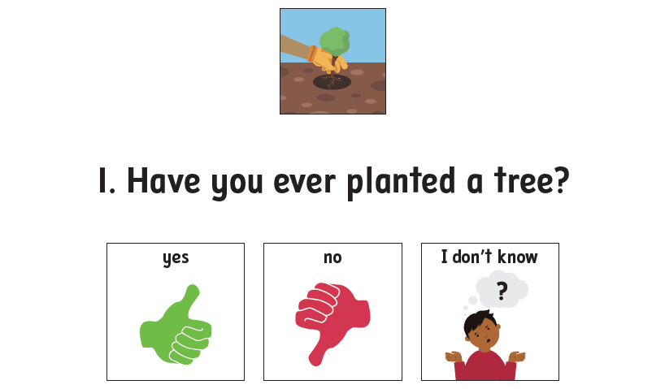
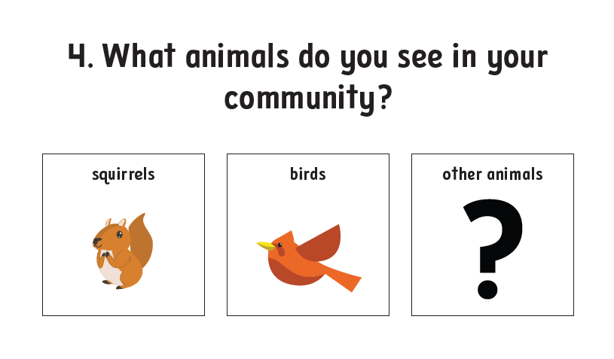


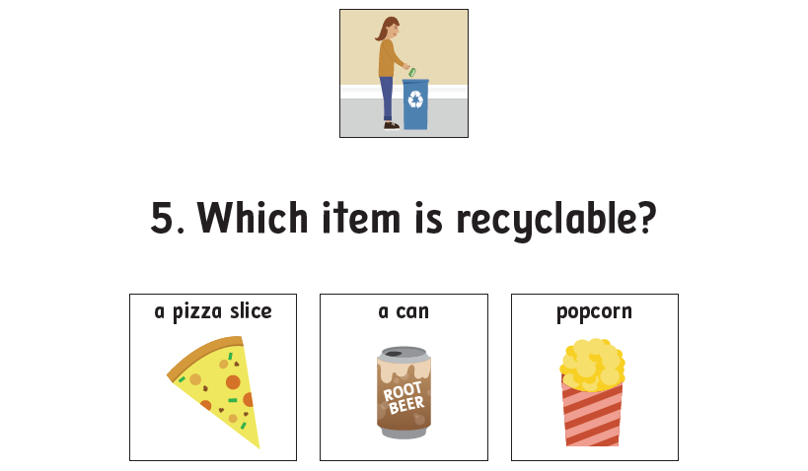

Morning Meeting (ATU): Conversation Starters

Slide 34
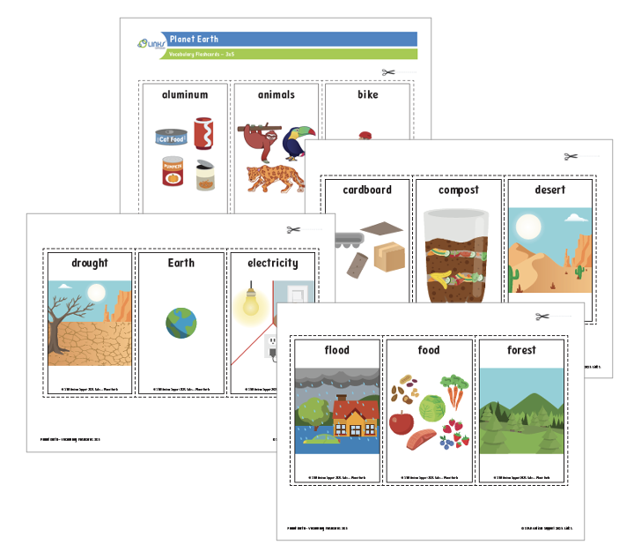
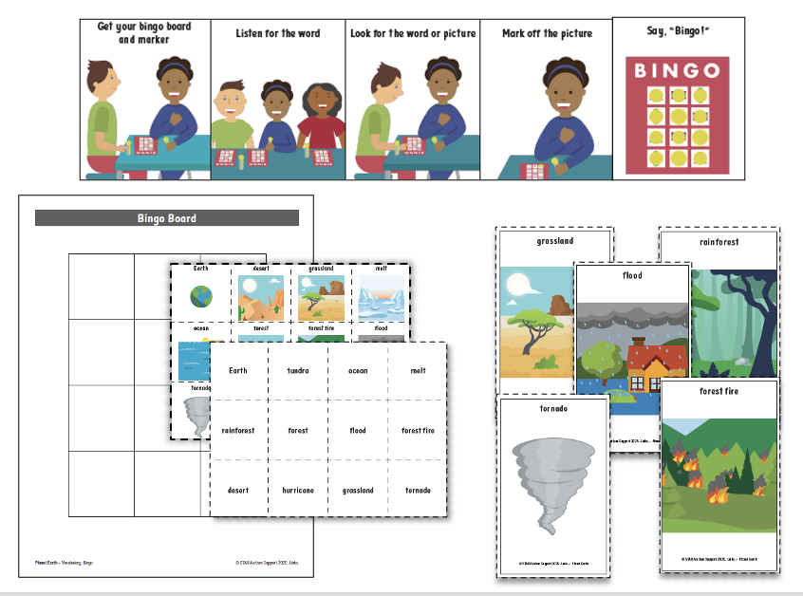
Vocabulary
Flashcards
Group Activities

Slide 35
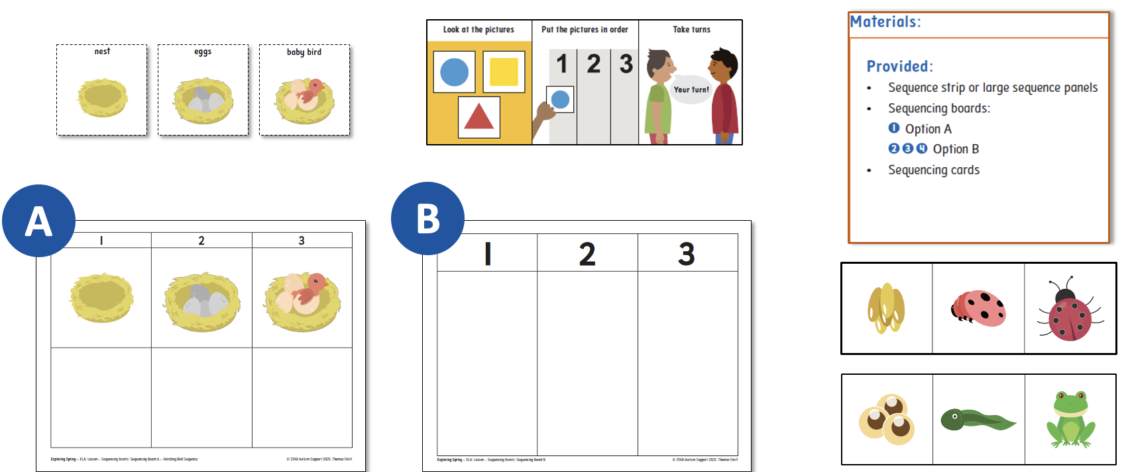
ELA: Sequencing Events

Slide 36
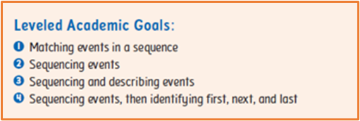
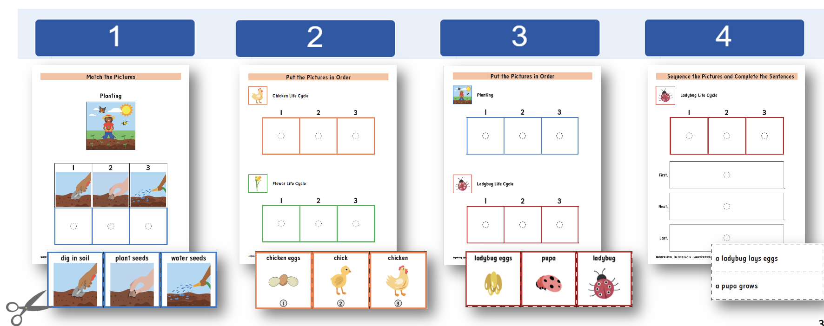
ELA Leveled Practice Activities

Slide 37
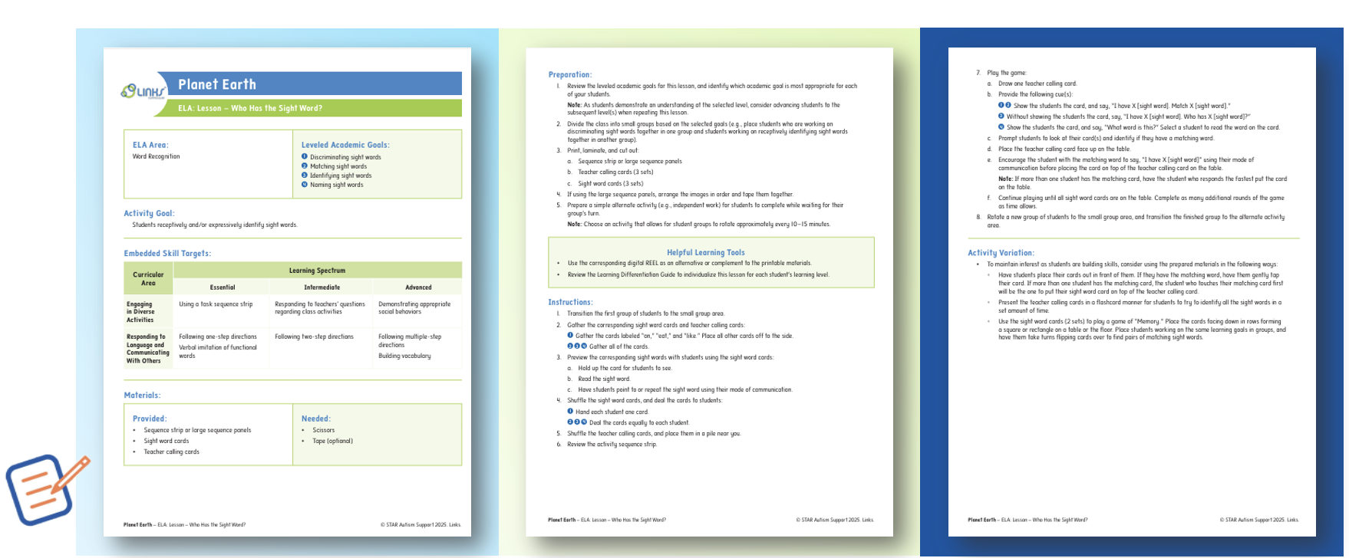
Lesson Structure

Slide 38
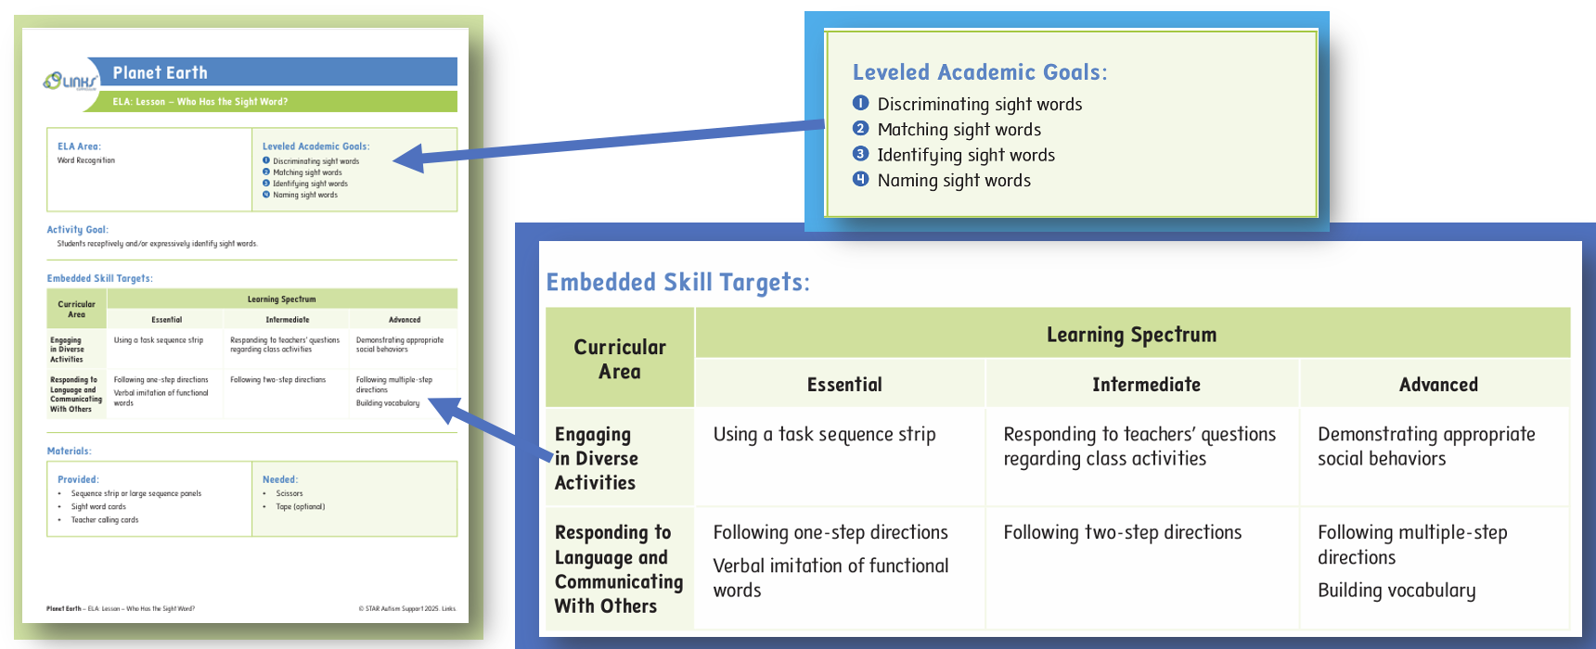
Embedded Skill Targets

Slide 39
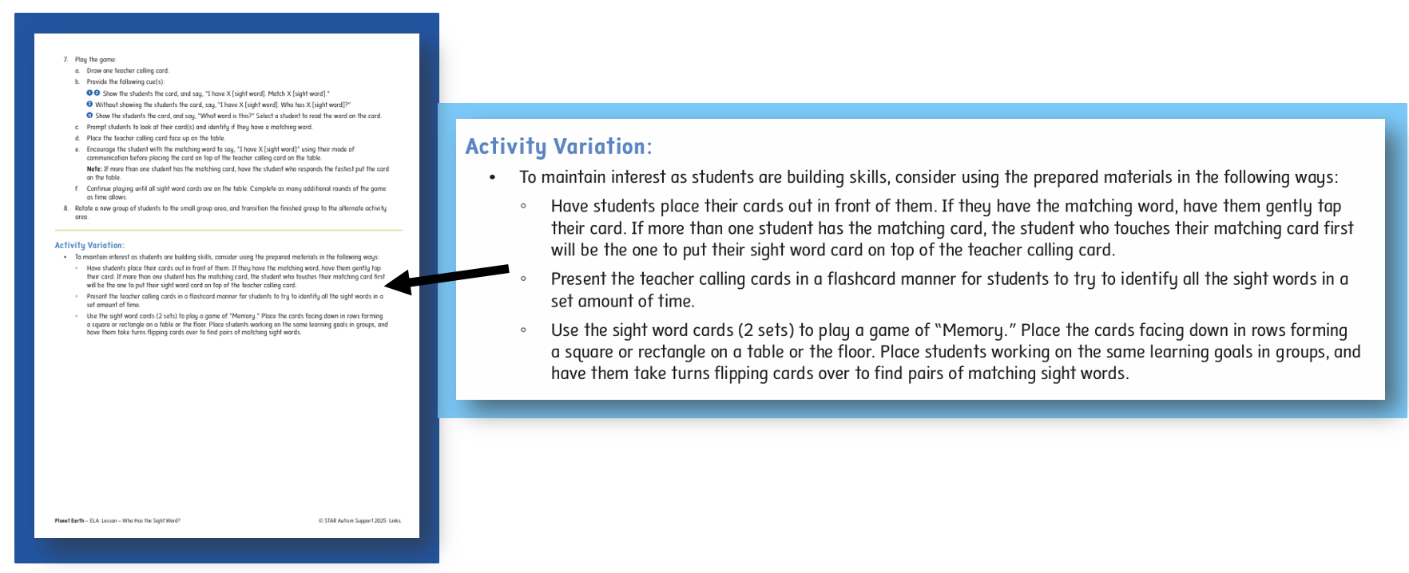
Lesson Variation

Slide 40
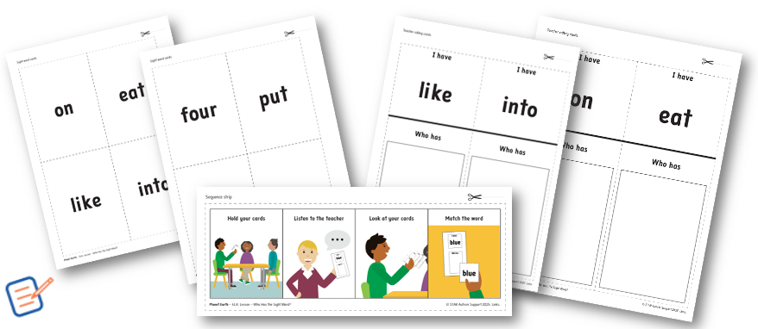
Printable Lesson Examples

Slide 41
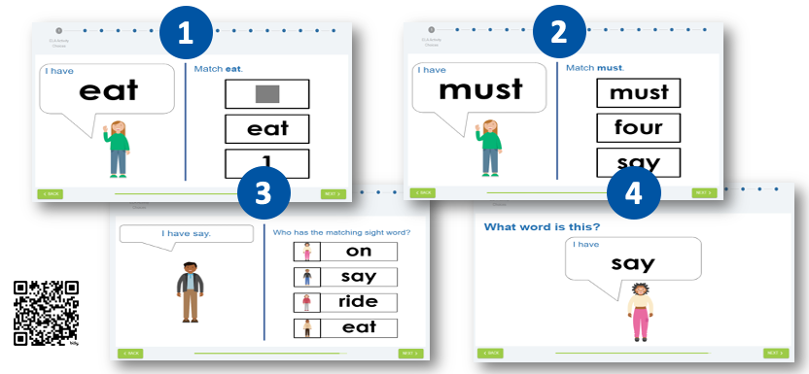
Digital Lesson Examples

Slide 42

Let’s Explore!

Slide 43
Scheduling for Success

Slide 44
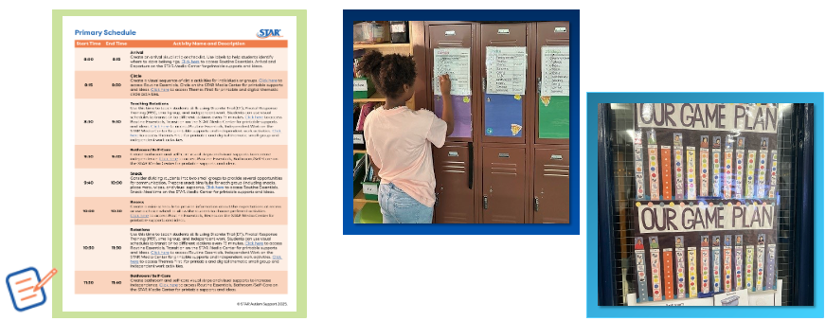
Schedule Samples

Slide 45
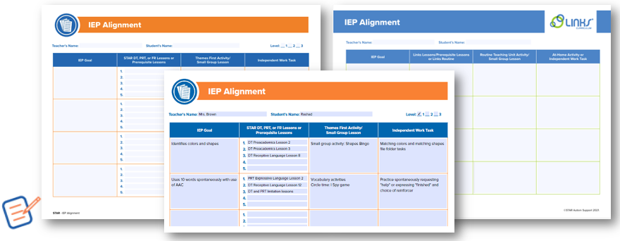
IEP Alignment tools

Slide 46
Resources

Slide 47
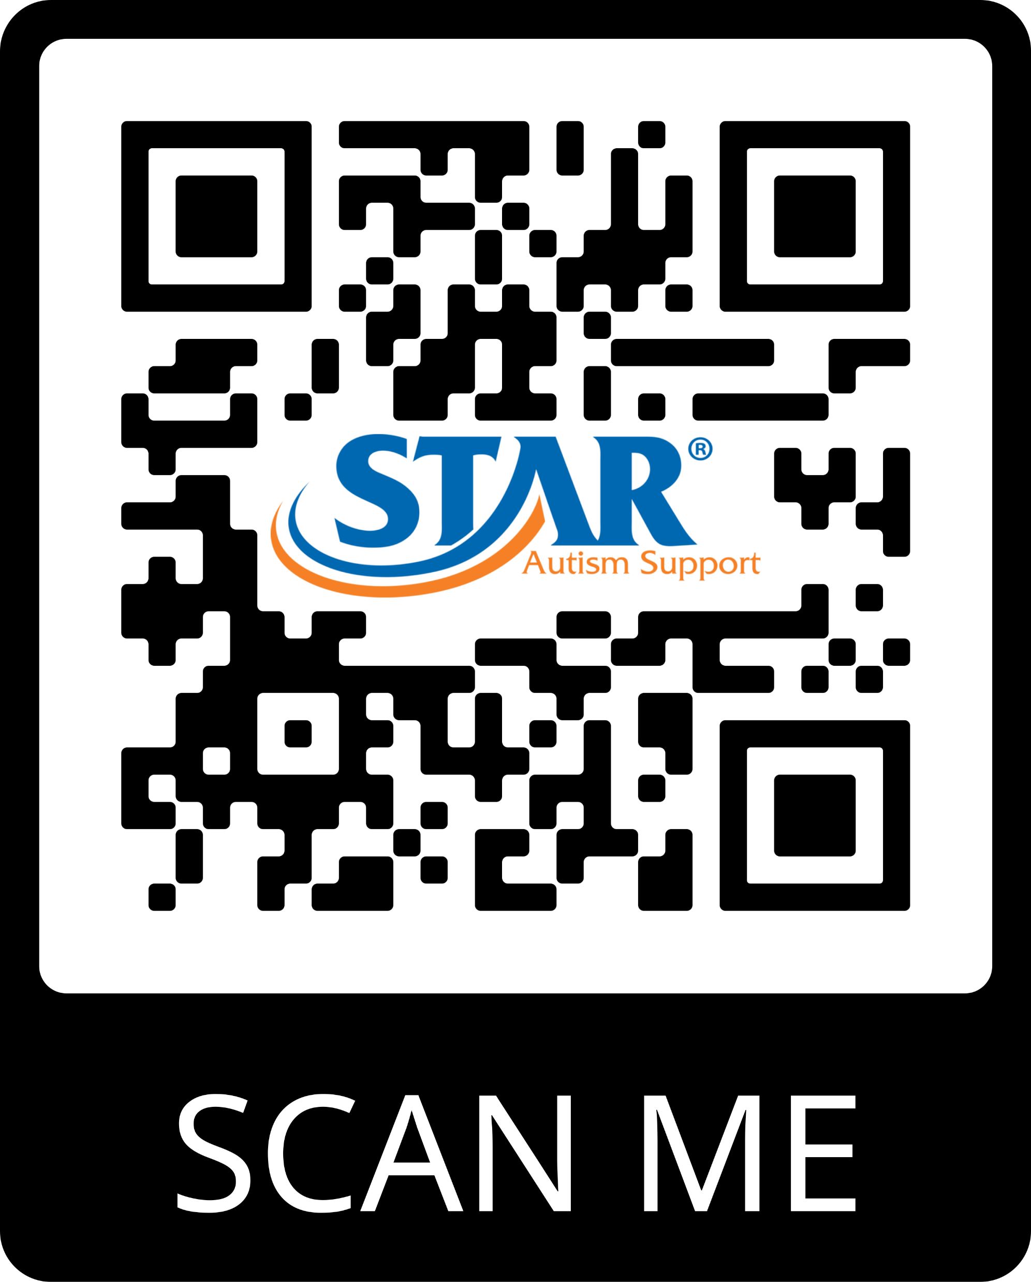

Free Home Supports
www.starautismsupport.com

Slide 48
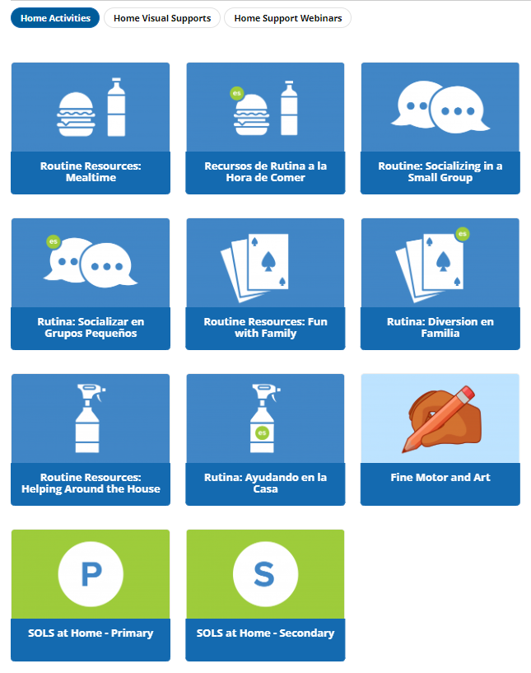
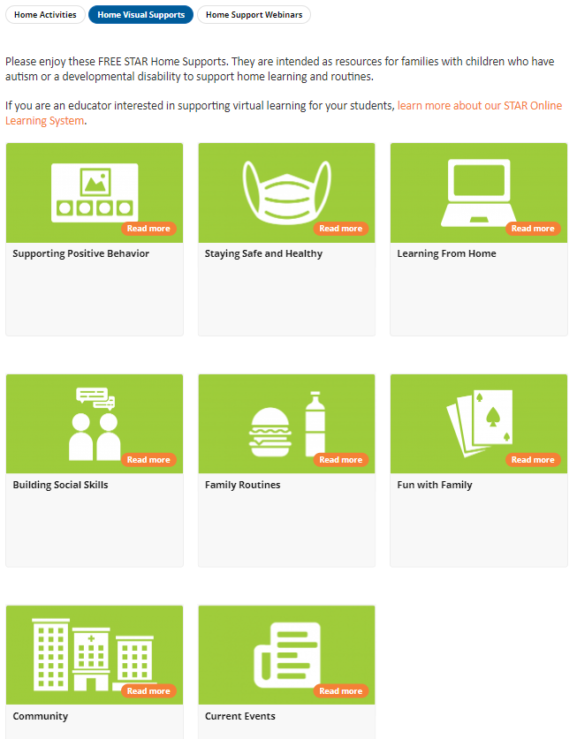
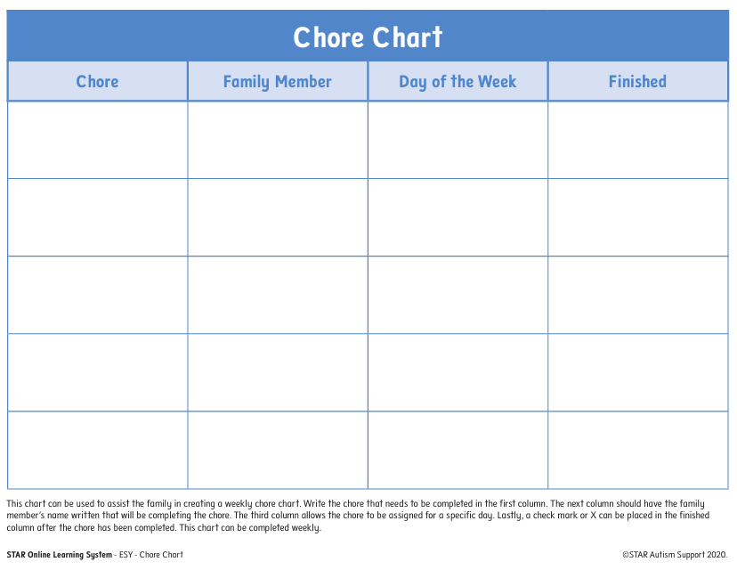
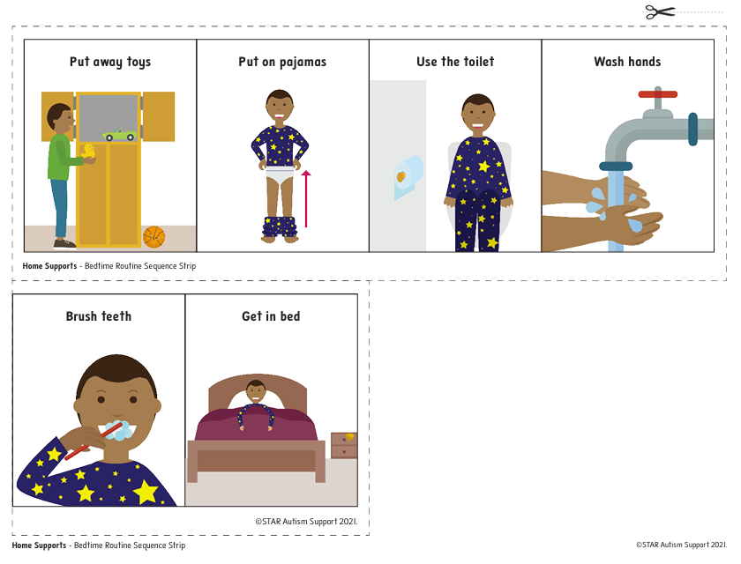
Home Support Activities and Visuals

Slide 49

Home Support Webinars
Routines
Motivation
Schedules
Visual Supports
Prompting
And more!

Slide 50


Thank you for joining us!
Questions?
Visit our website: www.starautismsupport.com
Email:
information@starautismsupport.com

Slide 51
References
Brainspring Publications. (2020). Scarborough’s reading rope. https://brainspring.com/content/blog-files/Scarboroughs-Reading-Rope-rgb-G1-102-UNI-032422.jpg
Browder, D. M., Wood, L., Thompson, J., & Ribuffo, C. (2014). Evidence-based practices for students with severe disabilities. Ceedar Document NO. IC-3. Ceedar Center.
Scarborough, H. S., Neuman, S., & Dickinson, D. (2009). Connecting early language and literacy to later reading (dis) abilities: Evidence, theory, and practice. Approaching difficulties in literacy development: Assessment, pedagogy and programmes, 10, 23-38.
Teaching Strategies. (2025, April 7). Science of Reading in early childhood classrooms: 6-part webinar. https://teachingstrategies.com/solution/science-of-reading/
Wong, C., Odom, S. L., & Hume, K. A. (2015). Evidence-based practices for children, youth, and young adults with autism spectrum disorder: A comprehensive review. Journal of Autism and Developmental Disorders, 45(7), 1951–1966. https://doi.org/10.1007/s10803-014-2351-z

Slide 52

Charting the Cs Conference 2025
Statewide Professional Development to Support the Workforce and Low Incidence Disability Areas in the State of Minnesota.
This presentation is partially funded with a grant from the Minnesota Department of Education using federal funding, CFDA 84.027A, Special Education – Grants to States.

