Slide 1

Data Changes Everything
Charting the Cs Conference 2025:
To Literacy and Beyond
Cooperation Communication Collaboration
April 30, 2025
Kelli Roddy, Data & Systems Architect
Kate Schroeder, M.S., BCBA, LBA

Slide 2

Data Changes Everything
Our Student Data System is an easy to use and effective data collecting tool that will help you improve your students educational outcomes and better support their learning.

Slide 3
What does our Add-on do?
Collect your student data
Case Manager | First Name | Last Name | Expectation 1 | Expectation 2 | Expectation 3 | Skill 1 | Skill 2 | Target Behavior 1 | Target Behavior 2
Sheri Purple | Cheryl | Adkins | In assigned place | Being responsible | Learning and completing tasks | Self awareness |  | Verbal/physical disruption
Fred Smith | Fredrick | Benson | In assigned place | Being responsible | Learning and completing tasks | Self awareness |  | Verbal/physical disruption | Noncompliance
Laurie Wagner | Dustin | Caldwell | In assigned place | Being responsible |  | Self awareness | Self management | Verbal/physical disruption | Elopement/out of place
Help Visualize that data

Slide 4
Why collect Student Data?
To confidently analysis the progress of your students over the school year
To isolate time periods, days of weeks, time of year or other factors that are causing your students to struggle
To establish interventions to help your students achieve success by determining:
Who requires interventions
What interventions should be implemented
When they should be implemented
Were they effective

Slide 5
What Happens without Good Data?
We risk continuing an ineffective intervention when no changes have occurred
Or worse, discontinuing an effective intervention when improvement was not perceived

Slide 6
What Type of Data does our Add-On Collect?
Classroom Expectations
Positive behaviors expected to be demonstrated in the classroom.
Based on the Positive Behavior Interventions and Supports (PBIS) framework.
Social Emotional Skills
Positive approaches to better understand and manage emotions and how to related to others.
Based on the Collaborative for Academic, Social, and Emotional Learning (CASEL) framework.
Target Behaviors
Specific behaviors chosen to decrease through intervention.

Slide 7
What can be Personalize with our Add-On?
Although the Type of Data is fixed, you can personalized the following for your students:
Categories within each data type
The use of time periods and the description of those time periods
Dividing the students by teacher or case manager
Using reinforcers for Social Emotional Skills

Slide 8
Getting Started
Decide what type of data to measure for each student
0-3 Classroom Expectations: In Assigned Place, Being Responsible, etc.
0-3 Social Emotional Skills: Relationships, Self Awareness, etc.
0-3 Target Behaviors: Noncompliance, Physical aggression, etc.
Determine how to define each type
Make sure your definitions are clear, concise and objective
Understand the type of responses our Add-On allows
Only some responses can be easily analyzed
We use: Yes, No, No Opportunity
Not: Frequency, Duration, Scale

Slide 9
The Definition of what you Measure is Key
First Try
Verbal Aggression: yells, swears or insults
Better
Verbal Aggression: Verbal behaviors directed at others that exceeds the content appropriate for school setting. This includes name calling, threats to cause harm to others, swearing at others and/or making degrading comments about another person’s disability, sexual orientation, race, religion or culture. This does not include swearing that is not directed at others.

Slide 10
Formulating Your Definitions
Classroom Expectations
Answers Available: ‘Yes’, ‘No’
Write your definition so the desired response is ‘Yes’
Use: “Completing all expected class work and/or worked the entire class periods”
Not: “Did not complete expected class work or did not work the entire class periods”
Social Emotional Skills
Answers Available: ‘Yes’, ‘No’, ‘No Opportunity’
Write your definition so the desired response is ‘Yes’
Use: “Ignoring off task/disruptive peers”
Not: “Engaging in off task/disruptive peers”

Slide 11
Formulating Your Definitions cont.
Target Behaviors
Answers Available: ‘Yes’, ‘No’
Write your definition so the desired response is ‘No’
Use: “Leaving the environment, assigned location, or presence of others without requesting or having expressed permission”
Not: “Asked for permission to leave the environment, assigned location, or presence of others”

Slide 12
Think about the Process of Collecting Your Data
Who will be collecting the data?
Will they understand how to respond based on your definition?
Collecting reliable data means:
Having clear, measurable definitions
Get staff input in creating those definitions
Show them the results of their work
Inform them how the data is used
Train staff
Do not assume staff know how to respond - or know how to use the system
Stress that responses should be objective - it is not the place for sharing opinion
Practice taking data!

Slide 13
A Success Story

Slide 14
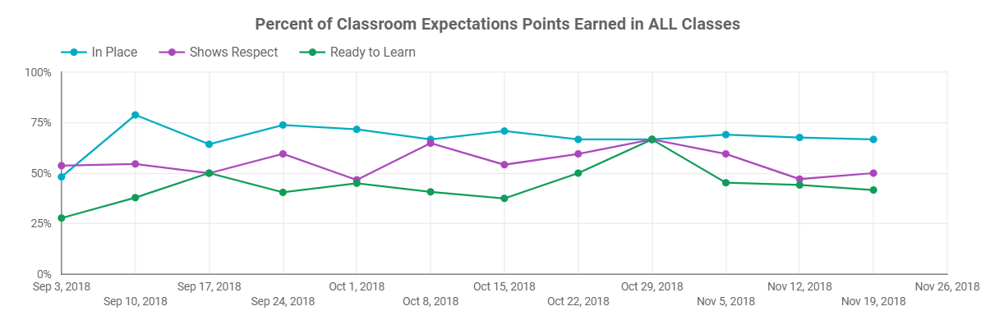
Quora High School Student
This student attended 916 schools for 4 years, with struggles each year
The goal for classroom expectations are 80+% in each category
Teachers and staff reported student was in need of behavioral intervention - which our data reflect

Slide 15
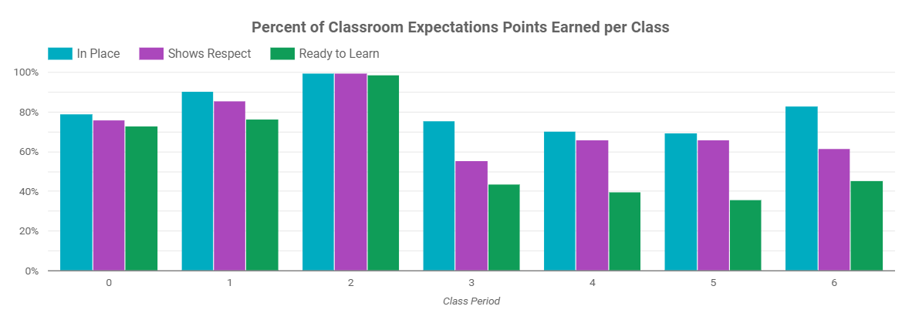
Quora High School Student cont.
Digging deeper, we saw the student was really struggling in the afternoon, which prompted an intervention targeting just those afternoon classes.
Although the case manager was on board, there were doubts. Before having our data system, so many things were tried but they did not produce the desired results.

Slide 16
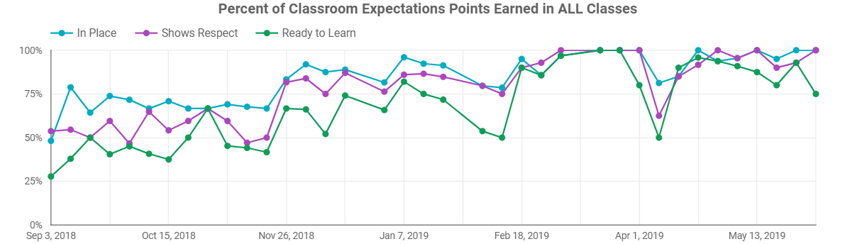
Quora High School Student cont. 2
After the intervention was in place, how did the rest of the school year go?
There was a steady increase in classroom expectation with the student ending the year with all expectations 80+%
The student transitioned back to their home district where the student continued to do well - getting a job and being nominated for student of the month
Intervention
Baseline

Slide 17
Setting Up The
Student Data System
Google Sheets™ Add-on

Slide 18
Using our Add-On
Follow the steps outlined on the How to Use page of our Add-On’s website
Enter at least one student and one row of data.
Sam Sample
Create your visualization with Looker Studio. The steps to follow are on our How to Use page
Make sure you delete the sample data from your spreadsheet after your report has been created
Need help with categories and definitions?
Check out our example categories and questions

Slide 19
Supporting your Efforts
Example Categories and Definitions
How to Use Page
Additional Resources
Looker Studio Training
Staff Data Entry Directions
If you will be sharing a roster you can protect and hide spreadsheet tabs to protect your data
You can also set up a daily calendar invite or send an email with the spreadsheet link to help staff remember to enter data
Student Behavior Data - Paper Template
Inevitably, there will be a time when the internet is down so a paper document could be needed
Set this up in advance and ensure it is accurate and matches your spreadsheet

Slide 20

Changes needed for a new School Year
You will need to change the School Year in your System Info sheet
Responses will continue to accumulate and trends can be viewed across years
OR
You can create a “New” spreadsheet, going through all of the steps on the How to Use Page
Specify the new school year during setup
Then copy and paste over your roster, delete past students, add new students

Slide 21

Visualizing your Data with Looker Studio
Google’s Looker Studio is a no-cost tool that turns your data into informative, easy to read, easy to share, and fully customizable dashboards and reports.

Slide 22
Looker Studio - a Business Intelligence Tool
Business intelligence (BI) is a technology-driven process to analyze the data used by organizations to make informed decisions.
Collects, manages and visualizes data to yield insights that inform strategies and help drive better decision making.
Using BI Dashboards
Show how current performance compares with past performance and how data is trending over time.

Slide 23
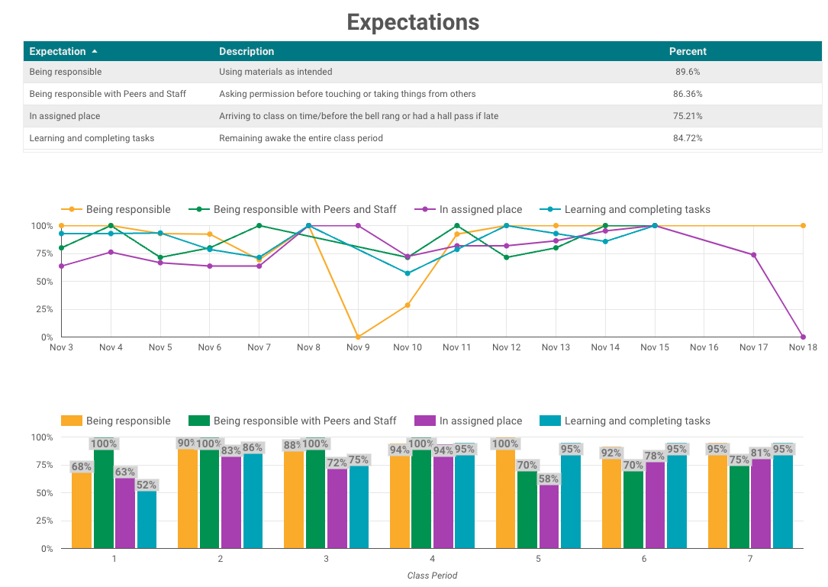


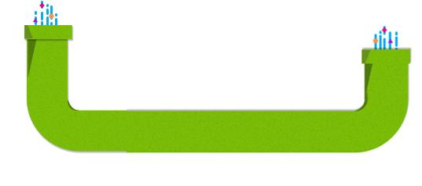
What Makes up a Looker Studio Report?
Data
The Report
Your data will be
Data Source (Pipe)

Slide 24
What is in those Pipes (Data Sources)?
Dimensions
Attributes of your data such as Student Name, Date, Category, School Name
Metrics
Quantitative measurements such as Percent of Expectations, Percent of Target Behavior, Count of Reinforcers, Number of Incidents
Calculated fields - creating both new dimensions and new metrics

Slide 25
What will the Reports show?
Aggregation
Used to summarize the data - Average, Count, Count Distinct, Max, Min, Sum
Graphs and charts
Create line, bar, and pie charts, geo maps, area and bubble graphs, tables, pivot tables, and more

Slide 26
Questions?
Please provide your feedback
Contact Us!

Slide 27

Thank you!
Kelli Roddy: kroddy@916schools.org
Kate Schroeder: kaschroe@916schools.org

Slide 28
Charting the Cs Conference 2025
Statewide Professional Development to Support the Workforce and Low Incidence Disability Areas in the State of Minnesota.
This presentation is partially funded with a grant from the Minnesota Department of Education using federal funding, CFDA 84.027A, Special Education – Grants to States.

