Slide 1

Cooking in the Classroom:
A fun way to teach functional skills while embedding literacy, communication and social skills!
Charting the Cs Conference 2025:
To Literacy and Beyond
Cooperation Communication Collaboration
Katy Coleman and Polly Moen

Slide 2
Planning:
The how to guide for creating a comprehensive cooking unit.

Slide 3
What is the makeup of our classrooms and who else do we collaborate with?
We teach in a setting 3 autism classrooms
Our students are with us 60% or more of their day
Demographics: 6 students and 2 Education Support Professional (ESP)
We have Kindergarten-2nd grade students

Slide 4
What is the makeup of our classrooms and who else do we collaborate with? cont.
We have a variety of communication needs.
Fully verbal students to fully non-verbal
Student with devices. Some students are very fluent on their devices and others are just learning their device
Our teaching team for the cooking group is comprised of
2 teachers
1 speech therapist
Depending on the needs of the group, possibly an ESP or 2

Slide 5
How do we group students?
Cooking groups are based on a variety of factors
Communication level of our students
We collaborate with our speech therapist to determine the groups
When a student’s communication ability may fit in either group, we tend to push them and group them with the students who are slightly more advanced.

Slide 6
How do we group students? cont.
Cooking groups are based on a variety of factors
Behavior needs of our students
Does a student need ESP support to complete tasks?
Is there enough adult support for that student in the group?
What are the triggers of the students?

Slide 7
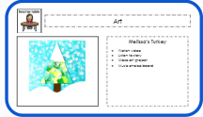



What do the other students do when not in the cooking group?
The other group is doing an art project in the other classroom.
We plan the art project each week and our ESPs run the group.

Slide 8
What do the other students do when not in the cooking group? cont.
The group has a set of slides and the routine is the same for each week.
Listen to a song
Listen to a story
Make the art project
Take turns choosing songs from a song choice board

Slide 9
How to choose a recipe? Where do we find recipes? Variety of factors
We choose recipes based on a variety of factors
Complexity of the recipe
Building of vocabulary
Our students

Slide 10
How to choose a recipe? Where do we find recipes?
Where do we find recipes
We have created our own recipes
TPT: Search Cooking
Made for Me Literacy
Simply Special Ed
Mrs. D’s Corner

Slide 11
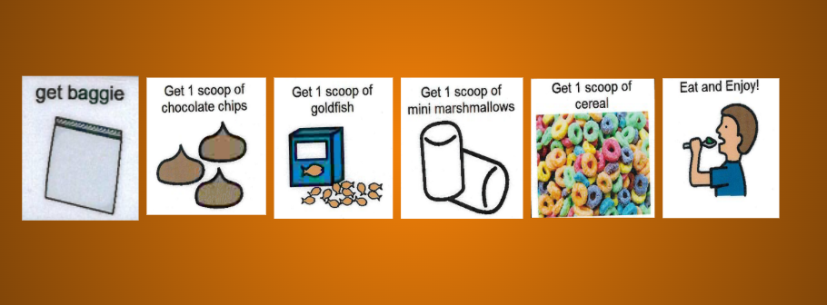
How to choose a recipe? Where do we find recipes? Cont.
Complexity of the recipe
Recipes with a few ingredients or supplies tend to happen earlier in the school year
Recipes with simple directions happen earlier in the school year

Slide 12
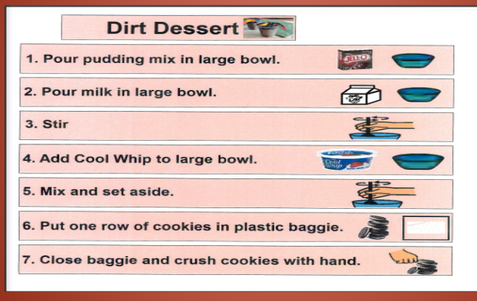
How to choose a recipe? Where do we find recipes? Complexity of the recipe
Complexity of the recipe
Recipes with more complex directions or those that are group recipes are done later in the school year

Slide 13
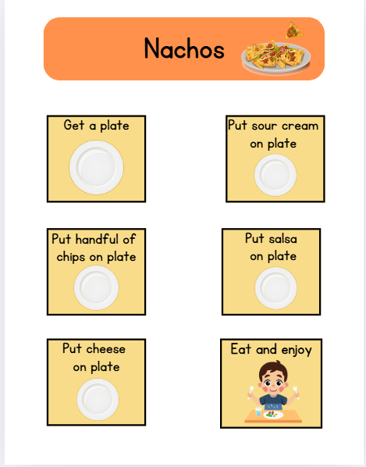
How to choose a recipe? Where do we find recipes? Choice.
Complexity of the recipe
Some recipes lend themselves to choice, in these recipes we let the students choose their ingredients

Slide 14
How to choose a recipe? Where do we find recipes? Building of vocabulary
Building of vocabulary
Recipes that build off of vocabulary already taught
Example: If a spoon was used to stir in one recipe, the next month we may look for a recipe that uses a spoon to scoop instead.
Recipes that use different tools/utensils
Example: whisk, spatula, popcorn popper, etc…

Slide 15
How to choose a recipe? Where do we find recipes? Our students
Our students
Some of our students are picky eaters
Recipes that have ingredients are students like but are presented in a different way

Slide 16
How to choose a recipe? Where do we find recipes? Picky eaters
Our students
Some of our students are picky eaters
Recipes that have different textures
Collaborate with Occupational Therapist for students with limited foods
Think about how best to expand their pallets and sensory aversions
Think about having students touch or lick rather than eating

Slide 17
How to choose a recipe? Where do we find recipes? Allergies
Our students
Allergies and cultural needs are also considered

Slide 18
How to choose core words?
We collaborate with our speech therapist
We choose words that students:
See in other recipes
Example : make, put in, open
Use in other parts of their day
Examples: help, I want
We may choose more complex phrasing to expand their sentences
Example: Can I have…?

Slide 19
How to choose social skills?
We collaborate with our speech therapist
We consider IEP goals
The social skills may not align perfectly with goals
We may be teaching a prerequisite of the goal or expanding on a goal

Slide 20
How to choose social skills? Cont.
We consider the dynamics of the group
We may notice a lack of a skill during a group that we need to work on
Example: how to get others attention, how to wait a turn
We consider the recipe
Some recipes may lend themselves to turn taking or ordering from each other

Slide 21
How to choose social skills? cont.
We consider the dynamics of the group
We may notice a lack of a skill during a group that we need to work on
Example: how to get others attention, how to wait a turn
We consider the recipe
Some recipes may lend themselves to turn taking or ordering from each other

Slide 22
How do we pay for supplies?
We fund our supplies through our PTSA
We are a line item in their budget every year
When we first asked, we explained the benefits of what our cooking group was.

Slide 23
How do we pay for supplies? Cont.
Other ways to get funding
Ask your principal
Ask your special education department
Ask parents to donate money
Apply for a grant
Put shelf stable supplies on the back to school supply list

Slide 24
Prepping:
Creating the materials you need to teach the cooking unit.

Slide 25
Teacher materials
We create the lesson in Boom Cards.
You could also use Google Slides or Powerpoint
Lesson slides are same week to week
Buy the supplies
Create any video models needed

Slide 26
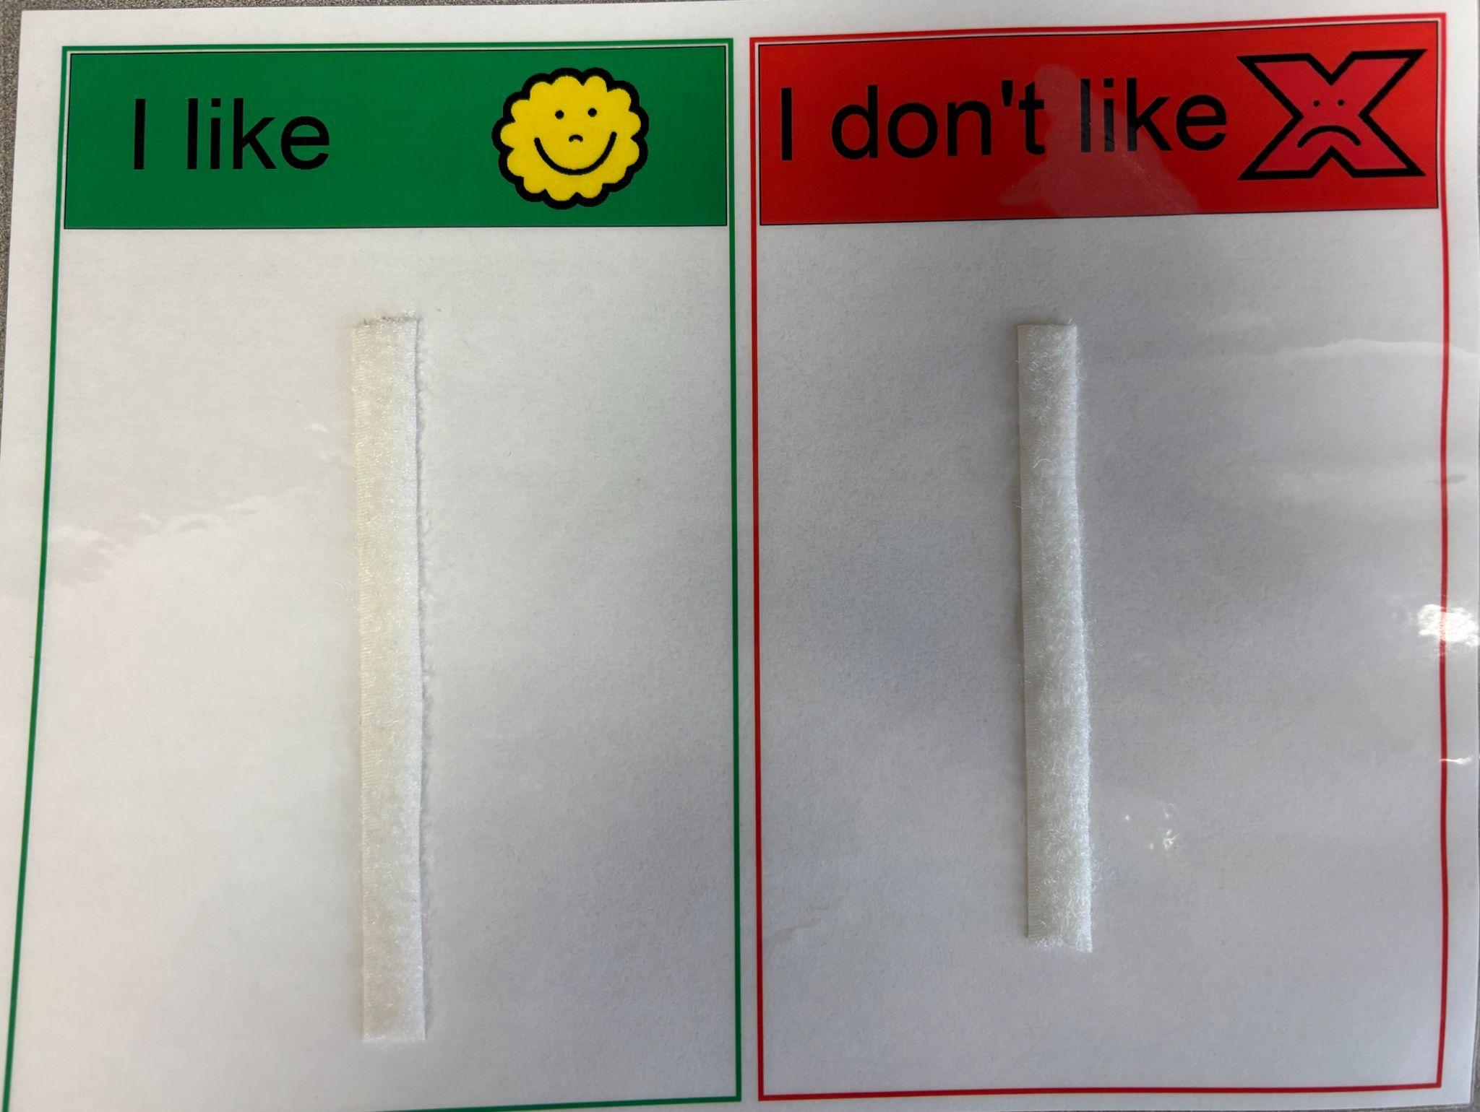
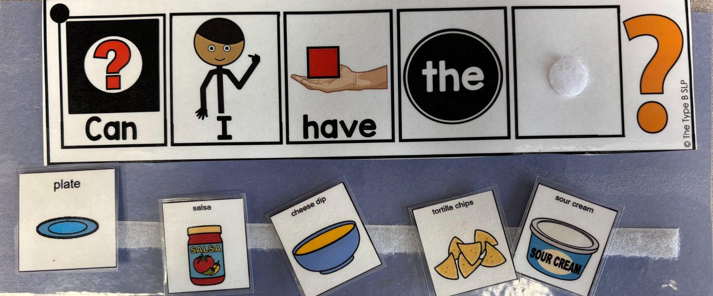
Student materials
Create the visuals
Specific recipe visuals
Recipe
Taste test
Communication boards
Program AAC devices
Consult with your speech therapist on what words are needed or what word patterns are for certain words

Slide 27
Implementation:
Everything is planned and prepped…
How to we put the plan in action?

Slide 28

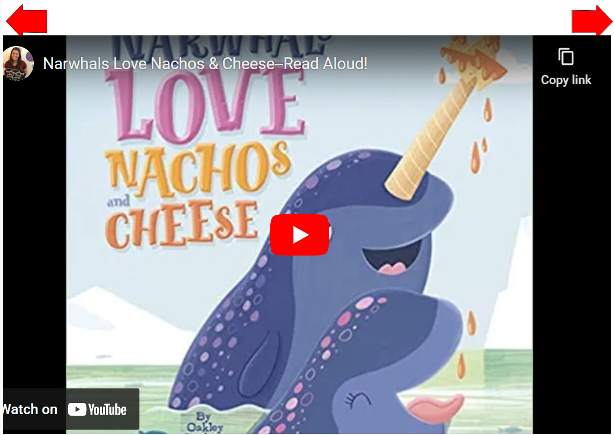
Weekly Cooking Slides:
Used during weeks 1-3 Wash Hands
Wash your hands is the screen students see when they walk into the room.
They listen to a story on YouTube that is on theme for the recipe.

Slide 29
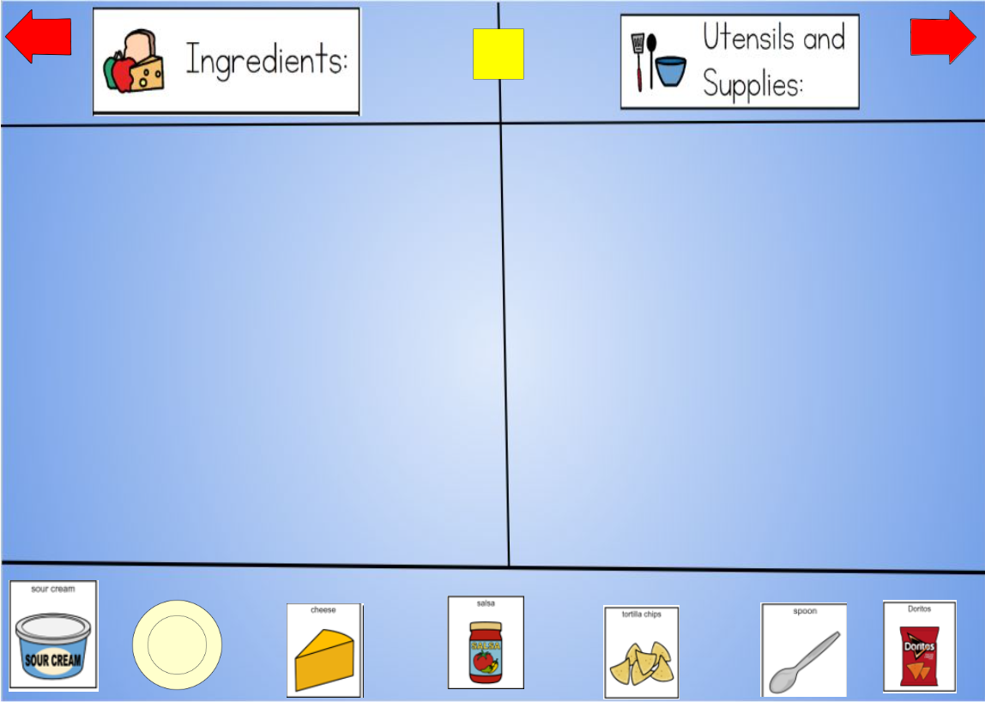
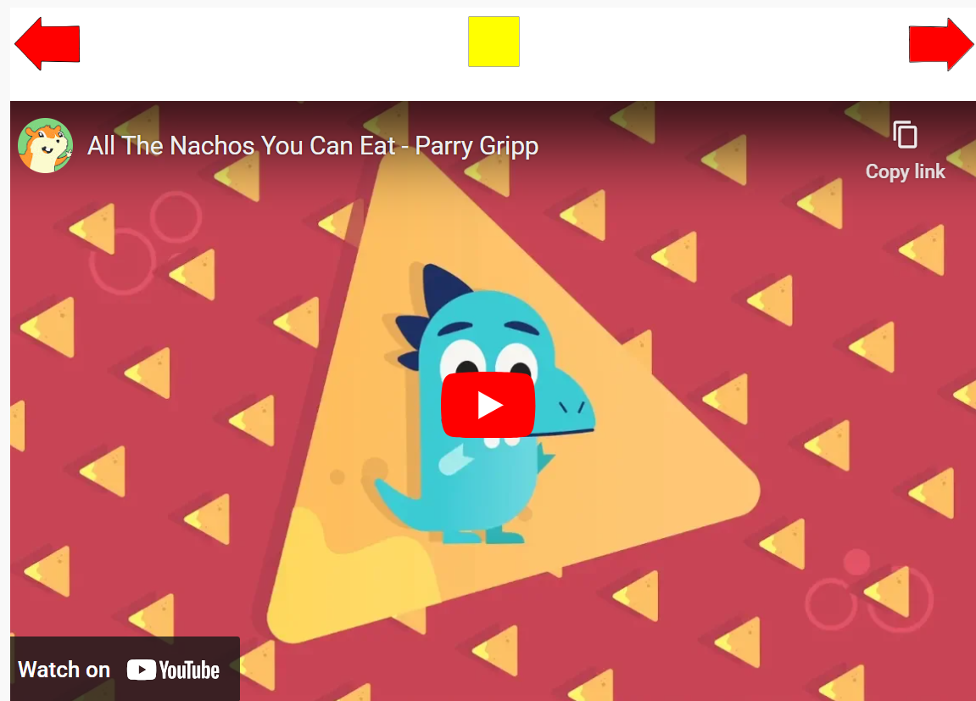
Weekly Cooking Slides:
Used during weeks 1-3
Sort recipe items into ingredients and tools
End all lessons with a song on theme with the recipe

Slide 30
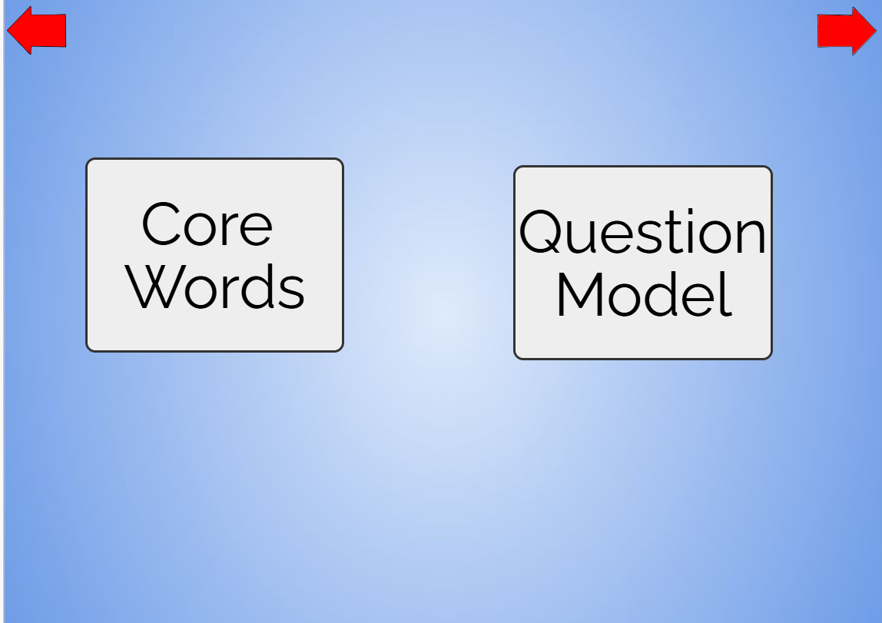
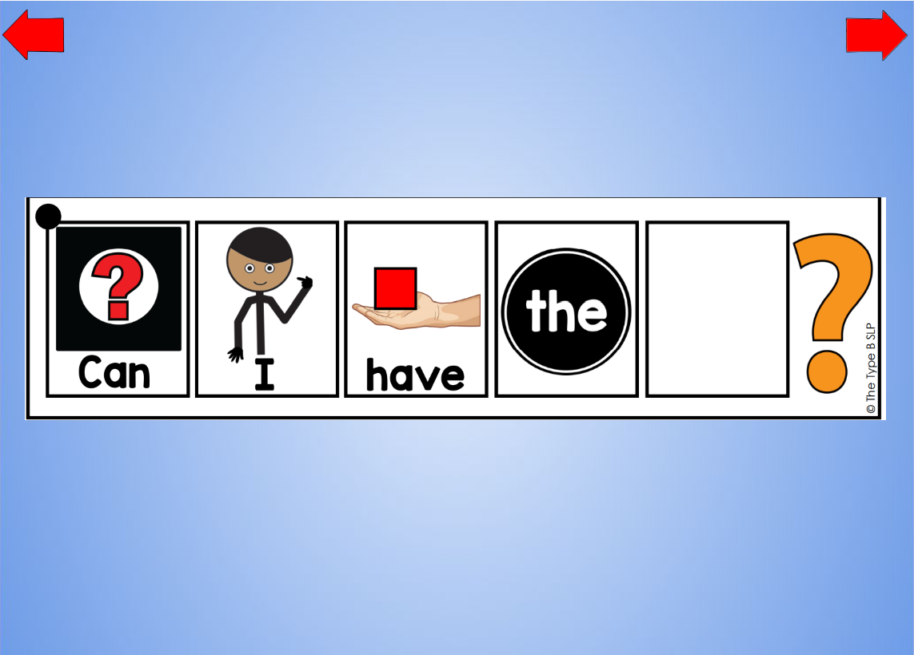
Weekly Cooking Slides:
Used during weeks 1-3 Core Words
Teachers can chose from Core Words or Question Model depending on the group
Question Model
Video model of sentence step

Slide 31

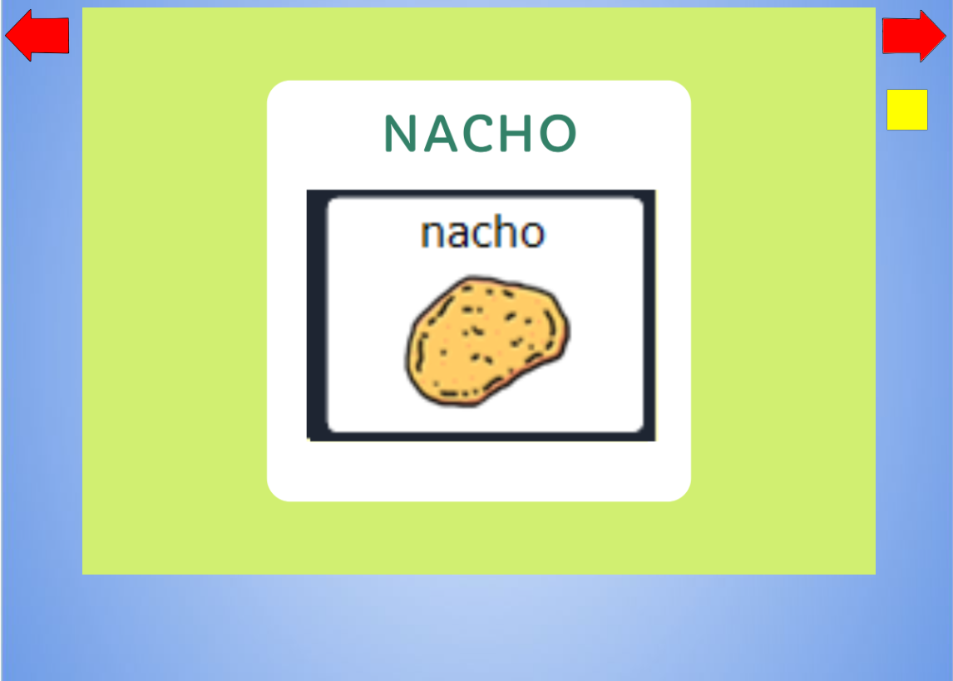
Weekly Cooking Slides:
Used during weeks 1-3 Modeling
Cooking Core words
Model where to find core words on LAMP device
Speech therapist leads this part
Slides were made using Canva

Slide 32
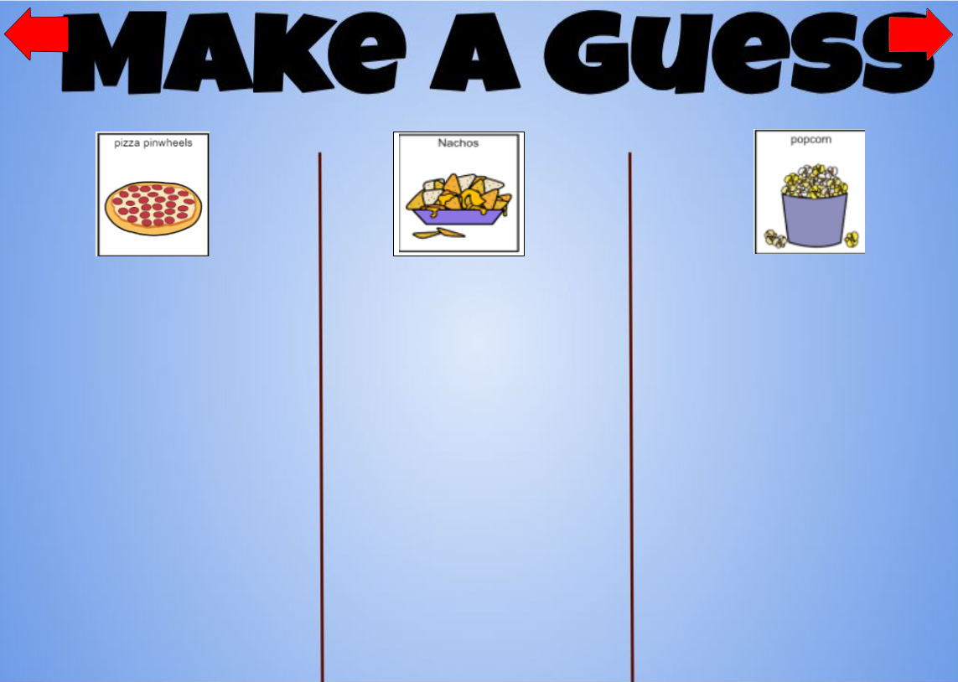
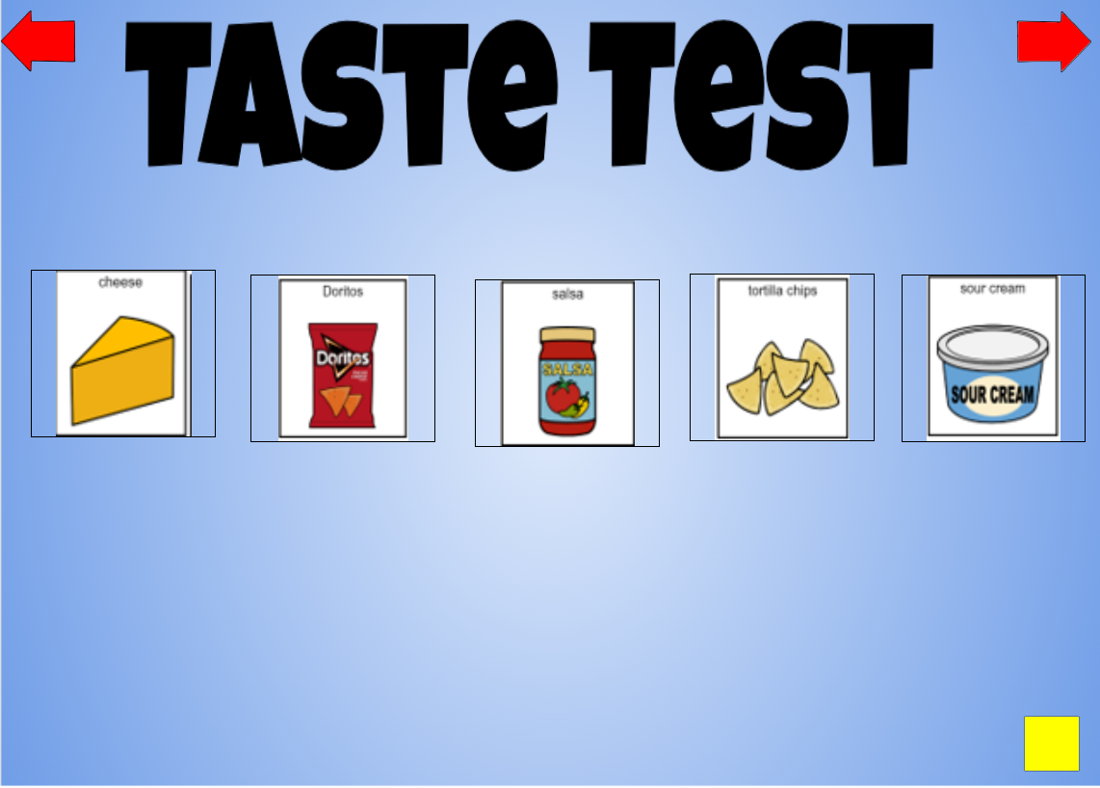
Week 1 Cooking Slides
Students make a prediction based on ingredients and tools discussed in previous slide.
Students taste the ingredients used in the recipe

Slide 33
Week 1 Cooking Slides; Like, Don’t Like
Students place the icons of the ingredient on either “I Like” or “I Don’t Like” mat
Students then move the icons from the “I Like” side only to their question mat.

Slide 34
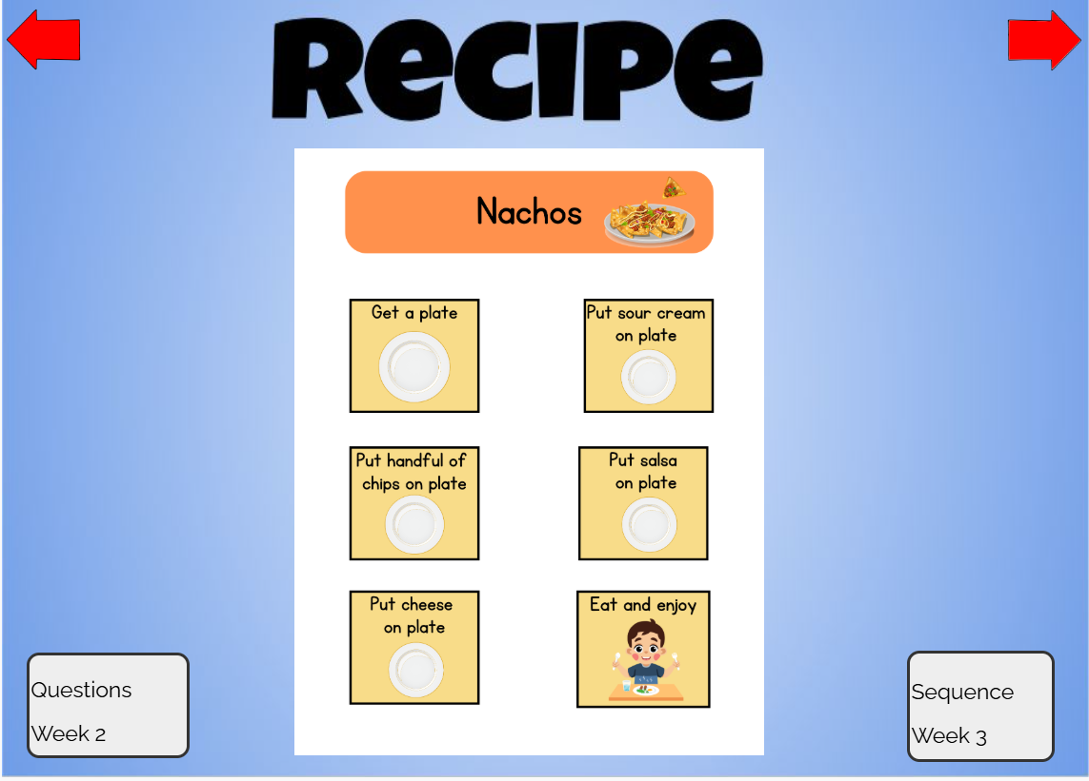
Time to make the recipe!
Students get a copy of the recipe to complete.
Students are working to ask staff and peers for the things they need.
Students are completing all steps of the recipe as independently as possible.
Students get to eat the snack at the end

Slide 35
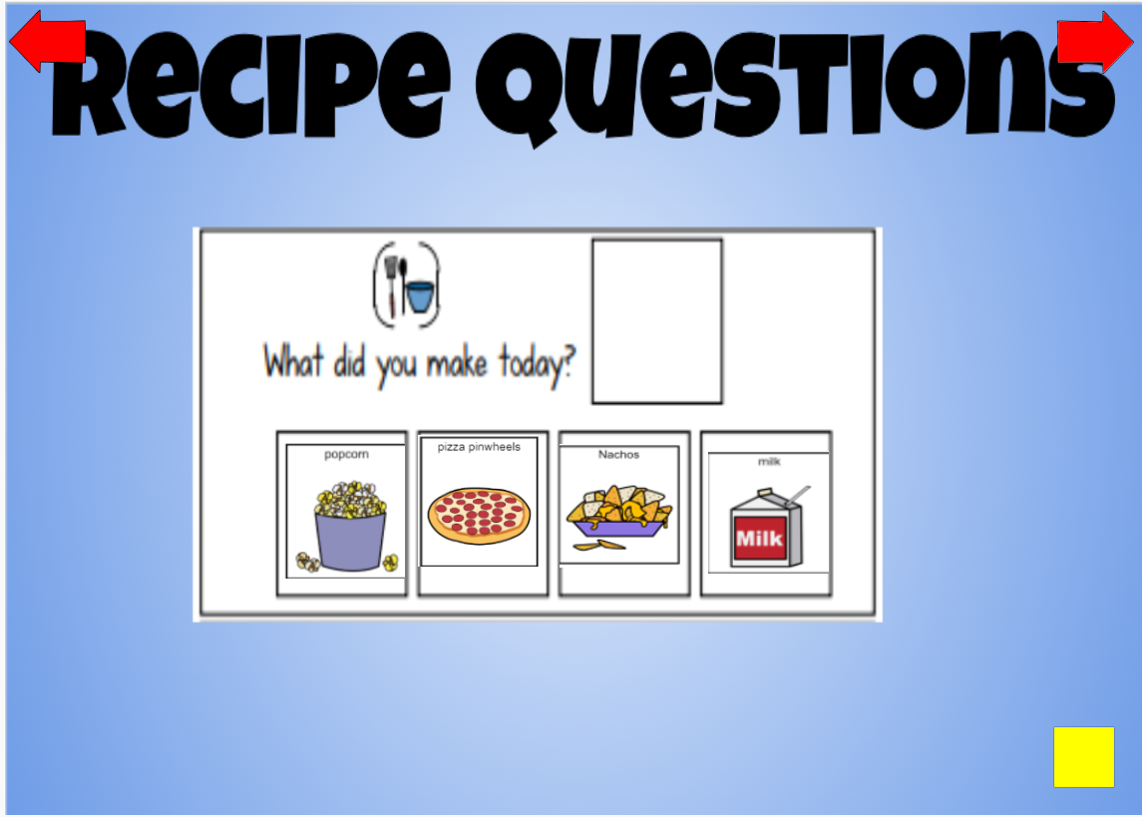
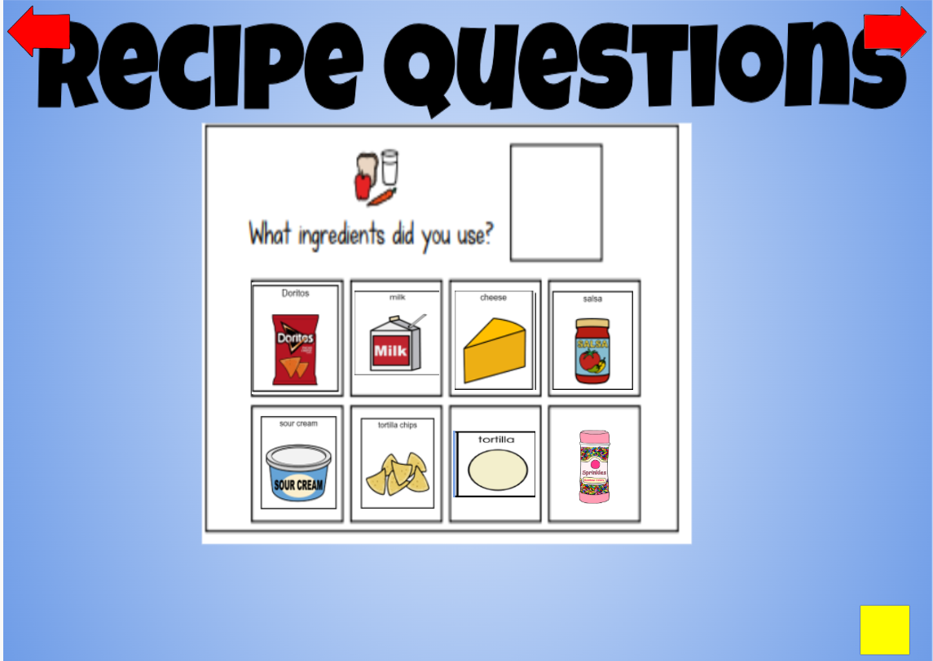
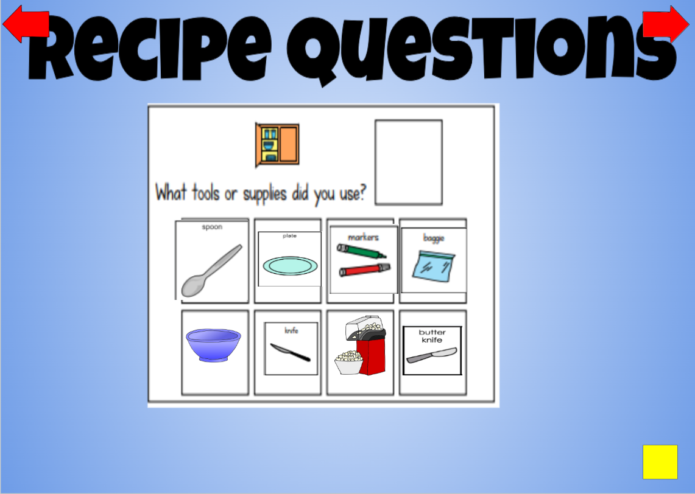
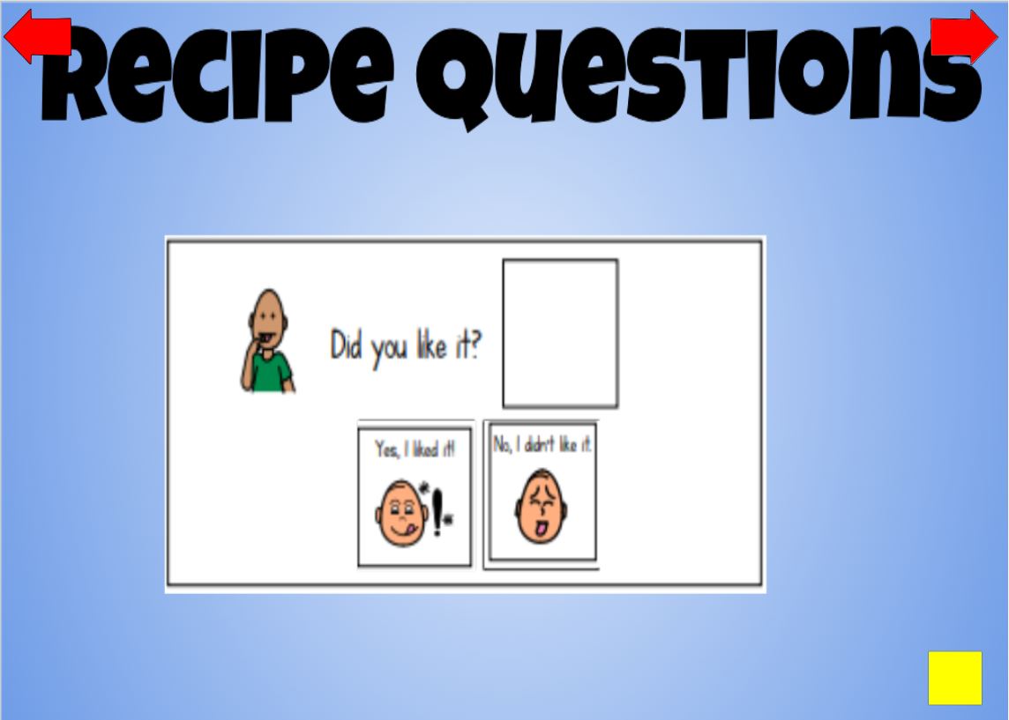
Week 2 Cooking Slides
Students take turns answering a variety of questions on the board.

Slide 36
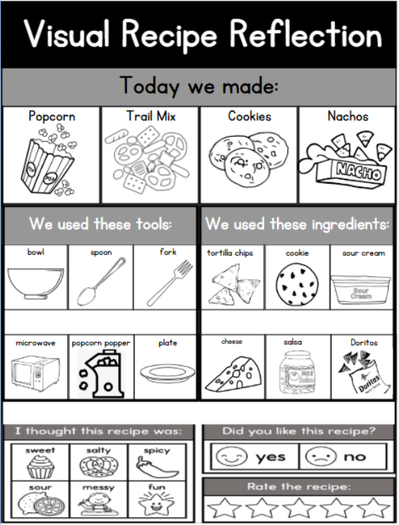
Week 2 Cooking Slides Reflection
Students then fill out a recipe reflection sheet to take home.
Students share what they did in cooking with their parents using the recipe reflection sheet.

Slide 37
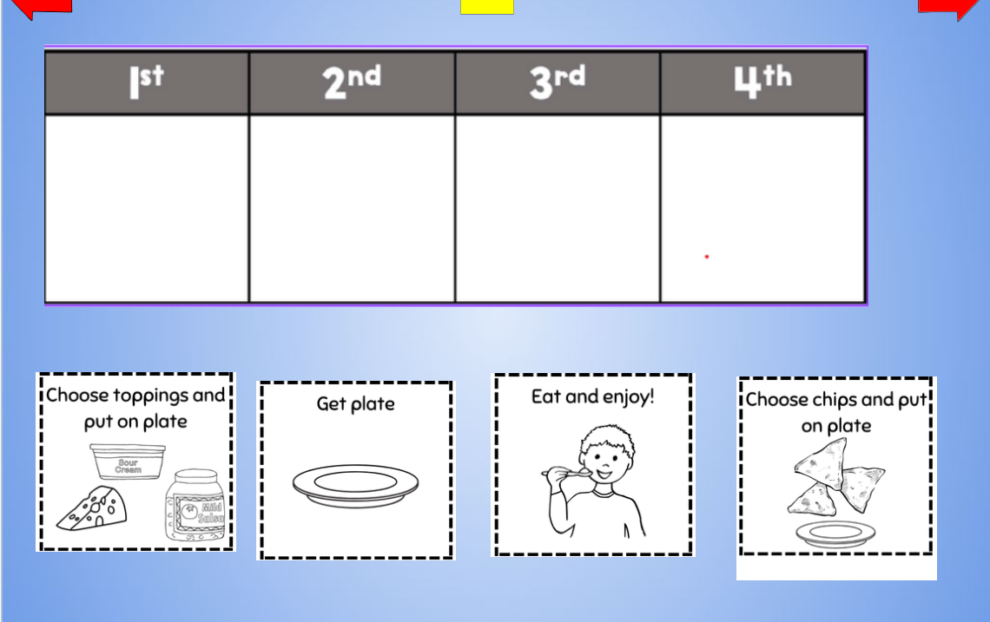
Week 3 Cooking Slides
After the recipe, students work together to figure out the sequence of steps.
Students then complete a sequencing sheet to take home.
Works on retell skills
Helps with home/school connection.

Slide 38
Reflection:
Did the lessons accomplish what we intended?
What supports are still needed?

Slide 39

Things we consider weekly/monthly
Are students grouped appropriately?
Move students based on communication, cognitive, and behavioral needs.
Other supports needed for the next week?
Decide on additional visuals that may be needed
Record video modeling
Do we need to expand for more language?
Start the process all over again with planning, prepping, and creating slides/boom deck

Slide 40

Thank you!
Katy Coleman and Polly Moen
cacoleman@rochesterschools.org
pomoen@rochesterschools.org

Slide 41
Charting the Cs Conference 2025
Statewide Professional Development to Support the Workforce and Low Incidence Disability Areas in the State of Minnesota.
This presentation is partially funded with a grant from the Minnesota Department of Education using federal funding, CFDA 84.027A, Special Education – Grants to States.

