Slide 1

Supporting Youth Transitions: Exploring the MN Transition Framework and Person-Centered Practices
Charting the Cs Conference 2025:
To Literacy and Beyond
Cooperation Communication Collaboration
April 30, 2025
Presented by: Dana Page, Ph.D. and Sarah Robinson

Slide 2
Ten Minnesota Commitments to Equity
*Prioritize equity.
Start from within.
*Measure what matters.
Go local.
Follow the money.
*Start early.
Monitor implementation of standards.
*Value people.
Improve conditions for learning.
*Give students options.

Slide 3
Today’s Agenda
Introductions
MN Youth in Transition Framework and Toolkit
Person-Centered Practices – Charting the LifeCourse
My Vault
Q&A

Slide 4
Meet Today’s Specialists

Slide 5
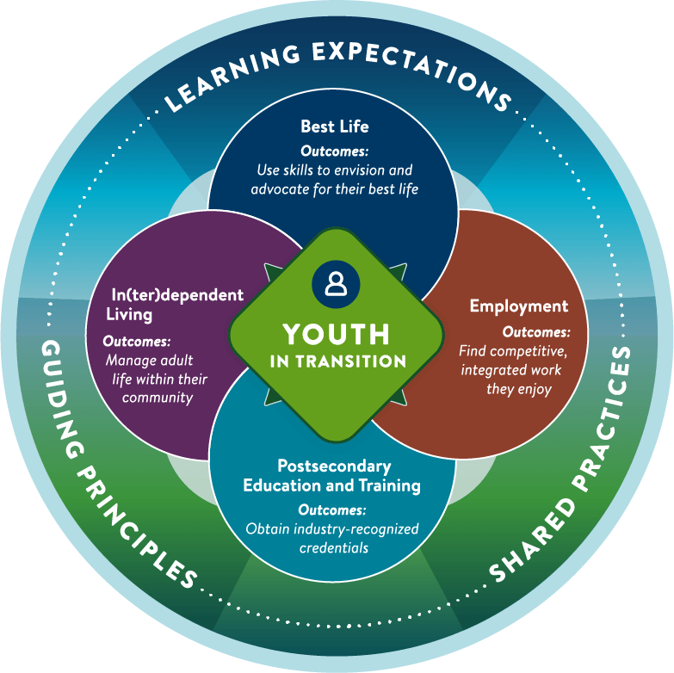
Minnesota’s Youth in Transition Framework

Slide 6
What is the MN Youth in Transition Framework?
Minnesota’s Youth in Transition (YiT)
Framework defines quality transition planning, empowering professionals, students, and families across the state to work together toward the same outcomes for youth.
Developed by E1MN and transition leaders statewide.

Slide 7
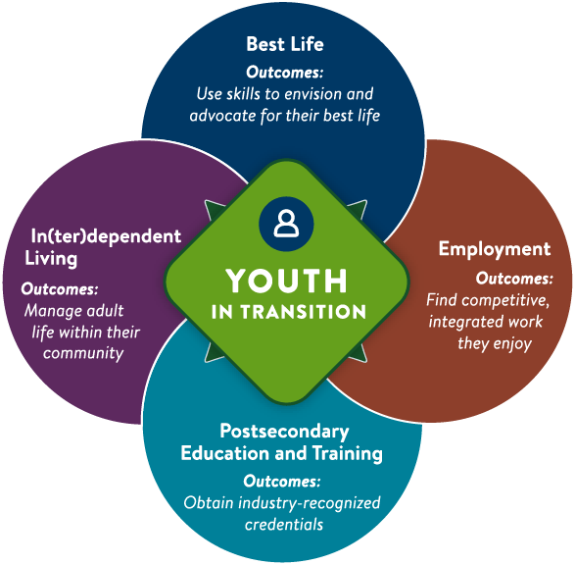
Improved Youth Outcomes
The Framework defines the improved youth outcomes all transition professionals in Minnesota are working toward.
Best Life Youth use self-determination and leadership skills to envision and advocate for their best life.
In(ter)dependent Living Youth successfully manage in(ter)dependent adult life within their community.
Employment Youth find competitive, integrated work they enjoy.
Postsecondary Education and Training Youth access postsecondary education and training options and obtain industry-recognized credentials.

Slide 8
Three Key Elements of the YiT
The Framework’s three key elements create the foundation for effective transition planning and programming.
Guiding principles
Learning expectations
Shared practices

Slide 9
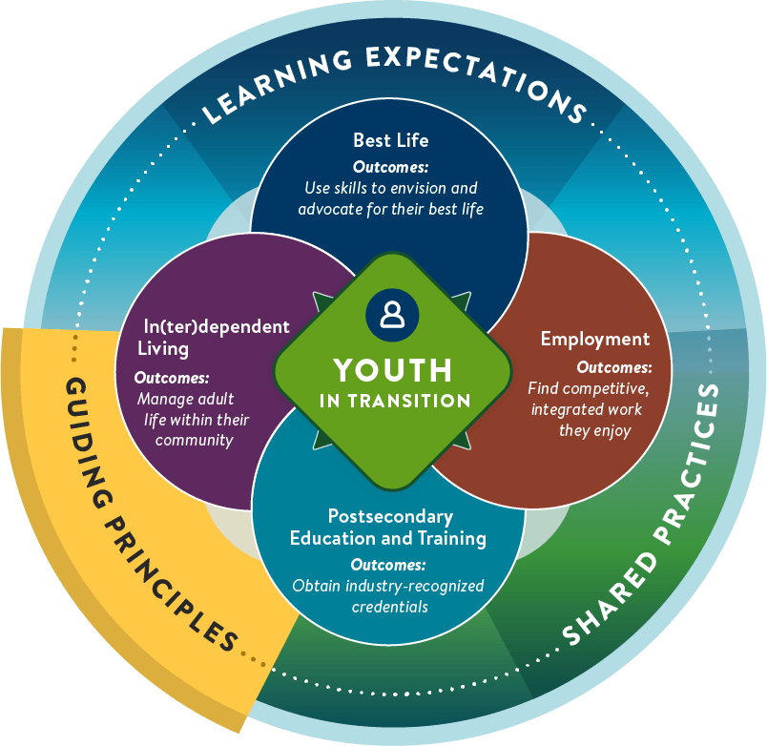
Key Element 1: Guiding Principles
The guiding principles are the beliefs that guide decisions at the system, agency and professional level and serve as the foundation for what we do and how we do it.
The youth is at the center of transition planning.
Families play a key role in successful transition outcomes.
Transition planning should start early in a youth’s life.
High expectations matter.
Strong partnerships support a smoother transition to adulthood.
Success is measured by improved youth outcomes

Slide 10
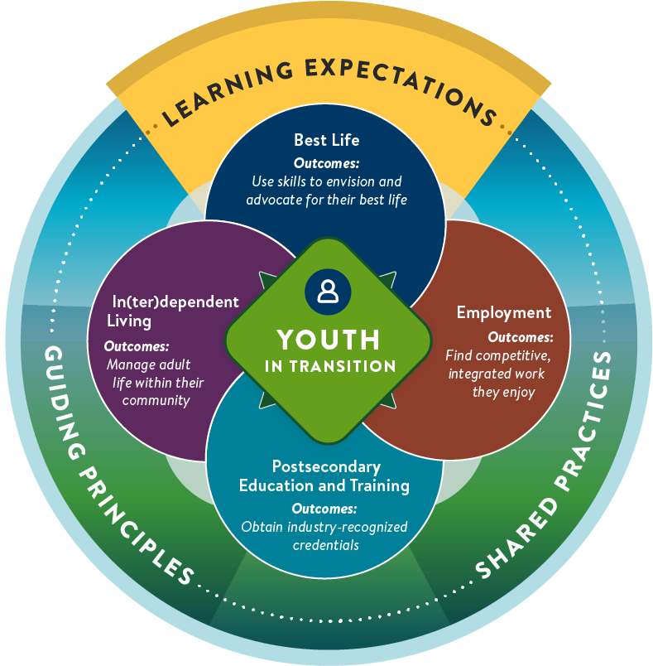
Key Element 2: Learning Expectations
Learning expectations define the topics all youth in transition should explore. Exploration of topics in these four categories helps students develop the knowledge, skills and supports they need to prepare for and live the life they want in adulthood.
Best life
In(ter)dependent living
Employment
Postsecondary education and training

Slide 11
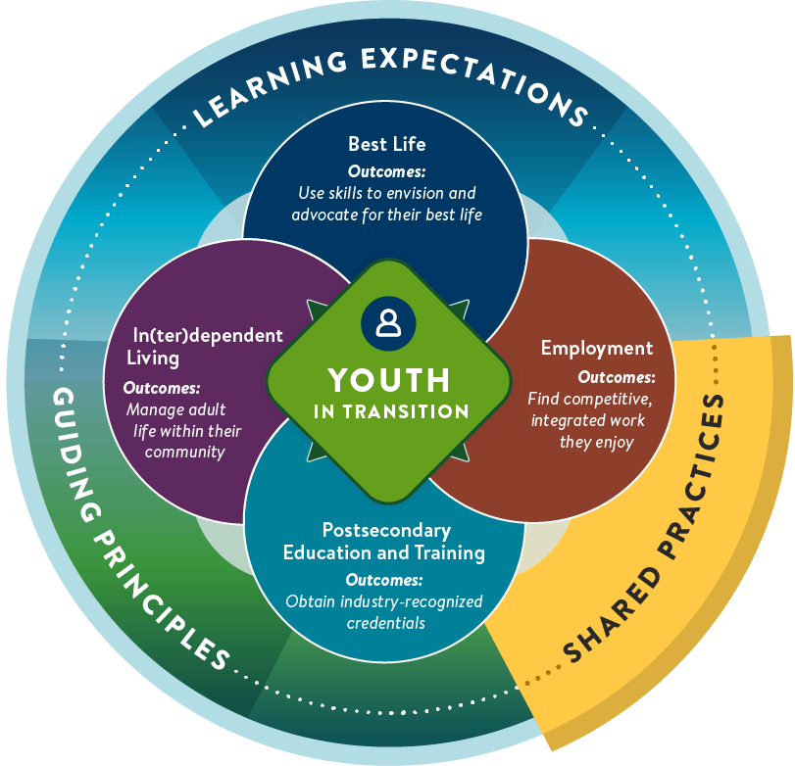
Key Element 3: Shared Practices
Shared practices are collective ways of working using the same practices, processes and tools. The goal is to have consistent, person-centered experiences for youth and families while optimizing the role of everyone on the youth’s transition planning team.
Person-centered practices
Collaborative partnerships
The youth-planning process

Slide 12
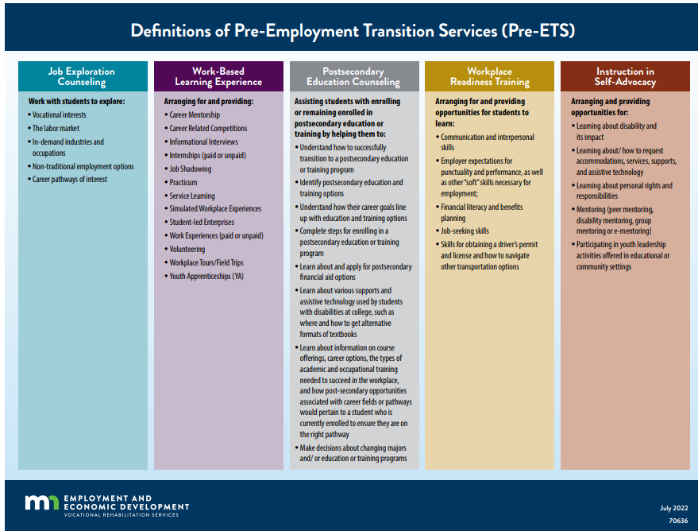
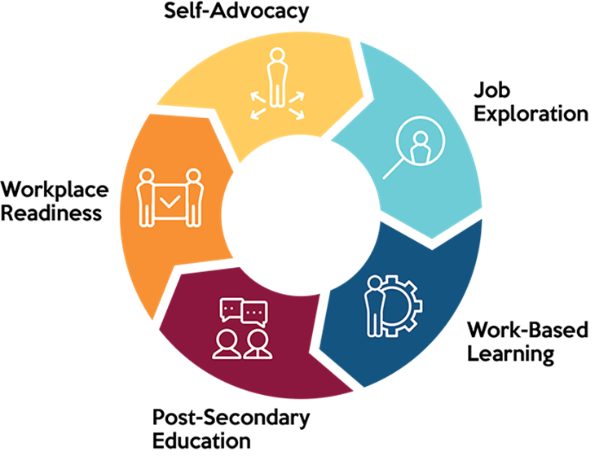
All Transition Services Align to a Pre-ETS Category
Click here for this desk aid

Slide 13
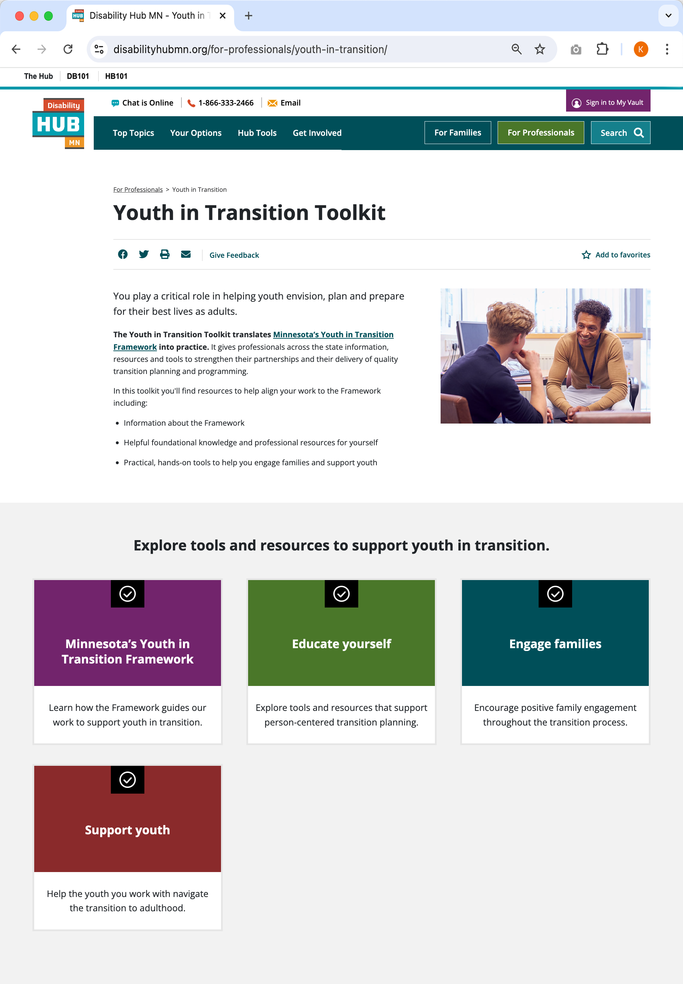
Youth in Transition Toolkit
To support professionals in implementing Minnesota’s Youth in Transition Framework, a comprehensive toolkit is available online. The Youth in Transition Toolkit provides statewide access to up-to-date resources and tools to help professionals implement the Framework.
Check it out at disabilityhubmn.org/YIT-toolkit

Slide 14
Disability Hub
Disability Hub website
Informed Choice: Understand the informed choice standard and how you can help people with disabilities lead inclusive lives
Benefits Planning: Learn how benefits support work, and find tools to help you address concerns so people can get ahead through work
Work: Consider steps you can take to introduce the idea of work and to engage people in rewarding employment
Housing: Find out how to support and empower people to explore housing options and reach their housing goals

Slide 15
Disability Hub, cont.
Youth in Transition: Find tools and resources to implement the youth in transition framework with the youth you support
Hands-On Tools: These tools can help inform the person's positive summary and be included in their employment portfolio

Slide 16
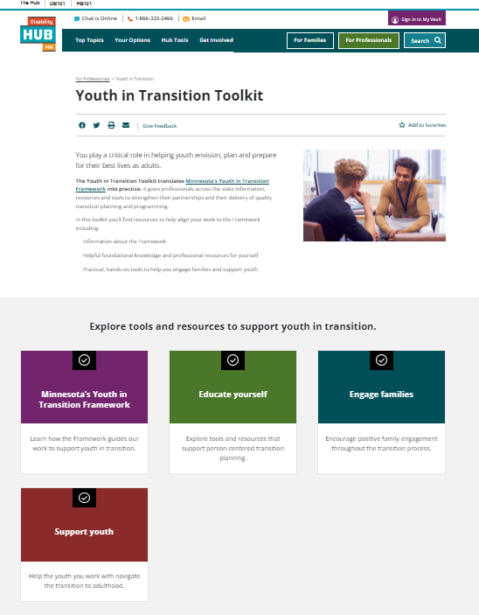
Youth in Transition Toolkit structure
The toolkit is organized into four sections:
Minnesota’s Youth in Transition Framework
Educate yourself
Engage families
Support youth

Slide 17
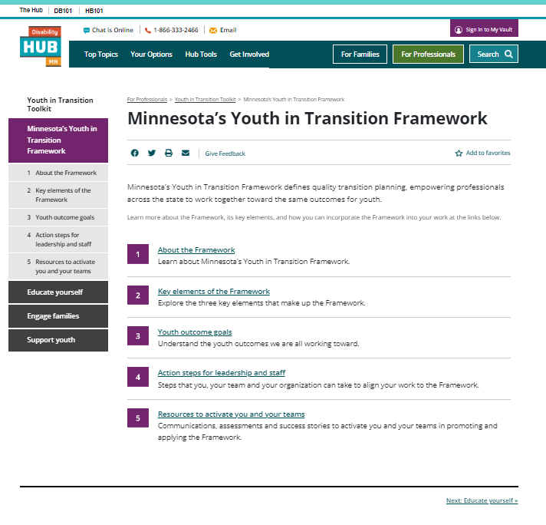
Minnesota’s Youth in Transition Framework section
Professionals can start here to:
Learn about the Framework, its key elements, and youth outcomes
Find action steps for leadership and staff aka Tab 4 (a great place to start!)
Get resources to activate themselves and their teams

Slide 18
Action Steps for Leadership and Staff
Staff, including special education teachers / coordinators, vocational rehabilitation staff, and case managers have an important role in aligning their work to Minnesota’s Youth in Transition Framework.
Those in leadership, including special education directors / supervisors, Vocational Rehabilitation regional area managers, and waiver case manager supervisors, have an important role in applying and implementing Minnesota's Youth in Transition Framework.

Slide 19
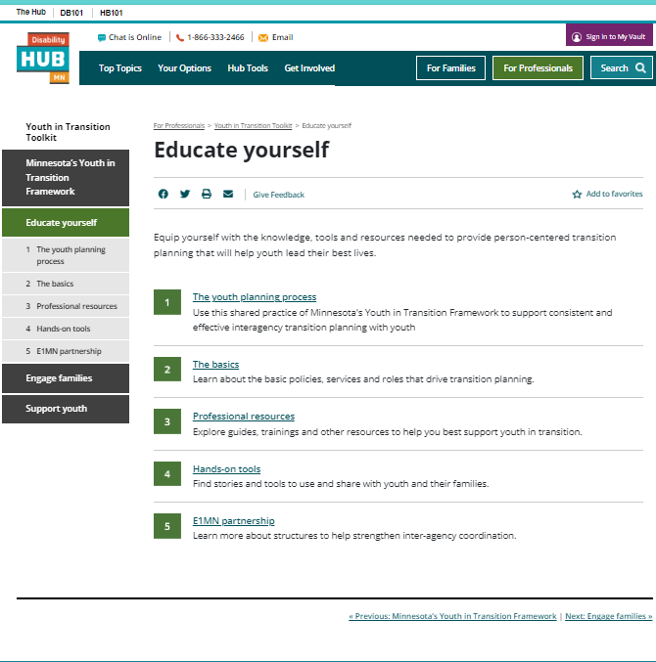
Educate yourself
Professionals can start here to:
Learn about the transition framework and the E1MN partnership
Youth planning process
Get basic information about plans, policies, services and roles
Find resources for their own professional development

Slide 20
Core resource to use with youth: Transition/Pre-ETS Inventory
Complete with youth and their support team. The inventory can be used to identify:
The youth’s transition-related strengths and needs
Which transition services will be a priority this year
Which learning stage the youth is in for each topic
Who on the youth’s team will provide each transition service (by using the “notes” section).
Transition/Pre-ETS Inventory.

Slide 21
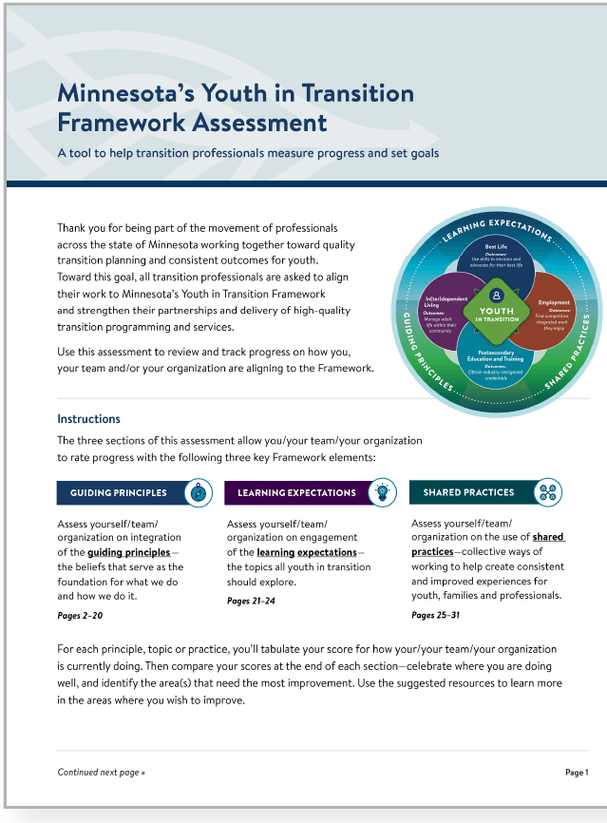
Core assessment for professionals: Minnesota’s Youth in Transition Framework Assessment
Allows professionals to measure their progress in aligning their work to the Framework and set goals.
*New version came out March 2025!
Framework Assessment

Slide 22


Engage families
Here professionals can find information, resources and tools to:
Invite families into the transition process, and
Engage them as partners in their youth’s transition and employment success.
Each topic in this section is structured in two parts:
LEARN:
DO:
Information professionals can use to develop their knowledge
Activities and information professionals can share with families

Slide 23
Support youth
This section is organized by the framework’s four domains—My best life, In(ter)dependent living, Employment, and Postsecondary education and training.
Under each domain, professionals will find information ideas and activities to support transition planning.
Each topic in this section is structured in two parts:
LEARN:
DO:
Information professionals can use to develop their knowledge
Activities and information professionals can share with youth

Slide 24
Youth in Transition Classroom Curriculum
Youth in Transition Classroom Curriculum information
E1MN created curriculum for educators to use with students to help support Minnesota’s YiT Framework. These 20-25 minute lesson plans help students see and plan for what life after high school might look like. Videos, discussion questions, real-life stories, tools, and activities are used.
Through the lessons students can start envisioning for themselves:
what they want and how they can live their best life
what living in(ter)dependently could look like for them
what they want for meaningful employment
what postsecondary education or training program they might want to do

Slide 25
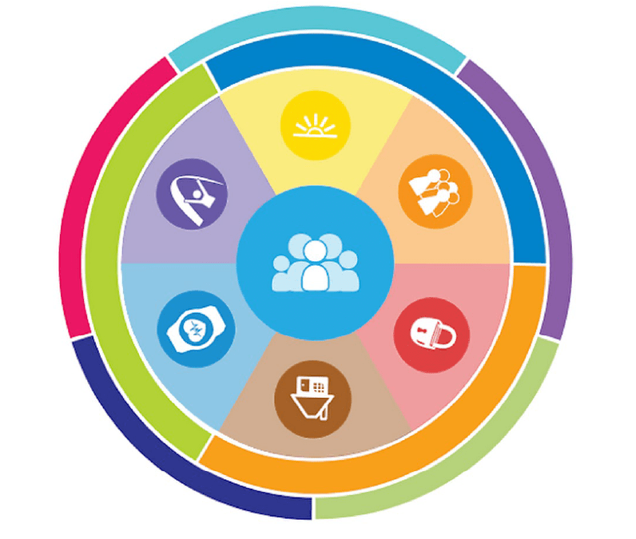
Charting the LifeCourse™

Slide 26
Charting the LifeCourse™ Framework
Person Centered Planning Resources
Can be used independently by individuals or with support from family or team members.
Can be used throughout the lifespan.
Can be used to support IEP team conversations and decisions.
Can be used with general or individualized communication supports.

Slide 27



Person Centered Planning Tools
Person Centered Planning Tools
My One Page Profile
Life Trajectory
Integrated Supports Star
Use the one-page profile to describe yourself — what people like about you, what's important to you and how to best support you.
Use this worksheet to envision your best life and identify the steps or experiences needed to get there, including what you don't want your life to look like.
Use this worksheet to write about the tools, resources and people in your life, and how they help you live an inclusive life in the community.

Slide 28
My One Page Profile
The starting point
Helps the individual consider their strengths and what is important to them
Helps the individual consider what kinds of supports they need

Slide 29
Life Trajectory
What is the vision for the individual's desired life outcomes?
What steps need to be taken to help get there?
What outcomes does the individual desire to avoid?
What steps need to be taken to avoid them?

Slide 30
Integrated Supports Star
Use the star to plan for outcome identified in the life trajectory.
Use to frame conversations regarding new experiences:
Employment
Decision making
Community participation
Taking risks

Slide 31

My Vault: Communication and Planning Tool

Slide 32
What is My Vault?
My Vault is a shared tool for planning across agencies.
Secure, personal account used by people with disabilities and those who support them to explore and plan, store and share files, create contact lists, and clearly document activities that lead to an informed choice.
Disability Hub MN - Vault

Slide 33
How can youth and families use My Vault?
Youth and families can:
Know who's on their team, who can help with what, and how to contact them
Access information and plans electronically
Store documents safely and in a single place
Access tools and activities to plan and prepare for work and life after school
Easily and securely share information and files
Store their own information, plans and resources after graduating from high school or a transition program

Slide 34
How can professionals use My Vault?
Professionals can:
Plan and share information in a secure way.
Connect and collaborate with others on a person's team
Access tools to help a person set and reach goals
Securely store and share files
Document steps a person takes toward informed choices about work, benefits and housing

Slide 35
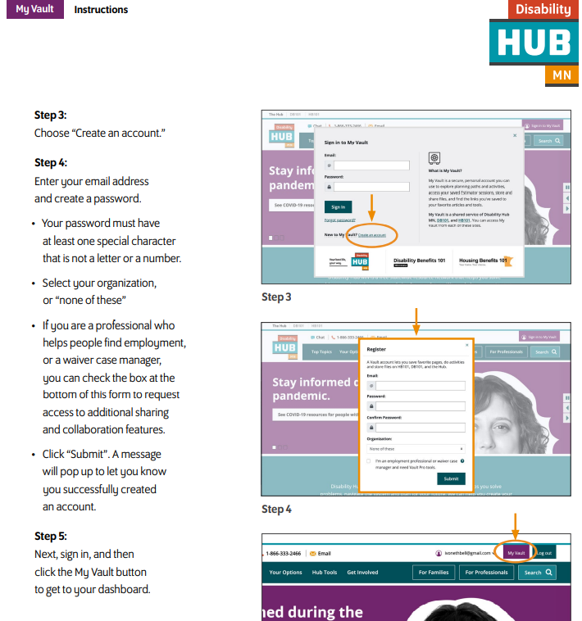
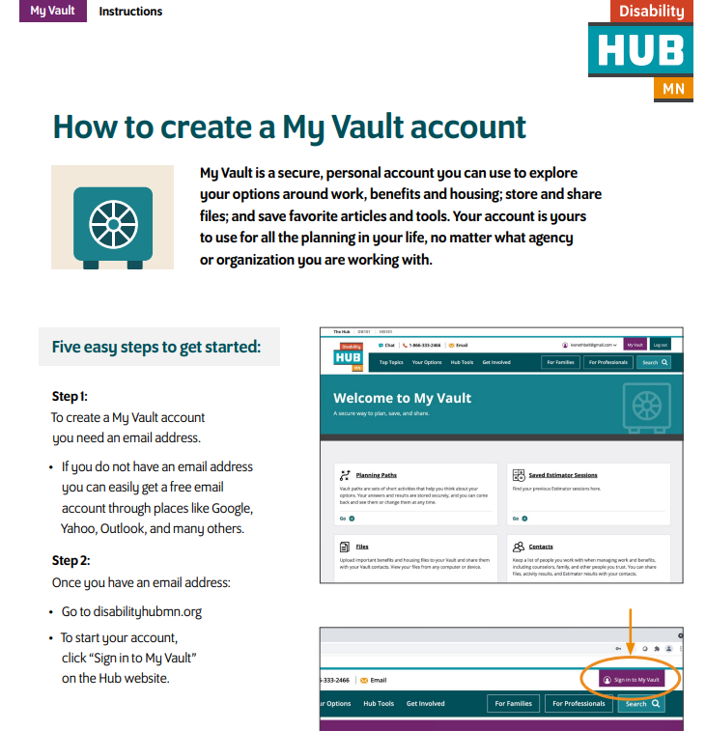
Creating My Vault Account
How to Create a My Vault Account

Slide 36
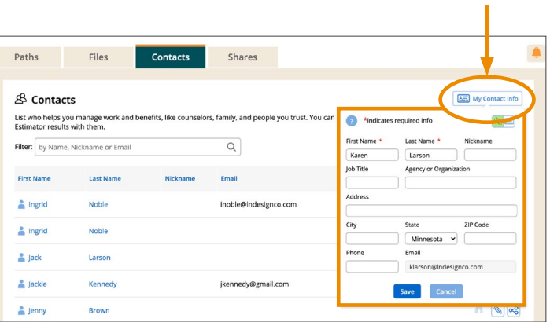
Adding Contacts, Store and Share Files
Add Contacts, Store and Share Files

Slide 37
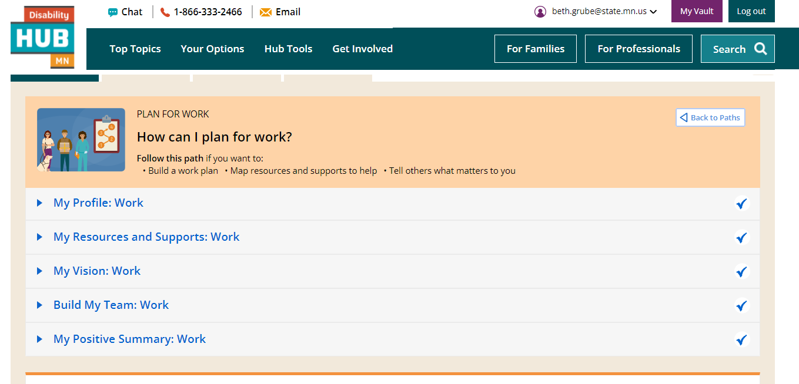
Online Resources: Planning Paths
Planning Paths
Work Path
Best Life Paths
Benefits Path
Housing Paths

Slide 38
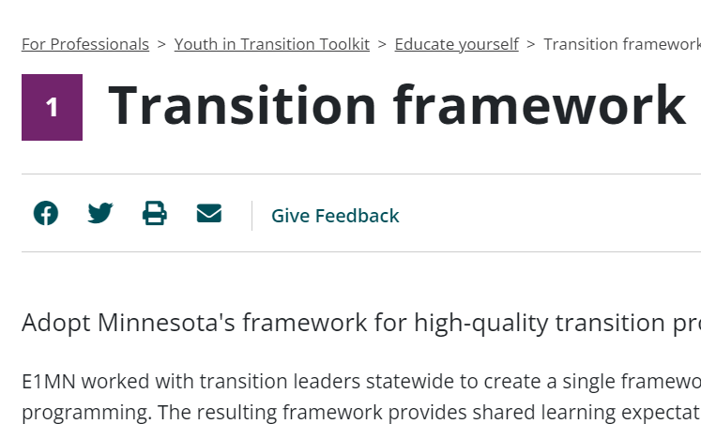
Give Feedback
The Disability Hub is continuing to evolve…
While you are using the Hub, please use the “Give Feedback” link
What is missing?
What should be changed?
What additional resources do you use?

Slide 39

Questions?

Slide 40
Resources
Charting the LifeCourse (Disability Hub)
LifeCourse Nexus
Person-Centered Practices (MDE)
Ten suggestions for adding person-centered features in IEP's
Person-Centered Thinking: One-Page Descriptions
Transition Resources
Online Resources to Support Transition Planning

Slide 41

Thank you!
Dana Page, Ph.D. 651-582-8347, dana.page@state.mn.us
Sarah Robinson 651-582-8892, sarah.robinson@state.mn.us

Slide 42
Charting the Cs Conference 2025
Statewide Professional Development to Support the Workforce and Low Incidence Disability Areas in the State of Minnesota.
This presentation is partially funded with a grant from the Minnesota Department of Education using federal funding, CFDA 84.027A, Special Education – Grants to States.

