Slide 1

STAR Program – Assistive Technology Resource for Minnesotans
Charting the Cs Conference 2025:
To Literacy and Beyond
Cooperation
Communication
Collaboration
Sunday, April 27, 2025
Amy Perron

Slide 2
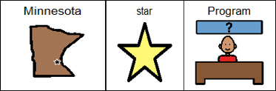
Minnesota STAR Program Overview
System of Technology to Achieve Results (STAR)
Minnesota’s federally funded Assistive Technology Act Program
Housed within the MN Department of Administration
Providing services to ALL MINNESOTANS
  No proof of disability required.
  There is no cost for the STAR Program services

Slide 3
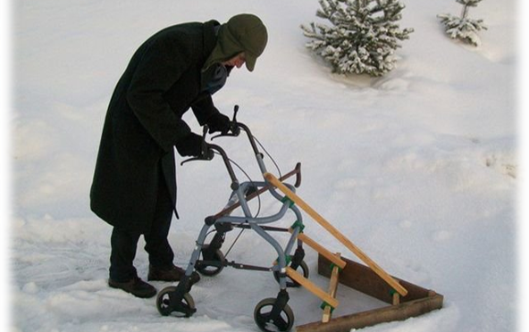
What is Assistive Technology
Any item that helps someone with a disability do something that might otherwise be difficult or impossible for them to do!
Assistive technology devices
Assistive technology services

Slide 4
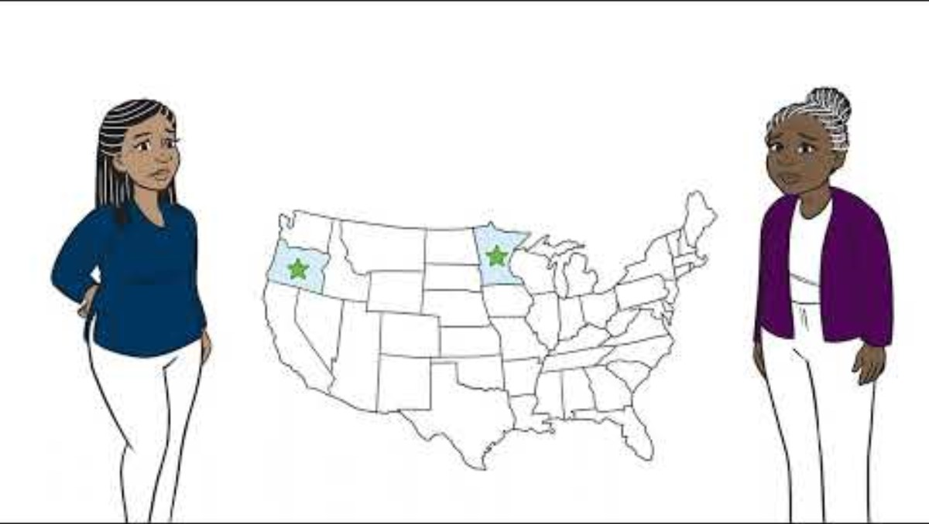
Assistive Technology: Live Life Your Way
Assistive Tech: Live Life Your Way

Slide 5

Minnesota STAR Program Services
Device Demonstrations
Device Equipment Loans
  Short-Term
  Open-Ended (limited availability)
Information and Assistance
Training (groups)
Technical Assistance (agencies)

Slide 6
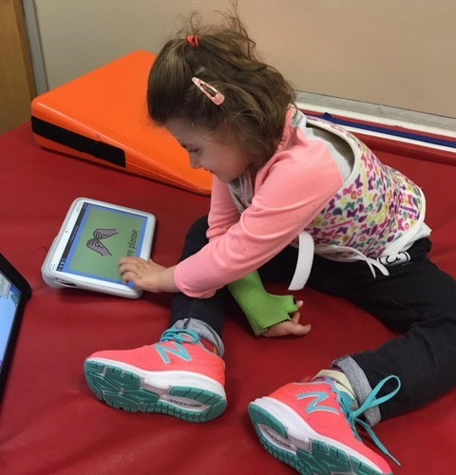
STAR Program Device Demonstrations
Requested by individual, family member, guardian or professional
Compare device features
Demonstrate one or more devices
Live and interactive
Assist with decision making

Slide 7
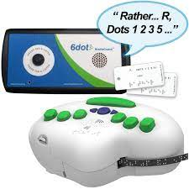
STAR Program Device Loans
Short-term device loan (45 days or less)
  Provides an opportunity to test out the equipment in their own environments.
  Assist with decision making
  Professional Development
  Short-term accommodation
Open-ended loan

Slide 8

Loan Process
Decide which device to be requested.
  Unsure? Call or email STAR or a contract partner for consultation.
Call or email STAR or contract partner to arrange for device demonstration or an equipment loan.
Complete appropriate paperwork and surveys

Slide 9
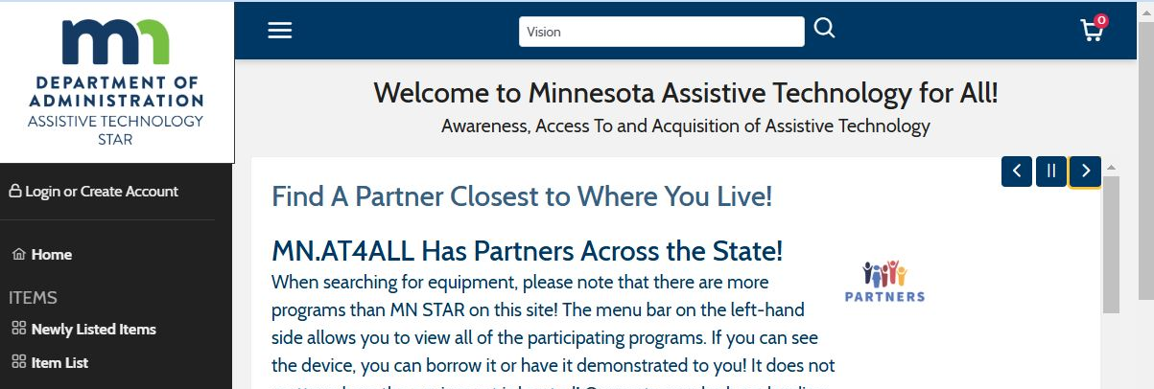
MN.AT4All.com – Online Lending Library

Slide 10
Categories of Equipment
Vision
Hearing
Speech Communication
Cognition/Learning
Daily Living
Environmental Adaptations
Computer Related
Mobility
Recreation/Leisure

Slide 11

Considerations
Successful assistive technology (AT) selection & implementation is a process
AT recommendations are not one size fits all
Team approach is preferred
Consumer “Buy-In” is key
The process is fluid. As the individual’s needs change so will their AT

Slide 12








STAR Contracted Partners
Notes:
Minnesota STAR Program serves all Minnesotans, but we couldn’t do it without the help from our valuable partners. Our partners are located throughout the state.

Slide 13

Contact us
MN STAR Program Main Website - www.mn.gov/star/
MN STAR Program Device Library- https://mn.at4all.com/
MN Guide to Assistive Technology- https://mn.gov/admin/at/
Email- star.program@state.mn.us
Telephone- 651-201-2640

Slide 14

Thank you!

Slide 15
Charting the Cs Conference 2025
Statewide Professional Development to Support the Workforce and Low Incidence Disability Areas in the State of Minnesota.
This presentation is partially funded with a grant from the Minnesota Department of Education using federal funding, CFDA 84.027A, Special Education – Grants to States.

