Slide 1

AAC Consideration Kits
for MN Schools
Charting the Cs Conference 2025:
To Literacy and Beyond
Cooperation
Communication
Collaboration
April 29, 2025
Rebecca Tetlie -MNSHA AAC Committee
Amy Perron – MN STAR Program Director

Slide 2

Learning Outcomes
Participants will learn about the MN STAR Program and its lending library.
Participants will identify the contents of the AAC Consideration Kits.
Participants will identify how to access the AAC Consideration Kits.
Participants will learn the requirements of borrowing the Kits.
Participants will be able to describe two ways the AAC Communication Kit can help identify students who can benefit from AAC

Slide 3
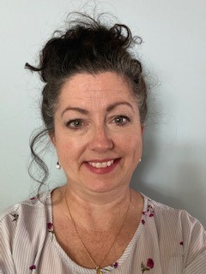
Introduction & Disclosures
Amy Perron has worked at the Minnesota STAR program for eight years. First serving at the Programs Assistive Technology Specialist and currently as Program Director.
No Disclosures to share
Contact: amy.perron@state.mn.us

Slide 4
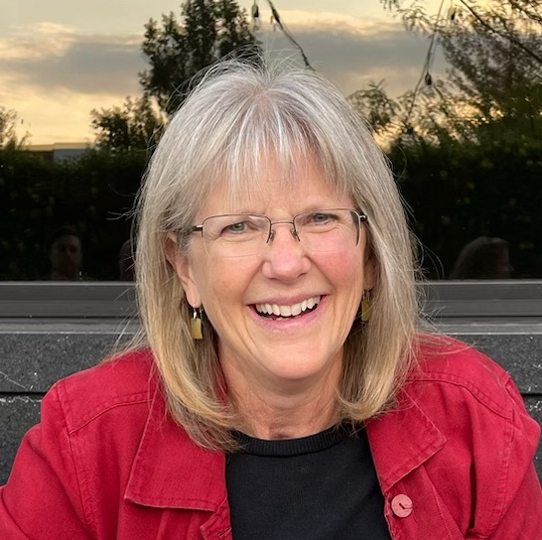
Introduction & Disclosures, Continued
Rebecca Tetlie MA, CCC-SLP is a speech-language pathologist and has worked with St. Paul Public Schools for 34 years where she led the Assistive Technology Team with a focus on augmentative communication and assistive technology for reading. She retired in 2020.
Non-financial: Member of ASHA, MNSHA & co-chair of the MNSHA AAC Committee.
Contact: rebecca.tetlie@gmail.com

Slide 5
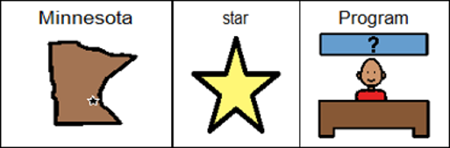
Minnesota STAR Program
System of Technology to Achieve Results (STAR)
Minnesota’s federally funded Assistive Technology Act Program
Providing services to ALL MINNESOTANS
  No proof of disability required
  No cost for program services

Slide 6

Contracted Partners
Minnesota State University Moorhead Regional Assistive Technology Center (RATC)
North Dakota Assistive
Pacer Center
St. Cloud State University
ALS Association
Live Life Therapy Solutions
Lighthouse Center for Vital Living
Southeastern MN Center for Independent Living

Slide 7
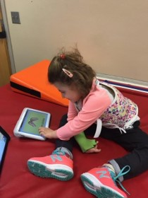
Minnesota STAR Program Services
Device Demonstrations
Device Equipment Loans
  Short-Term
  Open-Ended (limited availability)
Information and Assistance
Training

Slide 8
STAR Demos and Loans
Device Demo
Device Loan
Requested by individual, family member, guardian or professional
Demonstrate one or more devices
Compare similar device features
Live and interactive
Assist with decision making
45 days or less
Provides an opportunity to test out the equipment in their own environments.
Assist with decision making
Professional Development
Short-term accommodation

Slide 9
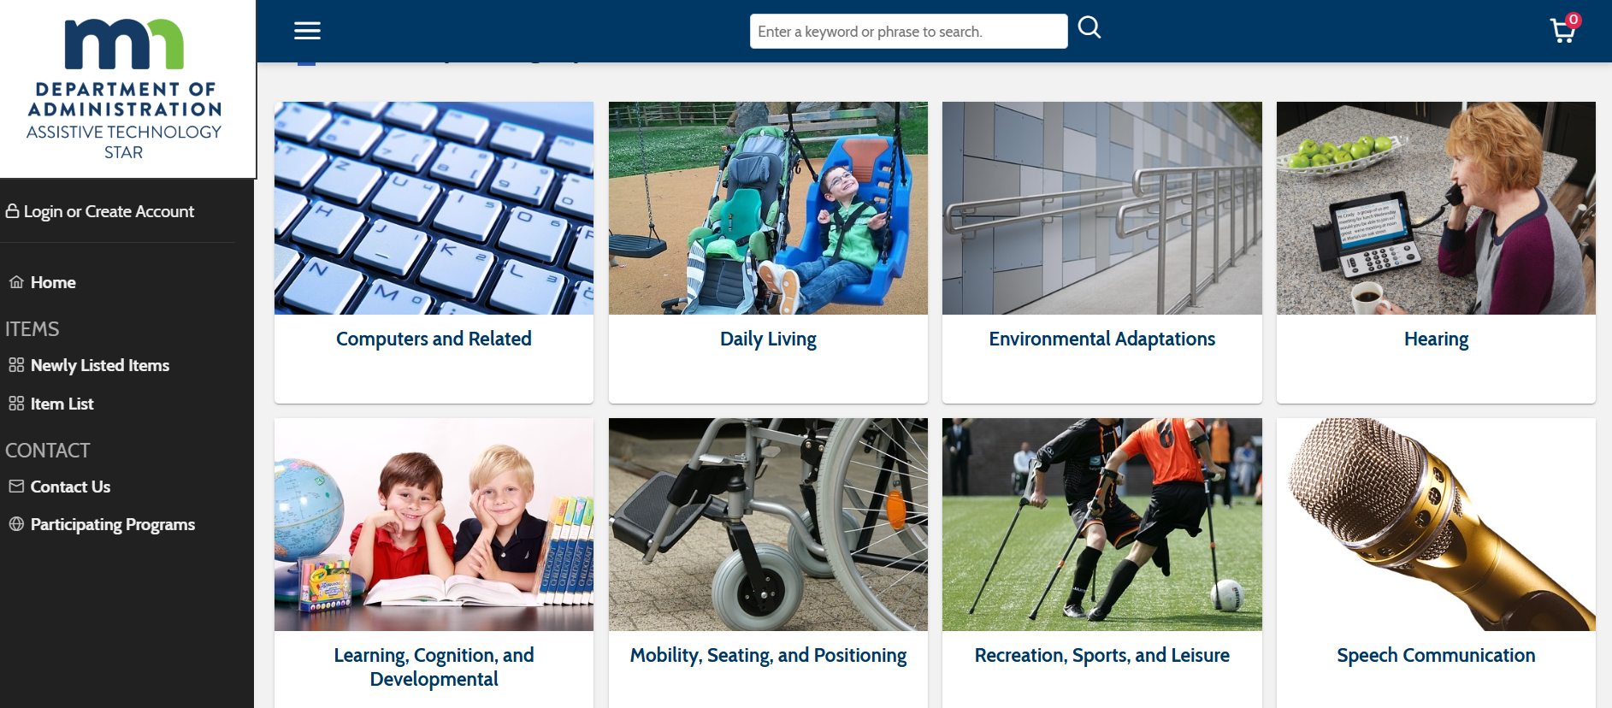
Online Lending Library: MNAT4ALL

Slide 10

AAC Consideration Kit Development
Funding & Inception
MN AAC Practitioner Survey
Goals Identified
Content & Resources Development Committee
AAC Kit Assembly
AAC Kit Pilot
Planned Updates

Slide 11

AAC Consideration Kit Statewide Survey
WHO:
90 Respondents
Licensures included: Speech, SPED Teachers, OT, Admin
All age groups
Surveys were distributed to the following listservs:
  MN Speech Language (MDE)
  MN Low Incidence Network (MDE)
  AAC (MNSHA)
WHEN:
Survey Duration: 12 Days (Nov 22- Dec 4)

Slide 12
AAC Consideration Kit Statewide Survey, Cont.
WHERE?
Responses came from 19 counties
  4 Metro counties
  15 Outstate counties
WHAT?
Student Needs:
  Express wants & needs and Highly engaging activities for AAC
Tools:
  AAC iPad, Multi-button, Core Word Displays, Wearable, One Button
  AAC Apps: TouchChat, TD SNAP, Proloquo2Go
Languages:
  English, Spanish, Somali, Karen, Vietnamese, Hmong, Other

Slide 13

AAC Consideration Kit: Goals
Create an easy-to-use AAC Kit for IEP teams
to consider AAC for students which will:
Identify AAC features that enable success
Provide data in feature match to identify AAC systems for a possible formal evaluation
Provide ideas for engaging students for communication success

Slide 14
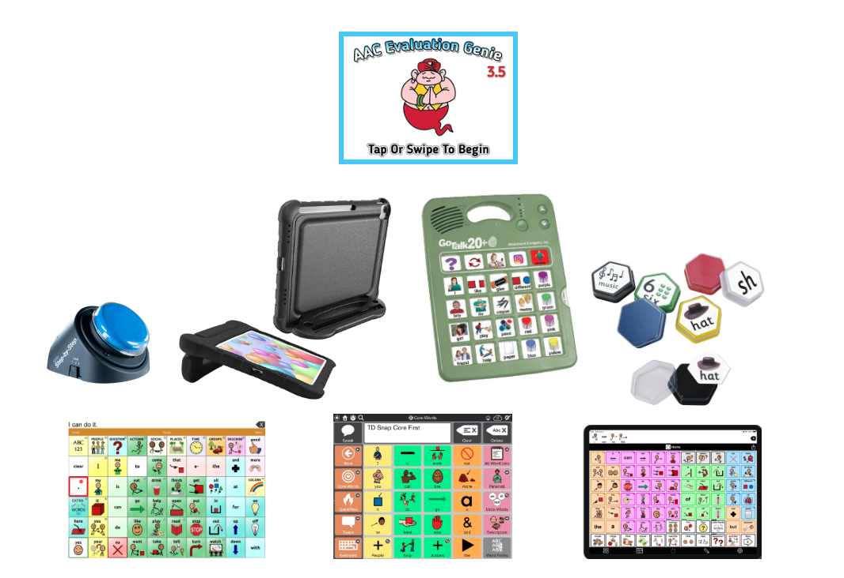
AAC Consideration Kit Equipment
Low Tech Symbol Displays
Talking tiles - 6 pack
Little Step by Step
GoTalk 20+ Light Touch
iPad Generation 10
  Protective case
iPad Apps
  TouchChat HD-WP*
  TD Snap
  Proloquo2Go
  AAC Genie*

Slide 15

Loan Specifics
Who?
Available to MN IEP teams
How? Contact MN STAR Program
651-201-2640 telephone
Star.program@state.mn.us
MN.AT4ALL.com
Time Period: 8 weeks
Includes a guided timeline
Where: MN STAR Program and select partners

Slide 16

Guiding Principles
Communication Bill of Rights
SETT Framework for AT Consideration
Assume Potential
Evidence-Based Practices

Slide 17

Digital Resources
How to Use the Kit
Quickstart Guides
Strategies to Boost Success
Highly Engaging Activity Ideas
Guidelines for Choosing an AAC Display
Consideration
Access Resources
Data Collection Tools

Slide 18

How to Use the Kit
Week 1: Unpack, Get Familiar & Check-In
Week 2: Choose Engaging Activities, Access Methods, Specific AAC Symbol Displays
Week 3: Try the customized AAC tools with your student
Week 4: Try AAC tools with your student & make adjustments
Week 5: Try AAC tools with your student in customary environments
Week 6: Try AAC tools with your student to add symbols & independence
Week 7: Try to add symbols, independence, home environment
Week 8: Determine Outcomes & Check-In

Slide 19

Quickstart Guides
Description
Written Quickstart
How to Videos

Slide 20

Guidelines for Choosing an AAC Display
General Tips for Success
How to set up the iPad as AAC Device
Symbolic Users
Emergent Users

Slide 21

Strategies for Boosting Success with AAC
Engage and Motivate
Model & Pause
Create Opportunities
Follow the Student’s Lead
Honor Any Communication Attempts

Slide 22

Highly Engaging Activity Ideas
Young Students
Elementary Students
Secondary Students

Slide 23

Addressing Challenges to AAC Consideration
Collaborate with Specialists
Train communication partners
Motor Challenges
Self Regulation Challenges
Vision Challenges
Engagement Challenges

Slide 24

Outcomes
What motivated the student?
What access systems enabled success?
AAC features enabled success?
What implementation strategies enabled success?
What environments did you try the AAC?
What TASKS was the student able to access?
Would the student benefit from an AAC system?
What systems would be appropriate to trial?
What are the Next steps?

Slide 25
AAC Consideration Kit: How to Access
Application on STAR Home Page
Home Bases
  STAR St. Paul
  St. Cloud State University
  Minnesota State University Moorhead Regional Assistive Technology Center (RATC)

Slide 26
AAC Consideration Kit: Summer Pilot
Seeking 6 IEP teams to pilot this summer
Timeline: 8 weeks in June-July
Willingness to follow process & submit feedback
How to Apply

Slide 27

Thank you!
Rebecca Tetlie – Rebecca.Tetlie@gmail.com
Amy Perron – amy.perron@state.mn.us
images from www.freepik.com

Slide 28
Charting the Cs Conference 2025
Statewide Professional Development to Support the Workforce and Low Incidence Disability Areas in the State of Minnesota.
This presentation is partially funded with a grant from the Minnesota Department of Education using federal funding, CFDA 84.027A, Special Education – Grants to States.

