Slide 1

Ready, Set, Action!
Coaching the Assistive Technology implementation plan into action in Early Childhood Settings
Charting the Cs Conference 2025:
To Literacy and Beyond
Cooperation
Communication
Collaboration
April 2025
Jodi Altringer and Michelle Steele

Slide 2
Objectives
Describe the impact of coaching and its effectiveness in supporting effective AT implementation.
Identify coaching strategies to use in your practice.
Identify resources and tools to support coaching and the effective implementation of AT across daily activities and routines in early childhood settings.

Slide 3
Why Coaching?
Positive outcomes of coaching:
Increased implementation of Evidence-Based-Practices
Changes in teaching practices
Teachers feel supported and open to trying new strategies

Slide 4
Coaching and assistive technology?
Increased confidence and capacity in all adults leads to:
Increased effective and consistent use of assistive technology
Increased participation and engagement of children
Increased learning outcomes

Slide 5
Getting started with coaching: Teaching practices
Provide a defined set of practices.
Provide opportunities for learners to identify strengths and needs related to the practices.

Slide 6
Example Teaching Practices: Step Up AT
Step Up AT Teacher Strengths and Needs Assessment.
You can find this at stepupat.org. Go to the Resources tab and scroll down to Coaching Resources.
Example practices:
Make it easier for children to join in classroom activities by giving them switches and other tools.
Use pictures or talking tools to help children communicate.

Slide 7
Example Teaching practices: Augmentative and Alternative communication (AAC)
Create a list of practices from sources such as this article from Assistiveware:
I model a variety of communicative functions using their system during everyday activities and routines.
  I use parallel talk while using the child’s system
  I use self talk while using the child’s system
  I narrate navigation while modeling
I use an expectant pause to create communication opportunities.
I attribute meaning to any communication attempts.
I add more words or ideas to children’s communication attempts.

Slide 8
Getting Started: Make a plan
Identify a practice as a focus
Collaborate to develop a plan
Document the plan
Provide enough details so roles are clear

Slide 9
Coaching Strategy: Create a coaching toolkit
For each practice, collect and organize the following:
Learn more about it resources
Illustrations of the practice
Implementation supports

Slide 10
Coaching Toolkit: Learn more about it
Knowledge, skills, theoretical foundations, why.
Define the important components of the practice
Provide illustrations of the practice
Provide examples and non-examples
Use short videos, articles and infographics

Slide 11
Coaching Toolkit: Develop implementation supports
Help learners remember what they have learned, what they need to do and when to do it by using implementation supports such as:
Matrices
Implementation checklists
Scripts
Tip sheets
Visual supports
Memes and infographics

Slide 12
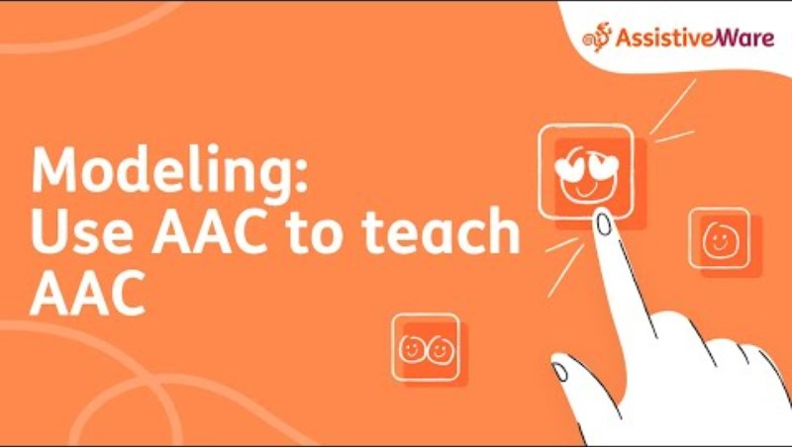
Coaching Toolkit: Learn more about modeling AAC

Slide 13
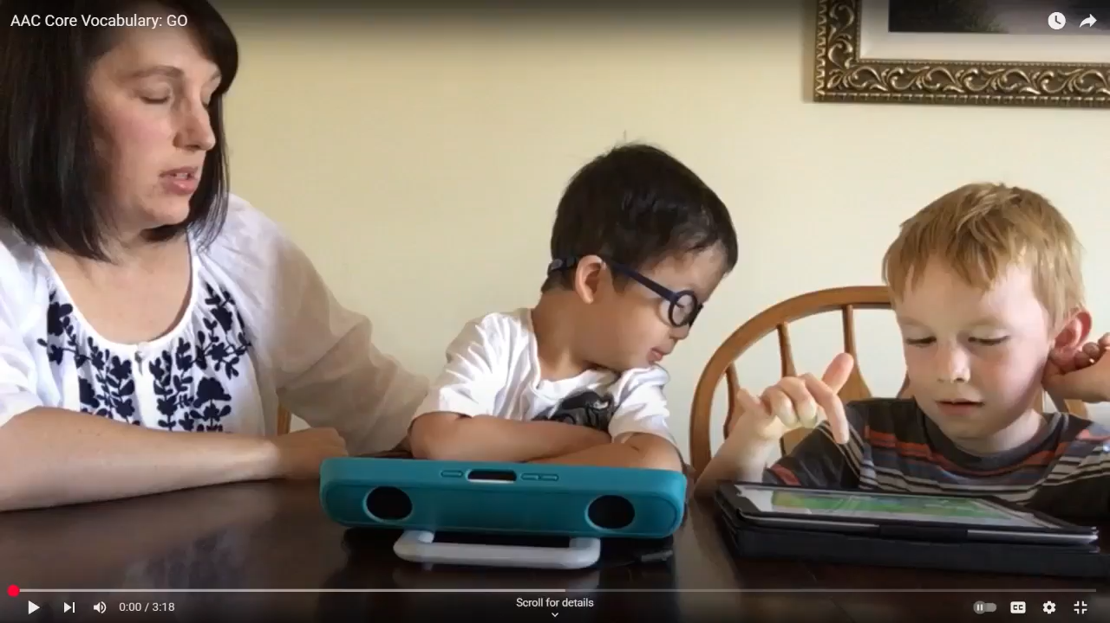
Coaching Toolkit: See modeling in action, video

Slide 14
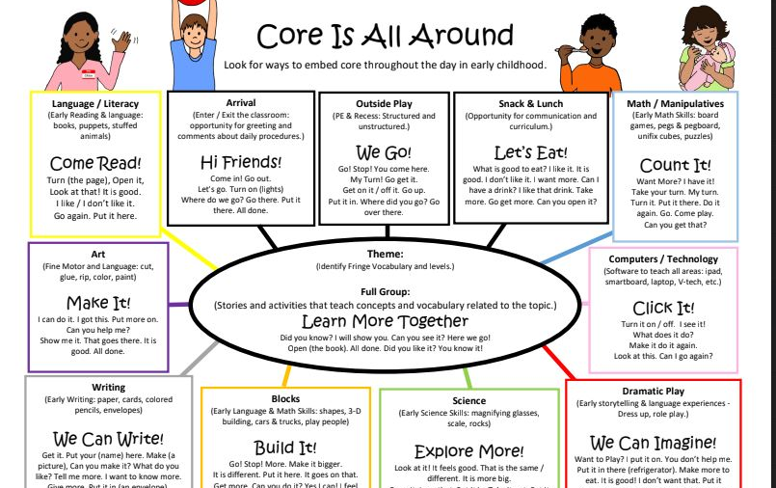
Coaching Toolkit: Modeling Core Matrix
Helps adults identify when to use the practice
This one includes target words and scripts

Slide 15
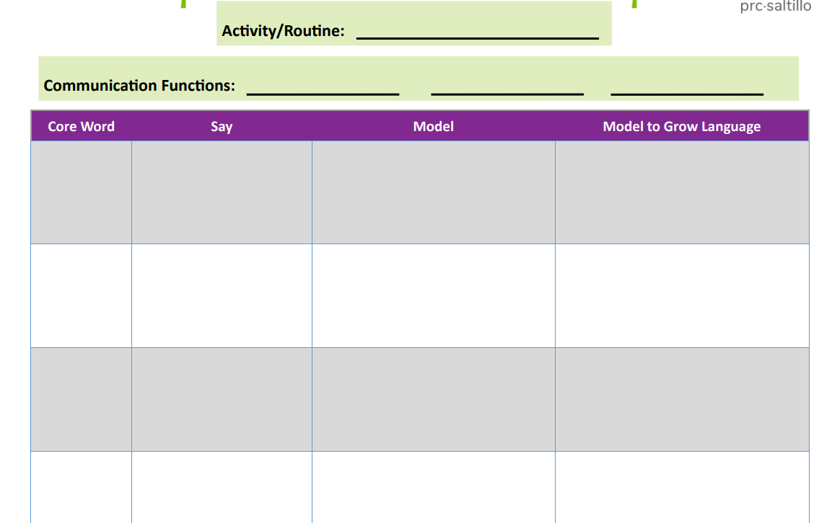
Coaching Toolkit: Modeling AAC plan and script
Provide prompts for words to model and scripts for creating communication opportunities.

Slide 16
Step Up AT learn more about it resources
Step Up AT Project video library on You Tube
Step Up AT modules
@stepupatproject5640
Short videos of AT practices
Device demonstration
Videos available in English and Spanish
Short modules
Free
https://www.development.stepupat.org/

Slide 17
Coaching Strategy: Rehearse
Rehearse
Practice
Role play
Reflect and problem Solve

Slide 18
Coaching Strategy: Model
Effective modeling:
Discuss the plan for modeling with the learner
Explain what you will be doing and why
Give the learner a job
Reflect

Slide 19
Coaching strategy: Observation
Coach observes the teacher implementing the practice at an agreed upon time. Make a plan for the observation:
What data will the coach collect?
What will the coach watch for?
What real time support might be provided? (gestural cues, verbal cues)

Slide 20
Coaching strategy: Reflection
Provide opportunities for the teacher to reflect on their implementation of the practice.
What went well?
How did that feel?
What was challenging?
What did you notice when…?
What would you keep the same, change?

Slide 21
Coaching strategy: Feedback
Feedback is:
Focused
Specific
Supportive and constructive

Slide 22
Feedback Tips and Strategies
I Notice Statements
  Supportive: I noticed that you xxxx and this is a great example of xxxx.
  Supportive: I noticed that you xxx and this is important because xxx.
  Constructive: I noticed xxx, some strategies you might consider are xxx.
  Constructive: I noticed xxx, something you might try is….
Use language of teaching and learning familiar to your team
Keep suggestions specific and simple
Feedback can be provided in written form, emails, notes

Slide 23
My coaching action plan
What are your next steps?
Find practices, create lists of practices
Create, find and display easily understood visuals
Collect and share videos of amazing implementation in practice
Collect and organize articles and videos of the practices
Record others using the practices
Learn more about reflection and feedback
Try out some feedback starters
Plan rehearsal or modeling
Explore the Step Up AT website

Slide 24
Resources: General
Step Up AT website: https://www.stepupat.org/
Closing the Gap Article: A Coaching Mindset for Better AT Implementation: https://online.flippingbook.com/view/471571059/
Head Start Practice Based Coaching resource page: https://headstart.gov/professional-development/article/practice-based-coaching-pbc
The Essentials of Practice Based Coaching in Early Childhood Settings: https://products.brookespublishing.com/Essentials-of-Practice-Based-Coaching-P1288.aspx

Slide 25
Resources: Teaching Practices
Step Up AT Teacher Needs Assessment: https://www.stepupat.org/wp-content/uploads/C3-Teacher-Strengths-and-Needs-Assessment-FROM-COACHING-MANUAL-V3-1.pdf
Oakland Schools Providing Communication Opportunities with AAC Checklist: https://www.communicationmatrix.org/Uploads/Posts/8371/Opportunities Self Assessment.pdf
Assistiveware article Communication Partner Skills for AAC learners: https://www.assistiveware.com/learn-aac/build-communication-partner-skills

Slide 26
Resources: Teaching Practices, Continued
Communication Partner Observation and Reflection Guide: https://ddwa.org.au/wp-content/uploads/2024/04/DDWA-Communication-Partner-Observation-and-Reflection-Guide-updated-02042024.pdf

Slide 27
Resources: Make a plan
Step Up AT action plan form: https://www.stepupat.org/wp-content/uploads/Action-Plan.pdf
Head Start action plan form: https://headstart.gov/sites/default/files/pdf/no-search/coaching-corner-pbc-coach-training-action-plan-b.pdf
Augmentative and Alternative communication action plan form: https://ussaac.org/wp-content/uploads/2018/10/JEPL-AAC-Implementation-Action-Plan.pdf

Slide 28
Resources: Learn More about It
Step Up AT project video learning library: https://www.youtube.com/@stepupatproject5640/videos
Step Up AT project learning modules: https://www.development.stepupat.org/
AAC Learning Lab resources: https://aaclanguagelab.com/resources?category=teaching-and-therapy-material
AAC Strategies Webinar: https://youtu.be/s8pMaoFNAH4?si=Cc_nSYWyVMAwZl7G
Kate Ahern Prompting hierarchy visual: https://youtu.be/JrzkV36P1Ys?si=KkNuKuseCjglmG1A

Slide 29
Resources: Learn More about It, Continued
Lauren Enders Gonzales Pinterest Board AAC signs, posters and memes: https://www.pinterest.com/lasenders/aac-memes-signs-and-posters/
Modeling AAC video: https://youtu.be/LqeAipcciVQ?si=HSuGa7zBKMeayP6E
AAC Core vocabulary illustration video: https://youtu.be/UZSwwbhyExE?si=BGkgrNGIBu2aM0ur
Lesson Pix Core vocabulary resources: https://lessonpix.com/articles/5/214/Core
Video: Aided Language Stimulation explained: https://youtu.be/flFNMky22-U?si=F6MePeckL48rsJxA
The Art of Attributing Meaning video: https://youtu.be/JrzkV36P1Ys?si=KkNuKuseCjglmG1A

Slide 30
Resources: Matrices and planning tools
NCQTL Activity matrix for modifications: https://center-elp.org/wp-content/uploads/2018/09/curriculum-modifications-module-5-activity-matrix.pdf
Let’s Grow Language planning form: https://aaclanguagelab.com/resources/lets-grow-language
Lesson Pix Core is All Around blank planning matrix: https://lessonpix.com/images/EarlyChildhoodModelCoreLanguagePlans-Blank.pdf
Saltillo Core vocabulary activity planner: https://saltillo.com/images/putting-aided-language-into-practice-choosing-vocab-activity-first-.pdf

Slide 31
Resources: Observation
Head Start Observation form: https://headstart.gov/sites/default/files/pdf/no-search/pbc-mod-handout-template.pdf
Step Up AT Action Summary Form: https://www.stepupat.org/wp-content/uploads/Action-Summary-Form.pdf
Practical AAC Classroom Observation for Communication Opportunities with AAC: https://praacticalaac.org/wp-content/uploads/filebase/assessment/Classroom%20Observation%20for%20Communication%20Opportunities%20with%20AAC%20COCOA.pdf

Slide 32
Resources: Reflection and Feedback
Step Up AT Observation Debrief Guide: https://www.stepupat.org/wp-content/uploads/Observation_Debrief_Guide.pdf
PBC Coaching Reflection and Feedback Starter Phrases:
https://headstart.gov/sites/default/files/video/attachments/coaching-corner-series-starter-phrases.pdf?redirect=eclkc
Step Up AT Teacher Reflection Form: https://www.stepupat.org/wp-content/uploads/Teacher-Reflection-on-Practice.pdf
A Coaching Guide to asking reflective questions: https://info.teachstone.com/blog/a-coaching-guide-to-asking-reflective-questions-part-1

Slide 33
Resources: Reflection and Feedback, Continued
Head Start Constructive feedback examples: https://headstart.gov/sites/default/files/video/attachments/coaching-corner-series-constructive-feedback.pdf
Head Start Webinar Reflection and Feedback Strategies for Success: https://headstart.gov/video/reflection-feedback-strategies-success

Slide 34

Thank you!
Jodi Altringer
jodi.altringer@sourcewell-mn.gov
Michelle Steele
michelle.steele@sourcewell-mn.gov

