Slide 1

Adaptive Books for Literacy
Charting the Cs Conference 2025:
To Literacy and Beyond
Cooperation
Communication
Collaboration
April 29, 2025
Andrea Murphy
Kristin King-Aasum

Slide 2
Welcome and Introductions
Who are we?
Purpose of the presentation
Opening Question
“As we dive into this, we want you to be thinking- what and how can I create and modify books and materials within my classroom”

Slide 3
Outline
Objectives:
Understand what adapted books are
Learn the benefits of using adapted books in special education
Explore examples of adapted books
Resources/Website support

Slide 4
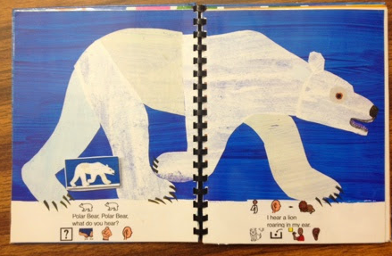
What Are Adapted Books?
Definition:
Adaptive books are specialized resources designed to support literacy development, particularly for children with special needs or diverse learning styles. These books are designed to be interactive, often using sensory, visual, or auditory elements to enhance engagement and accessibility.
Types of General Adaptations:
Visual Supports (e.g., pictures, symbols, large print)
Physical Supports (e.g., Velcro pieces, page tabs)
Sensory elements (e.g., textures, sounds, smells)

Slide 5
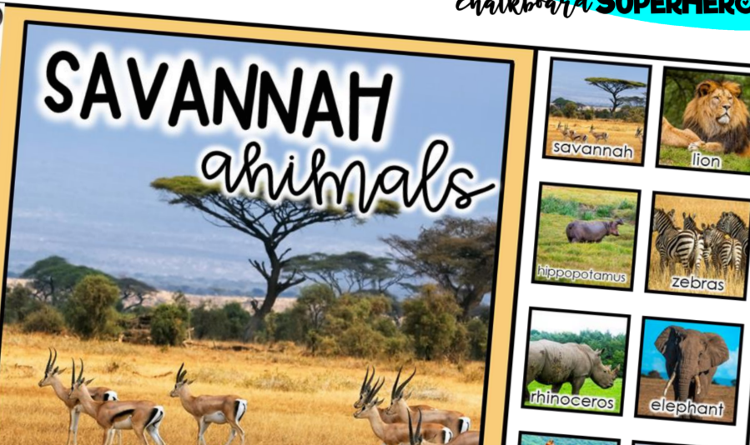
Why Use Adapted Books?
Benefits:
Accessibility: Provide access to literature for students with disabilities (e.g., visual impairments, motor challenges)
Engagement: Encourages participation through interactive features.
Skill Development: Enhances literacy, communication, motor, and cognitive skills.
Cross-curricular: Adapted books can be used for a variety of academic area and social skills
Individualization: Adapted books can be tailored to each student’s specific needs and support their IEP goals

Slide 6
Implementing Adapted Books
Best Practices:
Introduce books during lessons, free-choice time, or therapy sessions
Pair books with hands-on activities and sensory tools
Use them in small groups or one-on-one instruction
Adjust based on student response and progress
Data Collection:
Track progress in areas like engagement, comprehension, and communication
Collaboration:
Involve speech therapists, occupational therapists, families, and other professionals

Slide 7
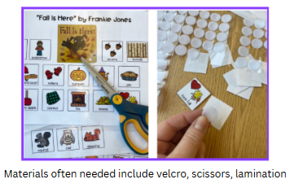
How to Create Adapted Books
Step-by-Step Process:
TIPS
Select a book based on the student’s needs and interests.
Plan adaptations (visual, tactile, or interactive).
Gather materials:
  Lamination sheets, Velcro, page tabs, textures
Assemble the book
Start small with simple adaptations
Use free online templates or DIY resources

Slide 8

Adaptive Books for Early Childhood
Adaptive books for early childhood literacy help young children, especially those with developmental delay or disabilities, engage in reading in a way that matches their learning needs and sensory preferences. These books are typically hands-on, interactive, and designed to support foundational skills in language, comprehension, and fine motor development.

Slide 9
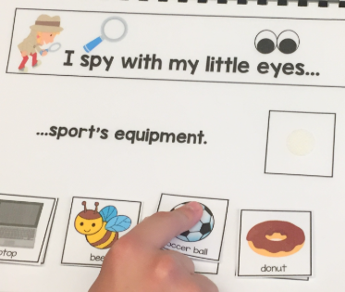
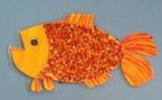
Early Childhood Examples
1. Interactive Touch-and-Feel Books
Features: Incorporate textured materials like fabric, foam, and sandpaper into books to make stories more sensory-friendly. These books might use soft fur for animal characters or rough sandpaper for a character's “path.”
Benefits: These tactile experiences support sensory processing, vocabulary development, and language concepts like “soft,” “rough,” “smooth,” etc., and make the story more memorable for young children.
Tactile GoldFish

Slide 10
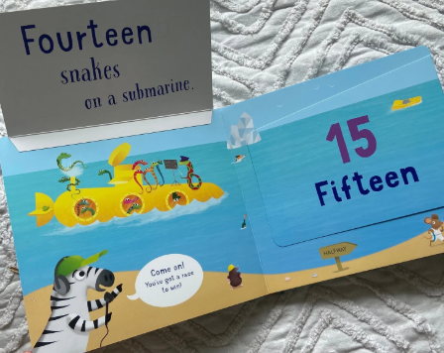
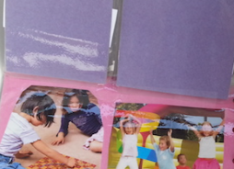
Early Childhood Examples, cont.
2. Flap Books and Peekaboo Books
Features: Add flaps that reveal hidden pictures or words to engage young children in a fun, interactive reading experience. The flaps can be made from durable materials to withstand frequent use.
Benefits: Flap books encourage curiosity, fine motor skills, and participation, as children lift flaps to see what’s underneath. They’re especially engaging for toddlers and preschoolers who love “peekaboo” games.

Slide 11
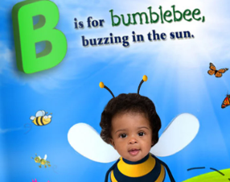

Early Childhood Examples, cont. 2
3. Personalized Photo Books
Features: Use photos of the child, their family, pets, and favorite places to create a highly engaging, personal book. These books can be simple, with photos and one or two words on each page to keep the focus on familiar, meaningful visuals.
Benefits: Personalized photo books boost engagement by making reading relatable and relevant, enhancing early comprehension and vocabulary around familiar people, places, and objects.

Slide 12
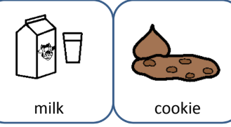
Early Childhood Examples, cont. 3
4. Interactive Vocabulary Books with Velcro
Features: Use Velcro-backed pictures or symbols (such as Picture Exchange Communication System [PECS] symbols) that children can place on each page of the book. These books can feature simple nouns (e.g., animals, food, toys) or verbs to match the story.
Benefits: This style supports early vocabulary development, language comprehension, and motor coordination as children practice matching pictures or words to the story. This is especially helpful for children with language delays or speech challenges.

Slide 13
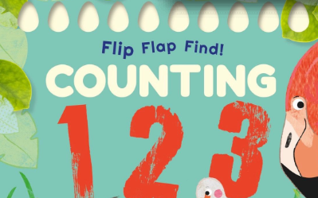
Early Childhood Examples, cont. 4
5. Lift-the-Flap Counting Books
Features: Use lift-the-flap pages to reveal items to be counted, such as “1, 2, 3 apples” or “4, 5, 6 stars.” Counting flaps can have texture or images to reinforce number recognition.
Benefits: Supports early math and number skills alongside literacy, reinforcing the concept of quantity and counting while integrating reading and storytelling.

Slide 14
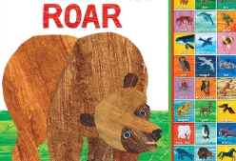
Early Childhood Examples, cont. 5
6. Cause-and-Effect Sound Books
Features: Sound buttons or recordable buttons that play audio related to the story (like animal sounds, a child’s name, or a character’s voice) can be attached to each page. Some sound books allow recording your own voice to say key vocabulary words.
Benefits: Cause-and-effect sound books are excellent for children who respond to auditory input, and they can encourage engagement and support children with auditory processing needs.

Slide 15

Early Childhood Examples, cont. 6
7. Adapted Social Stories for Routines
Features: Social stories are adapted to help children understand daily routines (e.g., bedtime, mealtime, going to school) or social skills. These books often include visuals that represent each step in the routine, with simple text.
Benefits: Social stories build vocabulary around everyday tasks, teach social skills, and support language comprehension by giving young children a clear, structured look at routines they encounter.
Cover page of a social story supported by pictures

Slide 16
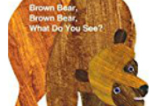
Early Childhood Examples, cont. 7
8. Interactive Rhyming and Repetitive Text Books
Features: Books with simple, repetitive phrases, and rhymes help children anticipate and participate in the story. Interactive elements like flaps, textured images, or sound buttons can enhance these rhythmic books.
Benefits: Repetition and rhyme build phonemic awareness, which is a foundation for early reading skills. Children love familiar patterns, which help them remember and predict text.

Slide 17
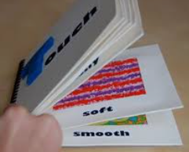

Early Childhood Examples, cont. 8
9. Color Recognition and Shape Books with Textures
Features: Each page features a different color or shape, with added textures that match the concept. For example, a red page might include a soft red fabric, and a blue page might have a shiny surface.
Benefits: These books help young children learn basic concepts like colors and shapes, which are essential for vocabulary development and early cognitive skills. Textures add a sensory element that makes learning more memorable.
DIY page “Bumpy”

Slide 18

Early Childhood Examples, cont. 9
10. Story Sequencing Books with Simple Steps
“Very Hungry Caterpillar”
Features: Simple books that tell a short story through clear, sequential images and text, with an option to rearrange pages or match Velcro-backed images in order.
Benefits: These help young children understand the beginning, middle, and end of a story, as well as develop early sequencing skills, which are foundational for comprehension.

Slide 19

DIY Tips for Making Early Childhood Adaptive Books:
Use Durable Materials: Laminate pages or use board books as a base to make books long-lasting.
Keep Text Simple: Use minimal text with large, clear fonts and high-contrast images to support comprehension.
Add Engaging Elements: Velcro pieces, textures, and bright colors make books inviting and interactive.

Slide 20

Adaptive Books for Elementary
Adaptive books for elementary-aged children focus on expanding literacy skills, including vocabulary, comprehension, sentence structure, and fluency. These books incorporate interactive, accessible elements that keep older children engaged while addressing diverse learning needs.

Slide 21
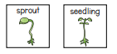
Elementary Examples
1. Interactive Vocabulary and Comprehension Books
vocabulary for a plant life cycle
Features: These books use Velcro-backed vocabulary words or symbols that children can match to pictures or sentences on each page. Some versions have comprehension questions or prompts children can answer by attaching the appropriate response.
Benefits: Matching words to images and answering prompts help reinforce vocabulary and reading comprehension. This format is ideal for children who benefit from hands-on interaction to connect words with images and meanings.

Slide 22

Elementary Examples, cont. 2
2. Social Stories with Detailed Contexts
Features: Social stories for elementary-age children go beyond simple routines and provide context for more complex social situations, like friendship skills, handling emotions, or navigating school environments. These books often include symbols, pictures, and step-by-step text.
Benefits: These adaptive books help children develop social-emotional literacy by teaching them appropriate social responses and understanding more complex social situations.

Slide 23
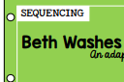
Elementary Examples, cont. 3
3. Sequencing and Retelling Books
Features: These books break stories down into sequential steps, allowing children to practice retelling or rearranging story elements. They often use Velcro-backed story pieces or images that children can move around to put events in order
Benefits: Sequencing and retelling books support reading comprehension, story structure understanding, and memory skills, all of which are essential for fluency and narrative literacy.

Slide 24
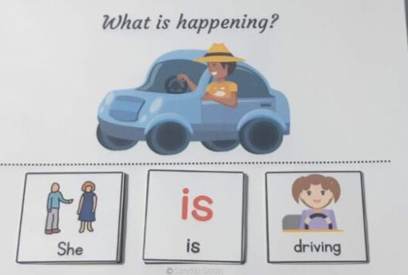
Elementary Examples, cont. 4
4. Sentence-Building Books
Features: These books focus on sentence structure and word order, using moveable word cards or sentence strips. Children can rearrange words to form sentences that match images or complete thoughts.
Benefits: Sentence-building books teach grammar, sentence fluency, and understanding of how words work together. They’re excellent for reinforcing language structure in a tactile way, especially helpful for children with language-based learning disabilities.

Slide 25
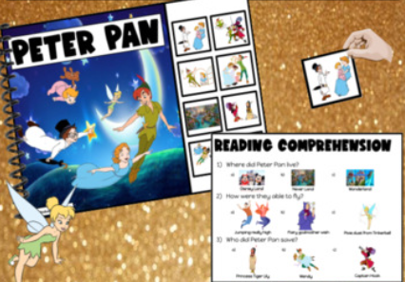
Elementary Examples, cont. 5
5. Adapted Chapter Books with Simplified Text
Features: Adapted chapter books take popular stories and simplify the text, incorporating larger print, short sentences, and sometimes visuals to support comprehension. Some versions add interactive elements, like comprehension questions or picture symbols.
Benefits: These books allow children who may struggle with traditional chapter books to experience age-appropriate stories while working on fluency, vocabulary, and comprehension at their level.

Slide 26
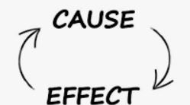
Elementary Examples, cont. 6
6. Cause-and-Effect Books with Interactive Sound or Motion Elements
Features: These books incorporate sound buttons, flaps, or motion-based features that children activate as they read. For example, children press a button to hear a sound effect or reveal a hidden picture that represents the next part of the story.
Benefits: Cause-and-effect books build engagement and understanding of narrative flow, which is important for comprehension. They are especially effective for children with attention challenges or those who benefit from multisensory experiences.

Slide 27

Elementary Examples, cont. 7
7. Digital Adaptive Books with Customizable Accessibility Options
Features: Digital adaptive books offer text-to-speech, customizable font sizes, and highlighted text for easier tracking. Some also provide interactive quizzes or vocabulary practice.
Benefits: Digital books provide accessibility features like adjustable text size and read-aloud options, which support children with visual impairments, dyslexia, or other reading challenges.

Slide 28
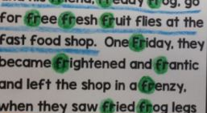
Elementary Examples, cont. 8
8. Phonics and Decoding Books with Embedded Supports
Features: Phonics books focus on specific phonetic patterns or sounds, with color-coded or bolded text to highlight the target phonics. Some use moveable letter tiles to allow children to practice forming the sounds.
Benefits: These books support phonics and decoding skills, which are essential for developing fluent reading abilities. The color coding and interactive elements make it easier for children to focus on specific sounds and letter combinations.

Slide 29

Elementary Examples, cont. 9
9. Comprehension and Questioning Books
Features: These adaptive books include simple text with comprehension questions embedded within the story. Children might answer questions by pointing, choosing a response from Velcro-backed options, or circling answers with a dry-erase marker.
Benefits: These books help reinforce comprehension by prompting children to think critically about the story as they read, rather than waiting until the end.

Slide 30
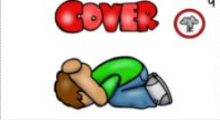
Elementary Examples, cont. 10
10. Nonfiction Adaptive Books with Visual Supports
Features: Nonfiction books designed for elementary-age readers use simple text with visuals, charts, and sometimes interactive elements to explain topics like animals, space, or historical events.
Benefits: These books provide age-appropriate nonfiction content, which helps expand vocabulary, comprehension, and background knowledge, essential for developing information literacy.
Page from Tornado drill
social story

Slide 31
DIY Tips for Making Elementary-Age Adaptive Books:
Add Visual Supports: Include simple illustrations or symbols to aid comprehension of abstract concepts or new vocabulary.
Incorporate Comprehension Prompts: Place questions within the story to encourage interaction and understanding as children read.
Make It Durable: Laminate pages or use a binder for books with Velcro pieces so children can interact with them repeatedly

Slide 32

Adaptive Books for Middle School
Adaptive books for middle school students are designed to support literacy development while meeting the unique needs of older students with learning differences. These books provide age-appropriate content with built-in adaptations to enhance comprehension, engagement, and independence in reading.

Slide 33

Middle School Examples
1. Adapted Novels and Chapter Books with Visuals
Features: Adapted novels take popular books or classics and simplify the text while retaining the main plot and themes. Some adapted versions add visuals, chapter summaries, or highlighted vocabulary to aid comprehension.
Benefits: These books make it easier for middle schoolers to access grade-level literature without being overwhelmed by complex language. They help students feel included in mainstream curriculum by reading the same stories as their peers.

Slide 34
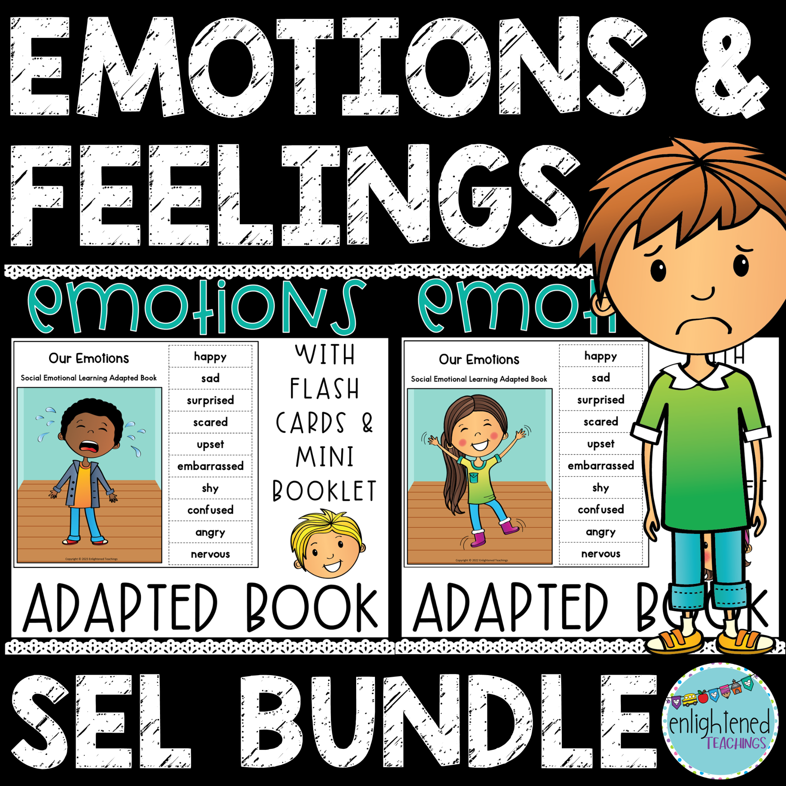
Middle School Examples, cont. 2
2. Social and Emotional Skill Stories
Features: Social-emotional books are tailored to address themes relevant to middle school students, like managing peer pressure, building confidence, or understanding emotions. These books often include discussion questions or reflection prompts.
Benefits: Social-emotional stories help students understand and manage complex social situations, improving their emotional intelligence and social skills. They provide an accessible way to discuss real-life issues through literacy.

Slide 35
Middle School Examples, cont. 3
3. Nonfiction Books with Visual Supports and Simplified Language
Features: These books present age-appropriate nonfiction topics, like science, history, or current events, with simplified language and added visuals, such as infographics or symbols. Some versions include comprehension questions or summaries at the end of each chapter.
Benefits: Nonfiction adaptive books broaden students’ general knowledge and build vocabulary related to specific subjects, which is essential for academic success in middle school.

Slide 36
Middle School Examples, cont. 4
4. Digital Adaptive Books with Customizable Accessibility Options
Features: Digital adaptive books are available on tablets or computers and include features like text-to-speech, adjustable font sizes, and embedded definitions. Some offer highlighting tools and interactive comprehension quizzes.
Benefits: Digital adaptive books provide flexibility, enabling students to customize their reading experience. These features are beneficial for students with dyslexia, visual impairments, or attention difficulties.

Slide 37
Middle School Examples, cont. 5
5. Cause-and-Effect Graphic Novels and Comic Books
Features: Cause-and-effect graphic novels use visuals and minimal text to highlight cause-and-effect relationships within the storyline. They often include symbols or cues to indicate connections between events.
Benefits: Graphic novels are visually engaging and help students who may struggle with longer, text-heavy books. Cause-and-effect connections reinforce critical thinking and narrative comprehension, essential for understanding more complex plots.

Slide 38

Middle School Examples, cont. 6
6. Life Skills and Functional Literacy Books
Features: Life skills books focus on real-world literacy, covering topics like managing money, cooking, personal hygiene, and understanding workplace behavior. The books include step-by-step instructions, visuals, and vocabulary relevant to practical life skills.
Benefits: These books equip students with functional literacy skills needed for daily life, which is crucial for middle schoolers preparing for increased independence and future vocational opportunities.

Slide 39
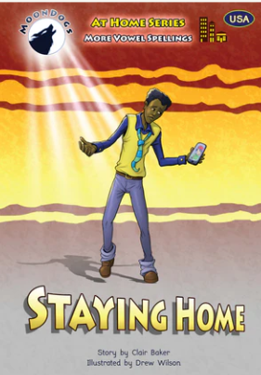
Middle School Examples, cont. 7
7. Phonics and Fluency Books with Middle School Themes
Features: Phonics and fluency books for middle schoolers focus on decoding and reading fluency while using age-appropriate themes. They may highlight specific phonics patterns or use repeated phrases with high-interest topics.
Benefits: These books support middle school students who need additional practice with foundational reading skills while ensuring that content remains relevant and engaging to their age group.

Slide 40
Middle School Examples, cont. 8
8. Adapted Science and History Books with Hands-On Components
Features: Adapted science and history books include simplified text alongside hands-on activities, like building models, conducting experiments, or creating timelines. Visuals, diagrams, and highlighted keywords help students understand complex concepts.
Benefits: These books offer a multisensory approach to learning, making abstract concepts more tangible and accessible. They’re especially useful for middle schoolers who learn best through hands-on experiences.

Slide 41
Middle School Examples, cont. 9
9. Adapted Poetry and Song Lyrics Books
Features: Adapted poetry books include poems or song lyrics with simplified language, visual aids, and built-in analysis prompts. Some versions might feature audio support, allowing students to listen as they read along.
Benefits: Poetry and song lyrics help students engage with language in a way that emphasizes rhythm, structure, and creativity, which can improve fluency and comprehension. Analyzing songs or poems also allows for deeper discussions on themes and emotions.

Slide 42
Middle School Examples, cont. 10
10. Current Events and News Adaptations
Features: Adapted current events books or magazines use simplified language to cover news stories, making them more accessible. Some versions have glossaries, discussion questions, and symbols to support understanding of complex topics.
Benefits: Reading about current events helps middle school students connect with the world around them, broadening their knowledge and vocabulary on global issues. It also supports critical thinking and prepares students for discussions about social studies and civics.

Slide 43
DIY Tips for Making Middle School Adaptive Books:
Use Simplified Language with Visual Cues: Break down complex sentences and use bold text for key vocabulary. Add pictures or symbols to help with comprehension.
Incorporate Relevant Themes: Use themes that resonate with middle school students, such as friendships, challenges, personal growth, and aspirations.
Add Discussion Prompts: Integrate prompts or questions to encourage critical thinking, comprehension, and connection to the text.
Use Durable Materials: If you create physical books, laminate pages or use binders with Velcro-backed elements for durability and easy manipulation.

Slide 44

Adaptive Books for High School
Adaptive books for high school students focus on building literacy skills while meeting the developmental and intellectual needs of older students. These resources provide content that is age-appropriate, functional, and relevant, helping students access the literature, academic materials, and life skills texts they need to succeed.

Slide 45
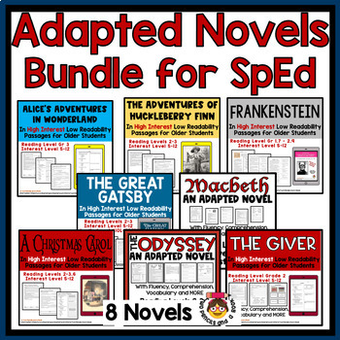
High School Examples
1. Adapted Classic Novels and Literature
Features: These books take classic high school texts and adapt them with simplified language, visual supports, and summaries for each chapter. Some versions include character maps, discussion questions, and visual cues for key themes.
Benefits: Adapted novels allow students with reading challenges to engage with classic literature and participate in class discussions. They make complex texts more approachable while retaining essential themes and literary elements.

Slide 46
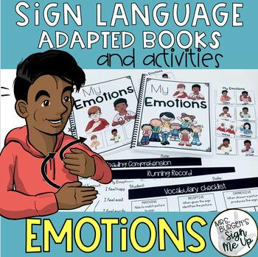
High School Examples, cont. 2
2. Social and Emotional Skill Books for Teens
Features: These books cover topics relevant to teenage life, such as self-esteem, peer relationships, conflict resolution, and managing stress. Many include interactive elements like reflection prompts or social scenarios with guided responses.
Benefits: Social-emotional skill books build emotional intelligence and social skills, equipping students with the tools to navigate high school social dynamics. They promote self-awareness, empathy, and effective communication.

Slide 47
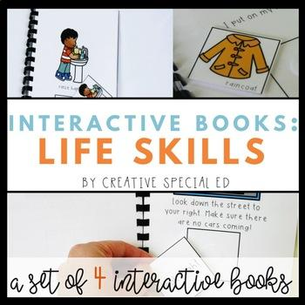
High School Examples, cont. 3
3. Career and Life Skills Books
Features: Career and life skills books teach students practical skills like resume writing, job interview techniques, budgeting, cooking, and basic first aid. They often include step-by-step visuals, vocabulary lists, and real-life scenarios.
Benefits: These books help high school students prepare for adulthood by building essential skills that will aid them in independent living and employment. They’re particularly helpful for students with intellectual or developmental disabilities.

Slide 48
High School Examples, cont. 4
4. Nonfiction Adaptations on Relevant High School Topics
Features: Adapted nonfiction books present current events, science, history, and other academic subjects in simpler language. They include visuals, glossaries, and comprehension questions to support understanding of complex topics.
Benefits: These books broaden students’ knowledge on real-world subjects, reinforcing literacy alongside academic content. They’re ideal for making textbooks more accessible to students who may struggle with traditional high school-level reading material.

Slide 49

High School Examples, cont. 5
5. Digital Books with Accessibility Features
Libby Library App
Features: Digital adaptive books are available through apps or e-readers and come with accessibility tools like text-to-speech, customizable font sizes, and embedded definitions. Many also offer highlighting, note-taking, and interactive comprehension quizzes.
Benefits: Digital books provide the flexibility for students to customize their reading experience based on their needs, whether for visual impairments, dyslexia, or attention challenges.

Slide 50
High School Examples, cont. 6
6. Graphic Novels with Age-Appropriate Themes
Features: Adapted graphic novels use minimal text combined with detailed illustrations to tell stories relevant to teens, such as friendship, identity, family dynamics, or fantasy adventures. Some versions include sidebars that explain vocabulary or themes.
Benefits: Graphic novels are engaging and less text-heavy, making them accessible for students who may struggle with traditional novels. They also encourage comprehension and critical thinking, as students must interpret both the visuals and the text.

Slide 51

High School Examples, cont. 7
7. Functional Literacy and Consumer Skills Books
Features: Functional literacy books focus on everyday reading tasks like understanding leases, reading pay stubs, following recipes, and interpreting public transportation schedules. These books often include real-life forms, checklists, and visuals to reinforce skills.
Benefits: These books are invaluable for teaching practical reading skills that students will need in adult life, especially those preparing to transition into more independent or community-based living situations.

Slide 52
High School Examples, cont. 8
8. Phonics and Fluency Books for Older Readers
Features: These books target phonics, decoding, and fluency while using themes relevant to teenagers, such as high school sports, music, and hobbies. Text may be bolded to emphasize particular sounds, with interactive elements to build fluency.
Benefits: Phonics and fluency books support high school students who still struggle with foundational reading skills, providing practice within age-appropriate content. This reinforces decoding and builds reading confidence.

Slide 53

High School Examples, cont. 9
9. Adapted Poetry, Lyrics, and Song Analysis
Features: Adapted poetry books include poems or song lyrics simplified for clarity, with visual aids, footnotes explaining vocabulary or themes, and prompts for analysis. Audio features allow students to listen as they read along.
Benefits: Poetry and song analysis encourages students to explore figurative language, rhythm, and expression. They also foster discussion on themes and emotions, which can be particularly impactful for high schoolers exploring identity and self-expression.

Slide 54
High School Examples, cont. 10
10. News and Current Events Adaptations
Features: News-based adaptive books provide simplified versions of current events and news stories, with visual aids, sidebars, and discussion questions. Some versions include maps or infographics to make complex topics more understandable.
Benefits: These books engage students with the world around them, promoting global awareness and vocabulary related to contemporary issues. They’re excellent for building critical thinking and preparing students for adult conversations and civic engagement.

Slide 55
DIY Tips for Making High School Adaptive Books
Choose Age-Appropriate Themes: Focus on themes like independence, identity, and social relationships that are relevant and relatable for high schoolers.
Incorporate Visuals with Vocabulary: Add visuals for complex vocabulary or abstract concepts to support understanding. Use charts, symbols, or images that relate to themes or key terms.
Use Summaries and Reflection Prompts: Include chapter or section summaries with reflection questions to support comprehension and encourage critical thinking.
Laminate and Bind for Durability: When creating physical books, laminate the pages or use spiral binding for ease of use and durability.

Slide 56

Websites/Resources
Websites:
Tar Heel Reader: Free, customizable books for all ages, available in multiple languages and with text-to-speech options. (Create Free Account)
Teachers Pay Teachers: Search for "adaptive books" to find pre-made or customizable books for different age groups. (Some Free/Some $$)
Boardmaker/Boardmaker Online: A tool for creating visual supports, symbol-based books, and interactive activities. (Purchase)
Twinkl: Special education and early childhood printable resources.

Slide 57
Websites/Resources, cont.
Websites:
Unite for Literacy: Offers free, simple nonfiction books with narrative text to support language development and reading comprehension
Newsela: Offers news articles at different reading levels and provides comprehension quizzes and discussion questions
Bookshare: Provides accessible e-books for eligible students with reading disabilities, including popular middle school novels and textbooks
Epic!: Subscription-based digital library offering a variety of books, including many accessible and interactive options for middle school readers

Slide 58
Websites/Resources, cont. 2
Websites:
Book Creator:Allows you to create interactive digital books with images, audio, and video.
Google Slides & Powerpoint: Great for making simple interactive books with clickable elements.
Pictello: An app for creating visual stories and talking books for non-verbal learners.
LessonPix: Helps create printable and digital books using customizable visual symbols
StoryJumper: Lets users create and share digital books with narration.

Slide 59
Websites/Resources, cont. 3
Websites:
Scholastic Teachables (formerly Scholastic Printables)
Do2Learn: Printable resources for special education, including visual stories and adaptive books
Autism Helper: designs top-tier, engaging resources tailored for individuals with autism and special needs
Autism Little Learners: printable resources for making adaptive books
Phonics Books: Decodable books for beginning and catch up readers
Libby Library App: offers free ebooks and audiobooks

Slide 60
Websites/Resources, cont. 4
Websites:
HelpKidzLearn: Features interactive switch-accessible books and educational games for young learners
Storynory: Free audiobooks that can be paired with switch-adapted media players for independent listening.
Star Media Center: provides resources to print
News-2-You: provides adaptive books and other resources for individuals with special needs, particularly those with communication or learning challenges.
SymbolStix PRIME: A tool for creating symbol-supported books

Slide 61

Wrap-Up and Call to Action, cont.
Summary:
Adapted books are tools to enhance accessibility, engagement, and learning.
They are easy to create and can be tailored to individual needs.
Closing Quote: “Education is not one-size-fits-all. Adapted books ensure every student has a chance to succeed.”

Slide 62

Q&A and Resources
Questions?
Discussion Prompt: What adaptations have worked well in your experience?
Resources (google drive folder)
Online templates and tools
suggested materials and suppliers
further reading or training opportunities

Slide 63


Thank you!
Andrea Murphy, amurphy@hved.org
Kristin King-Aasum, kkingaasum@hved.org

