Slide 1
De-Escalation Presentation
Charting the Cs Conference 2025
Sarah Larson

Slide 2
Schedule
Welcome (1 minute)
De-escalation - what does it mean and why is it important (10 Min)
Understanding OTHERS behavior (10 Min)
Understanding OUR behavior (15 min)
De-Escalation- Trauma Informed Approach (15 minutes)
Scenarios (5 Minutes)
Questions (2 Min)

Slide 3
Understanding OTHERS behavior

Slide 4
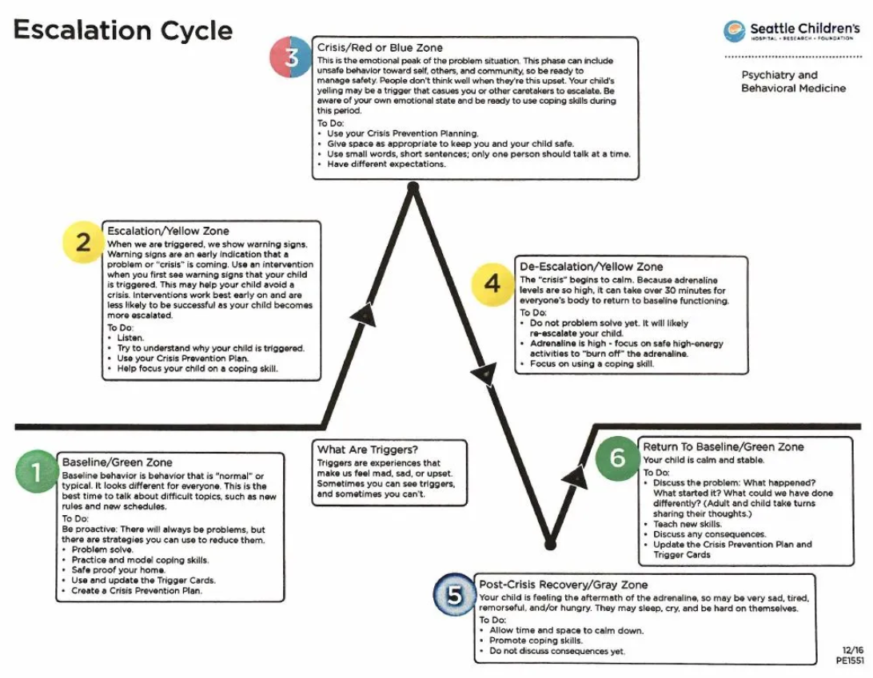
Escalation Cycle

Slide 5
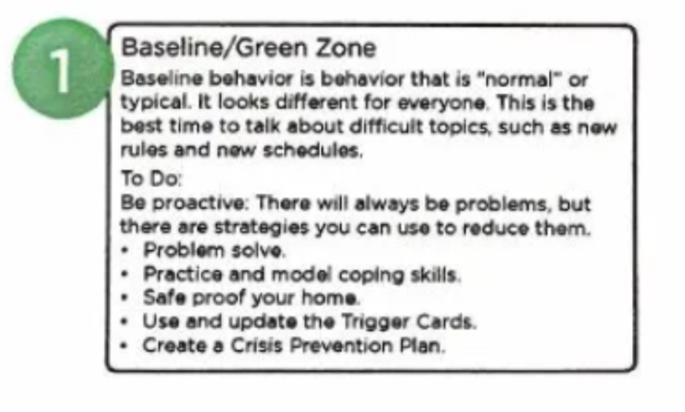
1: Baseline / Green Zone

Slide 6
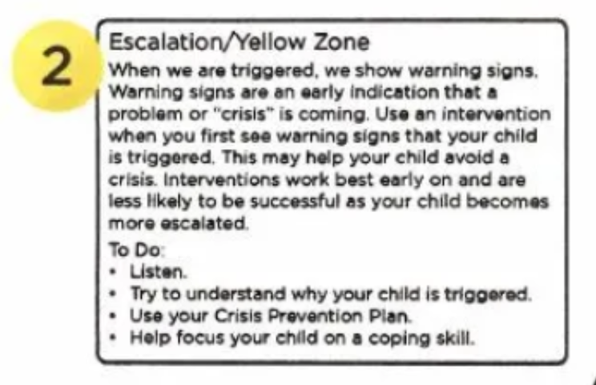
2: Escalation / Yellow Zone

Slide 7
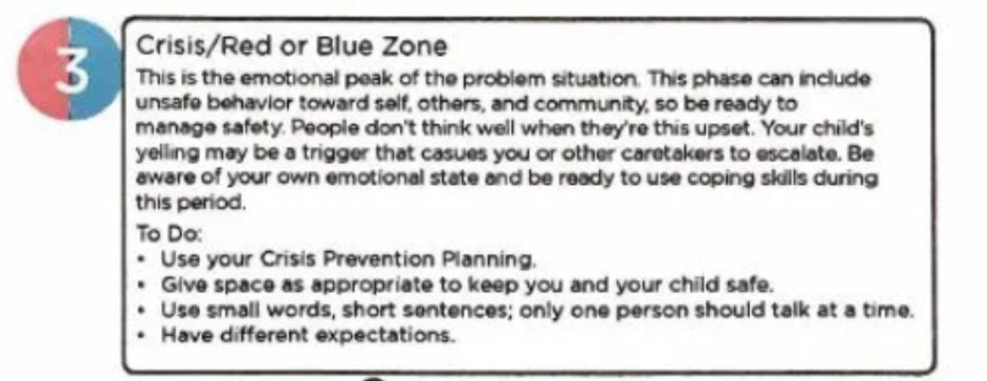
3: Escalation Crisis / Red or Blue Zone

Slide 8
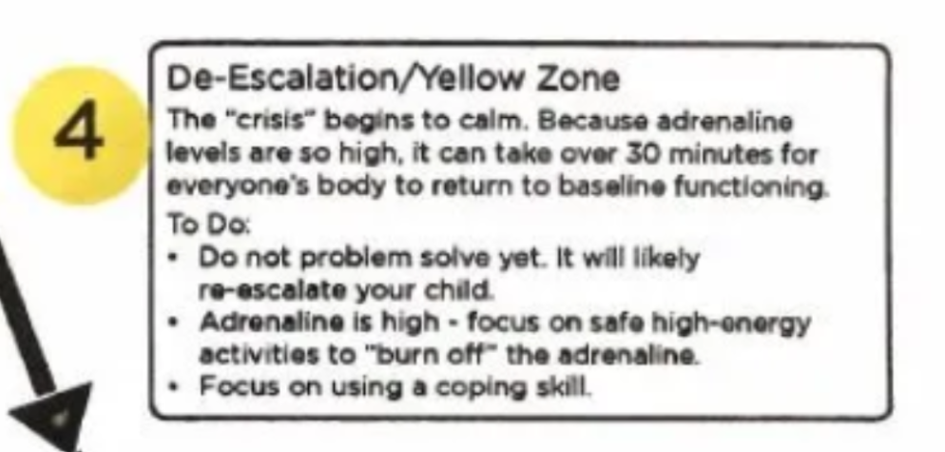
4: De-Escalation / Yellow Zone

Slide 9
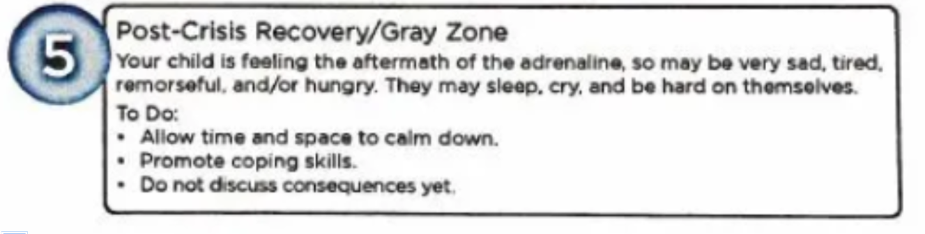
5: Post – Crisis Recovery / Gray Zone

Slide 10
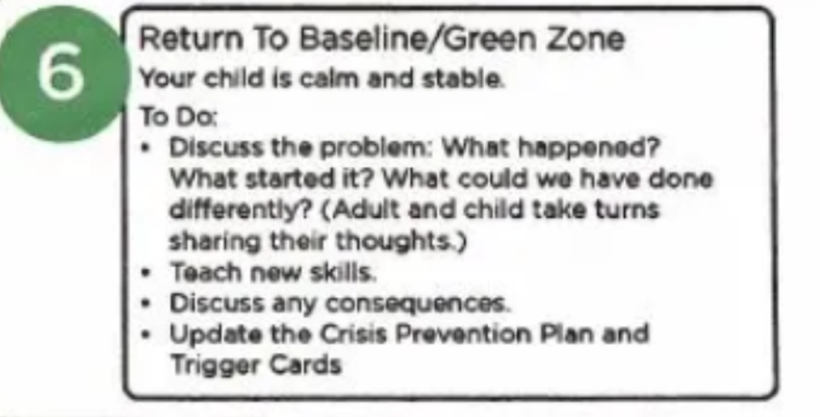
6: Return to Baseline / Green Zone

Slide 11
The Power of Mindset

Slide 12
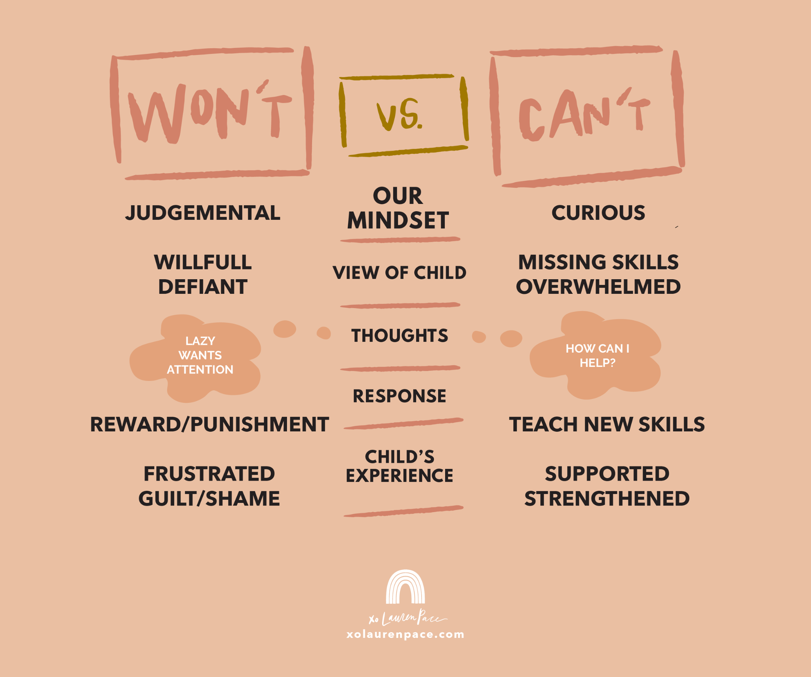
Won’t Vs. Can’t

Slide 13
Understanding OUR behavior

Slide 14
We all have behaviors to behaviors!
Trigger Behaviors- Share- What is your trigger behavior?

Slide 15
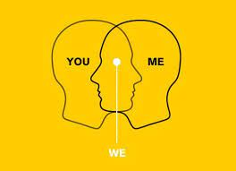
Behavior is Communication; Behavior Impacts Behavior

Slide 16
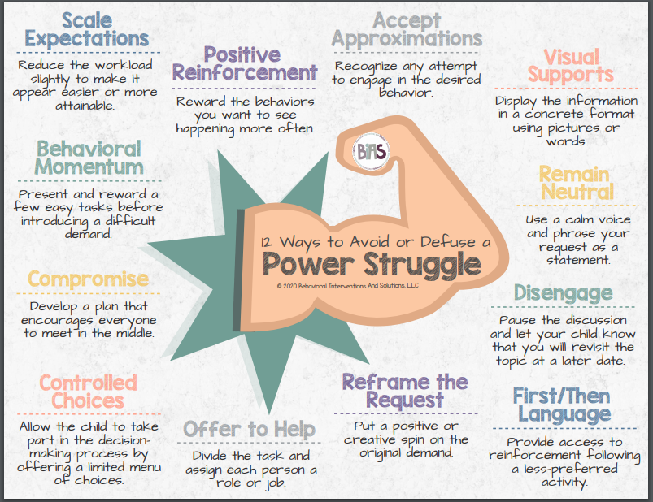
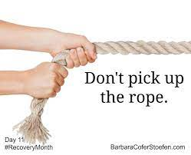
How to Avoid Power Struggles

Slide 17
Setting Limits
Setting limits is not the same as an ultimatum.
The purpose of limits is to teach, not to punish.
Setting limits is more about listening than talking.

Slide 18
Examples of Setting Limits
You can_______ When you______.
First______, Then_______.
When_______, Then_______.
If________, Then________. (Positive)
Would you like to ___ or_____.
You can either do_____ or_____.
Do you want to _________ now or in 5 minutes?
You are welcome to do ________ when you _______.
I will be able to listen when your voice is as calm as mine.
I am glad to discuss this when__________.
I care about you too much to argue. I’ll be happy to discuss this with you as soon as the arguing stops.

Slide 19
De-Escalation-Trauma Informed Approach

Slide 20
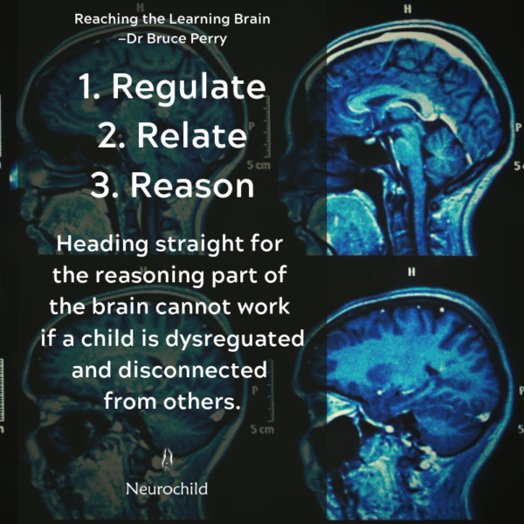
Bruce Perry’s - Regulate, Relate, Reason

Slide 21
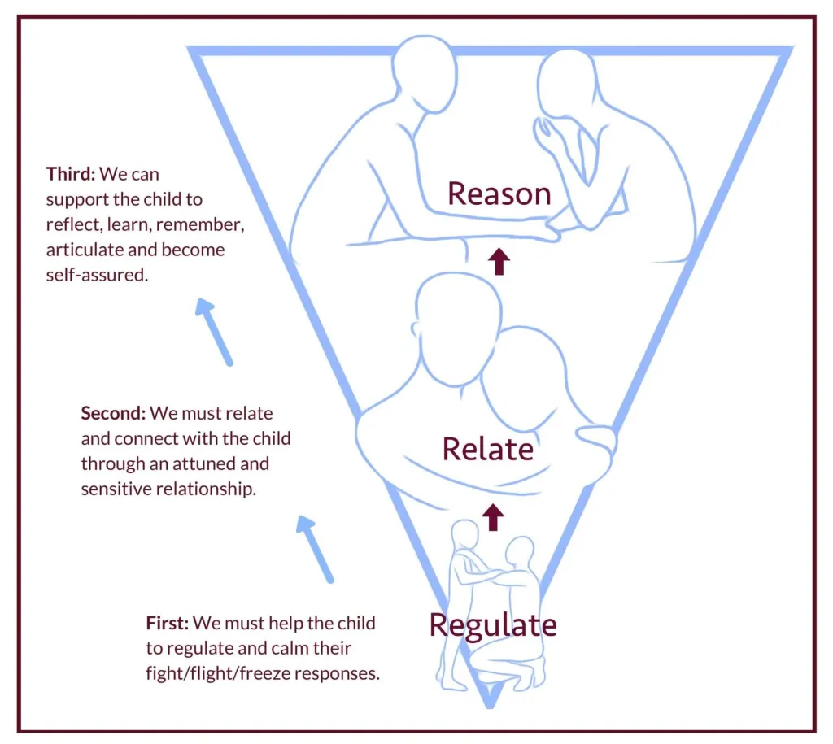
Regulate, Relate, Reason

Slide 22
Regulate
Watching from a distance (gives space and time while allowing you to monitor for safety)
Provide a safe and comfortable space
Controlled breathing
Grounding techniques (E.g., identify things you can see, smell, hear, feel and taste)
Demonstrate the activity yourself
We must help the child to regulate and calm their fight/flight/freeze responses.
What does this look like for the adult?
REMAIN CALM YOURSELF
Soothing tone
Limited words
Patterned, rhythmic activities

Slide 23
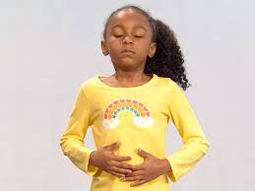
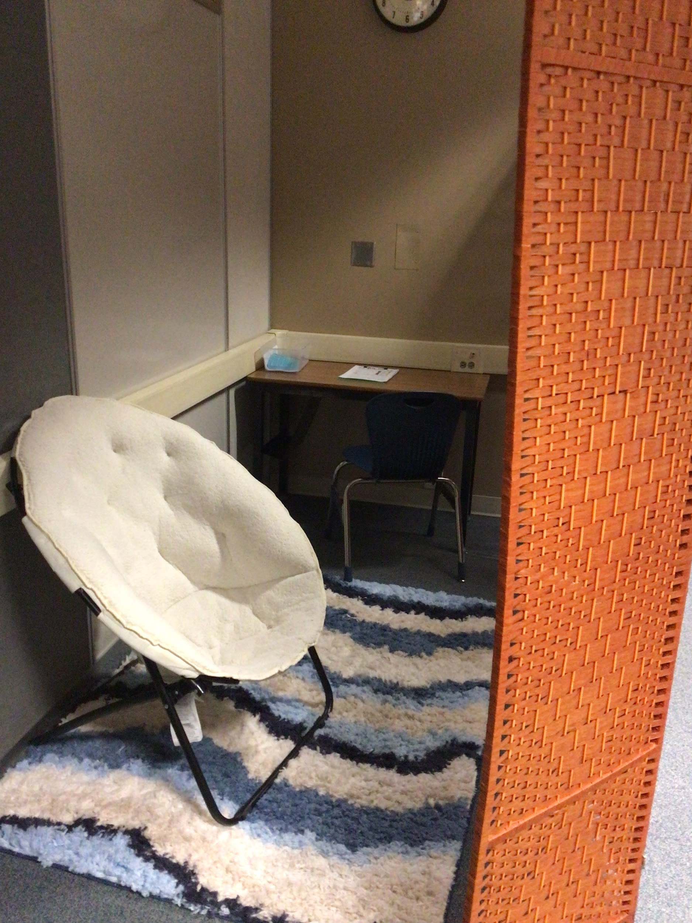

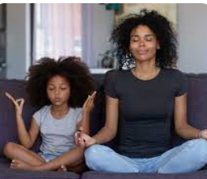


Regulate, cont.
To be ready to regulate another person, you might need to ground or calm yourself first. Find a way to regulate yourself (a controlled breath, a parental pause, an affirmation) before even opening your mouth to respond.

Slide 24
Relate
We must relate and connect with the child through an attuned and sensitive relationship. This is the most effective way to calm the nervous system. When we are around people we care about and trust, our bodies move back into a state that feels safe again.
What does this look like for the adult?
ACKNOWLEDGE HOW THEY FEEL (“You seem angry/sad/frustrated”)
Label their feelings out loud
Acknowledge how hard it is for them (“That was really hard for you” or “I understand this feels really tough”)

Slide 25
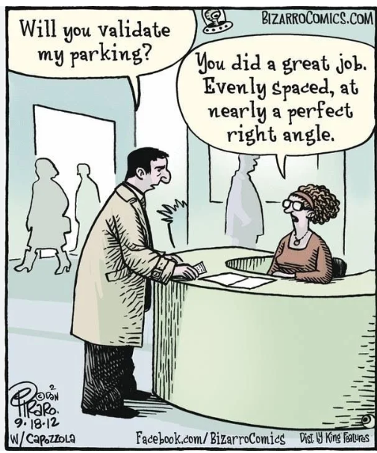
Relate, cont.
Having an attuned and sensitive relationship with the child or young person.
By empathizing with them and validating their feelings, adults can support the development of a connection.

Slide 26
Relate, cont. 2
When adults relate to and connect with children and young people, they are reminded that they are in a safe and secure environment where adults are interested in understanding them and supporting them to deal with their thoughts and feelings.
The child might look calmer now, but they are still processing, their stress hormones are still spiked, and they are still in a state of heightened arousal. This still isn’t the time to teach them anything.

Slide 27
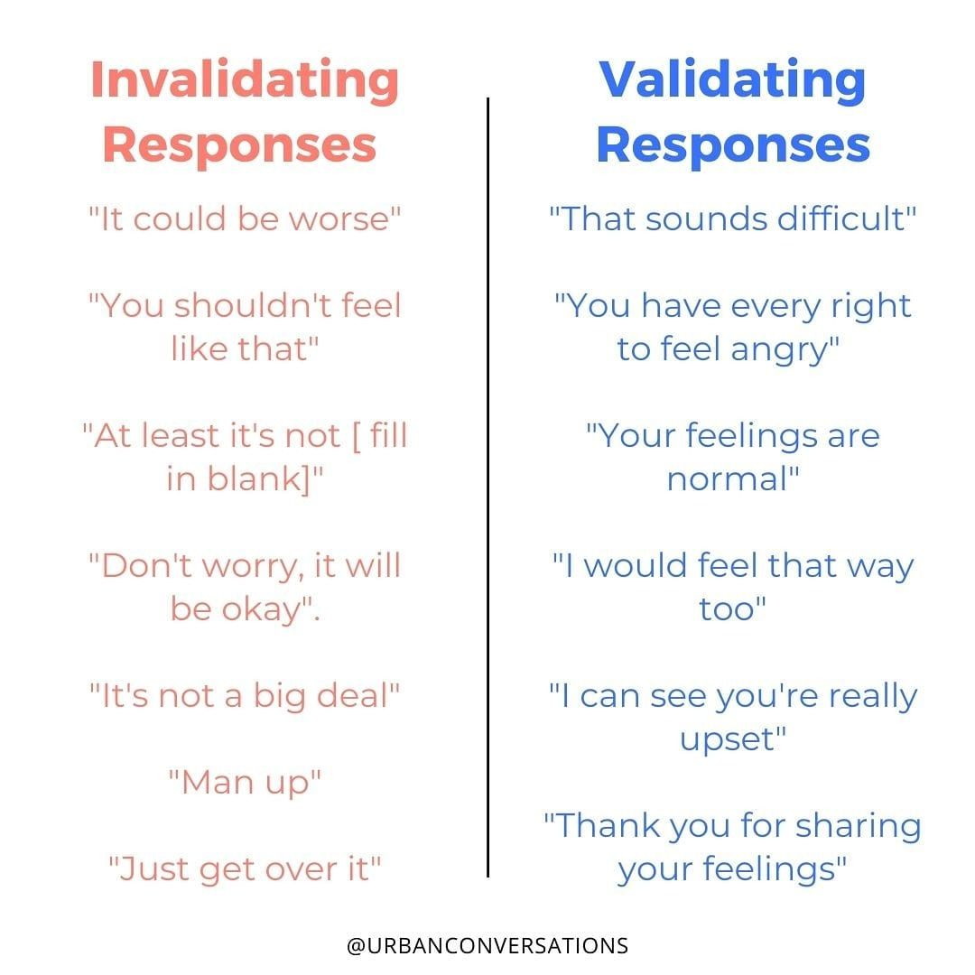
Invalidating Responses Vs Validating Responses

Slide 28
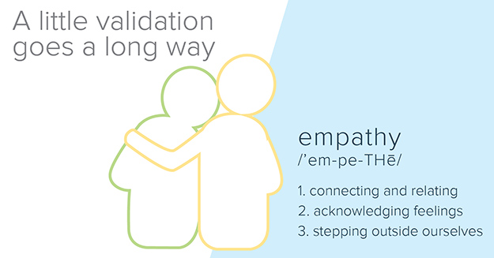
A little validation goes a long way - empathy

Slide 29
Reason
Finally, we can support the child to reflect, learn, remember, articulate and become self-assured. A reliable adult can, through words and reason, support a child to create logical and sequential connections to understand exactly what has just happened to them. They need a simple explanation of what is happening and what will happen next.
What does this look like for the adult?
Label their feelings out loud
Give a simple and clear explanation of what has happened, so they can put words to the sequence of events
Do lots of teaching of feelings, and exploring of emotions
Play around together to find ways of managing big feelings
Remind them of their safe places and safe people

Slide 30
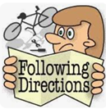
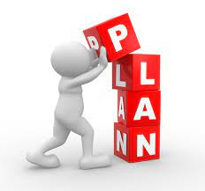
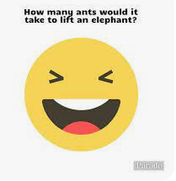
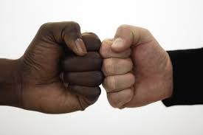
Reason, cont.
Student is calm and ready to engage with learning.
Once regulated and feeling connected, they can start to access the parts of the brain needed for reason.
It is at this stage that adults can support them to remember, reflect, articulate, and become self-assured.

Slide 31

More Tools for your Toolbox

Slide 32
Now what?

Slide 33
Scenarios
You are using these strategies and the behavior continues . . . now what?
How can we view these behaviors with the lens of Dr. Perry’s regulate, relate, and reason?
Hallway behaviors- Running? Can you use distraction instead?
Students who refuse- Think-How can we regulate, relate, and reason to get them to transition?
Basic Needs- Hungry, Sleepy, Thirsty, Bathroom needs?
What do you see? What are your biggest concerns?

Slide 34

Questions?

Slide 35

Thank you!

