Slide 1

Rethinking Guardianship for Transition Age Young Adults with Disabilities: The Promise of Supported Decision Making
Charting the Cs Conference 2025:
To Literacy and Beyond
Cooperation
Communication
Collaboration
April 30, 2025
Anita L. Raymond, LISW, CMC

Slide 2
Objectives
Explore reasons why families are often encouraged to seek guardianship when their child with disabilities turns eighteen and how to address concerns regarding safety, access, and vulnerability
Understand the benefits and potential downsides of guardianship
Describe decision making options for those with impaired decisional capacity, including supported decision making

Slide 3
Historically…
Happy 18th Birthday! Let’s talk about guardianship!
At diagnosis
Young teens or pre-teens
Other families
Benign, necessary step
Required by IDEA

Slide 4
Changing Perspectives About Guardianship
No longer the default
Policy, law and best practices emphasize self-determination and person-centered approaches
Removal of civil rights, transferred to guardian
Good intentions may lead to bad outcomes
  Overly protective decisions
  False sense of security
  Increased risk of abuse
  Person never learns how to be a good decision maker

Slide 5
Harsh Realities of Guardianship (potential)
Decreased or no sense of agency / self-determination
Perpetual childhood
Resulting feelings: frustration, anger, defeat
Reactions
  Increased resistance, decreased cooperation
  Communicating their emotions by “acting out” or “behaviors”
  Depression, isolation
  Learned helplessness

Slide 6
Practical Realities of Guardianship
Consent power, not compliance power
Bill of Rights:
  right to due consideration of preferences
  right to interact with people of their choosing
Future considerations
  what skills/supports are needed when guardianship ends in 72 months?
  successor guardian when current is not longer able to serve?

Slide 7
Legal Realities of Guardianship
MN Law Requires Trying Alternatives First
Impaired, lacking capacity to make decisions +
Unable to meet personal needs, even with help +
Identified needs can’t be met by less restrictive means, including
  Technological assistance
  Supported decision making
  Community or residential services
  Appointment of health care agent

Slide 8
Key Questions
Incapacitated to do what?
What has been tried, for how long, and why didn’t it work?

Slide 9
Is Guardianship All Bad? Should We Abolish It?
No! Guardianship is a valuable, effective, and necessary tool. When it’s needed.
Guardianship is the best tool when:
  need for protection and substitute decision making outweighs possible harms and unintended consequences
  powers of guardianship will effectively address the problem
  act of removing rights for the person’s own good won’t worsen the situation
  situation is so dire and there is no other way to address the person’s unmet needs or maltreatment or safety concerns
  all less restrictive options have been eliminated

Slide 10
Contemplating Parental Authority
Parents/legal guardians of minors: legal decision makers for all decisions
  Legal decision making authority? yes
  Child obeying/abiding parental decisions? Maybe
    “I want” “I won’t” “You can’t make me”
    Navigating and gaining compliance and cooperation
Planning for child’s age of majority:
  “goodbye and good luck”?
    Ready for adulting: college, student loans, residence, prescriptions, banking preparations, car insurance, broken hearts, job choices

Slide 11
Transitioning to Adulthood
Legal decision-making rights transferred to young adult
  Exceptions: alcohol consumption, car rentals
Cognitively ready?
Emotionally ready?
Practically ready?
Young adults: ready for complete independence?
  Without disabilities: very, very few are totally independent
  With disabilities: very, very few are totally independent

Slide 12
Conversations with Students and Parents
“Your legal decision-making rights transferred to child when they turn 18…”
  “…unless you get guardianship”
  vs.
  “….so let’s start planning”
Planning for adulthood
  What areas still need more skills and knowledge development?
  What areas need someone to do for them?
  Learning how to be good decision makers

Slide 13

Changing Drivers
Parent was the driver, child was passenger
Now, young adult is in the driver’s seat
Parent in passenger seat for some trips
Parent in back seat for some trips
Parent doesn’t need to be in the car for every trip
Parent and young adult prepare for reasonably safe trips together

Slide 14
Supported Decision Making: It’s the Law
Assistance from one or more persons of an individual's choosing in understanding the nature and consequences of potential personal and financial decisions which enables the individual to make the decisions and, when consistent with the individual's wishes, in communicating a decision once made.
MN Statute 524.5-102, Subd. 16a

Slide 15
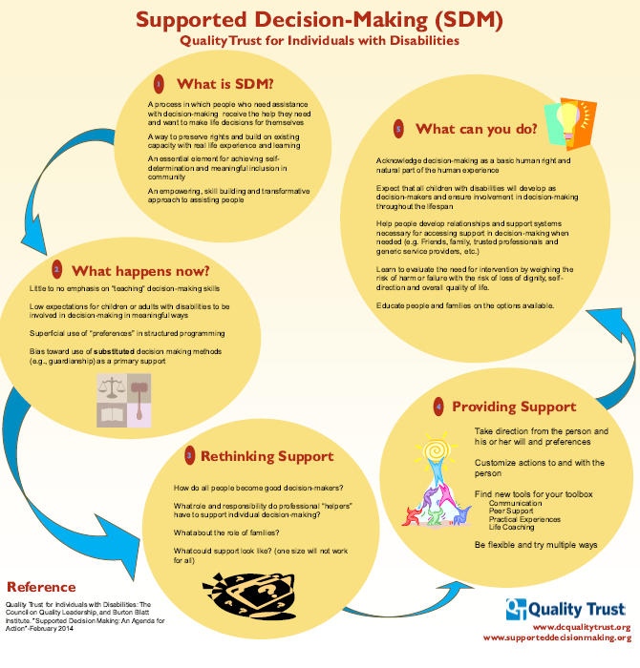
Supported Decision Making Highlights
People who need help with decision making receive the help they need and want
Preserves rights and builds on existing capacity with real life experience and learning
Essential element for achieving self-determination & meaningful inclusion
An empowering, skill-building, transformative approach to assisting people

Slide 16
Principles of Supported Decision Making
No one is completely independent
How we all make challenging decisions:
  Turn to trusted others or experts
  Gather information needed to make decision
People who have agency / self-determination have better outcomes

Slide 17
Identifying Areas of Needed Support / Skill-Building
Money management
Health care decisions / managing health conditions
Applying for MA Waiver, accessing Home & Community Based Supports
Special Education participation
Life Skills, Dating, Community Safety, Jobs

Slide 18
Powerful Tools: Supported Decision Making
Coaching/on-line resources to teach good decision making in relationships
Tech:
  Smart Phones: GPS, Maps, medication reminders, etc.
  Apps: Let Me Do It; Can Plan; Monefy
Creativity required: countless ways to support person’s safety and well-being

Slide 19
SDM Planning Tools and SDMAs
Charting the Life Course Framework
SDM Brainstorming Guide
How to Make a Supported Decision-Making Agreement
National Resource Center on Supported Decision Making
Remember: Written Supported Decision Making Agreements are NOT required!

Slide 20
More Powerful Tools
Representative Payee
Banking tools
Trusts, Power of Attorney
Appoint Health Care Agent (Health Care Directive)
Authorized Representative for MA / Waiver applications
Releases of Information (education, health, social service systems)
Person-Centered Planning process

Slide 21
But What About Bad Choices, Safety, and Vulnerability?
Building Scaffolds of Supports
Relationships
Community
Skill-building
Safety Nets
Risk/harm reduction
Goal: as safe as necessary (vs. as safe as possible)

Slide 22
Bad Choices or Human Choices?
Alcohol and other substances
Online dating
Dating and intimacy
Giving money to others
Medication choices
Food choices
Friend choices
Residential and care choices

Slide 23
Helping Families and Student Navigate “Bad Choices”
What is the Issue? Listen with non-judgmental true curiosity
Why is the choice important to the person?
Why do they want to…? Why don’t they want to…?
Is the choice really about something else?
  Trying to claim a sense of control in their life
  Expressing frustration or anger or fear
  Want to do what their peers are doing
Person is just dreaming out loud?

Slide 24
Navigating Choice & Safety
Help student understand how it will impact desired outcome, goals, and desires
Person-centered approaches
  Inquire to understand what is important to the student (personal choices)
  Help student understand what is important for the student (health and safety)
  Find ways to leverage important to so you can achieve important for.
Use leverage, negotiation, trials to find balance between safety and choice (happiness, quality of life)

Slide 25
Navigating Choice & Safety (cont’d)
Creative way to meet both? (temporary tattoo, GPS in phone)
Set them up for best chances of success instead of setting them up to fail?
  What will they accept? What are they willing to try?
  What can we live with?
  Trials, skill-building, coaching, partnering
Revisit later
Trusted relationship with supporter
  Is there someone else to have this conversation with them
  If they feel we’ll blame, restrict, they will never come to us if struggling

Slide 26
Summary: Supported Decision Making Key Principles
Philosophical, transformative approach
  helps people receive the help they need and want
  preserves rights and builds on capacity with experience and learning
  Essential element for achieving self-determination & meaningful inclusion
Viable, legal less restrictive alternative to guardianship
Umbrella term encompassing several (countless?) options
Everything we do to help person make decisions to get their needs met
Balances choice/quality of life with safety
How we all make decisions

Slide 27
Summary: Supported Decision Making Takeaways
No court involvement
Better chance of preserving relationship(s)
Less expensive
Better outcomes for the person
Along with additional tools, can accomplish a lot of what is sought in guardianship and/or conservatorship
Required by law to try before seeking guardianship/conservatorship

Slide 28
Summary: Guardianship Might Be Needed
Person can’t or won’t cooperate with others to get their needs met or help them make decisions (and we can’t overcome this resistance)
Person can’t appoint someone to help with decision making (Health Care Agent)
Person can’t sign a Release of Information to allow others to gather information and talk to providers
Rep Payee and Authorized Rep insufficient to meet needs

Slide 29
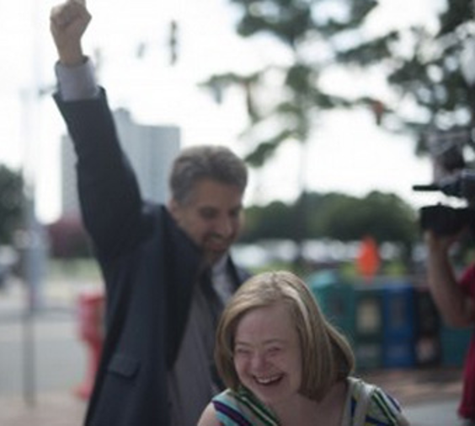
Education Professionals Play a Critical Role!
I don’t need a guardian. I just need a little help. ~ Jenny Hatch
To deny the right to make choices in an effort to protect people with disabilities from risk is to diminish their human dignity. ~ Robert Perske

Slide 30

Center for Excellence in
Supported Decision Making
Assessments
In-depth, personalized consultations for individuals, families, communities, professionals
Technical Assistance, trainings, education sessions
Guardianship Information Line
952-945-4174 1-844-333-1748 (toll free)
cesdm@voamn.org

Slide 31
For More Information
CESDM: links to articles, G&C FAQ and more
www.voamnwi.org/center-excellence-supported-decision-making
SDM / Gship Information Videos youtube.com/playlist?list=PLKJYnxTHNgqVUVjdT6NL29vvLqSQu0l-F

Slide 32
Attribution & Gratitude
This training was funded in part by the
Minnesota Department of Human Services,
Aging and Disability Services Division

Slide 33

Thank you!
Anita Raymond, LISW, CMC
Director, Center for Excellence in Supported Decision Making
952-945-4172, araymond@voamn.org
Guardianship Information Line
844-333-1748 (toll free)
952-945-4174 cesdm@voamn.org

Slide 34
Charting the Cs Conference 2025
Statewide Professional Development to Support the Workforce and Low Incidence Disability Areas in the State of Minnesota.
This presentation is partially funded with a grant from the Minnesota Department of Education using federal funding, CFDA 84.027A, Special Education – Grants to States.

