Slide 1

All You Need is APES!
Charting the Cs Conference 2025:
To Literacy and Beyond
Cooperation
Communication
Collaboration
April 28, 2025
Ginny Running and Kathy Castor
Prior Lake - Savage Area School District

Slide 2
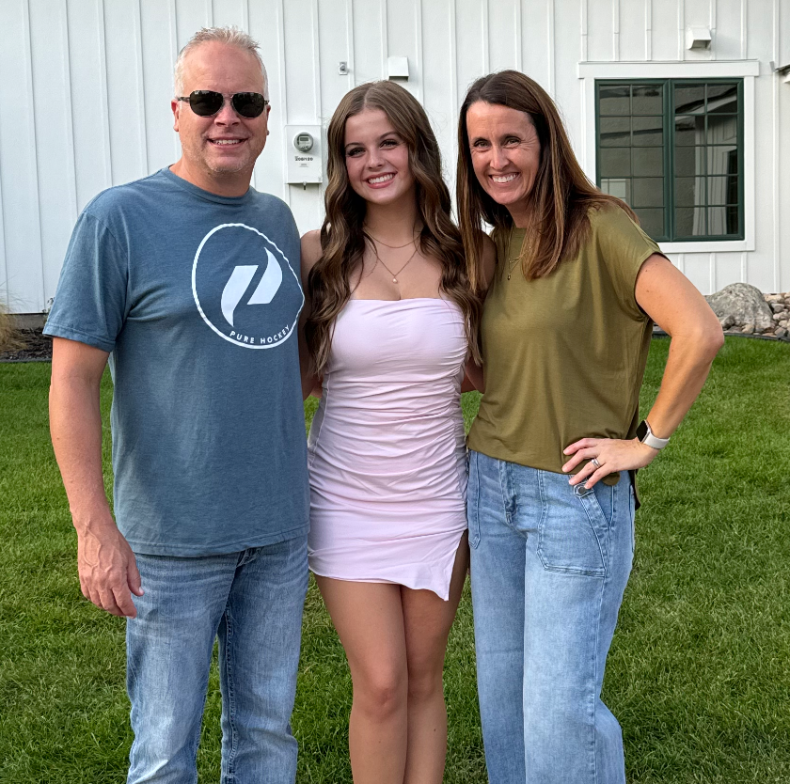
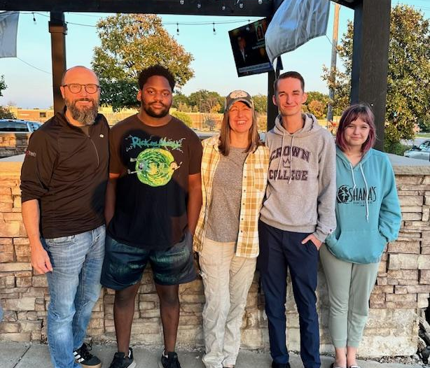
Who We Are…
Ginny Running:
Physical & Health Disabilities Teacher
Traumatic Brain Injury Specialist
(Former Life Skills Teacher of 15+ years)
Kathy Castor:
Speech - Language Pathologist
Assistive Technology Specialist
(Self Proclaimed DORK)

Slide 3

Outcomes for our session: APES is Where It’s At!
Active Participation and Engagement for Students
(with complex bodies and needs)
Review the need for increased & intentional planning for ALL students to be active participants in meaningful & engaging learning experiences across their school day (a.k.a. The What and Why of APES).
Unpack the two guiding principles influencing our work.
Participate in a show and tell of materials that were created as part of this initiative.
Reflect on our journey of creating materials and training staff.

Slide 4
Active Participation and Engagement for Students
(with complex bodies and needs)
This work…
Was sparked by repeated conversations thinking about and planning for our students with most significant needs.
Was influenced by “Making Curriculum Active and Meaningful for Students with Complex Bodies and Needs” - Julie Marzano and Emily McCarthy
Resulted in summer work that has continued into this year, including:
  Creation of materials, training of staff, Charting the C’s, funding requests
  Lots of brainstorming, more questions, more joy and more challenges

Slide 5

Guiding Principle #1
Help students become
PARTICIPATORS
not
SPECTATORS!

Slide 6

Barriers to Participation
BRAINSTORM TIME

Slide 7

Guiding Principle #2
If you can’t make it
better….
make it matter!

Slide 8
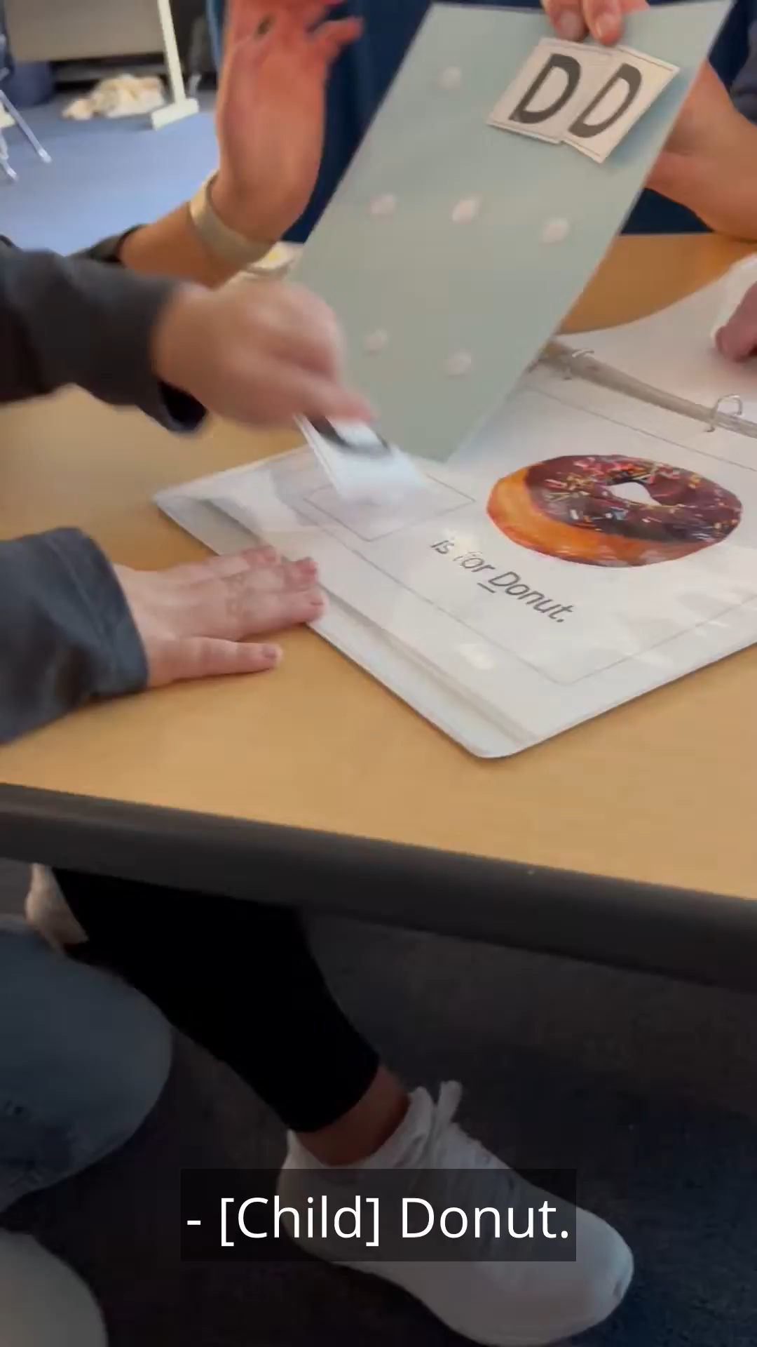
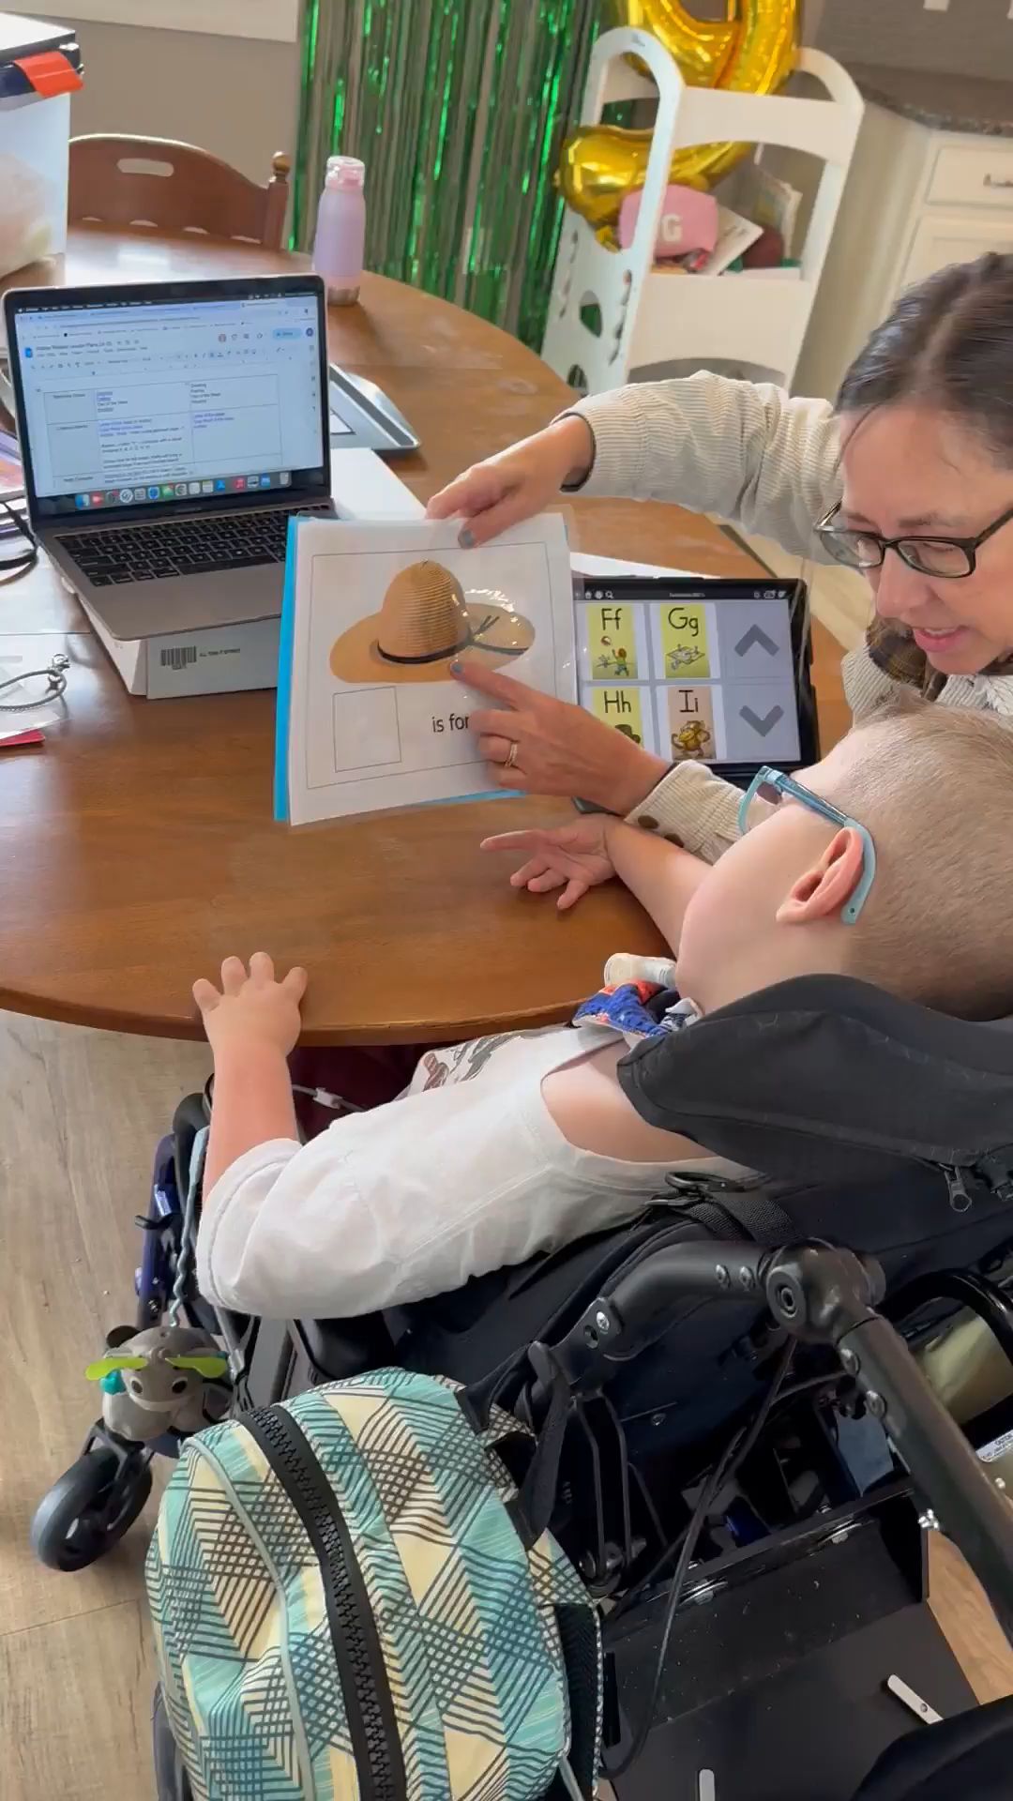
Examples in Action
Video 1 and 2: Errorless Learning ASD

Slide 9
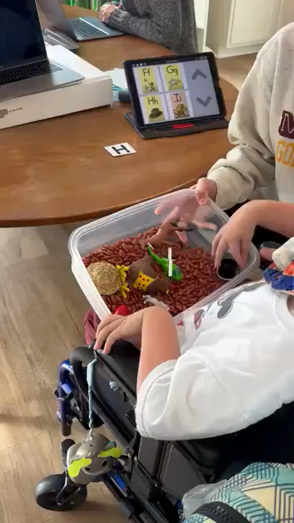
Examples in Action, continued 1
View video 3: Walter object

Slide 10
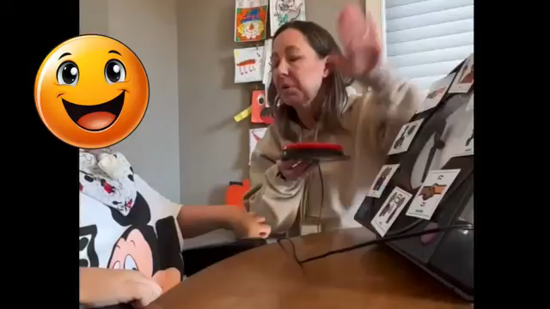
Examples in Action, continued 2
View video 4: Walter Greeting Spinner for Charting the C's.

Slide 11
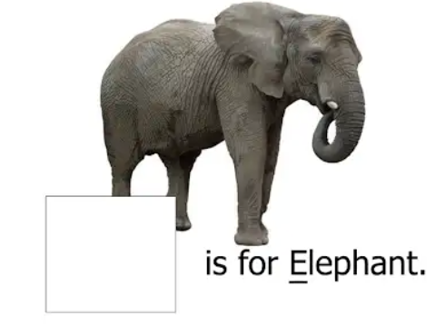

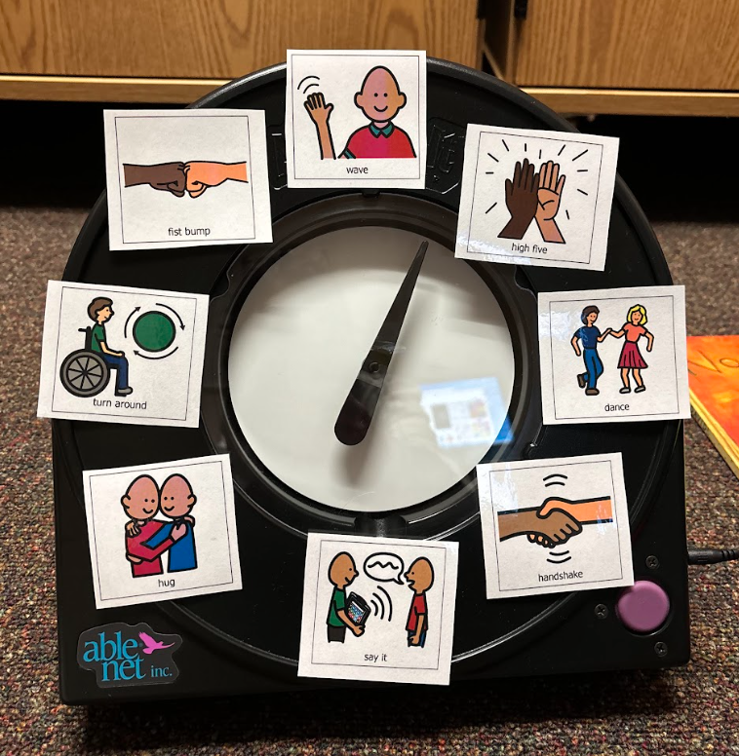


Time for Show and Tell!

Slide 12
Station Time!!
It is time for you to explore some materials we brought for show and tell.
Feel free to ask questions and give examples of your own if you have them!

Slide 13

Reflections

Slide 14
Resources
Errorless Learning Resources from Ginny and Kathy (https://shorturl.at/UBGez)
DISCLAIMER: Please be aware that the resources provided have not been reviewed for accessibility and / or copyright. These are meant to be printable materials for use with students. In addition, we are sharing the materials that we have created with an understanding that no attendee will try to claim credit for, sell or make financial gain from the work we have done.
These resources will be available through May 30th, 2025, at which time the folder will no longer be available.

Slide 15

Thank you!
Questions?
Kathy Castor, kcastor@plsas.org
Ginny Running, grunning@plsas.org

Slide 16
Charting the Cs Conference 2025
Statewide Professional Development to Support the Workforce and Low Incidence Disability Areas in the State of Minnesota.
This presentation is partially funded with a grant from the Minnesota Department of Education using federal funding, CFDA 84.027A, Special Education – Grants to States. The contents of this website do not necessarily represent the policy of the federal Department of Education, or the state Department of Education and you should not assume endorsement by the federal or state government.

