Slide 1

Connecting high leverage practices with the Science of Reading in your classroom for effective and efficient reading instruction.
Charting the Cs Conference 2025:
To Literacy and Beyond
Cooperation
Communication
Collaboration
April 30, 2025
Miriam White Ed.D.
Allyson Gagner MS

Slide 2
What are High Leverage Practices?
They look at:
  Collaboration
  Assessment (Data Driven)
  Effective Instruction
  Cultural inclusivity

Slide 3
What is the Science of Reading
Simple View of Reading
  If you can’t decode, you can’t read.
Not the whole story!!

Slide 4
Read This:
“England’s openers labored 34 balls before scoring their first boundary as Strauss cracked two fours through the leg side. Cook made a patient start before motoring past his skipper. ”

Slide 5
Or This
The fundamental problem of communication is that of reproducing at one point either exactly or approximately a message selected at another point. Frequently the messages have meaning: that is they refer to or are correlated according to some system with certain physical or conceptual entities. These semantic aspects of communication are irrelevant to the engineering problem. The significant aspect is that the actual message is one selected from a set of possible messages. The system must be designed to operate for each possible selection, not just the one which will actually be chosen since this is unknown at the time of design.

Slide 6
While you could read the words…
Did you understand what it said?
you need the vocabulary and background knowledge—
  in the first paragraph understanding the text requires cricket knowledge.
  The second paragraph requires understanding modern information theory

Slide 7
Here is a 3rd example that researchers: Recht and Leslie gave to 5th graders
Churniak swings and hits a slow bouncing ball toward the shortstop. Haley comes in, fields it, and throws to first, but too late. Churniak is on first with a single, Johnson stayed on third. The next batter is Whitcomb, the Cougars’ left-fielder. The ball is returned to Claresen. He gets the sign and winds up, and throws a slider that Whitcomb hits between Manfred and Roberts for a hit. Dulaney in and picks up the ball. Johnson has scored, and Churniak is heading for third. Here comes the throw and Churniak is out. Churniak argues but to no avail.”

Slide 8

reading ability had little impact on how well kids understood the story knowledge of baseball did
Good readers who didn't know baseball: 19/40
Poor readers who knew baseball: 27/40

Slide 9
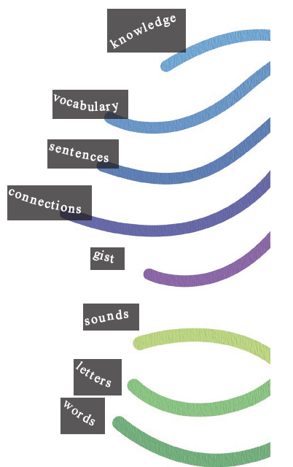
So how do we address this with our knowledge of teaching reading and high leverage practices
Scarborough’s Rope
Keeping an eye on Cultural responsiveness
Belief system that all students can improve
Knowing our students’ skill sets

Slide 10
Using High Leverage Practices for Instruction
Successful learning requires targeted perspectives, and is the responsibility of all around the learner to build up, support, and develop positive perspectives in all involved. This means seeing oneself as a change agent.
Educators cannot make students learn or behave; we can, however, create environments to increase the likelihood they do both.

Slide 11

Language Comprehension
is the ability to derive meaning from spoken words when they are part of sentences or other discourse. This component includes capabilities that develop and grow over a lifetime, contributing to full reading comprehension.

Slide 12
BACKGROUND KNOWLEDGE
The knowledge one possesses based on life experiences and previous learning that is stored in memory and acquired over time. Studies show that when a student already knows something about atopic, they are more likely to access and retain meaning effectively.
Connecting to background knowledge is a step we too often skip in order to get through the lesson, but this is a pivotal piece of instruction

Slide 13
Scaffolding Supports Principles
Dynamic Assessment: teachers need to have a deep understanding of what students know and are able to do along with what the student can do with supports. The teacher needs to be able to hear the student’s thinking or watch him preform the task
Knowledge of curriculum: what is the outcome, what are the standards, benchmarks, scope and sequence and prerequisites. Teachers who know their content are able to structure the instruction for their students easier

Slide 14
Scaffolding Supports Principles, cont.
Motivation, purpose, and engagement: Effective teachers in special education are attentive to the learner’s motivation and engagement and skills
Varying levels of support: Provide only the amount of support necessary to allow the student(s) to perform at a level they are not able to complete independently… think instructional level
Always: I do, We do, You do

Slide 15

EACH TIME A STUDENT LEARNS
A NEW CONNECTION— a tiny part of the student’s brain gets rewired. it’s like building a muscle
The red part shows where there is activity—millions of neurons firing.

Slide 16
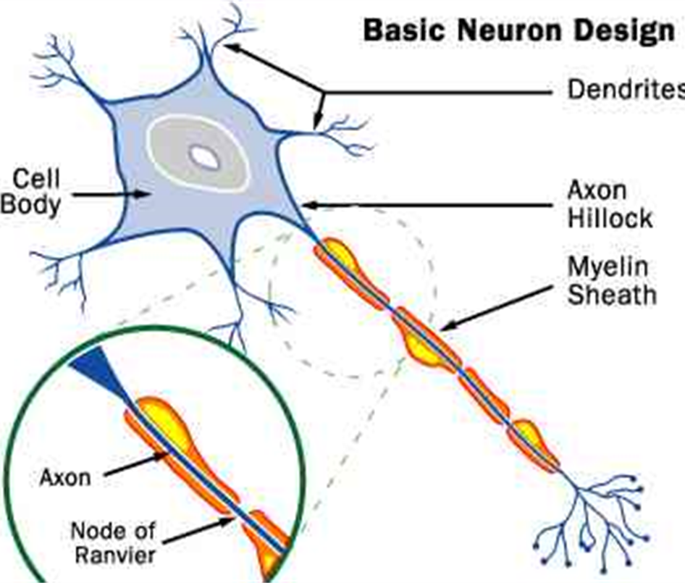
Exposure Wires the Brain
Every time we learn something new, a physical change occurs in the brain.
Neurons that fire together wire together

Slide 17
For Instruction to be Effective, Five Critical Features and Components must be addressed
Skills should be chunked into smaller steps.
Modeling and demonstration of new skills should be done by thinking aloud using simple language.
Prompts should be gradually faded to promote independence of the skill
Multiple opportunities for feedback should be offered.
Independent practice of the skill should be meaningful and help to retain and generalize the skill.
So let’s build on the following reading pieces…

Slide 18
Word recognition
requires subskills that are typically taught as foundational or early literacy skills to students as young as preschool.
Scaffolding
Instruction… High leverage practices… connection
(Brain) It’s called the visual word form area.⁹
no one is born with the connections between vision and speech, the connections that enable reading
Collect data; think of it as measurement. For instance, measure whether a strategy is having the expected impact, make sure there is fidelity of implementation.

Slide 19
PHONOLOGICAL AWARENESS / phonemes
Awareness of larger units of spoken language, such as syllables and onset-rime, and smaller units, phonemes. Phonological awareness helps students develop the understanding that words are made up of individual sounds (e.g., cat → /k/ /ă/ /t/).
… connection to dyslexia
… connection to fluid reading
words are made up of sounds (the technical term is phonemes)
Let’s connect to HLP

Slide 20
Phonological Awareness, cont.
The student has to build the visual word form area of their brain one connection at a time. They have to learn that p stands for the sound at the start of pen (usually) and ough stands for the sound at the end of though (sometimes).
Heikki Lyytinen, a Scandinavian neuroscientist, showed that the visual word form area begins to appear in the brain scans of non-readers after as little as five hours of training in decoding.
Let’s connect to HLP

Slide 21
Explicit Instruction Key Elements
Content
Design of Instruction
Making expectations and goals clear
Delivery of Instruction
Keeping student focused, engaged, & responding
Purpose of Practice
Providing guidance and support

Slide 22
DECODING /SIGHT RECOGNITION
Understanding the alphabetic principle and sound-symbol correspondences—or the idea that each sound is represented by a letter or group of letters—to efficiently unlock the written word (this is where phonics instruction comes into play).
Automatic recognition of learned words and spelling patterns. Word automaticity is what allows the brain to devote cognitive resources to the ultimate goal of reading—comprehension… goes straight to explicit instruction and knowing what the student knows
Let’s connect to HLP

Slide 23
VOCABULARY KNOWLEDGE
Reading comprehension relies on understanding most of the words being read. Developing robust vocabulary is an important aspect of foundational reading instruction. Students must be taught vocabulary explicitly and implicitly. They also need to learn about morphological units and gain word analysis skills to access more complex vocabulary.
Between the ages of 2 and 18, you learned 10 new words every day.
Students learn almost all them from context.
Let’s connect to HLP

Slide 24
Building Knowledge
Educators face the same problem: it would take far too long to explicitly teach all the words needed to close the gap between a low- and high- vocabulary student.
On the first day of school, that gap may already be several thousand words.
And it’s not just the number of words a child recognizes that drives reading comprehension. Making good connections and inferences depends on the richness of the word network he or she has built.
Let’s connect to HLP

Slide 25
LANGUAGE STRUCTURES
“Expert teaching of reading requires knowledge of language structure at all levels” (Moats, 2020a). To help students learn to analyze words down to the letter sounds and spelling patterns (something a good reader does unconsciously), teachers must have thorough knowledge of language structure from phonology all the way through morphology, syntax, and text structure

Slide 26
Understanding texts//writers
good readers stop, re-read and figure it out when something doesn’t make sense, but weaker readers just keep going—it’s not that they fail to figure it out; it’s that they fail to notice in the first place. They need explicit instruction in monitoring comprehension as they read.
Let’s connect to HLP

Slide 27
VERBAL REASONING
The way we think with and about words—or being able to understand and reason using words—is foundational to reading comprehension. Verbal reasoning includes everything from following instructions, whether verbal or written, to understanding concepts and problem solving around words, to inferring while constructing meaning.
teaching knowledge explicitly improves reading comprehension.
The Knowledge Gap… book
LITERACY KNOWLEDGE

Slide 28
Building Comprehension
The more words a student can decode, the more new words—and their meanings—they can learn.
Similarly, the more knowledge a student has on a topic, the more they can connect to on the same topic—and on related topics.

Slide 29
Let’s Connect
6 Strategies to help students succeed
Use standards and data-driven instruction.
Teach units based on a theme to build connections for students.
Teach “operating system” skills, not just content.
Enrich their day using the arts, movement, and sensory input.
Make every minute count with engaged learning.
Teach (and model) growth mindset
Let’s connect back to what we know about the science of reading

Slide 30
Use standards and data-driven instruction
Collect data at the beginning of the unit/chapter to understand the knowledge students have or don’t have
  Use formative assessments on a daily or weekly basis to evaluate student learning and the effectiveness of your lessons
  Adjust lessons based on student understanding
  Progress monitor students who are below grade level at least once a month to monitor growth
  Analyze summative assessments to inform teaching in the future
Let’s connect back to what we know about the science of reading

Slide 31
Positive & Corrective Feedback Features
Verifies and elaborates
Task or process (not learner)
Immediate feedback (struggling learners)
Goal directed
Focus on misunderstanding
Focus on lack of information
Consider student level and ability

Slide 32
Positive & Corrective Feedback
Feedback helps students develop effective strategies for learning
Thus, we need to know how to give effective feedback
Guiding Feedback:
  Where am I going?
  How am I doing?
  Where to next?
Scaffolding Feedback:
  Task level (corrective feedback)
  Process level (focuses on processes)
  Self-regulation level (Helps regulate thought)
Let’s connect back to what we know about the science of reading

Slide 33
TEACH COGNITIVE AND METACOGNITIVE STRATEGIES TO SUPPORT LEARNING AND INDEPENDENCE
Cognitive strategies are representative of things like; making predictions, summarizing, making meaning from context
Metacognitive strategies depict self-management and self-regulation; planning and monitoring. Metacognition is ‘thinking about thinking’
Both cognitive and metacognitive pieces need to used for the students to master the strategy to use it independently and correctly.
The teacher teaches the student the steps within the cognitive strategy and then supports the student’s use of metacognitive skills to use the strategy effectively.

Slide 34
What do we do
Teachers explicitly teach cognitive and metacognitive processing strategies to support memory, attention, and self-regulation of learning.
Learning involves not only understanding content but also using cognitive processes to solve problems, regulate attention, organize thoughts and materials, and monitor one’s own thinking.
Self-regulation and metacognitive strategy instruction is integrated into lessons on academic content through modeling and explicit instruction.
Students learn to monitor and evaluate their performance in relation to explicit goals and make necessary adjustments to improve learning.
**Let’s connect back to what we know about the science of reading

Slide 35
Connecting back to Reading Instruction
Think of the process of building a mental model as a sort of micro-comprehension. Weak comprehenders build poor models. Whichever macro-comprehension question you ask them, they answer poorly. But they don’t need more practice at the macro level—prediction or mapping character development.
They need better mental models. Let’s address strategies to help build this.

Slide 36
Connecting back to our premise
Connecting to the 5 language pillars:
  Phonological Awareness
  Phonics
  Vocabulary
  Comprehension
  Fluency
Connecting to our high leverage pra
  Collaboration
  Assessment (Data Driven)
  Effective Instruction
  Cultural inclusivity practices

Slide 37
References/Resources
High Leverage Practices for Inclusive Classrooms
Edited by: James McLeskey, Lawrence Maheady, Bonnie Billingsley, Mary T. Brownell, Timothy J. Lewis, 2019
High-Leverage Practices in Special Education
James McLeskey, J. Barringer, Lawrence Maheady, Bonnie Billingsley, Mary T. Brownell, Timothy J. Lewis, M. Jackson, D. Kennedy, L. Rodriguez, J. Scheeler, M.C. Winn, D. Ziegler; 2019

Slide 38

Thank you!

Slide 39
Charting the Cs Conference 2025
Statewide Professional Development to Support the Workforce and Low Incidence Disability Areas in the State of Minnesota.
This presentation is partially funded with a grant from the Minnesota Department of Education using federal funding, CFDA 84.027A, Special Education – Grants to States.

