Slide 1

Opening Pages: Creating Inclusive Literacy Spaces for Unique Learners!
Charting the Cs Conference 2025:
To Literacy and Beyond
Cooperation Communication Collaboration
April 28, 2025
Anna Hodnefield, MS, CCC-SLP
Karley Sykora, MS, CCC-SLP

Slide 2
Introductions
Anna Hodnefield, MS, CCC-SLP
Pillager Public Schools
Language Link, LLC
Karley Sykora, MS, CCC-SLP
Paul Bunyan Education Cooperative

Slide 3
Learner Objectives
By the end of our time together, you will…
Demonstrate an understanding of the challenges faced by students with low-incidence disabilities in accessing phonics-based literacy instruction.
Share evidence-based, practical strategies for adapting literacy materials to be accessible for students with complex learning needs.
Identify key elements of an inclusive literacy environment designed for students with low-incidence disabilities.
Confidently collaborate with teams to adapt reading instruction for students with the greatest learning challenges, ensuring a universally designed system that works for all students.

Slide 4
Literacy Instruction is a Right
Literacy Bill of Rights
“All persons, regardless of the extent or severity of their disabilities, have the basic right to use print.”
Literacy is a Human Right: Every individual, regardless of ability, deserves access to literacy instruction and tools.
Inclusive Literacy for All: Complex communicators and those with low-incidence disabilities can and should be taught to read and write.
Support Individual Expression: Literacy ensures everyone can share their unique voice, ideas, and needs in ways that are accessible and understood by all.

Slide 5
Definition of Key Terms
Low-incidence disabilities: typically, a prevalence rate of ~1% visual, hearing, traumatic brain injury, deaf/blind, orthopedic/physical impairments (spina bifida, cerebral palsy, etc)
Phonics-based literacy instruction: Phonics is foundational knowledge of the alphabetic code - how sounds connect to letters, the skills to manipulate them, and the rules that shape written language. It must be explicitly taught to all to ensure equitable access to literacy and empower every learner to engage with the world.
Universal Design for Learning (UDL): A framework that uses flexible methods, materials, and assessments to ensure instruction is accessible, inclusive, and aligned with each learner’s strengths and individual needs.

Slide 6
Misunderstanding about Phonics for Unique Learners
Too many children with complex needs are not given the opportunity to learn phonics, leading to a focus on while word or sight word memorization.
Whole word memorization: stored in visual memory, with limited capacity.
Phonics-based learning: stored in phonological memory, offering much greater capacity and the potential for unlimited word learning.
The memorization of sight words does not provide individuals with the flexibility to use what they already know about words to read unfamiliar or new words.

Slide 7
Challenges in Accessing Phonics-Based Literacy Instruction
Barriers Faced by Students
Physical, sensory, and cognitive challenges
Limited availability of adapted materials
Misconceptions about capability
Assumptions that phonics is too complex
Majority of curriculum and programs are designed for mainstream learners

Slide 8
Case Study

Slide 9
Evidence-Based Strategies for Adapting Literacy Materials
The question we must focus on is not “what do we teach”
it is “how do we make it accessible”

Slide 10
Evidence-Based Strategies for Adapting Literacy Materials, cont. 1
1. AAC Devices
Add phonics keyboard to the AAC device
Include vowel teams, digraphs, and other phonics elements- not just the alphabet letters.
2. Visual Place Marker (VPM):
Use colored dots to anchor auditory information.
Requires a communication partner to assign meaning to each dot.
Always include a "something else" option for flexibility.
Introduce the term "thinking voice" for internal processing.

Slide 11
Evidence-Based Strategies for Adapting Literacy Materials, cont. 2
3. Moveable Alphabet
Provide manipulatives with letters, digraphs, and vowel teams.
4. Physical Needs:
Consider tools like the "Eye Transfer Frame" (Ann Sullivan) to support physical access.
Explore different versions to match individual needs.

Slide 12
Evidence-Based Strategies for Adapting Literacy Materials, cont. 3
5. Sensory Needs:
Use semi-formal delivery of instruction to match sensory preferences.
Incorporate visuals to enhance understanding and engagement.

Slide 13
Teaching Approaches
Multisensory approaches
Support executive functioning skills (attention, focus, memory)
“A Place to Read” (Sullivan)
Systematic and explicit instruction
Exposure to phonological awareness, decoding, vocabulary, language structures, fluency, comprehension, and writing (Erickson)

Slide 14
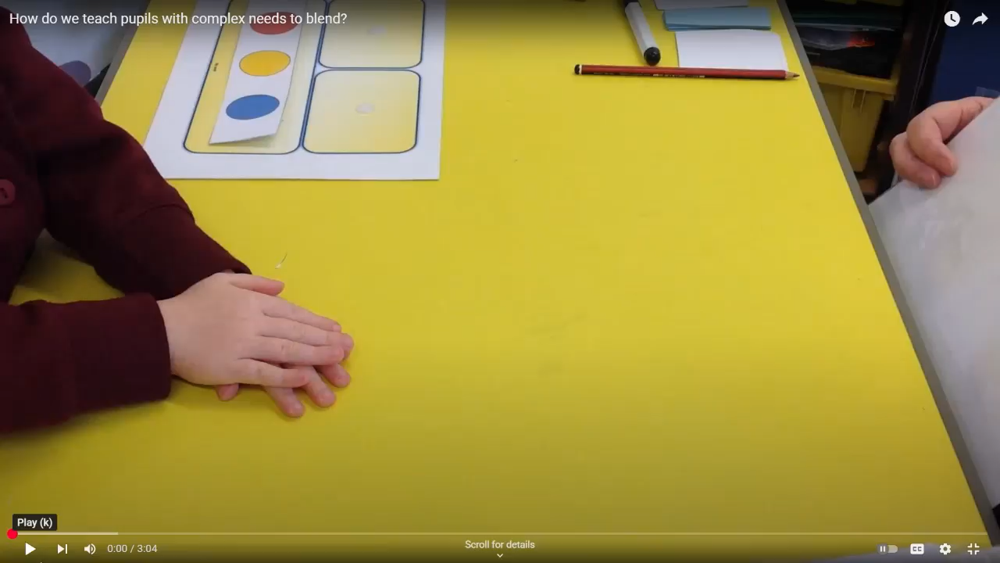
“A Place To Read” - video

Slide 15
Systematic, Explicit Instructional Routine Examples
Shared Reading
Alphabet & Phonological Awareness During Word Identification and Decoding
Predictable Chart Writing
Self-Selected Reading
Structured and Independent Writing

Slide 16
Creating Inclusive Learning Spaces
Visual Supports
Access to Communication
“Thinking voice” symbol
Access to VPM
Big Oops!
Wide range of AAC supports
Lanyard visuals
Staff training and support

Slide 17
Creating (More) Inclusive Learning Spaces
Books, Books, Books
Alternative Pencils
Alternative access
Increase durability
Modify text
Anything that provides access to all 26 letters of the alphabet
No pre-requisites!
Support the cognitive aspect of writing by reducing the motor demand

Slide 18
References
Erickson, K. A., & Koppenhaver, D. (2020). Comprehensive literacy for all: Teaching students with significant disabilities to read and write. Paul H. Brookes Publishing Co.
Erickson, K., Koppenhaver, D., & Musselwhite, C. (2020, June). Literacy Instruction for Students with Significant Disabilities. Literacy Instruction for Students with Significant Disabilities. https://literacyforallinstruction.ca/
Sullivan, A. (2023). Access to Phonics.

Slide 19

Questions?
Anna Hodnefield, MS, CCC/SLP, ahodnefield@isd116.org
Karley Sykora, MS, CCC/SLP, karley.sykora@isd181.org

