Slide 1

Going Further with Adolescent Literacy
Charting the Cs Conference 2025:
To Literacy and Beyond
Cooperation
Communication
Collaboration
April 29, 2025
Heather Prenovost, MS, CCC-SLP & Training & Implementation Supervisor with PRC-Saltillo
Christy Palmquist

Slide 2
Today's Learning Objectives:
Participants will identify strategies to increase word study skills for adolescent struggling readers.
Participants will list at least two tools and resources to help support literacy instruction for adolescent struggling readers.
Participants will describe the connections between verbal expression and written expression skills within the literacy framework.
Participants will identify at least one way they will implement these systematic instructional strategies into their literacy practice.

Slide 3

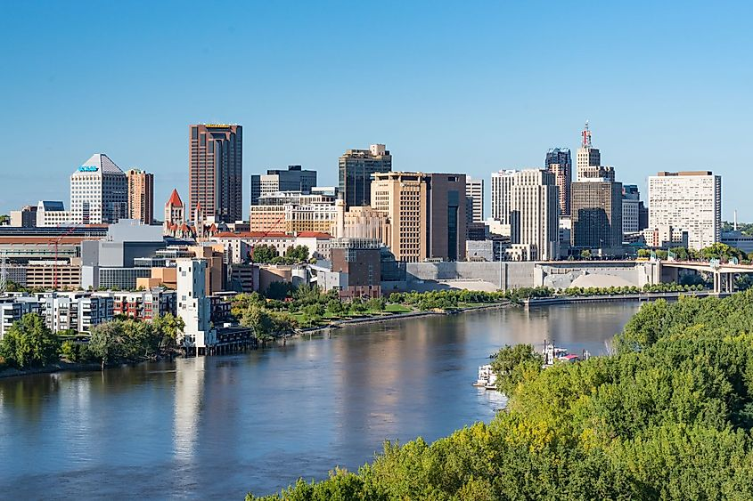

Our Story

Slide 4

The WHY:

Slide 5
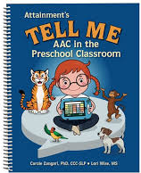
The WHY: Tell Me

Slide 6

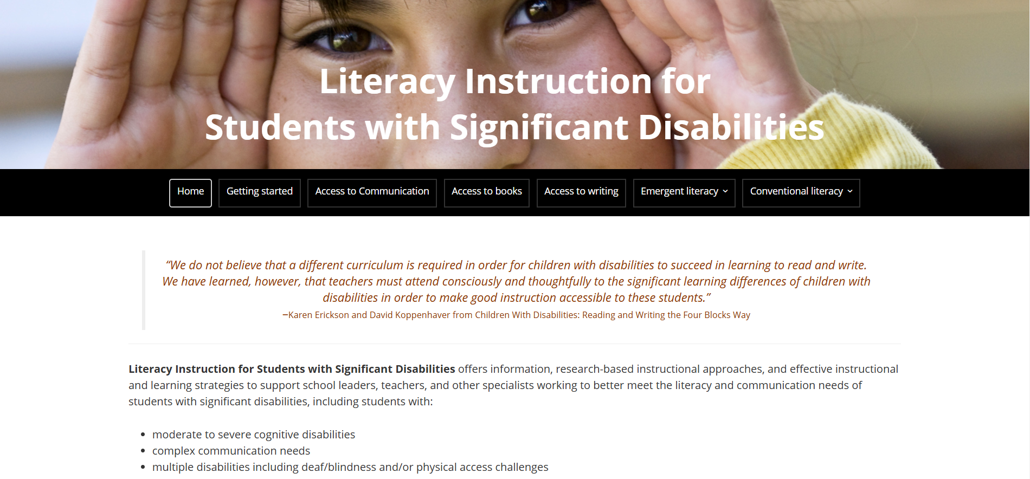
The WHY Continued:

Slide 7
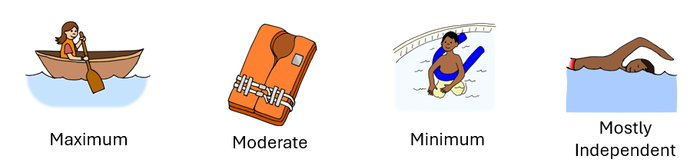
Reimagining How We Look at Support

Slide 8

Backing up a step

Slide 9
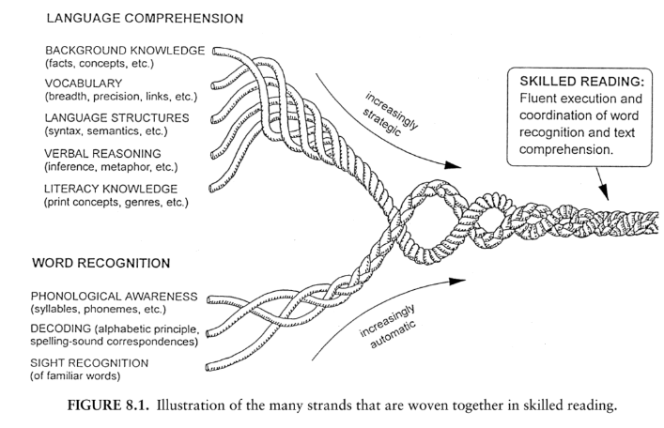
Language and Literacy: Reading Rope
Reading Rope
Scarborough, H. 2001 Connecting Early Language and Literacy to Later Reading (Dis)abilities: Evidence, Theory, and Practice, pg. 98

Slide 10
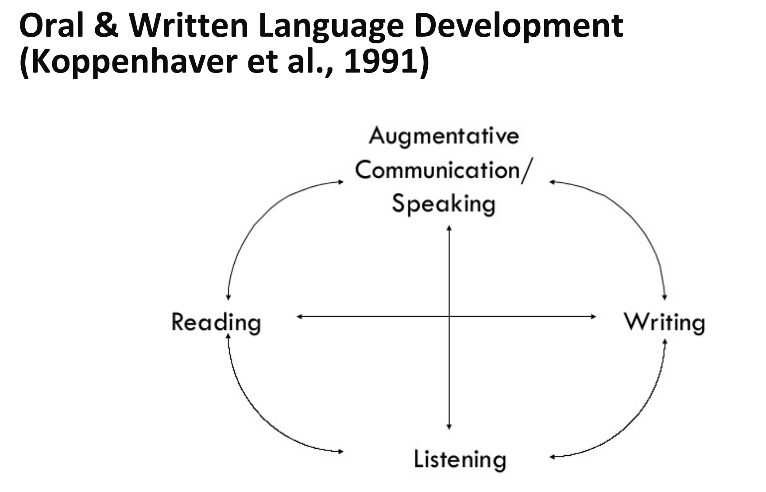
Connection between Speaking and Writing

Slide 11





Language and Literacy
5 Pillars of Reading
Phonemic Awareness
Phonics
Fluency
Vocabulary
Comprehension

Slide 12
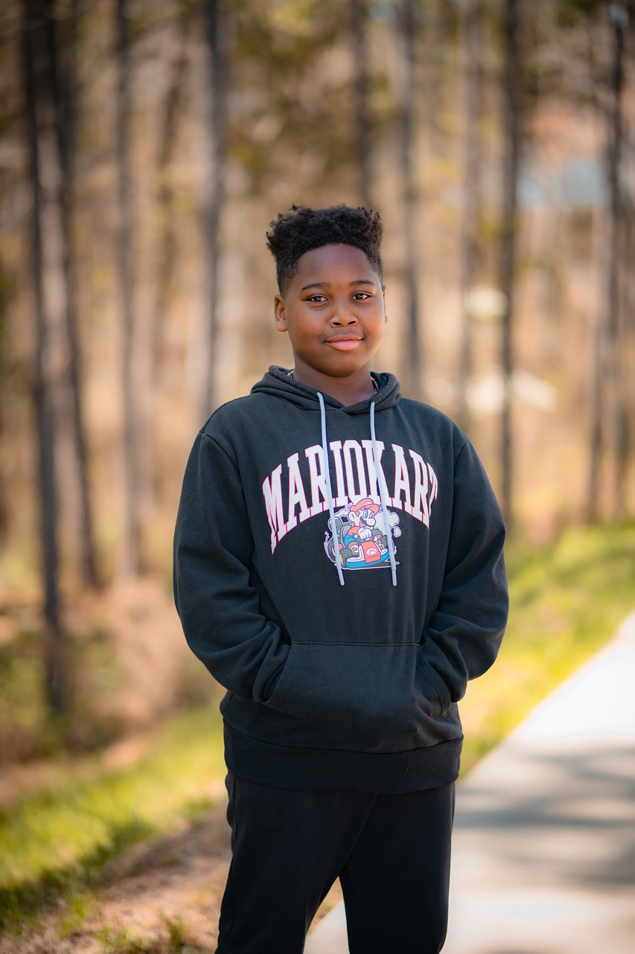
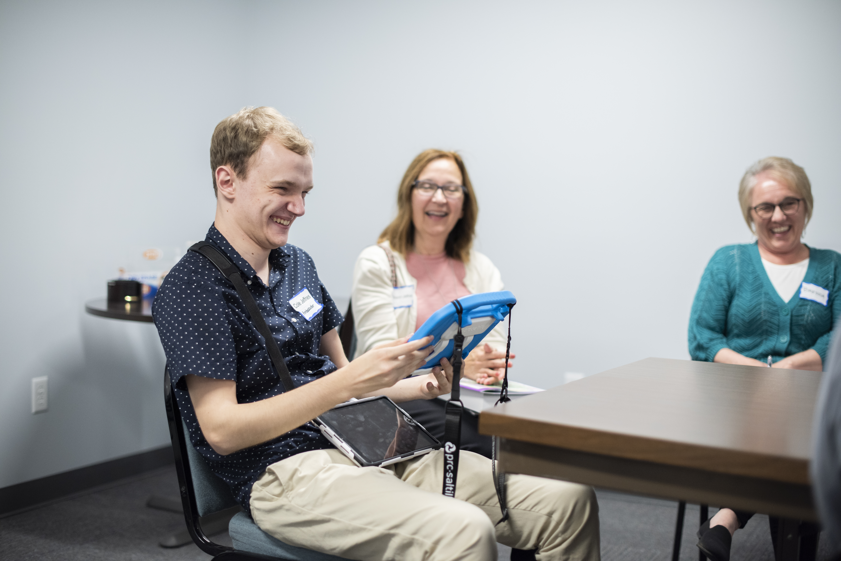

Language and Literacy: The importance of it all

Slide 13

Our core belief
No one is too anything to learn to read and write —not too intellectually, emotionally, neurologically, or physically challenged to learn to read and write; to become literate (Yoder, 2001).

Slide 14
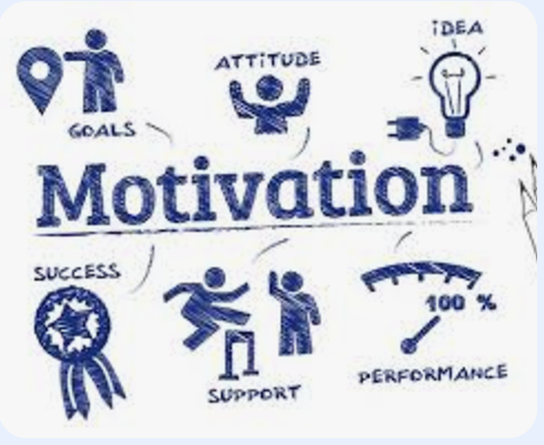
Motivation and Engagement

Slide 15
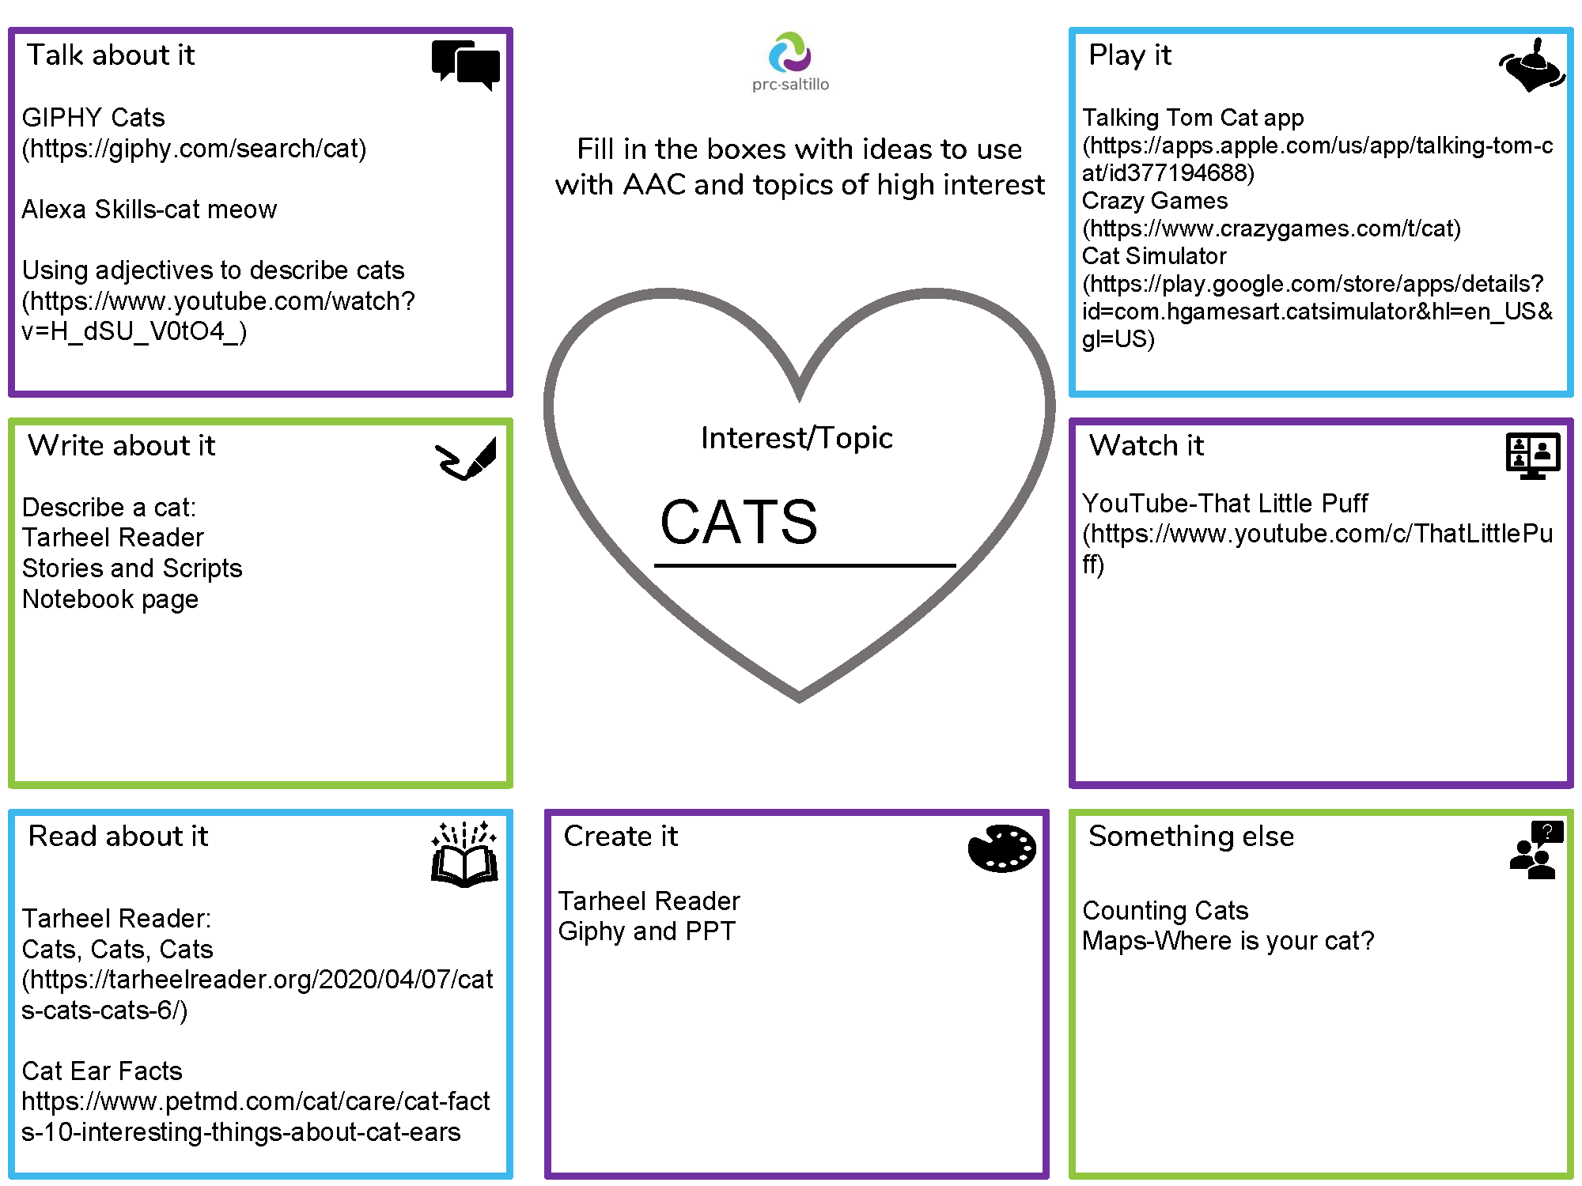
Motivation and Engagement: literacy intervention

Slide 16

Comprehensive Literacy Instruction

Slide 17
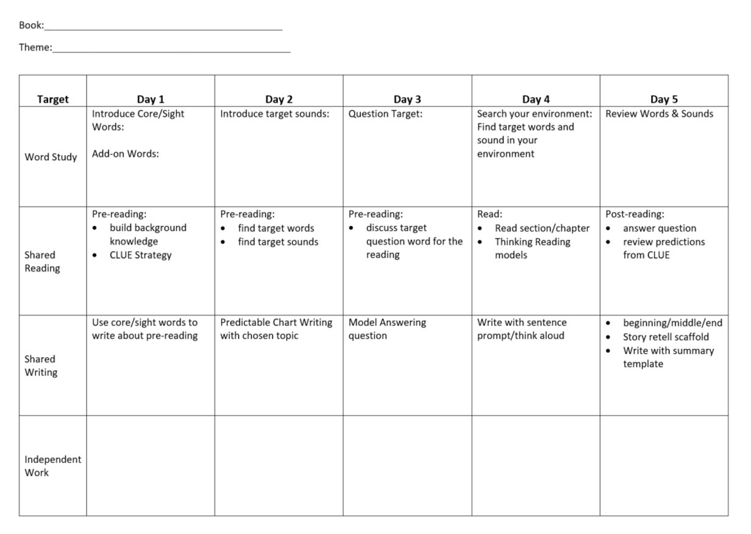
Framework

Slide 18

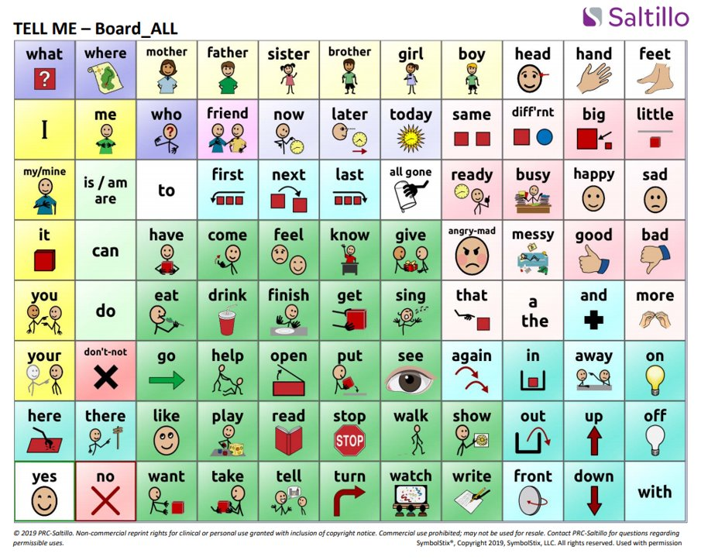
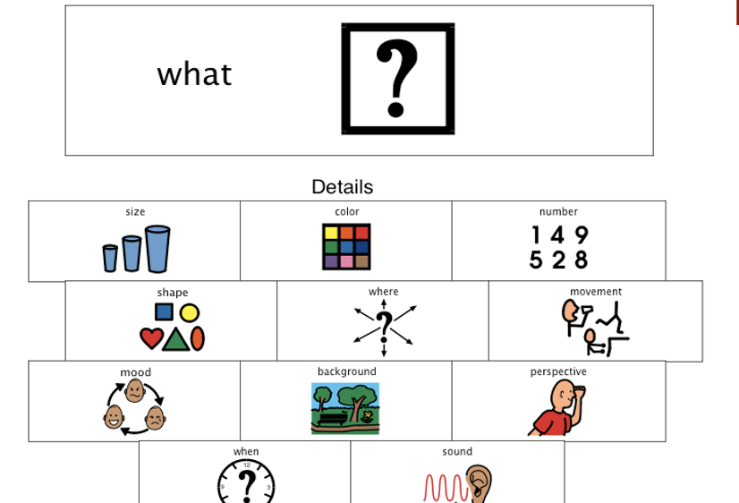
Literacy Instruction

Slide 19





Theme: Friendship and Challenges

Slide 20
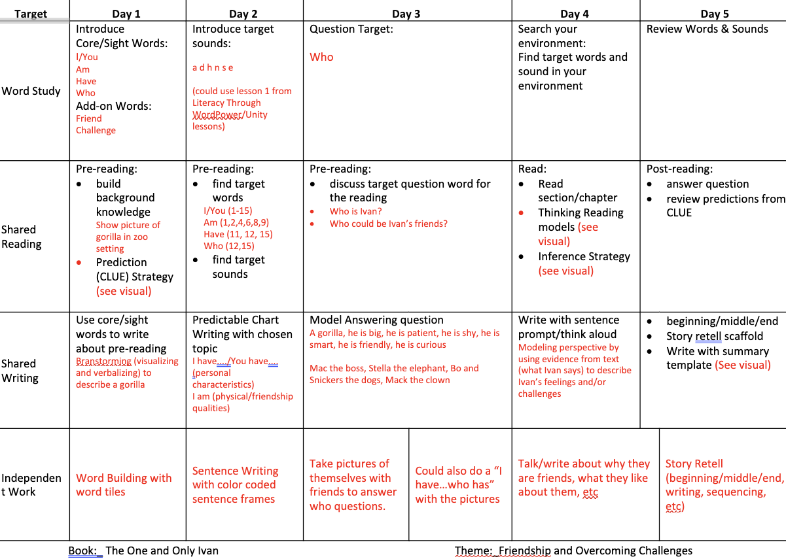
Sample Framework

Slide 21
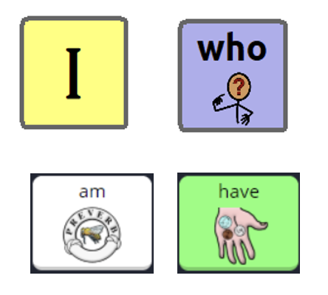
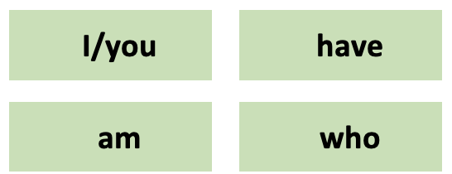
Word Study:

Slide 22
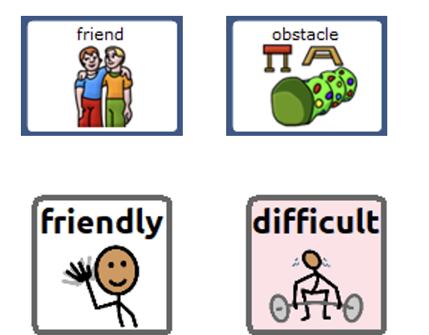
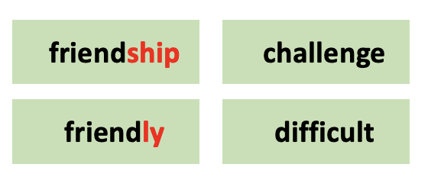
Word Study

Slide 23
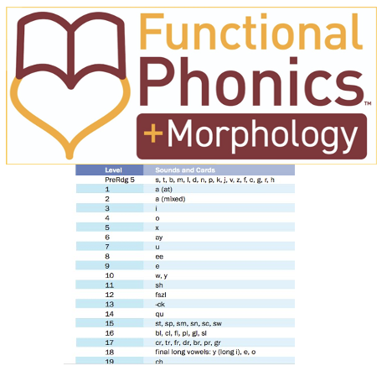
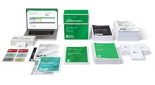
Word Study: Morphology

Slide 24
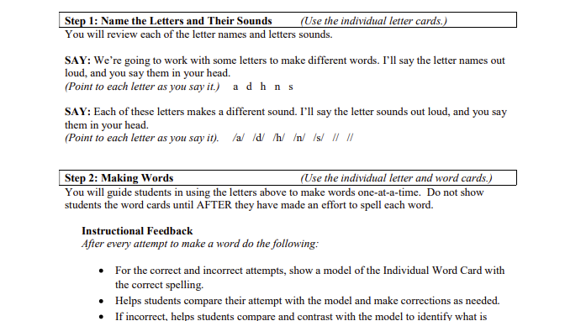
Word Study: Making Words with Letters

Slide 25

Word Study: Questions

Slide 26
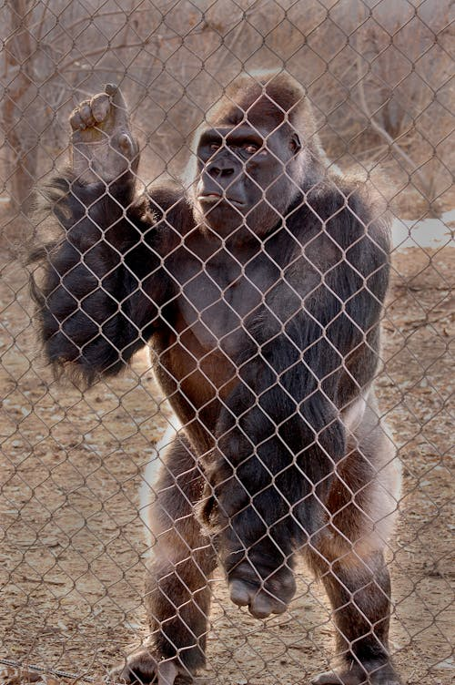
Shared Reading

Slide 27
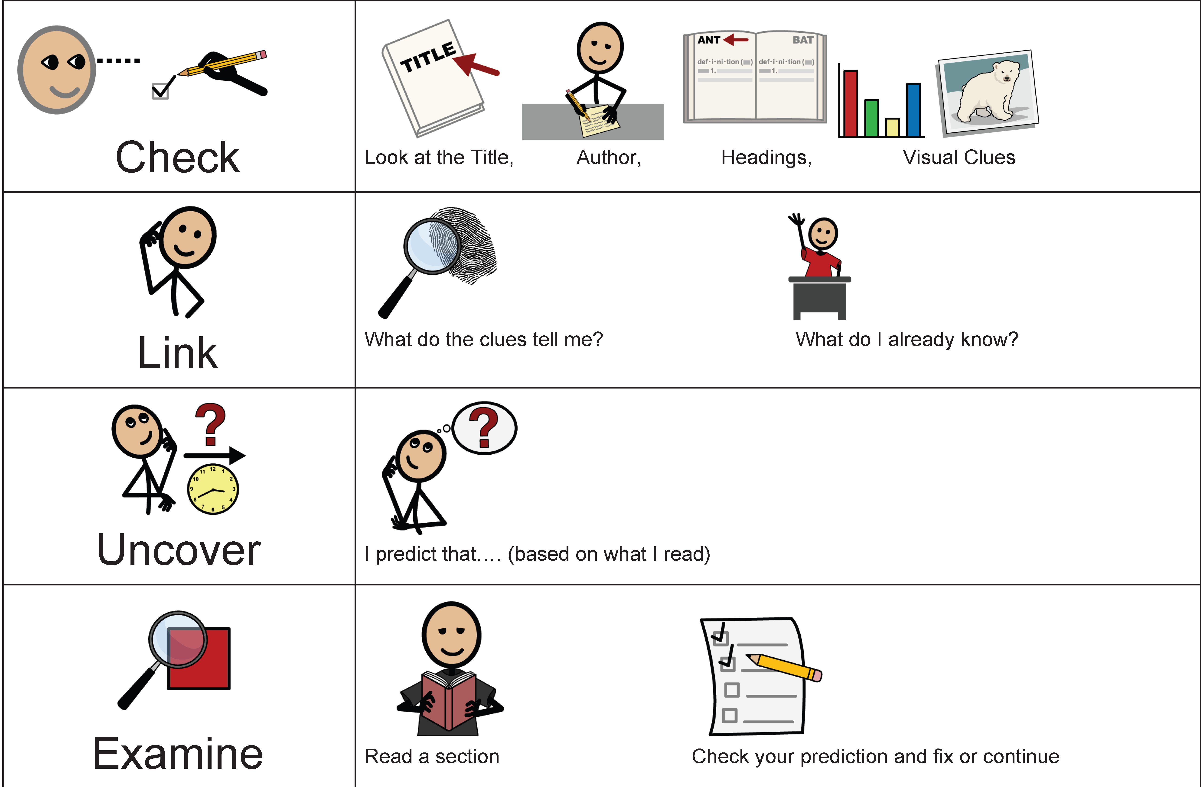
Comprehension Strategy: Prediction

Slide 28

Shared Reading: Finding sight words

Slide 29
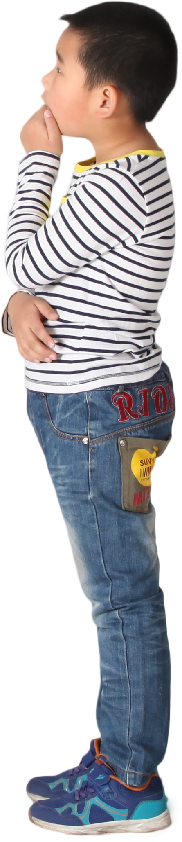
Shared Reading with Ivan
Who is Ivan? How would I describe him?
Who could be his friends?

Slide 30
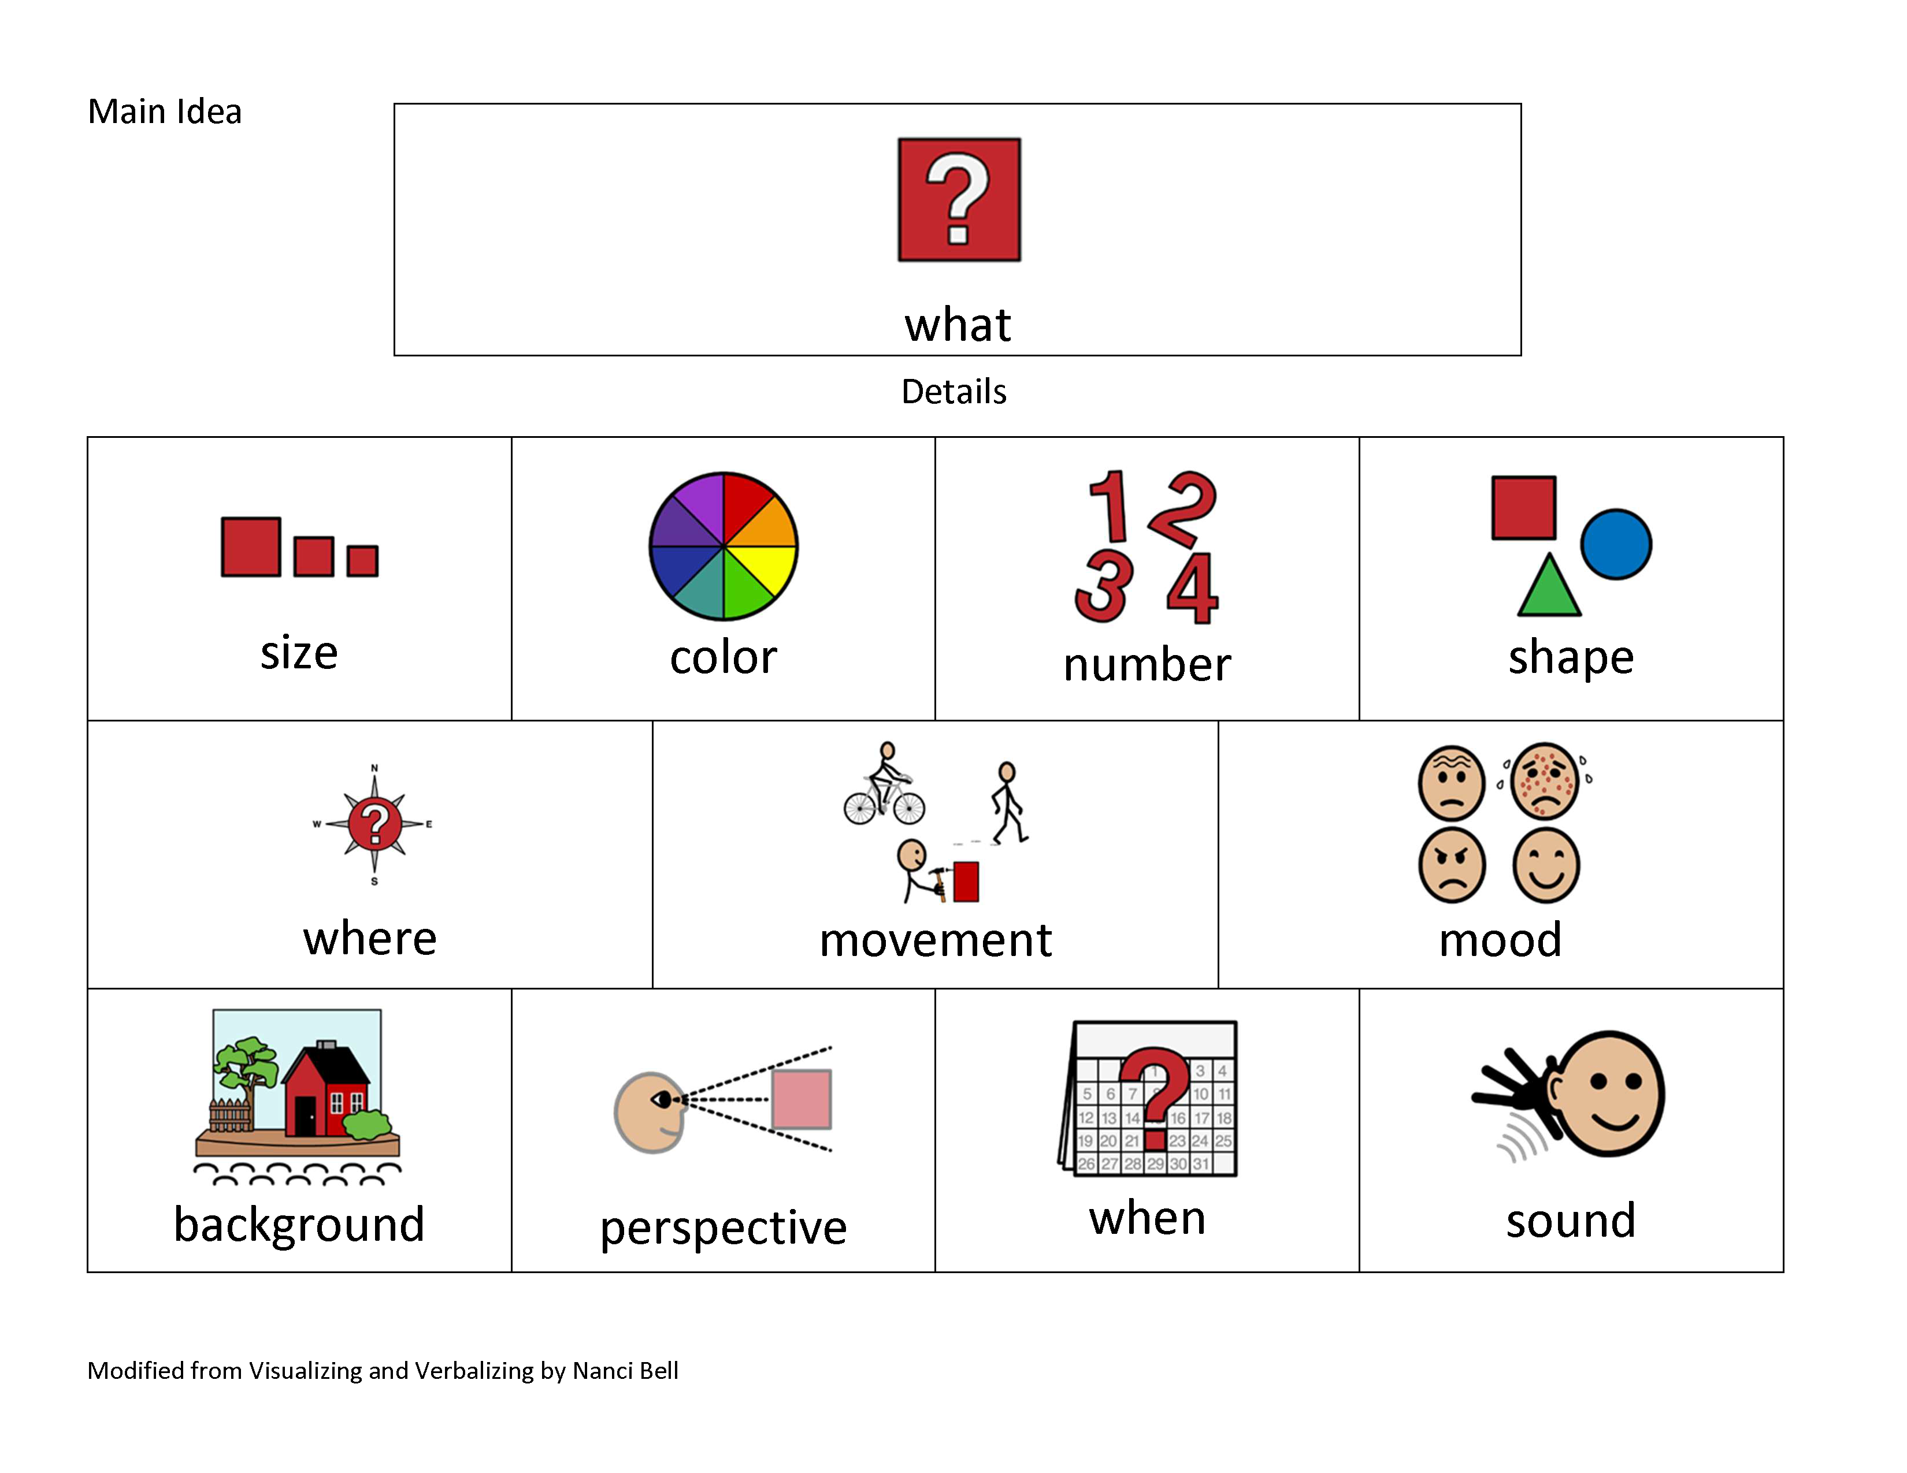
Shared Reading: Visualizing and Verbalizing

Slide 31
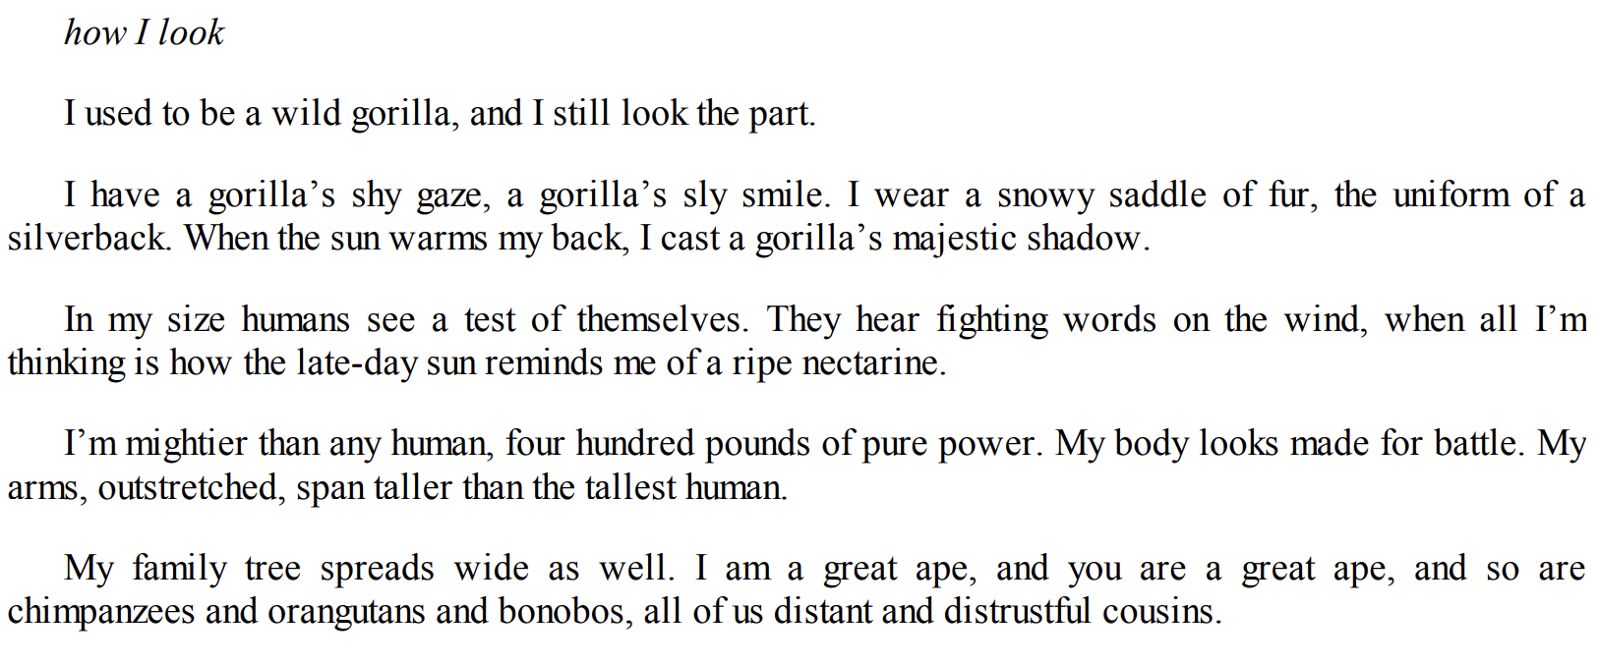
Shared Reading: Visualizing and Verbalizing cont

Slide 32
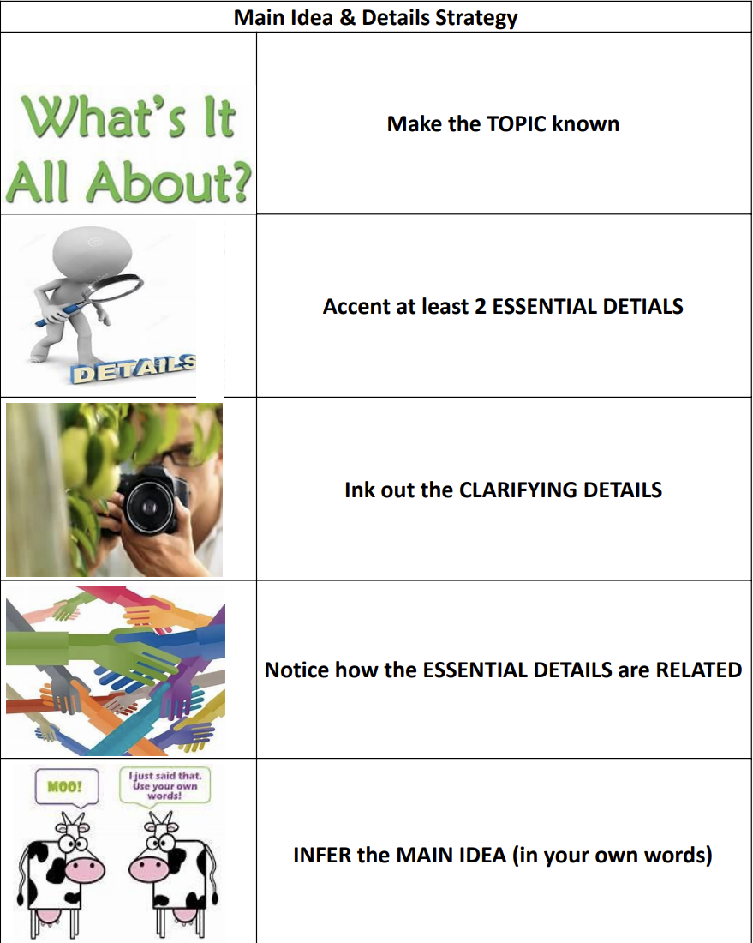
Strategy: Main Idea and Details

Slide 33
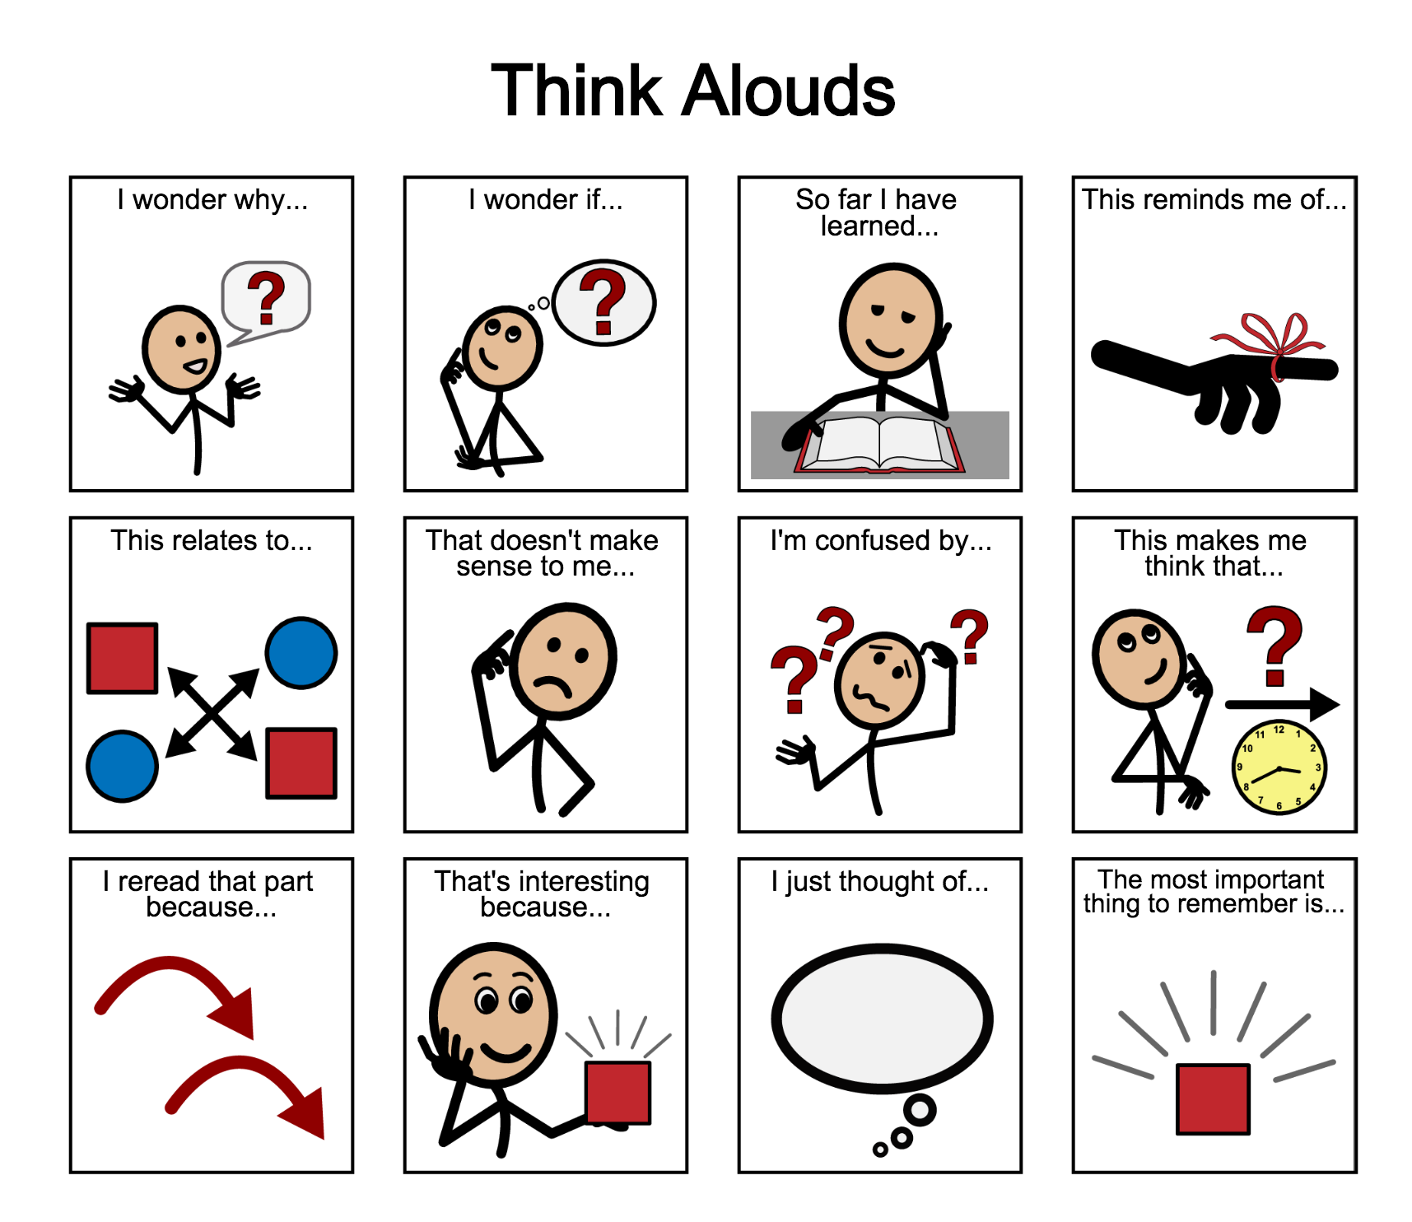
Shared Reading: Thinking Reading

Slide 34
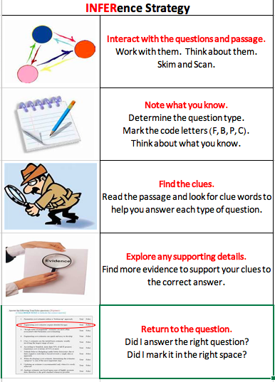
Shared Reading: Inference Strategy

Slide 35
Shared Writing: Visualizing and Verbalizing

Slide 36

Shared Writing: Personal
I have....
You have...
I am...

Slide 37
Shared Writing: About Others
Who is Ivan?
Who are Ivan's friends?

Slide 38
Shared Writing

Slide 39
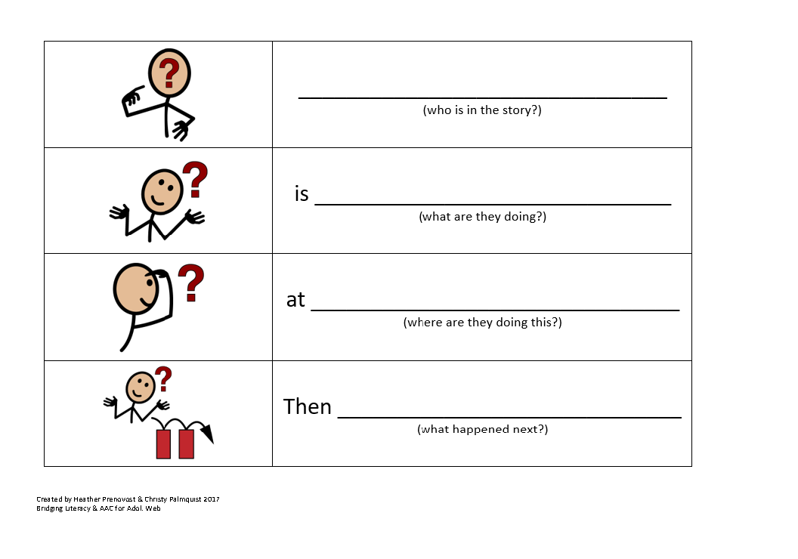
Shared Writing:

Slide 40
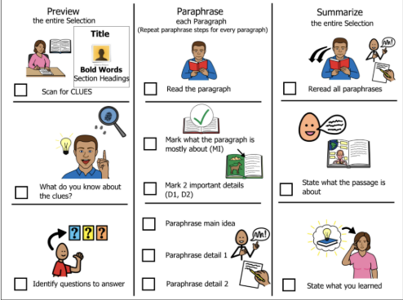
Comprehension Strategy: Summarization

Slide 41
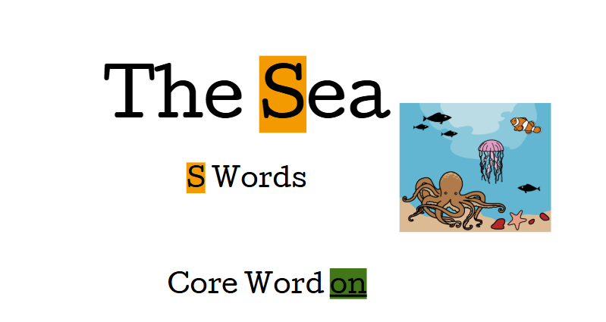
Independent Work: Word Study

Slide 42
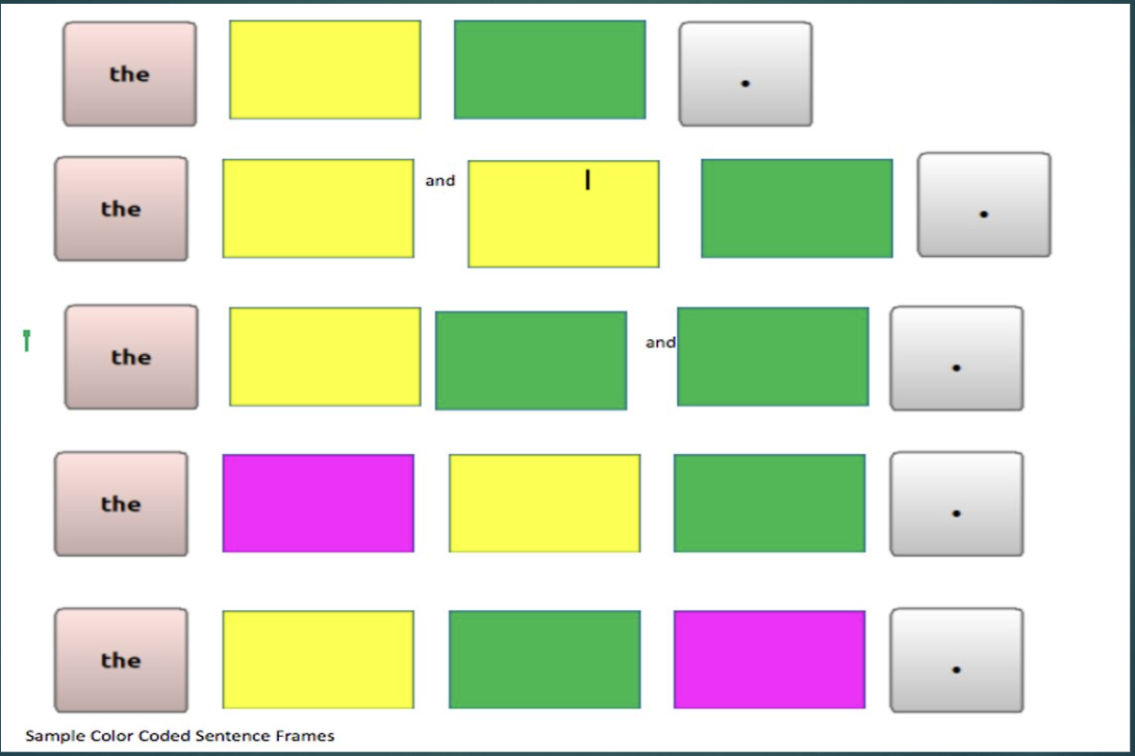
Independent Work: Coding

Slide 43
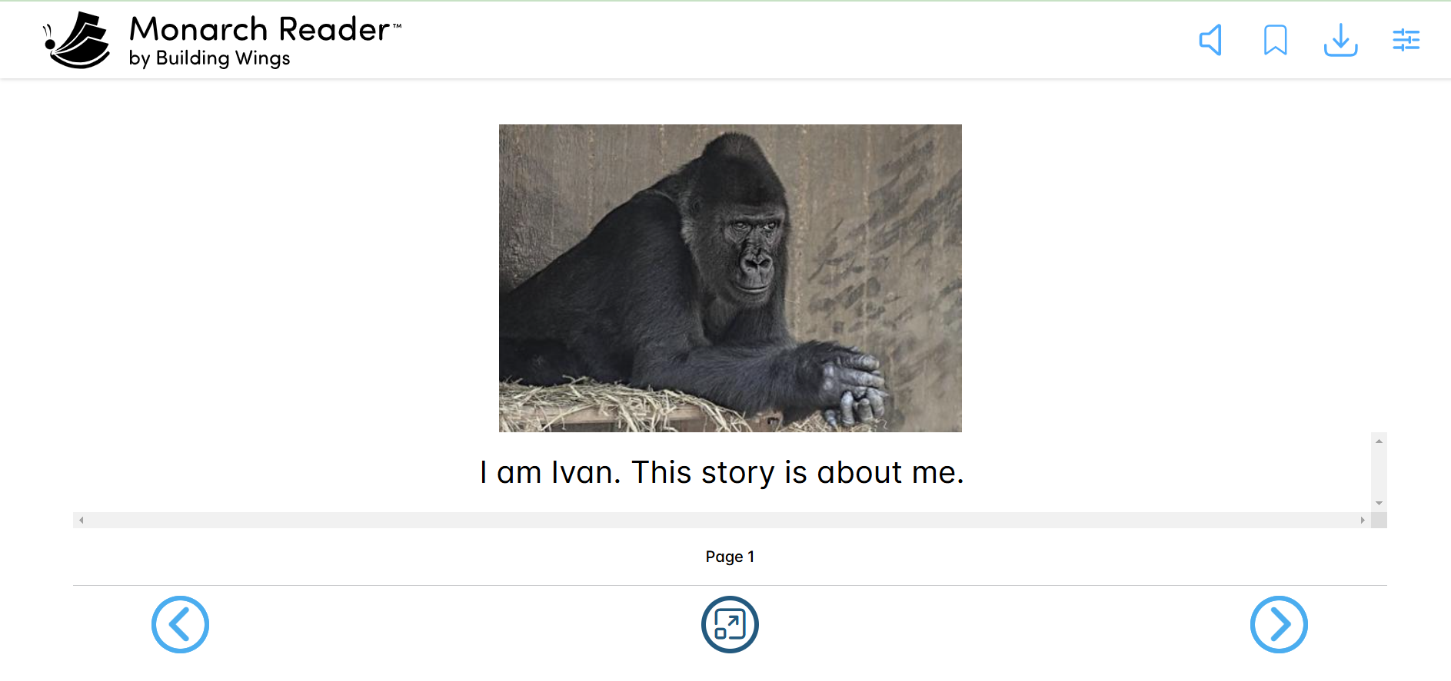
Independent Work: Monarch Reader

Slide 44
Independent Work: Magic School AI
How I Look
I used to be a wild gorilla, and I still look like one!
I have a shy gaze like a gorilla and a sly smile too. I wear soft, snowy fur, just like a silverback gorilla. When the sun shines on my back, I make a big, cool shadow.
People look at my size and think about themselves. They hear tough words in the wind, but all I think about is how the warm sun reminds me of a sweet nectarine.
I am very strong, weighing four hundred pounds! My body looks ready for action. When I reach out my arms, they stretch wider than the tallest person!

Slide 45
Independent Work: Magic School AI, cont.
How I Look, cont.
I am very strong, weighing four hundred pounds! My body looks ready for action. When I reach out my arms, they stretch wider than the tallest person!
My family is big too. I am a great ape, just like you! Chimpanzees, orangutans, and bonobos are also my distant cousins.
This might be surprising.
I find it hard to believe I am connected to a group of silly chimps. There is no good reason for their behavior!

Slide 46

Independent Work: Who Questions

Slide 47
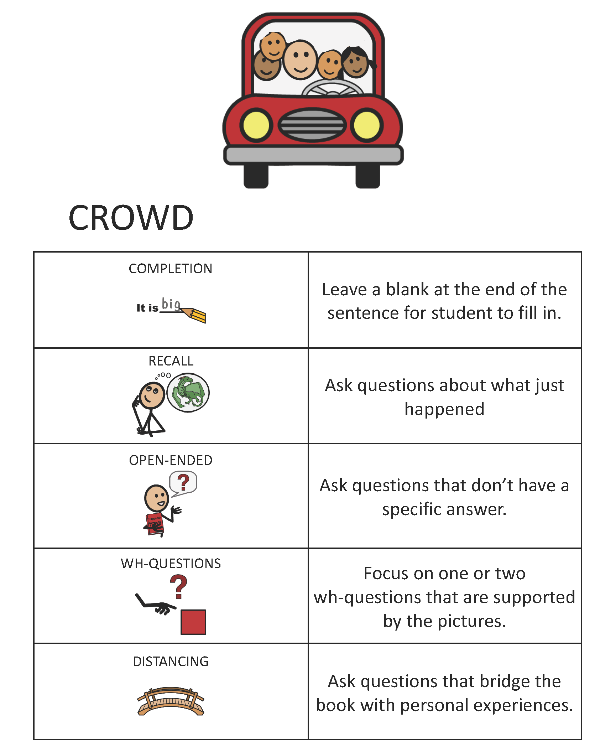
Independent Work: CROWD

Slide 48

Thank you!
Heather Prenovost, heather.prenovost@prc-saltillo.com
Christy Palmquist, christine.plamquist@spps.org

Slide 49
Charting the Cs Conference 2025
Statewide Professional Development to Support the Workforce and Low Incidence Disability Areas in the State of Minnesota.
This presentation is partially funded with a grant from the Minnesota Department of Education using federal funding, CFDA 84.027A, Special Education – Grants to States.

