Slide 1

Artificial Intelligence and Literacy
Efficiency for Staff, Success for Students
Charting the Cs Conference 2025:
To Literacy and Beyond
Cooperation
Communication
Collaboration
Presentation Date: April 2025
Presenter Name: Amanda Peters

Slide 2
Learning Objectives
I will be able to name three Artificial Intelligence(AI ) tools I can use to save myself time customizing materials to meet students’ individual needs.
I will be able to evaluate tools that will benefit my students and myself.
I will be able to list 3 attributes of an effective AI prompt.

Slide 3
Agenda
Learn AI tools that will save you time and help your students be more independent.
We will explore the free versions of the tools…
    Curipod
    MagicSchool ai
    Brisk
    Goblin Tools
    Seeing AI and Google Lookout

Slide 4
Links
AI and Literacy Resource Sheet
Blog post with updated AI Toolkit for the Special Education Service Provider

Slide 5
AI as an Electric Bike not a Robot Vacuum
“We envision a technology-enhanced future more like an electric bike and less like robot vacuums. On an electric bike, the human is fully aware and fully in control, but their burden is less and their effort is multiplied by a complementary technological enhancement.”
-U.S. Department of Education, Office of Educational Technology, Artificial Intelligence and Future of Teaching and Learning: Insights and Recommendations, Washington, DC, 2023.
This report is available at https://tech.ed.gov/ai-future-of-teaching-and-learning/

Slide 6
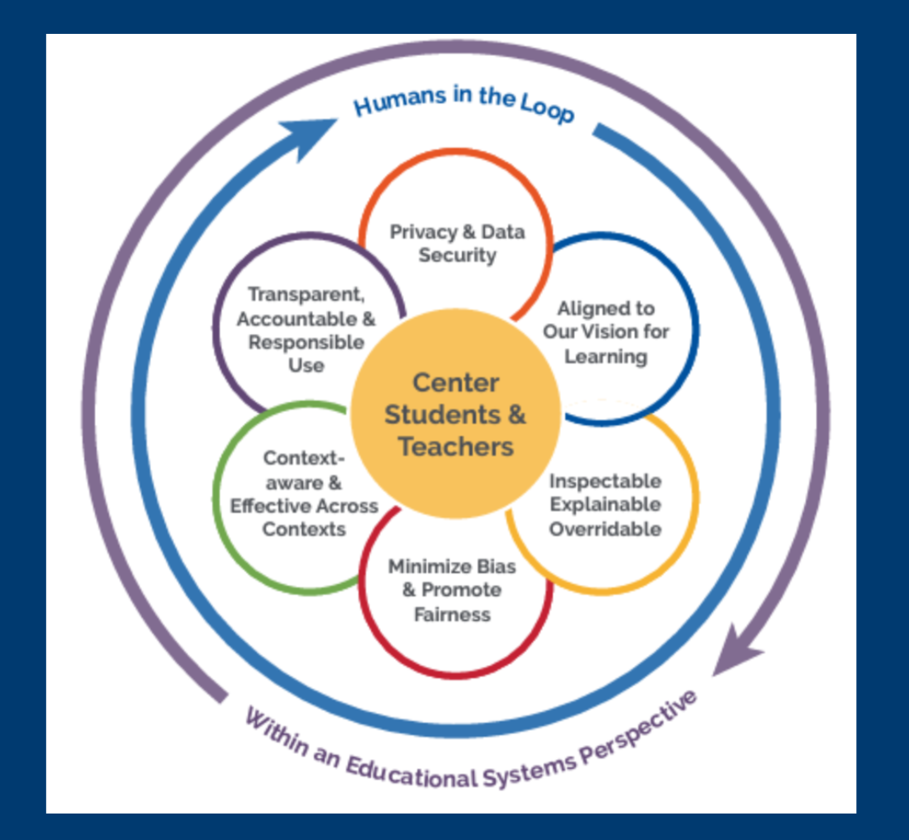
Humans in Control of AI

Slide 7
AI Prompting 101
Prompting AI is different than conducting a Google search
Effective searches are short, concise and cast a wide net
Effective prompts describe clearly and specifically what you want the LLM to produce

Slide 8
AI Prompting 102
Define the role you want the AI to assume -Begin your prompt with “You are a master occupational therapist”
Define the task you want the AI to complete - “Create a choice board that helps students work on their pincher grasp.”
Add important details to make sure that you get the results you want -“The choice board should allow for a wide variety of fine motor activities. Materials available include crayons, markers, playdough, close pins, and string.”
Remember that you are having a conversation and can ask for revisions to your results

Slide 9

Thank you!
Amanda Peters
amanda.peters@isd917.org

Slide 10
Charting the Cs Conference 2025
Statewide Professional Development to Support the Workforce and Low Incidence Disability Areas in the State of Minnesota.
This presentation is partially funded with a grant from the Minnesota Department of Education using federal funding, CFDA 84.027A, Special Education – Grants to States.

