Slide 1

Linking Literacy to the
MN Transition Framework
Charting the Cs Conference 2025:
To Literacy and Beyond
Cooperation
Communication
Collaboration
Presentation Date: April 2025
Presenter Name: Dr. Kayleen Taffe, Reading Specialist
Presenter Name: Amanda Peters, Instructional Technology Coach

Slide 2
Agenda
  Literacy screening protocols for students transition aged
  Intervention classes and progress monitoring at the transition level
  Tying literacy to the Minnesota Transition Framework
  Creating a scope and sequence for your transition curriculum based on the MN Transition Framework
  Assistive Technology and Artificial Intelligence Tools to assist with literacy activities in the transition curriculum

Slide 3
Screening Protocols
  Fastbridge is our screening tool
  Most students take the aReading
    K-2 take the earlyReading
    4-12+ take early reading under these “no” conditions
    Knowing most of the letters most of the time
    Engaging actively during shared reading
    Having a means of communication and interaction
    Understanding that writing involves letters and words

Slide 4
Intervention Classes
  Students are encouraged to enroll in reading intervention class if
    they are below expectations in aReading and their fluency scores is low
    they take the earlyReading
  Reading intervention is determined by the diagnostic assessment: curricula being used
    Readtopia/Go
    Sonday
    Rewards

Slide 5
Progress Monitoring
Students are using Fastbridge for weekly progress monitoring. Depending on the diagnostic information most progress monitoring in on fluency.

Slide 6
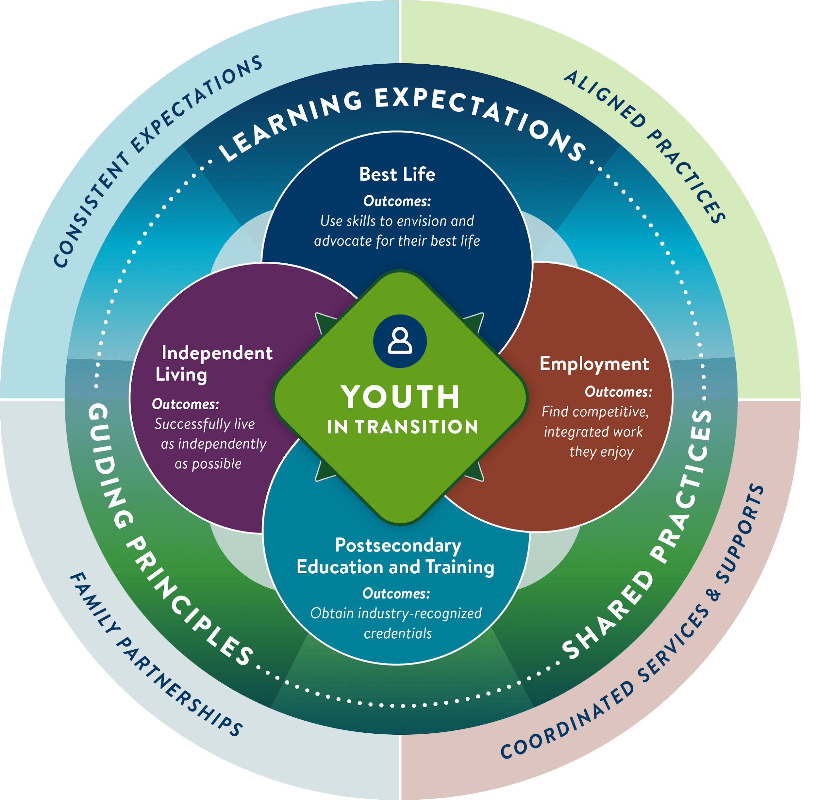
MN Transition Framework
Minnesota’s transition framework defines high-quality transition planning and programming for youth with disabilities and those who support them.

Slide 7
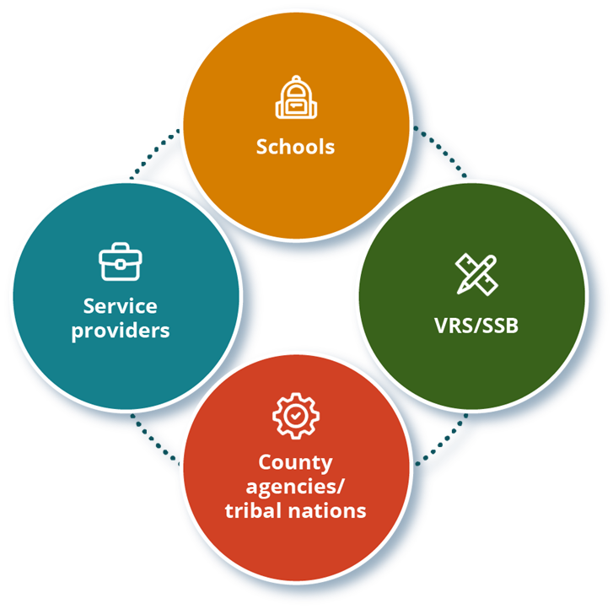
The Framework was created through collaboration of:
Minnesota Department of Human Services
Minnesota Department of Education
Minnesota Department of Employment and Economic Development

Slide 8
Minnesota’s Transition Framework features three key elements:
Guiding principles
Shared practices
Learning expectations

Slide 9
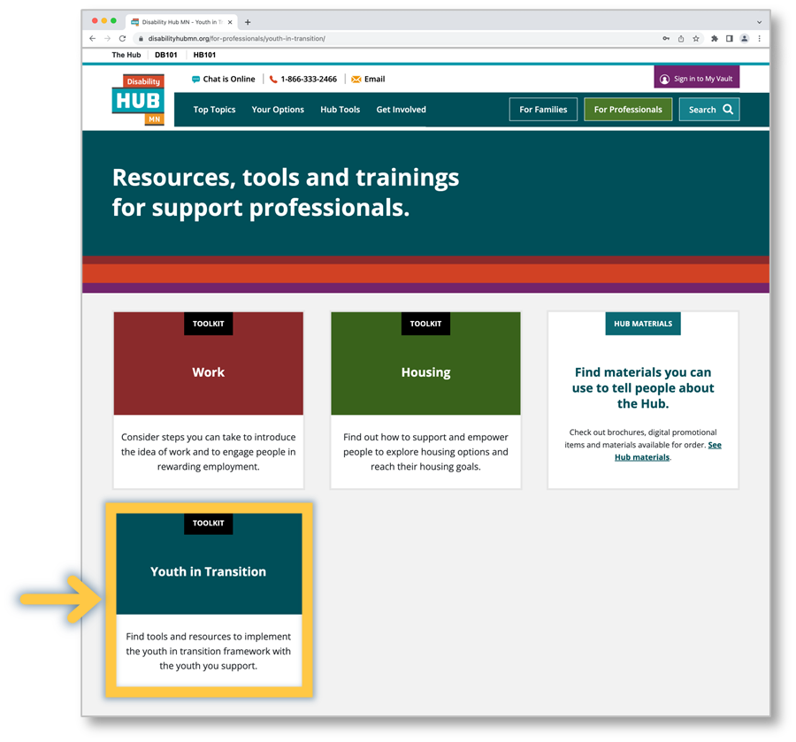
Youth in Transition Toolkit
The Youth in Transition toolkit (disabilityhubmn.org) helps professionals implement Minnesota’s Transition Framework.

Slide 10
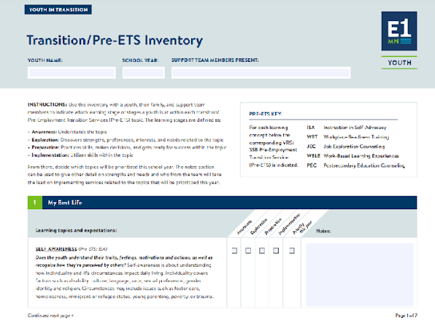
Identify Pre-Employment Transition Services (Pre-ETS) Strengths and Needs
Use the Transition (Pre-ETS) Inventory with the youth’s team to:
Identify and prioritize the youth’s strengths and needs
Identify youth’s learning stage(s) within each of the transition/Pre-ETS topics

Slide 11


Slides 5-9 courtesy of:
Heather Kosec, Youth Services Manager, heather.kosec@state.mn.us
Alyssa Klein, Youth Services Coordinator, alyssa.klein@state.mn.us

Slide 12
Modified the Transition Pre-ETS Survey
Made it a Google Sheet so people can collaborate
Added a literacy question

Slide 13
Converted the Transition Pre-ETS Survey into a Scope and Sequence for Transition Curriculum
Now when a need is identified on the Pre- ETS Survey, staff can find the curriculum to meet that need
We assigned grade levels for when curriculum would be covered
Transition Curriculum/Activities added came from
  MCIS
  MN Disability Hub (Youth in Transition Toolkit)
  Project Discovery
  Transition Curriculum
  Eventually we want to add lessons our staff have created themselves

Slide 14
Help Yourself to a Copy of the Inventory and Scope and Sequence
917 Version of the Student Pre-ETS Survey in Google Sheet format
Transition Scope and Sequence Template based on the MN Transition Framework

Slide 15
Assistive Technology and Artificial Intelligence Tools to Assist with Literacy Tasks in the Transition Curriculum
CPen Reader Pens
Snap&Read iPad app - when students need forms read and they need to type on them
Seeing AI iPad app when students just need to hear text (or currency read) - Google Lookout app is an Android option for students using Android phones
Bookshare, including for students taking CTE classes
Text Leveler tools in Brisk, MagicSchool AI, IEP CoPilot
Text translator tools in Brisk and MagicSchool AI
Text generator tools in Brisk and MagicSchool AI - for text at a specific reading level about a specific transition topic

Slide 16
Thank you!
Dr. Kayleen Taffe
kayleen.taffe@isd917.org
Amanda Peters
amanda.peters@isd917.org

