Slide 1

Boosting Engagement: The Power of Co-Participation and Differential Attention
Charting the Cs Conference 2025:
To Literacy and Beyond
Cooperation Communication Collaboration
April 29, 2025
Erin Nelson, BCBA LBA

Slide 2
Agenda
Introductions
Co-Participation
The “what” and “why” of co-participation
When to use Co-Participation
Model, Practice, (and feedback!)
Elements of Social Attention
What are they?
How to use them for good

Slide 3

Introductions
Erin Nelson MA, BCBA LBA
School-Based+ Behavior Analysis
20-ish years in education
early childhood-college level
Support staff, para, substitute teacher, classroom teacher
Passion= increasing confidence and success through understanding

Slide 4
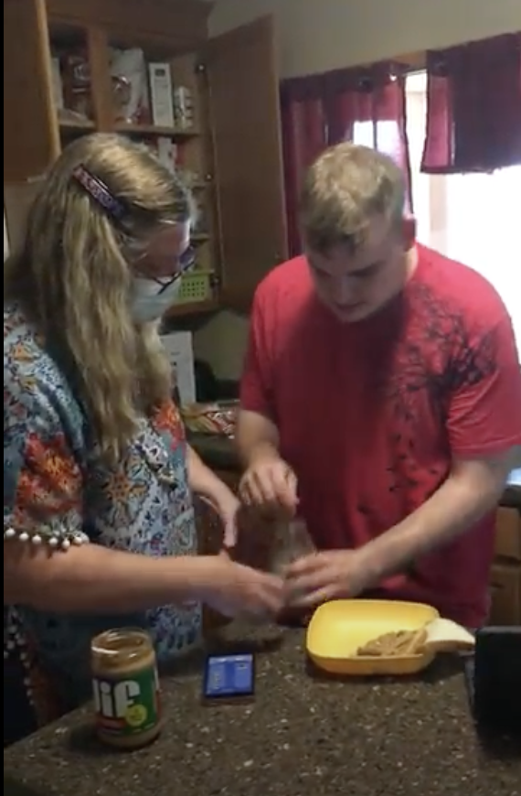
What is Co-Participation?
Process of modeling a desired behavior, task, activity to engage our learner in what we’d like them to do
“Becoming the student”
staff/adult does what the student should be doing
Takes the place of verbal directives, redirection, repeating instructions
(Concept formulated and put forth by Wendy Selnes/Brih Design)

Slide 5
Who can Co-Participation Help?
Students who…
Engage in a lot of refusal behaviors
Have difficulty focusing
Lack confidence
Have difficulty initiating tasks
Struggle with academic content
Enjoy attention/want or seek out attention

Slide 6
Why Co-Participation?
People (students) will more often follow what you DO more than what you SAY
You become a visual support
You also have the capability and potential to provide social attention (more on this later)
Increase Engagement and Follow Through
Para call-out story*

Slide 7
What does Co-Participation Look Like?
In the classroom
Raising hand, looking at the speaker, attending to and participating in classroom activities
having a duplicate copy of materials and working on them in close proximity to the student(s) needing support
talking through
“Oh, I’ve done something like this before. I think I remember. I have to…”
Looking and acting like a “model” student

Slide 8
2- What does Co-Participation Look Like?
In Re-Regulation
Staff participating in/modeling a coping/calming strategy
taking deep breaths
squishing putty in their hands, coloring, holding a stuffie, using a fidget, etc
*throwing a safe item in a safe way
*punching a safe item in a safe way (punching bag)
Very few to NO words
Not asking questions
Not giving directions/requests

Slide 9
Co-Participation
What’s involved
What’s not involved
Staff doing/participating in what they want the student(s) to do
class activity
worksheet/independent work
regulation/calming strategies
jobs, tasks, chores, etc
Talking aloud to self/others about the task
Asking a lot of questions
Verbal directions, re-directions
Saying things like, “no,” “don’t”, “you need to…” or “that’s not how…”

Slide 10

Is Co-Participation Cheating??
Intent is to increase engagement
Learning is occurring, even when student is not directly engaged
Student “L” in 2nd grade
Grade on what is known to be independent
mark/specify items done on their own
alternative methods of assessment

Slide 11

Let’s Practice
I do
We do
You do
Let’s talk about it

Slide 12

When Could You Incorporate Co-Participation?
Time/activity in your day
Specific student
Upcoming student project or task
What materials would you need?
Who would need to help/know about it?

Slide 13

Elements of Social Attention
Talking TO or ABOUT a person
“What are you doing?”
“Benny has had a tough morning and made some not so great choices.”
Eye Contact
looking directly at someone
looking at a task, speaker, ground
Physical Orientation, Proximity and Body Language
Stance- face to face, side to side
gestures, facial expressions
touching, chasing, holding

Slide 14

Dialing in our Social Attention
We want to give MORE attention when students are doing something desired
More positive verbalizations
More eye contact
More positive physical interactions (if student desires)

Slide 15
Co-Participation and Attention
Focus our attention on the desired outcome vs the undesired behavior
Can dial up or down how much social attention we provide based on their engagement/desired actions
Our attention is so valuable!
Words are the currency of your attention
What do you want to PAY for?
Pay attention and purchase to desired behaviors
Pay attention and purchase undesired behaviors

Slide 16

Questions, Comments, other discussion?

Slide 17


Thank you!
Erin Nelson
erin.nelson@contigolearning.com

Slide 18
Charting the Cs Conference 2025
Statewide Professional Development to Support the Workforce and Low Incidence Disability Areas in the State of Minnesota.
This presentation is partially funded with a grant from the Minnesota Department of Education using federal funding, CFDA 84.027A, Special Education – Grants to States.

