Slide 1

Mastering the English Language Arts Standards: Scaffolding for Success for All Learners
Charting the Cs Conference 2025:
To Literacy and Beyond
Cooperation
Communication
Collaboration
April 30, 2025
Stacie Stensrud, Lauren Walker, Kelsey Black

Slide 2
Topics for Today
Legal Foundations and the Standards
Implementation Connections to the Standards
Reading Alt MCA Sample Passage and Items
Unpacking a Standard Example
Unpacking Standard Group Activity
Unpacking a Benchmark Activity
New Accommodations for Reading MCA IV in 2026
Resources

Slide 3
Legal Foundations and the Standards
FAPE
IDEIA, IDEA, ESEA, NCLB
AA-AAAS
Depth: not defined in federal lang.
Breadth: scope, range
Complexity: level of cognitive difficulty

Slide 4
Implementation Definitions
Accommodations: the HOW​
Modifications: the WHAT​
Depth, Breadth, Complexity: considers both the WHAT and the HOW; use as a framework to design instruction​

Slide 5
Implementation: Making Connections
Teams should consider appropriate depth, breadth, and complexity when planning:​
  Individual lessons​
  Whole units​
  IEP accommodations, modifications, goals, and objectives​
  District teams can support their teachers and case managers by including these considerations in curriculum selection​
Collaboration tip! Ensure all teachers and service providers understand the WHY behind considering depth, breadth, and complexity so they buy in to the planning process and provide appropriate supports. ​

Slide 6
Implementation: Accessibility Frameworks
Differentiation
Learning Progressions
Task Analysis
Universal
Design for Learning
Assistive Technology
Person
Centered Practices

Slide 7
Implementation: Continuing Connections
Train
Review
Model
Collaborate

Slide 8
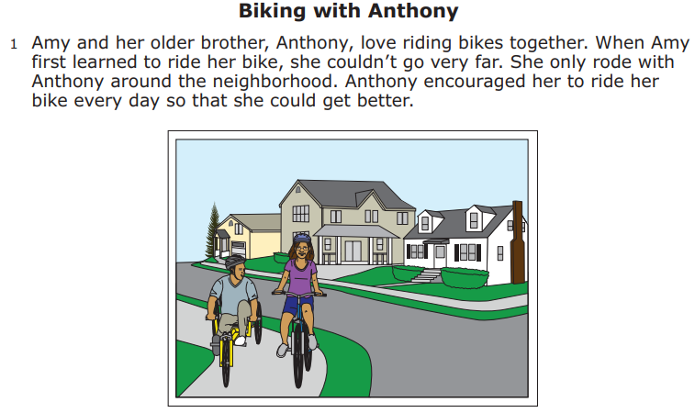
Grade 10 Sample Reading Passage 1

Slide 9
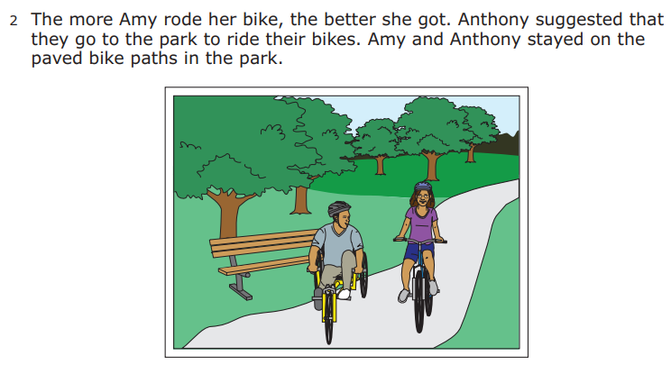
Grade 10 Sample Reading Passage 2

Slide 10
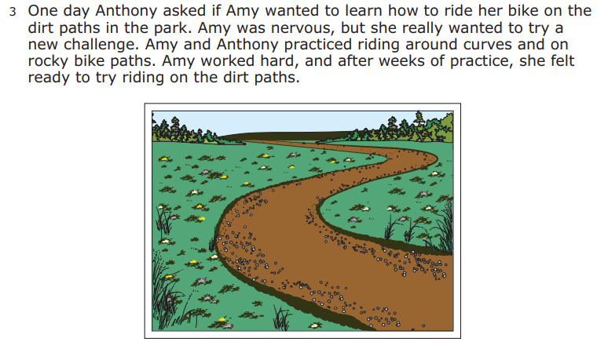
Grade 10 Sample Reading Passage 3

Slide 11
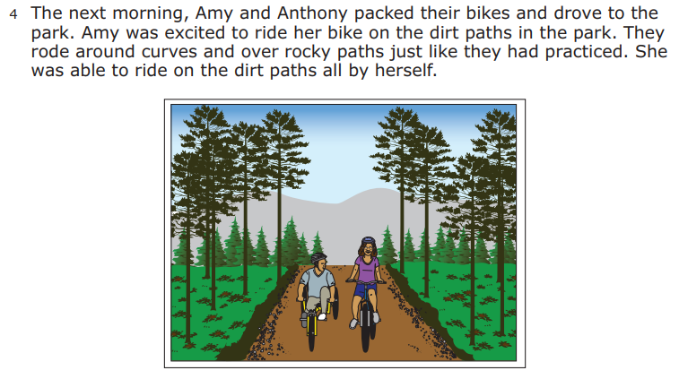
Grade 10 Sample Reading Passage 4

Slide 12
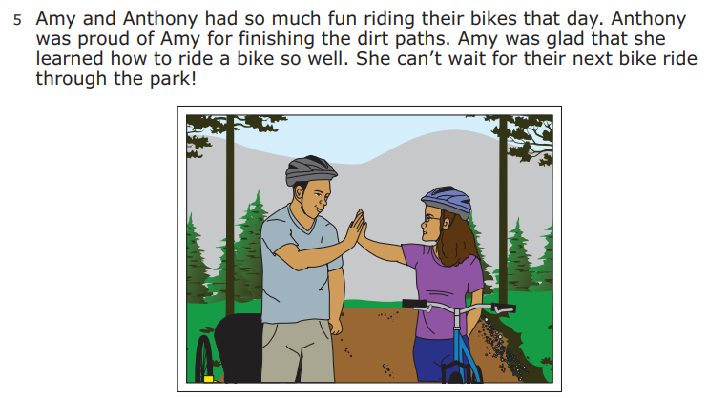
Grade 10 Sample Reading Passage 5

Slide 13
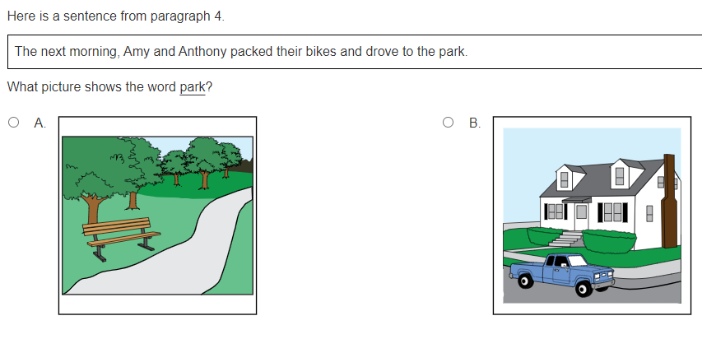
Access Point A Item

Slide 14
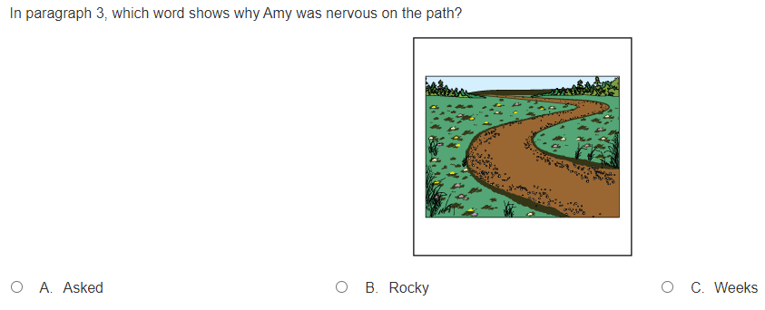
Access Point B Item

Slide 15
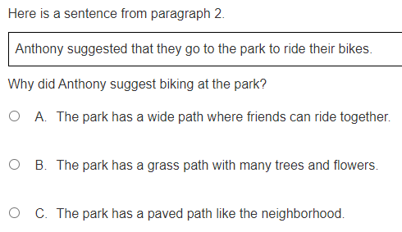
Access Point C Item

Slide 16
Unpacking A Standard Grade 10 Example
Standard R8 | General Benchmark 10.1.8.1 | Extended Benchmark 10.1.8.1
Examine the impact of vocabulary, including words and phrases, on content, style and meaning of complex literary and informational texts. | Evaluate the impact of vocabulary, including key words or phrases with multiple meanings, on content, style and meaning of literary text. | Explain the impact of vocabulary on keywords, content, and meaning of literary text.

Slide 17
Access Point Descriptions Grade 10 Example
Extended Benchmark: Explain the impact of vocabulary on keywords, content, and meaning of literary text.
Access Point A: The student will match a word or phrase with multiple meanings from the text to a picture.
Access Point B: The student will identify a word that would have the greatest impact on the text
Access Point C: The student will explain the impact of choice of word/phrases on content, style, or meaning of the text.

Slide 18
Extended Benchmark Details
Benchmark Description
Extended Benchmark Description
Specific knowledge or skill that a student must master to complete part of an academic standard in this grade level
Written based upon the benchmark to be reduced in depth, breadth and complexity

Slide 19
Access Point Details
Access Point Descriptions
Access Point A: Describes skills with the least complexity
Access Point B: Describes skills with moderate complexity
Access Point C: Describes skills with the most complexity

Slide 20
Writing Extended Benchmarks (EBM)
Look at the main skills and core knowledge in the general benchmark
Decide what can be reduced in the general benchmark to reduce the depth, breadth, and complexity
Begin with a verb
  Use Verb list or DOK list as needed
  Think of the skill you are targeting and DOK level when picking a verb
Add in the key skills that apply to the benchmark

Slide 21
Reducing Depth, Breadth, and Complexity Examples
  This could be the verb used
    “Evaluate the impact of vocabulary” changed to “Explain the impact of vocabulary”
  This could be limiting the skills to a portion of the skill
    “Content, style and meaning of literary text” changed to “Content and meaning of literary text” by taking out style
  This could be changing a skill to less complicated skill
    “Key words or phrases with multiple meanings” changed to “Key words”

Slide 22
Writing Access Points (AP)
Begin with “The student will (verb)….”
  Similar to an objective when writing an IEP
  AP A is at the knowledge level
  AP B is at the knowledge or comprehension level
  AP C is at the comprehension or application level
  Should not be verbatim of the EBM
  Use specific instead of general verbs

Slide 23
Writing Access Points 2
Add specific details of the skill to describe what is needed to show knowledge of the skill
  Examples: match a word or phrase, would have the greatest impact, impact of choice of word/phrases

Slide 24
Tools for Unpacking Standards
2020 Minnesota K-12 Academic Standards in English Language Arts
Verb List
DOK List
Unpacking Benchmarks Guidelines
Unpacking a Standard Worksheet Example

Slide 25
Writing an Extended Benchmark Practice Activity
Standard R2 | General Benchmark 5.1.2.1 | Extended Benchmark 5.1.2.1
Read and comprehend independently A) both self- selected and teacher-directed texts, B) complex literary and informational texts, and C) from multiple sources representing perspectives and identities like and unlike their own from dominant, non-dominant and marginalized social groups. | Read independently and monitor understanding of grade-level text; self-correct as needed, independently using strategies including, but not limited to, making inferences and connecting text to background knowledge.

Slide 26
Writing Access Points Practice Activity
Extended Benchmark:
Access Point A:
Access Point B:
Access Point C:

Slide 27
Unpacking A Standard Activity
Standard W1 | Grade K-2 Benchmark 0.2.1.1 | Grade 3-5 Benchmark 4.2.1.1 | Grade 6-8 Benchmark 7.2.1.1 | High School Benchmark 10.2.1.1
Foundations of Writing: Demonstrate knowledge of oral language, orthography, grammar and mechanics to express ideas in writing. | Recognize that words are represented in written language by specific sequences of letters, which are separated by spaces, and put in a specific order to create a sentence. | Use correct punctuation (including punctuation of dialogue and commas with clauses), spelling, capitalization and grammar authentically in writing. | Consistently write and edit work for correct punctuation, spelling, capitalization and grammar. | Write and edit work so that it follows the guidelines in a style manual appropriate for the discipline and purpose, with guidance.

Slide 28
Uses of Unpacked Standards Discussion
What did you think about the process of unpacking standards?
  What worked well?
  What could be changed?
How would you use the unpacked extended benchmarks and access points?

Slide 29
Social Studies Example Benchmark
Standard 5.3.13.1 | General Benchmark | Extended Benchmark
Geospatial Skills and Inquiry: Apply geographic tools, including geospatial technologies, and geographic inquiry to solve spatial problems​ ​ | ​Create and interpret both fixed and dynamic maps that represent the same places in early America from different perspectives and times.​ | Find and describe given locations within early America using fixed maps.

Slide 30
Social Studies Example Access Point Descriptions
Extended Benchmark: Find and describe given locations within early America using fixed maps. ​
Access Point A: The student will identify a map of early America.
Access Point B: The student will find a given location on a map.
Access Point C: The student will describe a location on a map in relation to another location.

Slide 31
2026 Reading MCA-IV Updates
The Reading MCA-IV will include new accommodations for students:
Screen Reader Assistive Technology version will be an approved accommodation for a small number of students with documented blindness or vision impairments that severely limits or prevents them from accessing printed text and have not yet learned braille
Read aloud accommodations (human script, Text to Speech) will be an approved accommodation for a small number of students
  with documented blindness or vision impairments that severely limits or prevents them from accessing printed text and have not yet learned braille that do not use screen readers
  with deafness or a hearing impairment whose disability is due to a documented history of early and prolonged language deprivation

Slide 32
New Reading MCA-IV Accommodations in 2026
New accommodation for all students who use assistive technology that interacts with the test form:
A Non-Screen Reader version for use with other AT devices (ex. using switches or a head mouse)

Slide 33
Resources
2020 Minnesota Academic Standards in English Language Arts
DOK List
Verb List
Unpacking a Standard Worksheet Template
Unpacking Benchmarks Guidelines

Slide 34

Thank you!
Stacie Stensrud and Lauren Walker
Alt.assessment.mde@state.mn.us
651-582-8384
Kelsey Black, Kelsey.Black@state.mn.us
651-582-8843

Slide 35
Charting the Cs Conference 2025
Statewide Professional Development to Support the Workforce and Low Incidence Disability Areas in the State of Minnesota.
This presentation is partially funded with a grant from the Minnesota Department of Education using federal funding, CFDA 84.027A, Special Education – Grants to States.

