Slide 1

Unlocking Literacy: Phonological Foundations for Diverse Learners
Charting the Cs Conference 2025:
To Literacy and Beyond
Cooperation
Communication
Collaboration
April 30, 2025
Nicole Perman
Speech Language Pathologist, Lake Park Audubon Schools
nperman@lpa.k12.mn.us
Raina Askin, Literacy Coach Lakes Country Service Cooperative raskin@lcsc.org

Slide 2

Raina Askin
3 Time Dragon Graduate
    BS in Elementary Education
    Master’s in Educational Leadership
    Ed Specialist Degree (Prek-12)
Former MTSS Mentor
Former Prek-12 Principal
LETRS Facilitator, PBIS Trainer, Lindamood Bell, CAREIALL, PLC, and Trauma Informed Trained
Current COMPASS Literacy Coach for LCSC

Slide 3
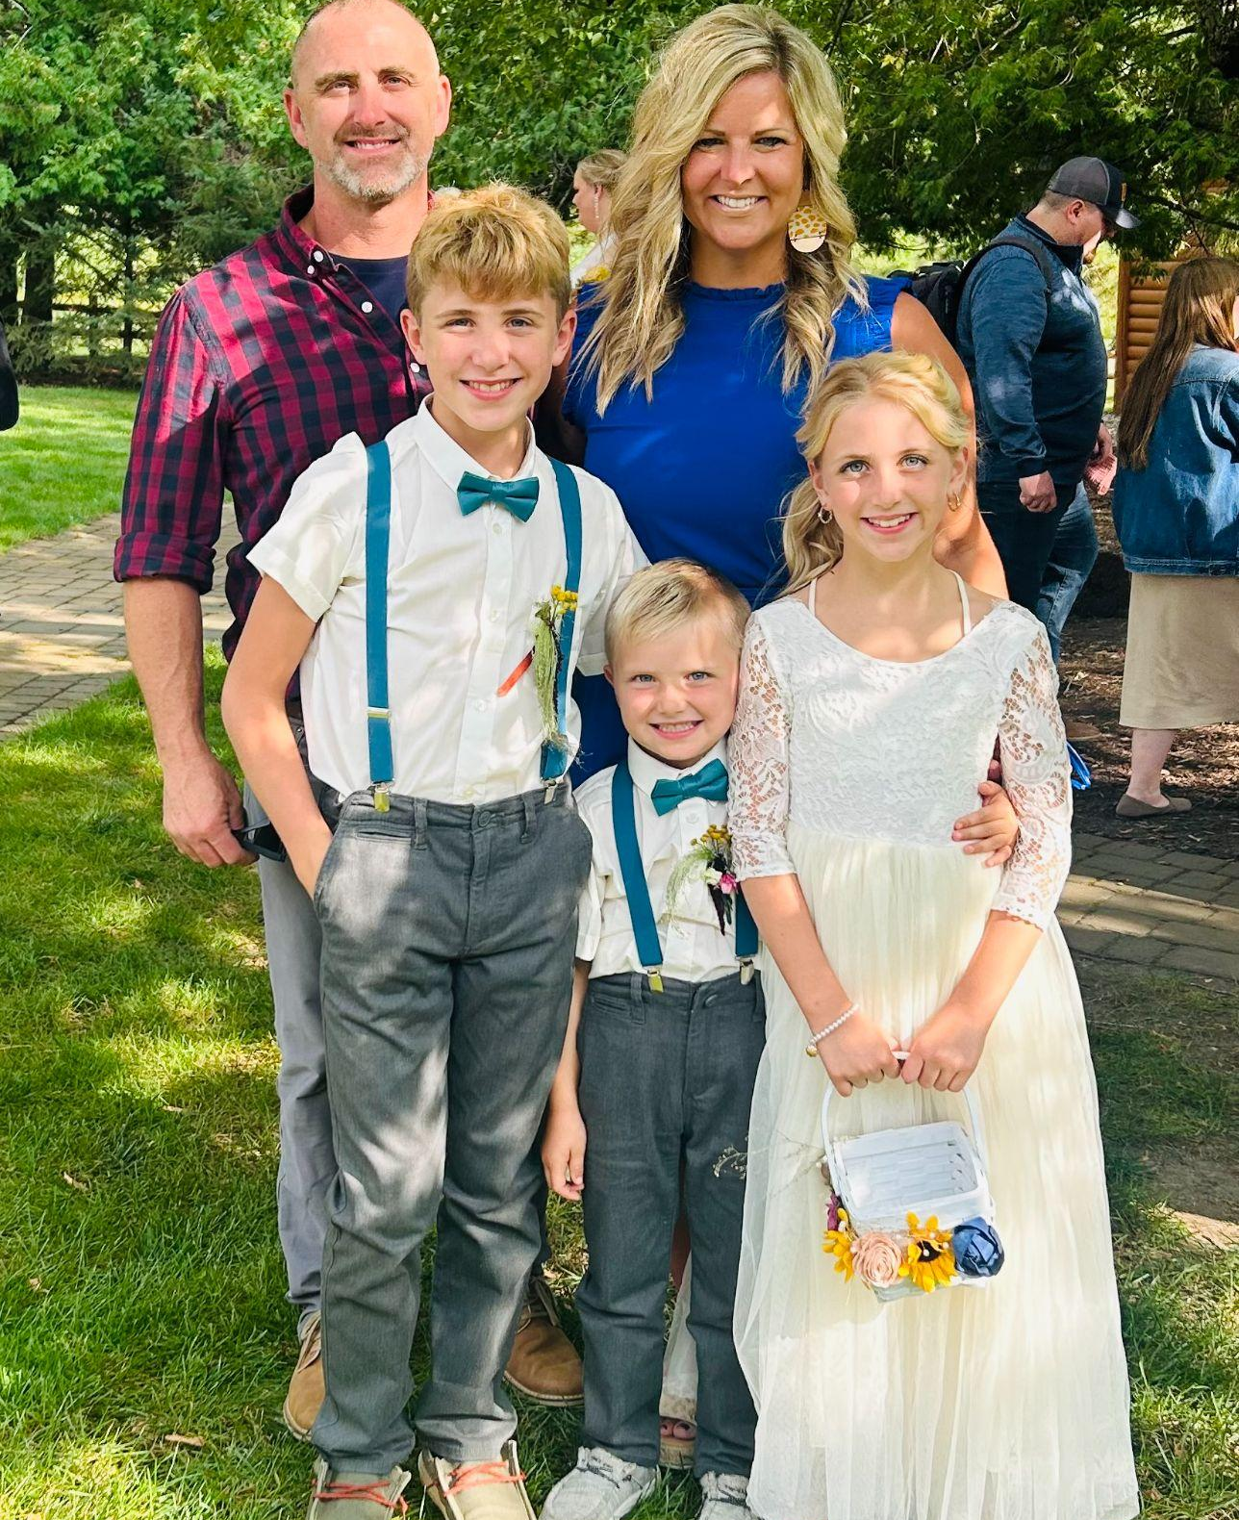
Nicole Perman
SLP with 15+ years of experience
BS in Speech Language Hearing Sciences
MS in Speech Language Pathology
Certificate of Clinical Competence ASHA
Passion for literacy
    Trained in Lindamood Bell LIPS
    Certified LETRS Facilitator
Current SLP in the Lake Park Audubon School District (Active member of the MTSS teams, PBIS team leader, TCIT coach )

Slide 4

By the end of the course, participants will be able to:
Define phonological skills
State the importance of phonemic awareness as a predictor of reading success
Apply and differentiate phonological instruction, strategies and experiences across ages, and needs to support phonological development
Understand the significance of assessment of phonological skill levels

Slide 5
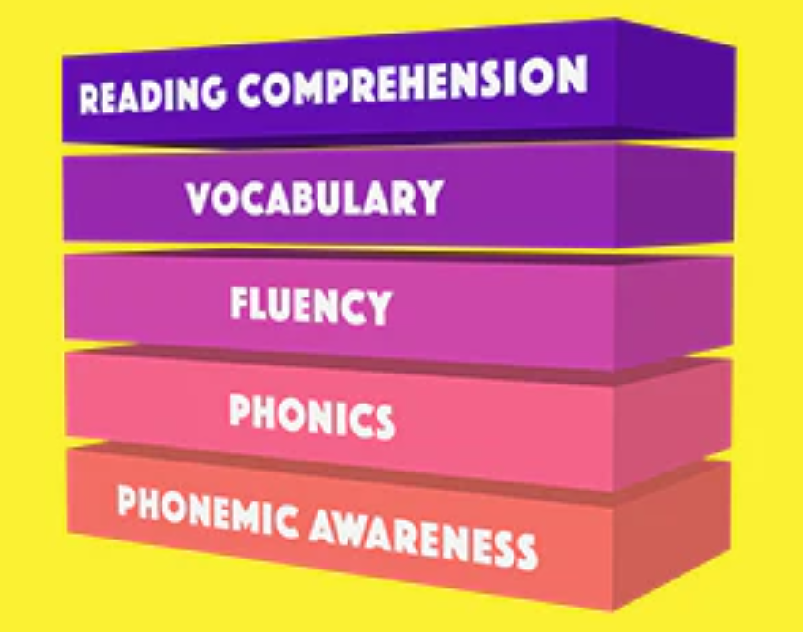
Building Blocks of Literacy
Phonics – rules between phonemes and graphemes (letters)
Phonemic/Phonological Awareness - ability to perceive and discriminate individual sounds, rhyming, blending, segmenting, and manipulating speech sounds
Oral Language – spoken words to express one’s knowledge and ideas.
Image: Mrs. Wordsmith Website

Slide 6
Building Blocks of Literacy, cont.
Text Comprehension - ability to process text, understand meaning, & to analyze using the reader’s bkgd knowledge relies on syntax, semantics, & linguistic skills, relational reasoning.
Vocabulary (semantics) – the words in a language and their meaning
Reading Fluency - ability to read with speed, accuracy, and proper expression

Slide 7
Building Blocks of Literacy, cont. 2
Plus Speech Sound Acquisition – students with speech sound disorders often show difficulties in phonology and morphology
Plus Morphology – supports reading fluency, phonological awareness, syntax, and vocabulary acquisition

Slide 8
Differences Between Phonological
and Phonemic Awareness
Phonological Awareness
Phonemic Awareness
The ability to hear and manipulate larger units of sound.
syllable segmentation
onset rime
alliteration
rhyming
The ability to identify and manipulate individual sounds (phonemes) in spoken words.
phoneme blending
phoneme segmenting
Segmenting & Blending proficiency is a major predictor of future reading problems. (Scarborough & Brady, 2002)

Slide 9
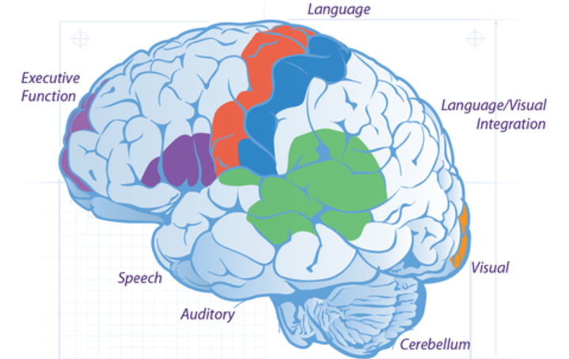
Speech to Print
The two best indicators of reading success are phonemic awareness and alphabet knowledge.
The more we provide the oral language foundation, the faster the sound-letter correspondence begins to take shape.(Moats, 2000 and Moats, 2005)
Image credit: https://learningbydesign.com/why-spell-links/

Slide 10
Definition of Literacy
Literacy encompasses the knowledge and skills students need to access, understand, analyze, and evaluate information, make meaning, express thoughts and emotions, present ideas, and opinions, interact with others and participate in activities at school and in their lives beyond school (Ewing, 2016).
The word literacy is defined as the ability to read, write, speak and listen in a way that lets us communicate effectively and make sense of the world.
(National Literacy Trust: literacytrust.org.uk/)

Slide 11
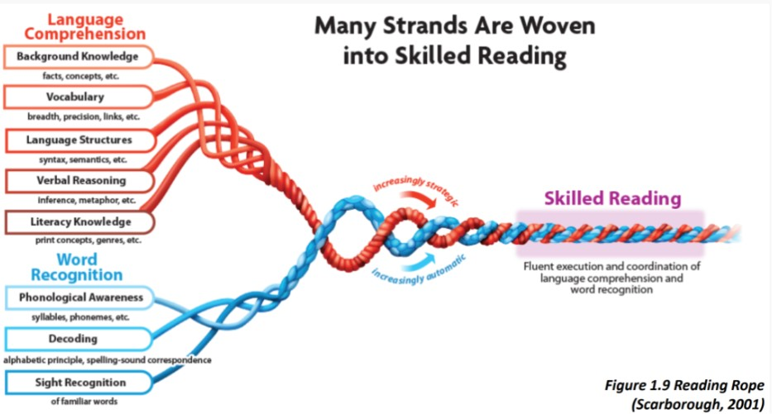
Scarborough’s Reading Rope
Scarborough’s Reading Rope (view larger image)

Slide 12


Reflection on Brain Science and Learning Theory
What is something that squares with your thinking?
What is still circling in your head?

Slide 13
Dyslexia & Specific Learning Disabilities
Dyslexia is a specific learning disability that is neurobiological in origin. It is characterized by difficulties with accurate and/or fluent word recognition and by poor spelling and decoding abilities. These difficulties typically result from a deficit in the phonological component of language that is often unexpected in relation to other cognitive abilities and the provision of effective classroom instruction. Secondary consequences may include problems in reading comprehension and reduced reading experience that can impede growth of vocabulary and background knowledge.
(Lyon, Shaywitz, & Shaywitz, 2003, p. 1); https://dyslexiaida.org/definition-of-dyslexia/

Slide 14
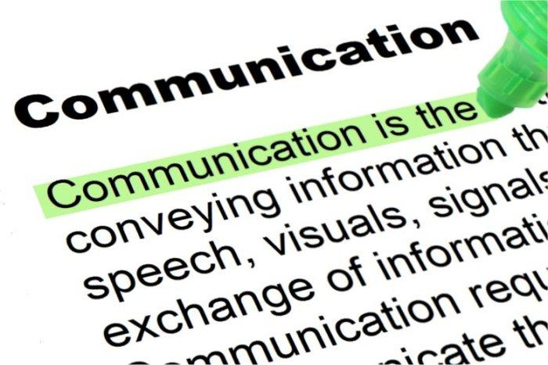


Categories of Developmental Reading Difficulties
Phonological
Orthographic
Comprehension

Slide 15
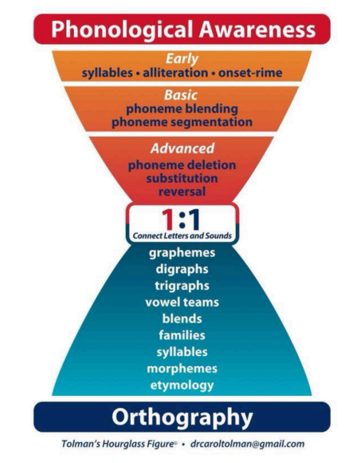
Carol Tolman’s Hourglass
Carol Tolman’s Hourglass (view larger image)
Keys
Phonological Awareness
Phonemic Awareness at Increasingly Complex Levels.
1:1 Correspondence Shifts Strategies Used
Vocabulary & Context Throughout

Slide 16
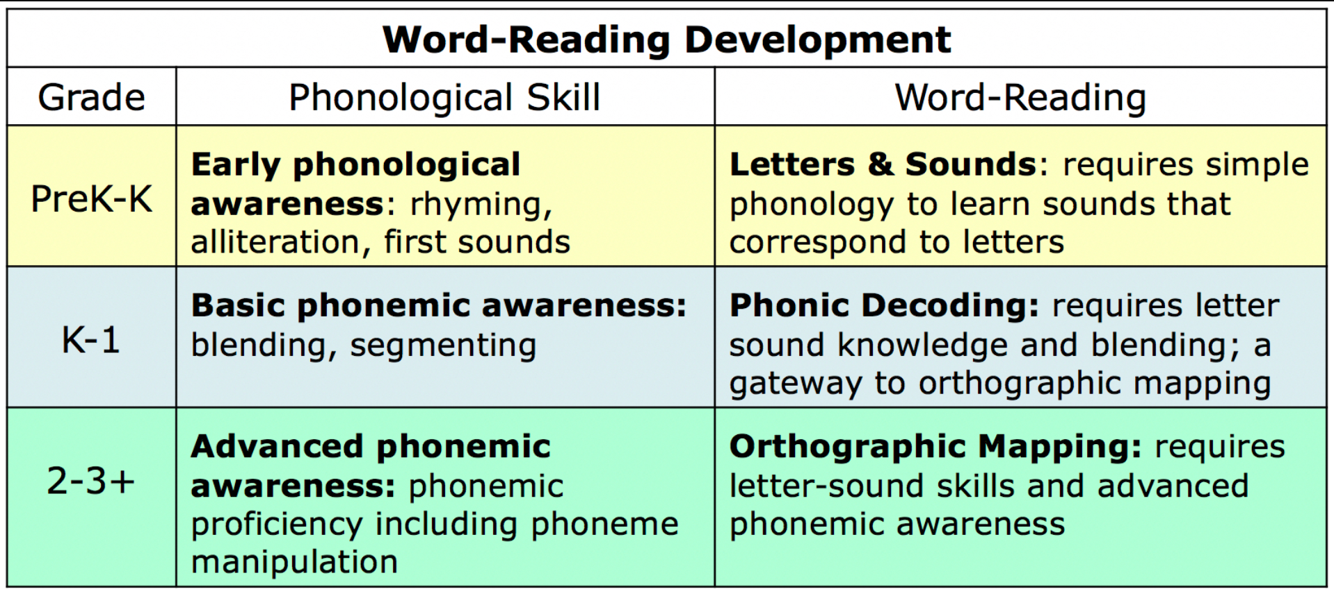
Typical Progression (Source: “Keys to Literacy”)
Typical Progression
(view larger image)

Slide 17
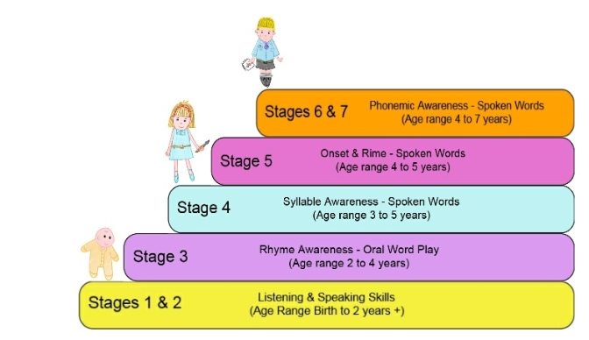
Phonological Instructional Tools and Techniques
Early Oral Language Skills
  Listening & Speaking
Basic
  Rhyming & Syllable Detection
  Phoneme Isolation, Blending and Segmenting
Advanced
  Manipulation, Deletion, and Substitution
www.teachphonics.co.uk

Slide 18
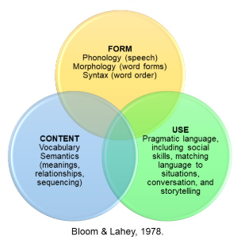
Expressive (Speaking) Oral Language
Expressive & Receptive (Listening) Keys
Samples of Expressive Oral Language
Audio link to 8 Year Old (going into 3rd grade) - Dash
Audio link to 9 Year Old (going into 4th grade) - Averi

Slide 19
Oral Language Development Tools
Turn & Talk
What is expressive language?
Application tools:
Modeling & Expanding (grammar, vocabulary, syntax, context)
Imitate (grammar, vocabulary, sound production)
Conversational Turns
Engage in open-ended conversations (tell me…)
Expand/teach vocabulary
Encourage imaginative play
Provide commentary throughout the day

Slide 20
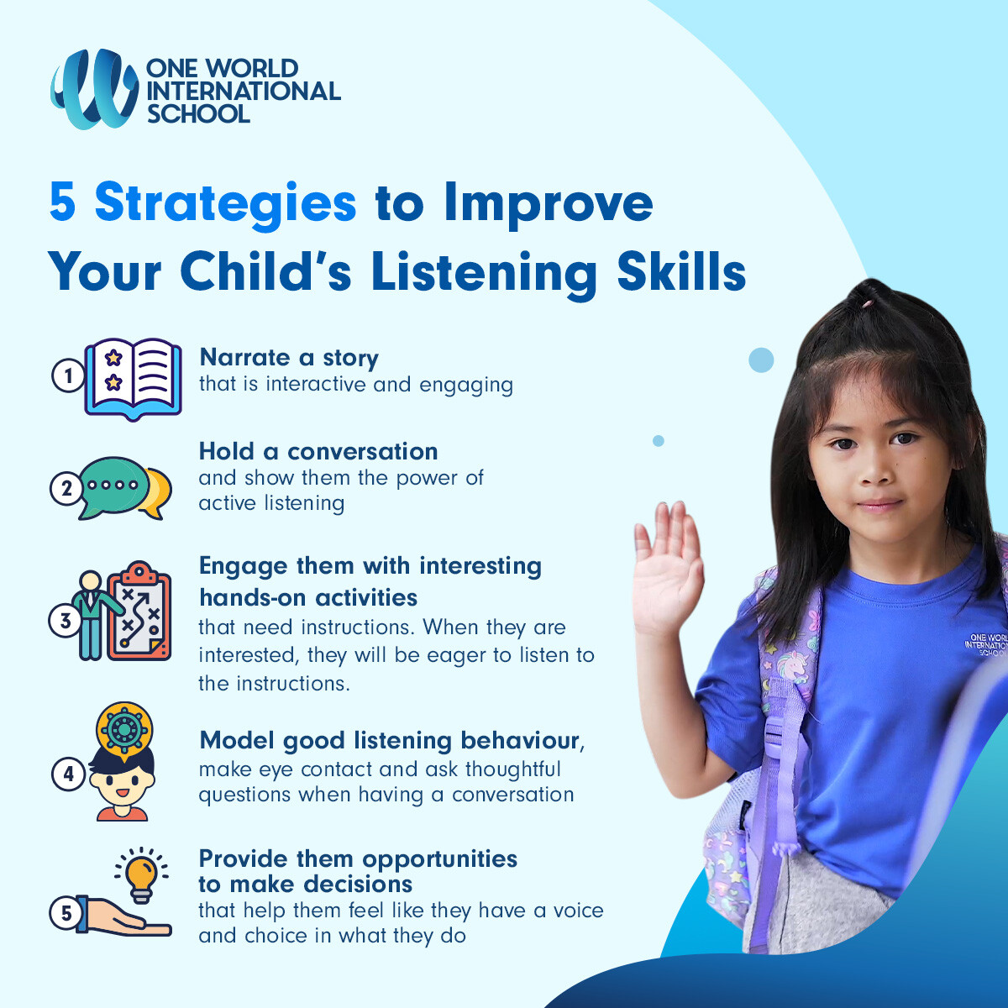
Early Listening Skills and Rhyming
Early Listening Skills (view larger image)
Create a Phonological Rich Environment
Songs and Singing
Nursery Rhymes, Rhyming Sorts, Sentence Completion, I Spy Rhyme
  3 things:name 3 things rhyme
Read Alouds
  Choose books that emphasize rhyme, rhythm, and repetition
Practice Following 1-2 Step Oral Directions

Slide 21
Early Listening Skills and Rhyming, cont.
Create a Phonological Rich Environment
Poetry
Listen for the Sound
Alliteration Games
Instrument play (ID sounds)
Understand Basic Concepts
Identification of body parts, parts of room, etc.

Slide 22
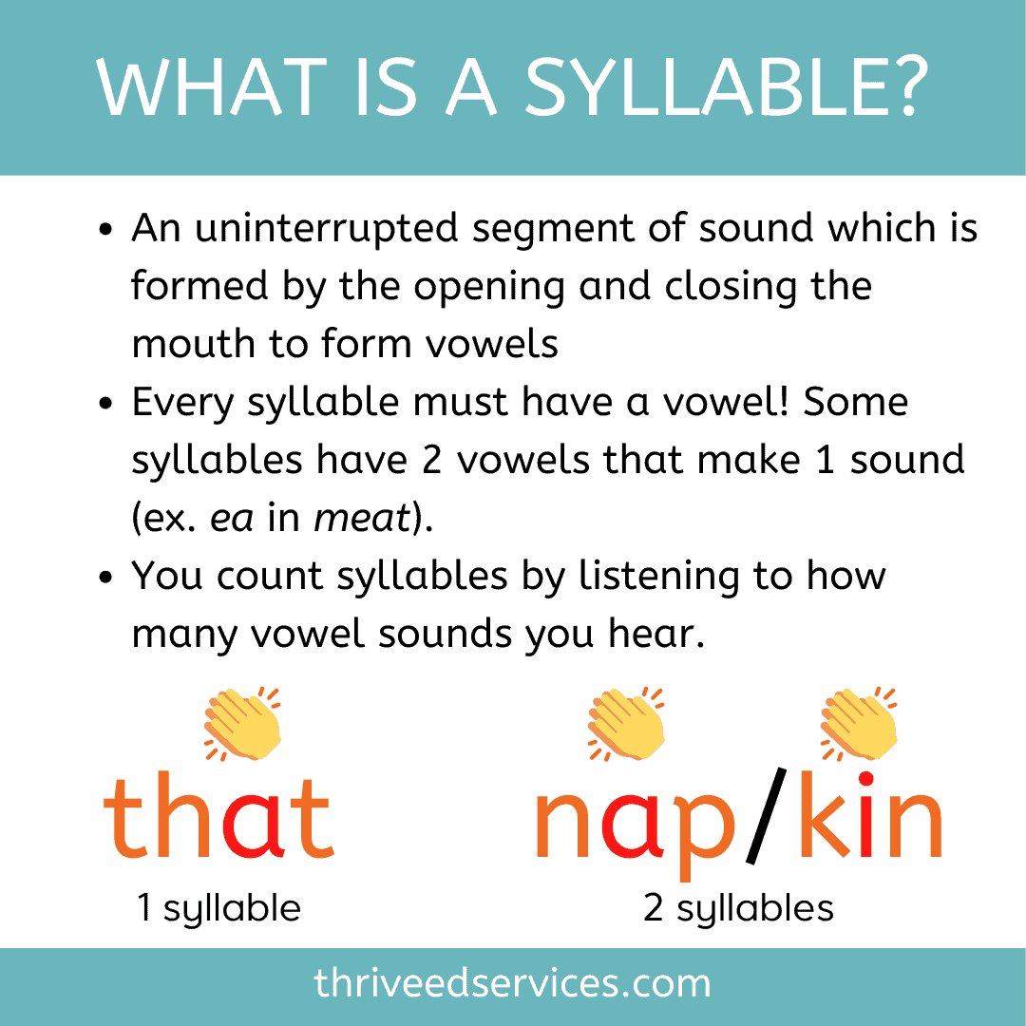
Syllable Detection
Clap, Stomp, Hop, Tap Syllables
Use Instruments to tap out syllables
Chin Drop Test
Syllable Sorting (Ex. Pocket Chart Sort)
Syllable Bingo
Building Words with Blocks
Syllable Frames
Multisensory (Play-Doh, Treasure Hunt)

Slide 23
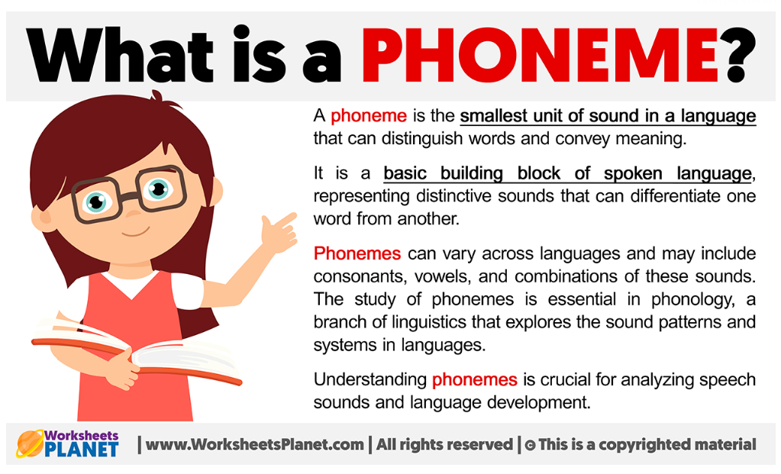
Understanding Phonemes
Understanding Phonemes
(view larger image)

Slide 24
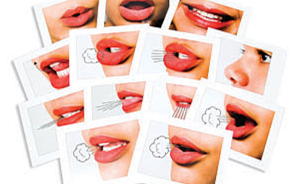
Phoneme Isolation
Teach isolated speech sounds using articulatory features
continuant/stop, noisy/quiet, front/back
  Continuant= s, f, sh, z, v, th
  Stop= t, d, b, p, k, g
  Noisy (voiced)= b, d, g, v, z, vowels
  Quiet (unvoiced)= p, t, k, f, s, sh
  Front = p, b, d, t, s, z, f
  Back = k, g, h
Source: Pro-Ed Lips Mouth Cards

Slide 25


Understanding Phonemes, cont.
How familiar are you with the categories of phonemes that we just practiced?

Slide 26
Understanding Consonant Production
 | Bilabial | Labiodental | Dental | Alveolar | Palatal | Velar | Glottal
Manner | - + | - + | - + | - + | - + | - + | - +
Stop | /p/ /b/ |  |  | /t/ /d/ |  | /k/ /g/
Fricative |  | /f/ /v/ | /th/ /th/ | /s/ /z/ | /sh/ /zh/ |  | /h/
Affricate |  |  |  |  | /ch/ /j/
Nasal | /m/ |  |  | /n/ |  | /ng/
Liquid |  |  |  | /l/ | /r/
Glide | /wh/ /w/ |  |  |  | /y/

Slide 27
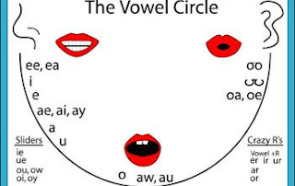
Understanding Vowel Formation
*Chin Placement*
*Mouth Formation*
Let’s Practice together!
Source:
Flipping Pages Book Club Blogspot

Slide 28
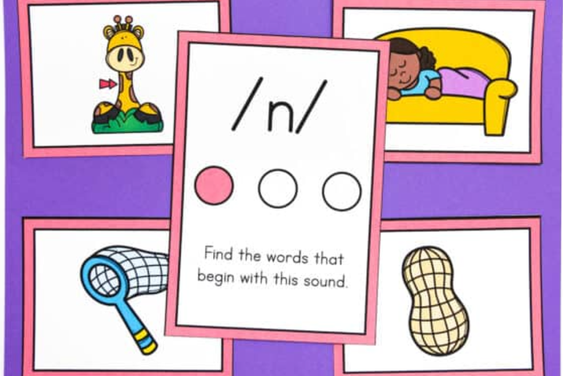
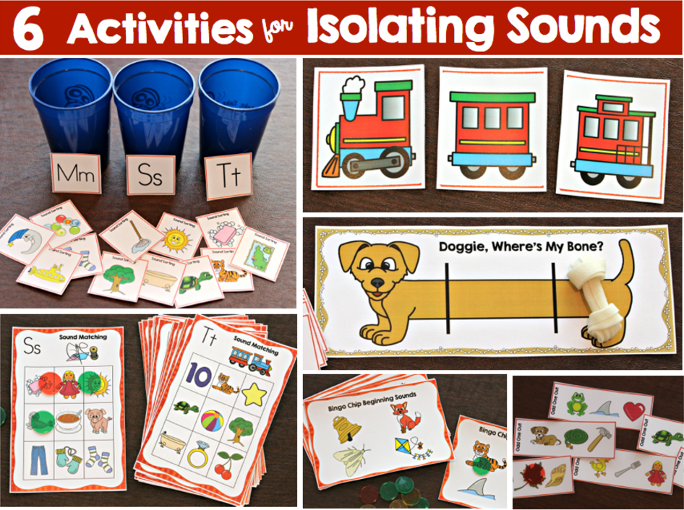
Phoneme Isolation Activities
I spy something that begins with ‘ffff’
Treasure hunt– find me something that begins with mmmmm
10 things— name 10 things that start with ‘b’
Identifying the sound heard in beginning, middle, end of CVC words
Fill in the missing phoneme
Visual Phonics
Source: Libby Klinner Teaching & Make, Take, and Teach Blog

Slide 29
Segmenting and Blending
Blending is the ability to combine individual sounds, phonemes, to make a word. An example of blending is saying the individual sounds /c/ /r/ /a/ /b/ followed by the ability to say those sounds together as a whole word, crab.
Segmenting is the ability to hear a whole word and isolate each sound, phoneme, individually. An example of segmenting is saying the word sledge and then isolating each sound /s/ /l/ /e/ /j/.

Slide 30
Phoneme Blending and Segmenting Word Chain Practice!
Skill Progression
Games/Strategies
Blending (individual phonemes)
Robot Talk, Songs & Cheers
Mystery Word
Blending Slide
Spider Web (yarn w/letters)
Tap/Map/Zap
Segmenting (Whole to individual)
Build a word (identify phonemes)
Picture Cards
  CV/VC (at/be)
  CVC (cat)
  CCV/VCC (ble/aft)
  CCVC/CVCC (snip/best)
  CCVCC (troops)

Slide 31
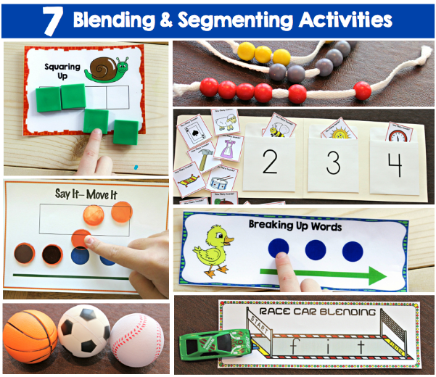
More Phoneme Blending & Segmenting Activities
Use of colored squares, chips, tiles, mouth pictures and eventually letters to blend and segment sounds
  Sound Train: use toys or cards to represent sounds.
  Say the sounds slowly and move the car across
  Stretch and Slide: stretch out the sounds using hand motions, then slide hands together to blend
Elkonin Boxes: Use boxes to represent sounds
  Slide counters or tokens into each box as you blend sounds to form a word.
Source: maketaketeach.com

Slide 32
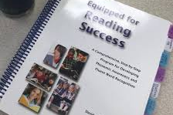
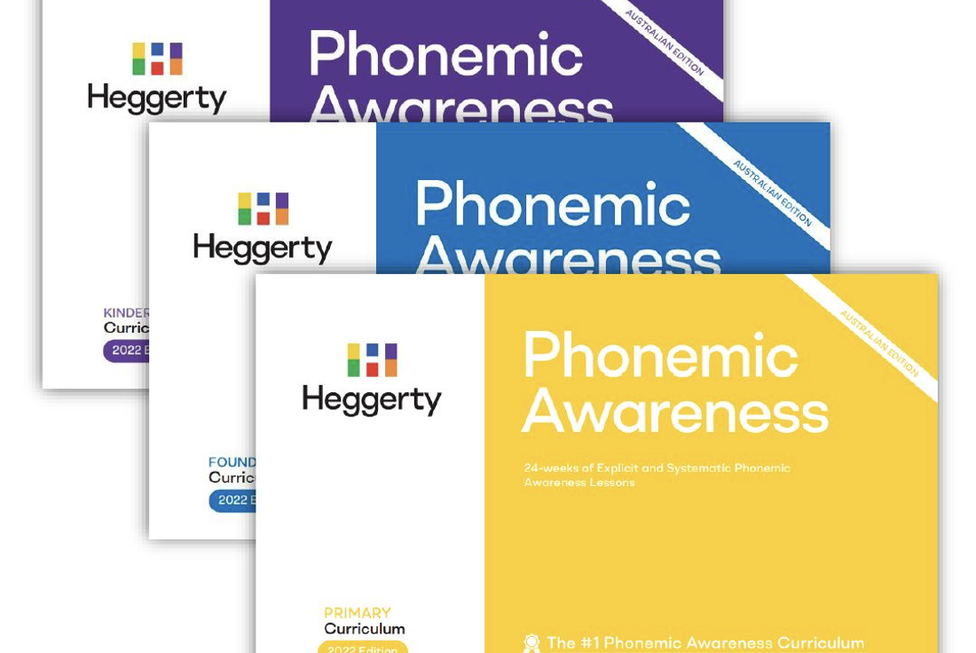
Advanced: Manipulation, Deletion, Substitution
Use of colored squares, chips, tiles, mouth pictures and eventually letters to blend and segment sounds
Kilpatrick Word Drills Examples:
      “Say tub, now say tub but change the /t/ to a /l/, Lub”
      “Say ran, now say ran but change the /a/ to an /u/, Run”
      “Say crash, now say crash without the /r/, Cash”

Slide 33
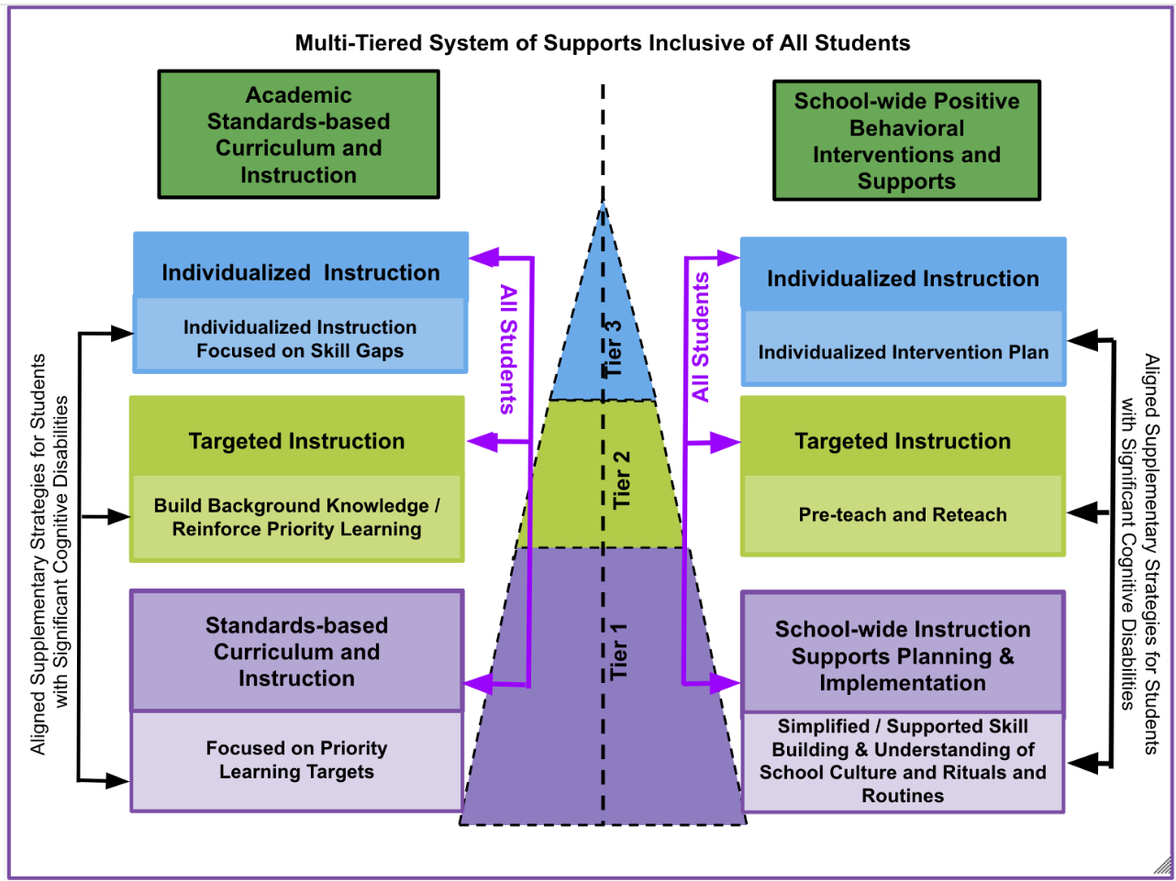
Multi-Tiered Systems of Supportive Inclusive of All
Multi-Tiered Systems of Supportive Inclusive of All (view larger image)

Slide 34
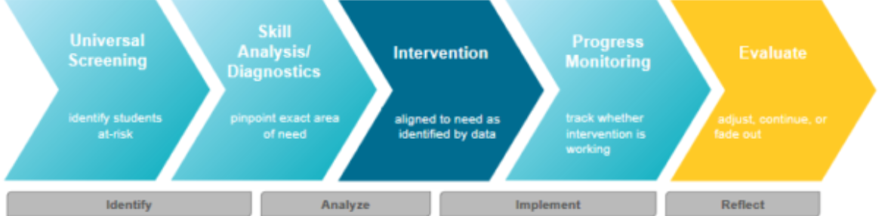
MTSS Identification and Response ‘Cycle’ (Illuminate Education)
MTSS Identification and Response ‘Cycle’ (view larger image)

Slide 35
Evaluation and Assessment
Standardized & Normed Evaluation Examples (Compares student performance)
Phonological Awareness Test (PAT-2)
Test of Phonological Awareness (TOPA)
Lindamood Auditory Conceptualization Test (LAC-3)*
Formative Assessment Examples (Gather Evidence of Student Learning)
Kilpatrick’s PAST (Diagnostic)
Heggerty Assessment (Curriculum Based Measure)
FASTBridge and Acadience Reading (Screening & Progress Monitoring)

Slide 36

Lingering Questions and Thoughts?
Thank you for the opportunity to learn together!

Slide 37
Resources
Pillars of Reading: Dr. David Kilpatrick on Phonemic Awareness (Video)
Tools4Reading at 95percentgroup.com/tools-4-reading/
Dr. Mary Dahlgren “Sound Walls and Phonemes” Video
Reading Rockets at readingrockets.org
Reading Universe at readinguniverse.org
dese: Massachusetts Department of Elementary and Secondary Education

Slide 38

Thank you!
Nicole Perman, nperman@lpa.k12.mn.us
Raina Askin, rainaaskin@gmail.com

Slide 39
Charting the Cs Conference 2025
Statewide Professional Development to Support the Workforce and Low Incidence Disability Areas in the State of Minnesota.
This presentation is partially funded with a grant from the Minnesota Department of Education using federal funding, CFDA 84.027A, Special Education – Grants to States.

