Slide 1

Monarch Magic
Charting the Cs Conference 2025:
To Literacy and Beyond
Cooperation Communication Collaboration
April 29, 2025
Kristi Portugue
Holly Beckmann
Amy Neils

Slide 2
Learning Objectives
Meet the Monarch
Learn the benefits
Student case studies
early childhood
elementary
high school
What’s next?

Slide 3
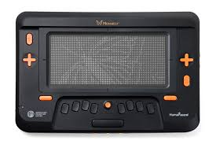
The Monarch

Slide 4
What is the Monarch?
The Monarch Braille Display is a groundbreaking device designed to make tactile reading more accessible for visually impaired users. Its magical aspects include:
Dynamic multi-line braille
Versatility in content
Innovative technology
Portability
Accessibility features

Slide 5
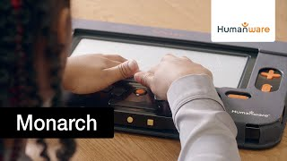
The Why Behind the Monarch - Video

Slide 6

Mastering the Monarch

Slide 7
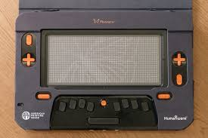
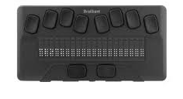
10 lines vs. one line

Slide 8
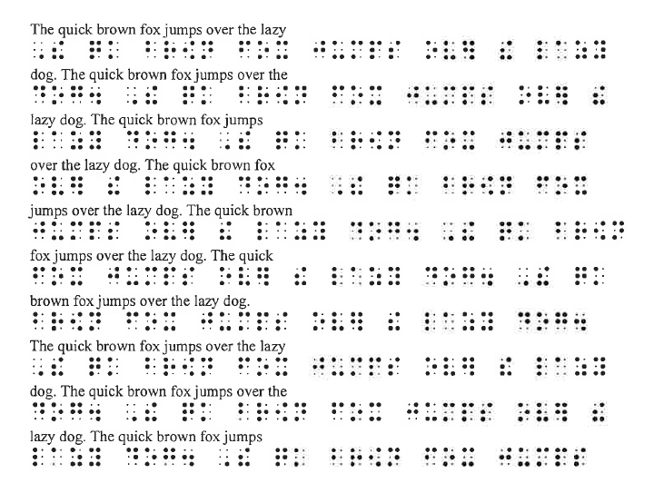
Display Comparison with Print

Slide 9
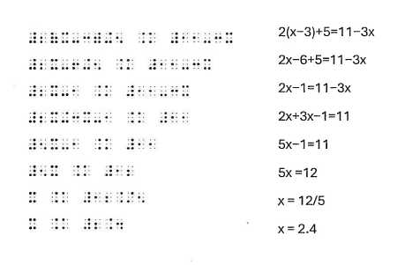
Math Equations

Slide 10
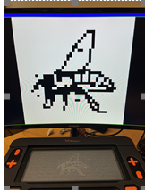
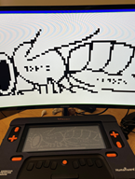
Tactile Images
Empowering accessibility through refreshable tactile graphics
Navigate and explore images
Cost and time effective
APH Tactile Graphics Image Library

Slide 11

Rewrite, Redo, Revise

Slide 12
Main Menu
Braille Editor: KeyBRF
Tactile Viewer
Internet Browser: Ecosia (Beta)
Word Processor: KeyWord
Math: KeyMath
File Manager: Files
Victor Reader
All Applications

Slide 13
Other Benefits/Functions:
24-hour battery life after only 3-4 hours of charging time
Portable visual display connectivity via HDMI for teachers or peers
3840 Pins for detailed graphics
Infrared sensor
Internet access: Ecosia
Apps and games like chess

Slide 14
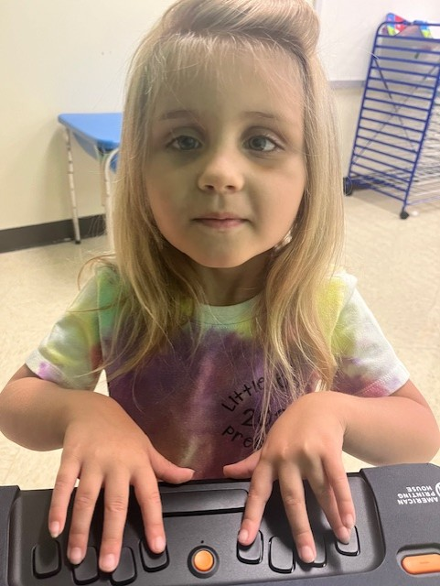
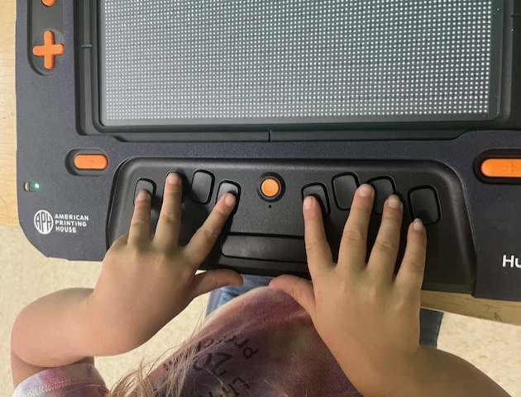
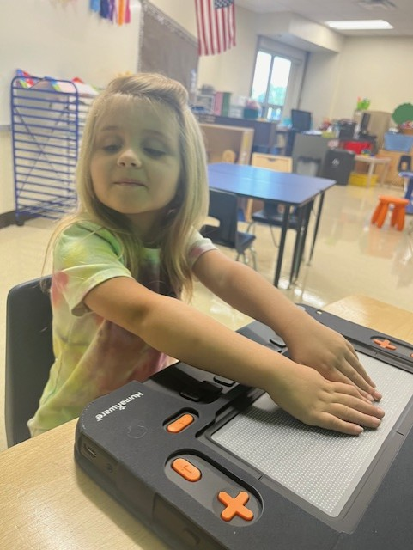
Case Study: Early Childhood Student

Slide 15
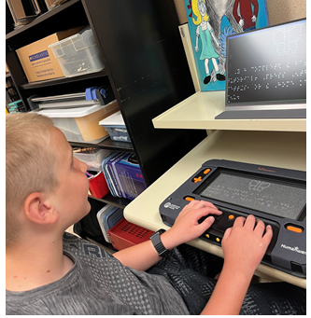
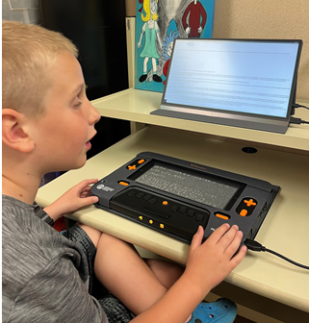
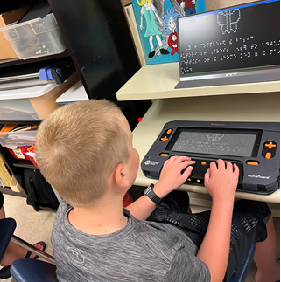
Case Study: Elementary Student

Slide 16
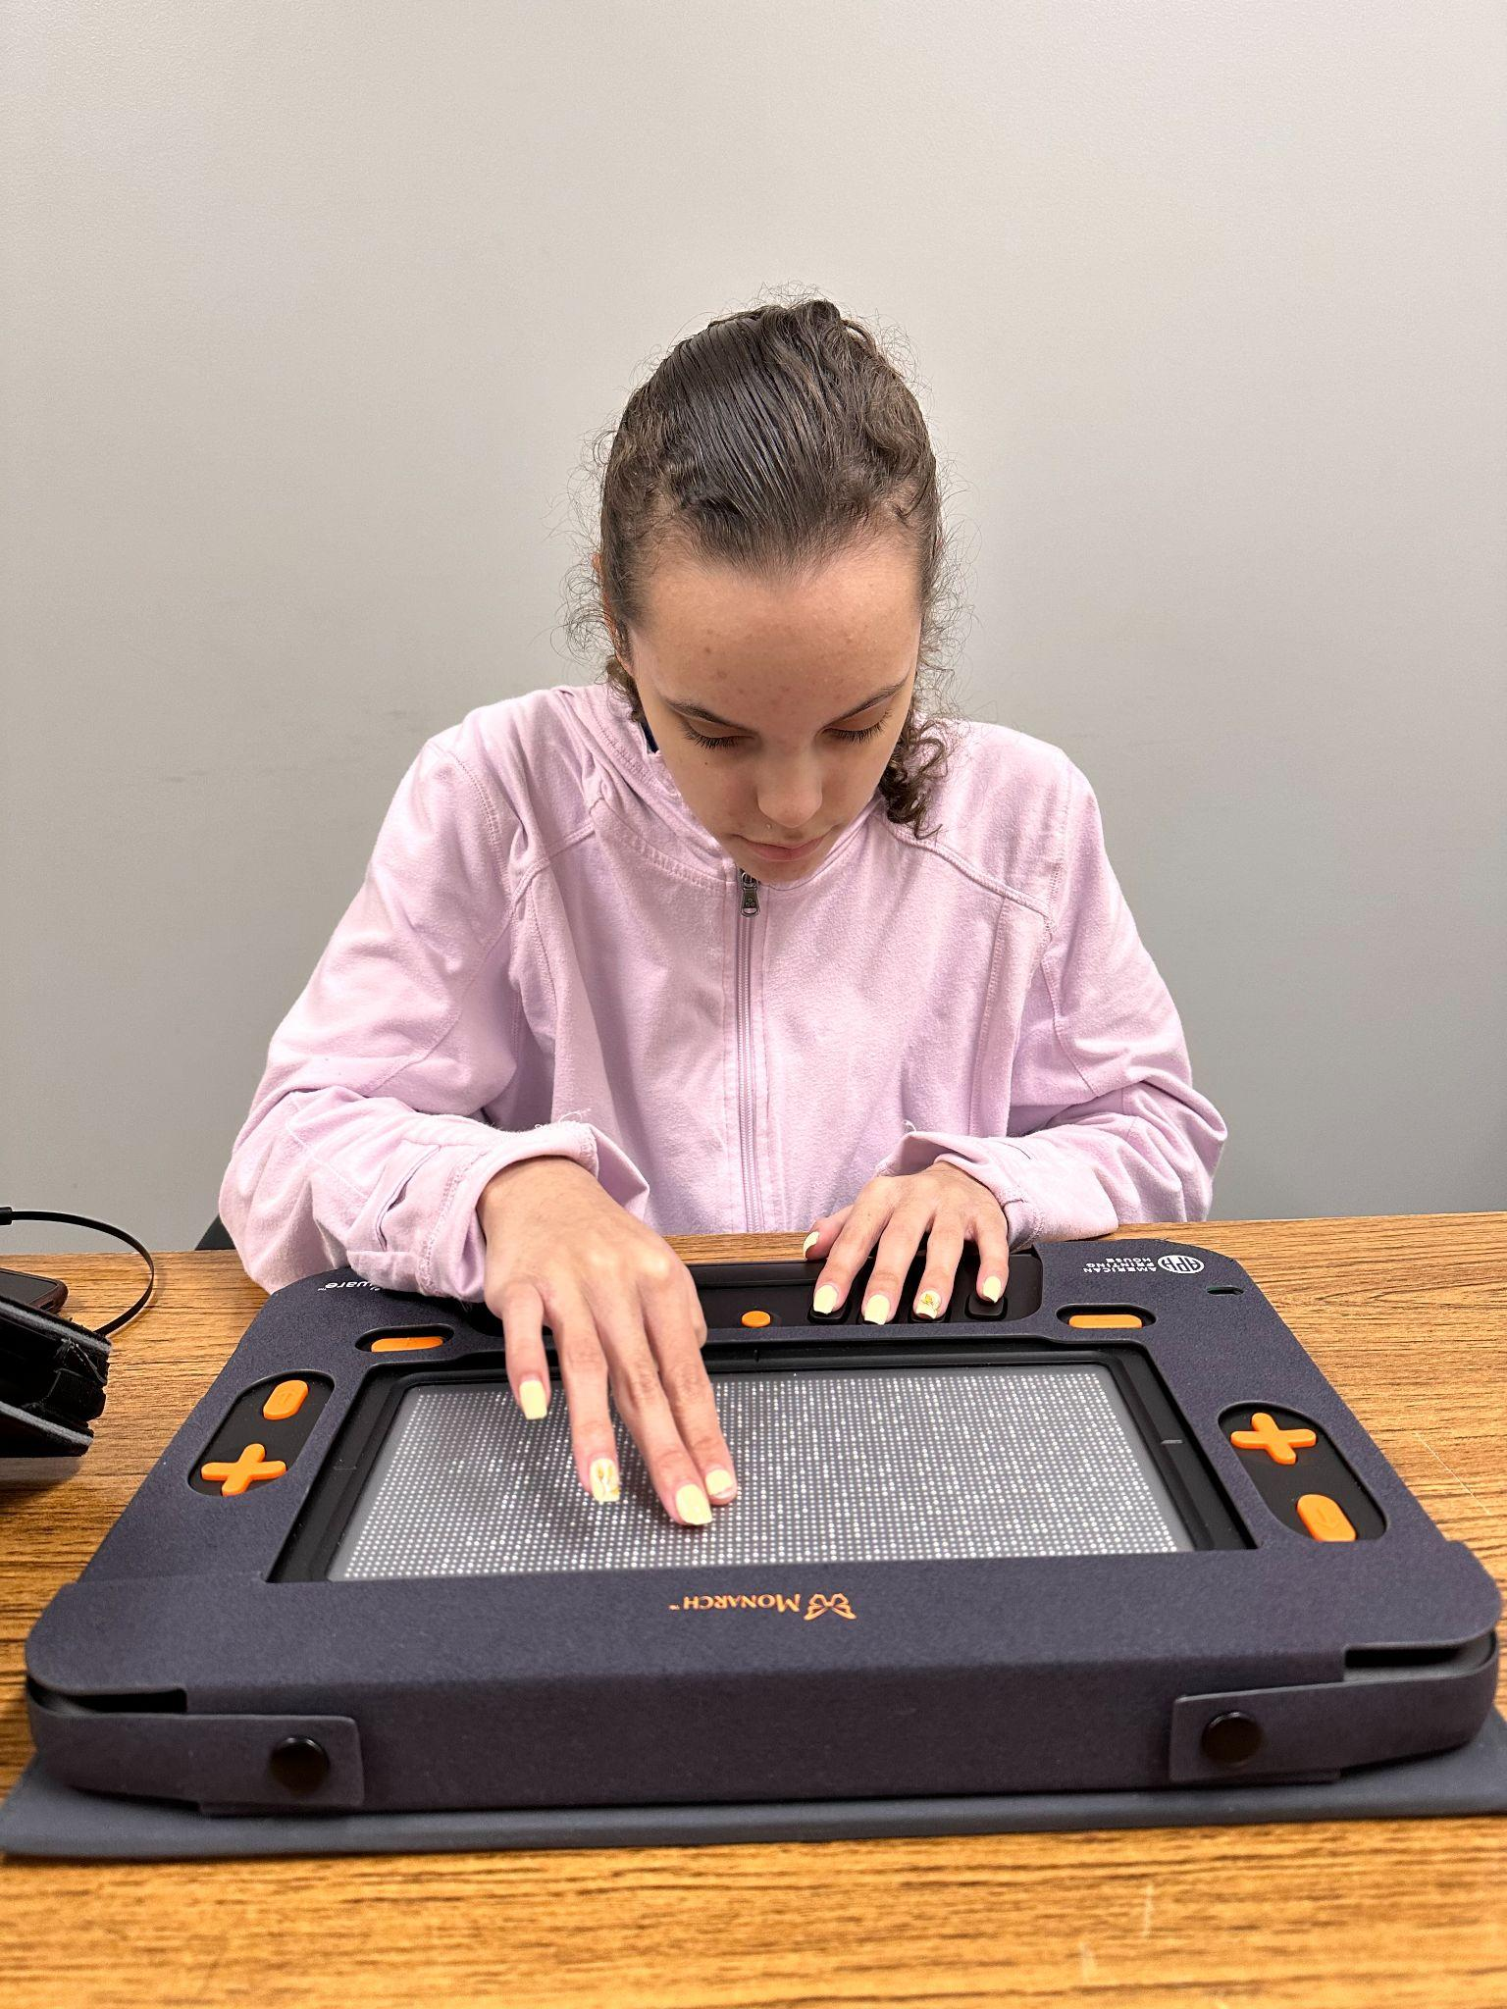
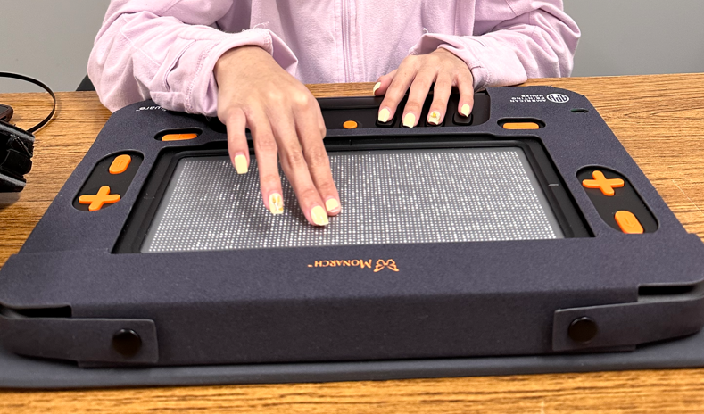
Case Study: High School Student

Slide 17
What’s Next?
Wing It
Monarch Transition and Employment Program (MTEP)
Developing terminal mode
Developing screen reader capabilities
New apps in development

Slide 18
Resources
https://www.aph.org/meet-monarch/
Video: https://www.youtube.com/watch?v=TJdMAk-hN3A

Slide 19

Thank you!
Amy Neils, aneils@mnscsc.org
Holly Beckmann, hbeckmann@mnscsc.org
Kristi Portugue, kportugue@mnscsc.org

