Slide 1


Put Me In Coach:
Successful Collaboration in Part C Service Delivery
Charting the Cs Conference 2025: April 29th
To Literacy and Beyond
Cooperation Communication Collaboration
April 29, 2025
Marleigh Van Arsdale
Katie Barth
Jess Moen

Slide 2
Session Outcomes:
Literature - Evidence-based literature in support of Part C collaborative practices, specific for children with hearing loss and their family.
Resources - Minnesota specific resources to support Part C collaborative practices.
Stories - Learn more from examples of Part C collaborative practices happening in Minnesota.

Slide 3
Session Goals:
Make a Plan - Utilize at least 1 resource to support Part C collaboration practices in your service delivery.
Network - Discuss collaborative practices and strategies to consider utilizing.

Slide 4
About Us:
Katie Barth - Itinerant Teacher Deaf/Hard of Hearing & Hard of Hearing Individual
Marleigh Van Arsdale - Itinerant Teacher Deaf/Hard of Hearing & Hard of Hearing Individual
Jess Moen - MN Statewide Specialist Early Hearing Detection & Intervention
Who else is here today?

Slide 5
Terms:
Low Incidence Providers - Low incidence refers to disability areas that occur rarely or in low numbers. In Minnesota there are seven low incidence disability categories: Autism Spectrum Disorder (ASD). DeafBlindness (DB), Deaf/hard of hearing (DHH), Other Health Disabilities (OHD), Physically Impaired (PI), Traumatic Brain Injury (TBI), and Blind/Visually Impairment (BVI)
Part C - Special education services for children birth until they turn 3 years.
Best Practices in Early Intervention = Evidence-based Quality Intervention Practices (EQIP) - An approach to early intervention which incorporates evidence-based practices to build caregiver capacity using coaching interaction practices and to embed intervention into daily routines in the child’s natural environment.
Individualized - Unique needs of the child and family

Slide 6
Terms 2 (continued):
Primary Service Provider (PSP) / Primary Coach Approach (PCA) - One team member selected to serve as the liaison between the family and other team members.
Secondary Service Provider (SSP) - A team member who uses coaching to support the PSP, parents, and other care providers.
Teaming - A regularly scheduled, formal or informal opportunity, for colleague-to-colleague coaching and support to build the capacity of parents and care providers.
Joint Visits - A visit in which a SSP accompanies the PSP in order to coach and support when a question or issue is identified by the PSP, family members, other care providers, or other team members. (some programs refer to this as consultative or co-visit)

Slide 7

Collaboration defined
Collaboration refers to interaction relationships between adults, such as family members and professional who work together to achieve mutually agreed upon outcomes/goals.
Wording from the Division for Early Childhood (DEC) Recommended Practices (RP) Interactive Glossary, 2025

Slide 8
Division for Early Childhood Recommended Practices Teaming and Collaboration (TC): Key Points
(TC1) Represents multiple disciplines working together as a team to plan and implement supports and services to meet unique needs of each child/family.
(TC2) Work together as a team to regularly exchange expertise, knowledge, and information to build team capacity, solve problems, plan, and implement interventions.
(TC3) enhance team functioning and interpersonal relationships with an among team members.
(TC4) Informal and formal resources to meet [informed] family-identified child and family needs.
(TC5) one primary liaison between the family and other team members based on [informed] child and family priorities and needs.

Slide 9
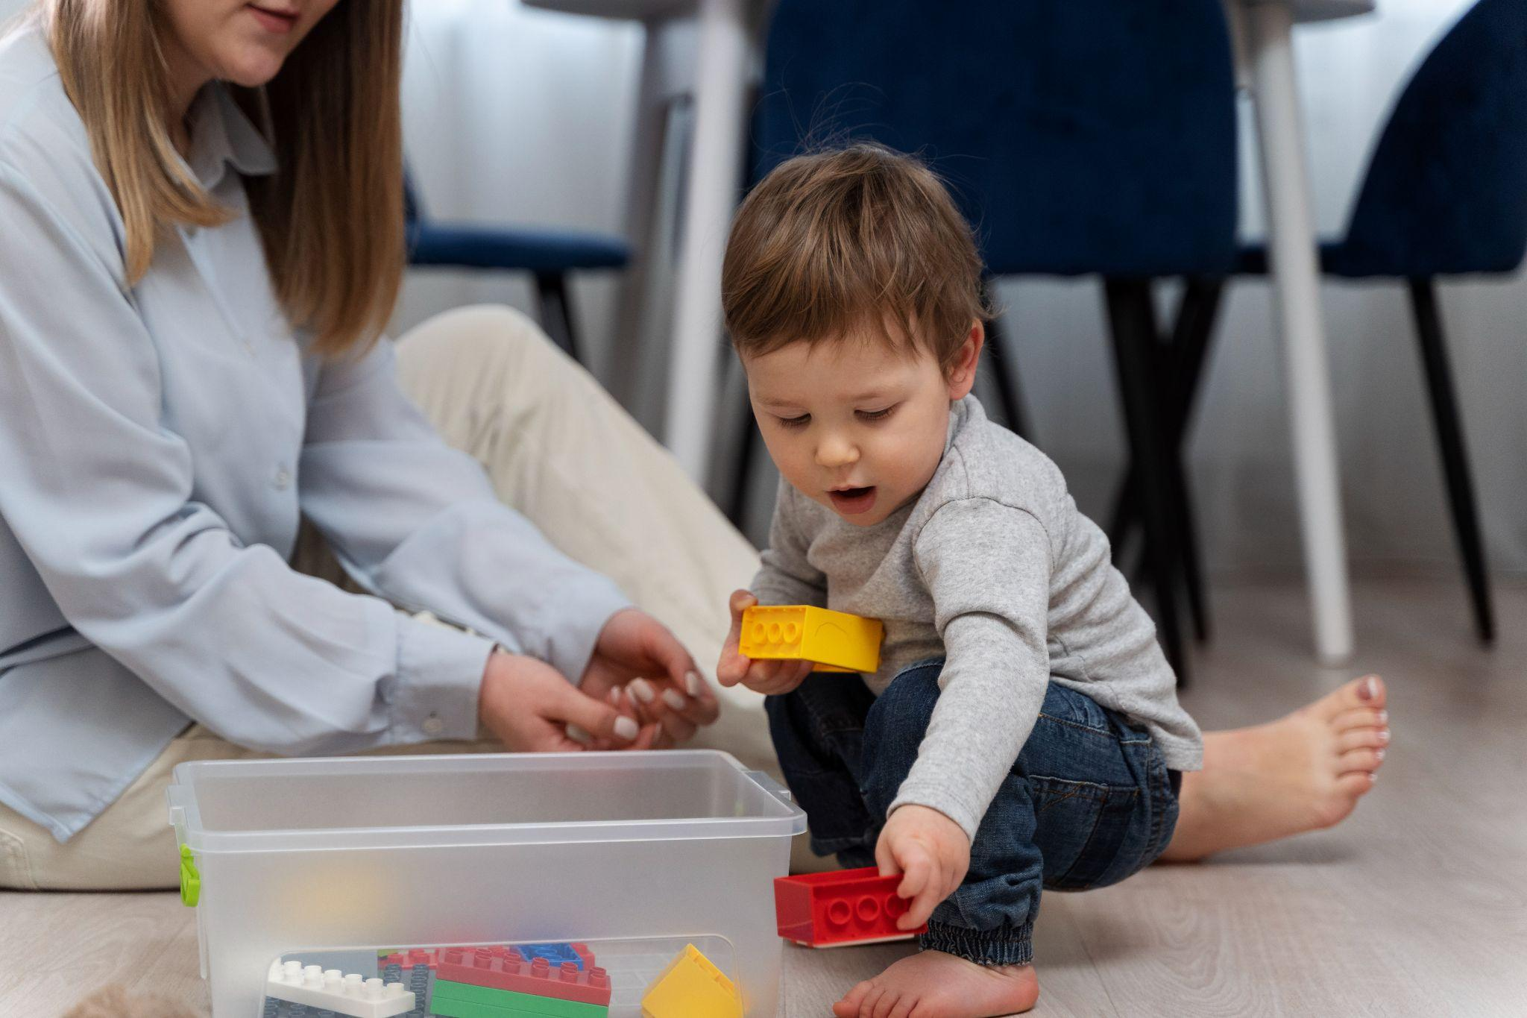
Self Reflection:
Identify a challenge/barrier you currently encounter regarding collaboration in Part C when working with a child who has a low incidence disability and their family.

Slide 10
Session Outcomes: LITERATURE
Literature - Evidence-based literature in support of Part C collaborative practices, specific for children with hearing loss and their family.
Resources - Minnesota specific resources to support Part C collaborative practices.
Stories - Learn more from examples of Part C collaborative practices happening in Minnesota.

Slide 11

Literature: NASDSE
Importance of Specialized Providers:
All early intervention (EI) providers need education and training that support early childhood best practices (Francois, Coufal, & Subramanian, 2015). Examples include: practices that support culturally responsive, family-centered services in naturally occurring environments, routines and everyday activities; coaching families to implement Individualized Family Service Plan (IFSP) goals; writing developmentally appropriate goals for the child; monitoring development and making recommendations to the IFSP team about modifications to service provision; knowledge of community resources families can access; and recognizing abuse and neglect and reporting it accordingly.

Slide 12
Literature: NASDSE, cont.
Importance of Specialized Providers:
What separates an EI provider for children who are deaf or hard of hearing from a general EI provider? In addition to the general knowledge that all EI providers must have, EI providers for children who are deaf or hard of hearing require formal, specialized education and training in deafness. (page 15)
Optimizing Outcomes for Students who are Deaf or Hard of Hearing Educational Service Guidelines, NASDSE

Slide 13

Literature: DCD
The Role of TODHH
Given their [teachers deaf/hard of hearing (TODHH)] in-depth knowledge of the types of services from which a student who is DHH may benefit, TODHH are able to collaborate with professionals included on the IEP/IFSP team and to provide field specific expertise. TODHH should be involved in initial and ongoing evaluations to determine special education services and accommodations needed to access instruction and standardized testing. (page 9)
Teachers of Students Who are Deaf or Hard of Hearing A Critical Resource Needed for Legal Compliance, 2022.

Slide 14
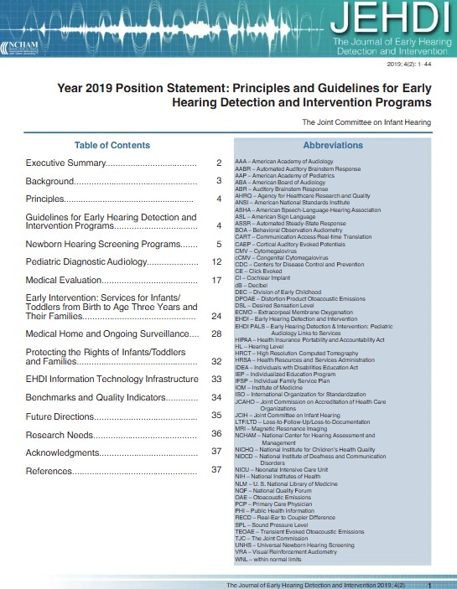
Literature: JEHDI
Updated Principles Beyond EHDI 1-3-6 Goals
8. The EHDI system should be family-centered with infant and family rights and privacy guaranteed through informed and shared decision-making, and family consent in accordance with state and federal guidelines.
9. Families should have access to information about all resources and programs for intervention, and support and counseling regarding the child’s educational and communication/language needs.

Slide 15
Literature: JEHDI, cont. 1
Updated Principles Beyond EHDI 1-3-6 Goals
10. All infants and children, regardless of newborn hearing screening outcome, should be monitored within the medical home according to the periodicity tables regarding their communication development (American Academy of Pediatrics [AAP] Committee, 2017).
Teachers of Students Who are Deaf or Hard of Hearing A Critical Resource Needed for Legal Compliance, 2022.

Slide 16
Literature: JEHDI cont. 2
Updated Principles Beyond EHDI 1-3-6 Goals
11. Professionals with appropriate training should provide ongoing surveillance of communication development to all children with or without risk indicators.
12. Appropriate interdisciplinary early intervention programs for identified infants and their families should be provided by professionals knowledgeable about the needs and requirements of children who are deaf or hard of hearing (JCIH, 2013).

Slide 17
Literature: JEHDI cont. 3
Updated Principles Beyond EHDI 1-3-6 Goals
13. Early intervention programs should recognize evidence-based practices and build on strengths, informed choices, language traditions, and cultural beliefs of families they serve. (page 4)
Teachers of Students Who are Deaf or Hard of Hearing A Critical Resource Needed for Legal Compliance, 2022.

Slide 18
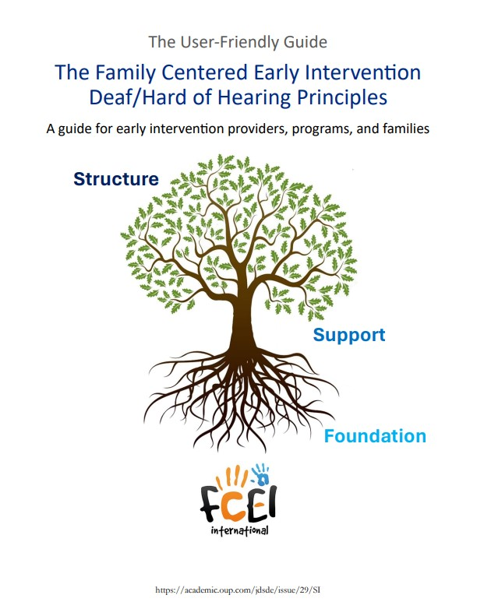
Literature: Family Centered Early Intervention (FCEI) International
Principle 7: Trained FCEI-DHH Providers
Principle:
EI Providers need to have certain qualities so they can connect with and build relationships with families and other providers.
They also need competency in their own area of expertise, in general early intervention, and when providing specific support to children who are DHH. Trained EI Providers offer effective, professional, equitable, and inclusive FCEI-DHH supports to promote children and family outcomes. (page 8)
The Family Centered Early Intervention Deaf/Hard of Hearing Principles: A guide for early intervention providers, programs and families.

Slide 19
Literature: FCEI International cont.
Principle 8: Teamwork Among Professionals
Recommended Collaborative Practices:
These include effective communication, sharing of information and skills, joint planning, compromise, modeling, acknowledgment, and establishing mechanisms to support teamwork. (page 10)
The Family Centered Early Intervention Deaf/Hard of Hearing Principles: A guide for early intervention providers, programs and families.

Slide 20

Session Outcomes: RESOURCES
Literature - Evidence-based literature in support of Part C collaborative practices, specific for children with hearing loss and their family.
Resources - Minnesota specific resources to support Part C collaborative practices.
Stories - Learn more from examples of Part C collaborative practices happening in Minnesota.
Part C Intervention Services for Infants and Toddlers (Birth to Age 3) with Sensory Loss: Recommended Collaboration Practices (January 2024)

Slide 21
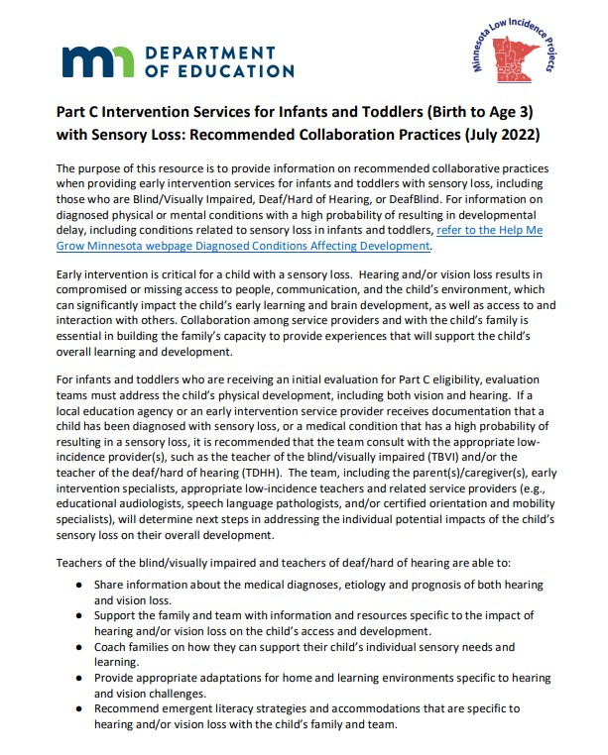
Resources: MN Article
Teachers of the blind/visually impaired and teachers of deaf/hard of hearing are able to:
Share information about the medical diagnoses, etiology and prognosis of both hearing and vision loss.
Support the family and team with information and resources specific to the impact of hearing and/or vision loss on the child’s access and development.
Coach families on how they can support their child’s individual sensory needs and learning.

Slide 22
Resources: MN Article, cont.
Teachers of the blind/visually impaired and teachers of deaf/hard of hearing are able to:
Provide appropriate adaptations for home and learning environments specific to hearing and vision challenges.
Recommend emergent literacy strategies and accommodations that are specific to hearing and/or vision loss with the child’s family and team.

Slide 23
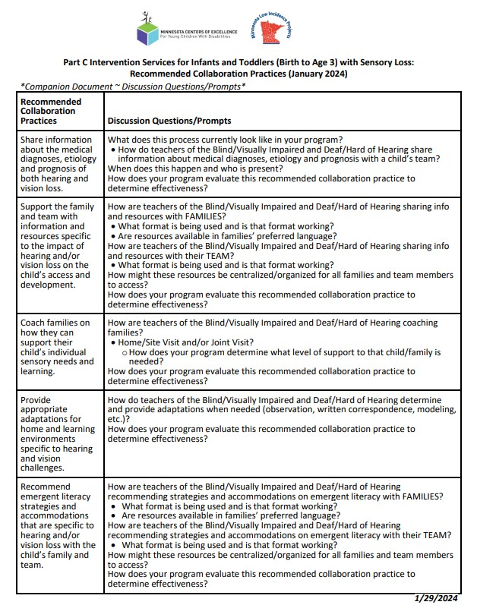
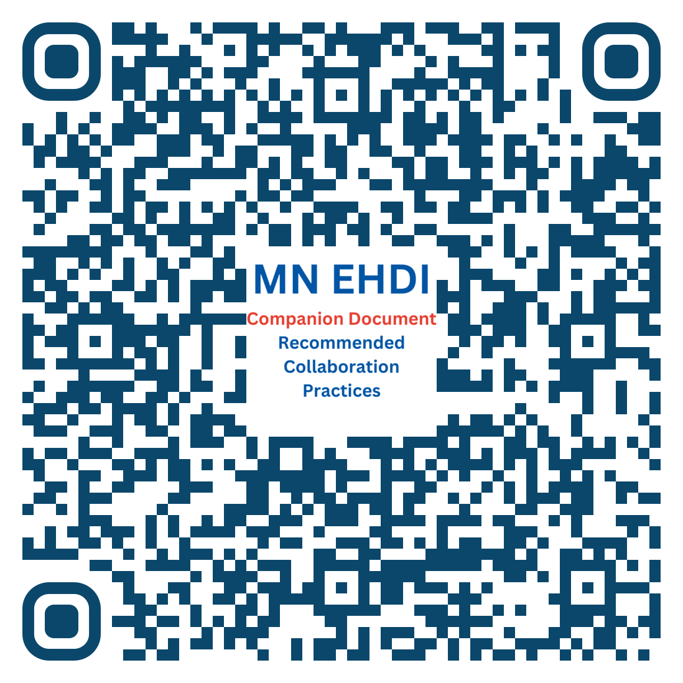
Resources: MN Part C Collaboration Companion Document
Part C Intervention Services for Infants and Toddlers (Birth to Age 3) with Sensory Loss: Recommended Collaboration Practices (January 2024)

Slide 24
Resources: MN Part C Collaboration Companion Document Recommended Practice #1
Recommended Collaboration Practices | Discussion Questions/Prompts
Share information about the medical diagnoses, etiology and prognosis of both hearing and vision loss. | What does this process currently look like in your program? How do teachers of the Blind/Visually Impaired and Deaf/Hard of Hearing share information about medical diagnoses, etiology and prognosis with a child’s team? When does this happen and who is present? How does your program evaluate this recommended collaboration practice to determine effectiveness?

Slide 25
Resources: MN Part C Collaboration Companion Document Recommended Practice #2
Recommended Collaboration Practices | Discussion Questions/Prompts
Support the family and team with information and resources specific to the impact of hearing and/or vision loss on the child’s access and development. | How are teachers of the Blind/Visually Impaired and Deaf/Hard of Hearing sharing info and resources with FAMILIES? What format is being used and is that format working? Are resources available in families’ preferred language? How are teachers of the Blind/Visually Impaired and Deaf/Hard of Hearing sharing info and resources with their TEAM? What format is being used and is that format working? How might these resources be centralized/organized for all families and team members to access? How does your program evaluate this recommended collaboration practice to determine effectiveness?

Slide 26
Resources: MN Part C Collaboration Companion Document Recommended Practice #3
Recommended Collaboration Practices | Discussion Questions/Prompts
Coach families on how they can support their child’s individual sensory needs and learning. | How are teachers of the Blind/Visually Impaired and Deaf/Hard of Hearing coaching families? Home/Site Visit and/or Joint Visit? How does your program determine what level of support to that child/family is needed? How does your program evaluate this recommended collaboration practice to determine effectiveness?

Slide 27
Resources: MN Part C Collaboration Companion Document Recommended Practice #4
Recommended Collaboration Practices | Discussion Questions/Prompts
Provide appropriate adaptations for home and learning environments specific to hearing and vision challenges. | How do teachers of the Blind/Visually Impaired and Deaf/Hard of Hearing determine and provide adaptations when needed (observation, written correspondence, modeling, etc.)? How does your program evaluate this recommended collaboration practice to determine effectiveness?

Slide 28
Resources: MN Part C Collaboration Companion Document Recommended Practice #5
Recommended Collaboration Practices | Discussion Questions/Prompts
Recommend emergent literacy strategies and accommodations that are specific to hearing and/or vision loss with the child’s family and team. | How are teachers of the Blind/Visually Impaired and Deaf/Hard of Hearing recommending strategies and accommodations on emergent literacy with FAMILIES? What format is being used and is that format working? Are resources available in families’ preferred language? How are teachers of the Blind/Visually Impaired and Deaf/Hard of Hearing recommending strategies and accommodations on emergent literacy with their TEAM? What format is being used and is that format working? How might these resources be centralized/organized for all families and team members to access? How does your program evaluate this recommended collaboration practice to determine effectiveness?

Slide 29
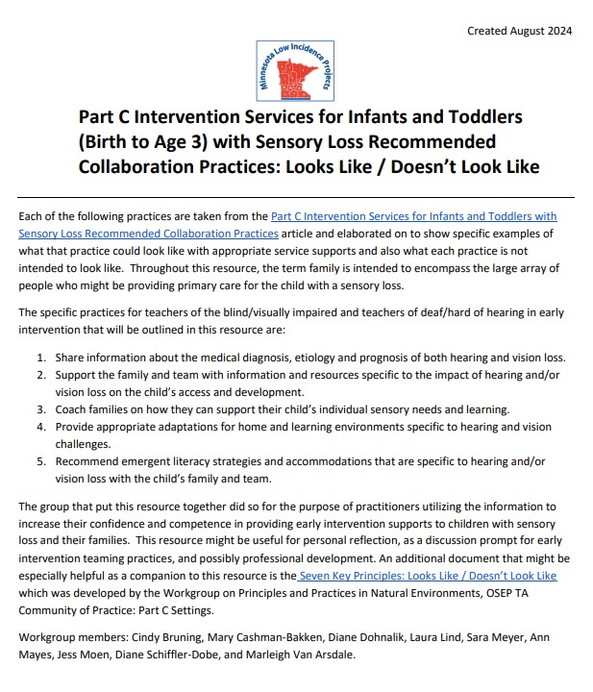
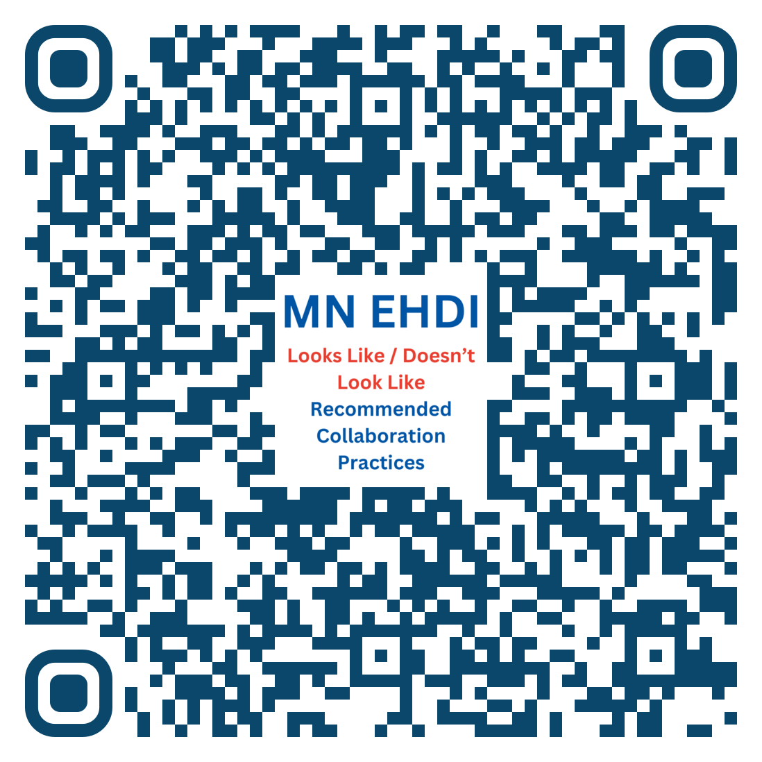
Resources: MN Part C Looks Like / Doesn’t Look Like
Part C Intervention Services for Infants and Toddlers from birth to 3 years old

Slide 30
Resources: MN Part C Looks Like / Doesn’t Look Like (example 1, page 3)
Support the family and team with information and resources specific to the impact of hearing and/or vision loss on the child’s access and development.
Looks Like | Doesn’t Look Like
Ensure that low incidence specialists are available to be a child’s primary service provider and/or secondary service provider, as makes sense for the child, family, and their individual needs. The low incidence specialist is also available for joint visits with the child and family. | Not inviting low incidence specialists to come to the home in order to gather an understanding of how the child functions in his/her primary environment. This may limit the ability to make family and child-centered recommendations for both current and future programming, environmental adjustments, or amplification needs.

Slide 31
Resources: MN Part C Looks Like / Doesn’t Look Like (example 2, page 3 & 4)
Support the family and team with information and resources specific to the impact of hearing and/or vision loss on the child’s access and development.
Looks Like | Doesn’t Look Like
Joint visits are provided as requested by the family or service providers, as appropriate. Family members might not always have enough knowledge about the sensory loss to know what questions to ask or that a joint visit could be helpful. Therefore, it is important for low incidence providers to have continuous interactions with the family and team, so that they can share relevant sensory loss information. | Joint visits are only provided when driven by a question/request from the family. Joint visits are only provided during previously established service minutes, regardless of child, family or service provider needs/requests.

Slide 32
Session Outcomes: STORIES
Literature - Evidence-based literature in support of Part C collaborative practices, specific for children with hearing loss and their family.
Resources - Minnesota specific resources to support Part C collaborative practices.
Stories - Learn more from examples of Part C collaborative practices happening in Minnesota.

Slide 33
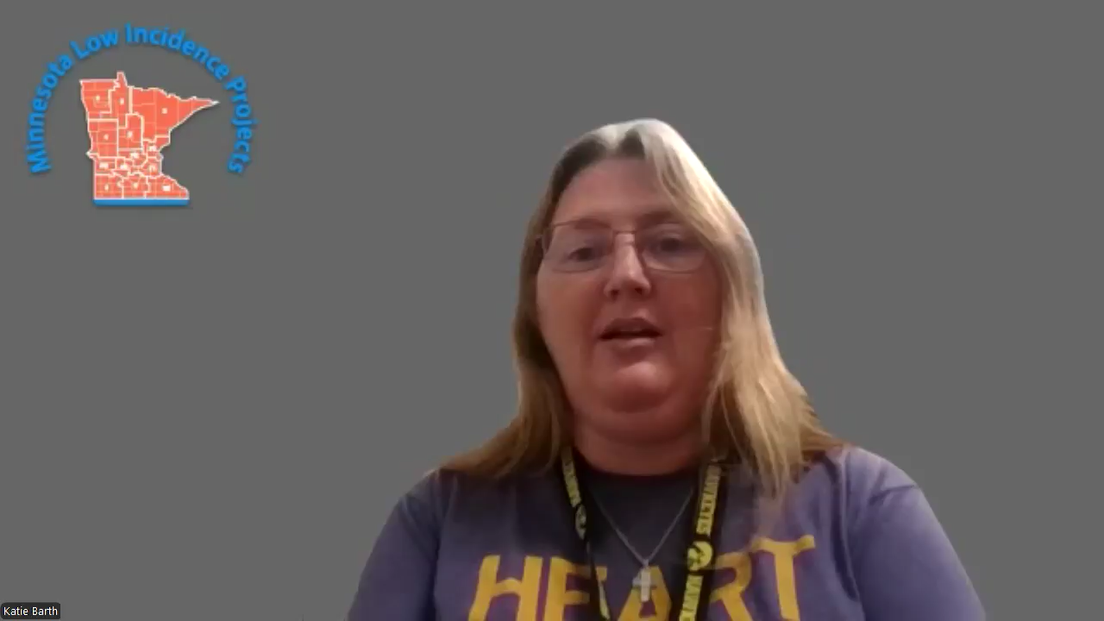
Story: Routines Based Intervention - video
Team focuses on family priorities while considering sensory impact on family routines.

Slide 34
Routines Based Intervention Considerations
Ensure that you are collaborating with your programs low incidence providers to consider how the child’s disability impacts their daily routines.
Ensure you and your team (including low incidence providers) are familiar with the Routines Based Interview process.
Involve the teachers of low incidence disabilities in planning for the routines based interview questions and/or inviting them to participate in the interview.
Ask questions specific to the impact of the child’s sensory loss on their daily routines. (example: When the child wakes up, how are they receiving communication input prior to putting on their hearing aids?)

Slide 35

Story: Service Provider Availability - video
Becoming available to be a PSP for my team

Slide 36
Service Provider Availability Considerations
Low incidence specialists are considered and/or available to be a child’s primary service provider (PSP) and/or secondary provider (SSP), as makes sense for the child, family, and their individual needs.
Use the Companion Document Discussion Questions/Prompts to discuss with your team (including your low incidence providers) how each of the recommended collaboration practices can be/are available in your program.
Use the MN Part C Looks Like/Doesn’t Look document to familiarize yourself and your team (including your low incidence providers) with recommended early intervention practices for children with sensory loss.

Slide 37
Service Provider Availability Considerations, cont.
If a low incidence provider, logistically is not able to be a PSP, could they be considered as a SSP who participates in frequent/scheduled joint visits?
Consider any biases, assumptions, and/or logistics you may have regarding who could fill the role of a PSP or SSP.

Slide 38

Story: Joint Visits - video
Importance of team members being available to join visits with the child/family.

Slide 39
Story: Joint Visits
Joint visits are provided as requested by the family or service providers, as appropriate.
Coordinate together (include the low incidence provider) about the purpose and plan of the joint visit, while allowing flexibility if questions/concerns arise outside of the identified plan. (Example: A BVI teacher joins a visit to observe the child in their natural environment, so that they can provide accessibility support.)
Include all team members (including low incidence providers) in professional development on how to coach families. This will support/allow all providers to coach families on their area of expertise. (simultaneous coaching can occur!)

Slide 40
Story: Joint Visits. Cont.
Ensure low incidence providers have continuous interactions with the family and team so they can share relevant sensory loss information and families remain fully informed.
Each child and family are unique, it is important for low incidence providers to observe the child and family in their environment to ensure they are providing most relevant information on the potential impact of the sensory loss.
Family knowledge about sensory loss varies and they might not know what questions to ask or that a join visits could be helpful.

Slide 41

Story: Teaming Meetings
Scheduling ideas so all team members are involved

Slide 42
Story: Teaming Meetings
Low Incidence providers support the full team in understanding the child’s diagnosis, etiology, prognosis, potential impacts on daily routines, and strategies to support the child and family specific to the sensory loss.
Use the Companion Document Discussion Questions/Prompts to discuss with teams and start a dialogue about how each of these recommended collaboration practices can/are available in your program.
Ensure all team members (including low incidence providers) are part of planning and participating in teaming meetings (formal or informal), as makes sense for them.
Decide the best method for team members to share information with each other, which is accessible for all.

Slide 43

Stories from the field
What successes/creative ways has your team collaborated in Part C?

Slide 44

Next Steps
Think back to the challenge/barrier for Part C Collaboration that you identified earlier.
What is a possible next step you could take to address that challenge/barrier?
What resources or ideas, that were shared today, might support you?

Slide 45

Thank you!
Marleigh Van Arsdale, mvanarsdale@rrsec.org
Katie Barth, kbarth@isd761.org
Jess Moen, jess.moen@brightworksmn.org

Slide 46
Resources: Literature
Optimizing Outcomes for Students who are Deaf or Hard of Hearing Educational Service Guidelines Third Edition, National Association of State Directors of Special Education, Inc (NASDSE) https://www.nasdse.org/docs/nasdse-3rd-ed-7-11-2019-final.pdf
2022 Teachers of Students Who are Deaf or Hard of Hearing A Critical Resource Needed for Legal Compliance on Behalf of the Board of Directors of the Division for Communication, Language, and Deaf/Hard of Hearing https://successforkidswithhearingloss.com/wp-content/uploads/2022/06/DCD-Position-Paper-2022-Remediated.pdf

Slide 47
Resources: Literature, cont.
Year 2019 Position Statement: Principles and Guidelines for Early Hearing Detection and Intervention Programs, The Journal of Early Hearing Detection and Intervention (JEHDI), The Joint Committee on Infant Hearing https://www.audiology.org/practice-guideline/year-2019-position-statement-principles-and-guidelines-for-early-hearing-detection-and-intervention-programs/
The Family Centered Early Intervention Deaf/Hard of Hearing Principles: A guide for early intervention providers, programs, and families https://www.fcei.at/dl/nNNLJmoJKOkkJqx4KJKJmMJKlKML/FINAL-FCEI-GuideBook-print_pdf

Slide 48
Resources: Minnesota Low Incidence Projects EHDI
Minnesota Low Incidence Projects Early Hearing Detection & Intervention Resources https://mnlowincidenceprojects.org/Projects/ehdi/ehdiResources.html
Article - Part C Intervention Services for Infants and Toddlers (Birth to Age 3) with Sensory Loss: Recommended Collaboration Practices https://education.mn.gov/mdeprod/groups/educ/documents/hiddencontent/cm9k/mdm0/~edisp/prod034482.pdf
Companion Document - Part C Intervention Services for Infants and Toddlers (Birth to Age 3) with Sensory Loss: Recommended Collaboration Practices https://mnlowincidenceprojects.org/documents/ehdi/Companion_Doc_to_Sensory_Loss_Collaboration_Practices.pdf

Slide 49
Resources: Minnesota Low Incidence Projects EHDI, cont.
Minnesota Low Incidence Projects Early Hearing Detection & Intervention Resources https://mnlowincidenceprojects.org/Projects/ehdi/ehdiResources.html
Article - Part C Intervention Services for Infants and Toddlers (Birth to Age 3) with Sensory Loss: Recommended Collaboration Practices https://education.mn.gov/mdeprod/groups/educ/documents/hiddencontent/cm9k/mdm0/~edisp/prod034482.pdf
Companion Document - Part C Intervention Services for Infants and Toddlers (Birth to Age 3) with Sensory Loss: Recommended Collaboration Practices https://mnlowincidenceprojects.org/documents/ehdi/Companion_Doc_to_Sensory_Loss_Collaboration_Practices.pdf

Slide 50
Resources: MN Best Practices in Early Intervention Share Site (previously EQIP Share Site)
MN Best Practices in Early Intervention Share Site https://sites.google.com/metro-ecsu.org/mn-eqip/home?authuser=0
Share Site: Routines Based Interview https://sites.google.com/metro-ecsu.org/mn-eqip/natural-learning-environment-practices/routines-based-interview
Share Site Primary Coach Approach to Teaming https://sites.google.com/metro-ecsu.org/mn-eqip/primary-coach-approach-to-teaming?authuser=0
Share Site Teaming Meetings & Collaboration https://sites.google.com/metro-ecsu.org/mn-eqip/primary-coach-approach-to-teaming/teaming-meetings-collaboration?authuser=0

Slide 51
Resource: Part C Specific
Division for Early Childhood (DEC) Recommended Practices (RP) https://www.dec-sped.org/dec-recommended-practices
DEC RP Interactive Glossary https://www.dec-sped.org/_files/ugd/95f212_26fd2a7b804c40ea908fe5f58a65ec52.pdf
[Early Intervention] Seven Key Principles: Looks Like / Doesn’t Look Like, OSEP Workgroup on Principles and Practices in Natural Environments https://ectacenter.org/~pdfs/topics/families/Principles_LooksLike_DoesntLookLike3_11_08.pdf

Slide 52
Resource: Part C Specific, cont.
FIPP CASE tools, Joint Visit Planning Tool When Using a Primary Service Provider Approach to Teaming, M’Lisa Shelden, Ph.D., & Dathan Rush, Ed.D. https://drive.google.com/file/d/1Xcgbmdl6Ytld-ijDeEmLPctoqgkPOZBo/view
The Early Intervention Teaming Handbook The Primary Service Provider Approach Second Edition (2022), M’Lisa Shelden & Dathan Rush

Slide 53
Resource: Videos
Story: Routines Based Interview (Katie Barth) https://youtu.be/GeN5xLI170k
Story: Service Provider Availability (Cindy Bruning) https://youtu.be/wzceXVzBZ3A
Story: Joint Visits (Marleigh Van Arsdale) https://youtu.be/dG19oWM7p4w

Slide 54
Charting the Cs Conference 2025
Statewide Professional Development to Support the Workforce and Low Incidence Disability Areas in the State of Minnesota.
This presentation is partially funded with a grant from the Minnesota Department of Education using federal funding, CFDA 84.027A, Special Education – Grants to States. The contents of this presentation do not necessarily represent the policy of the federal Department of Education, or the state Department of Education and you should not assume endorsement by the federal or state government.

