Slide 1

Practical Interventions to Challenging Behavior
Charting the Cs Conference 2025:
To Literacy and Beyond
Cooperation Communication Collaboration
April 30, 2025
Kelley Foehrkolb, BCBA, LBA

Slide 2

Kelley Foehrkolb, BCBA
Work:
Board Certified Behavior Analyst (BCBA) 9 years @ Northfield Schools
District Autism Coach, Davenport, Iowa
15+ Years Elem & Secondary Special Education Teacher
Variety of programs & settings:
ASD, NB, DCD, Resource - Setting 1 - 4
Iowa and Colorado

Slide 3
Kelley Foehrkolb, BCBA, continued
Education:
Bachelor's degree in Special Education & Elementary Ed University of Northern IA
Masters in Special Education Morningside University
BCBA Florida Institute of Technology

Slide 4
Practical Interventions to Challenging Behaviors
Agenda
Reviewing the Science of Behavior
Behavioral Interventions
Preventing Behavior from occurring
Responding to Challenging Behavior

Slide 5
Reminder
We all work with students with challenging behavior - some minor and some much more consuming of our day. No matter, our goal is always to reduce challenging behavior and increase appropriate behaviors. Learn some practical and in the moment ways to help prevent the behavior from occurring along with ways to respond when it does occur. These strategies won't solve all your challenges but will go along way for you and your staff with a tool belt of ideas on what you can do!

Slide 6
Reviewing the Science of Behavior
Applied Behavior Analysis (ABA) Review
Functions of Behavior

Slide 7
ABA REVIEW

Slide 8
Applied Behavior Analysis
Applied Behavior Analysis (ABA) is the study of behavior.
Applied Behavior Analysis is a scientific approach for discovering environmental variables that reliably influence socially significant behavior and for developing a technology of behavior change that takes practical advantage of those discoveries (Cooper, Heron & Heward, 2008).
ABA changes the environment in order to change the behavior.

Slide 9
Understanding Behavior
BEHAVIOR is EVERYTHING we do…
Challenging behaviors are those that are dangerous or that interfere with learning and functioning
Desirable behaviors are those we would like to teach and encourage.

Slide 10
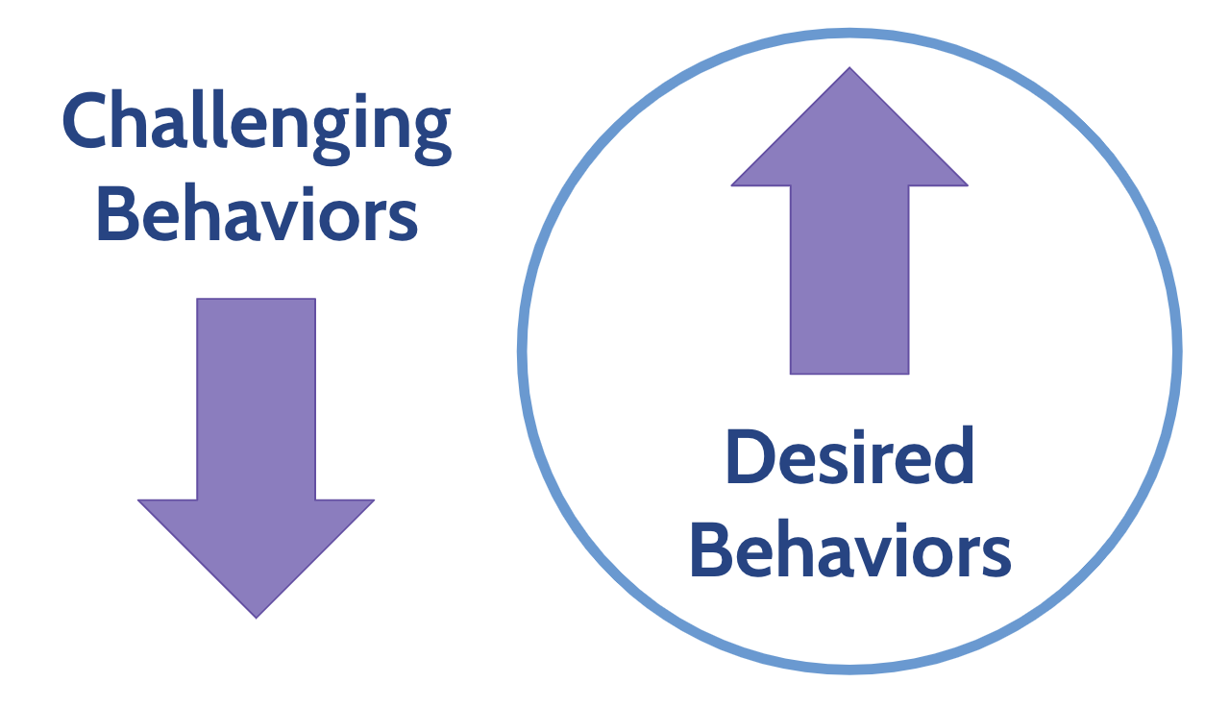
Changing Behaviors

Slide 11
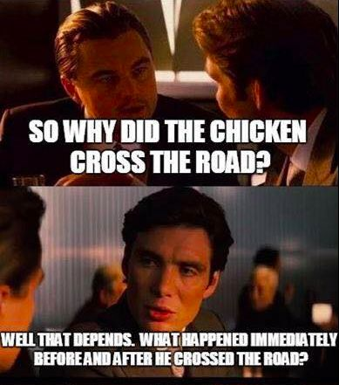
The A-B-Cs of Behavior
A = Antecedent
B = Behavior
C = Consequence
Antecedent → Behavior → Consequence

Slide 12
The A-B-Cs of Behavior, continued
A = Antecedent – What happens just BEFORE the behavior we are focused on
Focusing on the ANTECEDENT helps prevent the behavior from NEEDING to occur
Focus on triggers in the environment
Antecedent → Behavior → Consequence

Slide 13
The A-B-Cs of Behavior, continued 2
B = Behavior – What the person DOES.
Important to know and understand
Only the person can change their behavior
Antecedent → Behavior → Consequence

Slide 14
The A-B-Cs of Behavior, continued 3
C = Consequence – What happens right AFTER the behavior.
We determine the likelihood of what behavior will occur in the future
What do you want to see MORE of?
Reinforcement!
Antecedent → Behavior → Consequence

Slide 15
Setting Events
Events that happen before the antecedent or trigger for the challenging behavior. It effects the likelihood that a challenge behavior may or may not occur
Influence how we respond to student behavior
Helps to understand WHY a behavior might be occurring
“Plan A” or “Plan B” response

Slide 16

Setting Events, continued
Examples:
TRAMA
Hungry
Tired
Medication
Coffee…or no coffee
Sick
Argument before school / work

Slide 17
FUNCTIONS OF BEHAVIOR

Slide 18

What’s the Function???
WHY is the student engaging in this behavior?
What are they trying to gain access to or escape from?
FOUR Functions of behavior
Sensory (Automatic)
Escape
Attention
Tangible
Need to understand the function of the behavior:
In order to know how to help change the behavior
To know what replacement behavior to teach
To help in create a behavior plan.

Slide 19
FUNCTIONS OF BEHAVIOR, continued
Obtaining / Access to:
Attention (for adult or peers)
Tangible (get activity or item)
Sensory
Escaping / Avoiding
Demand / Tangible (from difficult task or non-desired activity)
Person / Social - adult or peer
Sensory

Slide 20
Common Functions of Behavior
To Obtain/ Get:
To Avoid/Escape:
Peer attention
Adult attention
Desired activity
Desired object/ items
Sensory stimulation: auditory, tactile, etc.
Difficult Task
Boring Task
Easy Task
Physical demand
Non-preferred activity
Peer
Staff
Reprimands

Slide 21
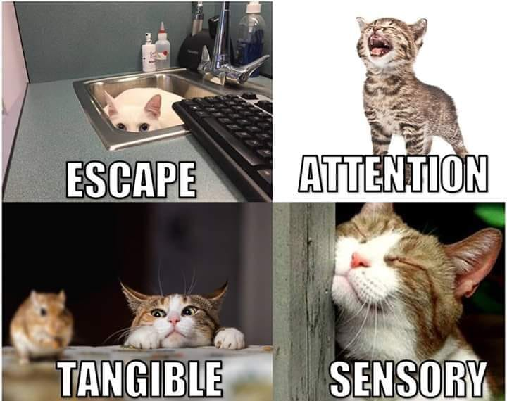
Function of behavior example 1

Slide 22
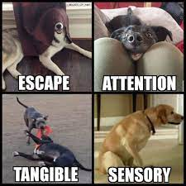
Function of behavior example 2

Slide 23
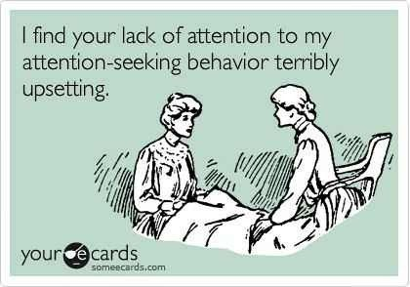
Attention
Person engages in this behavior to obtain attention.
Maintained by positive reinforcement.
Can be maintained by any form of attention.
Positive
Negative
Verbal
Proximity
Eye contact
Laughter

Slide 24
Attention, continued
Sometimes students engage in inappropriate behaviors to obtain attention
Individuals may be motivated to obtain attention that doesn’t seem desirable to most people.
Why?
Can be easier to obtain negative attention
Negative responses may be more intense
May not have the social skills to differentiate between desirable and undesirable social responses.

Slide 25
Attention Examples
Student walked in the hall quietly and was given a “thumbs up” by a teacher
Student told a joke and peers and teachers laughed
Student ran around the classroom and teacher gave prompt to sit down
Student blurted out answers in class and was told several times to raise his hand following the blurt
Student made silly noise and staff rolled their eyes

Slide 26
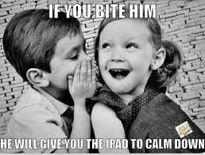
Tangible
Student engages in this behavior to gain access to items, or activities.
Maintained by positive reinforcement.
Not uncommon for parents & teachers to use as a distraction or redirection as a way to stop difficult behavior.
Child in grocery store check out aisle
Calming props/activities when the child engages in challenging behavior

Slide 27
Tangible Examples
Student given puzzle to “calm down” during a tantrum
Teacher gave student a snack to calm student down while crying
Student refused to hand iPad to teacher so teacher let them use it to avoid further escalation
Student skipped class to play video games at home

Slide 28
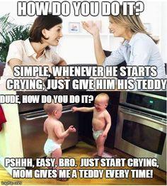
Sample 3

Slide 29
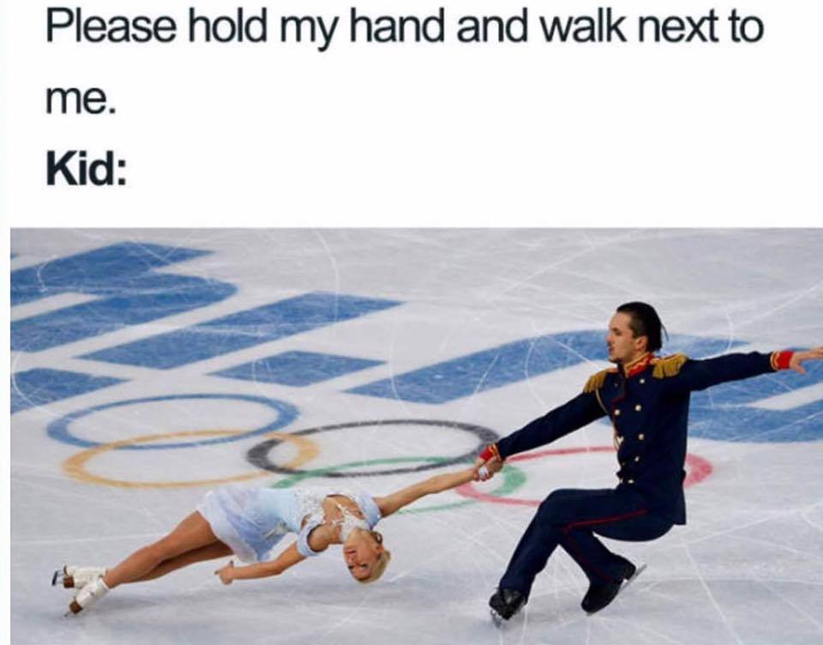
Escape/Avoid
Person engages in this behavior to escape from an activity or avoid participating in the activity altogether.
Maintained by negative reinforcement.
A common function of challenging behavior seen in schools.
Avoid academic demands
Avoid social interactions

Slide 30
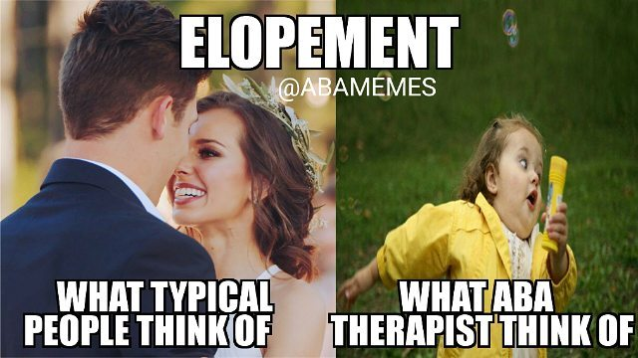
Escape/Avoid Examples
Ignore phone when a telemarketer calls.
Cross street to avoid interaction with someone.
Tell teacher you feel sick when you have a test, sent to nurse.
Student yells at peer during work and sent to time out.
Student screams during circle time so the teacher allows him to sit in the reading center instead of disrupting the group.
Student sitting at desk with head down and hood up, pretending to be asleep

Slide 31
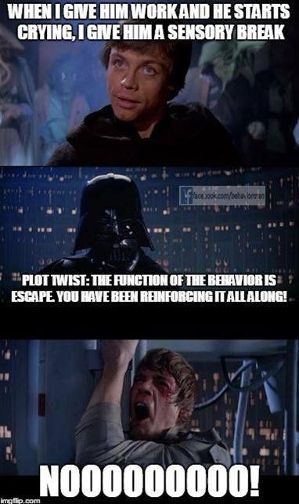
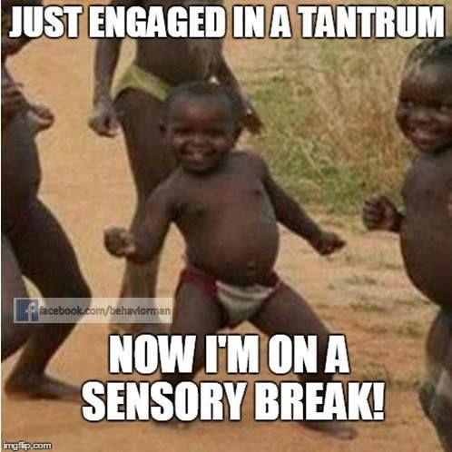
Function of behavior example 3

Slide 32
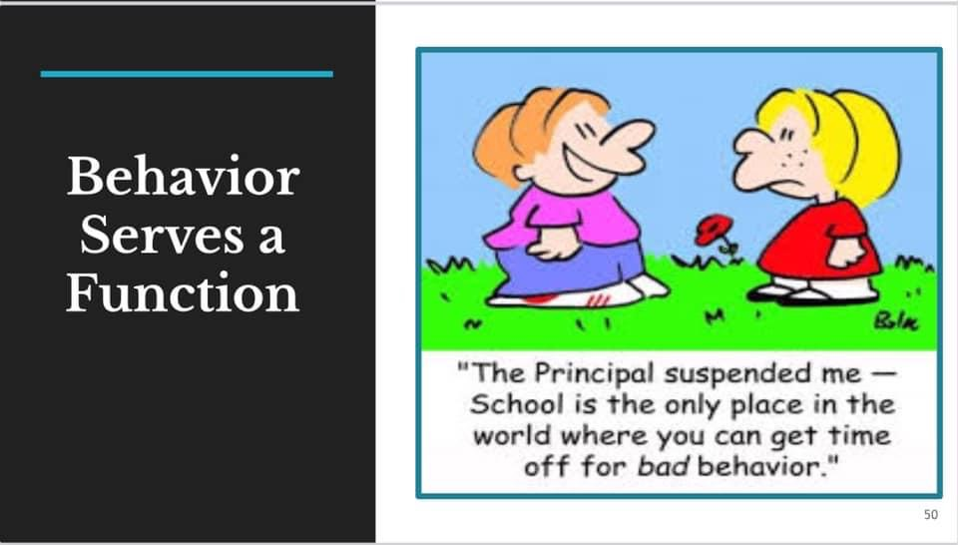
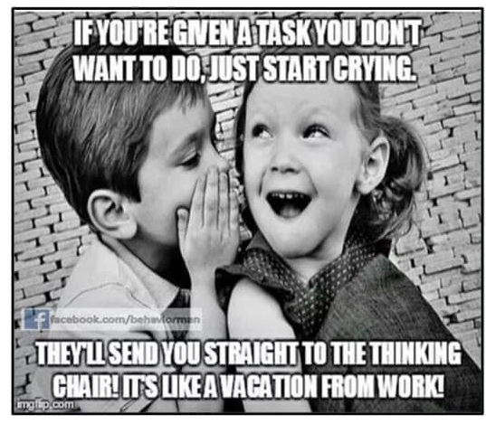
Function of behavior example 4

Slide 33
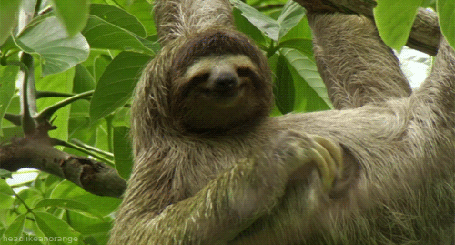
Automatic Reinforcement
Person engages in this behavior to produce some sort of internal stimulation.
The behavior itself is reinforcing
Automatic reinforcement function is often proposed when no changes in the environment are noted before or after the behavior occurs.
Often occurs when the individual is alone.
Maintained by positive or negative reinforcement.
Scratching an itch is an example of automatic reinforcement

Slide 34
Automatic Reinforcement Examples
Talking to yourself
Getting a blanket when you’re cold
Watching fingers/ “shadow hands”
Child is alone and is rocking back and forth or flapping hands in front of face.
Student running after sitting for an extended period of time
Feeling other’s clothing
Head hitting

Slide 35
Multiple Functions
Some behavior may serve dual functions
Multiple functions in same setting
Example: Peer attention and escape from work when yell out during math lesson
Multiple functions in different settings
Escape from math class
Obtain art teacher’s attention
It can sometimes be hard to separate functions in a school setting as challenging behaviors often have multiple consequences
Example: both pulled out of classroom (escape) and talk to principal (attention)

Slide 36
BEHAVIOR INTERVENTIONS

Slide 37
A quote
The behavior of the student is the most reliable indicator of how things are going. -Tyler Fovel, BCBA

Slide 38
Changing How We View Behavior
Behavior is COMMUNICATION
Behavior is purposeful - it has a function
Behavior is learned and is related to the context in which it occurs

Slide 39
Changing How We View Behavior, continued
Behavior is interactive with people and the environment
YOU are part of the environment
“We are 50% of every interaction with a child, so we have a lot of control over that interaction.”
You can only change YOUR behavior

Slide 40
Changing How We View Behavior, continued 2
We must view student’s challenging behaviors as a teaching problem in which errors need to be eliminated and correct responses need to be taught and strengthened
Just like we do when we teach a new concept or lesson…

Slide 41
“If a child doesn’t know how to read, we teach
If a child doesn’t know how to swim, we teach
If a child doesn’t know how to multiply, we teach
If a child doesn’t know how to drive, we teach
If a child doesn’t know how to behave, we…….
Punish? Teach?
Why can’t we finish the last sentence as automatically as we do the others?”
-John Herner

Slide 42
Research tells us...
Effective teachers and staff:
Spend more time responding and praising expected behavior than responding to inappropriate behavior
Know that student do NOT learn when presented with aversive consequences
Understand we DO learn better ways of behaving by being taught directly and receiving consistent feedback on the behaviors that we want to see

Slide 43
How do they do it??
Being less REACTIVE
Being more PROACTIVE

Slide 44
ANTECEDENT INTERVENTIONS AND MODIFICATIONS
Managing yourself Instructional Control Pairing Antecedent modifications Extinction Burst

Slide 45
MANAGE YOURSELF FIRST

Slide 46
First steps to managing behavior….
Manage
yourself
first!

Slide 47
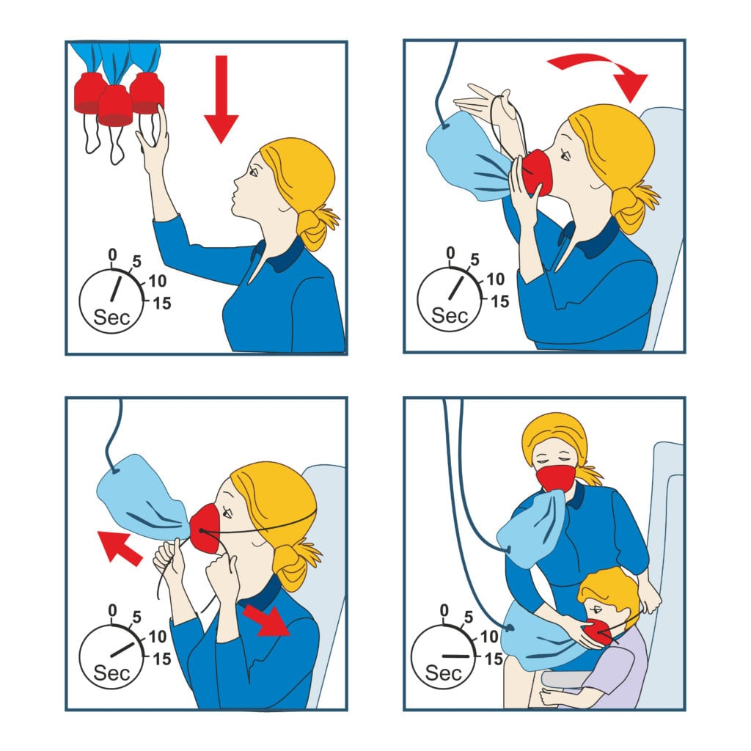
Put your oxygen mask on first!

Slide 48

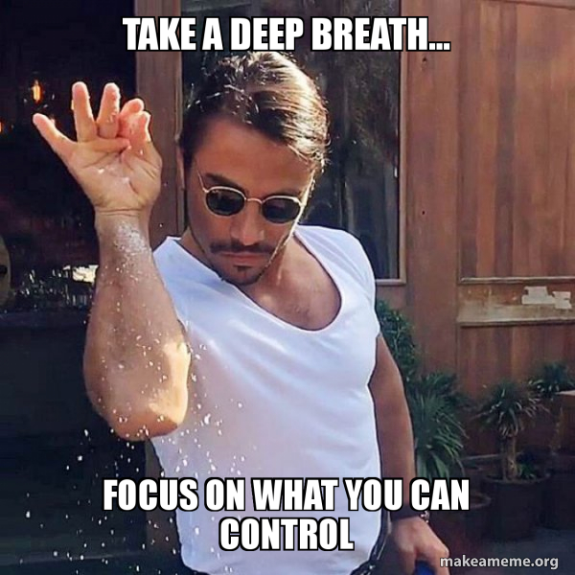
Keep yourself calm!
Don’t take it personally!
Put up your invisible shield.

Slide 49

NON-VERBAL COMMUNICATION!
Neutral voice tone and rate
How do you want to be talked to when you are upset?
Be aware of body language
If someone can’t hear your voice, what does it look like you are saying when they watch you?

Slide 50

DON’T PICK UP THE ROPE! Don’t get in a “tug-o-war” with the student.
What behaviors can you IGNORE?
Don’t sweat the small stuff – “Just right portion”
Ignore the BEHAVIOR – NOT the student!
If you find you did pick up the rope – just PUT IT DOWN…

Slide 51
Responding to Challenging Behaviors
How you respond when the small behaviors DO occur will determine the future likelihood of those behaviors occurring AGAIN!
How can YOU behave differently so that the STUDENT will behave differently.

Slide 52
INSTRUCTIONAL CONTROL and PAIRING

Slide 53

Instructional Control
When you have instructional control - you and the student have a positive working relationship where the student wants to follow your lead.
This is an ongoing process throughout the relationship with the student.
Is the student coming TO you or running AWAY from you?

Slide 54
Instructional Control, continued
How to get instructional control:
When you don’t have instructional control you see:
PAIRING
Be in control of the reinforcement
Follow through with what you say
Tell don’t ask (“want to do your math?”)
All staff respond consistently
Be prepared before you giving demands
Create opportunities to address and teach problem solving
Show the student how it will benefit them to follow your directions
Arguing / debating
Walking away / ignoring
Staff avoiding giving demands to avoid student response
Staff rationalizing challenging behaviors

Slide 55
Pairing - What is it?
Pairing is the process of combining (i.e. pairing) the learning environment, people, and setting with ALREADY established reinforcers (the items you have already determined to be rewarding)
Through pairing you want to create an environment in which the student wants to be in and wants to learn (i.e. willing learner)
Results in YOU becoming reinforcing to the child!
Want student to see you as the deliverer of “all good things”.

Slide 56
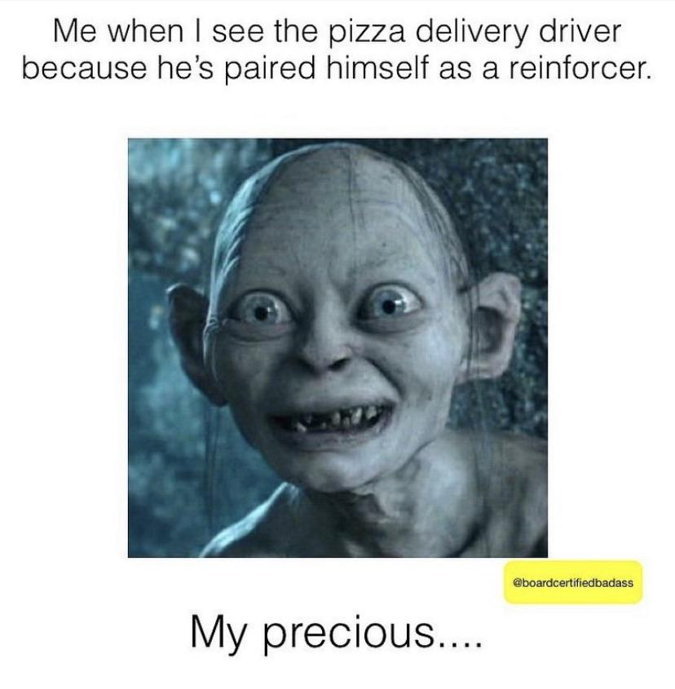
Pairing - why is it important?
To establish a rapport
To learn what motivates a student
To become associated with fun / positive things
To gain instructional control
WITHOUT PAIRING YOU ARE JUST PUTTING OUT ONE FIRE AFTER ANOTHER WITHOUT ADDRESSING THE UNDERLYING ISSUE.
Motivated students will be paying attention and ready to learn!

Slide 57

When to Pair?
First meeting a student
Before an instructional activity
Each time you re-engage with your student
Between activities or during breaks
We often miss great opportunities to pair by letting students take breaks on their own or have free time without adult interactions
During preferred activities
After a tough behavior moment (e.g. students needed to leave room because of a challenging behavior)

Slide 58
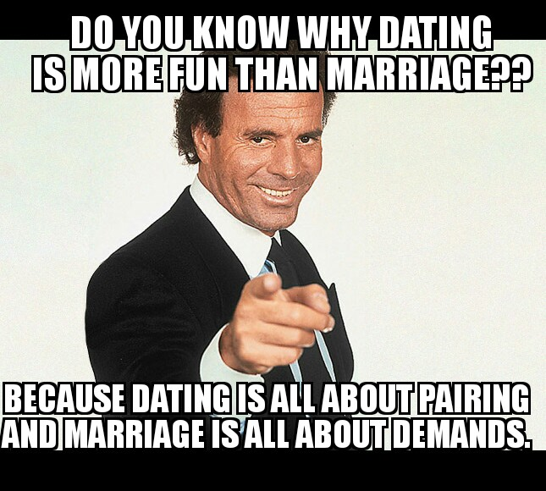
Pairing

Slide 59
Antecedent Modifications

Slide 60
Implement Interventions Based on Modification of Antecedents
What does it mean to modify antecedents as an intervention?
These modifications are happening PRIOR to the challenging behavior occurring
This is a preventative method to the challenging behavior versus reactive responding to the challenging behavior
In order for this intervention to be effective, data on the A-B-C’s of behavior is needed with clearly defined antecedents to the behavior

Slide 61
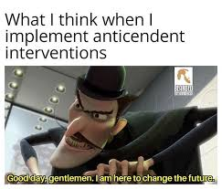
Examples of Antecedent Modifications
There are MANY different types of antecedent modifications. We use them all the time and don’t even realize it.
There are a couple key ones that we will cover today:
Preventative Prompts
Non-contingent Reinforcement
Choices
Visual supports
Praise Statements

Slide 62
Preventative Prompts
PREVENTATIVE PROMPTS
Brief reminder of the expectations, just prior to when the behavior should be demonstrated
“Raise your hand when you know the answer.”
“In a calm voice, tell me your concerns.”
“Remember, after I give you an instruction, you will say OK and do it right away.”
”In a minute but not yet.”
When you have taught the skill, then you can use these quick reminders to cue the students to the behavior you want to see before they engage in it.

Slide 63
Non-Contingent Reinforcement (NCR)
Reinforcement that is not delivered based on the occurrence of a behavior, but instead on a fixed-time schedule.
This is considered an antecedent intervention, because the goal of this is to provide the child with reinforcement before he engages in the challenging behavior, therefore making engaging in the challenging behavior to gain reinforcement is less likely.

Slide 64
NCR Examples
Student engages in disruptive behavior to gain attention from teacher. Intervention: teacher gives student attention on a fixed-schedule throughout the day.
Student leaves classroom and runs in hallways. Intervention: movement breaks are scheduled at specific times throughout the day.
Student engages in challenging behavior of going through teacher’s cupboards to gain access to a snack. Snack breaks are provided throughout the day.

Slide 65
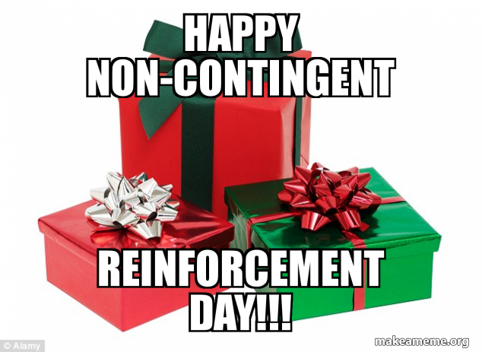
Non-contingent reinforcement meme

Slide 66
Offering Choices
Offering choices to a student is an excellent and very easy way to modify the antecedent so that they engage in the behavior you want to see instead of the behavior you don’t want to see.
Best part - YOU get to pick the choices - gives you control over the options but gives the student a sense of control of what is happening to them and be a part of the decision making.
Remember: Keep options limited and only offer options you can deliver

Slide 67
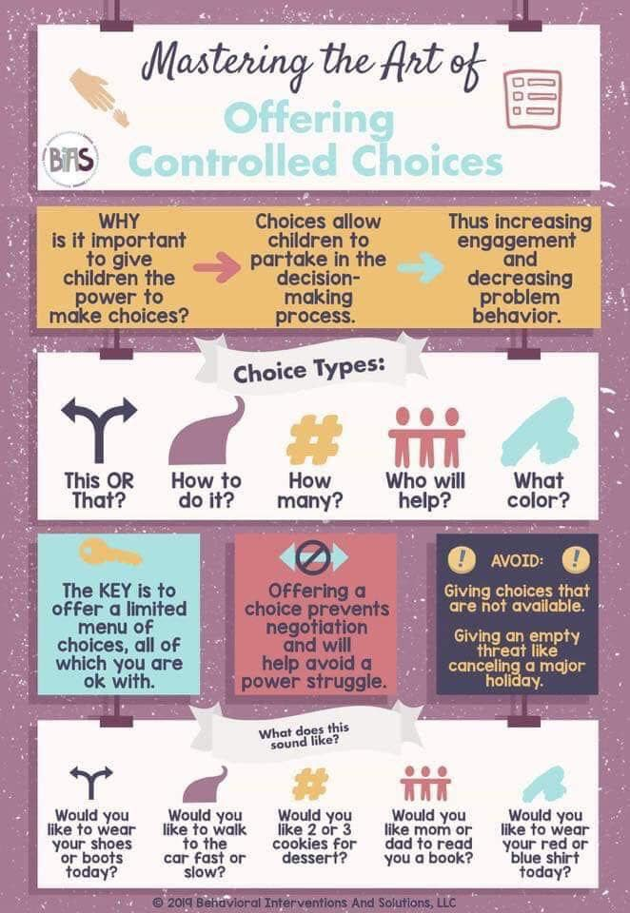
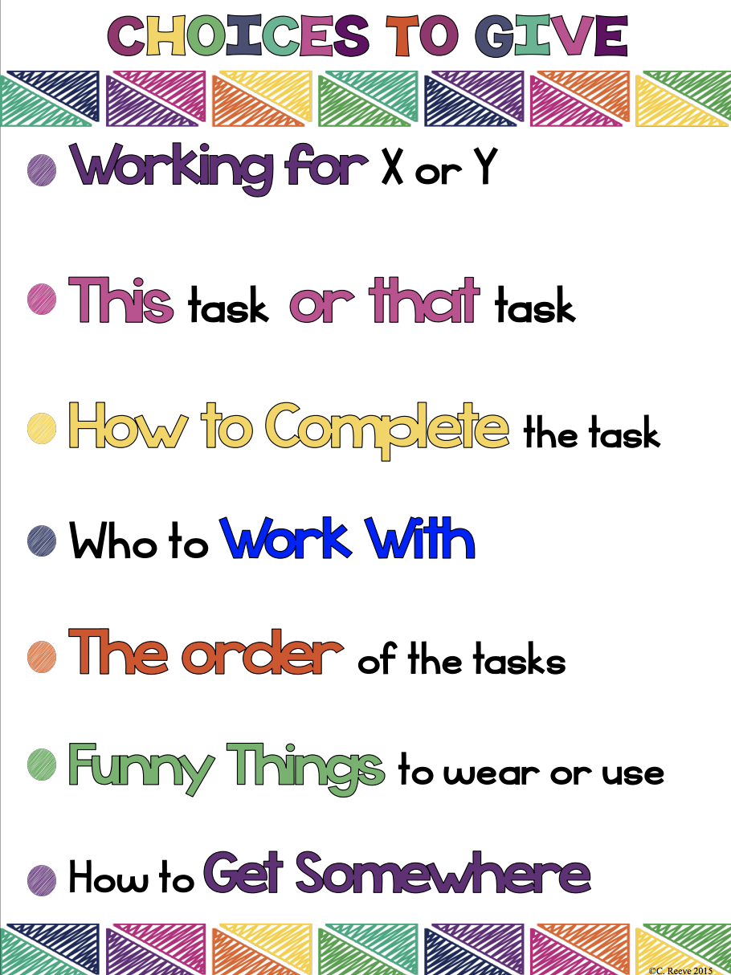
Choices examples

Slide 68
Visual Supports
Visual supports do not necessarily mean a visual (Boardmaker or picture) schedule. It means anything that provides a cue visually to a student for how to engage in the appropriate behavior.
Examples:
Timer
Classroom schedule
Checklist
Post it note with next step
Calendar
Make sure they are age appropriate!
Think about your day -- how many visual prompts do you use and not even realize it?

Slide 69
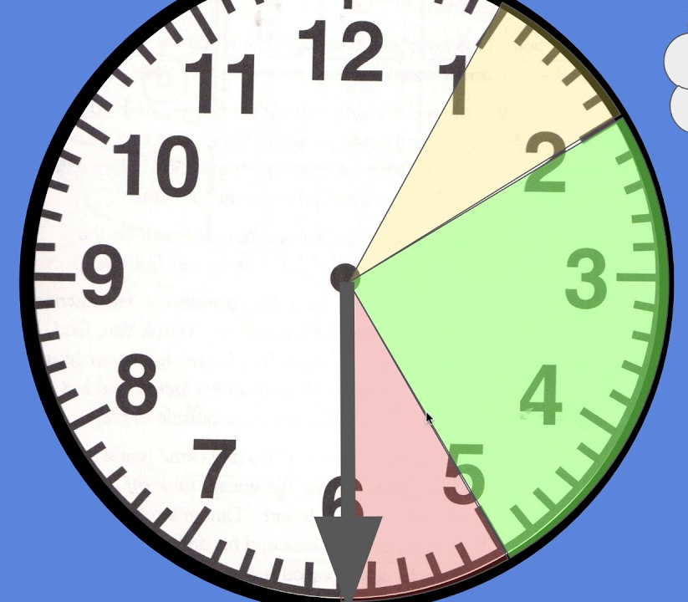
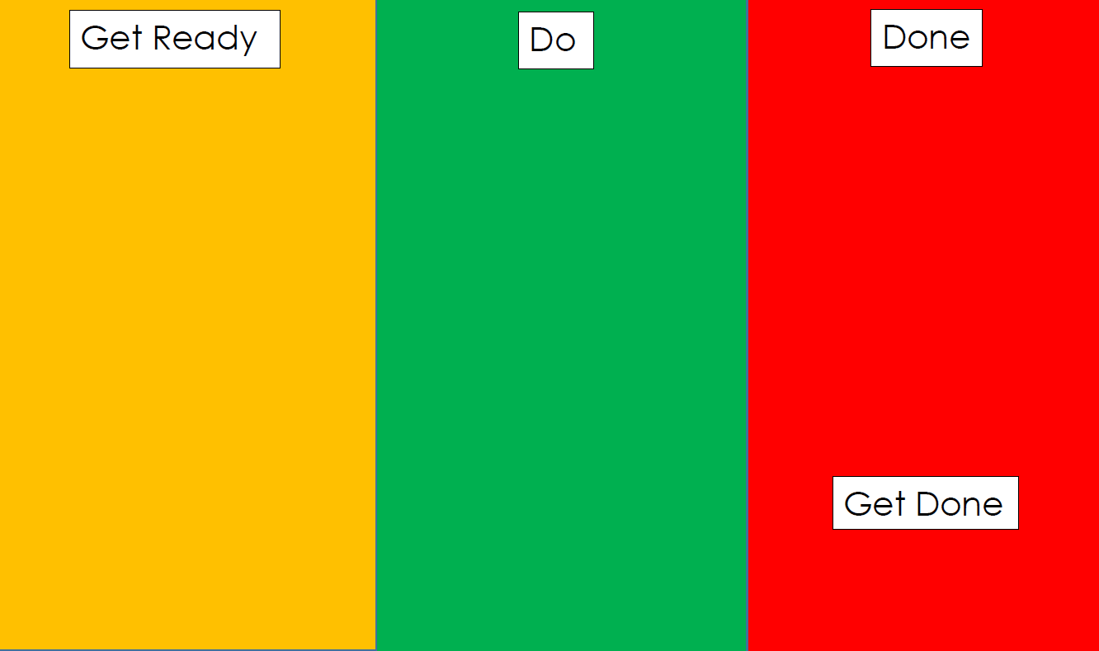
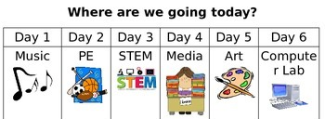
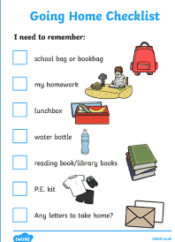
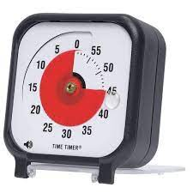
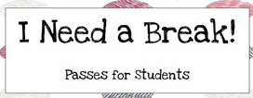
Visual Supports Example

Slide 70
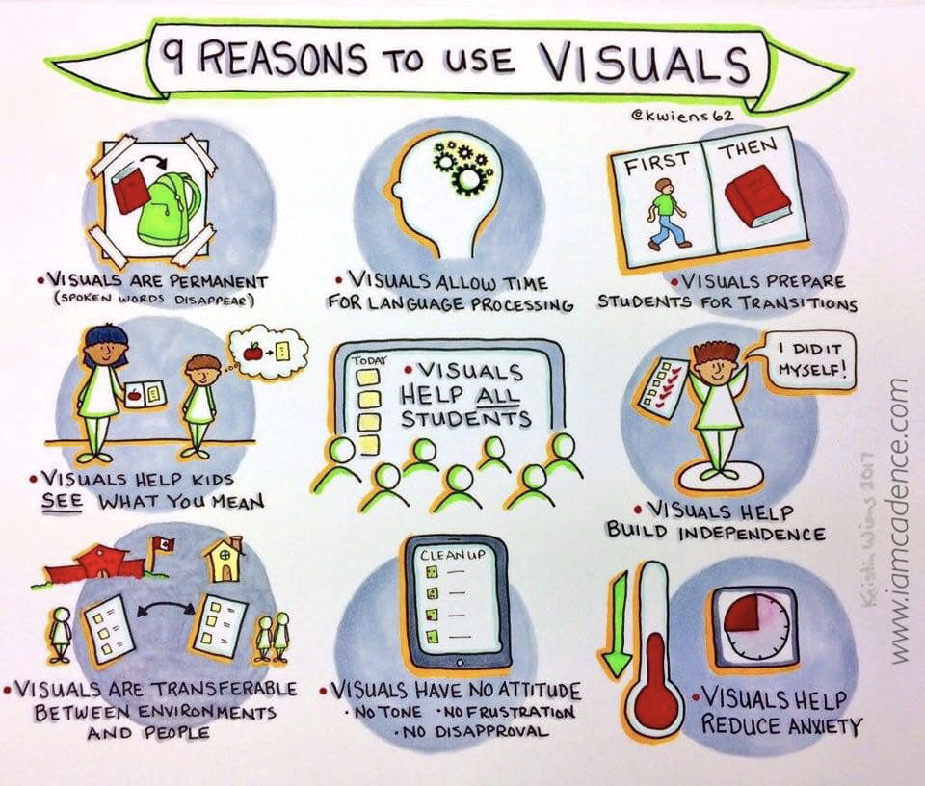
Reasons to use Visual Supports
Permanent
Allow for processing
Prepare for transitions
Help SEE what you mean
Help ALL students
Build independence
Transferable
No non-verbal language
Reduce Anxiety

Slide 71
Modification of Antecedents
More examples of interventions using modification of antecedents:
Scheduled breaks
Visual schedules
Work modification
Pre-teaching
Simplified instructions
Prompts
Warnings of upcoming changes in routine
Offer choices
Tests read aloud to student
Change seats
Keep student and specific peers separate
Scheduled snacks

Slide 72
Modification of Antecedents, continued
A few things to consider:
Make sure to keep reinforcing appropriate alternative behaviors!
What data collection will be used to show if the antecedent modification is effective?
This will take time to produce the desired change in behavior, so allow for this time
When will you determine it is time to fade back on these modifications?

Slide 73
CONSEQUENCE INTERVENTIONS

Slide 74
EVERYONE will use whichever behavior works most effectively and efficiently for them to attain their desired outcomes.
We ALL engage in this EVERYDAY in ALL ENVIRONMENTS!

Slide 75
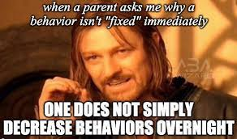
Even if you do everything perfectly, we can’t avoid some challenging behaviors or situation.
But what can we do to MINIMIZE the challenging behaviors???

Slide 76
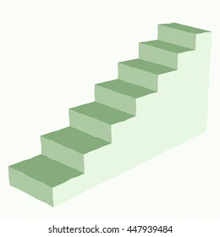
Managing the escalation of challenging behavior
Think about a student’s behavior as if they are on a flight of stairs.
Each step is an increase in the level/intensity of their challenging behavior.

Slide 77
Managing the escalation of challenging behavior, continued
OUR job… We need to focus on helping the student to come back down and get off the steps.
Help the student to not need to go up higher on the steps…to keep at a lower intensity.

Slide 78
Responding to Students
Provide Help
Set limits effectively
Use good corrective strategies
Distract and Reset
Incompatible Behaviors
Behavior Momentum
Give them Time

Slide 79
PROVIDING HELP

Slide 80
Providing Help, continued
The student may be using their challenging behavior to let you know they have a want or need.
How can you help meet their need?
How can you solve the problem?
Do this for LOWER level behaviors… For higher level behaviors, move on from offering help – “if the help was going to help, it would have already helped”

Slide 81

Providing Help, continued 2
What is the FUNCTION of the student’s behavior?
S - Sensory
E - Escape
A - Attention
T - Tangible

Slide 82
Providing Help, continued 3
If you know what the function of the behavior is, you can help them fill that need, but in a more appropriate way.
Escape - Do they need a break?
Attention - Can you work with them instead of alone?
Tangible - Can you give them the words to better request what they need?
Sensory - Movement or calming activity?

Slide 83
LIMIT SETTING

Slide 84
Limit Setting - Things to keep in mind…
Setting a limit is not the same as issuing an ultimatum.
The purpose of limits is to teach, not to punish.
Offering choices and stating the circumstance around those choses.

Slide 85
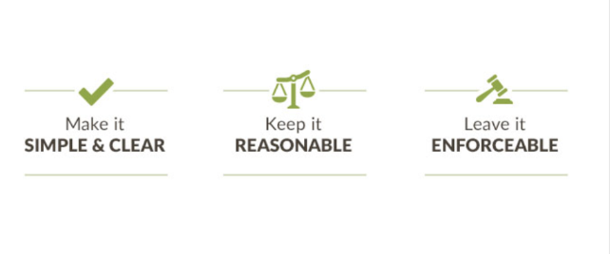
Sample 9

Slide 86
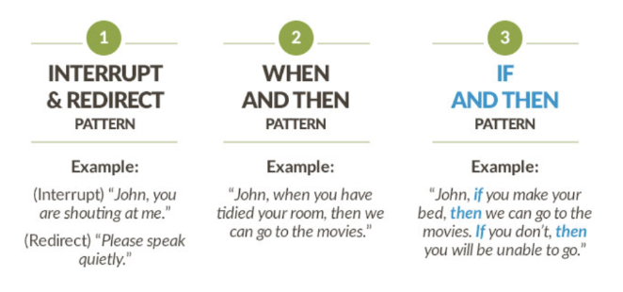
Sample 10

Slide 87
DISTRACT AND RESET

Slide 88
Distract and Reset, continued
DON’T just tell a student to “stop” or “calm down”!
Tell them what they could DO instead.
“Take a deep breath”
“Look at me”
“Put this over there”
“Turn off the light”
“Sit down”
USE LESS WORDS

Slide 89
Distract and Reset, continued 2
Change the topic or focus
Bring up something that is not related to the directions, expectations, behavior, etc.
Get them to SAY or DO something different!
Think of high interest areas for the student.
“Did you go to the game last night?”
What’s the best thing you watched on You tube lately?”
“What is your favorite color?”
“Did you see that” (pointing out the window)
Change Staff! Let someone else be the distraction!

Slide 90
Incompatible Behaviors
Ask them to do something that they can’t do the challenging behavior at the same time.
“Give me five”
“Put this over there”
“Walk like a penguin”
“Carry this”
“Take a deep breath”
“Don’t run, walk”
TELL - Don’t Ask!

Slide 91

Behavior Momentum
Behavior momentum is like getting the ball rolling down the hill.
You have to get it started and push it until it can keep going on it’s own…help them get started on responding to directions appropriately then increase the expectation as they are able to do it better and better.
Start with something simple - that you know they can do.
Start simple
Keep going and build up

Slide 92
GIVE THEM TIME!

Slide 93
Give them TIME! Continued
Give them time to come down ONE STEP – calmer not calm!
Helps avoid power struggles
Helps to keep you from, unintentionally, making the situation worse
They just need to show one small step towards less intense behaviors

Slide 94
Give them TIME! Continued W. A. I. T
Do not walk away - be ready to engage when they/you are ready
Stay close but giving them space
Always be watching and monitoring
Watch your non-verbal language
NO TALKING
W.A.I.T.
(give them time…)
Why Am I Talking?

Slide 95
Give them TIME! Continued
Other reasons to give them time…
They said to “Leave me alone” or “Get Away”
You know they just need some space
Anything else you try is making things worse
You are avoiding the power struggles
YOU need time

Slide 96
Consequence-based interventions
As a reminder, a consequence is anything that happens after the behavior occurs. This consequence can either increase or decrease the likelihood of that behavior happening again in the future.
Always go back to the FUNCTION OF THE BEHAVIOR!
Sensory
Escape
Attention
Tangible

Slide 97
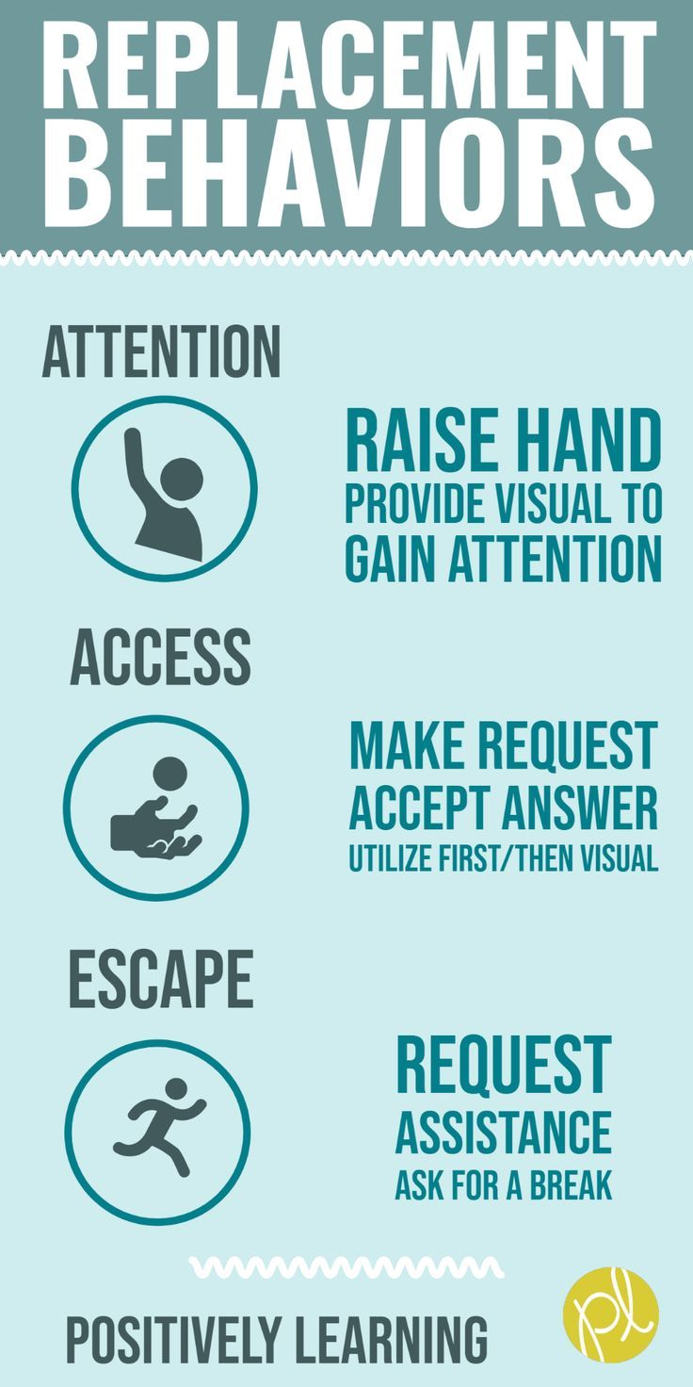
Replacement Behavior
When you know the function of the behavior - you can teach the student a replacement behavior that is appropriate for the environment AND serves the same function as the inappropriate behavior.
Teach these skills while building up the skills and strategies needed to behavior appropriately without the accommodations or additional support.

Slide 98
Replacement Behavior, continued
Ideally, meets these three conditions:
Achieve the same result
Be as efficient
Within the students ability
Consider what skills are underdeveloped that have not been learned or mastered. When these skills are missing, more supports may be needed.

Slide 99
Examples of Replacement Behavior
Examples:
Tapping on desk, making lots of noise to get a break= prompt them to ask for a break and reinforce with request granted
Disrespectfully refusing to read = teach option to say “I pass” first
Student has difficulty transitioning from preferred activity to non-preferred activity. Teach student an in-between transition strategy and prompt compliance.

Slide 100
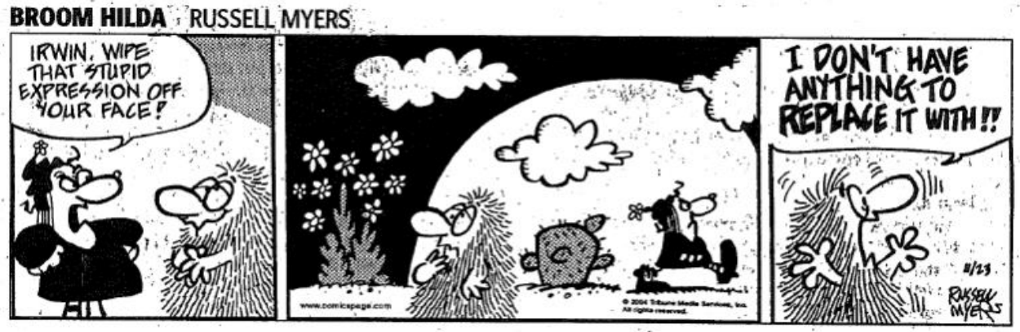
Replacement behavior example

Slide 101
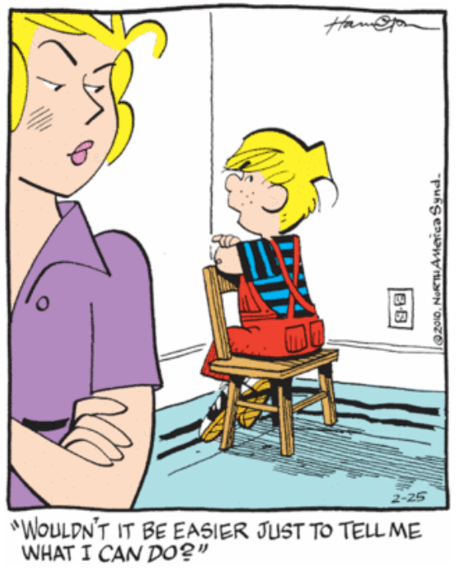
Replacement behavior example 2

Slide 102
Behavior Momentum and Premack Principles

Slide 103
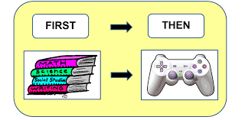
Premack Principle
Person will perform the less desirable activity to get access to the more desirable activity
FIRST / THEN!
“Grandma’s Rule”
“You have to eat all your vegetables to have some chocolate cake!”

Slide 104
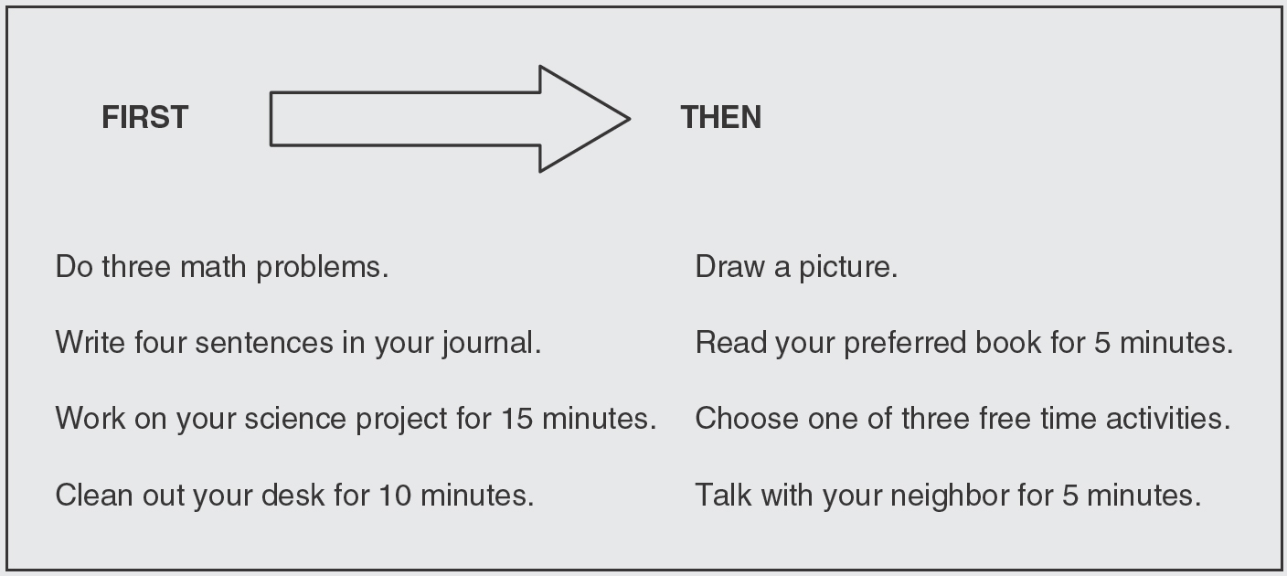
Premack Principle, continued

Slide 105
Premack Principle Examples
“We can read a story together if you read two pages first.”
“You can take a 10 minute break if you finish 5 math problems by yourself".
“First you clean up, then we’re going to the park!”
“You can watch a youtube video if you eat all your lunch today.”
“Who wants free time? (child raises hand) Okay, hurry and put your supplies away so we can have free time!”

Slide 106
Premack Principle, continued 2
Things to remember:
Explain what the reinforcer is first
Be consistent on delivery of reinforcement AFTER completion of task
Make sure the task is reasonable and reachable
State the demand THEN the reinforcement
Focus on the positive of getting desired item instead of the threat of losing it
Rx has to actually be reinforcing
Best practice is the rx matches the demand or skill

Slide 107
High Probability Requests
High Probability Requests or Behavior Momentum
Behavioral momentum interventions are designed to build a student’s “momentum” for following directions.
You start with demands that you know they CAN and WILL follow.
The goal of behavioral momentum is to create a “momentum of success”.

Slide 108

Behavioral Momentum
Just like a boulder rolling down a steep hill will gain speed and momentum, so does a behavior the more we engage it (appropriate or inappropriate).
This momentum will keep the student “rolling down the hill” in the direction we want, so that he or she is more likely to continue following subsequent instructions, even ones that are difficult or disliked.

Slide 109
Key things to remember...
Reinforce!
As the student completes each easy request, be sure to deliver praise or other types of reinforcement to the student. This is the key! The student should enjoy what happens after he or she correctly follows your instruction. This will build “momentum” for the student in doing what you ask him or her to do. Then, deliver the difficult request. Again, be sure to provide reinforcement to the student if she or he completes the instruction appropriately.

Slide 110
Key things to remember...Cont.
Vary the requests!
It is important to vary the presentation of the high-p requests. Do not deliver the exact same sequence of high-p requests each time. If the high-p request sequence is the same each time, the sequence becomes a cue for the student that a low-p request is imminent.

Slide 111
Considerations...
They should be brief & simple to complete
They should be able to be delivered in the context or setting in which the difficult request is typically presented
The easy requests need to be things that are in the students repertoire
If the student is not capable of completing the difficult task, this intervention will not work
A crucial component is that the student receives reinforcement after they successfully complete each easy request prior to receiving the next request

Slide 112
Considerations... continued
They are not meant to be “fired” at the student in rapid succession.
The student may find this even more aversive than the difficult instruction itself.
But, too much of delay between the easy requests loses the momentum.
You may want to deliver the instructions quietly or discreetly so that it does attract embarrassing attention
If the student is not capable of completing the difficult task, this intervention will not work

Slide 113
Fading Procedure
This intervention is not intended to be a permanent method of increasing compliance. As the student experiences success with this intervention, it is important to take steps to “fade”, or decrease, its use. When fading the intervention:
Try not to fade out this intervention too quickly. Once the student is experiencing success, try subtracting one of the easy instructions for the next several times. Assuming the student is still experiencing success responding to the difficult instruction, continue to subtract easy requests until you are able to give the problem instruction without incidence.

Slide 114
Fading Procedure continued
Continue to provide reinforcement to the student for following the difficult instruction. You might also slightly decrease (but not eliminate) the reinforcement you provide for following the easy instructions, and focus your reinforcement on student compliance for the difficult instructions.

Slide 115
Planned Ignoring and Extinction Burst

Slide 116
Planned Ignoring

Slide 117
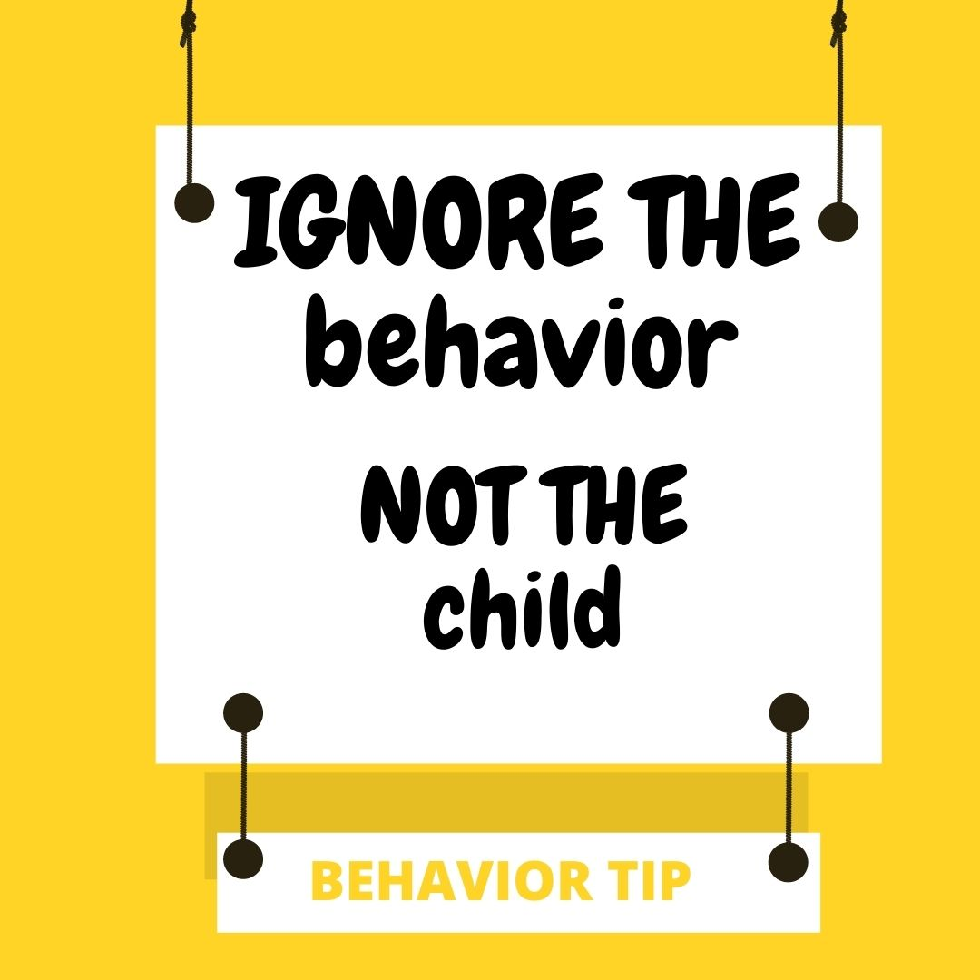
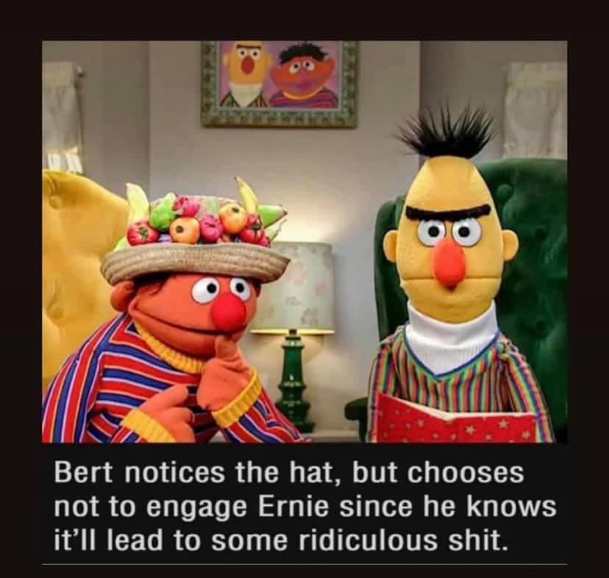
Planned Ignoring, continued

Slide 118
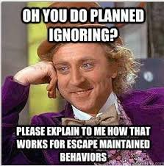
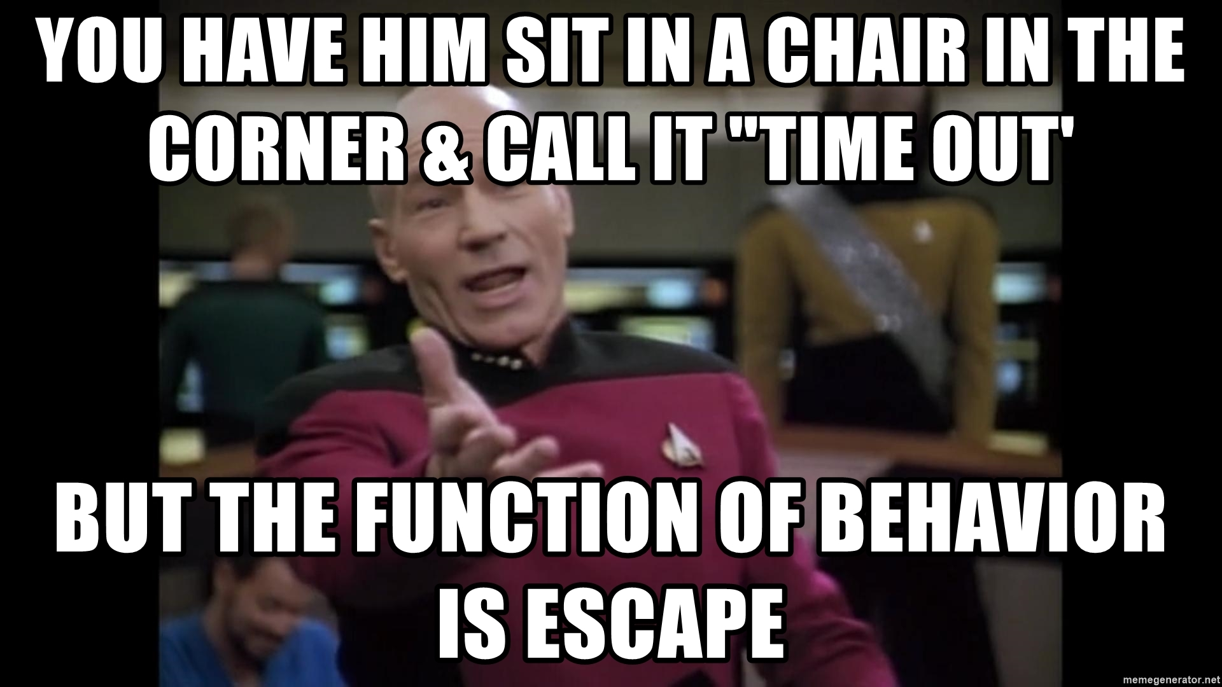
Why behavior function is important with planned ignoring...

Slide 119
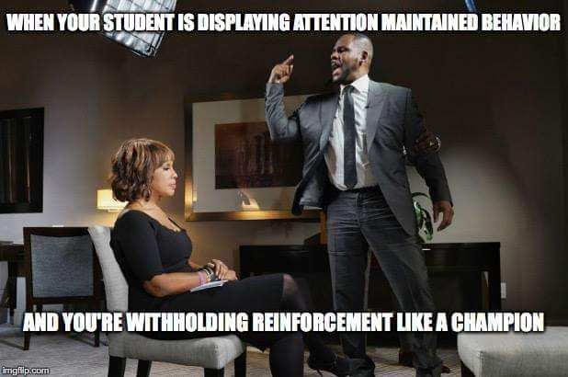
Withholding Reinforcement example

Slide 120
Things to Consider with Planned Ignoring
Do you have control over the reinforcer maintaining the behavior?
This can be hard to do in a school setting and needs to be discussed with the team
Are their ways to control the environment to make control of the reinforcer possible?
Example: smaller, controlled, one-on-one setting for brief time through beginning of extinction procedure
ALWAYS teach a replacement behavior
Function-based replacement behavior
Prepare for the Extinction Burst

Slide 121
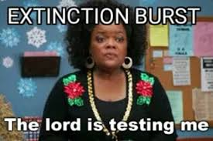
Extinction Burst
An extinction burst is an initial increase in frequency and/or intensity of the behavior when the reinforcement of that behavior is removed.
This is common
Expect it
Plan for it
You can get through it!

Slide 122
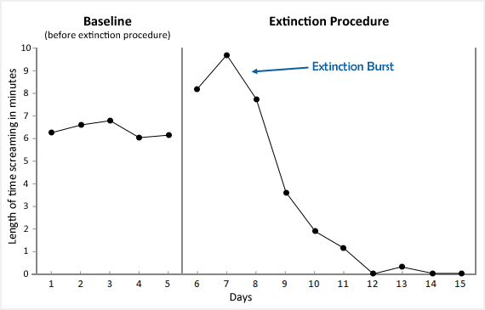
Extinction Burst, continued
Example of data of a behavior that was put on extinction

Slide 123

Thank you!
Kelley Foehrkolb, BCBA, LBA
kfoehrkolb@northfieldschools.org

Slide 124
Charting the Cs Conference 2025
Statewide Professional Development to Support the Workforce and Low Incidence Disability Areas in the State of Minnesota.
This presentation is partially funded with a grant from the Minnesota Department of Education using federal funding, CFDA 84.027A, Special Education – Grants to States.

