Slide 1


Empowering Voices: Using AAC to Support Literacy Skills in Developing Communicators
Charting the Cs Conference 2025:
To Literacy and Beyond
Cooperation
Communication
Collaboration
April 29, 2025
Jen Erickson
Chloe Converse

Slide 2
Who are we?
Jen Erickson - Speech language pathologist who has worked with students aged 5-18 with a focus on AAC. Experience consulting and supporting SLPs and students who use AAC as well as develop and teach AAC courses for graduate students.
Chloe Converse - Speech language pathologist who has worked in the pediatric clinical setting and public school setting. Experience working with students with complex communication needs.
Currently, we both work at Bridge View School in Saint Paul which is a federal four level programming serving students who are autistic, have developmental cognitive disabilities, and those who are complex communicators.

Slide 3
Learning Objectives
Name at least two communication systems (low, mid, or high tech), that might be used by complex communicators during classroom literacy activities
Demonstrate how to implement at least one AAC mode to increase student participation and engagement in classroom literacy activities
Identify at least one resource that can support the use of Augmentative and Alternative Communication (AAC) in literacy-based activities

Slide 4
What is Augmentative and Alternative Communication (AAC)?
AAC encompasses a variety of communication modalities used for expression of communication including the following:
manual signs
gestures
finger spelling
tangible objects
line drawings
picture symbols
letter boards
speech-generating devices
(American Speech-Language Hearing Association, n.d.)

Slide 5
What is Augmentative and Alternative Communication (AAC)?
AAC is augmentative when used to supplement existing speech, alternative when used in place of speech that is absent or not functional, or temporary as when used by patients postoperatively in intensive care (Elsahar et al., 2019).
AAC falls under the umbrella of Assistive Technology (AT)

Slide 6
You might be considering AAC if someone…
Doesn’t have a way to express wants and needs
Uses 1-2 word phrases
Speech consists primarily of echolalia
Can’t communicate about things not in the immediate context
When tired, sick, or upset intelligibility is impacted
AAC strategies are needed for clarification for verbal communication
Speech is hard to understand over the phone or video chat
Does not initiate speech
Uses maladaptive behaviors instead of speech to communication
Specific ongoing health or medical needs

Slide 7
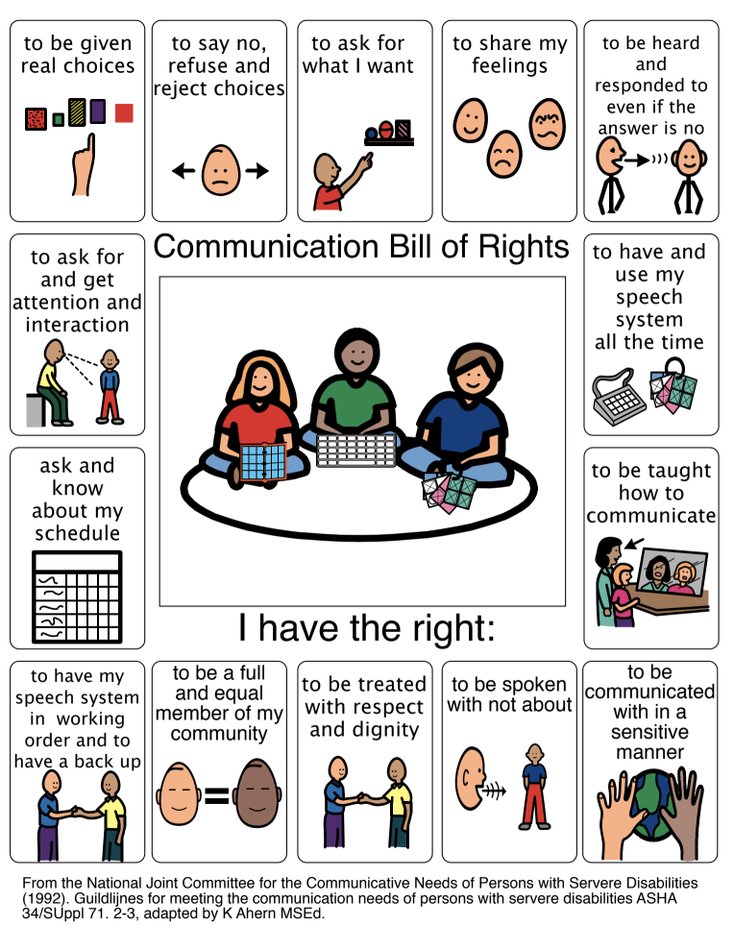
Communication Bill of Rights

Slide 8

Who are those with complex communication needs (CCN)?
Someone with complex communication needs (CCN) demonstrates difficulty and challenges in daily interactions due to limited use and understanding of natural speech
May see higher receptive language skills

Slide 9
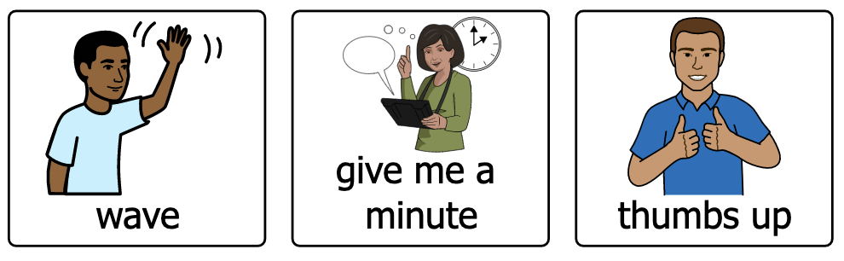
No-Tech AAC
Use of your body to communicate - signs, gestures

Slide 10
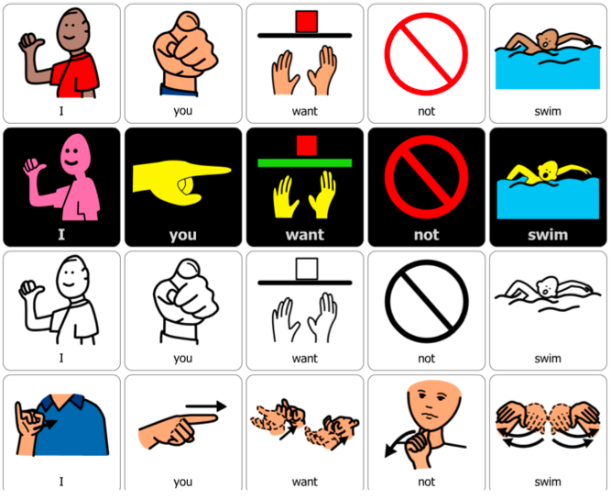

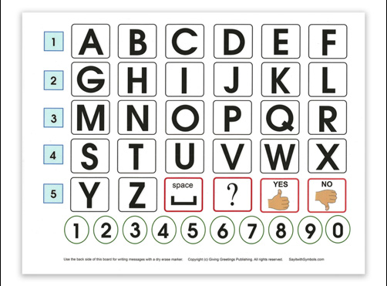
Low-Tech AAC
Non-electronic equipment or tool used outside of one’s body to communicate
picture symbols
pen and paper
alphabet board

Slide 11
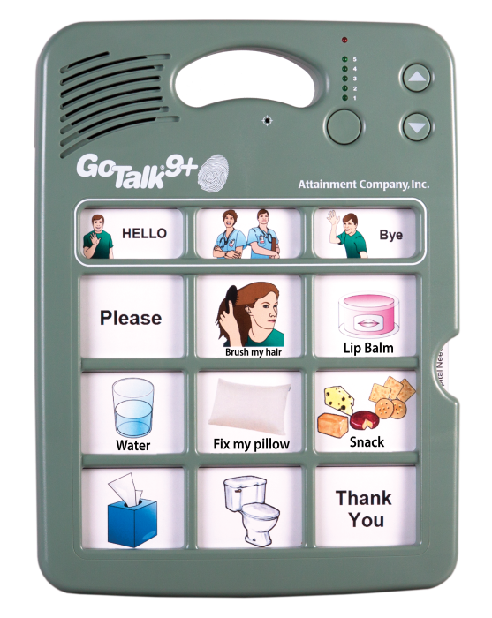
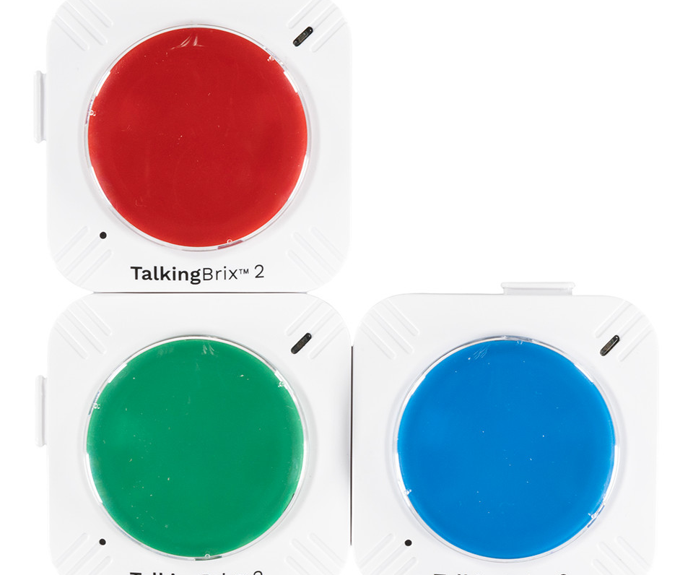
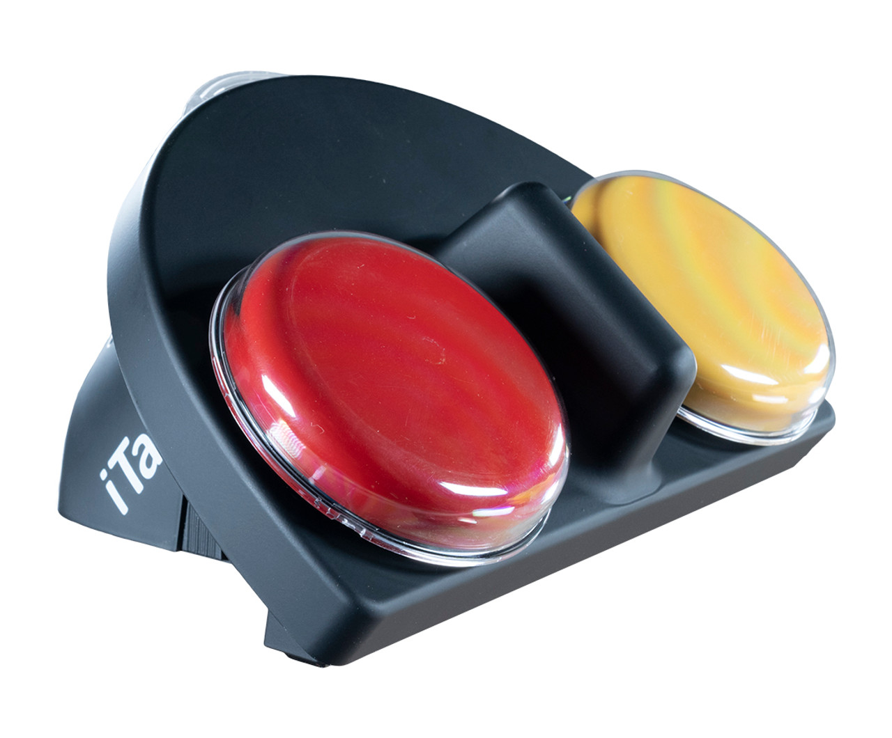
Mid-Tech AAC
Battery operated electronic devices
iTalk 2
GoTalk 9
Talking Brix 2

Slide 12
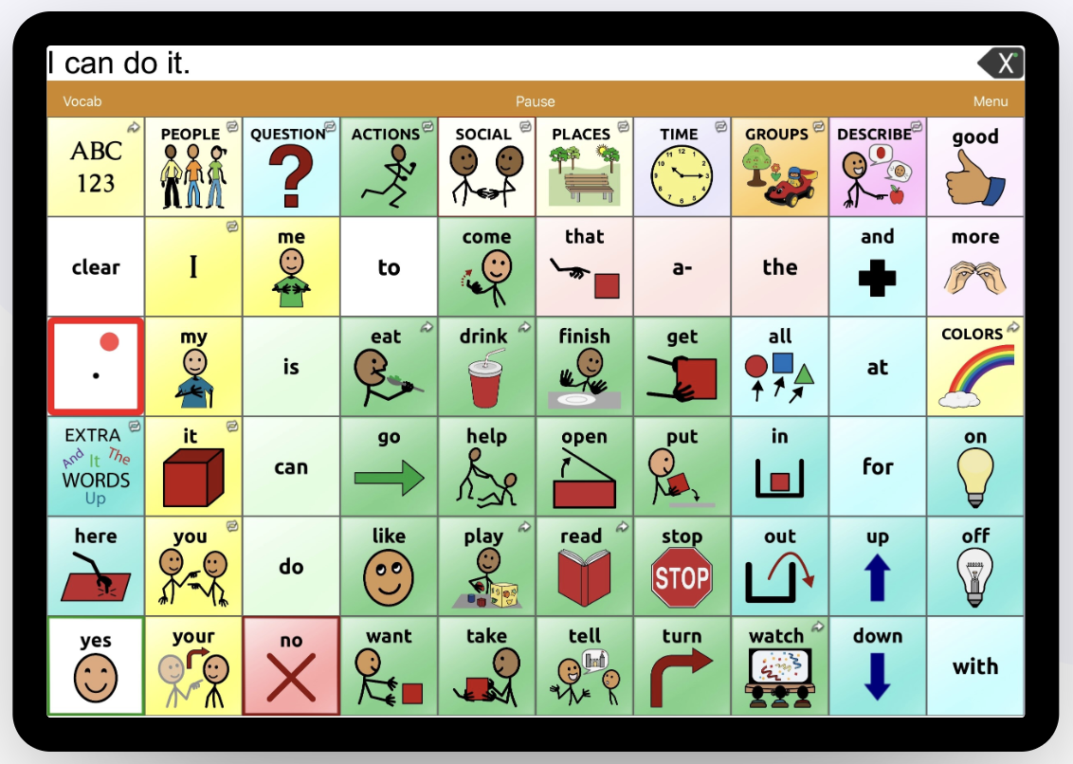
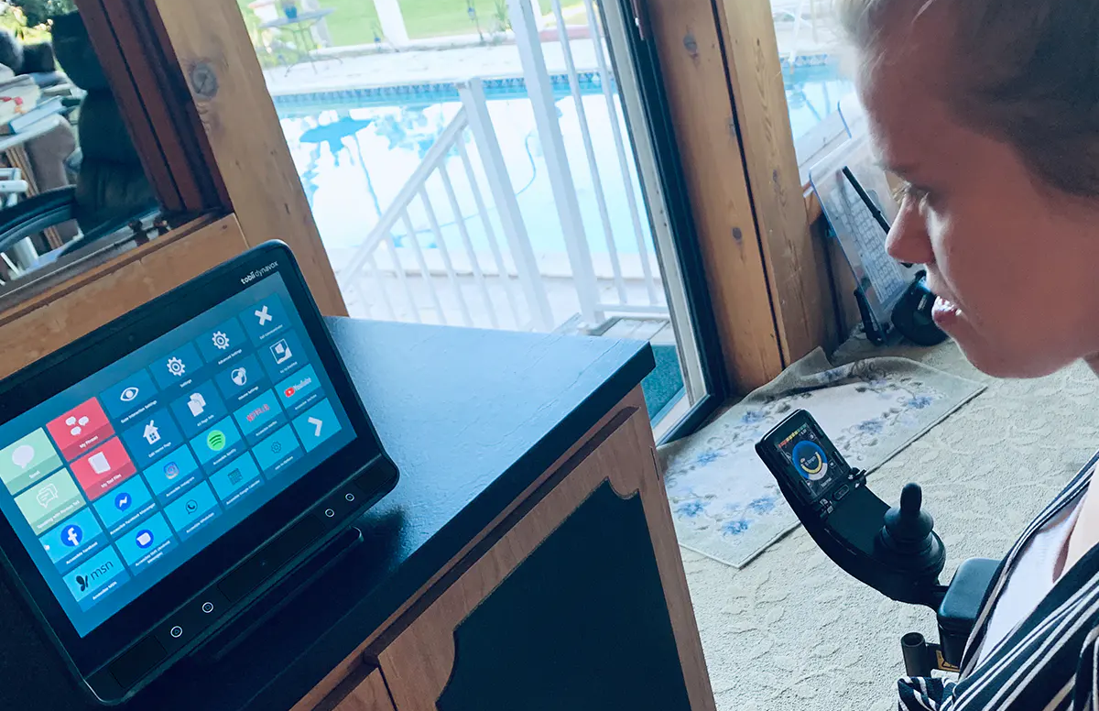
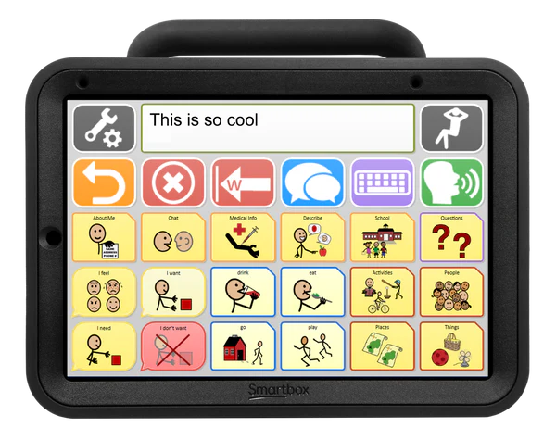
High-Tech AAC
Electronic devices with more advanced processors
Commonly referred to as Speech Generating Devices (SGDs)
Tablet with a communication application
Dedicated communication device
iPad with TouchChat
TobiiDynavox I-16
TalkPad Wego 8

Slide 13
How do we choose an AAC mode?
SETT framework: common method for determining Assistive Technology needs
SETT stands for:
    Student
    Environment
    Tasks
    Tools
Zabala, J. S. (1995)

Slide 14
How do we choose an AAC mode? continued
Student
What are the student’s strengths?
What are the student’s unique needs?
What instructional styles work best for the student?
Environments
Where (and in what contexts) does the student need to communicate?
Tasks
What does the student need to express?
Which of those communicative tasks can the student already express?
Tools
What communication system features are needed to meet the student’s communication needs (as determined by the first three sections)?

Slide 15
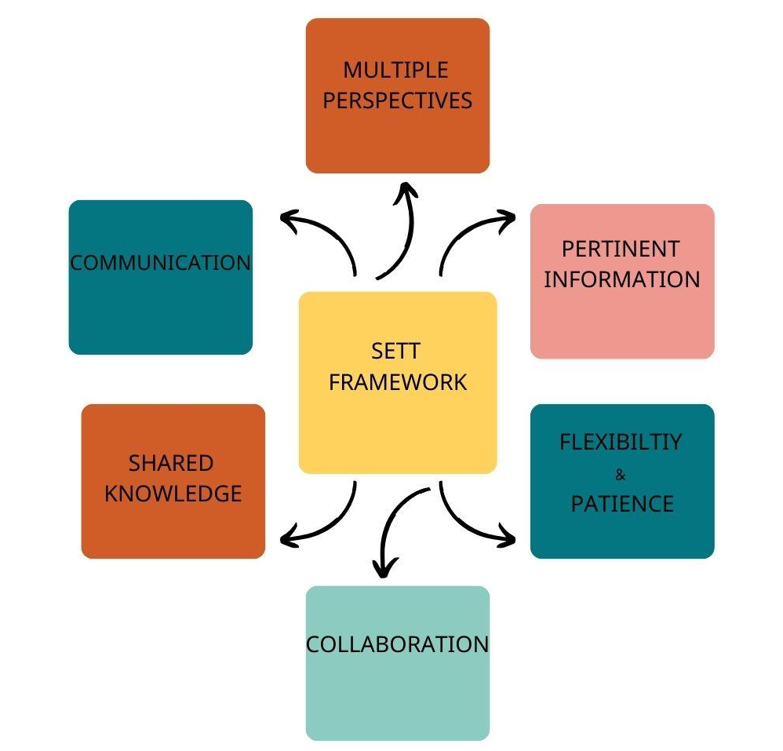
Critical Elements of the SETT Framework

Slide 16
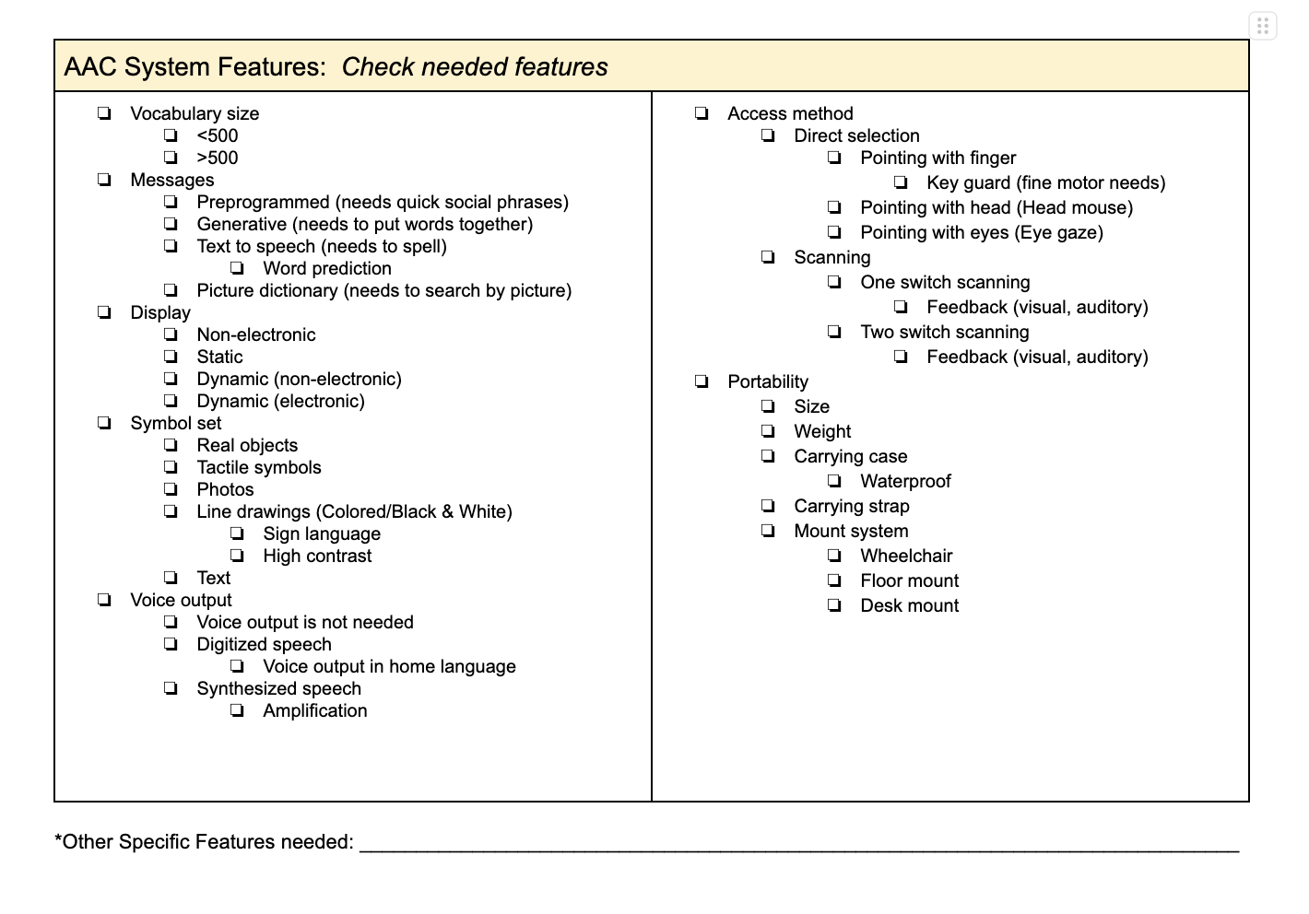
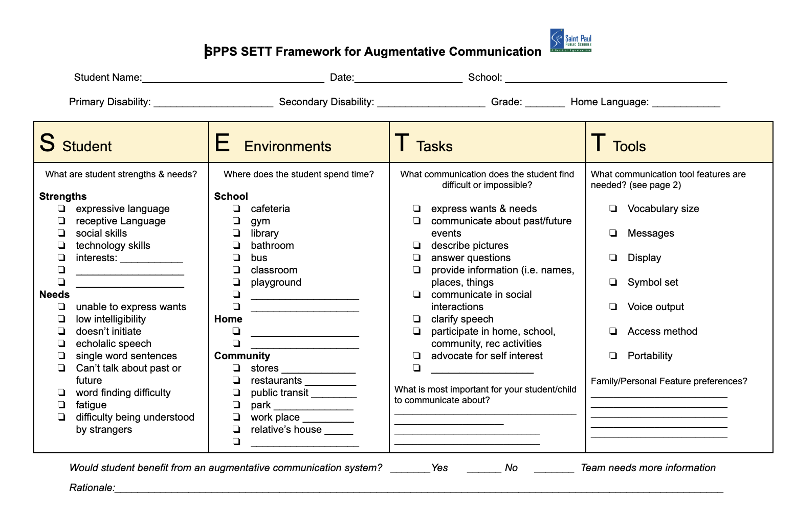
SETT Framework Worksheet

Slide 17
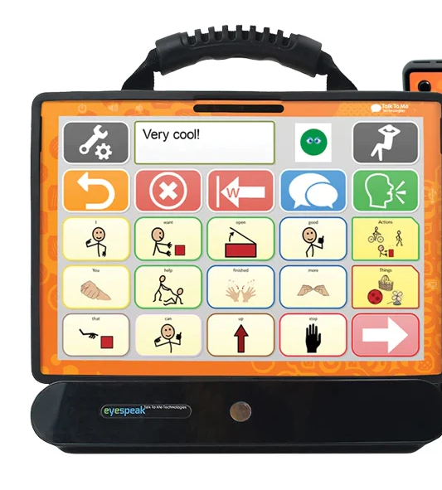
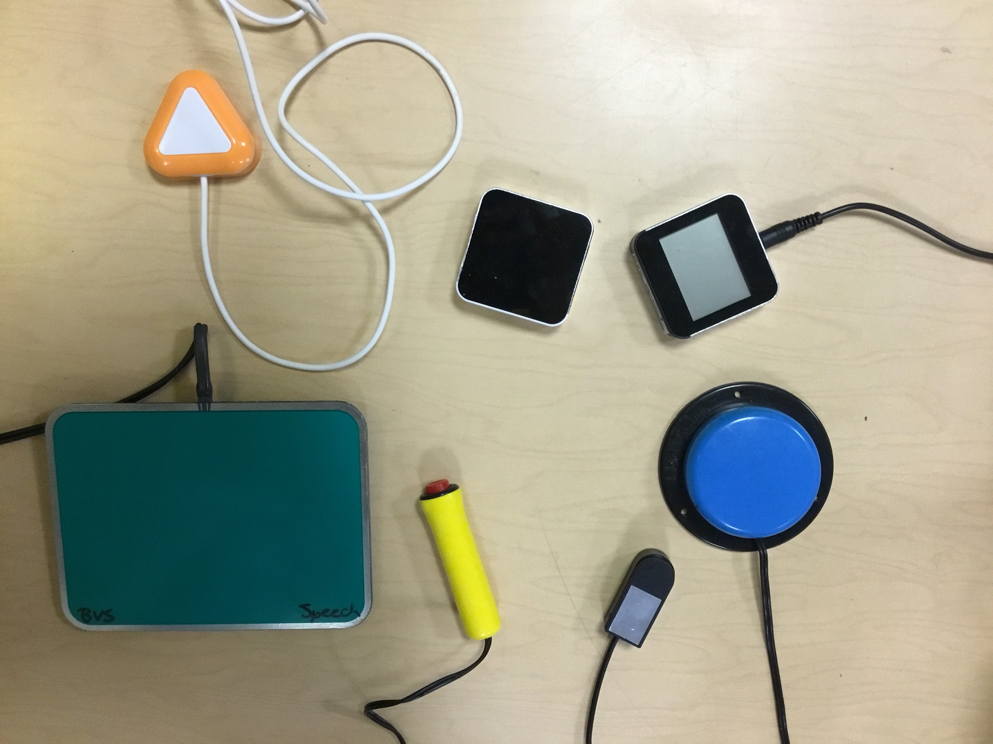
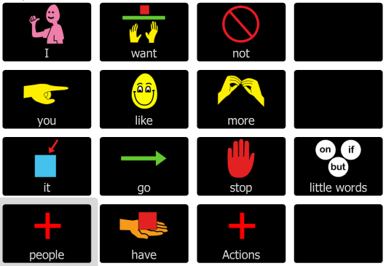
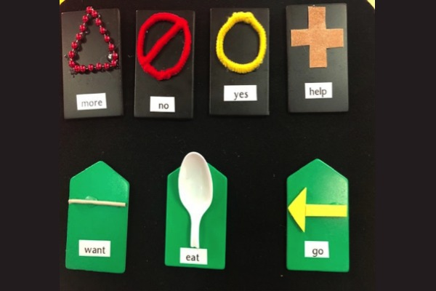
TOOLS: Access Method
How will the learner most efficiently and accurately access the communication modality?
Direct Selection
  Pointing/pressing
  Eye gaze
Various types of switches

Slide 18
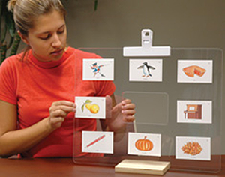
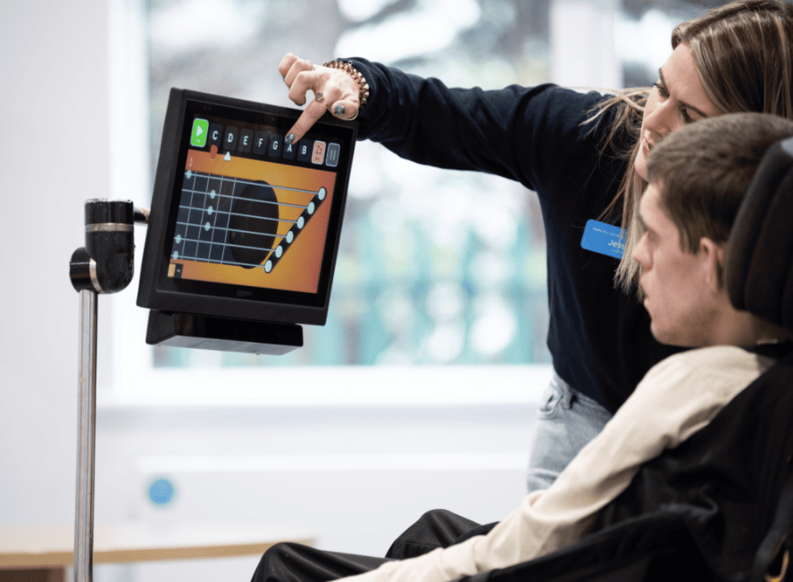
Tools: Eye Gaze
Direct selection with sustained eye gaze
Low-Tech: user sustains gaze on a symbol, communication partner will follow their gaze to interpret the desired message
High-Tech: user sustains eye gaze to make selections on a speech generating device

Slide 19
Tools: Switches
Used with various AAC modes
  Low tech: auditory partner assisted scanning using picture symbols
  Mid tech: recordable voice output devices
  High tech: switch scanning with speech generating devices
Placement
  Head
  Upper extremity
  Lower extremity
  Identifying a reliable and repeatable motor movement

Slide 20
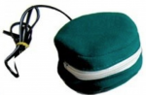
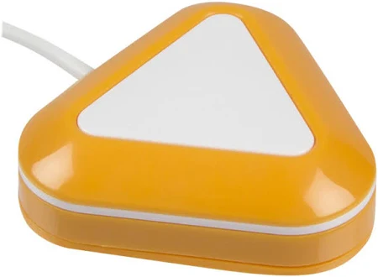
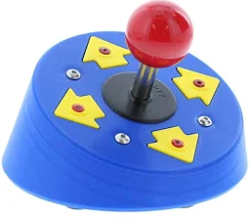

Tools: Switches
Ablenet Little Candy Corn Proximity Sensor Switch
Enabling Devices Petite Pillow Switch
Enabling Devices Joystick Switch
Ablenet Jelly Bean

Slide 21
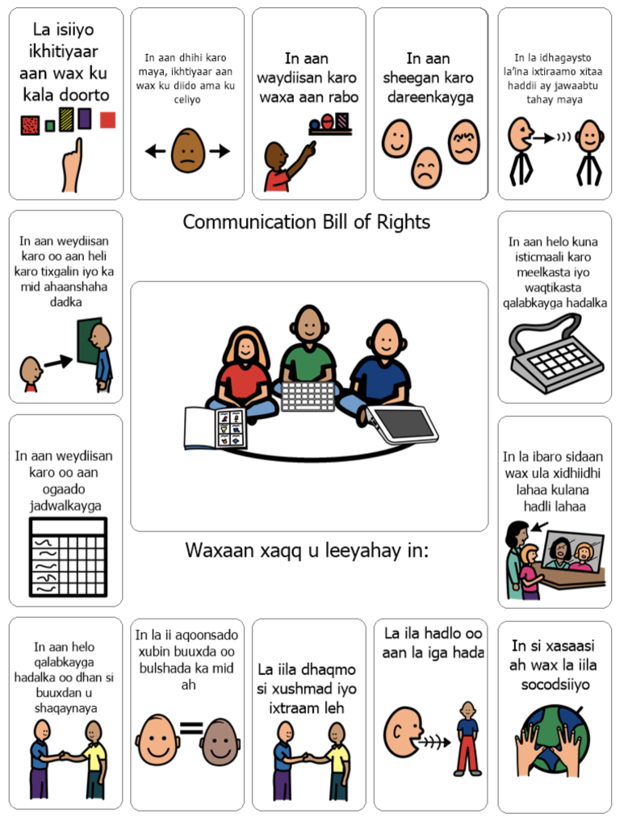
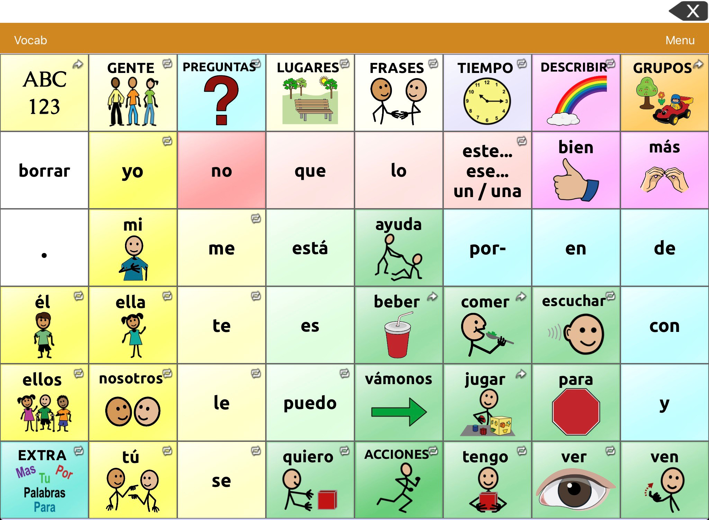
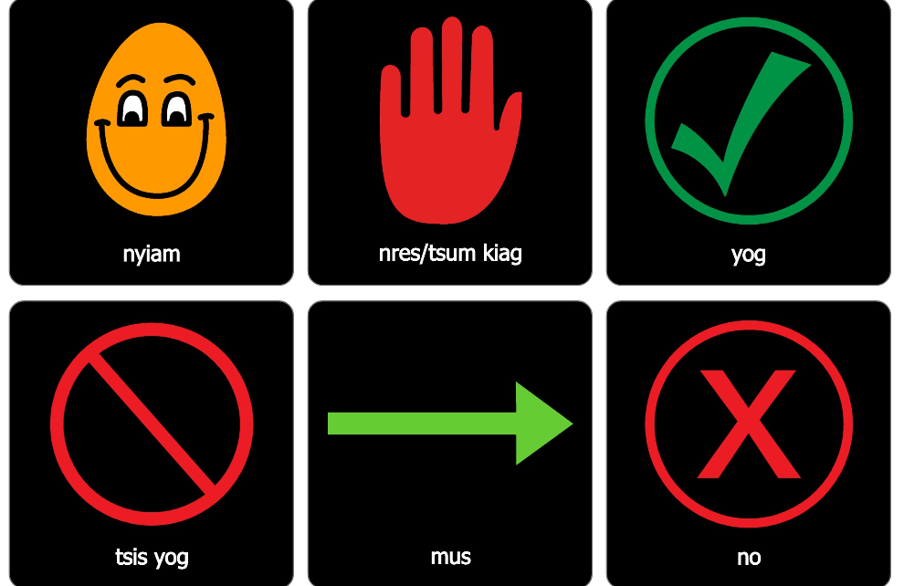
MLL Considerations
Translate symbols for home for low- or mid-tech AAC
Provide trainings for families
High tech device options
Record messages in the home language
User area with the home language

Slide 22
MLL Considerations, continued
How do we often see our students use their AAC systems?
To request
To get what they want
To get what they need
How do we move beyond to increase academic engagement?
To share opinions
To make connections
To comment
To answer questions

Slide 23
Challenges in Literacy Development for AAC Users
Learners who rely on AAC are regularly read to by their parents and teachers
HOWEVER when reading to individuals who rely on AAC, the adults dominate the interaction & provide few opportunities for the learners to participate
AND when asked to participate -- focused on the mechanics of the book (turn pages or point to pictures) rather than discuss the story to promote comprehension and develop language skills

Slide 24
Intervention to Promote the Development of Emergent Literacy Skills
AAC helps build literacy skills
language, sequencing, and exposure to print on AAC systems is help for people who can or are learning to read
Provide Access to Appropriate AAC for Emergent Literacy Activities
Teach Interaction Strategies to Literate Partners
Provide Independent Access to Reading Materials

Slide 25
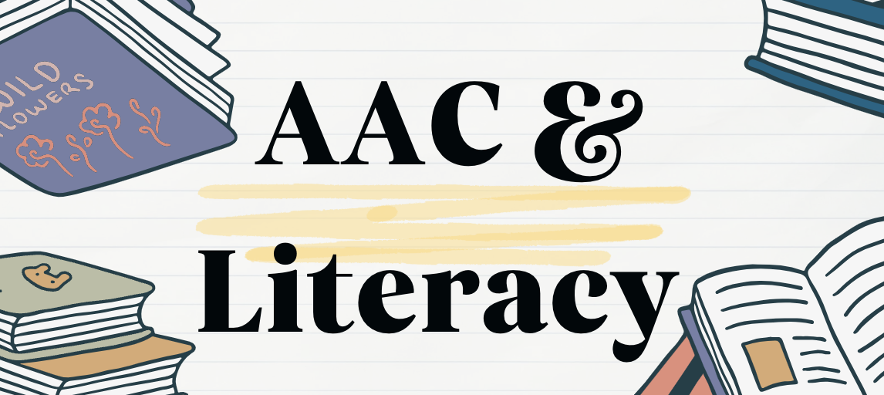
ACC & Literacy

Slide 26
Literacy Strategies
Have the student select the book… why?
  Increases autonomy
  This does not happen as much for children with disabilities as with typically developing children
  If the student is unable to point/gesture to their preferred book, how might this look using different communication modes?
Low-Tech: selecting “yes” or “no” picture symbols as book options are presented
Mid-Tech: partner assisted scanning to select “yes” or “no” as book options are presented
High-Tech: direct selection of “yes” or “no” as book options are presented

Slide 27
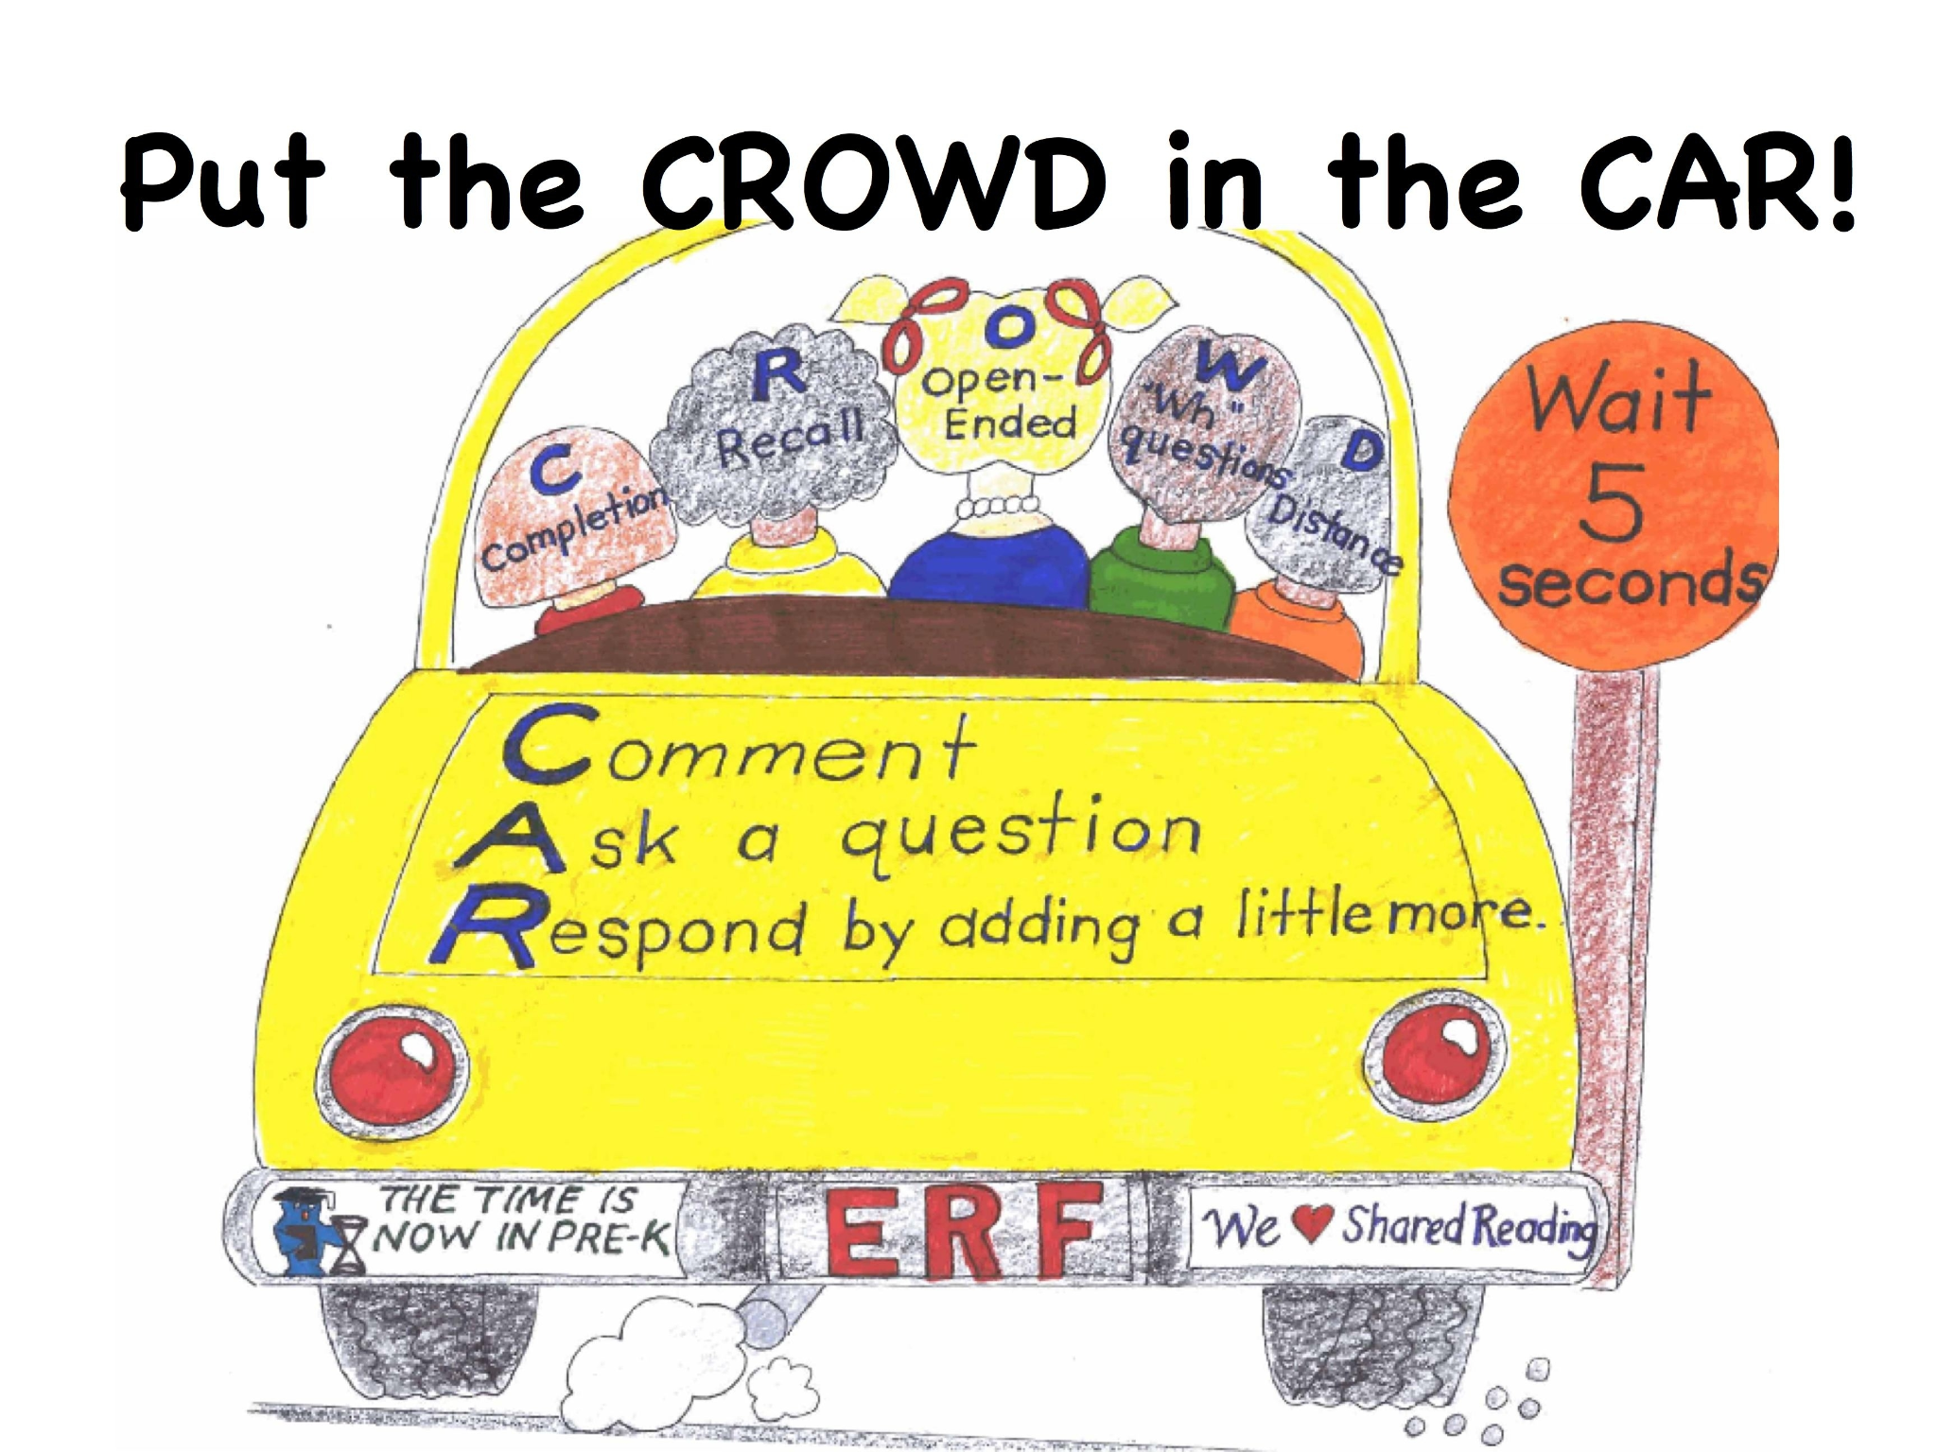
Put the CROWD in the CAR!

Slide 28
Put the CROWD in the CAR
Comment
Ask
Respond
Completion
Recall
Open Ended
Wh- Question
Distance

Slide 29
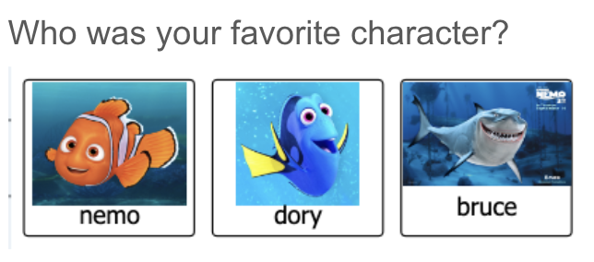
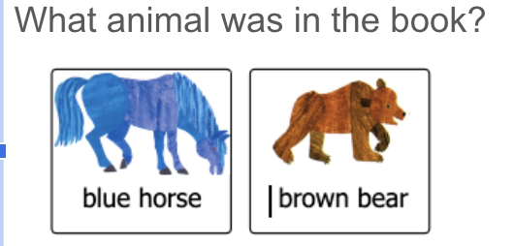
Answering Errorless Questions
Creating opportunities for shaping responses with emerging communicators and presuming competence
Preference Questions: allowing the opportunity to share likes and dislikes
Errorless Comprehension Questions: providing a field of choices to WH questions that are all accurate

Slide 30
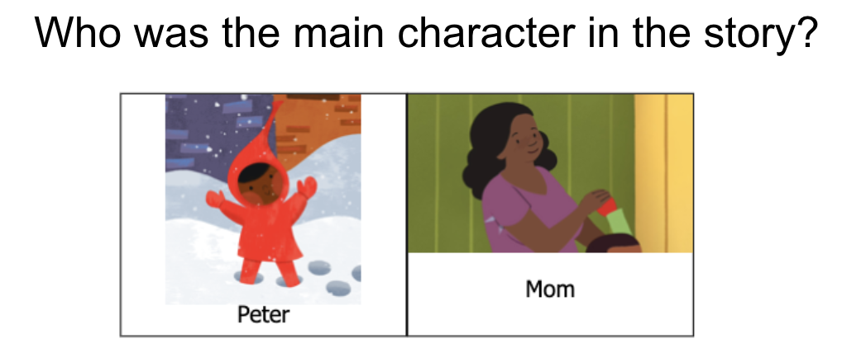
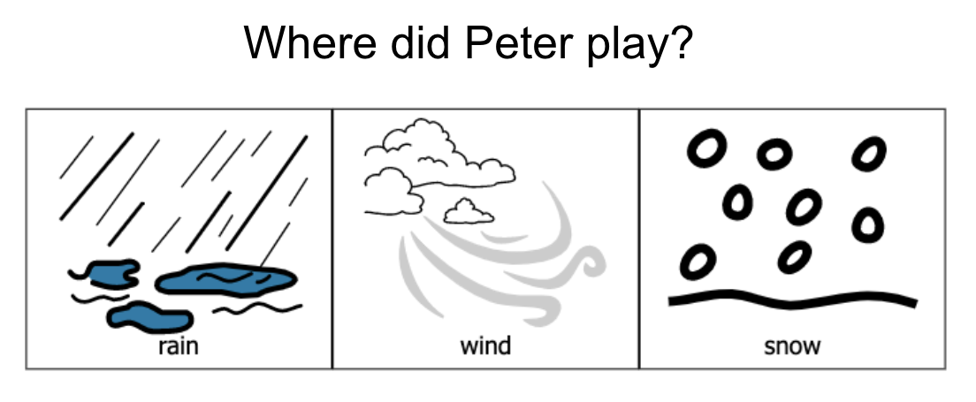
Answering Comprehension Questions
Creating opportunities for answering WH questions
Include literacy vocabulary: characters, settings, etc.
Provide opportunities to expand response, or provide additional information to relate to the story

Slide 31
Core vs. Fringe Vocabulary
Core Words
Words we use most frequently throughout the day
Can be any part of speech
Examples: “go”, “I”, “feel”
Fringe Words
Words we use less frequently throughout the day
Can be any part of speech
Typically context specific
Examples: “boat”, “Minnesota”, “purple”

Slide 32
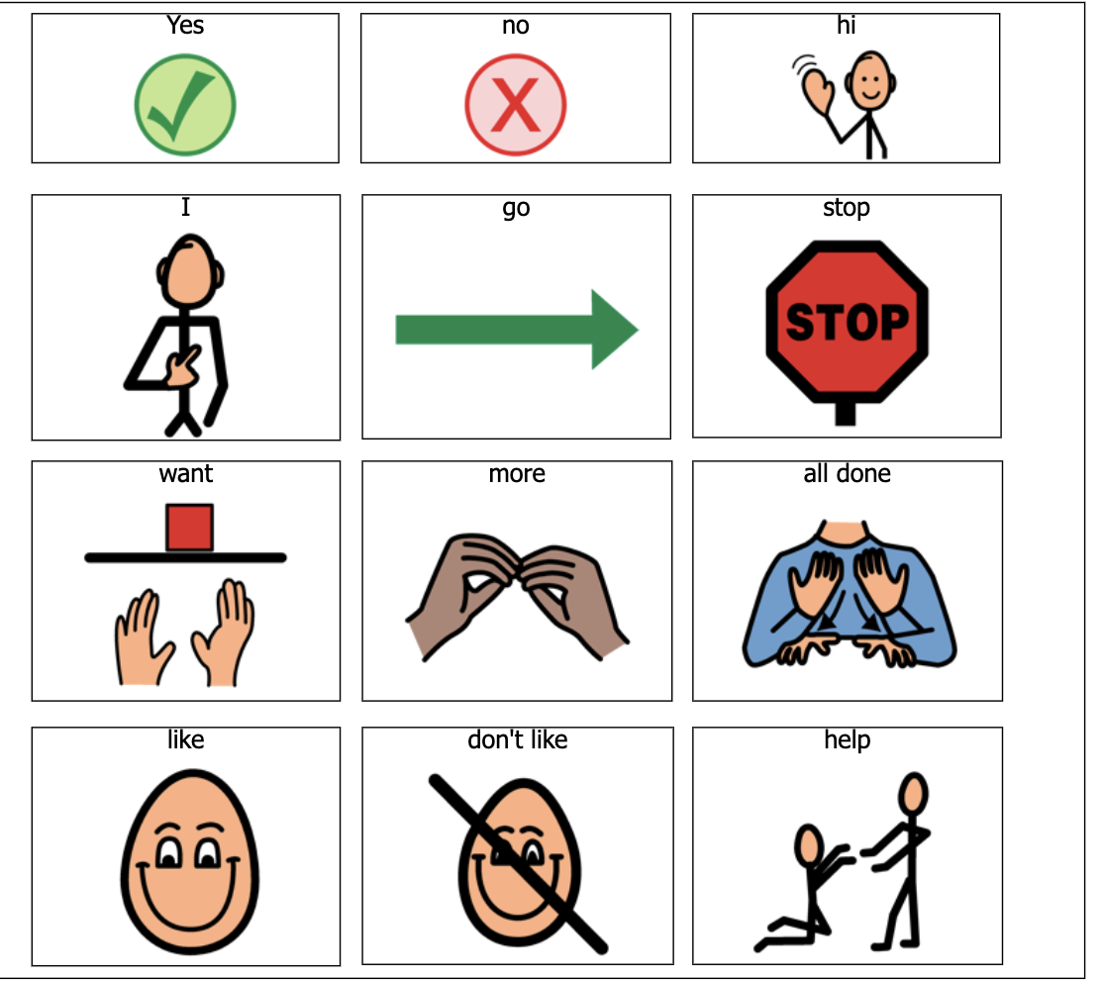
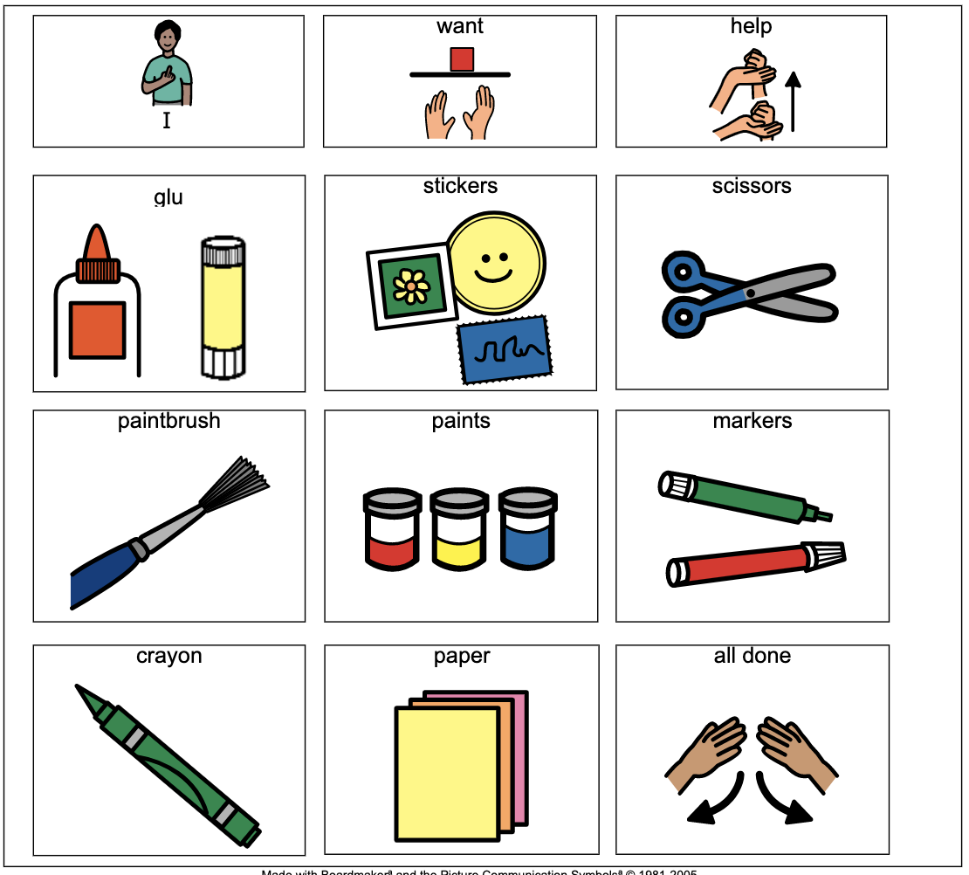
Core vs. Fringe Vocabulary: Low and Mid-Tech
Core Words
Core + Fringe Words
Activity Specific

Slide 33
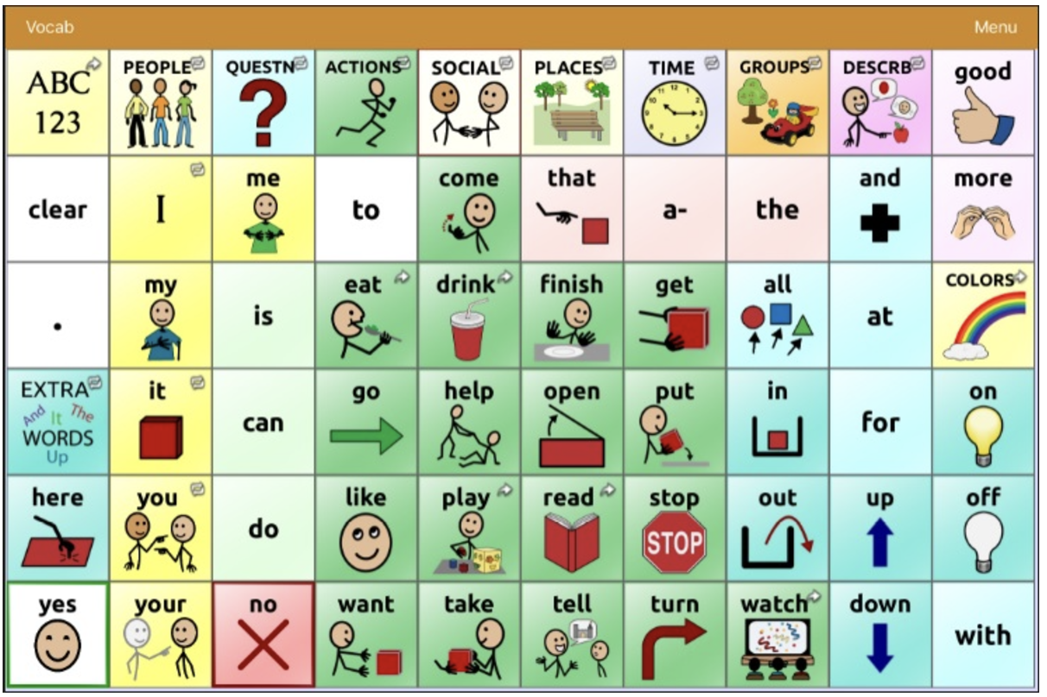
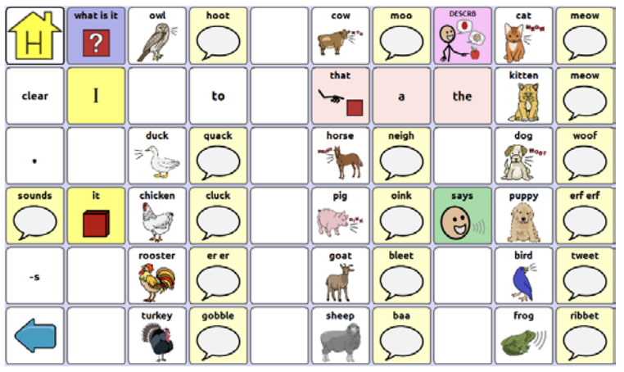
Core vs. Fringe Vocabulary: High-Tech
Home Page - more core words
Topic Page - more fringe words

Slide 34
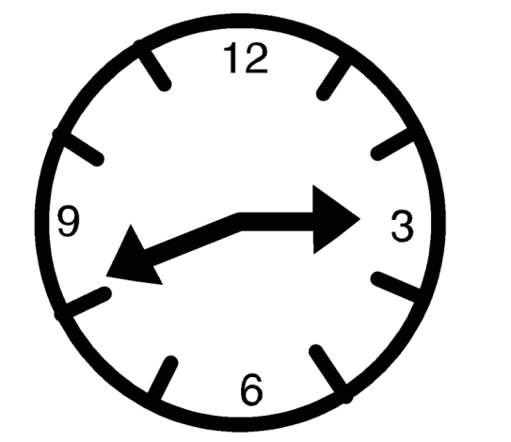
Wait Expectantly
Provide time for the learner to respond to a question, comment, or book passage
Some learners may need up to 30 seconds to process information and generate a response
Use facial expressions or gestures to indicate that communication is welcome

Slide 35
Aided Language Input
Use slow rate of speech while modeling with the communication system
Pause and give expectant look after modeling
Model with self talk (what you are doing) and parallel talk (what student is doing)
Model a variety of communicative functions
Model one more word than the child’s average length of sentence
Use 80: 20 ratio of statements to questions/commands

Slide 36

Inviting AAC Modes into Literacy

Slide 37
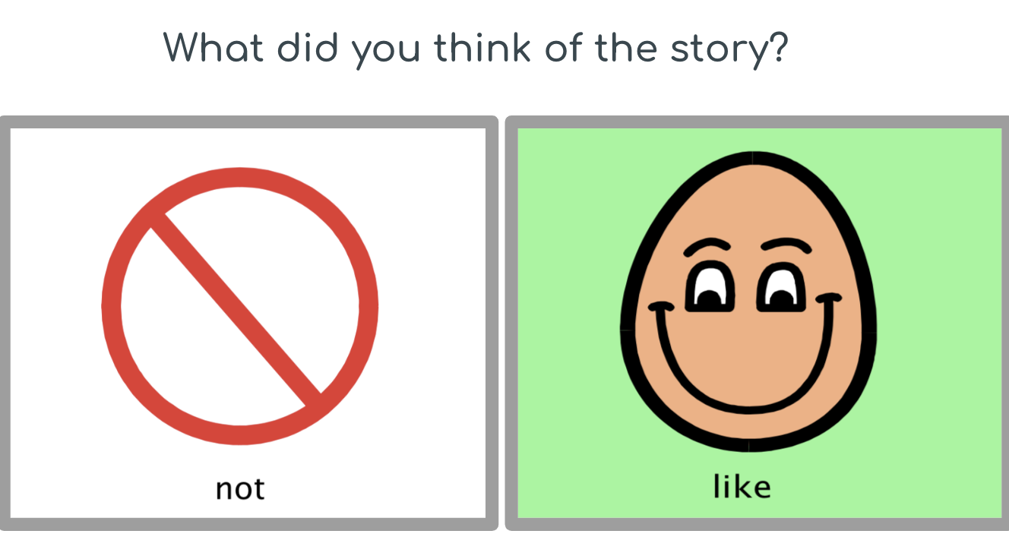
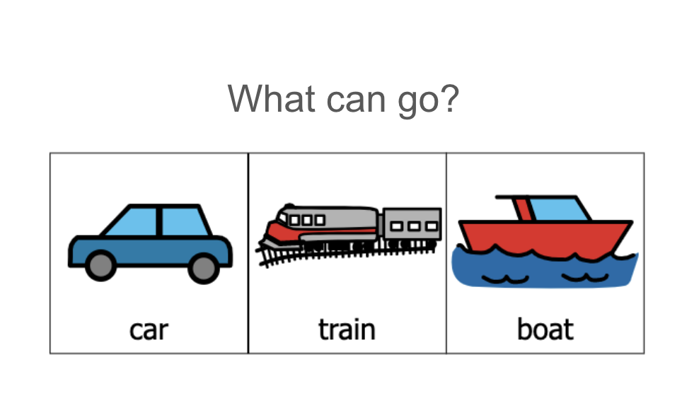
Examples of low-tech participation
Looking in the direction of a core word picture symbol as it is simultaneously read
Answering comprehension questions using picture symbols
Commenting on the story to share an opinion

Slide 38
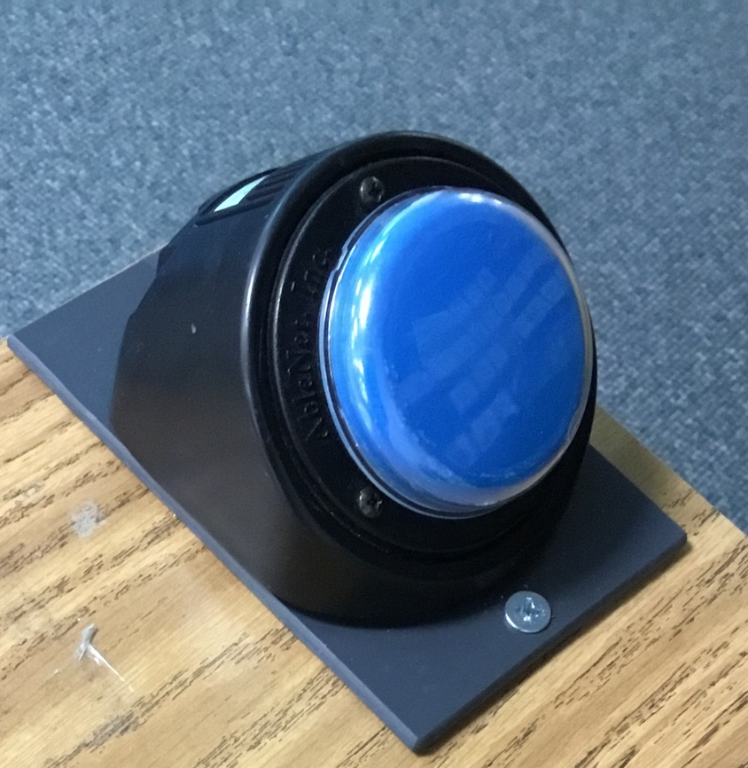
Examples of mid-tech participation
Activating a voice output device that has recorded repeated lines or a repeated core word to participate in the shared reading
Commenting about the book using partner assisted scanning
“Did you like the book?” Like/Not
“Do you want to read the page again?” Yes/No
Activating a bluetooth switch to “turn the pages” or with a compatible digital book (see Literacy Resources)

Slide 39
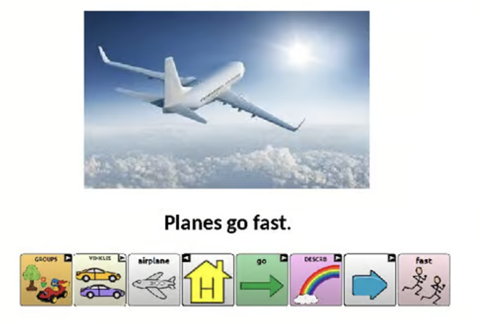
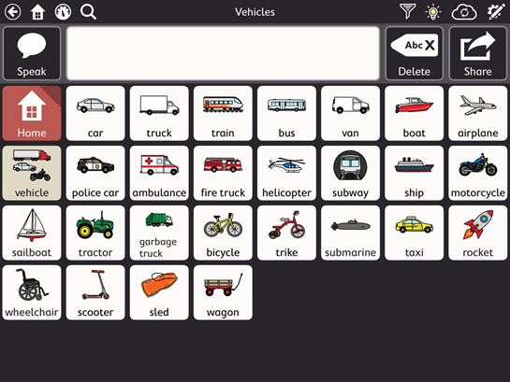
Examples of high-tech participation
Make a prediction about what the book topic
Label vocabulary
Describe the pictures

Slide 40
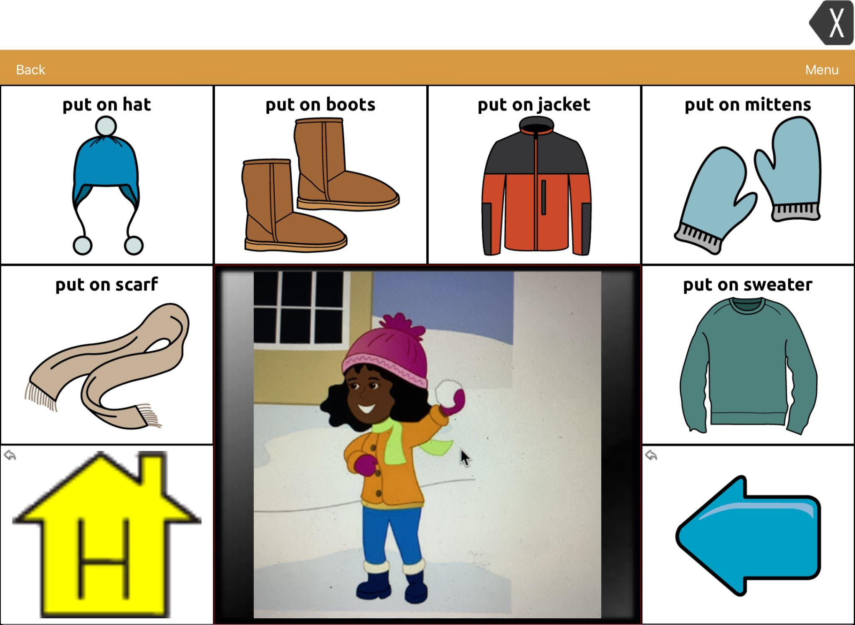
Examples of high-tech participation: Visual Scene Displays (VSDs)

Slide 41


From reading to writing
Create opportunities to work on emergent writing skills
Those with CCN require many opportunities to participate in emergent writing experiences that are scaffolded by their communication partner

Slide 42
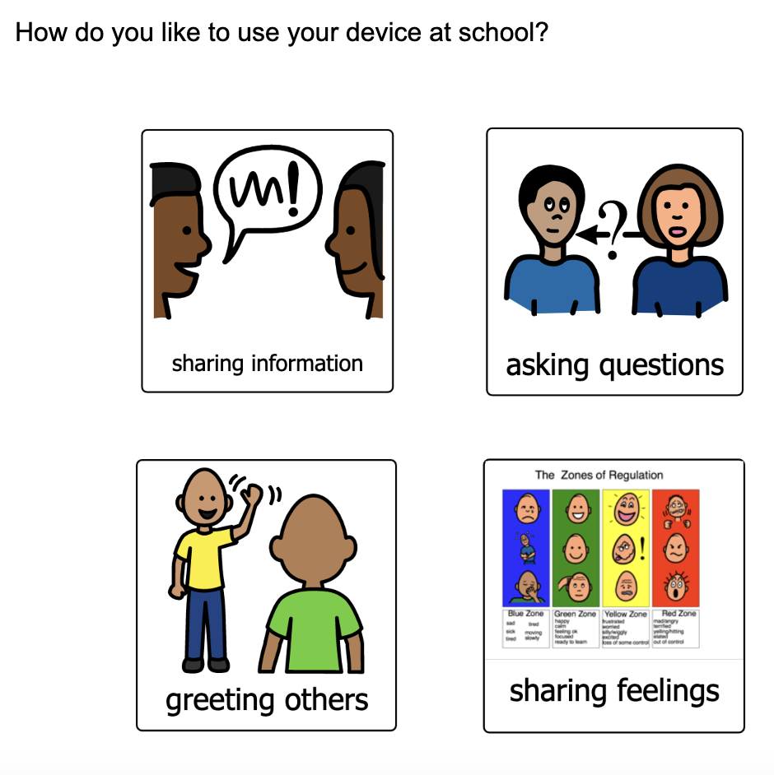
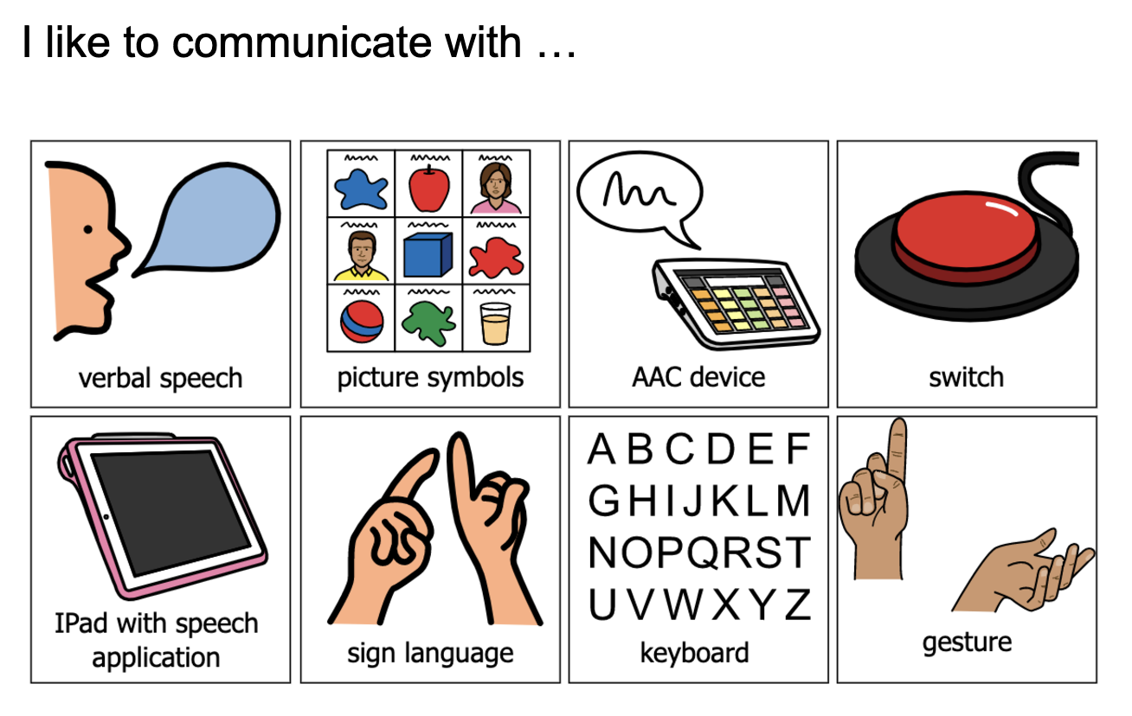
Self-Advocacy

Slide 43
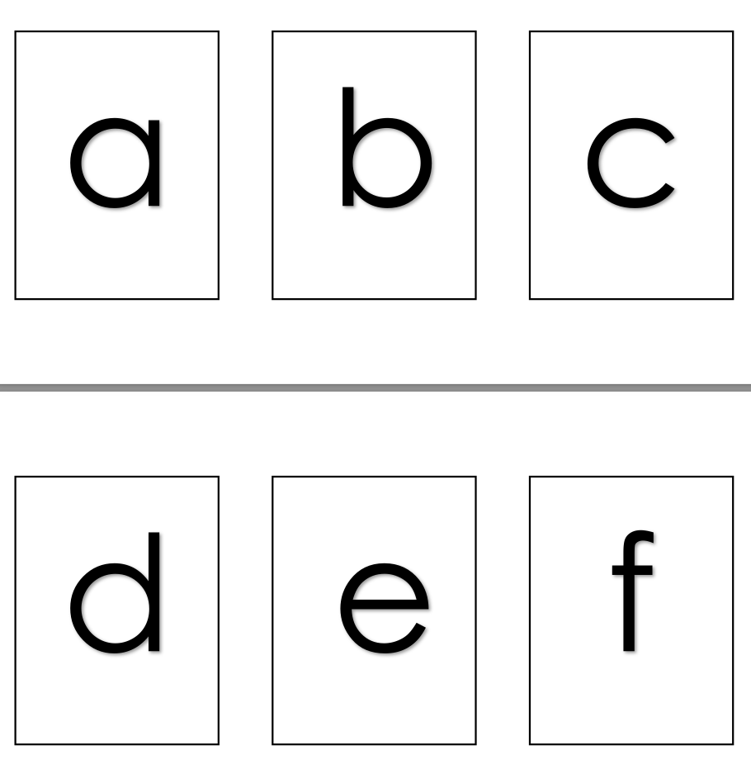
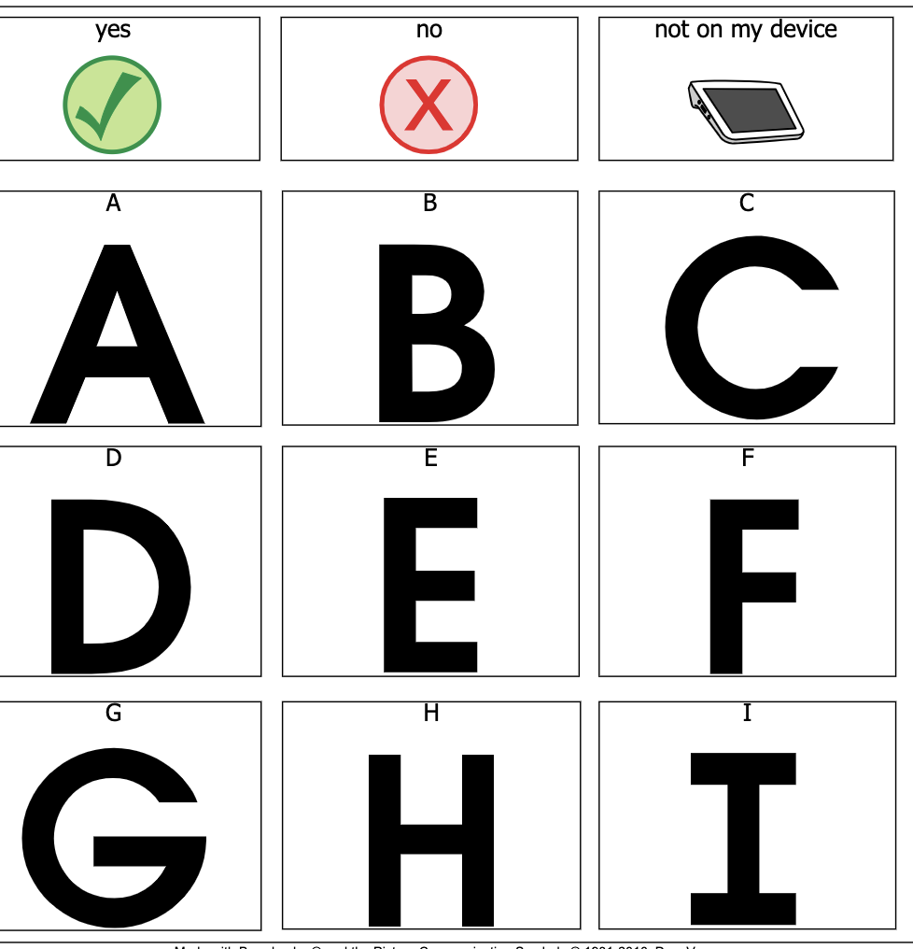
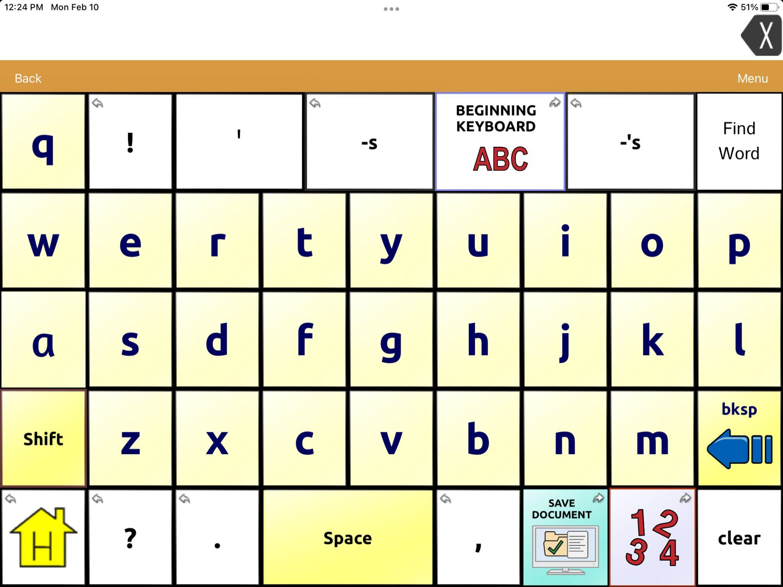
Writing
Low tech access using picture symbols or partner assisted scanning
Mid tech access to make choices for letters
High tech access exploration of the keyboard
Writing name
  With leveled prompting -- fading from most to least support

Slide 44
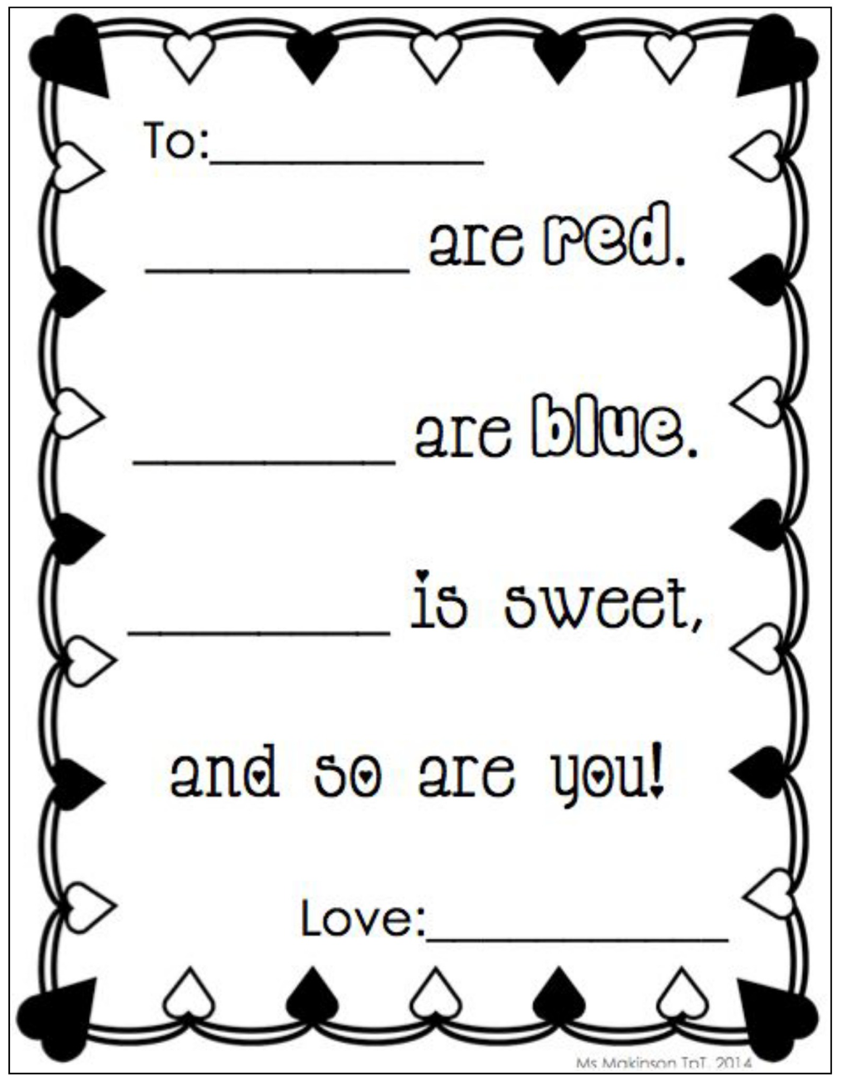
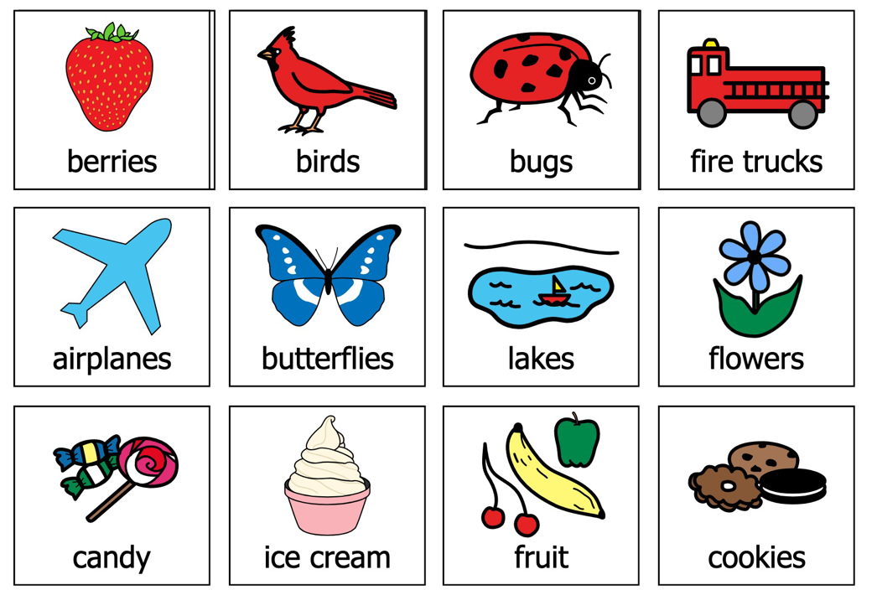
Becoming authors
Create a poem
Choices to fill in the blank

Slide 45
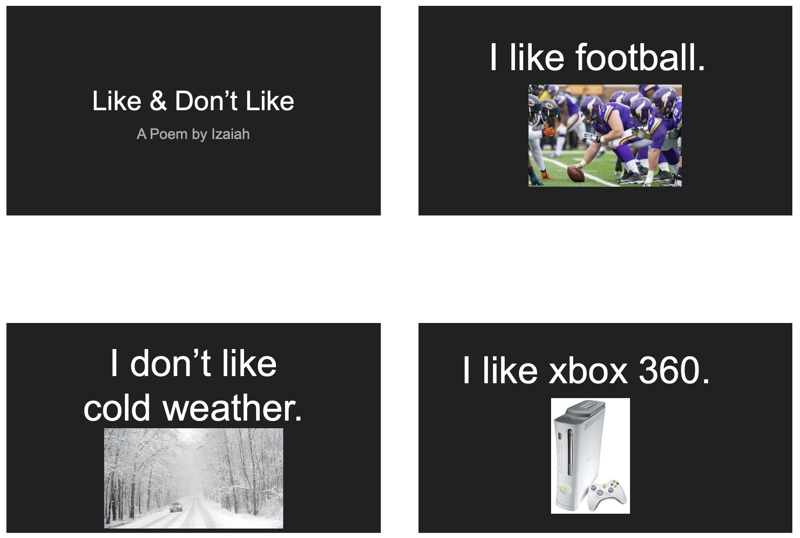
Becoming authors, continued.
Include preferred activities
Include a core word
Add repeating lines

Slide 46


Literacy Resources: Digital Books
Tobii Dynavox Core Word books
https://www.tobiidynavox.com/products/core-first-lessons
Monarch Reader
https://monarchreader.com/

Slide 47


Literacy Resources: Digital Books, continued.
Unite for Literacy
https://www.uniteforliteracy.com/
Reading A to Z
https://www.readinga-z.com/

Slide 48
Literacy Resources: Additional Resources
AssistiveWare Core Word Classroom
https://coreword.assistiveware.com/
PRC-Saltillo Literacy Planners
    https://www.prentrom.com/caregivers/implementation-activities
PRC-Saltillo Language Lab: Let’s Teach Core
  https://aaclanguagelab.com/resources/lets-teach-core

Slide 49
Literacy Resources: Additional Resources, continued.
AssistiveWare Core Word Classroom
  https://coreword.assistiveware.com/
PRC-Saltillo Literacy Planners
  https://www.prentrom.com/caregivers/implementation-activities
PRC-Saltillo Language Lab: Let’s Teach Core
    https://aaclanguagelab.com/resources/lets-teach-core

Slide 50
References
American Speech-Language-Hearing Association (n.d.). Augmentative and Alternative Communication (Practice Portal). Retrieved December, 22, 2024, from www.asha.org/Practice-Portal/Professional-Issues/Augmentative-and-Alternative-Communication/.
Elsahar, Y., Hu, S., Bouazza-Marouf, K., Kerr, D., & Mansor, A. (2019). Augmentative and alternative communication (AAC) advances: A review of configurations for individuals with a speech disability. Sensors, 19(8), 1911. https://doi.org/10.3390/s19081911
Erickson, Ph.D., K., Greer, Ph.D., C., Hatch, Ph.D., P., & Quick, Ph.D., N. (2022). Putting the CROWD in the CAR Facilitator Manual (p. 11) [Review of Putting the CROWD in the CAR Facilitator Manual]. Center for Literacy and Disability Studies, Department of Health Sciences, UNC-Chapel Hill.

Slide 51
References, continued
Government of South Australia Department of Education. About Complex Communication Needs (CCN). Retrieved February 10, 2025, from https://www.education.sa.gov.au/docs/support-and-inclusion/practice-guidance/complex-communication-practice-guidance.pdf
Hartmann, A. (n.d.). Integrating literacy with AAC instruction [Review of Integrating literacy with AAC instruction]. AssistiveWare. Retrieved February 10, 2025, from https://www.assistiveware.com/learn-aac/integrating-comprehensive-literacy-instruction#:~:text=Model%20key%20words%20using%20AAC,topics%20that%20are%20high%20interest
Shared Reading. Literacy Instruction for Students with Significant Disabilities. Retrieved February 10, 2025, from https://literacyforallinstruction.ca/shared-reading/

Slide 52
References, continued 2
Zabala, J. S. (1995). The SETT Framework: Critical areas to consider when making informed assistive technology decisions [Online] Retrieved from http://bit.ly/academiaSETT2005
Zangari, C. (2017, April 10). PrAACtical Resources: 10 Things You May Not Know About AAC [Review of PrAACtical Resources: 10 Things You May Not Know About AAC]. PrAACtical AAC. https://praacticalaac.org/praactical/praactical-resources-10-things-you-may-not-know-about-aac/

Slide 53
Questions?
Contact Information:
Jen Erickson: jen.erickson@spps.org
Chloe Converse: chloe.converse@spps.org

Slide 54

Thank you!

Slide 55
Charting the Cs Conference 2025
Statewide Professional Development to Support the Workforce and Low Incidence Disability Areas in the State of Minnesota.
This presentation is partially funded with a grant from the Minnesota Department of Education using federal funding, CFDA 84.027A, Special Education – Grants to States.

