Slide 1

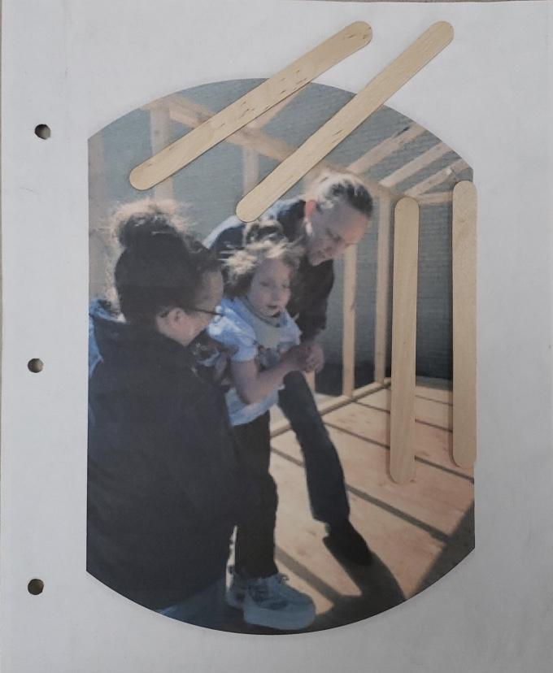
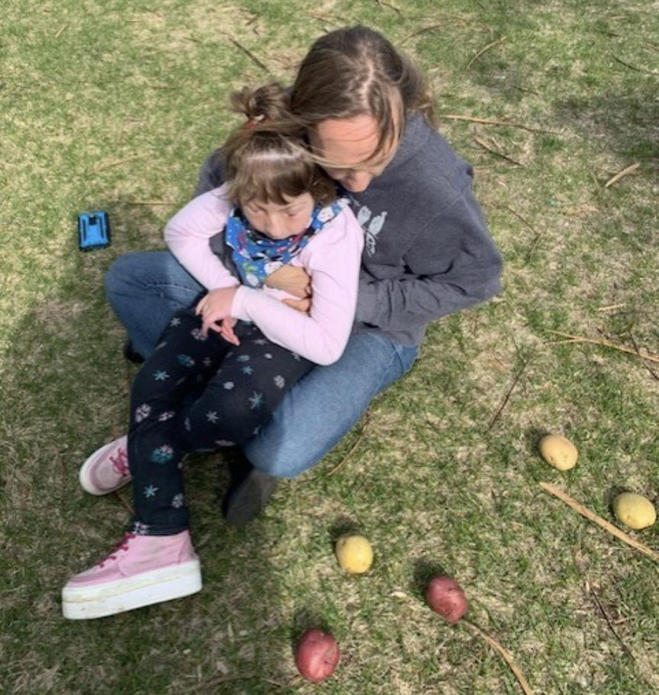
EXPERIENCE BOOKS
Charting the Cs Conference 2025:
To Literacy and Beyond
Cooperation Communication Collaboration
Presentation Date(s)
Krista M. Dillman, M.S., M.S., M.Ed.
krista.dillman@isd742.org
*photos shared with permission

Slide 2
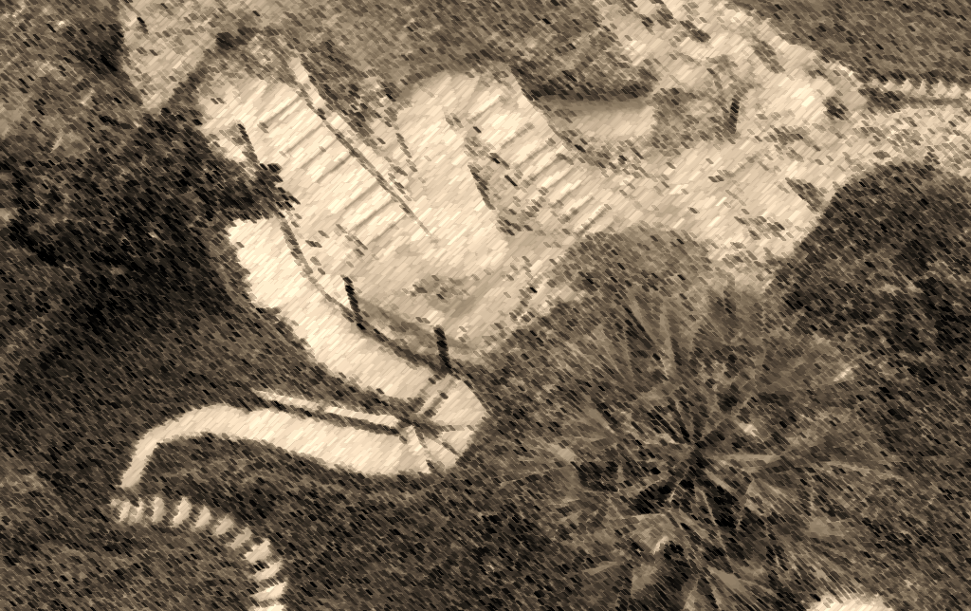
How did I get here?
Started ASL interpreting
Work in Disability Services
1st Masters in Voc Rehab
Teaching DHH/DB students
M.S. in DHH
Completed M.Ed. In DB
This Photo by Unknown Author is licensed under CC BY-NC-ND

Slide 3
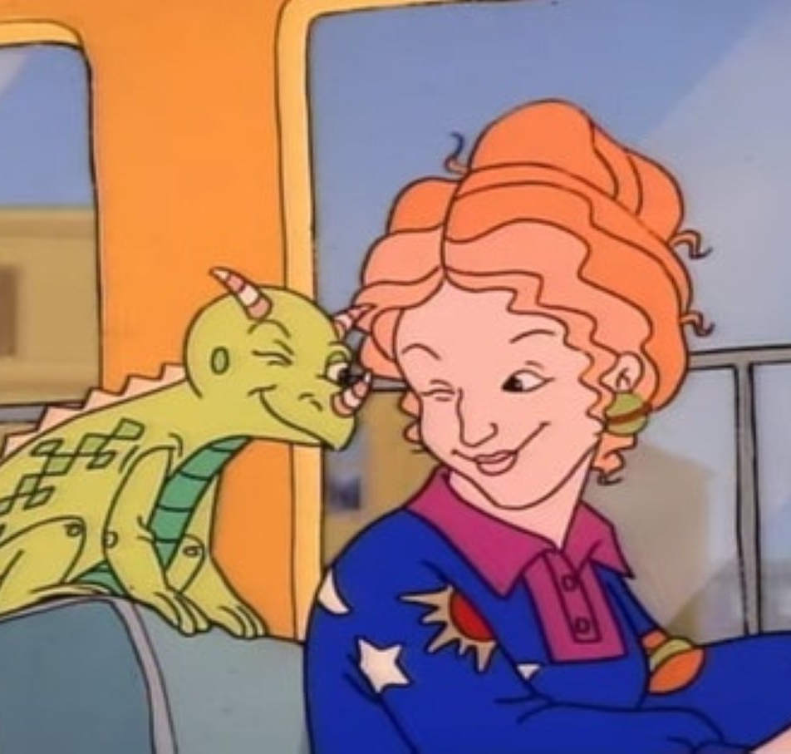
TAKE CHANCES, MAKE MISTAKES, GET MESSY
This Photo by Unknown Author is licensed under CC BY-SA

Slide 4
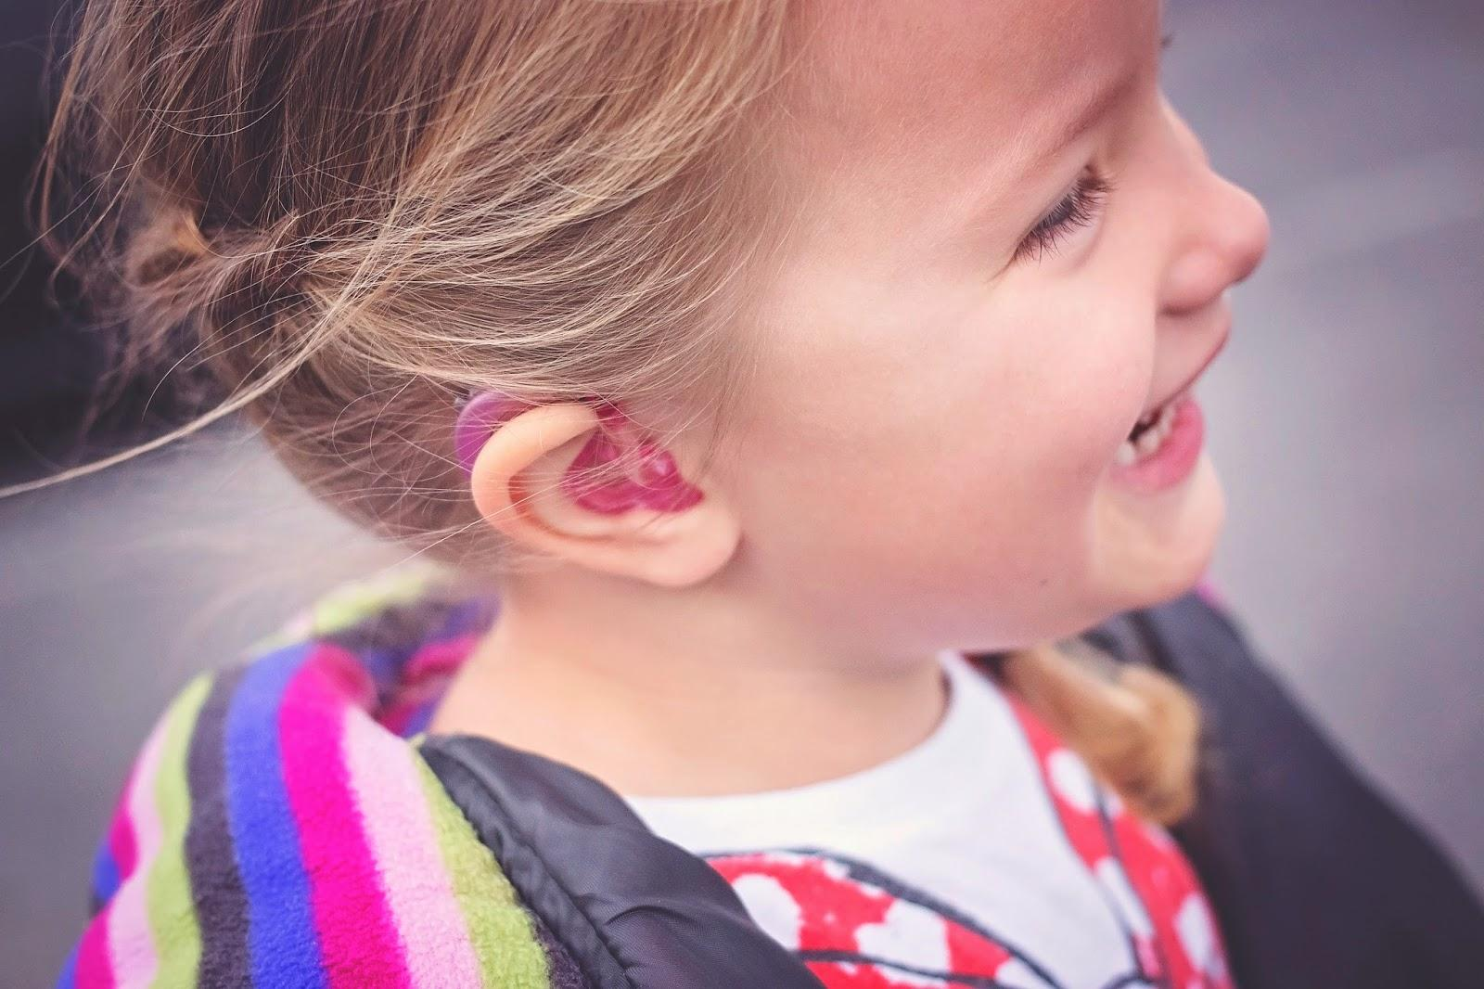
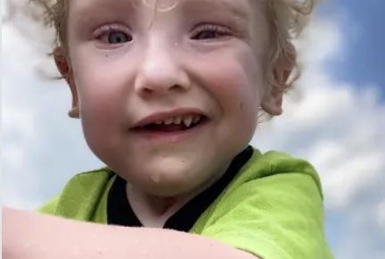
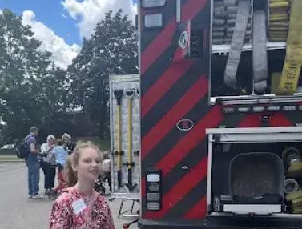
Why Experience Books?
Who are they for?
Why use them?
What is the benefit?
How can this be literacy?
This Photo by Unknown Author is licensed under CC BY-SA-NC
This Photo by Unknown Author is licensed under CC BY-SA-NC

Slide 5
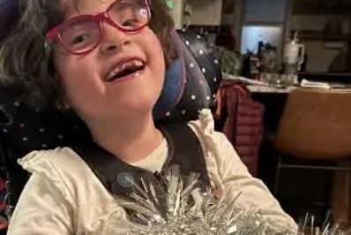
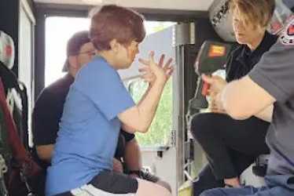
Experience Books are Literacy
Multisensory learning-Sensory channel assessment and Learning Media Assessment (Miller, n.d.)
Experiential learning
Opportunistic instruction (Krista’s term)
Mechanics of reading

Slide 6


Experience Books serve multiple purposes
Story telling
build memories
sequencing
vocabulary
talk about events
words, braille, pictures to tell a story
develop literacy skills (Hearing First, n.d.)
This Photo by Unknown Author is licensed under CC BY-SA-NC
This Photo by Unknown Author is licensed under CC BY-SA-NC

Slide 7

Access
hearing aids/glasses on
MORE and ALL-DONE sign/AAC
objects don’t magically appear
use of ALL-DONE basket throughout, model higher language
listen/watch for communication approximations, acknowledge
use student’s communication method, model higher lang.
make time for sign babble, ask questions, encourage more
FM system self advocacy

Slide 8

Activities
letter of the day, real object
Braille letter, tactile graphic, scanning, follow a line
write letter of the day-metallic or tactile paper on lightbox, OT goal, ProT following my hand, lightbox on/off V/Sign, air writing
find letter on AAC
object as part of Exp Book page or photo w/o background
song for letter of the day or CVI video
songs for movement, PT goals, music, rhythm, proprioceptive

Slide 9
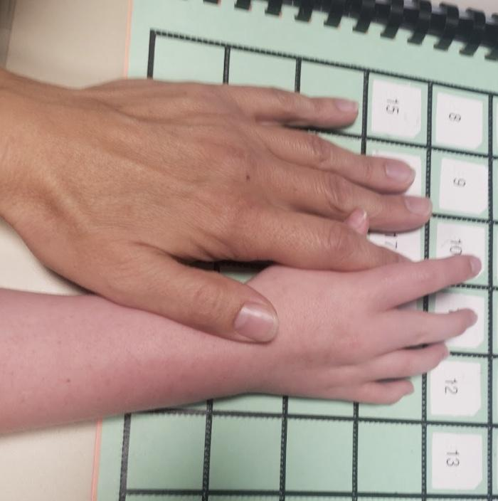
Strategies
wait time 10+ seconds
do with not for, staple, write, open glue, cutting
look for on/off, emotions, in/out, big/small, comparing use Total Communication Method throughout
expose to a variety of low/high tech assistive devices-lightbox, scissors, amplifiers, walkers, zipper pulls, braille devices
experiential learning, look for comments (horsie example)
plan activities to focus on one sense at a time not multiple
sensory breaks-timer, keep working with other senses, time
disinterested in activity, acknowledge the comment, review schedule

Slide 10
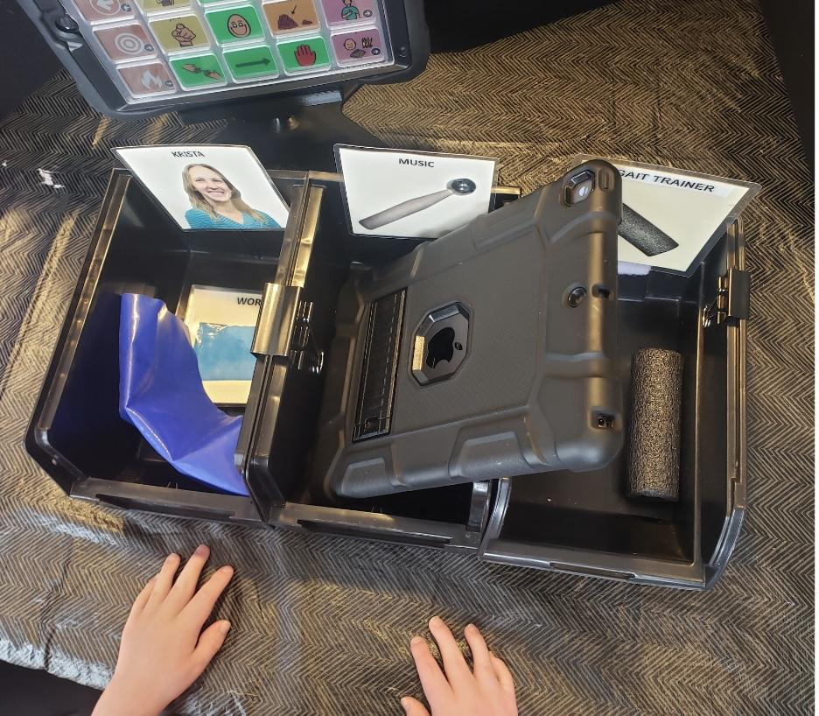
Routines
calendar, ASL listing, Protactile (ProT) listing, Voice, AAC (Total Communication Method)
explore object ProT with copresence, looking/telling turn taking
Finger Family song-family members, counting, Total Comm.
end with calendar, use ALL-DONE basket
say goodbye, ProT goodbye hand to hand, leaving on the back, say when you will be back, 7 day calendar ProT

Slide 11




Case Studies-service time
Molly direct 2 times per week for 30 min-3 times per week for 60 min, when homebound 5x/wk 60 min
Nate began with only indirect 1x/mo 30 min, but I increased to direct 1x/wk for 30 min and now 2x/wk for 45 min
Kyle began with only indirect 1x/mo 30 min, but I immediately changed it to direct 3x/wk for 60 min, 5x/wk for 60 min when homebound
George began with only indirect 1x/mo for 60 min, but I increased to direct 1x/wk for 60 and now 2x/wk for 45 min

Slide 12
Case Studies-Paths to Literacy ideas
M book from Paths to Literacy
M book
Spring has Sprung book from Paths to Literacy
Spring has Sprung
Face book from Paths to Literacy
Books for Very Young Children
Five Speckled Frogs from APH
Frogs

Slide 13
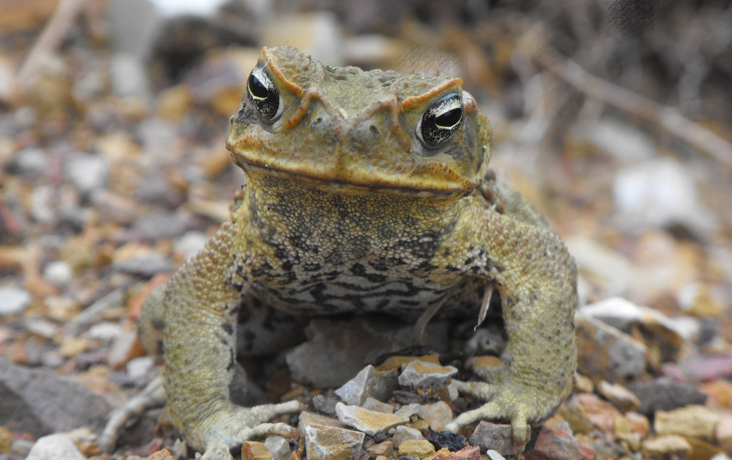
Topic Selection
Student interest-frog
Child Guided Assessment (Van Dijk, n.d.)
Scaffolding known concepts
Time required for a topic
Taking risks in topic selection-yearly, monthly topics, life skills
Grade appropriate topics/literature-Little House on the Prairie

Slide 14
Considerations
Multisensory lesson design (Paths to literacy, n.d.)
Assembling books, multiple reviews, daily review of topic
Reading with other staff or students, books in library, borrowing
Protactile, ASL, AAC, and spoken language inclusion
Intervener observing, inclusion, turn taking, and turning over
Tar heel reader-depending on vision/hearing

Slide 15
B sound book
What is being taught in this Experience Book?
Which sensory channels are being used?
How might this be expanded with other team members?
What can speech, OT, or vision be brought into this theme?

Slide 16
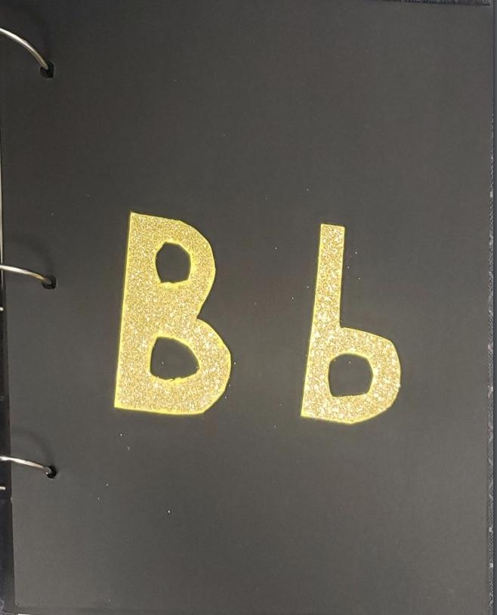
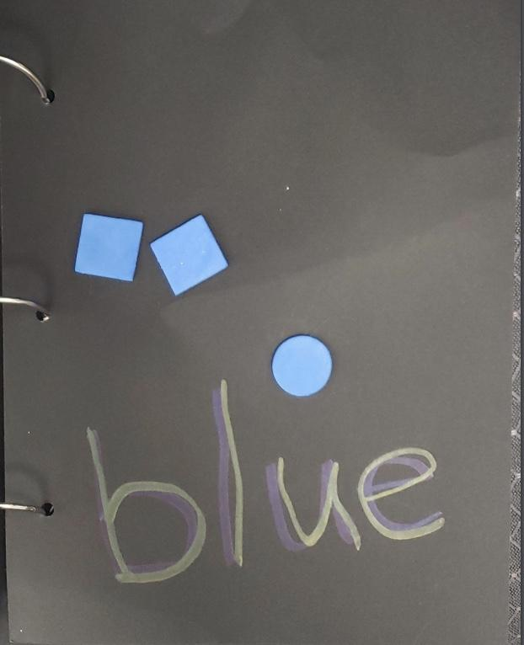
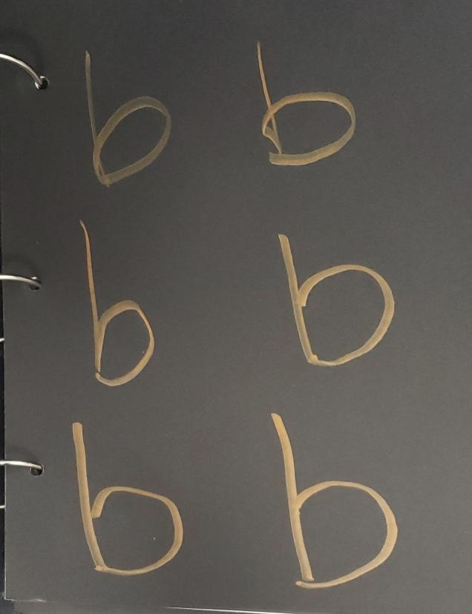
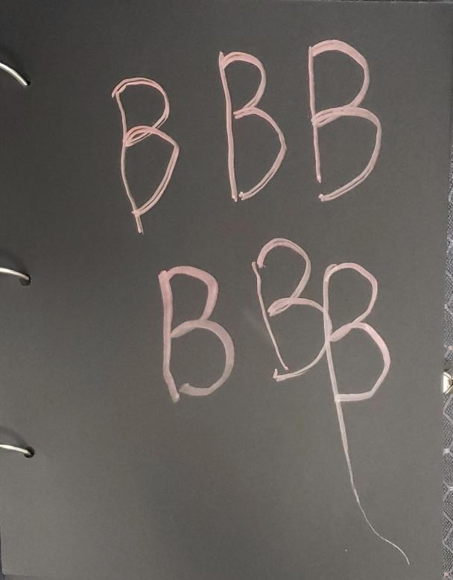
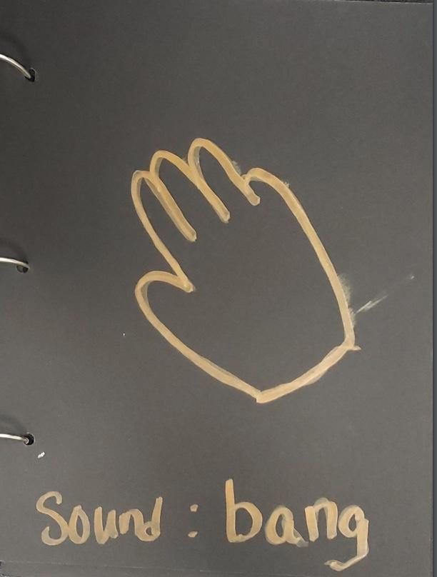
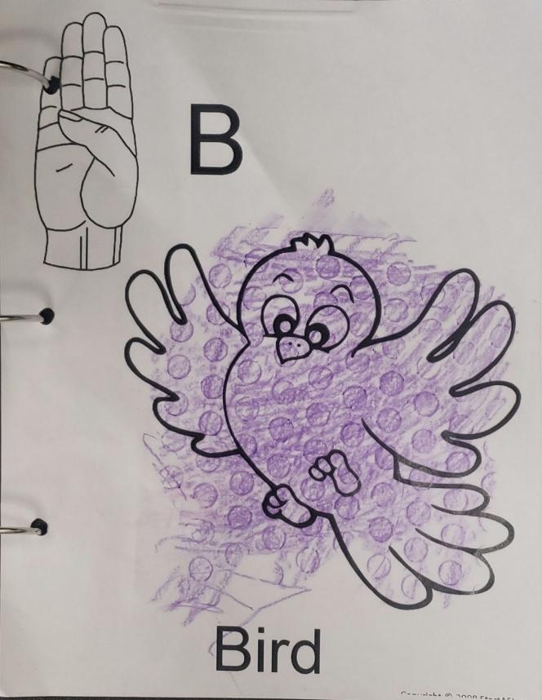
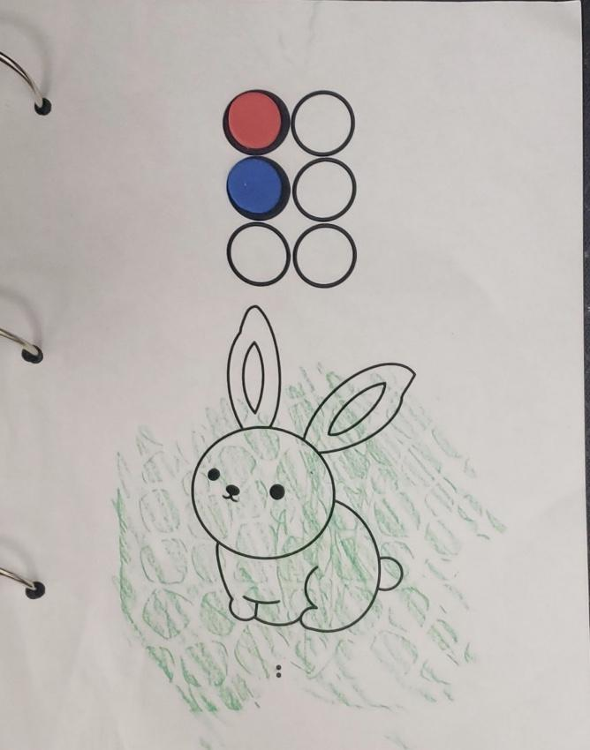
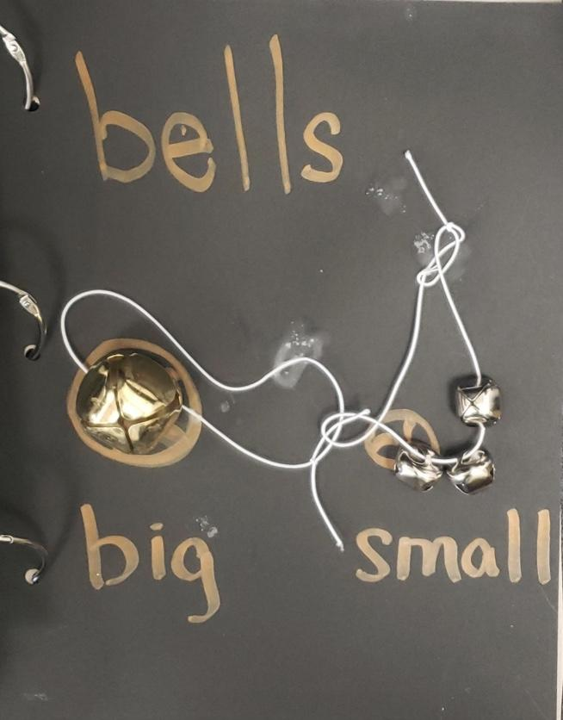
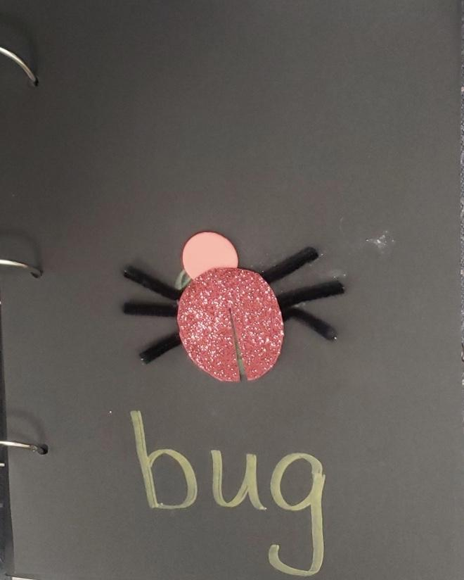
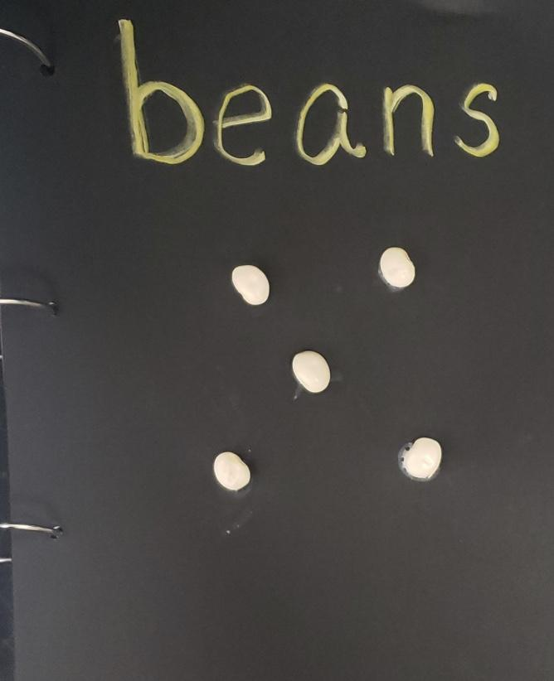
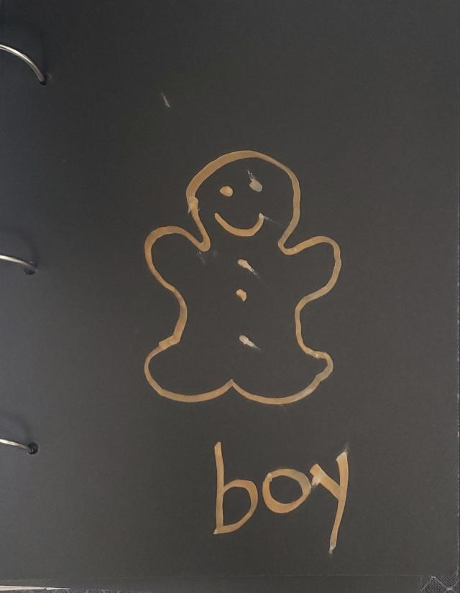
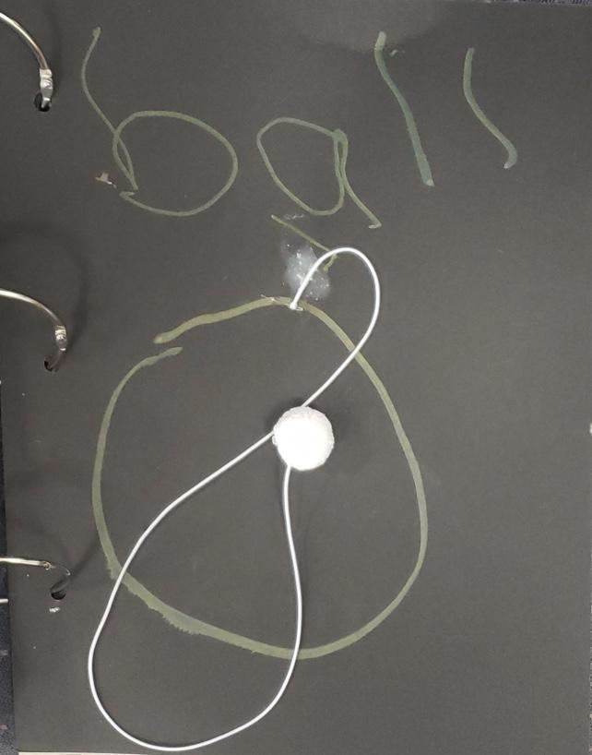
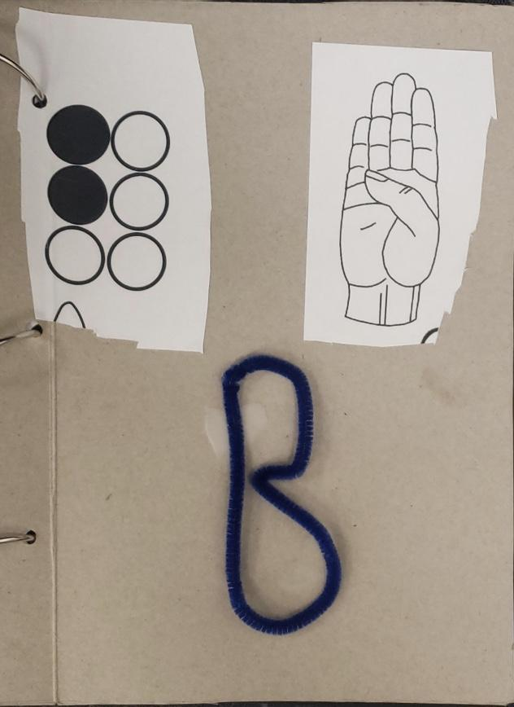
Photos of B sound book

Slide 17
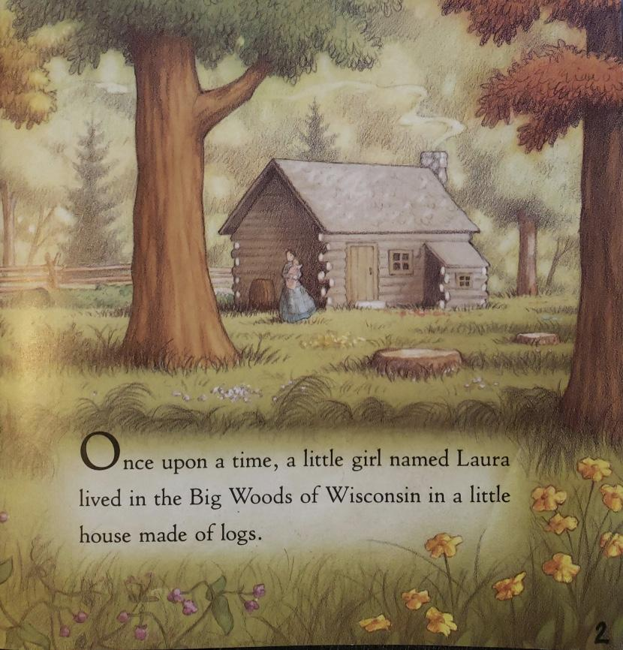
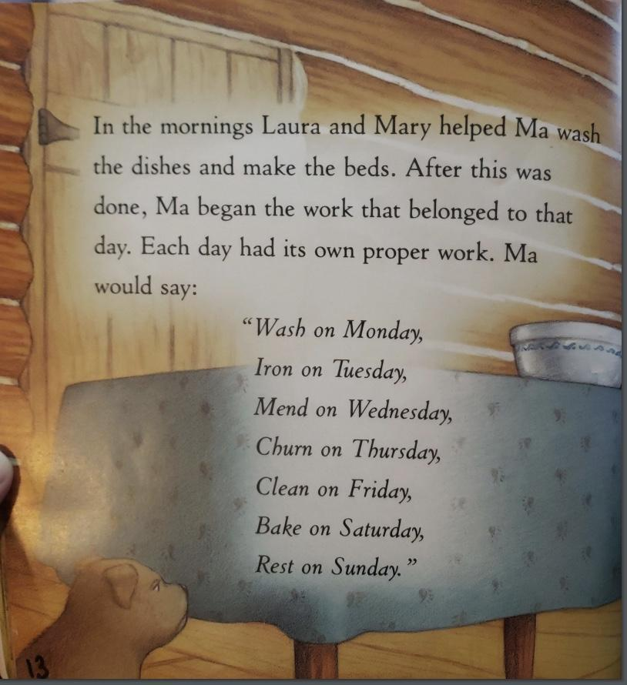
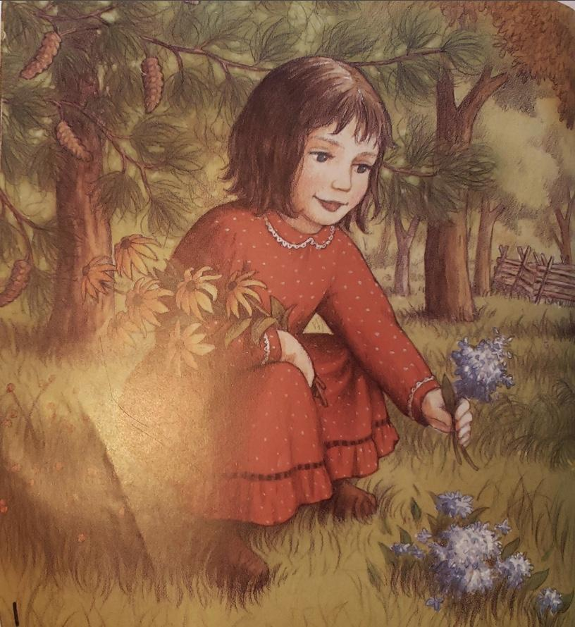
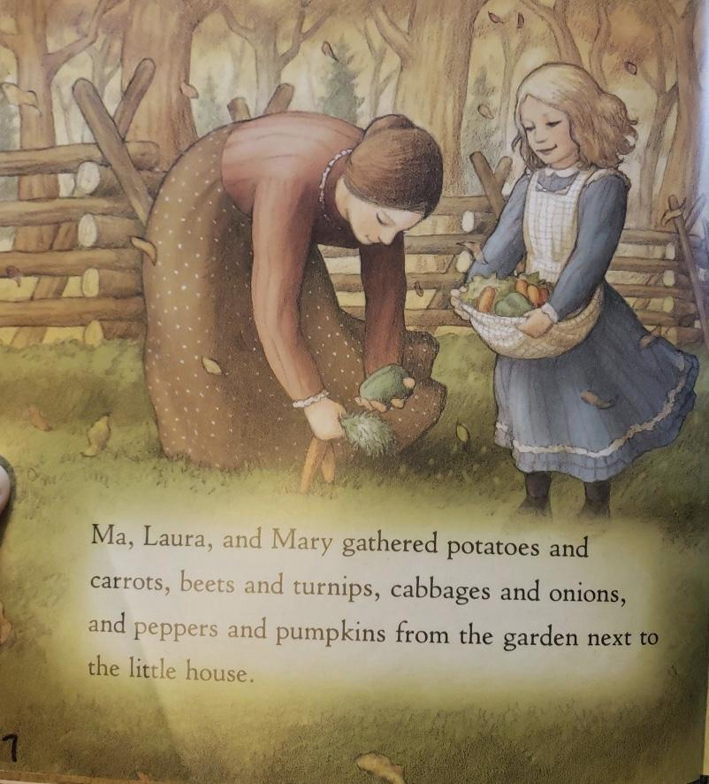
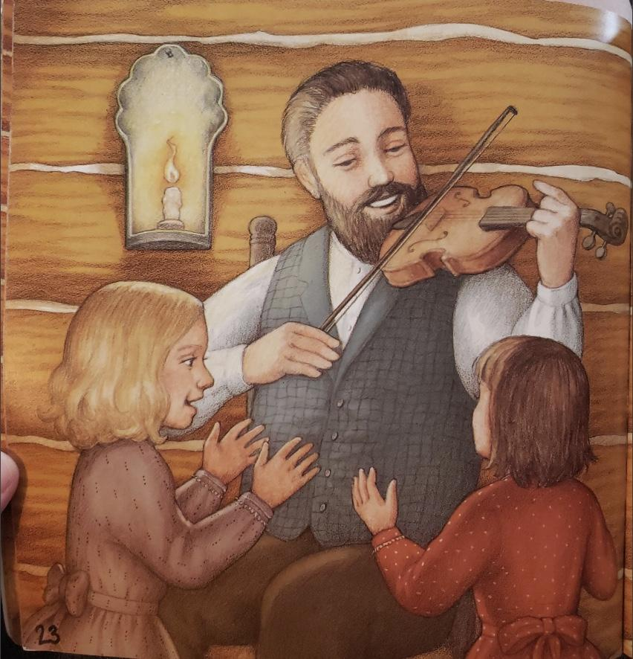
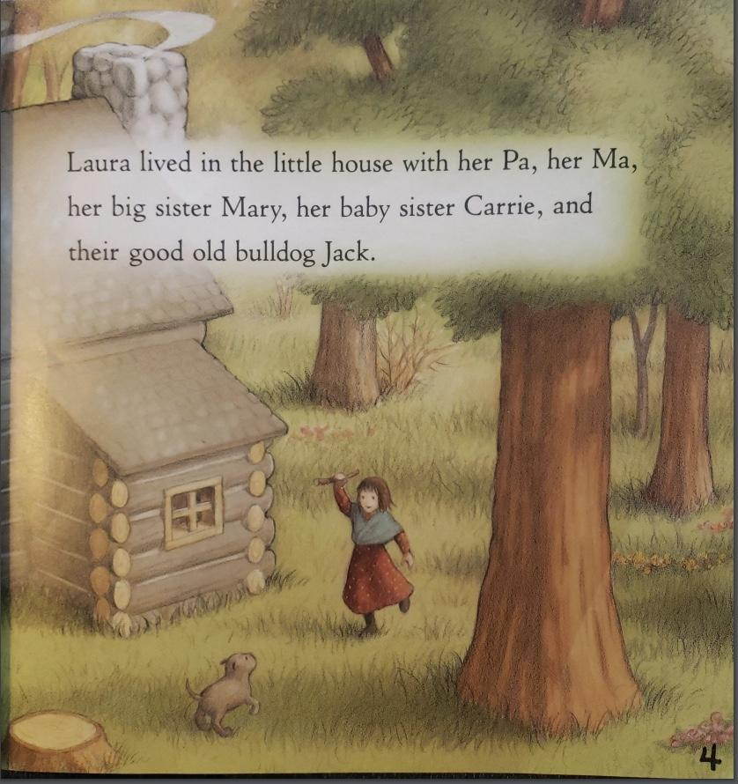

Little House-Winter Days in the Big Woods example
Feb-May
56 topics in 29 pages
completed19 topics
cooking
life skills
recreation
employment
academic skills
Lots of concept development
*photos shared with permission

Slide 18
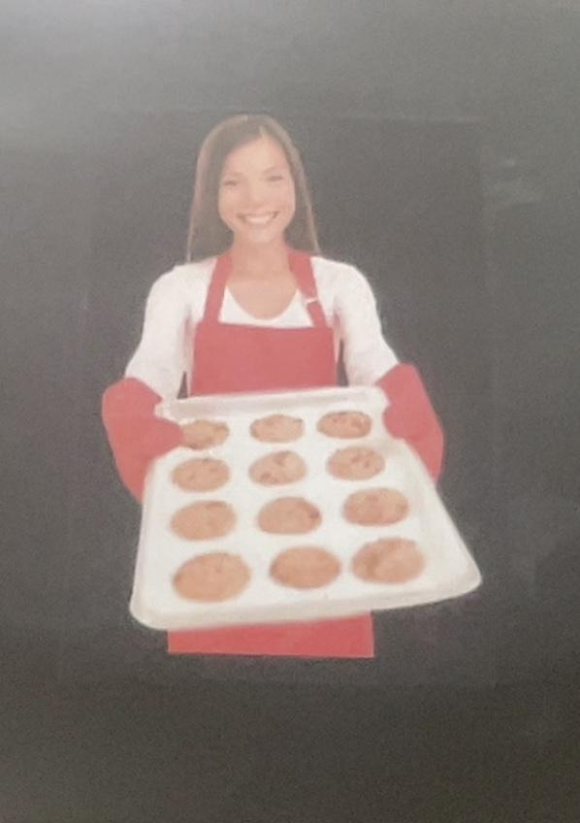

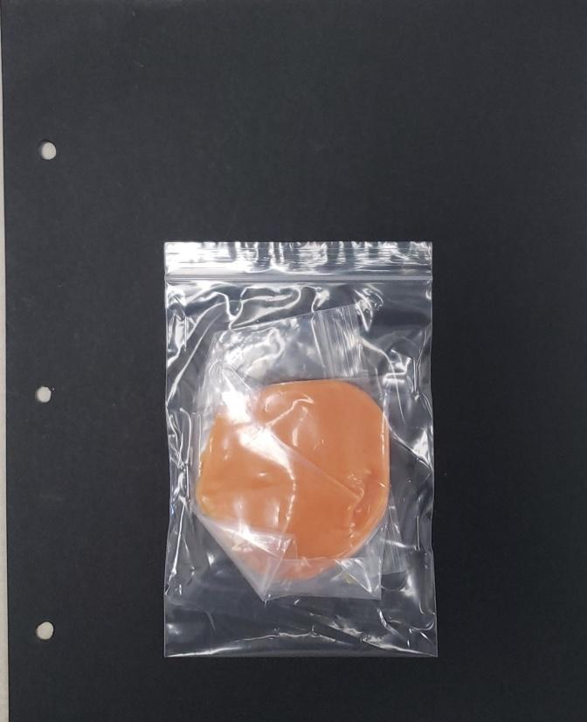
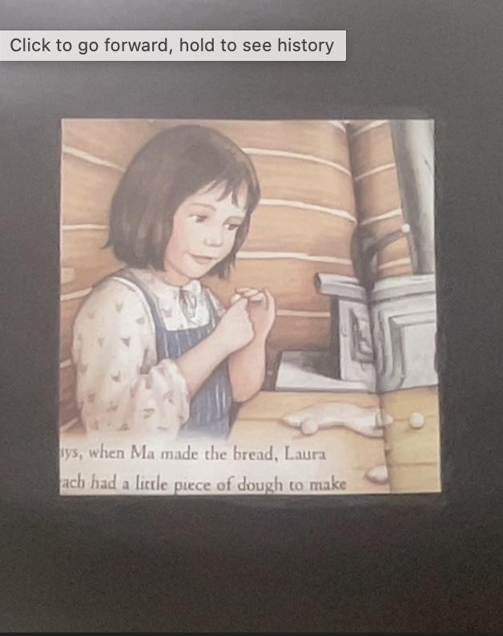
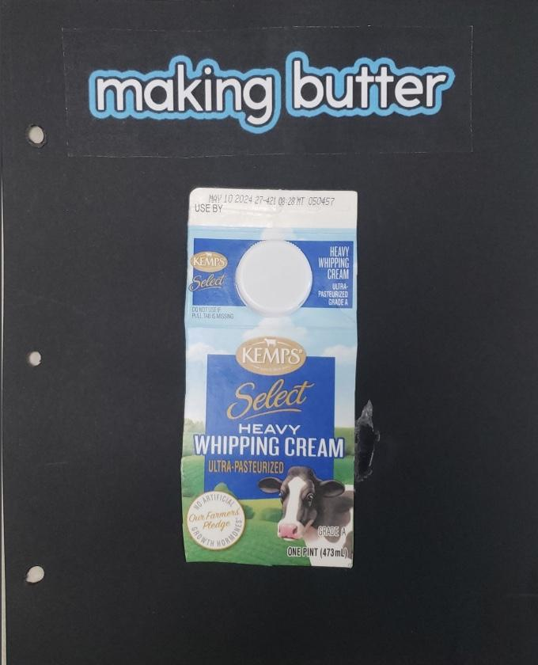
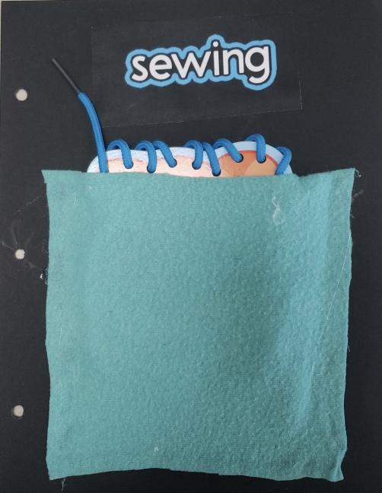
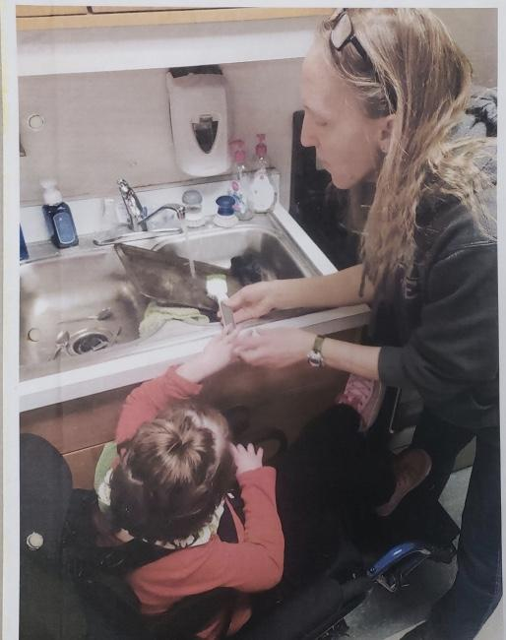
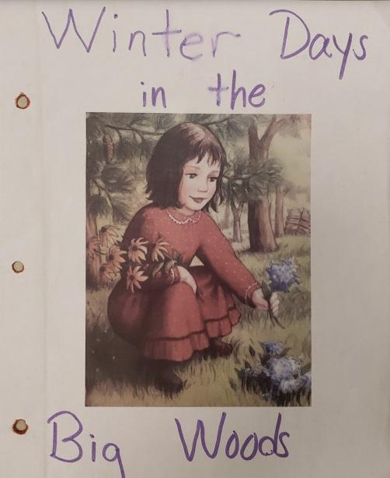


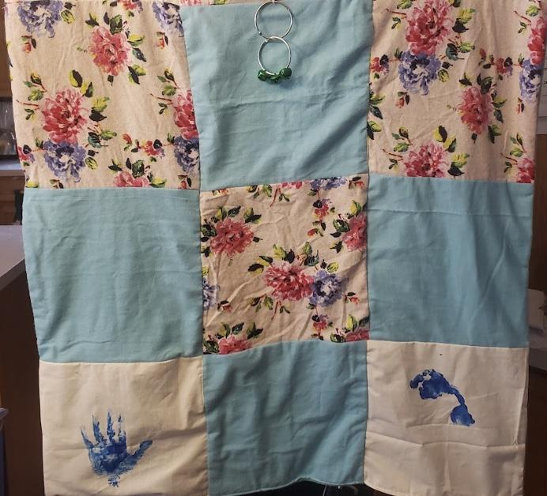
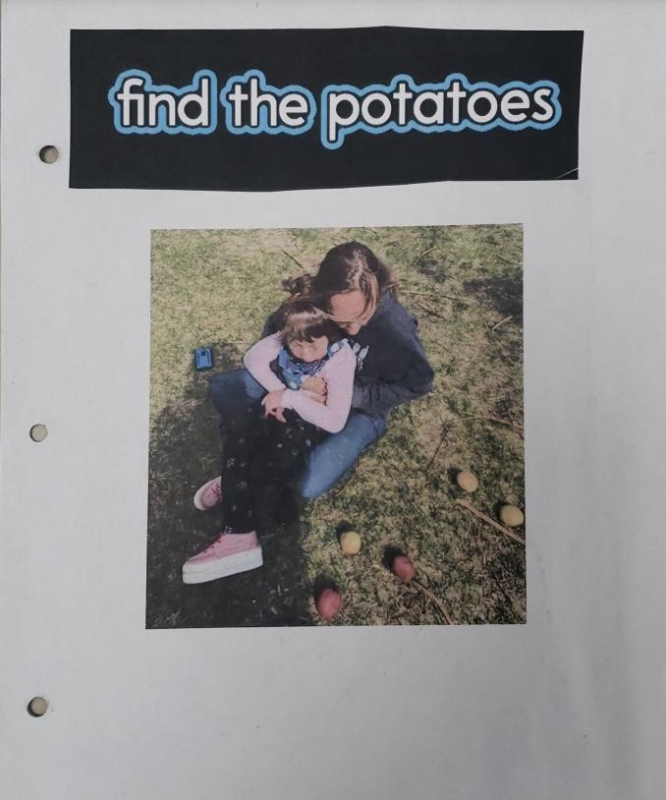
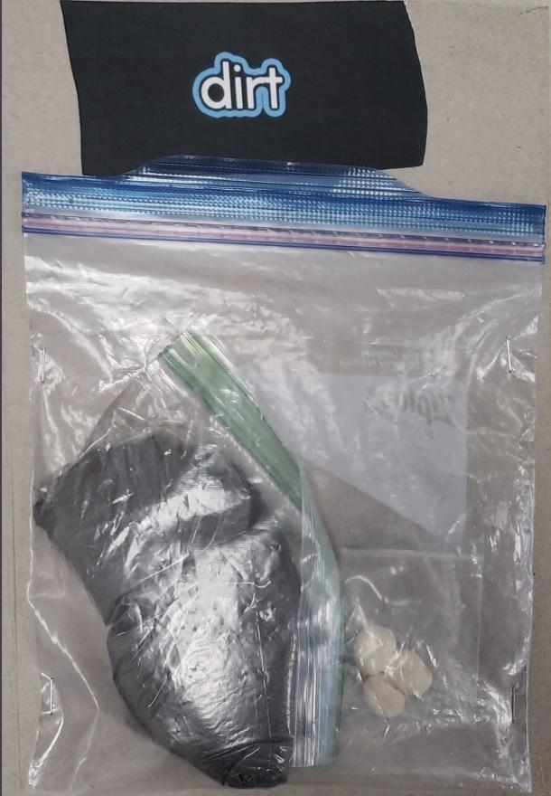
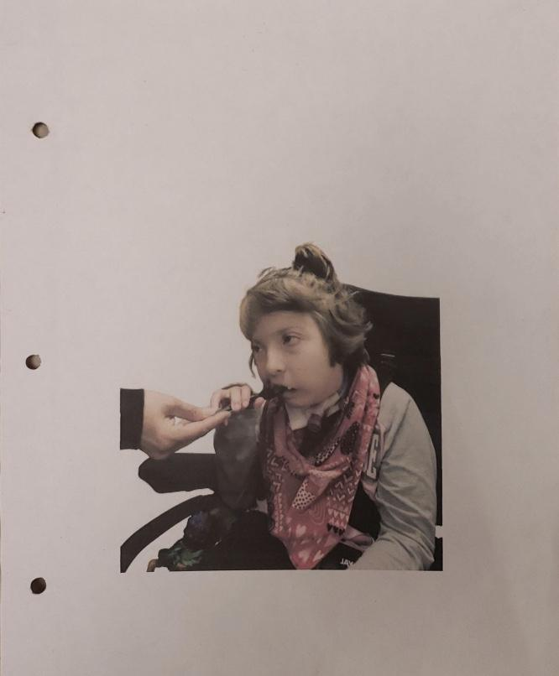
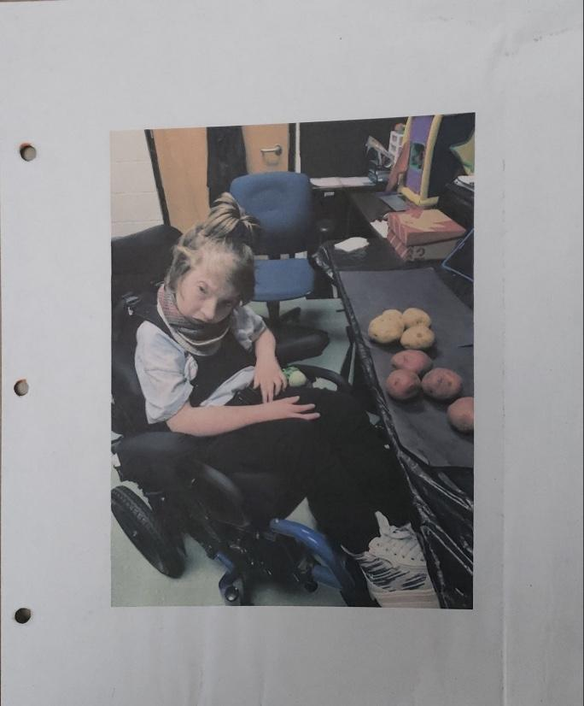
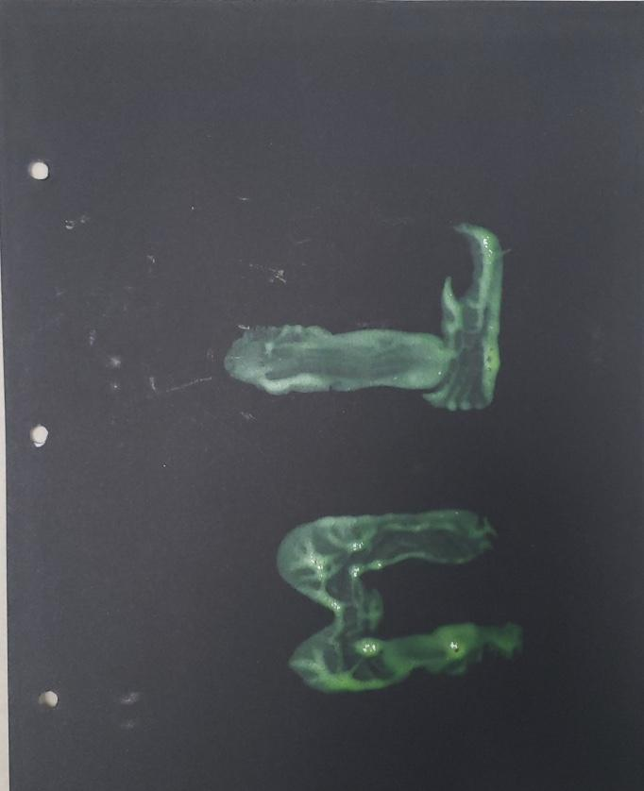
Example Exp Book
*photos shared with permission

Slide 19
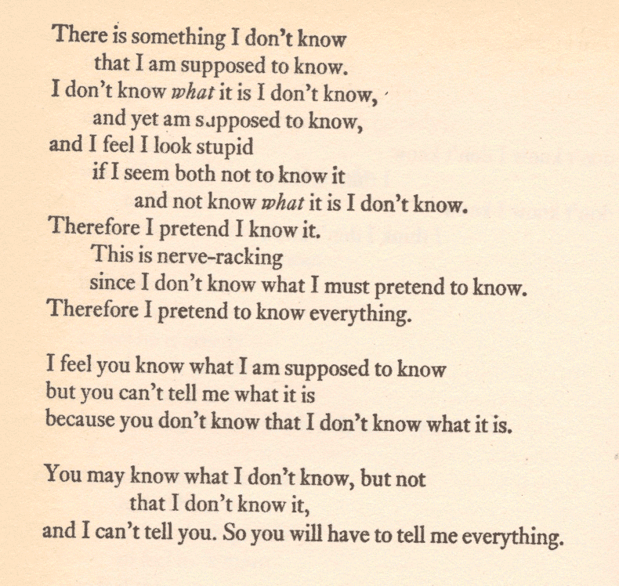
Poem
Laing, R. D. (1971). Knots. Ringwood, Victoria. Penguin. Retrieved from Poems etc. (rupert.id.au)

Slide 20
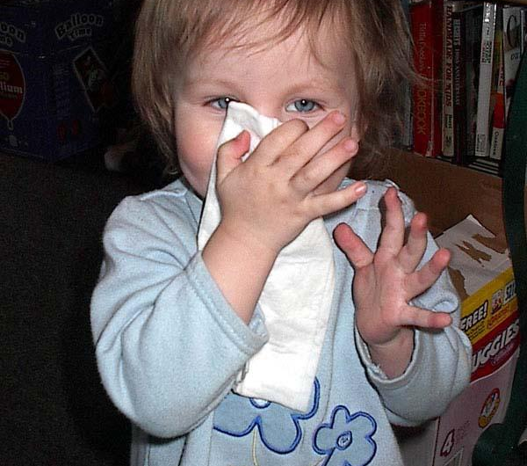
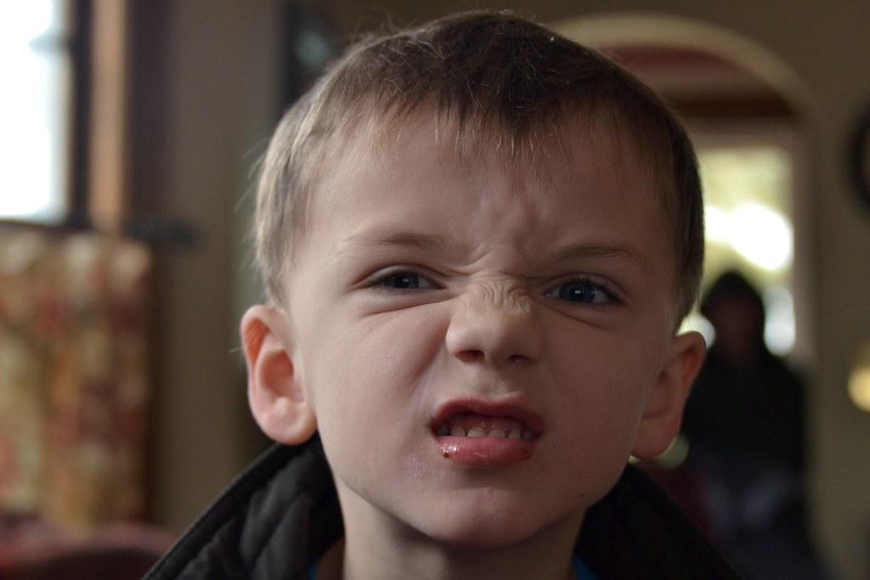

Opportunistic instruction (Krista’s term)
Sick
Sunny
Rainy
Hot
Cold
Movements
Eye gaze
Reaching
Body functions

Slide 21
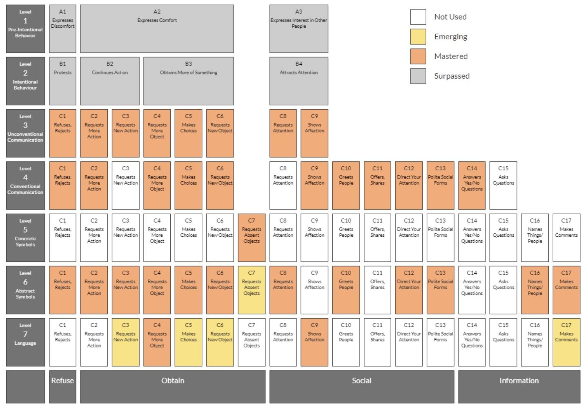
Communication Matrix
Refuse
Turn away
Close eyes
Obtain
Looking at
Glancing back and forth
Vocalizing
Social
Get attention/greetings
Information
Comments or yes/no questions

Slide 22

Question and Answer time

Slide 23
References p.1
Laing, R. D. (1971). Knots. Ringwood, Victoria. Penguin. Retrieved from Poems etc. (rupert.id.au)
Miller, C. (n.d.). Sample learning media assessments. Paths to literacy. Retrieved from https://www.pathstoliteracy.org/sample-learning-media-assessments/
Paths to literacy. (n.d.). Beyond sight: Enhancing learning with tactile and sensory experiences. Retrieved from Beyond Sight: Enhancing Learning with Tactile and Sensory Experiences – Paths to Literacy
Texas school for the blind and visually impaired. (n.d.). Literacy for little ones-online materials. Retrieved from https://www.tsbvi.edu/statewide-resources/professional-development/publications/literacy-for-little-ones

Slide 24
References p.2
Van Dijk, J. (n.d.). Child-guided Assessment Perkins school for the blind. Retrieved from https://www.perkins.org/resource/child-guided-assessment/
Wilder, L. I. (1932). My first little house books: Winter days in the big woods. Adapted from the Little House Books. Harper Collins Publishers, Inc.
American publishing house for the blind. (n.d.). On the way to literacy: Five little speckled frogs. Retrieved from https://www.aph.org/product/on-the-way-to-literacy-five-little-speckled-frogs/
Brauner, D. (n.d.). Interactive alphabet book for the letter M. Paths to Literacy. Retrieved from https://www.pathstoliteracy.org/interactive-alphabet-book-letter-m/

Slide 25
References p.3
Buchanan, L., Hayes, J., Montgomery, C., Peterson, L., Stagg, S. (2015, September). Concept development and responsive environments. In National Center on DeafBlindness, Open Hands, Open Access: Deaf-Blind Intervener Learning Modules. Monmouth, OR: National Center on DeafBlindness, The Research Institute at Western Oregon University.
Cooper, H. (n.d.). Tactile books for very young children. Paths to Literacy. Retrieved from https://www.pathstoliteracy.org/spring-has-sprung-ideas/
Cushman, C. (1993). Experience books: A tool for conversation. Retrieved from Experience Books: A Tool for Conversation – Paths to Literacy
Hearing First. (n.d.). Experience books. Hearing first. Retrieved from https://www.hearingfirst.org/what-to-do/road-to-literacy/experience-books

Slide 26

Thank you!

Slide 27
Charting the Cs Conference 2025
Statewide Professional Development to Support the Workforce and Low Incidence Disability Areas in the State of Minnesota.
This presentation is partially funded with a grant from the Minnesota Department of Education using federal funding, CFDA 84.027A, Special Education – Grants to States.

