Slide 1

Growing Two Trees with One Seed: Creatively Building Capacity in Assistive Technology (AT) Across One District
Charting the Cs Conference 2025:
To Literacy and Beyond
Cooperation Communication Collaboration
April 28-30, 2025
Jennifer Veenendall, OTD, OTR/L, ATP
Assistive Technology Specialist / Occupational Therapy Lead at West St.Paul-Mendota Heights-Eagan Area Schools (School District 197)

Slide 2

About Me
West St. Paul- Mendota Heights- Eagan Area Schools Assistive Technology Specialist and Occupational Therapy Lead
Artist, builder, upcycler
Jenn Veenendall, OTD, OTR/L, ATP

Slide 3

What is this Presentation About?

Slide 4

Learning Objectives
Recognize the needs assessment results that led to this work site initiative
Identify the work experience design and activities promoting district-wide AT consideration while developing student employment preparation
Analyze this initiative and design for broader application in other environments

Slide 5
What Led to this Program?
The Problems
Lack of AT consideration, implementation, and documentation
More work site opportunities needed for transition program students

Slide 6

The Solution
The
Solution
The Assistive Technology Resource Center (ATRC) Work Experience Program

Slide 7
Because I Love an Analogy…
The ATRC Work Experience
Vocational Skill Building for Transition Program Students AND AT Capacity Building

Slide 8

Assistive Technology Resource Center Work Experience
Students
Environment
Tasks

Slide 9
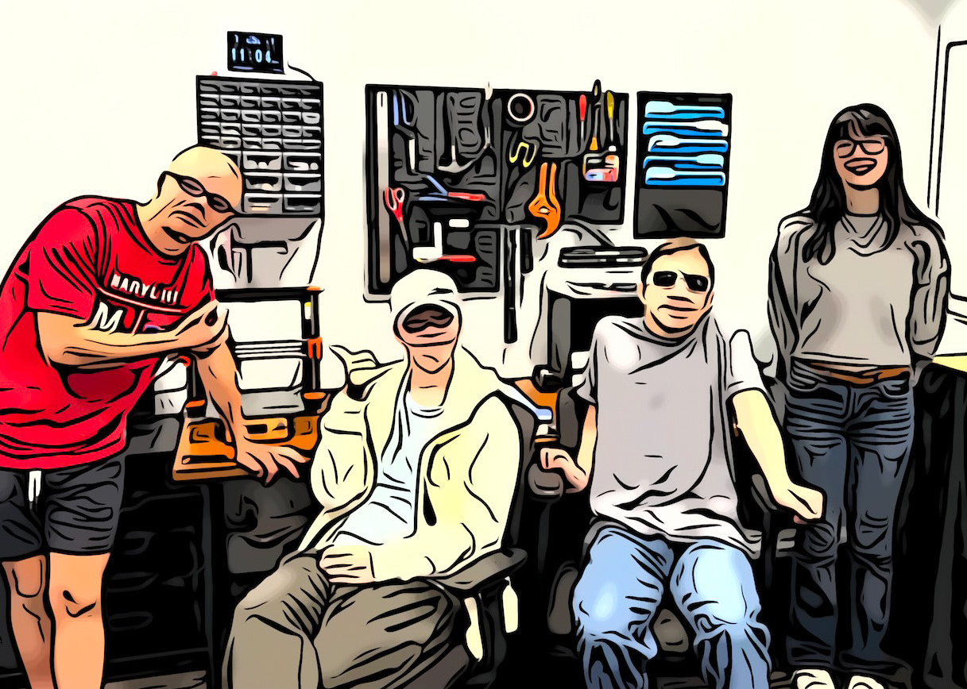
Students
Typically 1st-year students
Unclear AT needs
Wide variety of skills

Slide 10
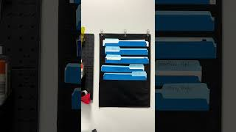
Environment - Video

Slide 11
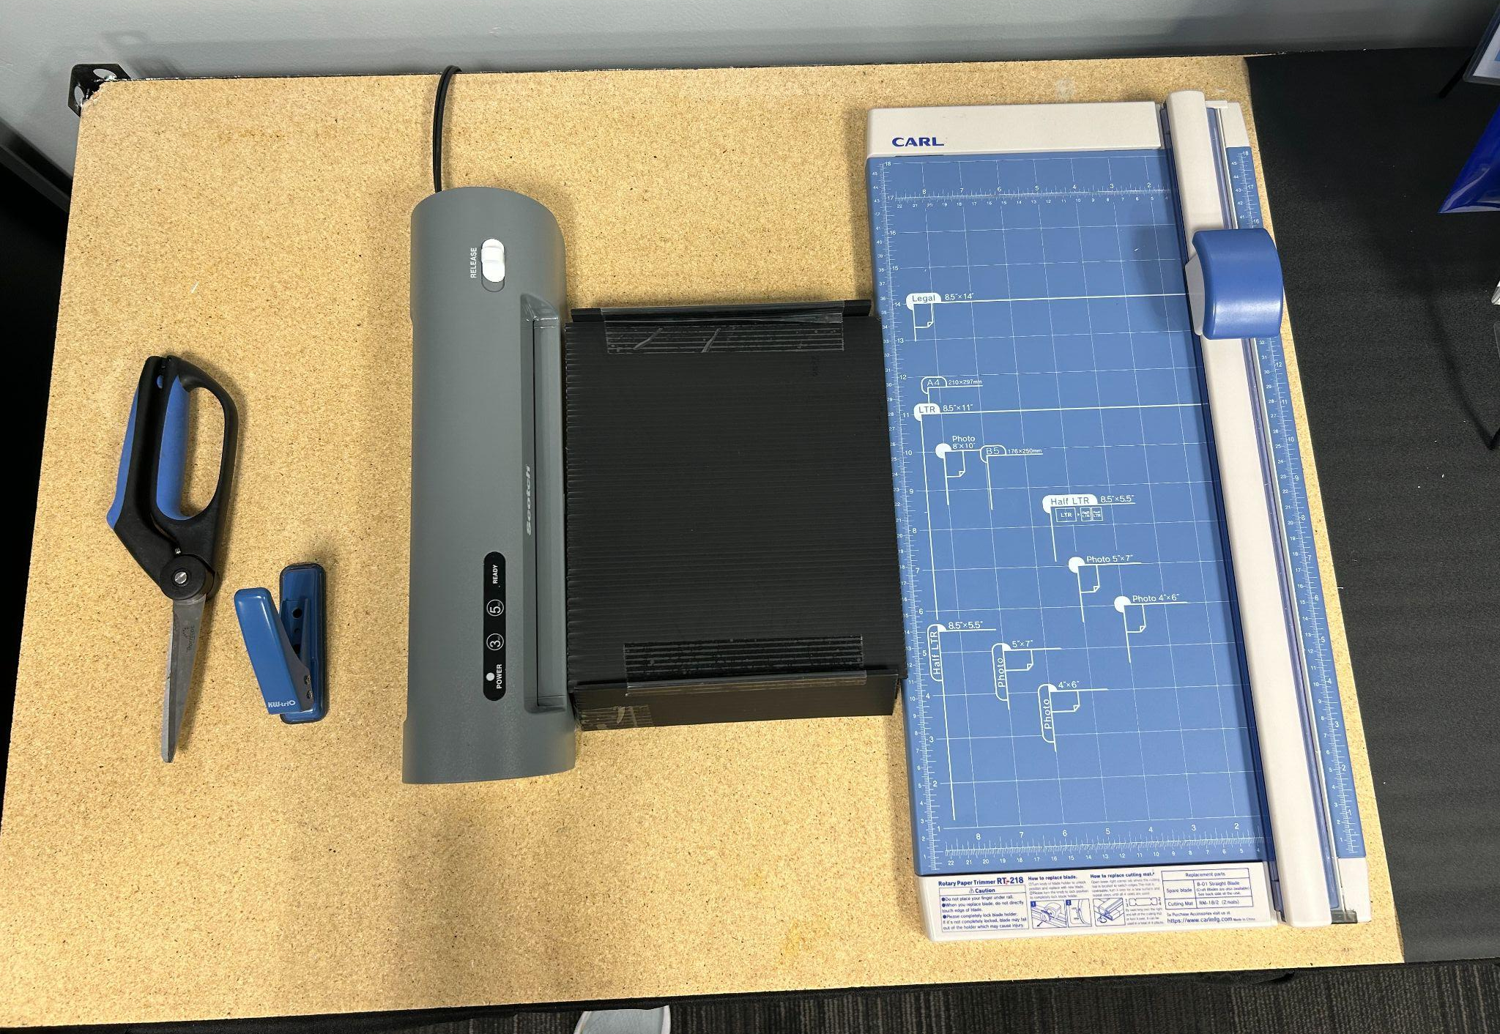
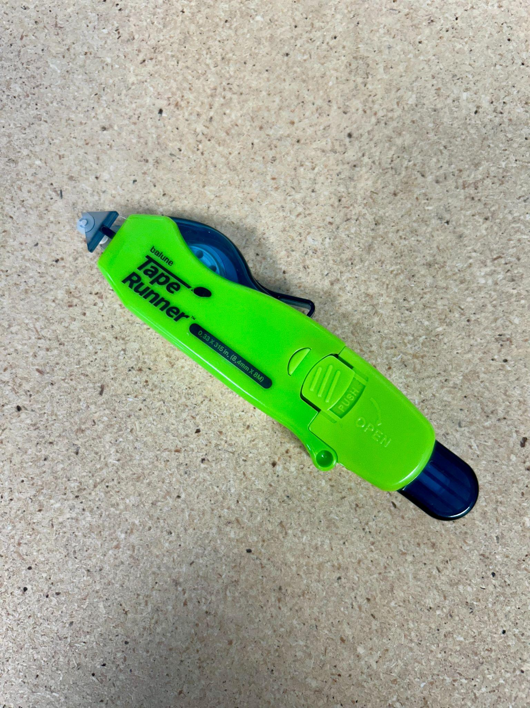
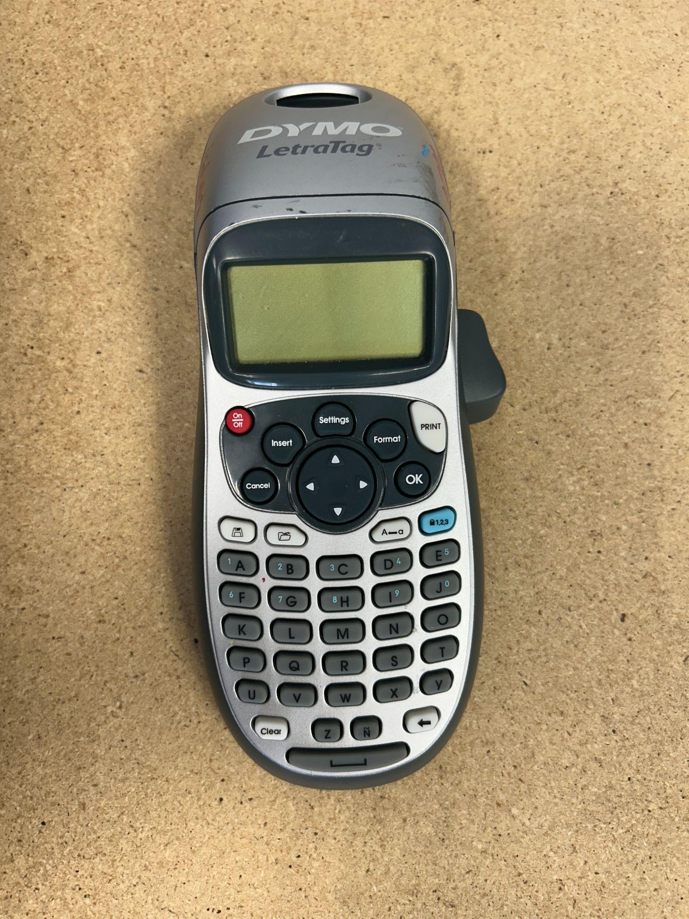
Environmental Modifications and Supports
Tools and Equipment
Tape runner
Self-opening scissors
Lever hole punch
Laminator tray
Adapted cutting board
Label maker

Slide 12
Environmental Modifications and Supports Cont.
Training and Instructions
Visual schedules
Written task steps
Video modeling (within apps or QR code to You-Tube)
Get Ready, Do, Done, Get Done visual planning template

Slide 13


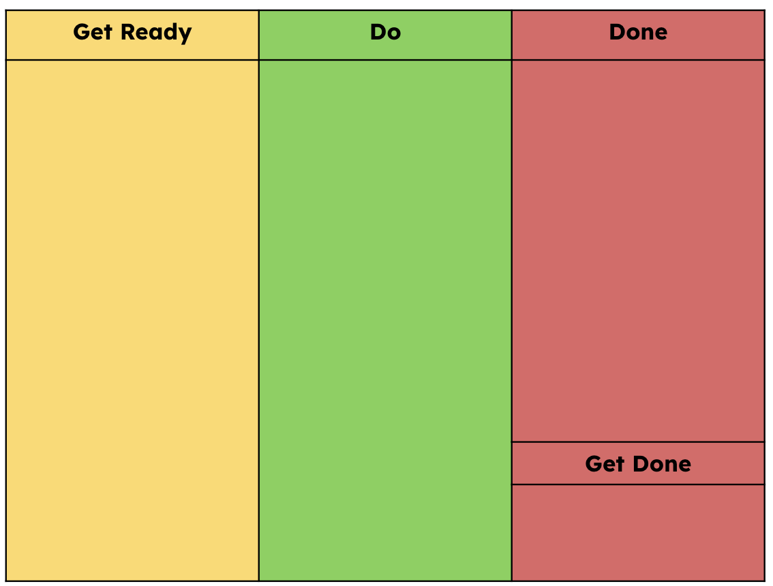
More Environmental Modifications and Supports
Training and Instructions Examples
Link to examples

Slide 14
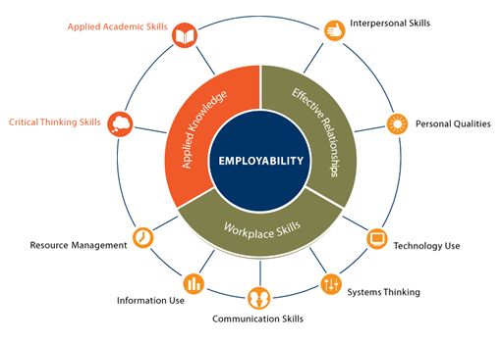
Tasks
Work completed in the ATRC directly aligns to the U.S. Department of Education’s Employability Skills Framework Workplace Skills
Link to Employability Skills Framework

Slide 15
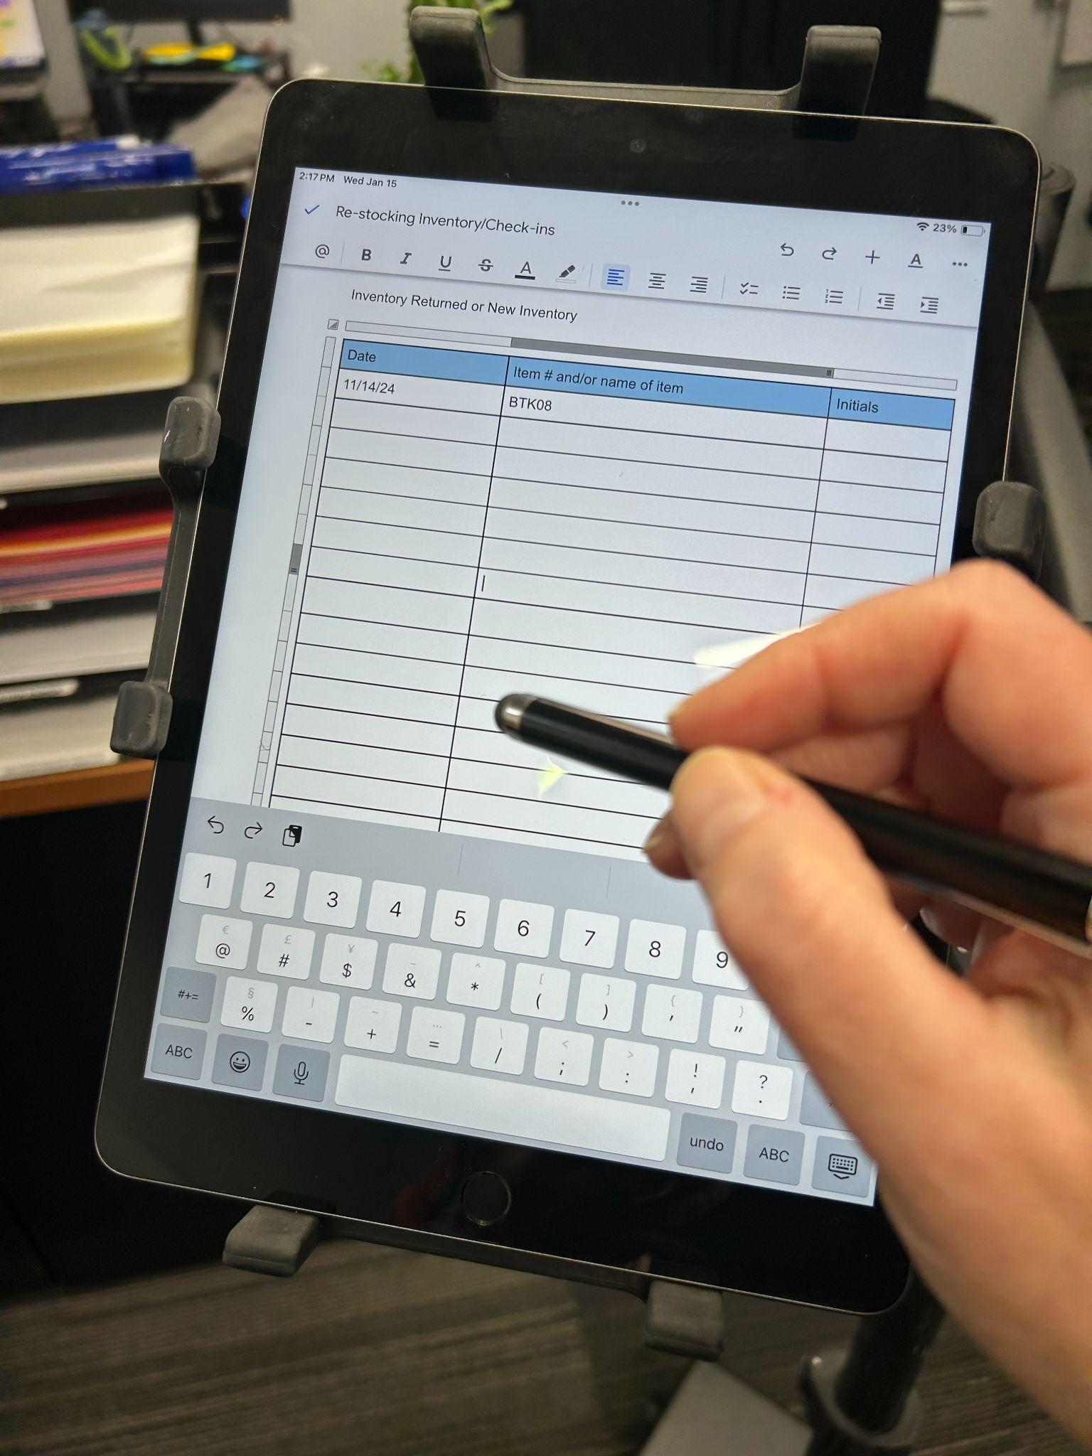
AT Lending Library Work
Data entry
Cleaning
Return to storage
Email communications

Slide 16
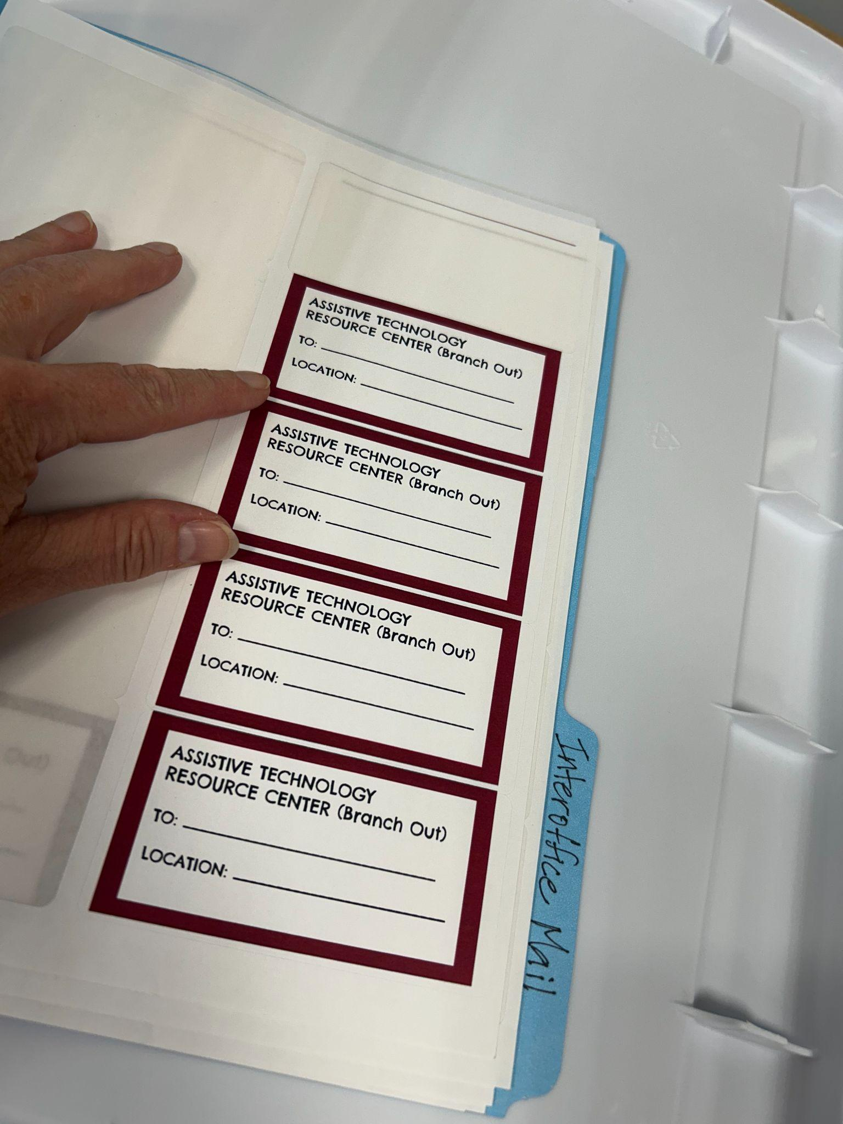
Shipping and Receiving Work
Assemble packages
Fill out shipping labels
Unpack new inventory
Check functionality of new items
Apply inventory label
Photograph and email

Slide 17
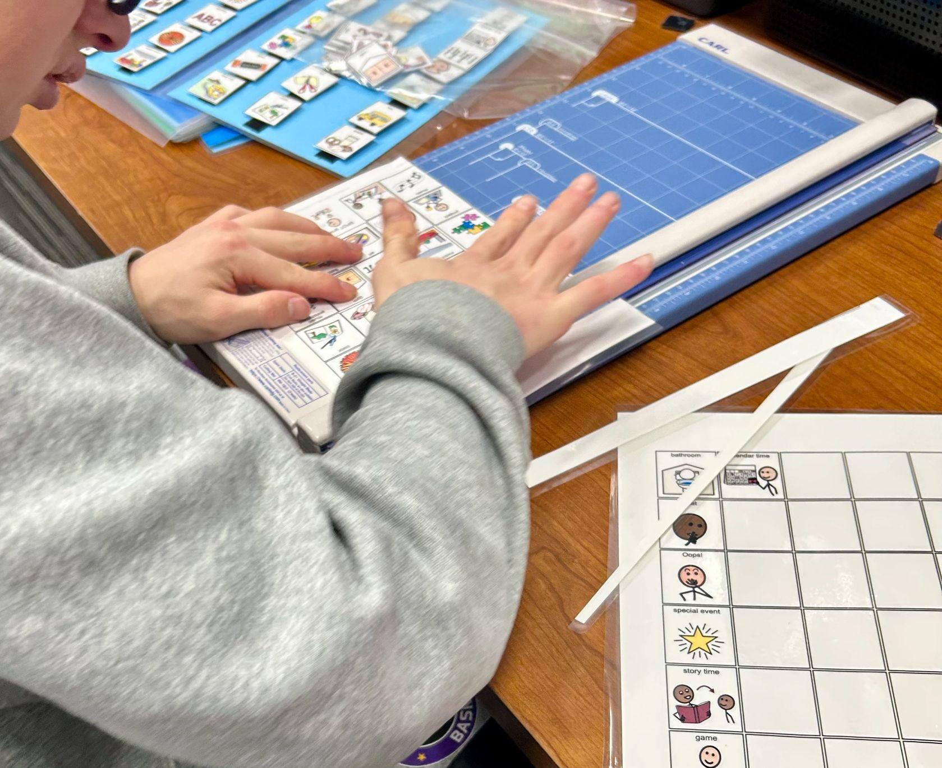
Visual Production Work
Visual schedules
Duration charts
Bound social stories
Visual scales
Spinners
First/Then boards
Token boards
File folder games
Custom orders

Slide 18
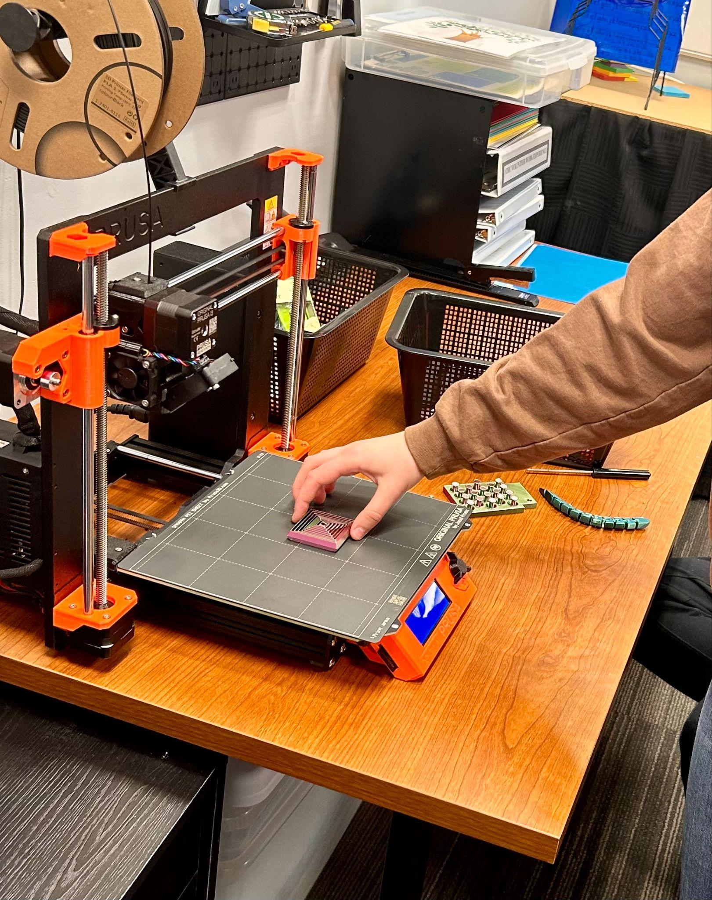
Low-Tech Fabrication Work
Weighted pencils
PVC grasping tools
PVC switch positioning devices
Pencil grips (3D printed)
Sensory supports (fidgets, weighted lap pads, shoulder wraps, and baby dolls)

Slide 19
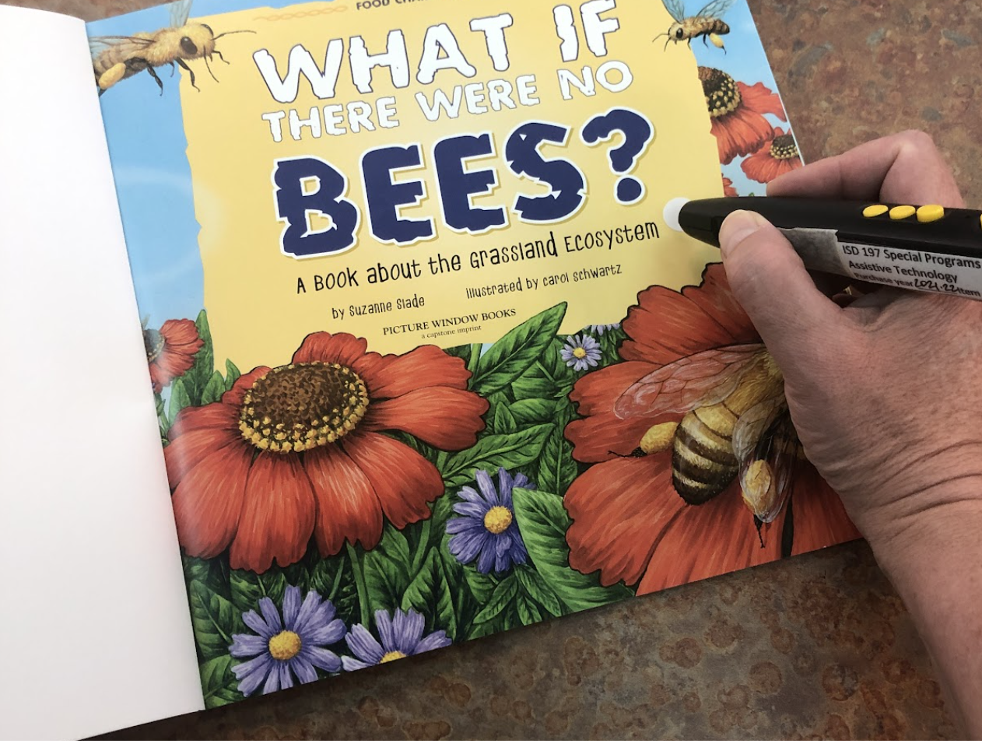
Audio Production Work
Penfriend sticker recording
Chapter books MP3s

Slide 20

ATRC Google Site
Link to ATRC Google Site

Slide 21

Barriers
Lack of collaboration time
Unpredictability of my schedule

Slide 22

Successes
Growth in work skills
Adaptive strategies and AT identified
More implementation of low tech AT throughout district
Less money spent on items we now fabricate within district

Slide 23

What I’ve Learned Along the Way
Grants are helpful
Illustrate the value of the work
Collect student thoughts

Slide 24

What’s Next / Future Planning?
General goals for the future involve the creation of tools and resources to support literacy across the district. Expand into “Production Center”

Slide 25
Tools and Materials to Support Literacy
Phoneme grapheme mapping tools
Visual tracking tools
Decodable books with Penfriend recorded supports

Slide 26
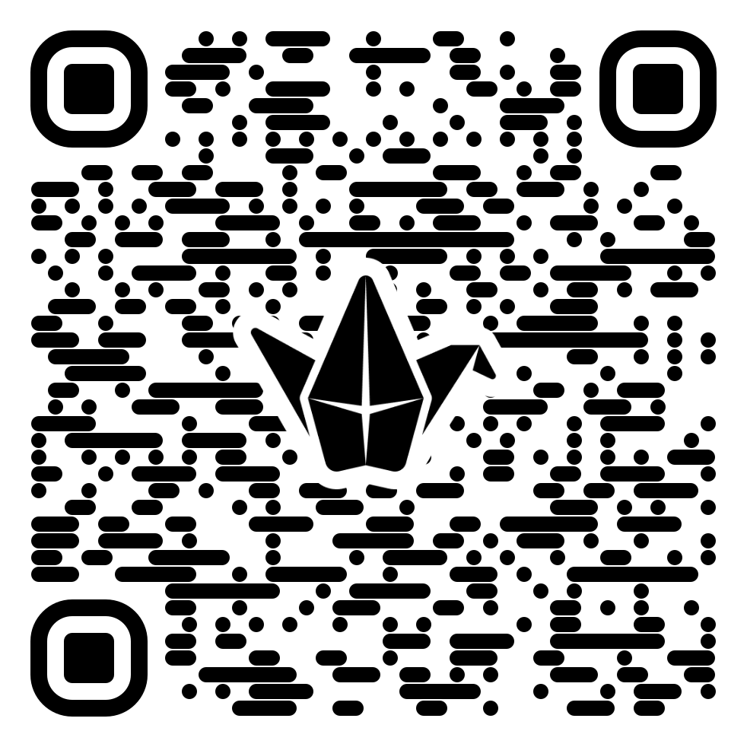
Think Tank (or Forestation Planning)
QR Code to Padlet
Link to Padlet

Slide 27

Thank you!
Jennifer Veenendall, OTD, OTR/L, ATP
jennifer.veenendall@isd197.org

Slide 28
Charting the Cs Conference 2025
Statewide Professional Development to Support the Workforce and Low Incidence Disability Areas in the State of Minnesota.
This presentation is partially funded with a grant from the Minnesota Department of Education using federal funding, CFDA 84.027A, Special Education – Grants to States.

