Slide 1
Don’t Quit! Increasing Personal Resilience Strategies for Educators
Lonna Housman Moline, Ed.D
Council for Exceptional Children-President Elect Division of Emotional and Behavioral Health
University of St. Thomas

Slide 2
Overview & Objectives
Understanding how teacher stress and coping skills are interrelated can apprise preventives and interventions to support educators.
Outcomes for participants include:
Explore common strains of educators
Review current research on teacher retention
Examine research-based strategies for resilience
Discover preventive and interventions for educator support
Engage in personal reflection of being an educator
Develop positive techniques to manage challenges

Slide 3
Teaching is rated as one of the most stressful occupations
Current rates of teachers leaving the field are quoted at 10-16% nationally.
Improving teacher retention is at the forefront of the profession.
Understanding how teacher stress and coping skills are interrelated can inform preventive and interventions to support educators.
This session will explore common strains of educators, explore strategies to build resiliency, and provide opportunities for personal reflection.
Approaches for increasing personal resilience are based on research and will be modeled.

Slide 4
Special education teachers need more mental health initiatives (Edsource)
Teachers can be heard saying, “the stress of recent years has led me to question my ability to carry on. There will come a point when I must prioritize my health over my career.”
According to the National Center for Educational Statistics,(2022) 45% of schools reported unfilled positions in special education roles, with 78% citing difficulties in hiring special education staff for the current school year.

Slide 5
Stress and Special Educators
Stress experienced by special educators is deeply ingrained in the inherent nature of their roles and in the perceptions surrounding them.
A key contributing factor is the idealization of special education teachers by schools, often portraying them as extraordinary individuals who are characterized as nurturing and self-sacrificing, willing to prioritize their students’ well-being over their own.
It’s commonplace to hear general education teachers express sentiments like, “I could never do what you do.” This portrayal creates unrealistic expectations for special educators, adding to the systemic sources of stress, which include unequal resource allocation and a shortage of adequately trained support staff.

Slide 6
Primary Sources of Stress
Daily management of challenging behavior exhibited by students in class without enough staff support. Stress affects students by hindering effective instruction, classroom management and the modeling of social-emotional skills. Stressed teachers are more likely to react unpredictably and employ ineffective behavior management strategies. (Edsource)

Slide 7
Primary Sources of Stress continued
'It's the endless stream of new government initiatives, the targets, the constant Ofsted monitoring,' she said. 'But because you know it's the children who benefit, you end up pushing yourself to excel in everything that's thrown at you. Of course that's impossible, so you end up feeling like you're never able to do anything well enough. You don't see that you've worked yourself into such a state of exhaustion that you're too tired to benefit the children anymore. You end up with your self-confidence and self-esteem on the floor.' (Depressed and Stressed, The Guardian)

Slide 8
Teach Self Care Strategies
Schools must implement programs dedicated to teaching self-care strategies and allocate resources to support these educators’ mental health and overall well-being.
These initiatives should involve professional development programs that prioritize physical wellness, encompassing exercise, dietary choices, and sleep, to sustain energy levels and enhance emotional resilience.

Slide 9
Social Emotional Learning Skills
It is vital to equip special educators with training in social-emotional learning skills. Training should cover the establishment of clear boundaries between their professional and personal lives, mindfulness practices, participation in yoga, and learning relaxation techniques.
Acquiring these skills can significantly reduce stress levels among special educators and provide positive role models for students who are also learning these skills in their classes.

Slide 10
Creating Supportive Communities
Special education teachers can create informal communities of practice with colleagues based on shared interests, facilitating connections with mentors, and therapists to seek guidance and share their experiences.
County based support community-example
These communities of practice can strengthen self-reflection practices to recognize and manage stressors effectively.

Slide 11
It is essential that schools prioritize special educators’ well-being
Support and implement targeted self-care strategies to sustain the educator's passion and dedication. This approach not only
Safeguard the mental and emotional health of educators
Enriches the educational experience for students with disabilities

Slide 12
5 Strategies for Recovering After Your Worst Day Teaching
Johanna Rauhala, Edutopia Ice crystallized on the windshield, then a tire burst on the way to school, making you late. By the time you arrived, the computer (with the video clip and presentation cued up) froze. Minutes later, Jason pulled the fire alarm while you tried to catch up on parent emails. During lunch duty, a student was punched in the nose. Your nose is stuffy while you explain to the principal right before an IEP meeting why your plans haven't been submitted yet. The day trudges along. . . At last, the final bell rings, and in your first quiet moment of the day, thoughts of leaving the teaching profession suddenly seem, well, right.
It's that moment when you want to say, "I quit!"

Slide 13
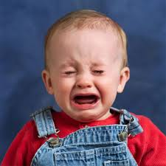
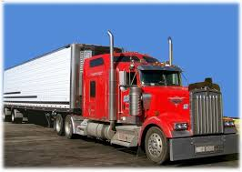
True Story

Slide 14
It's Not a Secret
Most teachers, at some point, feel like giving up. We feel the weight of not having done enough, feel the frustrations of negative media attention, and feel challenged by apathetic or disruptive students. Sometimes, it's overwhelming. That's when our tasks feels insurmountable and we can feel hopeless.
We want to quit. We're tempted to call in sick and plan for a sub. That can be too much work or the right call.
You can take that empathy and understanding normally reserved for students and focus it on yourself. You can consider some strategies for gently accepting your circumstances, reflecting on what is needed, and preparing to return tomorrow.

Slide 15
Another Way
Use the empathy and understanding normally reserved for students and focus it on yourself.
Consider some strategies for gently accepting your circumstances, reflecting on what is needed, and preparing for tomorrow.
What strategies?
(Edutopia)

Slide 16
1. Find a Friendly Shoulder
Call a trusted colleague, preferably one who's been teaching a long time.
Vent
Cry
Laugh hysterically
Have a beverage
Tell them about your struggles and frustrations
All teachers can recount a story of a crazed student or parent. Just ask them.

Slide 17
2. Breathe
This sounds simple, and it is. Sit with the discomfort and notice it. Acknowledge frustrations of the day and then let them go. Listen to your self-talk and try to be kind to yourself. Practice slow breathing. If possible, carry this habit into your workday. It will create space for less reactivity and a more grounded emotional stance.

Slide 18
3. Plan for Community
Consider pausing the scheduled lesson, and instead, take time to engage in team building activities with your students.
Connect with YOUR community of support.

Slide 19
4. Prioritize
Stacks of papers on your desk?
Parents waiting for your email?
Field trip permission slips to process?
Lesson set up for tomorrow?
When tasks overwhelms you -- write a list of everything that needs to get done in the next two days.
Look at this list and choose the top three tasks. These three are the must-dos, urgent actions that will help you survive until the next day.
After completing the must-dos, cross them off your list and go to sleep early.

Slide 20
5. Get Perspective
Devoting all our waking hours to teaching primes us for burnout.
It happens when the demands and expectations of our work drown out our joy.
Your other roles are important, too: friend, spouse, sibling, hiker, reader, dancer, joke-teller, or baker.
These other aspects of your personality need attention. Go to the forest or to a ball game. Get a massage. Read a book. Hang with your family and friends.
We can be good, caring, effective teachers, without sacrificing our personal lives.

Slide 21
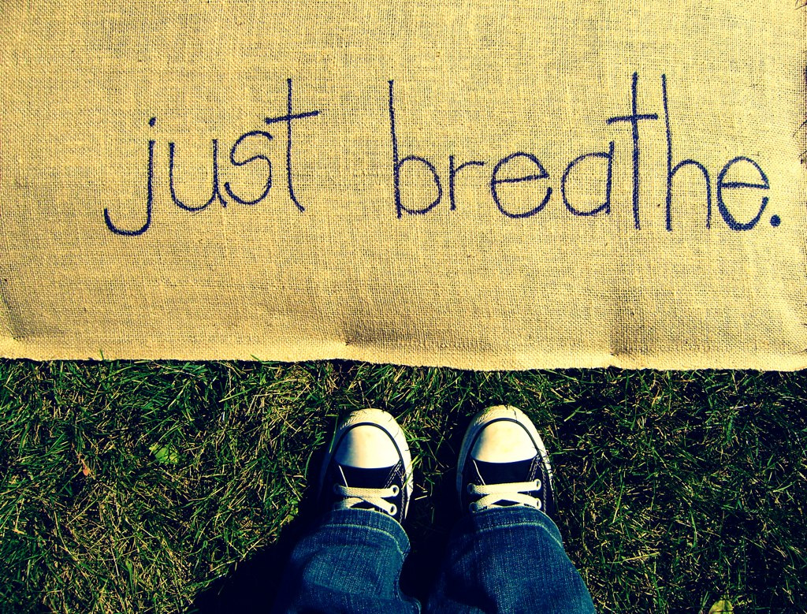
How to Relax
Perceive
Reframe
Laugh
Breathe
Play

Slide 22
Promoting Wellness for Educators:
Strategies and Results

Slide 23
Powerful Professional Development
100% satisfaction with training objectives
learn strategies to help reduce stress
learn strategies to be more positive
model strategies to use with students
Reduces educators’ immediate distress 85% of the time Produces positive impact for stress reduction and increase of overall workplace wellbeing!

Slide 24
Professional Development sessions for increasing well-being offer a convenient and beneficial opportunity for a support network that cultivates resilience.
Attending to the well-being of special education staff is a win-win situation.
When staff are flourishing, both student learning and teacher retention can increase.
In a survey of teachers, 85% reported they felt there was a need to develop policies that would enhance the wellbeing of teachers. However, with the demands of the job, many teachers may feel they do not have the time to create and maintain such support systems (Ferguson, Frost, & Hall, 2012).

Slide 25
Developing a Program
2017- All district Back to School assembly
Positive psychology strategies, well-being, social emotional learning
Presented at numerous conferences and districts
I suggested having workshops for our special education staff, got approval, designed sessions

Slide 26
Approved!
Professional Development during the school year
New Teacher Training
Summer Academy
One of the top 3 attended sessions
Includes all staff (general education, support staff)

Slide 27
All strategies are backed by research and are presented to participants along with actual activities to practice the strategies
Art
Mindfulness
Reflection
Celebrations
Reframing
Perspective taking
Play

Slide 28
Workshops & Trainings
Rewards and Reinforcement
Frame It
Relaxation
Examining Our Explanations
Be Ridiculous
Celebrations are Critical
Increasing Passion at Work
Anchor Your Awesomeness
We Need A Parachute
Stop Driving Yourself Crazy
Working Through Conflict
Fun and Laughter
Relationships are Required
Banishing Burnout
The Relevance of Reflection
Sink Self Sabotage

Slide 29
Planning the session
Sessions were each 2 hours
Relaxed, fun, snacks, drawing for prizes
Sessions provided resources for staff’s personal use, as well as resources to take back to the students.
Consistent day and time
Participants register through our SPED website. Paraprofessionals are paid their regular salary. Teachers are paid our PD rate.

Slide 30
Comments from Participant Surveys
We were provided great articles
Fun, relaxing class and atmosphere
I found the cognitive reframing information to be very helpful
I can see using this with my students
I like all the different resources you provided
The structure of the session is good. LOVE the projects that tie in the lesson!
I liked the mix of research and opportunity to try things
The opportunity to actually practice what was discussed
Ideas that were given for us were also made appropriate for classroom

Slide 31
Data Collection
Investigate educators’ levels of stress and explore what effect professional development, focused on personal wellbeing, had on educators. Understand how teacher stress and coping strategies are interrelated in order to provide preventive and intervention strategies to support educators.
Subjective Units of Distress Scale* SUDS
Perceived Stress Scale* PSS
Workplace PERMA-Profiler PERMAH
Informal Survey* Wellness Survey
*Used google form

Slide 32
Method
A series of 5 professional development sessions was offered to all Special Education Staff.
Sessions focused on personal well-being strategies.
Each 2 hour session had a wellness topic, research-based strategies, and provided time for participants to practice a strategy.
While strategies were focused on staff use, all strategies could also be used with students.
Sessions also allowed time for staff to connect in a positive, relaxed environment.

Slide 33
Participants
teachers
paraprofessionals
speech/language clinicians
work experience
coordinators
They self-selected which session they attended.
Group size ranged from 13-15.
Eight participants attended four or five sessions.
Others attended three or less.

Slide 34
Results
Subjective Units of Distress Scale (SUDS)
The SUDS is a tool for measuring the subjective intensity of distress currently experienced by an individual using a scale of 0 to 10.
Self assessment, individual identifies their current distress level on the scale.

Slide 35
Results continued
The SUDS was given to participants at the start and end of each session (pre/post)
Collected electronically
Average decrease of reported distress was 2.6
4 instances where the level of stress showed no change
2 reports of an increase in stress
Lowest average level of distress 2.2 reported after the final session

Slide 36
Results continued 2
Average reported distress level at start and end of each session
PRE POST
November 4.7 2.5
January 5.5 3.1
February 5.0 3.1
March 6.5 3.5
April 4.8 2.2

Slide 37
Further examination of rating scores
23 out of 125 responses fell in the elevated range, equal to or above 7
41 out of 125 responses fell in the middle range, defined as rating 4 to 6
62 out of 125 responses indicating low distress, defined as rating 3 or less
Higher ratings were indicated at the start of the session 91% of the time
**Eighty-four percent of the low distress ratings were recorded immediately following the wellness session.

Slide 38
Perceived Stress Scale (PSS)
PSS is a classic stress assessment instrument.
Developed in 1983 and continues to be a popular choice for understanding how different situations affect one’s feelings and perceived stress level.
Questions assess general level of stress, not specific to the workplace.

Slide 39
Perceived Stress Scale (PSS) continued
Individuals are asked to indicate how often they felt or thought a certain way over the past month. Some examples of questions include:
In the past month, how often have you felt unable to control the important things in your life?
In the last month, how often have you felt confident about your ability to handle personal problems?
In the last month, how often were you able to control irritations in your life?

Slide 40
Perceived Stress Scale (PSS) continued 2
Individual total scores on the PSS can range from 0 to 40 with higher scores indicating higher perceived stress.
Scores ranging from 0-13 are considered low stress.
Scores ranging from 14-26 are considered moderate stress
Scores ranging from 27-40 are considered high stress
Scale was used to collect staff stress levels over the course of the school year
Given to participants 5 times between November and April
Distributed via email a few weeks after each session
Participants were encouraged to fill out the scale each time, regardless of attending the previous session

Slide 41
Results from the PSS
Results from the PSS showed the earlier part of the school year was the most stressful (November) and April was the least stressful. The average reported stress level for each month fell within the “moderate” (14-26) range.
Average level of stress for each month
November 22.66
January 20.68
February 21.05
March 21.38
April 20.00
*Average 21.15

Slide 42
Compared to the Norm
Norms as reported by Cohen (1994)
Mean score of 12.1 for males
Mean score of 13.7 for females
When comparing scores from this study to the female norm, educators’ average stress level was 7.45 points higher than the norm.

Slide 43
The Workplace PERMA-Profiler
The Workplace PERMA-Profiler collected data specific to the workplace
Workplace PERMA is a variant of the PERMA-Profiler, which is a general measure of flourishing for adults. It measures the 5 domains of flourishing (as defined by Martin Seligman), including positive emotions, engagement, relationships, meaning, and accomplishment.
The Workplace Profiler changes the context of the questions to the work environment
Individuals are provided with a report on their PERMA and strategies to increase their well-being

Slide 44
Results from the Workplace PERMA Profiler
Increase in Overall Workplace Wellbeing
Average score in November was 6.71 and at the
Average score at end of the sessions, April, was 7.91
1.2 increase

Slide 45
Informal survey
Collected using a google form
17 respondents
Responses were all positive
94% responded that the sessions were a good use of their time
-One person responded “mostly”

Slide 46
Informal survey continued
When asked if they learned something to help them reduce stress, 47.1% strongly agreed and 52.9% agreed.
When asked if they learned something to help them be more positive, 52.9% responded “strongly agree” and 47.1% “agreed”.
Sessions also modeled strategies they could use with their students. When asked if this objective was achieved 41.2% strongly agreed and 58.8% agreed.
All respondents indicated that they would like to attend additional sessions.

Slide 47
Informal survey comments
healthy way to connect with other staff, positive tools to use, activities
connecting with colleagues, getting resources, time to rejuvenate
sharing our experiences and hearing others' stories
relaxed, small group, learning information that I can use at work and in everyday life
creative projects that let us collaborate with colleagues from other buildings
helped me to see certain things that we can adopt in our daily life, for Ex: Gratitude, Self Compassion which can change our perspective
each session included a project that I could take back and do with my class
format of presenting relevant research first and then doing a mindful activity with some room for creativity was both informative and stress-relieving. I loved it!

Slide 48
Individual Session Data
Results assessing participants’ stress levels at the individual sessions showed a reduction of 2.6 data points on a 1-10 scale.
Higher distress ratings were indicated at the start of the session 91% of the time.
Low distress ratings were recorded immediately following the wellness session 85% of the time.
Wellness sessions had a positive impact in immediately reducing distress.
When considering a change in distress levels over the course of the school year and five sessions, the average score on the PSS decreased from 22.66 to 20.00. Results from the Workplace PERMA-Profiler showed an increase in Overall Workplace Wellbeing rising from 6.71 to 7.91.

Slide 49
Relevance & Importance
When the research shows teachers with significant stress levels and low coping skills are associated with the poorest student outcomes, it becomes glaringly important to provide outlets and interventions to assist educators in reducing negative stress.
This study validated the elevated stress levels of educators and showed that “wellness strategies can reduce distress and increase overall workplace wellbeing.”

Slide 50
Resilience and Coping Skills (Harrison, Hoon, & Floet, 2021)
Resilience includes internal factors and external supports to overcome stressful events. When external supports are not present, stress can become toxic.
Problem-focused coping concentrates on resolving the problem. There are 3 subscales: positive reinterpretation and growth; active coping; and planning. Problem-focused coping can lead to the problem being successfully resolved, promoting competence and self-efficacy.
Avoidant emotion-focused coping, such as denial, venting, emotion and behavioral disengagement, uses strategies to lessen the negative affective response to the stressor. This might alleviate the immediate negative effects for the individual, however, is only temporary and the problem is unresolved.

Slide 51
Create Your Personal Resilience Plan
Developing social-emotional skills takes time, and resilience is an ongoing process of adaptation and growth.
Consider and try some of the research-based practices.
Notice which ones seem appealing and enjoyable for YOU.
Plan how you might incorporate one of these into your life.
Choose one strategy or practice to implement in your daily life for at least 5-10 minutes. (Keep it simple.)
What kinds of obstacles and barriers might arise? How might you address those obstacles? How will you encourage yourself to prioritize this plan?

Slide 52
Create Your Personal Resilience Plan
Commit to a plan.
“Care for yourself as hard as you care for those kids.”

Slide 53
Revisit Your Story
Create a brief timeline of several major events and turning points that made you the person and education professional you are today.
Choose 2 or 3 of these events and reflect on each one.
What feelings do you associate with the event? What lessons emerged for you? What obstacles and supports did you encounter?

Slide 54
Share Your Story
What feelings do you associate with the event? What lessons emerged for you? What obstacles and supports did you encounter?
What did you learn about your strengths, weaknesses, motives, and values
What major events and turning points made you the person and education professional you are today?
Five Ways To Reignite Your Passion for Teaching, Greatergood.berkely.edu

Slide 55
The Donkey

Slide 56
The Donkey in the Well
Jack was a donkey who fell in a well. The farmer tried everything he could to try to get him out, but in the end he feared that there was no hope for Jack and the farmer decided to just bury him. For every shovel of dirt that the farmer threw on his back, Jack shook it off and used that dirt to take a step up. Over and over this happened and each time he had more dirt thrown on him, he shook it off and took a step up. Pretty soon, Jack was able to walk out of the well and didn’t have to succumb to the fate that the farmer had planned for him.
Is life throwing you dirt? You can either let it bury you or you can shake it off and take a step up like the donkey in the well. We can either let our struggles weigh us down or we can use them to help us get where we want to go. Next time you face an obstacle, think of this story. Shake it off and take a step up!

Slide 57
Thank you!
Lonna Housman Moline
lonnamoline@gmail.com
TEXT: 612-812-2221

