Slide 1
Empowering Excellence Through
a Collaborative AAC Coaching Cohort
Karley Sykora, MS, CCC/SLP
Brainerd Public Schools
Kirsten Morton-Aldous, P/HD, TBI, OHD Specialist, AT Specialist
Paul Bunyan Education Cooperative

Slide 2
Welcome & Introduction
Karley Sykora, MS, CCC/SLP
Speech-Language Pathologist
Brainerd Public Schools
Kirsten Morton-Aldous, P/HD, TBI, OHD Specialist, AT Specialist
Paul Bunyan Education Cooperative (PBEC)

Slide 3
Learner Objectives
Participants will describe why a coaching model may be an effective way to build capacity of Individualized Education Program (IEP) teams.
Participants will identify key principles and strategies involved with a coaching model.
Participants will demonstrate knowledge of effective collaborative practices used within our coaching model.

Slide 4
Background and Purpose
Paul Bunyan Education Cooperative
6 Districts & 3 Charter Schools
Aitkin Public Schools, Brainerd Public Schools, Crosby Ironton Public Schools, Pequot Lakes Public Schools, Pillager Public Schools, Pine River Backus Public Schools, Crosslake Community School, Discovery Woods Charter School, and Pillager Area Charter School
Founding Professionals
3 Cooperative Staff Members
11 Speech-Language Pathologists (SLP)

Slide 5
Augmentative and Alternative Communication (AAC) Coaching Model Goals
Empower and build capacity in IEP teams to provide AAC support to learners who present complex communication needs.
Serve as a resource for AAC strategies
Provide support to speech/language pathologists as they lead IEP teams through the AAC Process.

Slide 6
Three Foundation Years
Year One (2018-2019) Monthly meetings/trainings, vendor visits, creating a shared knowledge
Year Two – Taking a Step Back (2019-2020) Continued monthly meetings/trainings, developed AAC Process Framework, developed a shared Google drive that matched AAC Process Levels
Year Three - Bringing in Our Colleagues (2020-2021) Introduced our process, presented at cooperative meetings, moved to monthly virtual roundtable meetings

Slide 7
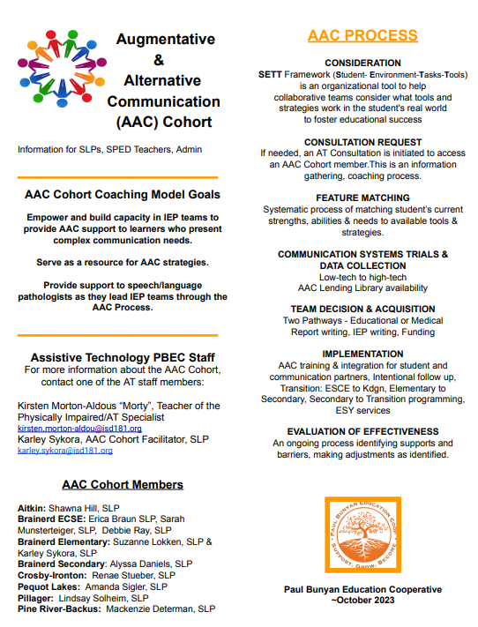
Our AAC Process
Teams flow from level to level, not necessarily in order listed

Slide 8
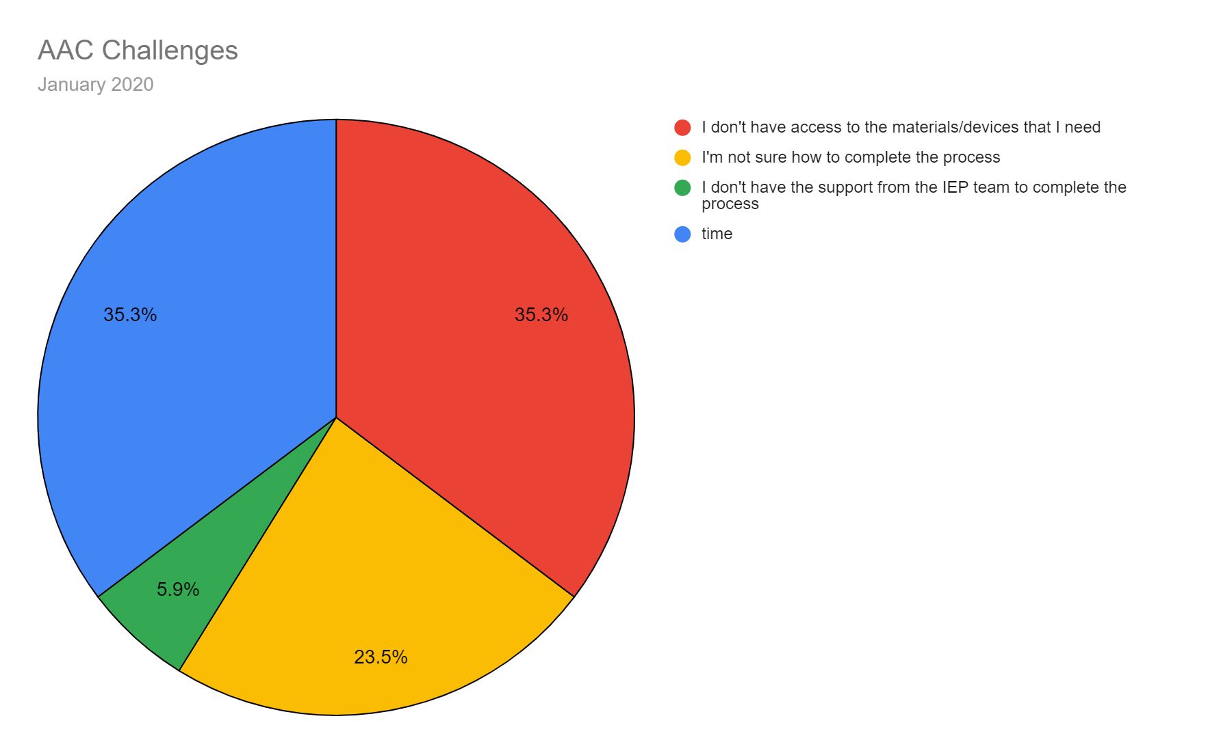
Letting Feedback Be Our Guide…
Surveys sent out quarterly to speech-language pathologists within the Paul Bunyan Education Cooperative helped us know where to focus.

Slide 9
Examples of How We Addressed Each Challenge
“I don’t have access to the materials that I need”
AAC Lending Library
Assistive Technology Lending Library barcode system
Shared Google Drive of resources
“I’m not sure how to complete the process”
Grant supported workshop by Rachel Madel + Chris Bugaj
AAC Tidbits
SETT Framework resources
Access to AAC Cohort Coaches

Slide 10
Learning to Use Coaching Questions
Cohort Coaches worked together to develop a “Quick Reference” document. Some examples of questions we developed are:
“What change do you and the IEP team want to see?”
“What does the team need in order to support this student and make this change happen?
“What features of a communication system are important for this student?”
“If “yes” to (a specific communication system), what did you say “no” to?”

Slide 11
(More) Examples of How We Addressed Each Challenge
“I don’t have the support I need from the IEP Team”
Relationship building
Empowering teams with strength-based coaching strategies
“Time”
The great mystery!
Administrative support

Slide 12
Coaching Strategy: Reflective Listening
Reflecting on the speaker’s message in your own words
“What I hear you saying is…”
“It seems as though…”

Slide 13
Coaching Strategy: Let’s Practice! Reflective Listening
Timmy’s teacher reports, “He never uses his device.”

Slide 14
Coaching Strategy: Let’s Practice!
Reflective Listening
Timmy’s educational assistant reports, “His device is never charged when it comes back to school.”

Slide 15
Coaching Strategy:
Strength-Based Coaching
Capitalizing on the positives! Proactive check-ins to build confidence and leverage areas of strength and growth.
“What went well today?”
“Why do you think it went well?”
“I noticed how you…”

Slide 16
Coaching Strategy: Let’s Practice!
Strength-Based Coaching
Ivan’s educational assistant (EA) has been working on using more wait time. She has an abrasive tone and is often observed speaking for Ivan (e.g., “Well, he thinks…”). She is known to ask repeated questions without giving Ivan enough time to process and respond. She is admittedly uncomfortable with AAC and often comments that she’s just a “dumb EA.”

Slide 17
Fast Forward to January 2024

Slide 18
The Result of Increased Assessment Capacity

Slide 19
Our Next Steps
Virtual Roundtable meetings for all IEP Team members held every 6 weeks: networking + problem solving
Cohort coaches meet in-person twice yearly
Working toward implementation plans and fidelity using the Quality Indicators for Assistive Technology (QIAT) matrices

Slide 20
Questions?

Slide 21
Thank you!
Karley Sykora, MS, CCC/SLP
karley.sykora@isd181.org
Kirsten Morton-Aldous, P/HD, TBI, OHD Specialist, AT Specialist
kirsten.morton-aldou@isd181.org

