Slide 1
Supporting Speaking and Writing Across the School Day
Colleen O’Connor and Jodi Dezale
Minneapolis Public Schools

Slide 2
Who is in the room today?
What is your role?
- special education teacher – SLP –OT – Assistive Technology – other?
How do you feel about teaching writing?
0 – UGH! Do I have to? 3- It’s ok 5- Best part of my day!!!

Slide 3
The presenters
Colleen O’Connor, special education teacher, and Jodi Dezale, speech language pathologist – 6 years of collaboration in setting 3 special education services.
We work with one other teacher, 8 assistants, and other related service providers.
MN literacy camp alumni dedicated to Comprehensive Literacy for All

Slide 4
Session objectives
Learn ways that expressive communication can be promoted.
Learn ways to develop a community that supports communication.
Get ideas for classroom activities.
Network and problem solve with others.

Slide 5
Our Program- Students
Our school includes students from prek-8, with many home languages.
Our program includes students with complex communication needs, primarily served through our setting 3 supports.
18 students, several different home languages, 12 AAC users

Slide 6
Environment
Most students spend the majority of their day in the special education setting. We use the Comprehensive Literacy for All framework.
We also have the opportunity to be in the community, such as our regular public library trips.

Slide 7
Tools for Talking – every day, everywhere!
No -tech communication boards, district wide CORE vocabulary with added alphabet, colors, and numbers.
High tech devices

Slide 8
Tasks – what we talk about!
Everything! Students always have their tools and staff is committed to modeling.
Regular large group activities (games, crafts, science, food) with a focus on CORE vocabulary as well as exposure to target fringe.

Slide 9
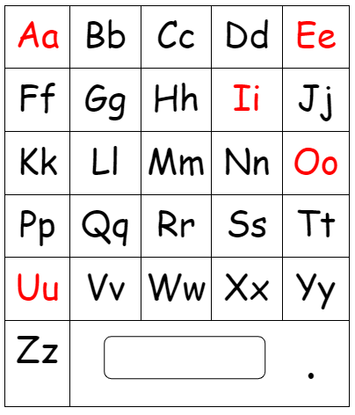
Tools for Writing – the beginning
Sensory Pencils – beads, blocks, or puzzle pieces that allow access to the whole alphabet
Flip book for partner assisted scanning
Alphabet page for partner scribe

Slide 10
Tools for Writing – next steps
Keyboards – with keyguards and positioning as needed
Pencils!
Observation and adjustments are ongoing to make sure each student has the most efficient tool for their current skills. Regular conversations about prompting and supporting.

Slide 11
Tasks – what we write about!
Independent writing – students choose a topic, generate ideas, and use their tools to write.
Students read their writing with an adult and may also share during author’s chair.
We provide pictures from our activities as well as images of high interest items from staff observation and parent report.

Slide 12
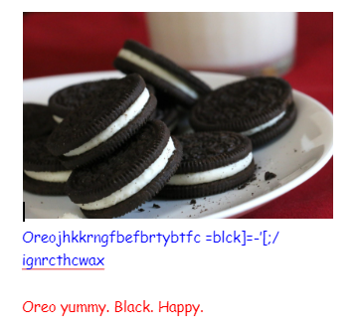
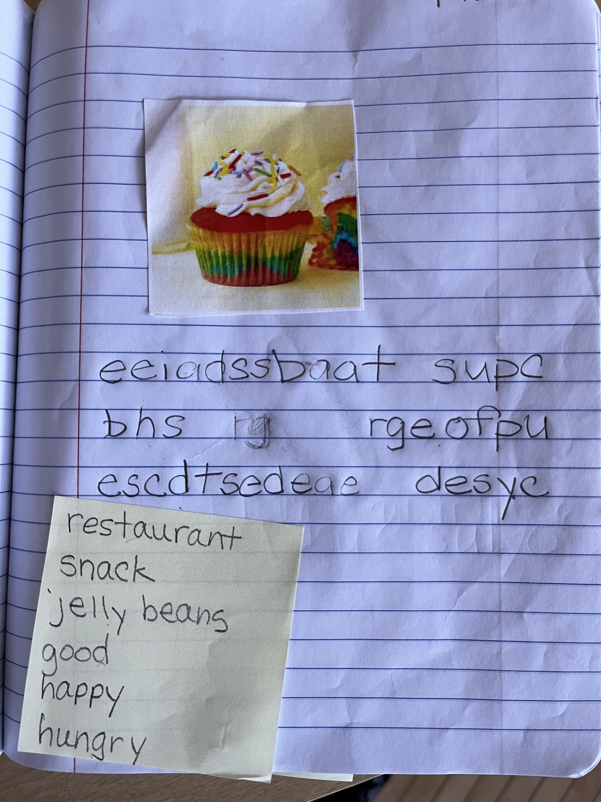
Tasks – what we write about! Samples

Slide 13
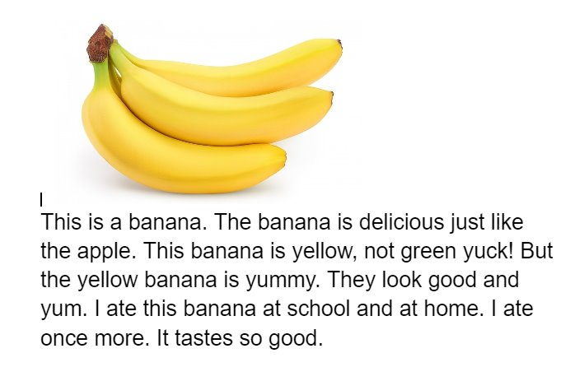
Tasks – what we write about! Other Sample

Slide 14
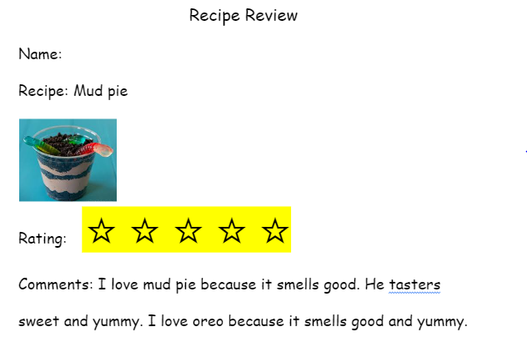
Tasks continued – structured writing
Students write book and recipe reviews.
We produce class books (often alphabet books) about some of our activities.
We share cards, letters, and emails.

Slide 15
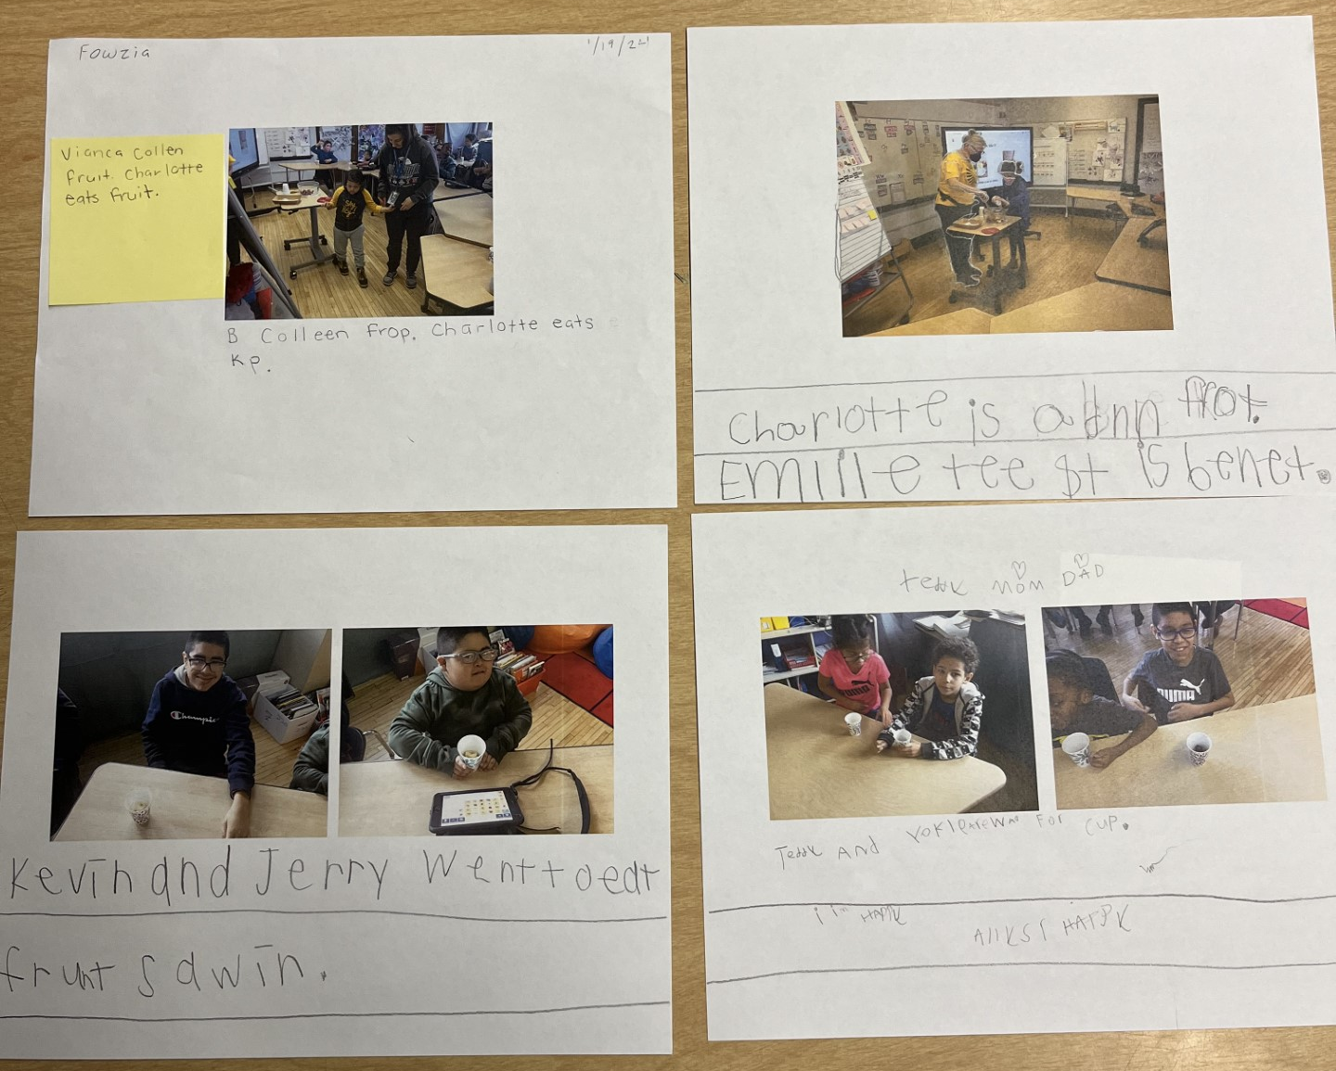
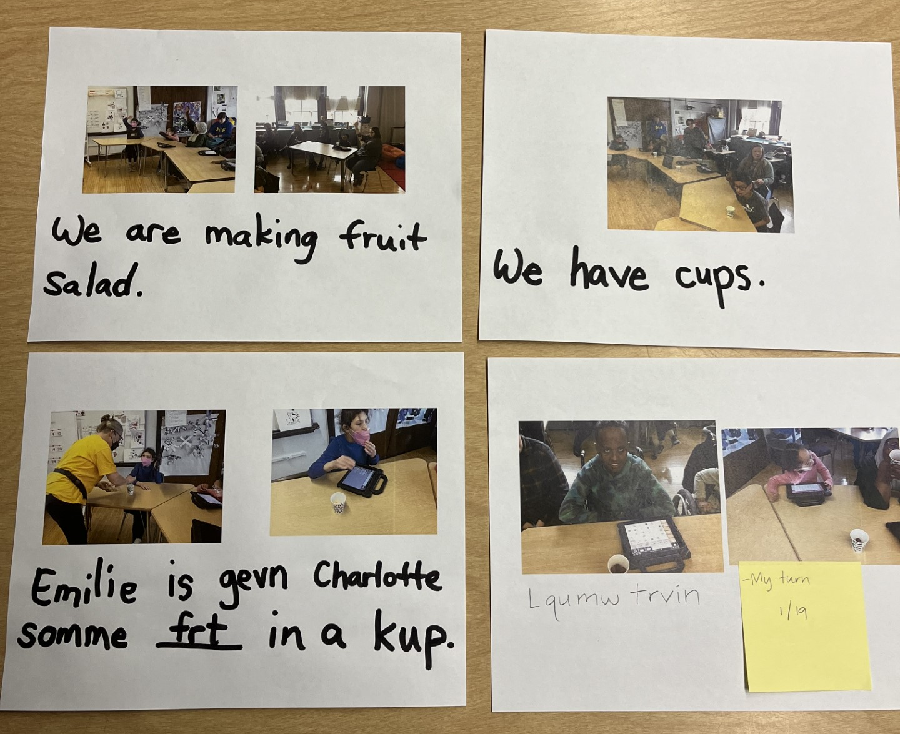
Cooking + Writing

Slide 16
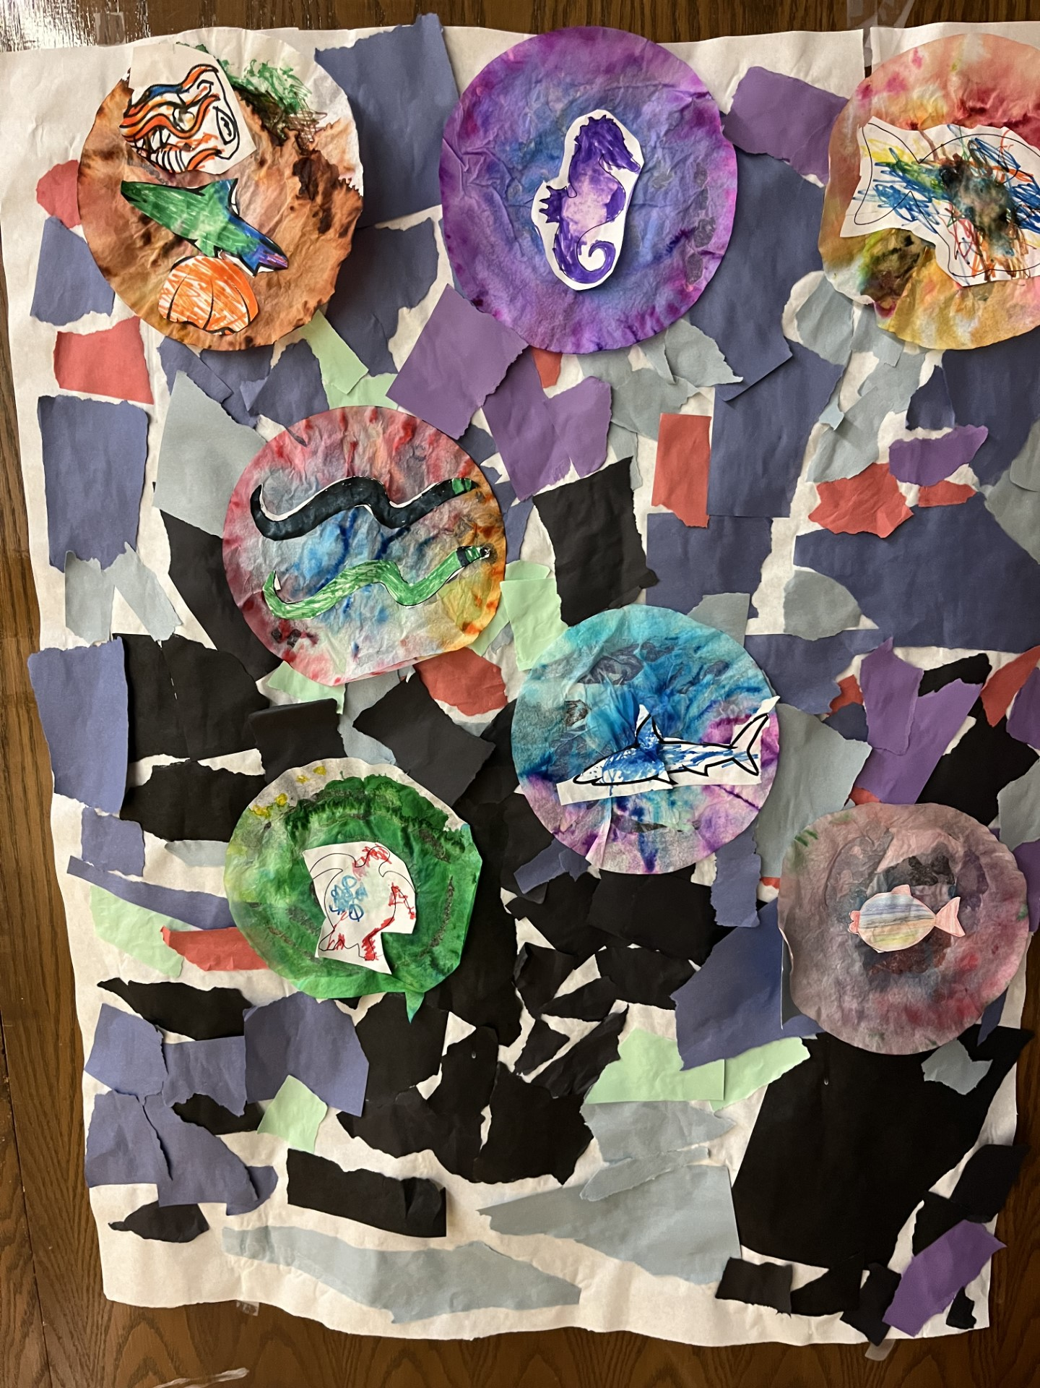
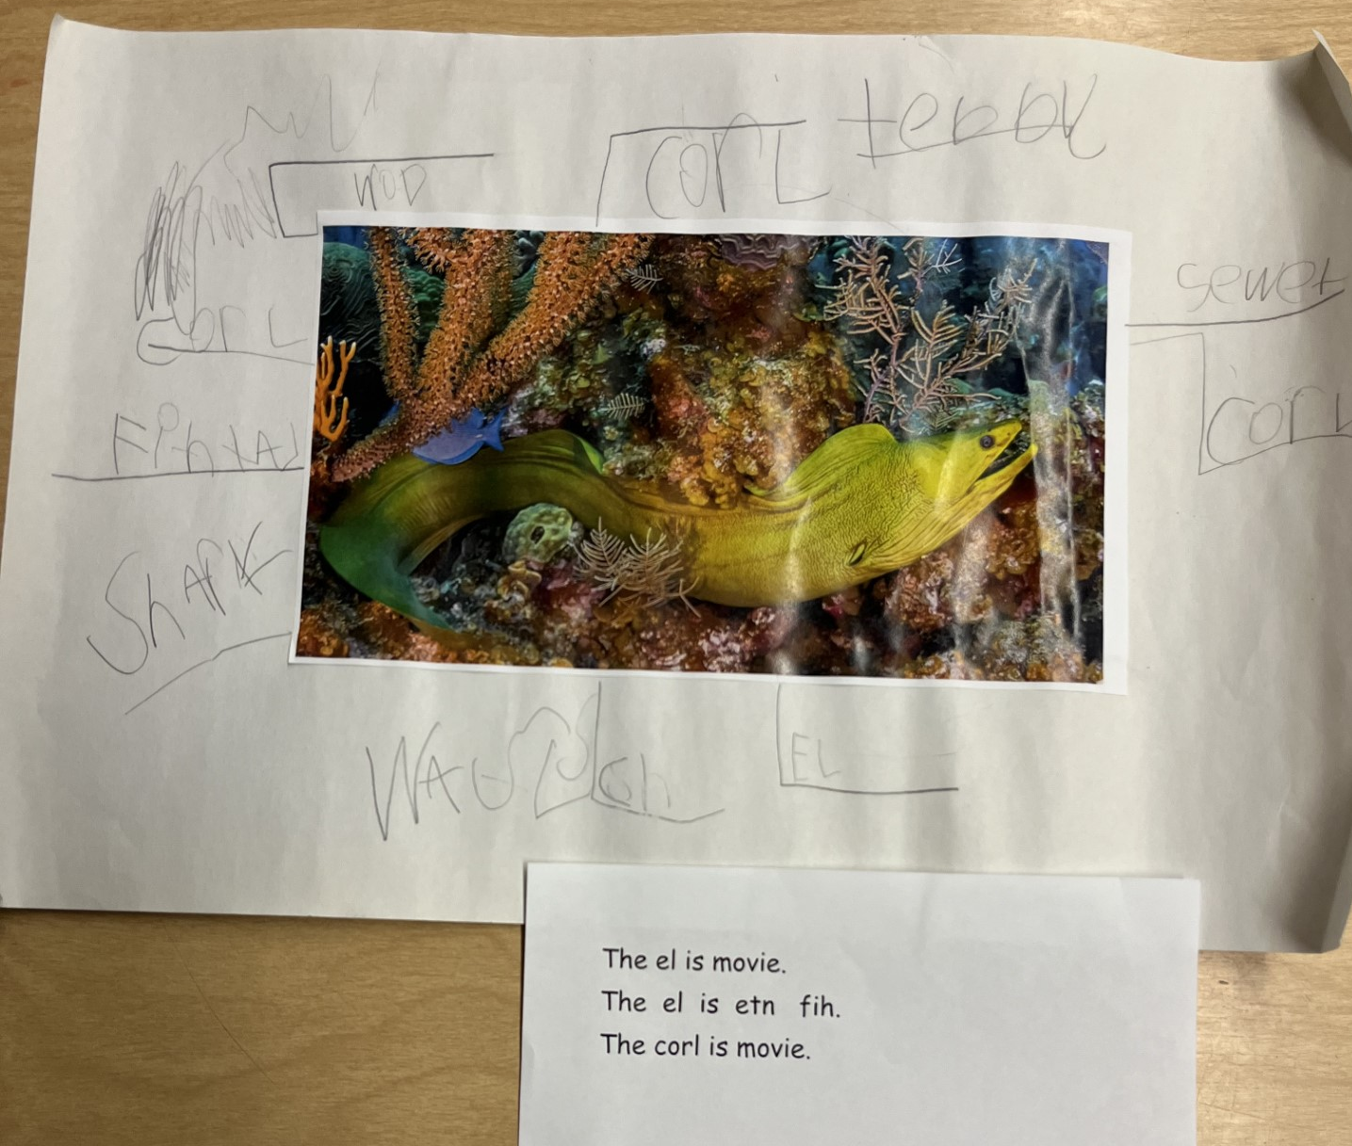
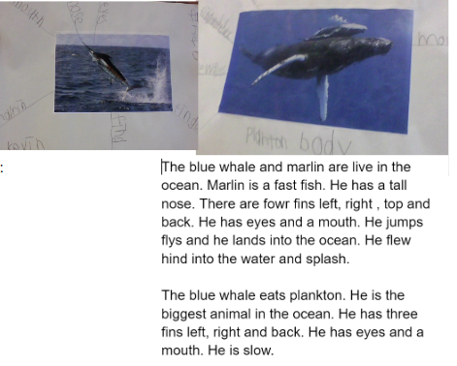
Coffee Filter Ocean Art Project + Writing

Slide 17
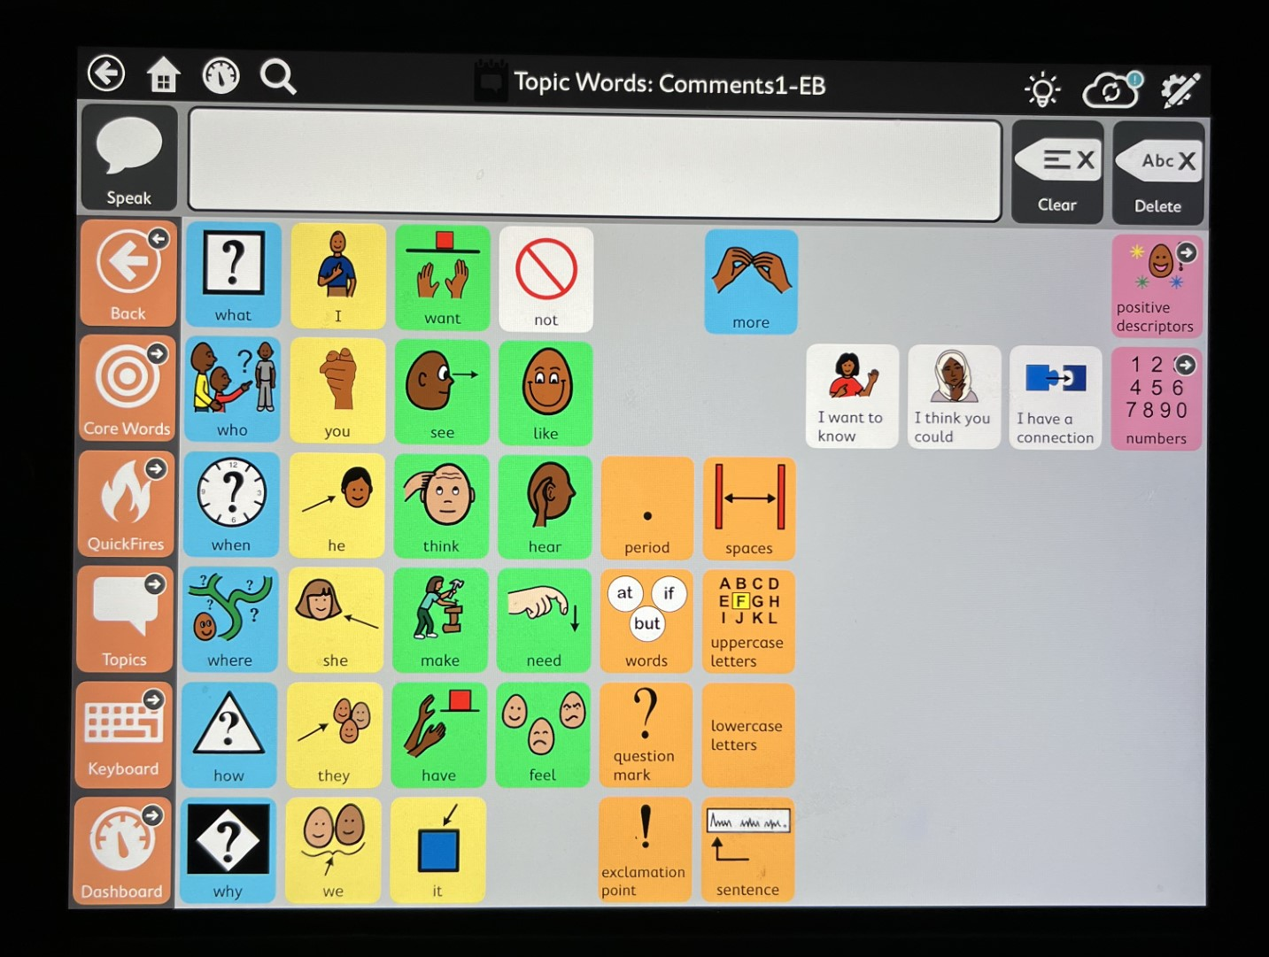
Author’s Chair
Opportunity for students to share their writing with classmates.
Communication opportunities through comments and questions.

Slide 18
Goals and Progress
Most students have SLP service and goals related to language.
Students have writing goals – generally based on the developmental writing scale.

Slide 19
Developmental Writing Scale

Slide 20
Resources
Developmental Writing Scale Jane Farrall

Slide 21
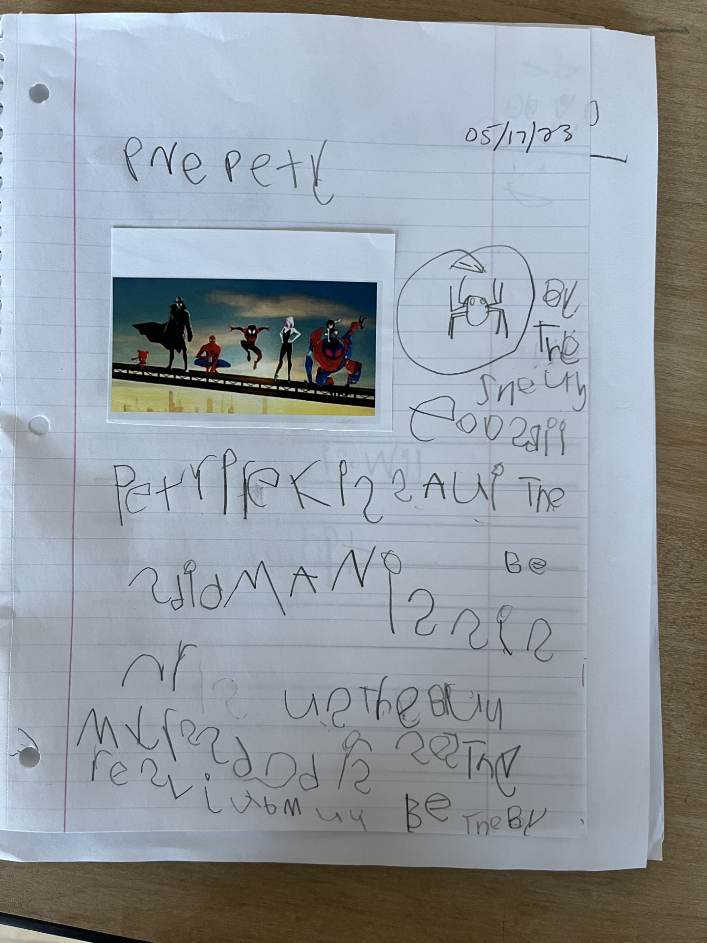
Success Stories
February 2, 2024

Slide 22
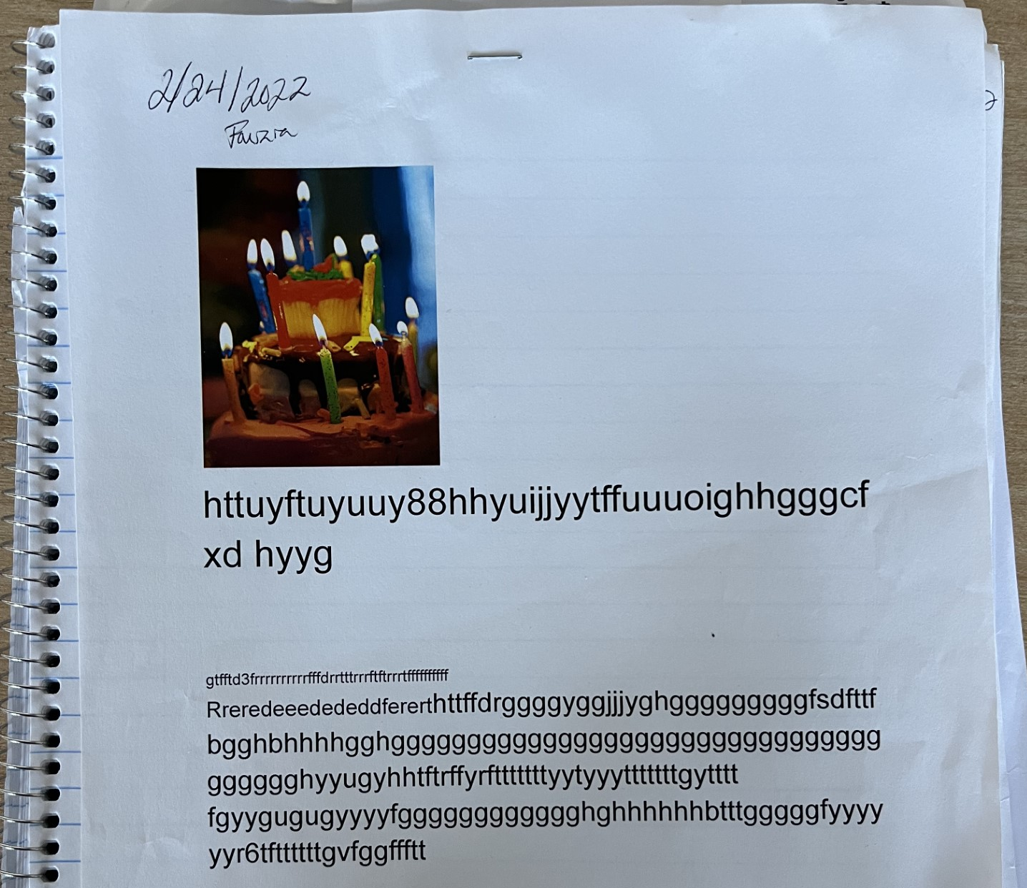
Success Stories
January 30, 2024

Slide 23
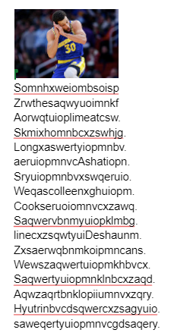
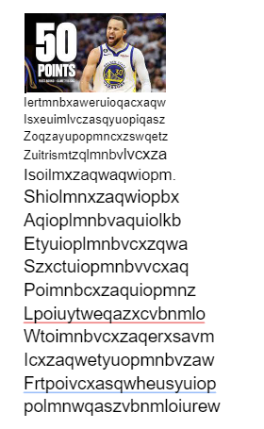
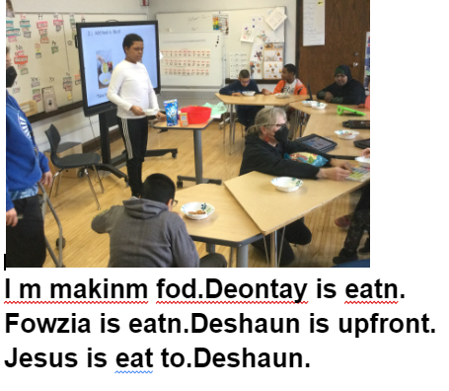
Success Stories
2023-2024 School Year:
2022-2023 School Year:

Slide 24
Challenges and next steps
Reducing our student's exposure to nonevidence based writing practices.
No copying!
Access to alternative pencils everyday!
Problem solving how to support students in their communication.
Problem solving how to support students when stuck on a Developmental Writing Scale level.

Slide 25
Group Discussion
How do you feel about teaching writing now?
0 – UGH! Do I have to? 3- It’s ok 5- Best part of my day!!!
What do people need now?

Slide 26
Questions????

Slide 27
Closing Slide, Thank you!
Jodi Dezale: jodi.dezale@mpls.k12.mn.us
Colleen O'Connor: colleen.oconnor@mpls.k12.mn.us

