Slide 1
Amendments to Specific Learning Disabilities (SLD) Eligibility Criteria
Updates and Implications
Victoria Weinberg, Ph.D.
Minnesota Department of Education SLD Specialist

Slide 2
Charge of the Committee
The committee will make recommendations for amending the rule. Responsibilities include:
Removing reference to discrepancy.
Defining inclusionary criteria and exclusionary criteria.
Proposing draft language that can be operationalized for training, implementation, and monitoring.
Defining the intended change and expected outcome that is measurable over time.

Slide 3
Agenda for the Day
  Participants will…
  Understand the scope and way the work is progressing.
  Understand the baseline of SLD eligibility in the state.
  Digest the priorities.
  Wrestle with the considerations.
  Uncover what we are already learning about the next right steps.

Slide 4
The Make-up of the Committee and Workgroups
Professional Organizations
Parents of students with SLD
Minnesota Administrators for Special Education (MASE)
Minnesota Speech-Language-Hearing Association (MNSHA)
Minnesota School Psychologist Association (MSPA)
  Advocacy Groups
  PACER Center Learning Disabilities Association (LDA) of Minnesota
  Upper Midwest Branch of the International Dyslexia Association (UMBIDA)
  The Reading Center/Minnesota Dyslexia Institute

Slide 5
The Make-up of the Committee and Workgroups Continued
Professional Organizations cont.
  Positions from Districts
Designs for Learning (DL)
INDIGO Education
Center for Applied Research and Educational Improvement (CAREI)
Hiawatha Valley Educational Cooperative
Special Education Case Managers
School Psychologists
MTSS Specialists
Adjunct Professors
MDE staff from 5 divisions

Slide 6
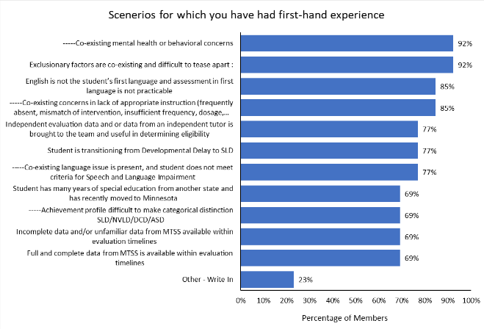
28 Parents and Professionals Are Co-creating the Recommendations
The committee has vast experience with eligibility decisions.
Multiple practitioners have worked in other states with similar criteria to what is being proposed.

Slide 7
Priorities of the Committee
Criteria will yield increased consistency in identification (district to district, region to region).
Address the overidentification of minority students.
Provide timely evaluation and generate useful data for program planning.

Slide 8
Considerations for the Work
Base it on up-to-date research.
Remove discrepancy but retain federal regulatory and other state rule requirements.
Use terms that will endure the test of time and updates from research.
The criteria must apply to all eight areas.
Distinguish recommendations for rule language from that of technical assistance.
Keep the focus on eligibility—don’t try to solve other problems with criteria.

Slide 9
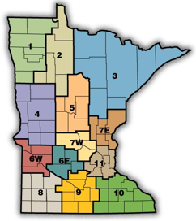
Change in Criteria has significant impact:
Public Schools and Districts—506
Number of Schools –2,252
351 Alternative Learning sites
126 Distance Learning Programs
Teachers—57,057
Special Educators 10,972

Slide 10
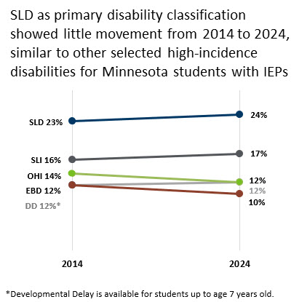
Prevalence of SLD and other High Incidence Disabilities
*Developmental Delay is available for students up to age 7 years old.

Slide 11
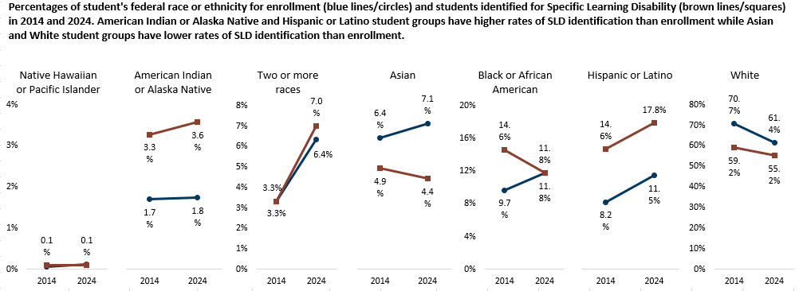
SLD Prevalence Intersection of Race
Notes:
MDE has heard from regional teams that there are inconsistencies in identification for different groups. Data tells us that there are variations in identification rates across the regions for different groups of students. The intersection of race and poverty magnifies those differences.
Regional variations:
Latino scholars: Regions 6 and 8, 10, and 11 have increased and higher rates of identification at intersection.
Native American Scholars: Regions 1 and 2, 3, and 4 have increased and higher rates of identification at intersection.
African American Scholars: Region 11 has higher rates for identification at intersections. Increased identification rates are equivalent in regions 7, 9 and 10.

Slide 12
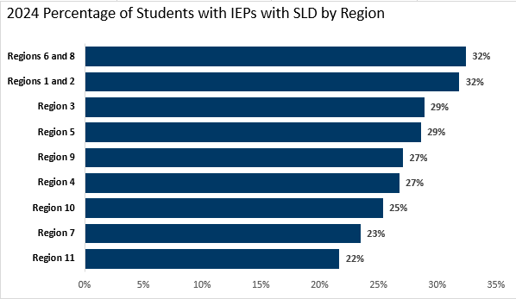
Change in Criteria has Significant Impact, continued 2

Slide 13
Remove Discrepancy and Retaining Federal Regulations Means
IQ tests are no longer required
Retaining
IQ tests not interchangeable with cognitive processing.
Cognitive processes overlap with other disabilities and are not reliable for sorting one disability from another—no longer recommended as criteria.
Right to comprehensive evaluation and independent evaluation on request.
Right to conduct an override when data or procedures cannot be applied.
Use of multiple sources of data and keep standardized assessments.
Farris, E. Alexander, E. And Odegard T, (2020); Fletcher, J. and Miciak J. (2024)

Slide 14
Universal Basis for SLD in Research
Lack of Achievement:
Below age or grade level standards
Achievement is Unexpected:
Given appropriate and evidence-based instruction
Student is Capable:
Evidence of learning can be measured
Cause:
Not primarily attributable or the result of other disability
Farris, E. Alexander, E. And Odegard T, (2020) pp. 9-13

Slide 15
Which of the terms would be problematic in a new rule?
Trend line, aim line, expected growth
DSM diagnoses such as dyslexia, dyscalculia, dysnomia, dysgraphia
Consistency, integrity, fidelity

Slide 16
Which terms should be defined in rule? Which should be defined in technical assistance?
Which terms should be clarified?
Relative peer group
Inadequate rate of progress
Intensity, duration, dosage, comprehensiveness, frequency
Primarily due to…

Slide 17
The purpose of criteria is to…
Identify students who have a learning disability that is not primarily the result of other disabilities or factors.
Distinguish disability from lack of appropriate instruction.
Design instruction for those who require specially designed instruction and supports to access and make continued progress in the general educational curriculum (IDEA).
Which of these do not fit the purpose ?
Too many _____ will qualify if…
Special educators are underprepared to teach
Districts don’t have the _____ to do this work
Students can’t be eligible if they didn’t get structured literacy in core

Slide 18
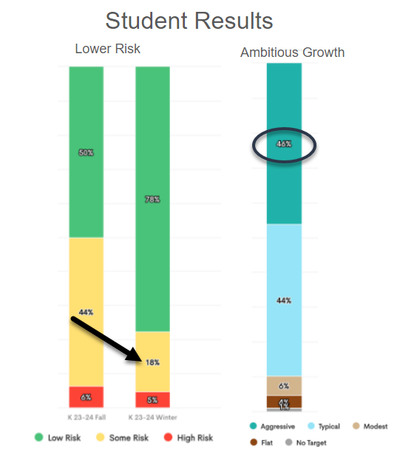
New Criteria will likely include use of charts and graphs
Comprehension is improved when data is visualized.
Committee's recommendations likely to include use of norms and comparison groups.
Providers of data such as GOM, MCA, etc. already include graphs, so they must transfer into Special Education Forms.

Slide 19
Next Steps
Complete usability testing to determine if recommendations can be applied, trained, monitored.
Determine baseline and ways of measuring if the proposed changes will address the priorities.
Anticipate the work ahead.

Slide 20
Already Being Uncovered
There are significant gaps in knowledge with current regulations and state rules.
Infrastructure to visualize data and progress as well as share data across districts and platforms will need to be built.
The application of changes may require differentiated procedures for non-public, home-schooled, or students without prior history.
Changes in criteria cannot fix all areas of concern. Eligibility determinations are an “adaptive problem” that requires systems, data, policies, and teams to collaborate effectively.

Slide 21
Thank you!
Vicki Weinberg
Vicki.Weinberg@state.mn.us

