Slide 1
AI Toolkit for Special Educators
By Amanda Peters, Instructional Tech Coach
April 2024
Statewide Professional Development to Support the Workforce and Low Incidence Disability Areas.

Slide 2
Agenda
Learn AI tools that will save you time and help your students be more independent. We will explore the free tools…
MagicSchool ai
Curipod
Chat GPT
Goblin Tools
Seeing AI and Google Lookout
Canva Magic Tools

Slide 3
Tasks pt 1
We will cover the features of the AI tools that will help us complete the following tasks:
Create social stories in 3 clicks
Generate interactive slides
Create lesson plans in record time
Adapt a lesson to a student’s reading level
Generate a Choice Board
Generate comprehension questions based on text or a YouTube video

Slide 4
Tasks pt. 2
We will cover the features of the AI tools that will help us complete the following tasks:
Generate decodable text on any topic
Break an assignment down into smaller steps
Empower students to be more independent readers with Seeing AI and Google Lookout
Empower students to creatively express themselves using Canva Magic Studio

Slide 5
Magic School AI
Generative AI made to save you prep time.

Slide 6
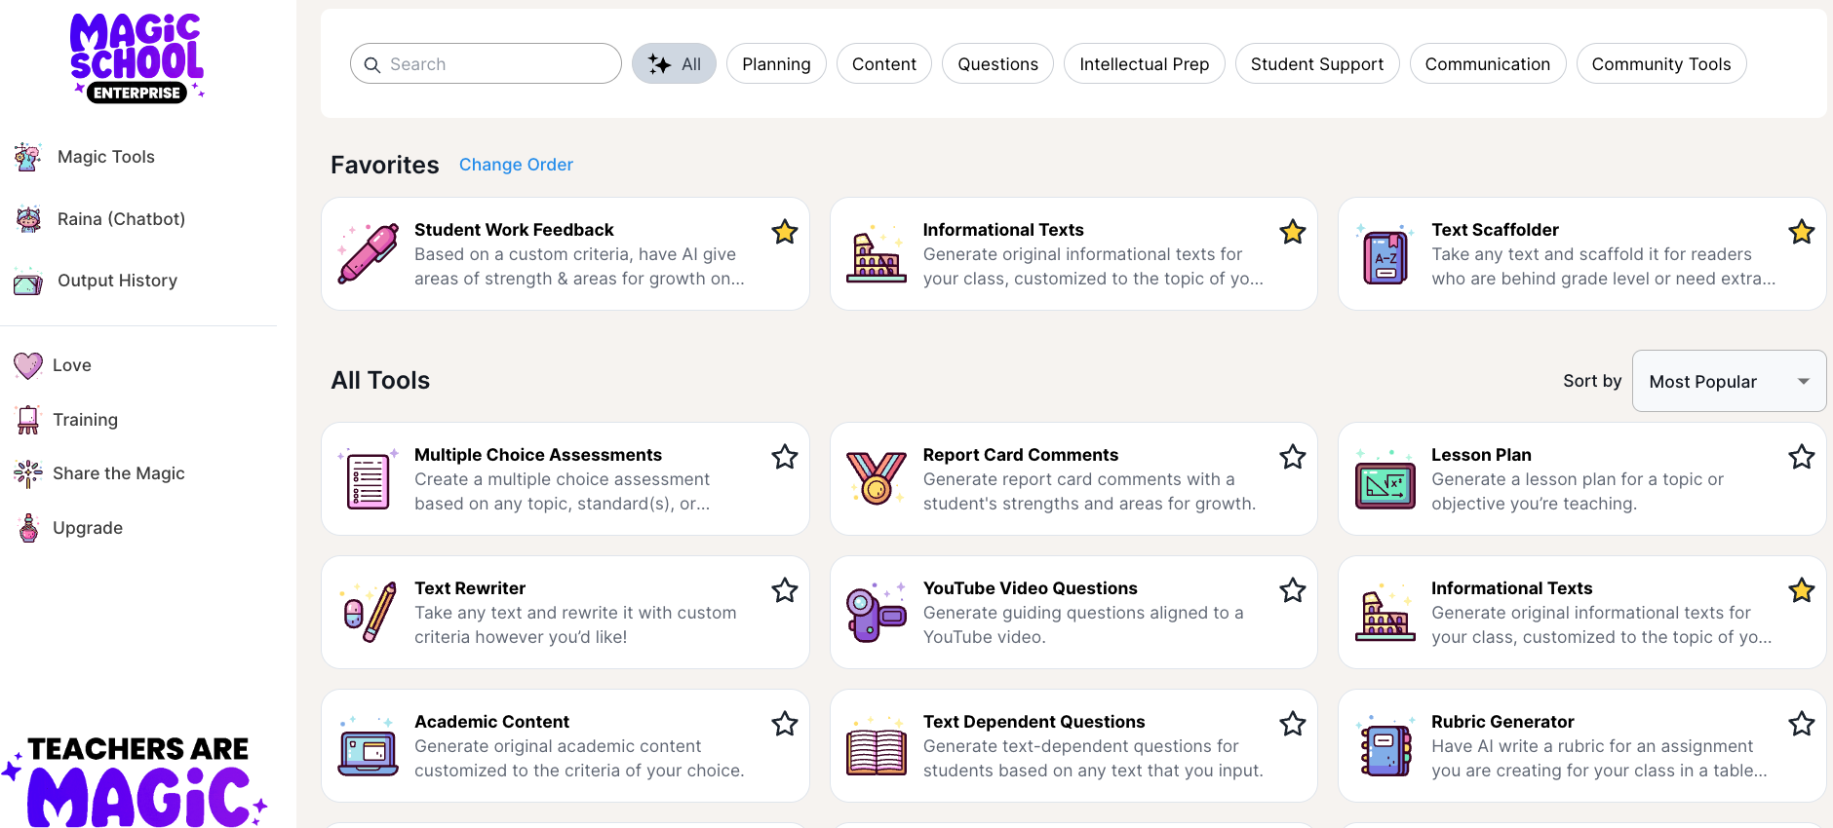
What is MagicSchool?

Slide 7
Best Practices for Using AI
Check for Bias and Accuracy: AI might occasionally produce biased or incorrect content. Always double-check before sharing with students.
The 80-20 Approach: Use AI for initial work, but make sure to add your final touch, review for bias and accuracy, and contextualize appropriately for the last 20%.
Know the Limits: AI's knowledge stops on its last training date, so recent topics may not be up to date.
Protect Privacy: Don't include personal student details like names or addresses. MagicSchool promptly removes any accidentally submitted information.

Slide 8
AI Prompting 101
Prompting AI is different than conducting a Google search
Effective searches are short, concise and cast a wide net.
Effective prompts describe clearly and specifically what you want the LLM to produce.

Slide 9
AI Prompting 102
Guidelines | Examples
Define the role you want the AI to assume | Begin your prompt with “You are a master occupational therapist”
Define the task you want the AI to complete. | Create a choice board that helps students work on their pincher grasp.
Add important details to make sure that your generated file matches the output you are looking for | The choice board should allow for a wide variety of fine motor activities. Materials available include crayons, markers, playdough, close pins, and string.

Slide 10
Getting Started with MagicSchool
Log in to:
App.magicschool.ai
Immerse yourself in the awe-inspiring beauty and complexity of the cosmos.
Experience the grandeur of the universe and marvel at its sheer magnitude.
Delve into the depths of space and witness the wonders that await you.

Slide 11
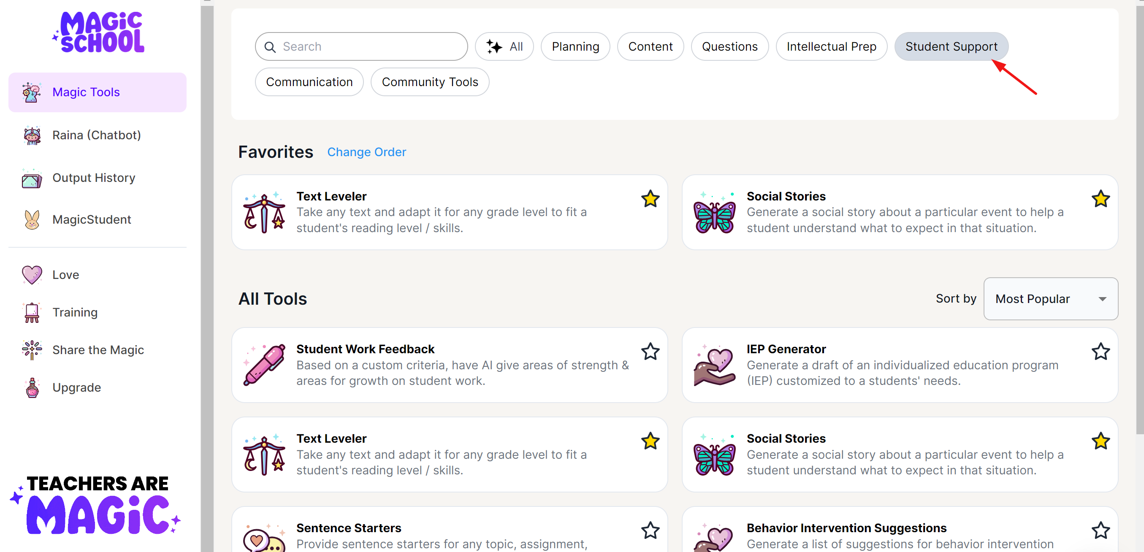
Getting started with MagicSchool
Log in at app.magicschool.ai

Slide 12
Try It Yourself
Look through the Student Support tools and:
Find a tool you would use often
Open the tool and try generating an output for a student or situation that would save you time.
Review the output you get and revise the prompt you gave if needed.

Slide 13
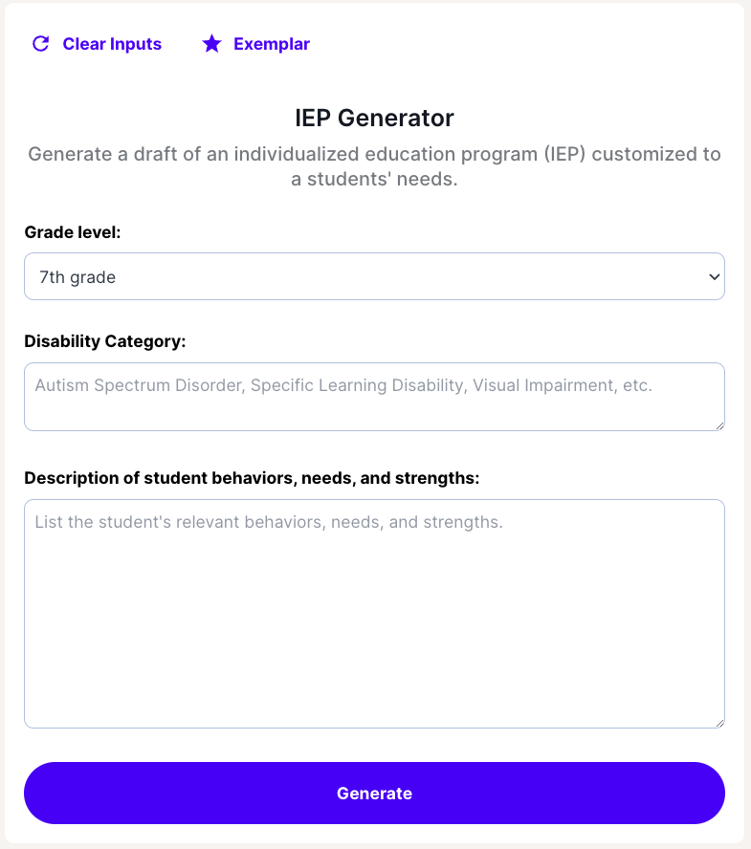
MagicSchool makes Prompting Easier
Each tool defines the task you want the AI to accomplish
Each tool allows you to quickly define the role you want the AI to assume.
You just have to fill in a few details.

Slide 14
Share out!
What tool did you use – what did you think of the results?
How did changing the prompt change your output?

Slide 15
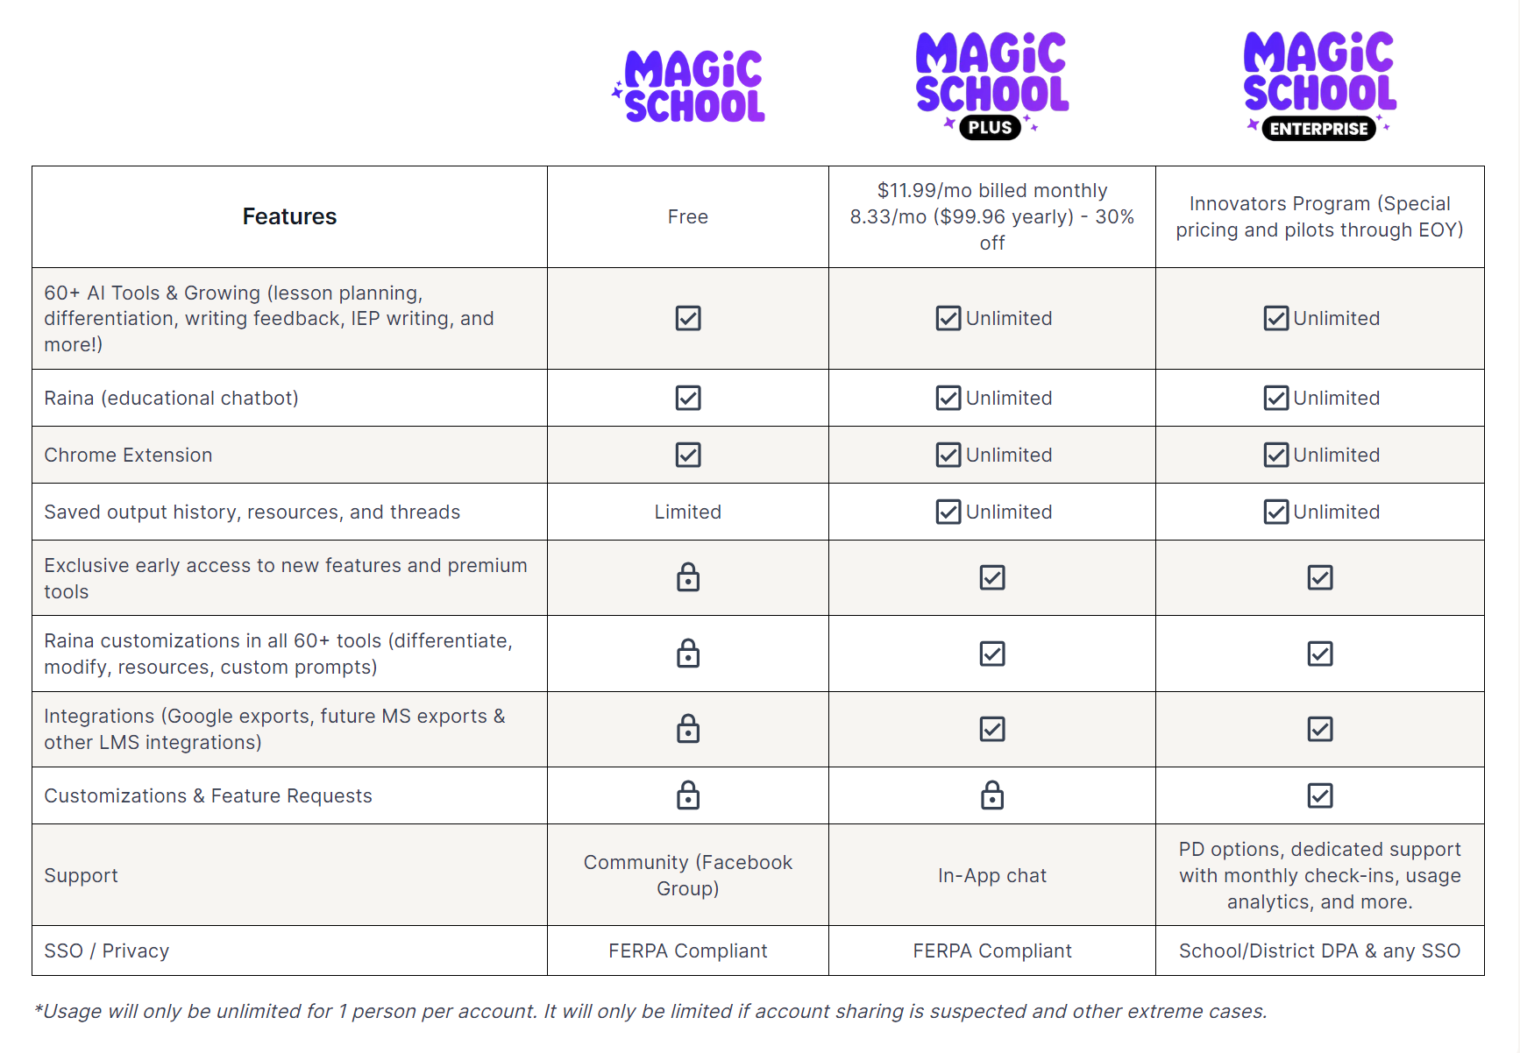
MagicSchool Free vs Paid

Slide 16
Curipod
Log in at https://curipod.com/
Generate interactive slides with just a few clicks.

Slide 17
Curipod Slides
Use Slides for
Types of Interactive Slides
Brain Breaks
Exit Tickets
Complete Lessons
Upload PDF to produce comprehension questions
So much more
Open Ended
Poll (multiple Choice)
Draw
Word Cloud
AI Feedback

Slide 18
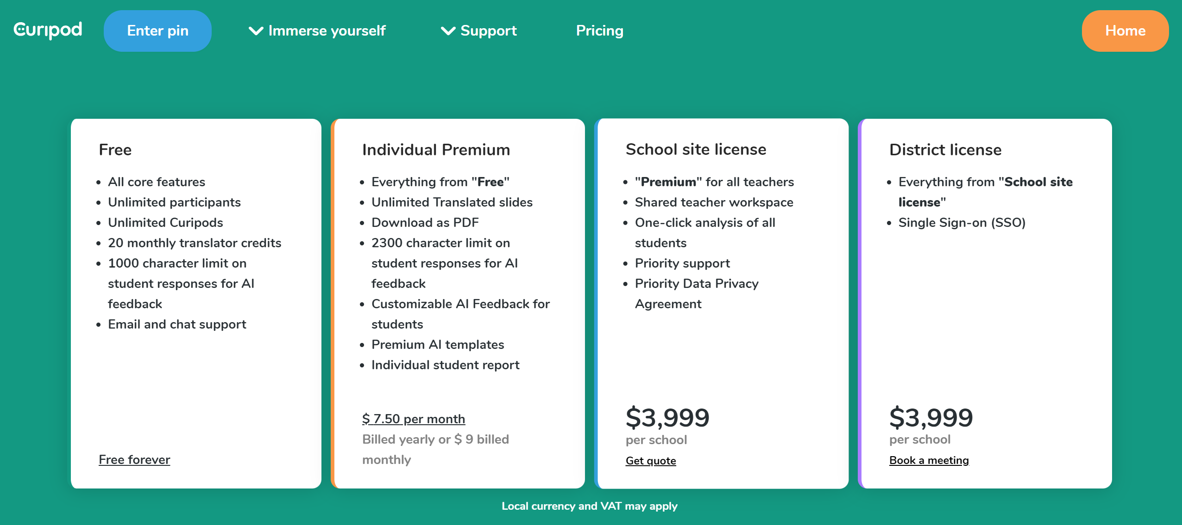
Curipod Free vs Paid

Slide 19
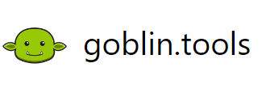
Goblin Tools
Log in at https://goblin.tools/
Generate checklists that break down big tasks into more manageable steps
Only free version available

Slide 20
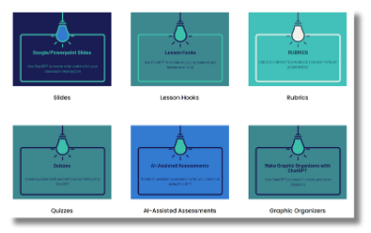
ChatGPT and Chatbot Prompt Library for Educators
Listing ChatGPT as something to have in your toolkit is like listing Google Suite for Education – unlimited potential for what it can do, but only if you know the right prompts to use.
GenAI Chatbot Prompt Library for Educators can help you find the correct prompts to use – especially helpful if you are new to using ChatGPT or other generative AI tools. Prompts available specially for Special Needs.

Slide 21
Seeing AI and Google Lookout
Seeing AI is an iOS app – works on iPad or iPhone. Point your iPad/iPhone at any text and hear it read out loud, scan a barcode and get product information, take a photo of someone and hear a description of the person- including identifying facial expressions.
Google Lookout – is an Android app with the same features as Seeing AI. Students can use either one to be more independent in reading in any environment.

Slide 22
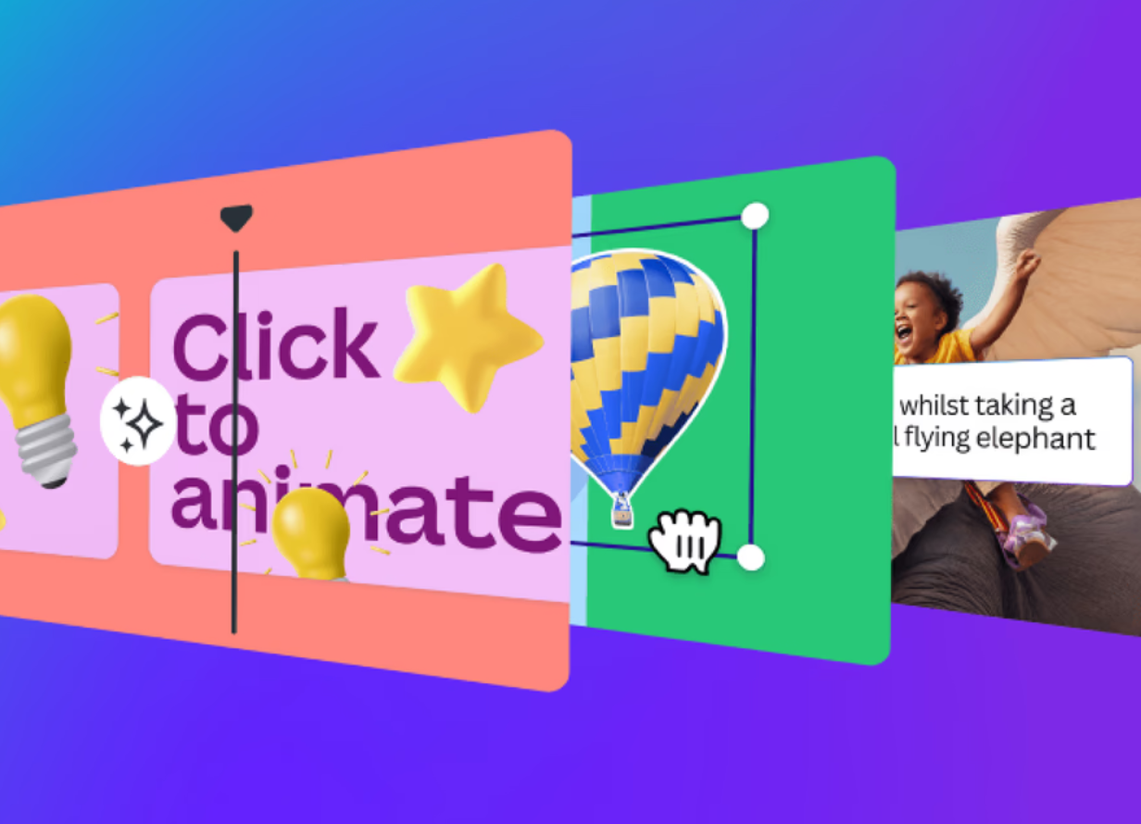
Canva Magic Studio
Canva is free for districts – must sign your district up to use the Magic Studio features.
Magic Write
Text to Image/Video
Docs to Decks

Slide 23
Thank you!
Amanda Peters
amanda.peters@isd917.org

