Slide 1
Assistive Technology for Education
Kursten Dubbels, Assistive Technology (AT), Accessible Educational Materials (AEM) Specialist
Statewide Professional Development to Support the Workforce and Low Incidence Disability Areas.

Slide 2
What is assistive technology (AT)?
  The Individuals with Disabilities Education Act (IDEA) includes the definition of assistive technology.
  34 CFR (Code of Federal Regulations) § (section) 300.5 Assistive technology device.
  AND
  34 CFR (Code of Federal Regulations) § (section) 300.5 Assistive technology services.

Slide 3
Assistive Technology Device
  Assistive technology device means any item, piece of equipment, or product system, whether acquired commercially off the shelf, modified, or customized, that is used to increase, maintain, or improve the functional capabilities of a child with a disability.

Slide 4
Assistive Technology Service
Assistive technology service means any service that directly assists a child with a disability in the selection, acquisition, or use of an assistive technology device. (Authority: 20 U.S.C. (United States Code) 1401(1))

Slide 5
What Makes an Item Assistive Technology?
An item, piece of equipment or product system.
Used to increase, maintain or improve the functional capabilities …
Of a Person with a disability.

Slide 6
Can you identify Assistive Technology?
I will share some items, and I want you to think if you would classify the item as assistive technology.
Answer Options:
It IS assistive technology (AT)
It IS NOT assistive technology (AT)
IT DEPENDS on additional information to determine if it is assistive technology (AT)

Slide 7
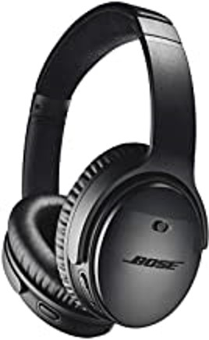
Are headphones AT?
Would you change your answer if I told you the headphones were noise cancelling?

Slide 8

Are straws AT?
Would you change your answer if I told you the straws did not bend?

Slide 9
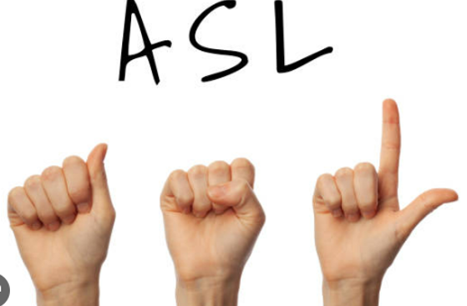
IS ASL (American Sign Language) AT?
Would you change your answer if I told you the ASL was generated by Artificial Intelligence (AI)?

Slide 10
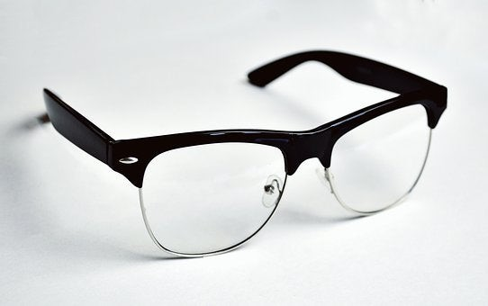
Are eyeglasses AT?
Would you change your answer if I told you the glasses were blue light blocking glasses?

Slide 11

Is a paper clip AT?
Would you change your answer if I told you the paper clip was purchased at a local office supply store?

Slide 12
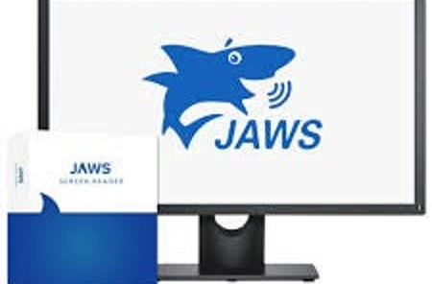
Is JAWS (Job Access with Speech) AT?
Would you change your answer if I told you that the software was used by an accessibility specialist?

Slide 13
Assistive Technology Guidance from Office of Special Education Programs (OSEP)
Released January 22, 2024
Dear Colleague Letter on the Provision of Assistive Technology Devices and Services
Myths and Facts Surrounding Assistive Technology Devices and Services Document
U.S. Department of Education 2024 National Education Technology Plan (NETP)
Updates to the Guidance on Center on Inclusive Technology & Education Systems (CITES)

Slide 14
Guidance Regarding Consideration
Assistive technology needs must be considered for Every Child who Qualifies for Special Education and Related Services.
Assistive technology needs are considered when the IEP is developed, reviewed and/or revised.
Consideration includes no/low tech devices to high-tech devices.
When developing transition plans, assistive technology should be considered and provided as appropriate.

Slide 15
OSEP Guidance Regarding Consideration Continued
This includes consideration services such as:
Customizing and adapting the device.
Training or technical assistance for the child and family as appropriate.
Training or technical assistance for educational professionals or other individuals who are otherwise substantially involved in the major life functions of the child.

Slide 16
OSEP Guidance for Part C
Assistive technology needs of the family to assist appropriately in the infant or toddlers development must be provided.
Assistive technology must be considered when a toddler transitions from early intervention services to preschool even if there isn’t assistive technology in their individual family service plan (IFSP).

Slide 17
OSEP Guidance: Assistive Technology Assessment
AT assessment is not required.

Slide 18
OSEP Guidance: Assistive Technology Services
Provision of an assistive technology device is not sufficient.
Services that are necessary must also be provided.

Slide 19
OSEP Guidance: Assistive Technology Documentation
Including the check box on an IEP form indicating that assistive technology has been considered is NOT sufficient.
Education agencies are responsible for providing assistive technology written into the student’s Individual Education Program (IEP).

Slide 20
Peer Reviewed Research on Accommodations
National Center on Educational Outcomes (NCEO) Accommodations Toolkit

Slide 21
OSEP Guidance: Access to Assistive Technology
Include access to assistive technology in academic and other environments to improve the student’s use and ensure access throughout the day.
On a case-by-case basis, the individual education plan team determines if assistive technology should be sent home to assure the student receives a free appropriate public education (FAPE).

Slide 22
OSEP Guidance: Procuring Assistive Technology
Assistive technology devices must be provided as soon as possible.
Assistive technology is identified and approved by the individual education program team.

Slide 23
OSEP Guidance: Definitions
Assistive technology and accessible technology are not the same thing.
Universal design for learning and accessible educational materials (AEM) are not the same thing.

Slide 24
OSEP Guidance Regarding Motivation and Efficacy
Received Assistive Technology in
K-12 Education
DID NOT Receive Assistive Technology in K-12 Education
99.8% of students graduated.
80.9% Attended a post-secondary education program.
79.6% of students graduated.
40.1% Attended a post-secondary education program.
From the National Longitudinal Transition Study2 (NLTS2) (2013).

Slide 25
Assistive Technology Technical Assistance and Lending Libraries
Minnesota’s Assistive Technology Act project, MN STAR (System of Technology to Achieve Results) provides technical assistance, device loans and demonstrations.
Minnesota Resource Libraries (MNRL) includes resources that can be checked out by licensed teachers and related service providers working with Minnesota students who are Deaf/Hard of Hearing (DHH) and Blind/Visually Impaired (BVI) and/or Deaf-Blind.

Slide 26
Funding for Assistive Technology
Local special education funding.
Reimbursement from Medical Assistance including waiver programs.
Medical Assistance reimbursement monies above the cost of device(s) purchased.

Slide 27
Current activities available to help support Assistive Technology Implementation
Assistive Technology Tuesday Professional Development Sessions 2023-2024
Asynchronous Professional Development Sessions 2022-2024

Slide 28
Closing Slide, Thank you!
Kursten Dubbels, AT, AEM and UDL Specialist
Kursten.Dubbels@state.mn.us
651-582-8562

