Slide 1
A Day in Our Lives
Chelsea Paulson
ASL Strand Workshop

Slide 2
A Day of Our Lives
Chelsea Paulson will empower professionals (teachers, educational interpreters/paraprofessionals) in supporting Deaf/Hard of Hearing children through ASL professional development on essential daily routine signs. Enhancing communication and understanding in school or after school.

Slide 3
ASL at Home
https://www.aslathome.org/
Made by Speech Language Pathologist - Razi M. Zarchy
Linguist - Leah C. Geer

Slide 4
Routine Based - ASL at Home
Ch. 1: 🍲 Mealtime
Ch. 2: 🛀 Bath time
Ch. 3: 🚽 Diaper changing & bathroom routines
Ch. 4: 📚 Book sharing
Ch. 5: 🛌 Bedtime
Ch. 6: 🤾 Playtime
Ch. 7: 🎨 Arts & crafts
Ch. 8: 🏕 Outdoors
Ch. 9: 🧹Cleaning up
Ch. 10: 👚👖 Getting dressed
Ch. 11: 👨‍👨‍👧‍👦 Family time
Ch. 12: 🐶🐱🐟Pets
Preview of the book:
Chapter 1
https://www.aslathome.org/chapter-1-meal-time

Slide 5
Core and Fringe Vocabulary

Slide 6
Core and Fringe Vocabulary, continued 2

Slide 7
Core and Fringe Vocabulary, continued 3

Slide 8
How do we build vocabulary at home?!
https://gcdasl.com/
Gallaudet ASL Dictionary online

Slide 9
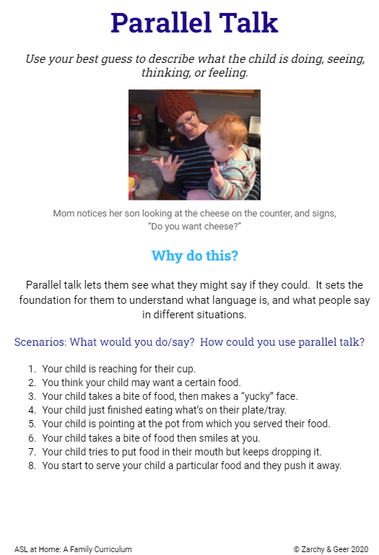
Parallel Talk
Use your best guess to describe what the child is doing, seeing, thinking or feeling.
© Zarchy & Geer, 2020

Slide 10
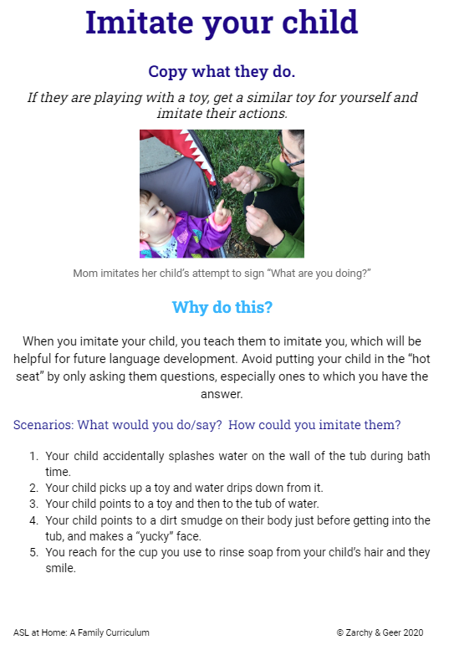
Imitate your child
Copy what they do.
If they are playing with a toy, get a similar toy for yourself and imitate their actions.
© Zarchy & Geer, 2020

Slide 11
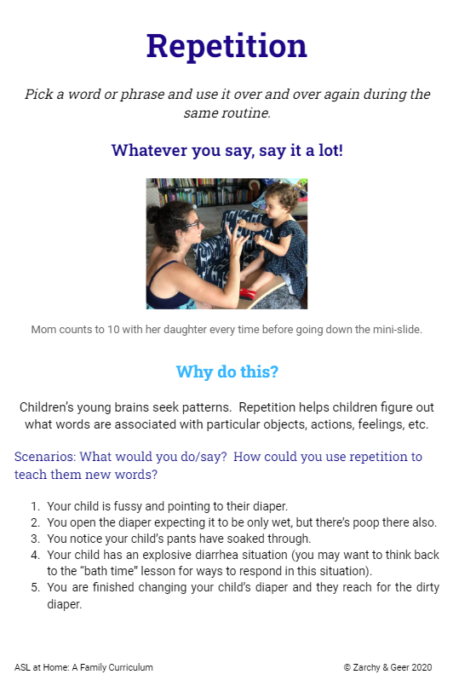
Repetition
Pick a word or phrase and use it over and over again during the same routine.
Whatever you say, say it a lot!
© Zarchy & Geer, 2020

Slide 12
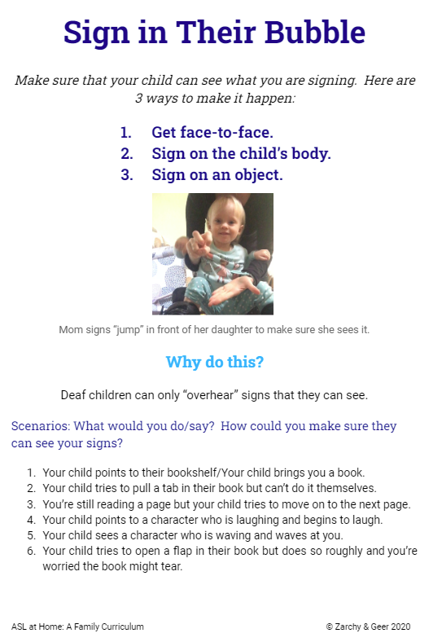
Sign in Their Bubble
Make sure your child can see what you are signing. Here are 3 ways to make it happen.
Get face-to-face.
Sign on the child’s body.
Sign on an object.
© Zarchy & Geer, 2020

Slide 13
Thirty Million Word by Dr. Dana Suskind, MD
Tune In
Take Turns
Talk More
Three T Initiative

Slide 14
Examples!
I am a Deaf mother of four kids of Deaf adults, kodas and my husband is Hearing… it is a challenge to foster a language rich environment especially to make sure that everyone is understood.
So, here are upcoming tools and examples!

Slide 15
Tools and examples

Slide 16
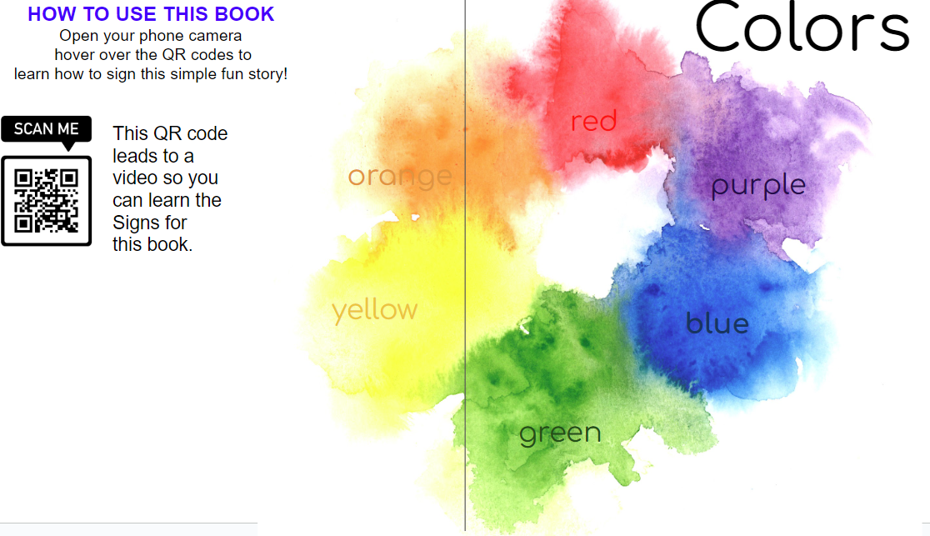
Tools and examples, continued 2

Slide 17
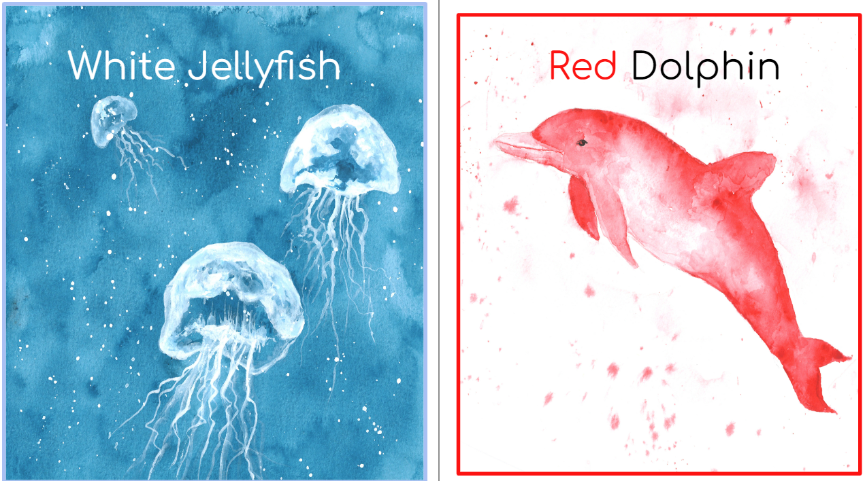
Tools and examples, continued 3

Slide 18
Tools and examples, continued 4

Slide 19
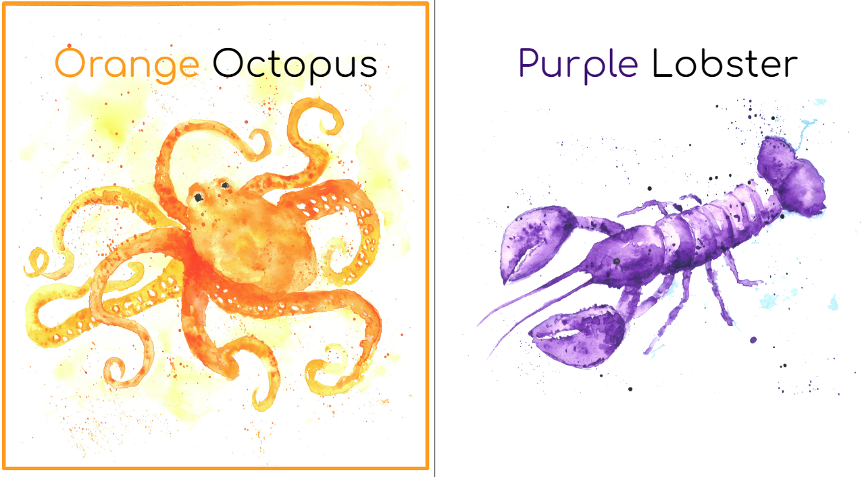
Tools and examples, continued 5

Slide 20
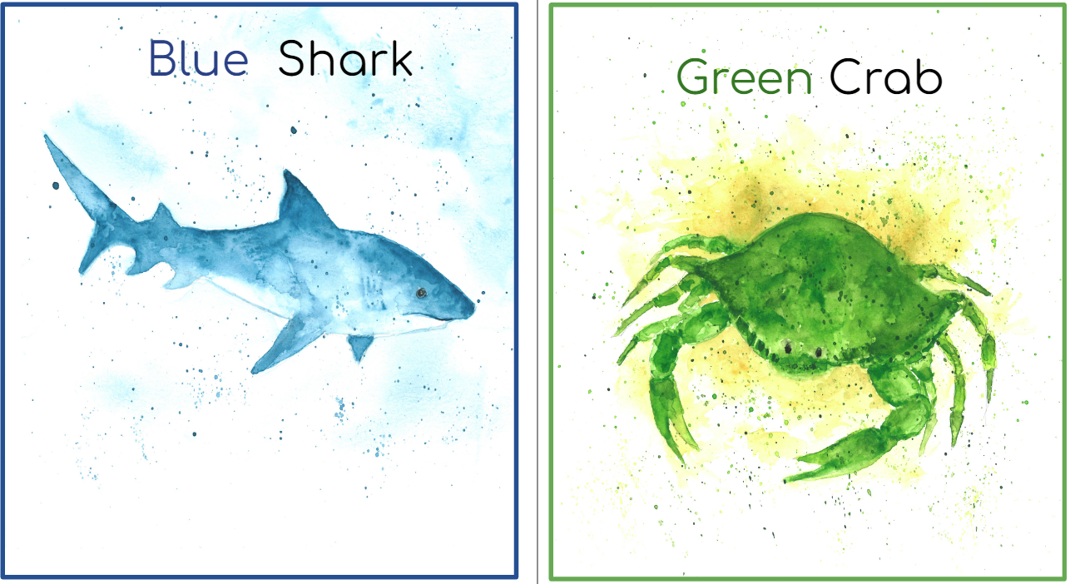
Tools and examples, continued 6

Slide 21
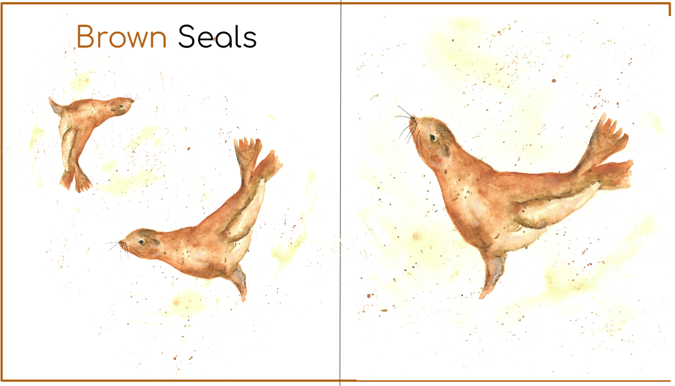
Tools and examples, continued 7

Slide 22
Tools and examples, continued 8

Slide 23
Painting a Picture - ASL at Home -
Hands Land on Prime - https://www.amazon.com/gp/video/detail/B07FYZYTDQ/ref=atv_dp_share_cu_r
Handshapes Poster - https://58creativity.com/products/42-handshape-flashcard-and-poster
Handcubes - https://handcubes.com/
ASL at Home - English and Spanish available: https://www.aslathome.org/
Learn to Sign with Your Baby - Cecilia S. Grugan and Illustrated by Brittany Castle https://a.co/d/iybIOiF

Slide 24
Minnesotaized Resources for ASL:
Deaf Mentors - https://www.lssmn.org/services/families/deaf-hard-of-hearing/mentor-services
Sign It! American Sign Language Made Easy offers several course packages geared to teens and adults. Sign It ASL is available for free to families in the US who have a child 36 months or younger who has any type of hearing loss. Apply at MyDeafChild.org.
Learn American Sign Language / Deaf and Hard of Hearing
U of M ASL Class - for more information - email asl@umn.edu
Minnesota State Academy for the Deaf and Metro Deaf School!

Slide 25
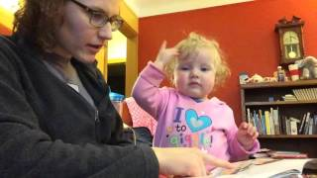
#WhyISign
This video was made in 2015 during EHDI conference.

Slide 26
Thank you!
Chelsea Paulson
MSAD Deaf/Hard of Hearing Outreach Specialist

