Slide 1
Digging Deeper: Collaboration While Working with Children with Hearing Loss
Katie Barth, M.A., Deaf Education, Gallaudet University
Deb Walters-Smith, Au.D., Audiology

Slide 2
About Us
Personal Information
Education Background
Work Experience
Current Position
How We Know Each Other

Slide 3
Why Collaborate
Different Areas of Training and Perspectives
  Medical vs Child/Family-Centered Lens
Synthesize information for Family/Staff
The “Why” behind Suggested Student Supports
Greater Parent Education + Better Staff Education = Best Outcomes for Students

Slide 4
Areas of Collaboration
Assessment
  Initial
  Re-evals
Determine Accommodations/Modifications/ Goals
Family/Student Education
In-servicing of Other Educational Staff
Listening Checks
Equipment and Troubleshooting

Slide 5
Evaluations -Standard Practice
Audiologist
Teacher of Deaf and Hard of Hearing
Observe classroom and school environments to assess access issues
Evaluate access to communication, social interaction, self advocacy and education needs
Assess expressive/receptive preferences and abilities to access communication
Observe classroom and school environments to assess access issues
Evaluate access to classroom communication, social interaction, self advocacy and education needs
Assess expressive/receptive preferences and abilities to access communication

Slide 6
Evaluations -Standard Practice, continued
Audiologist
Teacher of Deaf and Hard of Hearing
Perform functional and informal assessments of access of access to learning spaces
Interpretation of medical records: pre- & post-natal risk factors, audiologic, ENT, ENT surgical and genetics
Assess academic, communication, social/self-concept, and identify areas of need
Distinguish listening issues due to hearing status from learning/performance issues due to other conditions beyond hearing loss

Slide 7
Evaluations: Digging Deeper
Work together to provide parent education BEFORE the discussion of goals/ parent priorities (B-3) and planting seeds related to educational placement
Team discussion of goals/priorities related to the child’s hearing loss (B-3)
Choosing materials and appropriate assessments for functional listening
Part B: working collaboratively to complete a functional listening assessment with students with behaviors and/or low language/artic skills or unfamiliarity with the audiologist
Part C: sound observations with family present and participating
Participation in FGRBI Interview
LittlEars - Norms, First 2 years of life/post amplification fitting
Listening Fatigue - Vanderbilt Fatigue Scale (VFS-Peds) - Norms

Slide 8
Evaluations Digging Deeper
Functional Listening Evaluation
  Closed vs Open set
  Words vs Sentences
  Norm Referenced
  Visual Speech Reading Cues/Other visual supports
  Results drive accommodations, modifications, assistive technology

Slide 9
Accommodations/Modifications -Standard Practice
Audiologist
Teacher of Deaf and Hard of Hearing
Assess classroom acoustics and make recommendations to improve school environments (classroom choice, etc.)
Lead discussion of communication plan & effectiveness
Use need statements and current functioning to determine accommodations and modifications

Slide 10
Determining Accommodations/ modifications: Digging Deeper
  Together Audiologist and TDHH review evaluation data to determine accommodations, modifications, assistive technology (keep it individualized)
  Often overlooked accommodations that may be appropriate include:
    breaking information down into manageable chunks
    rest breaks for auditory/ listening fatigue
    moving small group discussions to alternate location (MS/HS)
    pauses to give time for prior knowledge or to formulate answers

Slide 11
Student/Family Education - Standard
Audiologist
Teacher of Deaf and Hard of Hearing
Teach hearing loss prevention and the importance of limiting noise exposure
Facilitate interactions between students with hearing loss to support: self-identity, advocacy, emotional support)
Hearing Assessment
Teach hearing loss prevention and the importance of limiting noise exposure
Facilitate interactions between students with hearing loss to support: self-identity, advocacy, emotional support)
Develop high expectations of auditory oral skills and provide intervention

Slide 12
Ongoing Student/Family Education - Standard
Audiologist
Teacher of Deaf and Hard of Hearing
provide support for development of:
  sign language skills.
  competence with communication in social, linguistic and academic contexts
  pragmatic language skills
  social skills and self concept
  self advocacy/ compensatory skills
  literacy skills

Slide 13
Ongoing Student/Family Education – Standard, continued
Audiologist
Teacher of Deaf and Hard of Hearing
develop comprehension abilities
preview/ review/ teach content vocabulary
teach to specific delays in math, reading, writing
deliver modified instruction in all academic areas of need (may be consultative)
Plan provide teachers with appropriate teaching strategies

Slide 14
Ongoing Student/Family Education – Standard, continued 2
Audiologist
Teacher of Deaf and Hard of Hearing
Act as liaison between students, parents, staff, and administrators to address ongoing student needs

Slide 15
Student/Family education: Digging Deeper
  Beyond discussing cause, degree and type of hearing loss, and familiar sounds audiogram, discuss Articulation Index (Count the Dot audiogram) and provide simulation
  Teach classes with students with hearing loss about how the ear works and hearing loss (ear obstacle course)
  Audiologist help identify students that might be good matches for parent and/or peer support and support DHH teacher in connecting them
  Audiologist supports DHH teacher in determining if access is an issue in a area where students aren’t making expected progress with appropriate interventions
    Formant frequencies

Slide 16
Ongoing Student/Family education: Digging Deeper
  Joint home visits for B-3 population
  Connecting families with outside supports (Hands and Voices, local Facebook groups, family events, Community Education ASL classes)
  supporting families in advocating at medical appointments, facilitating connection for CMV testing of birth blood spot for unknown etiology
  Providing families with research based information/ articles when appropriate
  Auditory training: audiologist is good resource for materials and information what is reasonable

Slide 17
In-servicing of Other Educational Staff - Standard
Audiologist
Teacher of the Deaf/ Hard of Hearing
Educate school staff about impacts of hearing loss and use of assistive technology
In-service classroom teachers about required daily monitoring of amplification
In-service teachers on appropriate modifications
Reach out to teachers when hearing status changes occur that will impact classroom performance
Educate school staff about impacts of hearing loss and use of assistive technology
In-service classroom teachers about required daily monitoring of amplification
In-service teachers on appropriate modifications
Plan/ provide general education teachers with appropriate teaching strategies

Slide 18
In-servicing of Other Educational Staff - Digging Deeper
  Simulation of child’s hearing loss
  Visual representation of hearing loss
  Providing extra information - formant frequencies, Count-the-Dot Audiogram
  Review of FLA - word level testing importance
  Inclusion of student with staff in-servicing, when appropriate: Google Slides, letter outlining what they want and do not want said/done
    Student present in demonstration of equipment (bonus - self-advocacy)
  DHH Top 10 presentation for all staff
  DHH trivia
  Discussion of Listening Fatigue and its impacts of learning
    Periodically checking out, hidden curriculum (I can’t expect to hear/learn like classmates, behaviors, physical fatigue, quality of life, etc.

Slide 19
Equipment and Troubleshooting - Standard
Audiologist
Teacher of the Deaf/ Hard of Hearing
Teach student about use of amplification and troubleshooting malfunctions
Appropriately select, set, validate & manage implementation of assistive hearing technology
Gather information to determine if amplification is fit optimally
Teach student about use of amplification and troubleshooting malfunctions

Slide 20
Equipment and Troubleshooting - Digging Deeper
One-on-one training in-person (DHH teacher + Audiologist) with equipment present
Audiologist provides DHH teacher with equipment resources:
  Cheat / summary Sheets
  Stored Videos
  Google Meets to troubleshoot equipment in live time
Audiologist has trust in DHH teacher to provide basic troubleshooting and repairs
Back-up parts provided to DHH teacher (audioshoe, extra receiver, Focus tubing)
DHH teacher understands strengths and limitations when troubleshooting and repairing equipment

Slide 21

Katie’s Soapbox

Slide 22
Listening Checks - Standard
Audiologist
Teacher of the Deaf/ Hard of Hearing
Perform basic technology checks and respond to student reports of malfunction
Train support staff in performing listening checks
Perform basic technology checks and respond to student reports of malfunction
Train support staff in performing listening checks
Provide documentation sheets for listening checks
Periodically check documentation of listening checks
Reach out to audiologist when concerns arise

Slide 23
Listening Checks - Digging Deeper
  Two specific parts of listening checks:
    Equipment Function
    Students’ hearing function through equipment
        Importance of Ling 10 sound test
        No sound response
  Thorough documentation of checks (custom made listening check sheets)
  Video of listening checks process - available in “Resources”
  work with audiologist if concerns arise (consistently missing sounds, they got before, having to move closer for student to repeat successfully)
  Use toys or pictures for nonverbal students, or young students

Slide 24
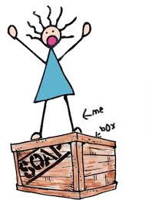
Deb’s Soap boxes

Slide 25
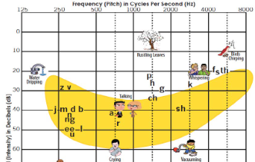
Familiar Sounds Audiogram vs. Count the Dot audiogram

Slide 26
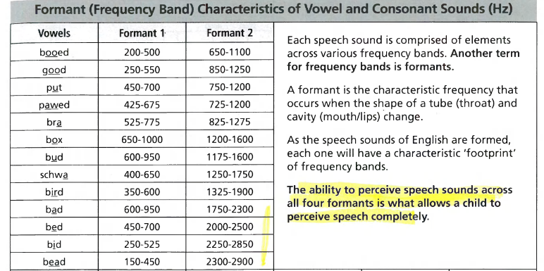
Why Familiar Sounds Audiogram is inaccurate: multiple frequency bands needed to distinguish between sounds

Slide 27
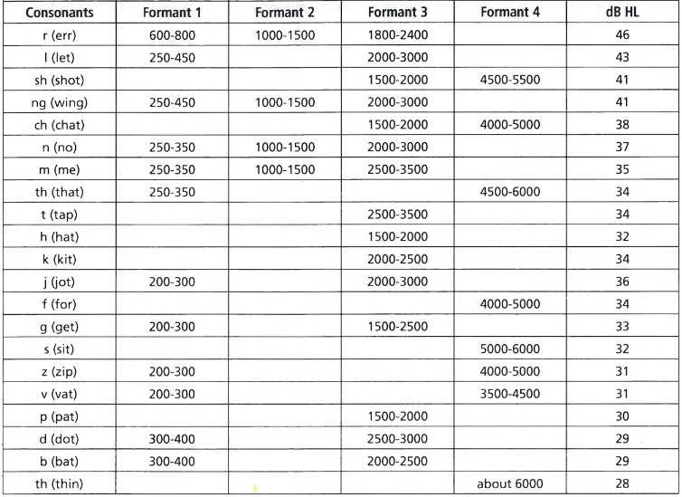
Multiple bands to distinguish between sounds (continued)

Slide 28
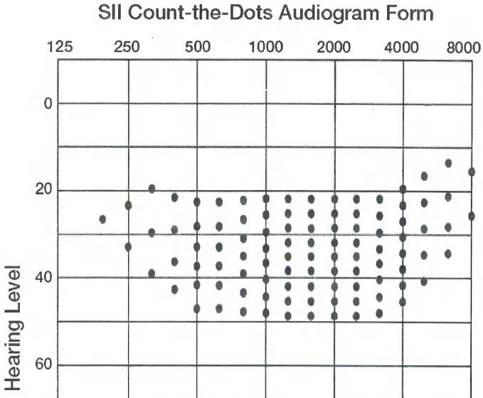
SII -Based Method for Estimating the Articulation Index
Plot Audiogram
100 dots = 100% of average English conversational speech from 1 meter; 1 dot = 1% of speech sounds.
Dots above threshold = % missed sounds

Slide 29
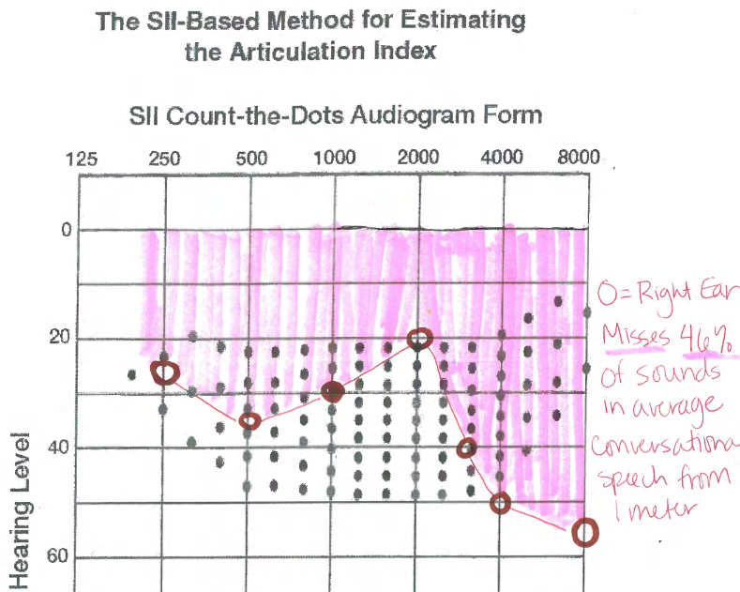
Same Hearing Loss- Count-the-dot Audiogram

Slide 30
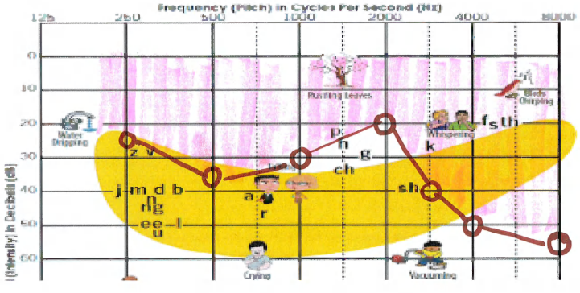
Hearing loss: Pink = Misses Only /K/,/F/,/S/,/Th/ + /P/

Slide 31
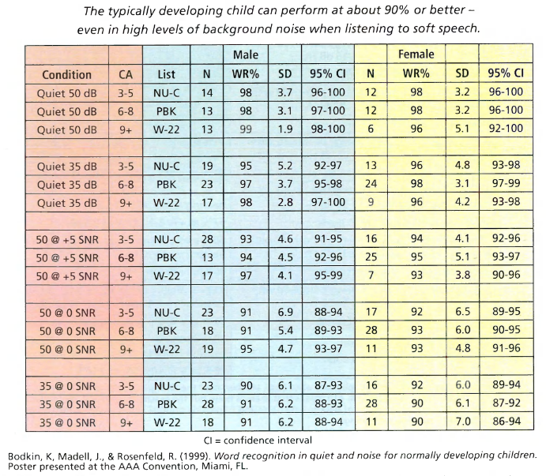
Word Recognition Materials with Normative Values
Reference: Anderson, Karen. Building Skills for Success in the Fast-Paced Classroom. Pg 107.

Slide 32
Rationale for Using Single Syllable Word Lists with Normative Values for Functional Listening Assessment
Represents worst case scenario when students are unfamiliar with topic/new vocab; they are unable to use contextual cues (i.e. chlorophyll, photosynthesis)
Ability to make comparisons with typically hearing peers to determine Hearing and Access Gap:
Explains listening fatigue for student
Note whether responses are delayed / said with confidence - listening effort
Provides documentation of what is needed to make instruction more EQUITABLE for each student?

Slide 33
Rationale for Using Single Syllable Word Lists with Normative Values for Functional Listening Assessment (Continued)
Provides documentation of what is needed to make instruction more EQUITABLE for each student? Could include the need for:
  Amplification/Assistive technology
  Listening Breaks
  Pre-teaching, Re-teaching, and/or Small Group Instruction
  Visual supports (Speech reading cues, Sign language, Visual phonics, Picture Supports, Real world experiences, Writing assignment on board, etc.)
  Shortened Instructions Punctuated/Innumerated by Order
  Optimal Acoustics
  Repeating Overhead Announcements/Alarms through FM System
  Quieter Location for Lunch, Small Group Cooperative Learning Groups

Slide 34
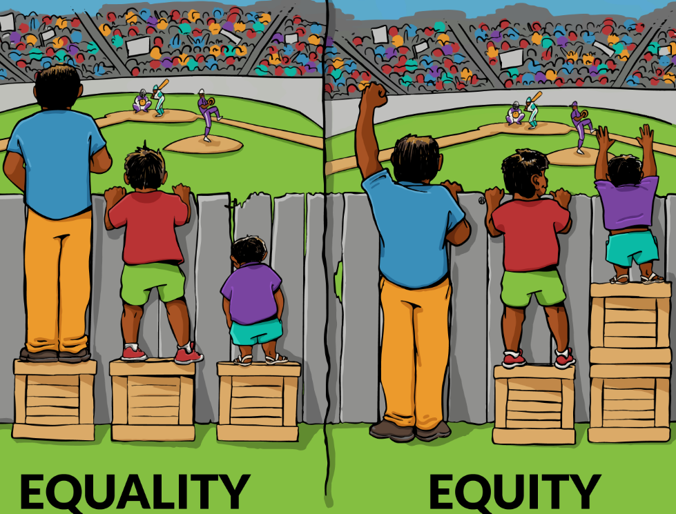
Equitable vs Equal

Slide 35
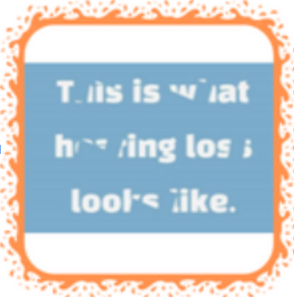

Equitable vs Equal - Listening through a damaged auditory system is not “equal.”

Slide 36
Resources
Hearing Loss Simulations- Bilateral hearing loss:
  Jane Madell, Hearing Loss in the Classroom: Need for FM and pass-around mic/teacher repeat peer responses into FM Transmitter
Hearing Loss Simulations - Unilateral: Med-El; requires use of over-the-ear headphones
Katie Barth’s “How to complete a Listening Check” Tutorial:
Functional Listening Assessment - Karen Anderson Normative Values - page ______ of Book, __________
Count-the-Dot Audiogram reference
LittlEars Auditory Questionnaire - purchase through Med-El
Vanderbilt Listening Fatigue Measure (Free):

Slide 37
Thank you!
Katie Barth: kbarth@isd761.org
Deb Walters-Smith: dewalters-smith@rochesterschools.org

