Slide 1
Social Emotional Learning - SEL in ASL
Lori Vigesaa, MS, LPCC, NCC, CI/CT
Clinical Supervisor of the Therapeutic Services Agency’s DHHDB Program
Chelsea Paulson, MA
MSAD DHH Outreach Specialist

Slide 2
Agenda
We will share what a harmonious collaboration looks like for DHH Teacher, Case Manager and Mental Health Professional on the IEP, and how to encourage successful sessions on a variety registers for long-term return on investment with DHH children.
What does a ‘collaboration’ look like?
Teaching Coping Skills for DHHDB students.
What is a register?
What is the difference between HIPAA and FERPA?

Slide 3
Willingness to Collaborate
It takes a village!
Two of the biggest barriers
Adding the missing pieces
Think of it as a “Turf War” (MY student/client)
Mindset
Collaboration
Student/Client need
When it is more than Social Emotional Learning

Slide 4
What Does Collaboration Look Like?
Parent
Administrator
Case Manager
Teacher
Therapist
Other Needed Professionals

Slide 5
What Does Collaboration Look Like? Continued
Teaching Coping Skills (1 student w/ high ADHD symptoms)
Teacher recognizing their boundary/know their limits
Sandpaper - friction not good for him, not good for me
Resources
Things to reduce friction
Fantastic Freddy - Wiggle-wiggles
PreK-K Conversations

Slide 6
Register - Elementary
Friendships
Emotional Regulation
Recognizing Thoughts and Feelings
Problem-solving
Theory of Mind development (catch up)

Slide 7
Register - Middle School
Friendships
Become more complicated
Loss of old friends - how to find your place
Puberty
Racing hormones
Understanding their bodies
Emotional Regulation
Peer Pressure Increases
Trying harder to fit in
Introduction of alcohol/drugs
Social Media
FOMO/Sextortion/Digital Self-harm
Positive Connections vs Cyber-bullying

Slide 8
Register - High School
All of these become even more amplified
Friendships
Emotional Regulation
Peer Pressure
Social Media
Pressures of Transition to Young Adulthood

Slide 9
Differences Between School Procedures and Mental Health Therapeutic Services
HIPAA vs FERPA
HIPAA - community providers
Confidentiality = Trust
Release of Information - limitations
Magic age of 16 years
Keeps medical records private
FERPA - school providers
Keeps educational records private, subject to educational need
Prohibits sharing identifiable information (age, name, disability)
Release of Information - your agency and school district have one on file.

Slide 10
Differences Between School Procedures and Mental Health Therapeutic Services, continued
Use of Educational Interpreters
Qualifications
Conflict of Interest
IEP Team Members
Access to Education Hindered

Slide 11
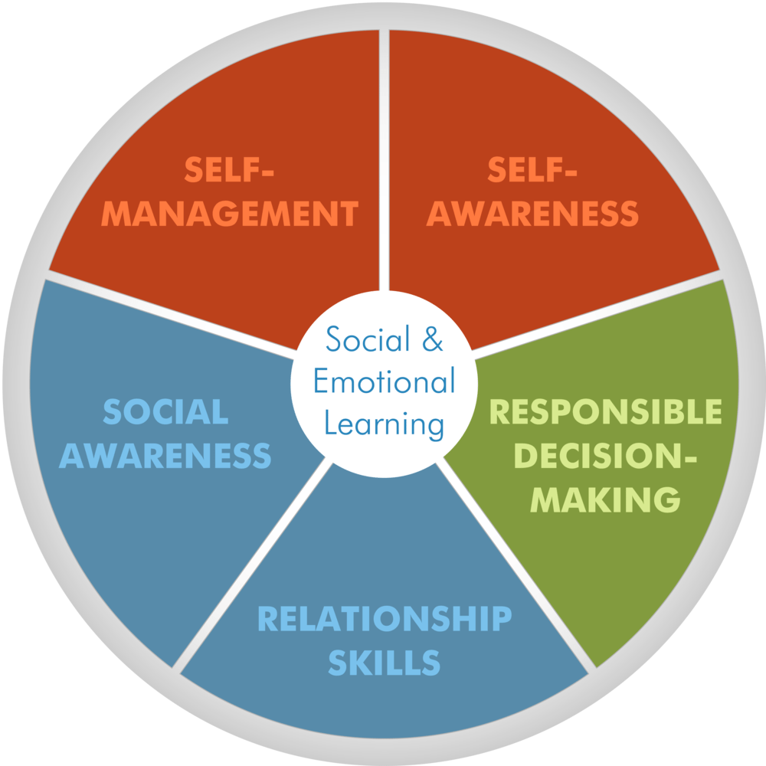
Social Emotional Learning and Therapy Are Different
Social Emotional Learning in School System according to PBIS
Tier 1 - Social cues, often are missed when child is in mainstreamed school. Explicitly taught.
Tier 2 - Check In-Check Out
Tier 3 - Child Study Team Meeting child specific - possible add to due process - Behavior Intervention Plan

Slide 12
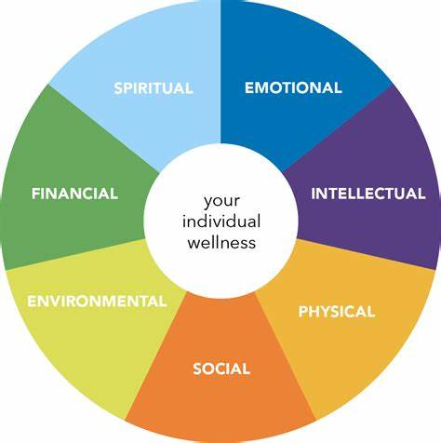
Therapy addresses
Therapy addresses
The cause
Coping skills
Practices the skills
Provides psychoeducation
Supports school faculty/staff
Supports family

Slide 13
Thank you!
Chelsea Paulson - chelsea.paulson@msa.state.mn.us
Lori Vigesaa - lvigesaa@tsapc.net

