Slide 1
Resources in Reading and More from the Minnesota Resource Library!
Presented by Matt Kevan
Charting the Cs Conference 2024

Slide 2
Matt Kevan
21st year in education
BA (Augustana University); MA in Deaf Education (University of Minnesota)
Taught various Deaf Education programs: residential, deaf centered, and rural itinerant
Taught 3 years of HS ASL and English Language Learners
Fifth year working for the libraries
School library, curriculum library, and Minnesota Resource Library

Slide 3
About Minnesota Resource Libraries
MN Resource Libraries is a statewide library providing information and resources to help educators and families meet the educational needs of Minnesota children and youth who have a hearing and/or vision loss
We offer:
Assistive Technologies
Curriculums
Assessments
Resources about disabilities and various instructional approaches

Slide 4
About Minnesota Resource Libraries
We also offer:
Literature
Shared Reading Project
DVDs – Instructional and Entertainment
Games

Slide 5
Who Can Use the MNRL? - Patron Types:
Professional:
Licensed professionals in the field.
Has access to all resources in the MNRL.
Community:
Has limited access to resources. Cannot receive AT Equipment, Curriculum, or Assessments.
Faculty:
Licensed staff working at Minnesota State Academies

Slide 6
Assistive Technology Checkouts:
On Demand:
Can be kept for as long as the student in enrolled in the district you serve.
AT Loan Equipment:
Checkout is good for 68 days. This allows districts to explore different AT technology before purchase.

Slide 7
On-Demand Procedures:
We contact all patrons with On-Demand items annually to verify if renewal is needed.
Some patrons have moved or retired; On-Demand items must be transferred to your replacement.
If student has graduated or no longer in your district, On-Demand items will need to be returned.
Please contact us.

Slide 8
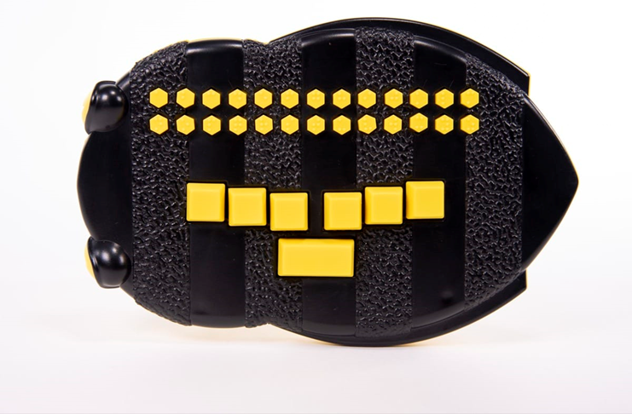
Braille Buzz

Slide 9
Chameleon 20

Slide 10
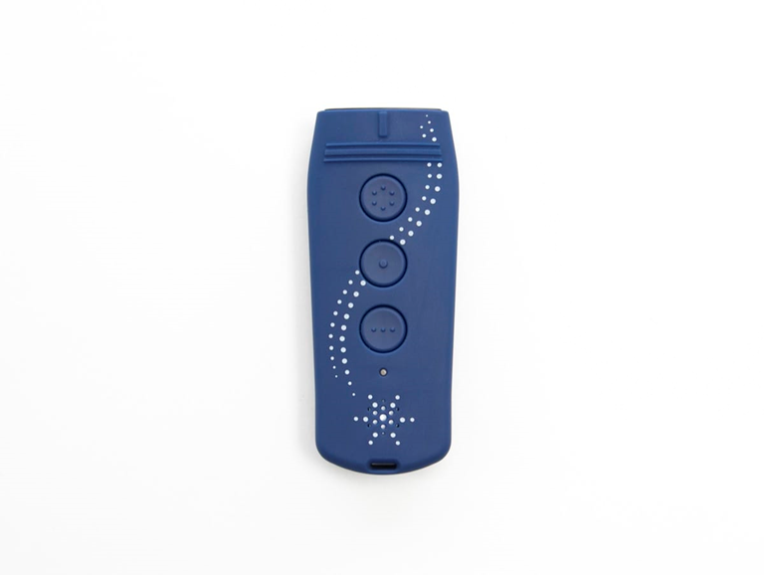
Color Star

Slide 11
Joy Player

Slide 12
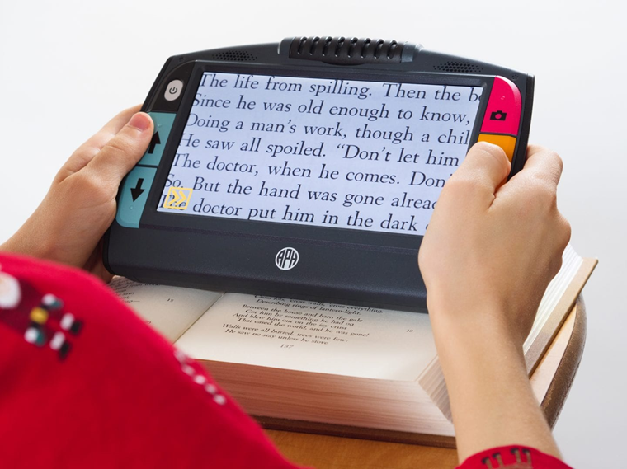
Juno Handheld Magnifier

Slide 13
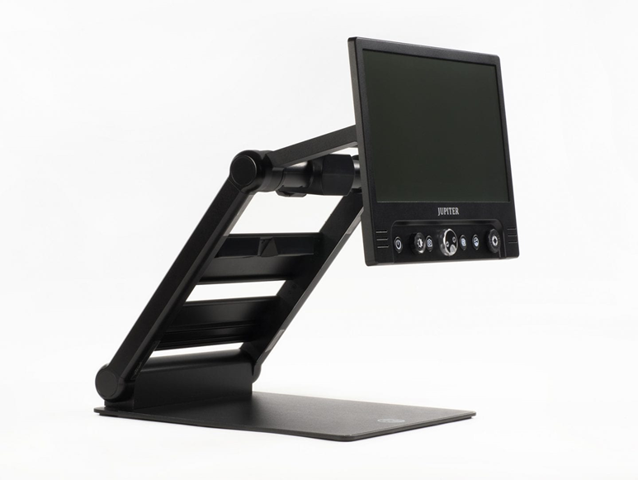
Jupiter Portable Magnifier

Slide 14
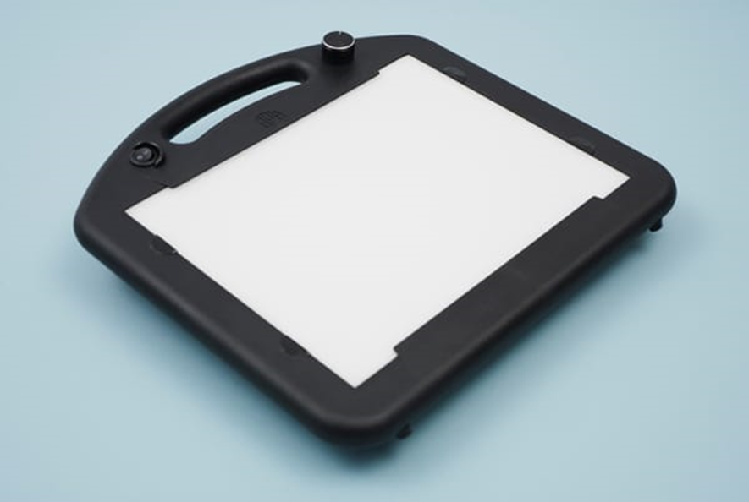
LED Mini Lite Box

Slide 15
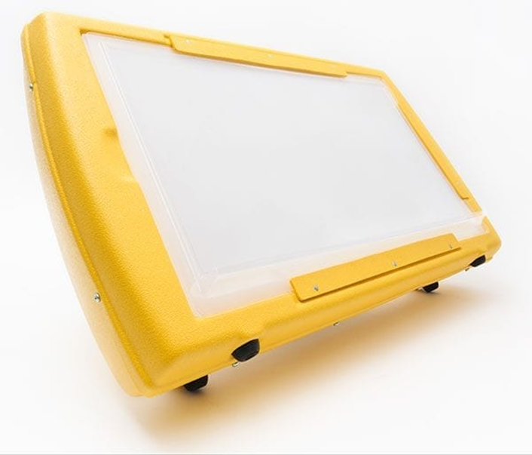
LED Light Box

Slide 16
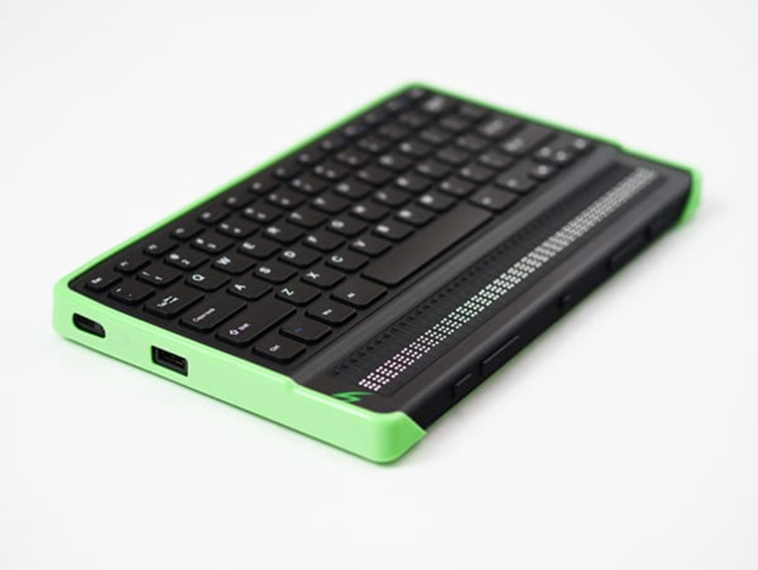
Mantis Q40

Slide 17
Perkins Brailler & Light-Touch Brailler

Slide 18
Handheld Video Mag HD

Slide 19
Resource Materials Checkouts:
Assessments:
68-day loans
Curriculums:
68-day loans
Books, Games, DVDs:
30-day loans

Slide 20
Assessments:
Assessments which districts do not have may be borrowed to determine strengths and need for students with a hearing and/or vision loss.
These loans are good for 68 days.

Slide 21
Assessment Spotlights:
The ASL Receptive Skills Test (ASL RST)
The for Auditory Comprehension of Language (TACL:4)
KeyMath 3 (Includes large print and braille formats)
Woodcock-Johnson IV (Includes large print and braille formats)
Developmental Reading Assessment (DRA-3)
Kaufman Test of Educational Achievement (KTEA-3)
Test of Early Reading Ability (TERA-4)
Differential Abilities Scales (DAS-II)

Slide 22
Curriculums:
Specially designed curriculums are available on loan to Teachers of the Deaf/Hard of Hearing and Blind/Visually Impaired.
These loans are good for 68 days.

Slide 23
Curriculum Spotlights:
High Interest/Low Level Reading Programs
Pre-Employment Transition Solution (Pre-ETS)
CID Spice for Life 2: Auditory Learning Curriculum
Visualizing & Verbalizing: For Language Comprehension and Thinking
Barraga: Visual Efficiency Program
Signing Naturally
SKI-HI
Sonday System: Multisensory Solutions for Reading

Slide 24
Books:
Books for professionals and families to learn more about DHH and/or BVI approaches and best practices
These loans are good for 30 days.

Slide 25
Books for Children Who are DHH or DeafBlind:
List created by Taylor Lovin and Emily Manson
The MNRL is collaborating and is using the list to add to collection
One place to see all books
Our goal is to have all books on the list
Books for Children Who are Deaf, Hard of Hearing, or DeafBlind

Slide 26
DVDs:
ASL Films (All 10 Films)
Signing Times and other DVDs for children and families to learn ASL
Mainstream movies featuring Deaf characters and ASL
Documentaries
Shared Reading Projects
ASL DVDs for interpreters and others to advance their skills
These loans are good for 30 days

Slide 27
Games:
These loans are good for 30 days.

Slide 28
Finding and Making Requests:
The MNRL catalog can be browsed, and requests can be made online.
We encourage all patrons to use the library system online.
Patrons can email us to determine what is available and requests can be made.

Slide 29
Returning and Renewing Checkouts:
When returning items, please place device in the original box that was provided to you.
Please wrap boxes with packaging paper.
Use Free Matter if applicable.
Insure AT Equipment
Contact us if you wish to renew. If item has a waitlist, you will need to return it.

Slide 30
Loan Mailing Challenges:
BVI – Free Matter
“Matter may be entered free of postage if mailed by or for the use of blind or other persons who cannot read or use conventionally printed materials due to a physical handicap.” - USPS
In the past, patrons were responsible with mailing loan returns back to us at their expense.
As of 2023-2024 school year, we are including Return Postages to all patrons.
AT Equipment loans still require patrons to pay package insurance for the value of the device.

Slide 31
Your Input is Encouraged:
What additions do you want to see in the library?
How can we better serve you?
Suggestions and feedback are always welcomed!

Slide 32
Thank you!
Minnesota Resource Libraries
Email: MN.Resource.Libraries@msa.state.mn.us
Matt Kevan
VP/Voice: 507-412-8904
Email: matthew.kevan@msa.state.mn.us

