Slide 1

Disability Hub MN™:
My Vault, a Resource for Transition Planning
Provided by Marcy LaCroix
Community Capacity Builder
Disability Hub MNTM

Slide 2
What is Disability
Hub MNTM?
Free statewide resource network
A simple, single access point
Safe, neutral, and trusted resource
Comprehensive—puts the pieces together

Slide 3
Who We Help…
Case Managers and Social Workers
Education professionals
Employment support professionals
Anyone in a support role
Family, Friends, Neighbors, etc.
Self-advocates
Anyone regardless of disability

Slide 4
You can ask us anything!
What are my health insurance options?
Support in finding community resources.
Can I live where I want and get the help I need?
Support in understanding what person centeredness means to me.
Can I work, or work more?
Troubleshoot issues with benefits and understand them

Slide 5
How We Might Help…
Contact information for a needed agency or service
Support in contacting an agency or organization
Understanding available options so a decision can be made
Work 1:1 with an Options Counselor to meet goals
Build knowledge around benefits, programs and tools for personal and professional success

Slide 6
Hub Helpful Tools
DisabilityHubMN.org
DB101
HB101
My Vault
MinnesotaHelp.info
Direct Support Connect

Slide 7
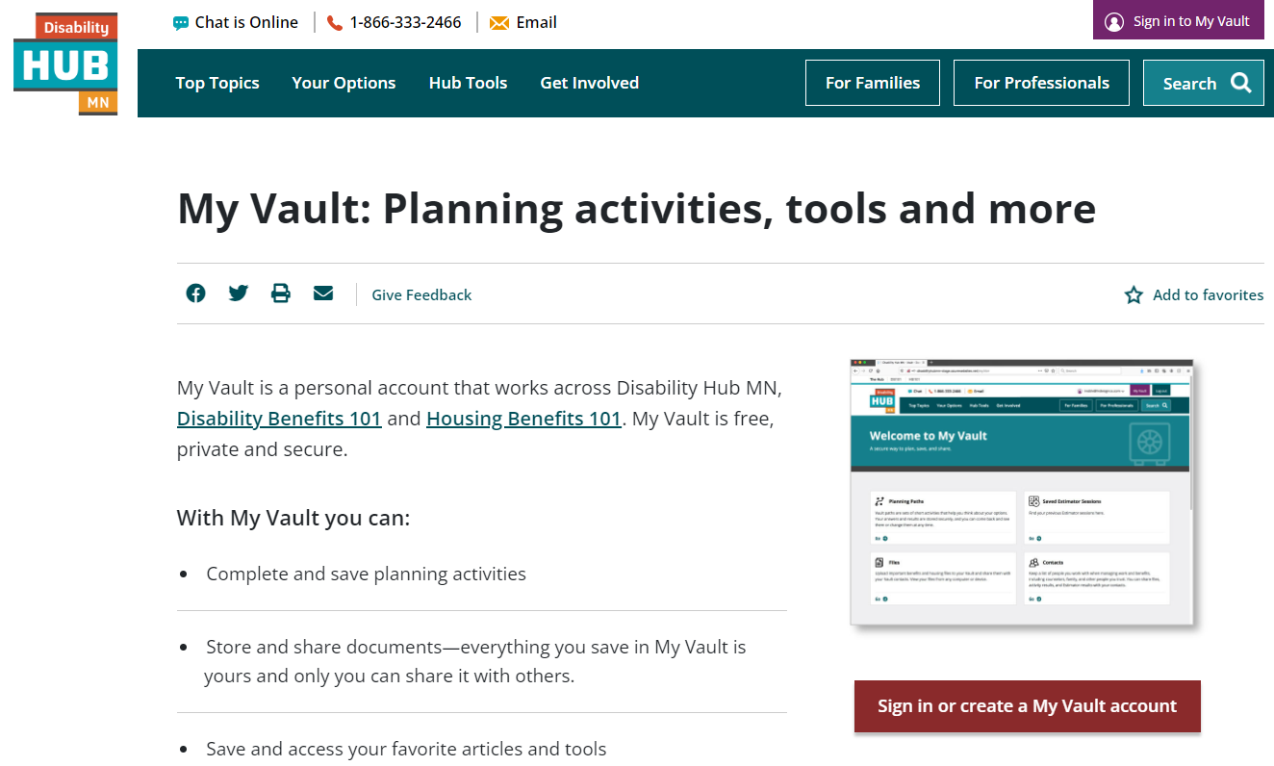
My Vault: Hub Tools

Slide 8
My Vault
An online tool to help people:
Securely store and share information
Streamline the process of sharing information
Safely and securely access their own benefit information
Tailor information to their own needs
Set goals and plan for their future

Slide 9
What’s Inside the Vault
Activities: interactive tools to see how you can increase income and manage healthcare through work
Files: upload files to the vault that can be shared between vaults
Contacts: create a list of people who help manage benefits

Slide 10
Disability Hub MN™:
Website Tour

Slide 11
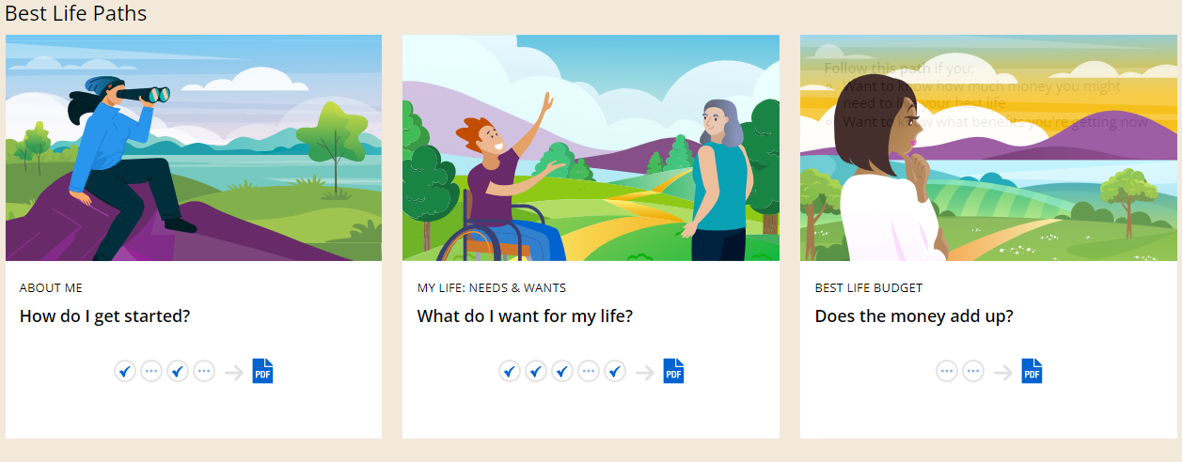
Best Life Paths

Slide 12
Best Life Path: About Me
Activities from the individual and the family’s perspective.
Identify existing supports
Helpful for others to know a person
Works for any life stage
Invites work to be part of the conversation

Slide 13
Best Life Path: My Life
Activities from the individual and the family’s perspective.
Explore what it “My best life” means
Identify steps to get to best life

Slide 14
Best Life Path: Best Life Budget
Identify current benefits
Understand the budget needed to live your best life

Slide 15
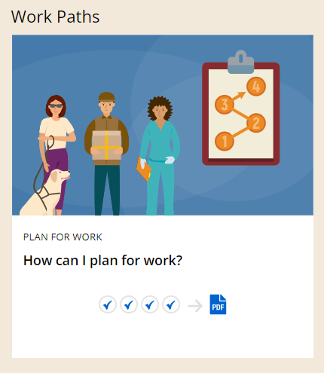
Work Paths

Slide 16
Work Paths: How can I Plan for Work?
My Profile: Work
  One-page profile to map resources and support and tell other what matters to you
My Vision: Work
  Identify what you want and don’t want in work and the steps to get there

Slide 17
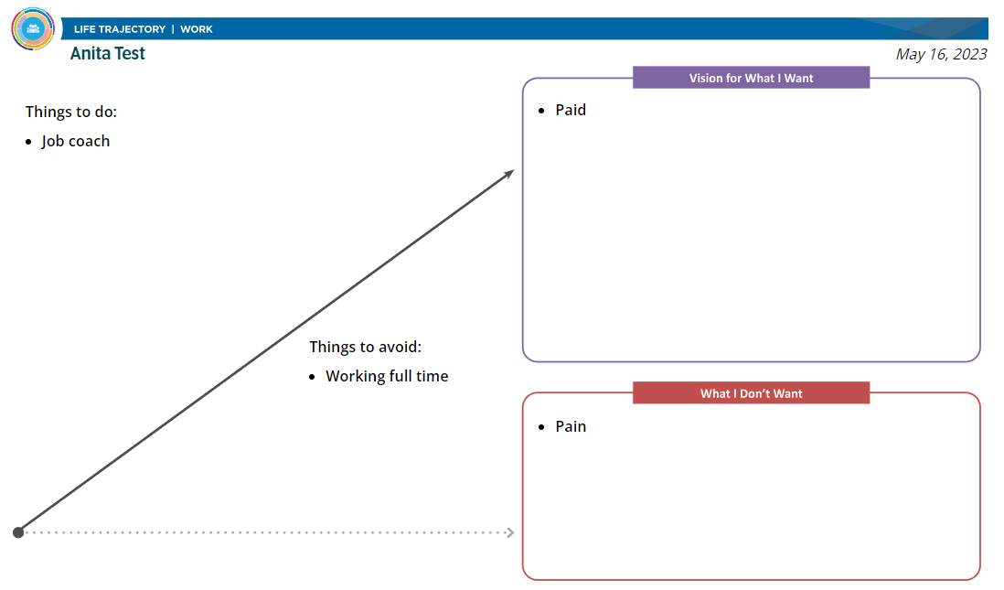
My Vision: Work

Slide 18
How can I Plan for Work? continued
My Resources and Supports: Work
  List what you have and what you need to reach your work goals
Build My Team: Work
  A list of people who support your employment

Slide 19
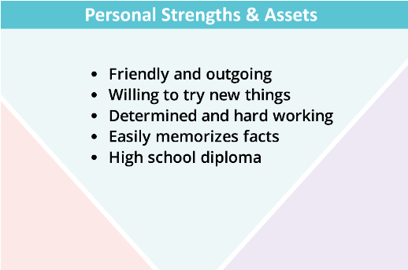
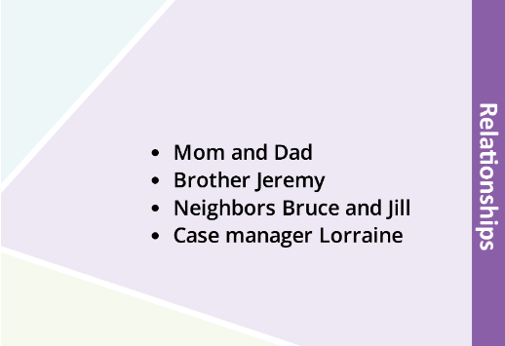
My Resources and Supports: Work

Slide 20
Questions?

Slide 21
DB101™ Tour

Slide 22
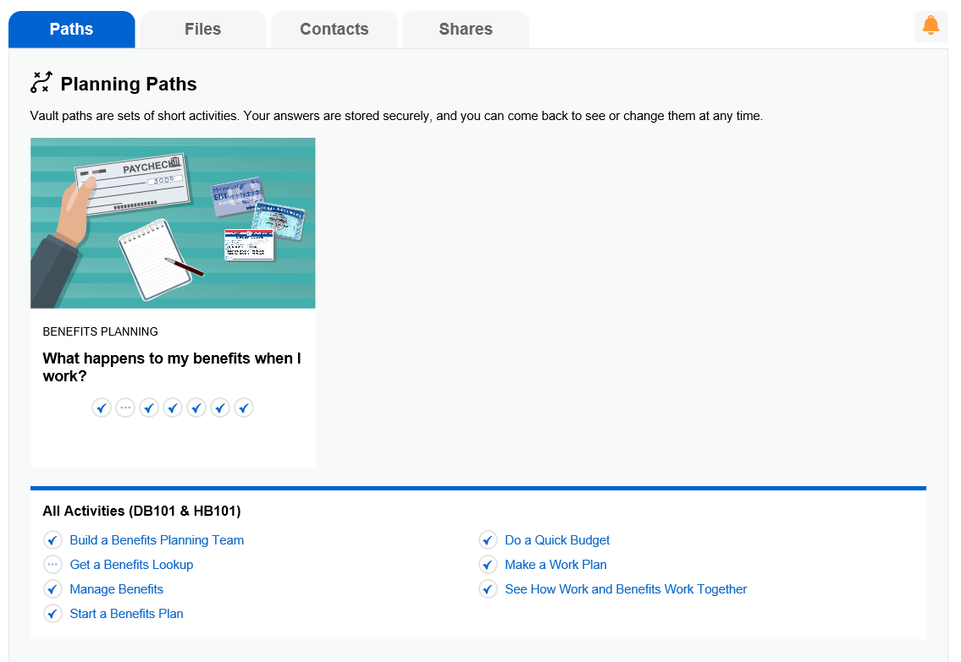
Planning Paths

Slide 23
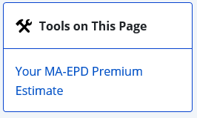
Estimators & Try Its
Three estimators: Work and Benefits Estimator, School and Benefits Estimator, and MA-EPD premium estimator
Program based Try Its embedded within program articles indicated by a tool icon

Slide 24
Try Its & Features
SSDI/SSI and work estimates
Minnesota Supplemental Aid (MSA) and Housing Support benefit estimates
Countable income tests for MA and Medicare Savings Programs
Health Coverage Income Limits
Finding the Right Health Coverage for You

Slide 25
Benefits & Work Estimator
Provides in depth analysis of a person’s benefits through a work attempt
Projects changes years into the future
Estimates changes to cash benefits, health benefits, and housing benefits

Slide 26
HB101™ Tour

Slide 27
HB101 Vault Activities
I Get to Decide: How do I get started?
Housing Needs and Wants: What do I want in a new place?
My Day, My Life: What help do I need?
Housing Budget: Does the money add up?
Present Myself: How can I make a good impression?
Live with Someone: How can sharing a place work for me?
Housing Sustaining Plan: How do I keep my place?

Slide 28
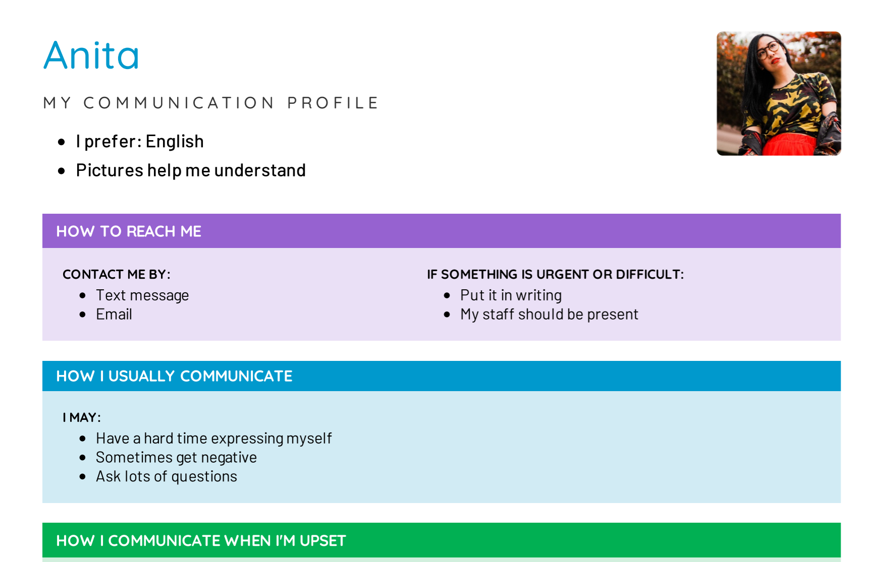
Vault Activity: Communication Profile

Slide 29
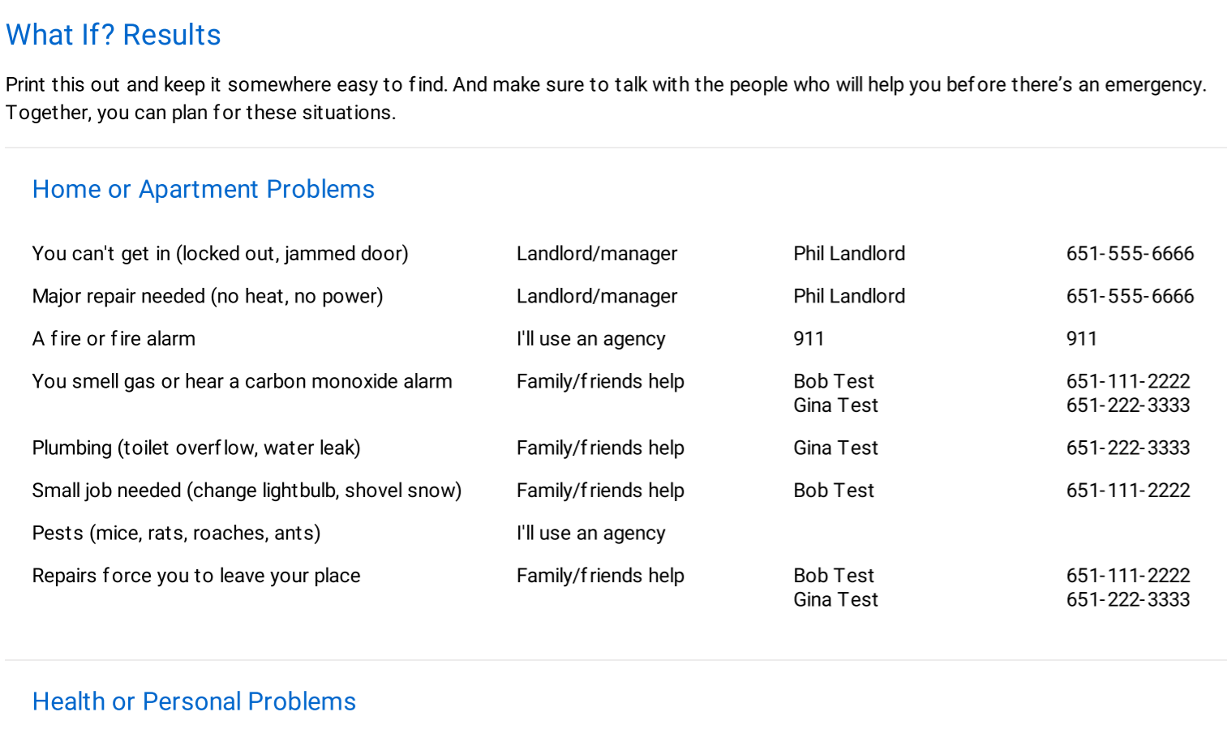
Vault Activity: My Day, My Life – What if?

Slide 30
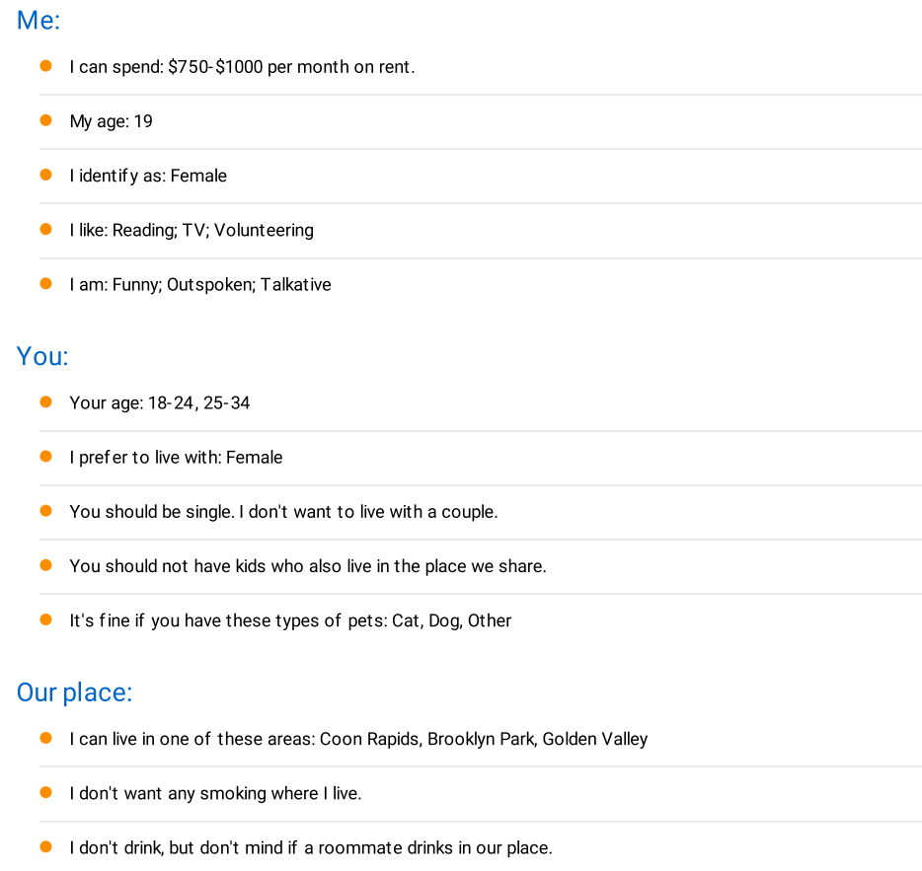
Vault Activity: Roommate Profile

Slide 31
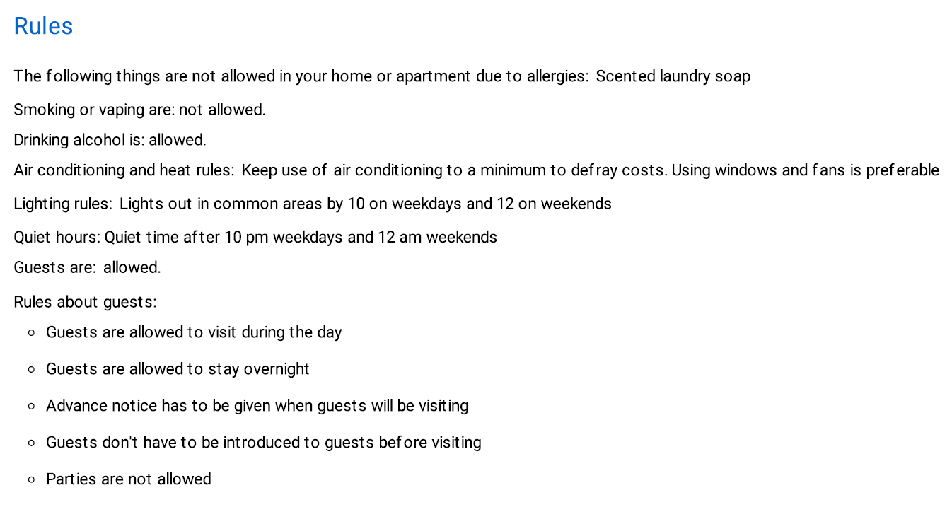
Vault Activity: Roommate Agreement - Rules

Slide 32


Follow us on Facebook!

Slide 33
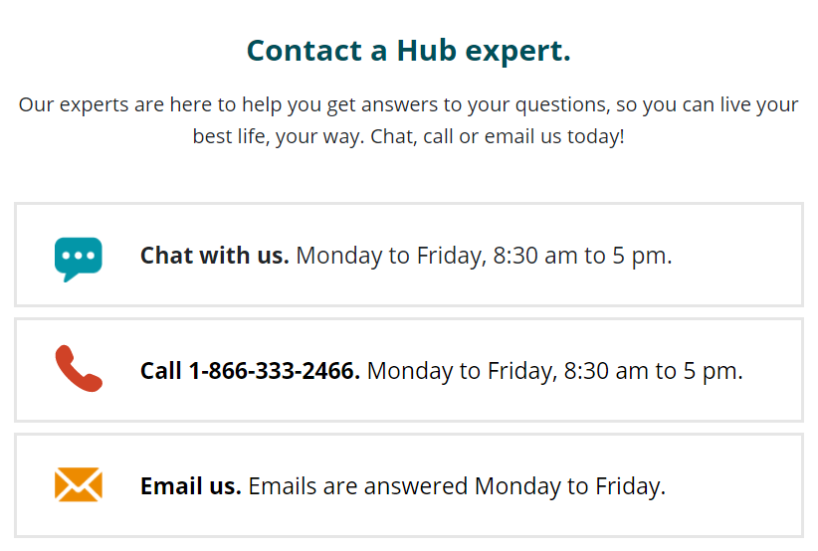
How to reach us?

Slide 34
Thank you!
Your best life, your way.
Disability Hub MN is a free statewide resource network that helps you solve problems, navigate the system, or plan for your future. Our team knows the ins and outs of community resources and government programs, and
has years of experience helping people fit them all together

