Slide 1
New tools, YES PLEASE!
Annie Lehrke-Minske
Statewide Professional Development to Support the Workforce and Low Incidence Disability Areas.

Slide 2
New Tools, YES PLEASE!
After this hour you will leave here with…
Knowledge about Google Draw
Knowledge about Canva
Two tools in your toolbox, simple and free
Ways to create templates, worksheets and more!

Slide 3
About Me:
Deaf and Hard of Hearing from 2002-2017
Taught Visual Arts from 2017-2022
Coordinator of Educational Services from 2022 to present
Recently obtained my Admin. Licensure
BFA in Visual Communications
M.Ed in Special Educations
Ed.S Educational Leadership/ Administration
Currently work in PreK-3rd Grade – supporting teachers, district assessment, special education and more!

Slide 4
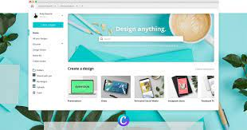
Canva
PROS
CONS
Templates made for education
Web –based / save in account – program
User Friendly – premade designs
Stock Photo Usage
Cannot download “Raw” Files / just finished files
Limits with templates/ Free version
Some alignment issues
Unique elements are not able to be created

Slide 5
Getting Started in Canva
Make an Account
Explore the EDUCATION tab
Library of premade
Curricular material
Support with creation AI
More! (include design your own)

Slide 6
Go to Prices and Plan:
Go to Education and TEACHER/ VERIFY

Slide 7
Examples

Slide 8
More examples

Slide 9
Let’s explore…
www.canva.com 10 min of peeking at site

Slide 10
Google Drawing – Beginner Friendly approach to graphic design
PROS
CONS
Intuitive and versatile drawing program
Cross-platform
Deep integration with Google Workspace applications
Free – great to work with teams / share
Backgrounds always transparent
Finding own graphics
Only “one sheet”
Templates

Slide 11
How to Add/Get Google Draw:
Go to your Google Drive
In the top left, click
FILE
NEW
MORE…..
Google Drawings.

Slide 12
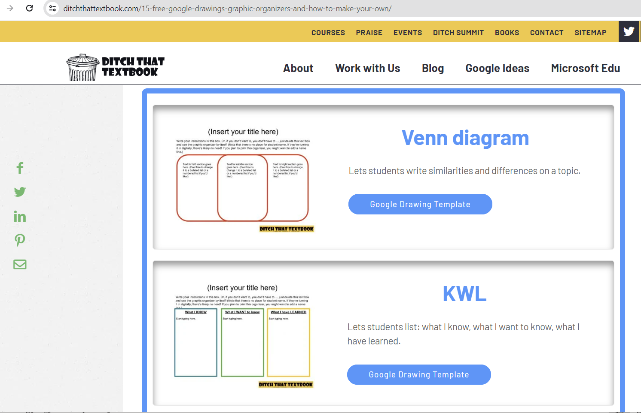
Templates for Google Draw
Go to: sites.google.com
Click on templates – options available
Or search “templates for Google Draw”
Example at right:

Slide 13
Examples
Made from scratch resources. Background is transparent, prints white.
Easy to move around – embedded graphics in google to access or upload

Slide 14
Tools
Scribble draw tool
Easy to change colors
Size and thickness options
Shapes/Boxes/Text
Touchscreen friendly

Slide 15
Let’s Explore
Go to your google drive to access Google Draw 10 min of playing with tools

Slide 16
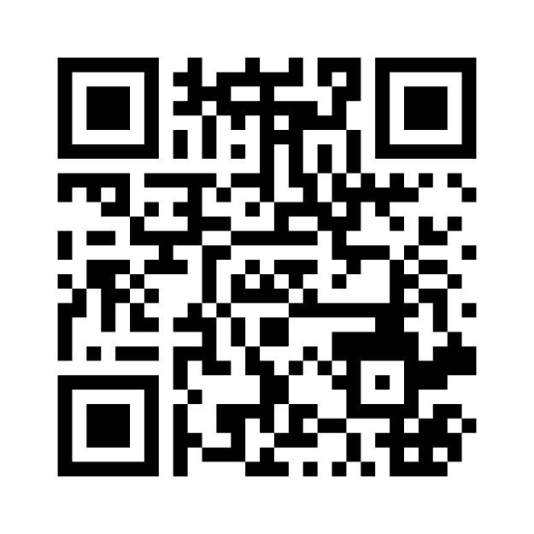
Survey
Please scan the QR code and answer the survey question.
THANK YOU!

Slide 17
QUESTIONS? THANK YOU!
Need links to templates or more? Email me!
Annie Lehrke Minske, 218-616-4750 alehrkeminske@parkrapids.k12.mn.us
Park Rapids Public School Coordinator of Educational Services

