Slide 1
Disability Hub MN™: A Resource Network
Provided by Marcy LaCroix
Community Capacity Builder
Disability Hub MNTM

Slide 2
What is Disability Hub MNTM?
Free statewide resource network
A simple, single access point
Safe, neutral, and trusted resource
Comprehensive—puts the pieces together

Slide 3
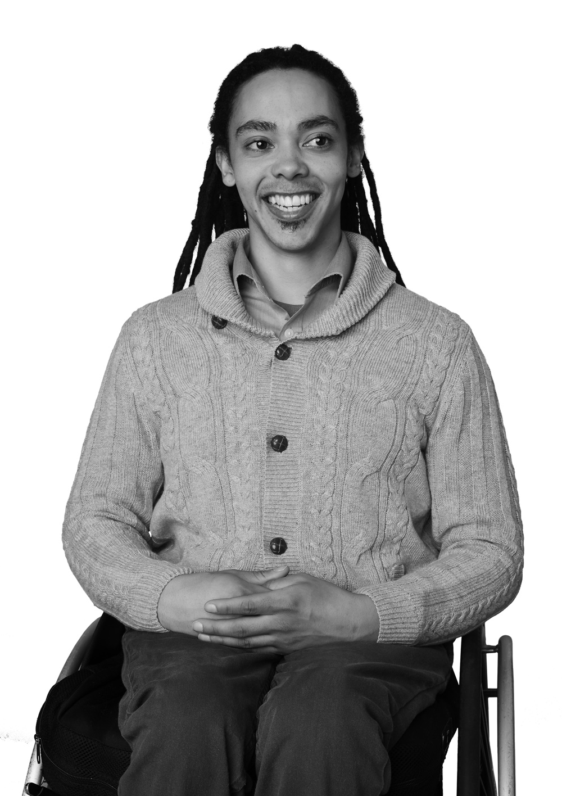
Our Team
Person Centered Trained Options Counselor
Some OC’s have additional credentialing in other areas of expertise
In multiple communities across Minnesota

Slide 4
Who We Help…
Case Managers and Social Workers
Education professionals
Employment support professionals
Anyone in a support role
Family, Friends, Neighbors, etc.
Self-advocates
Anyone regardless of disability

Slide 5
You can ask us anything!
What are my health insurance options?
Support in finding community resources.
Can I live where I want and get the help I need?
Support in understanding what person centeredness means to me.
Can I work, or work more?
Troubleshoot issues with benefits and understand them

Slide 6
Frequent Topics: 2023 Data
Health Benefits
Cash Benefits
Health & Wellness
Community & Family Support
Housing / Shelter

Slide 7
How We Might Help…
Contact information for a needed agency or service
Support in contacting an agency or organization
Understanding available options so a decision can be made
Work 1:1 with an Options Counselor to meet goals
Build knowledge around benefits, programs and tools for personal and professional success

Slide 8
Hub Helpful Tools
DisabilityHubMN.org
DB101
HB101
My Vault
MinnesotaHelp.info
Direct Support Connect

Slide 9
Disability Hub MN™: Website Tour

Slide 10
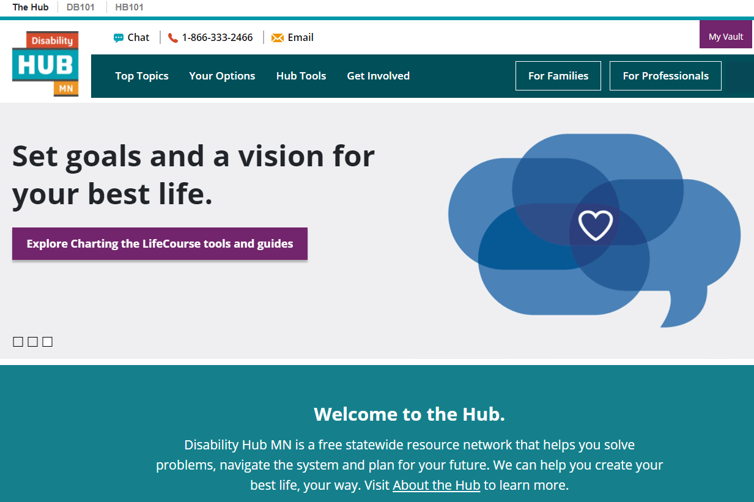
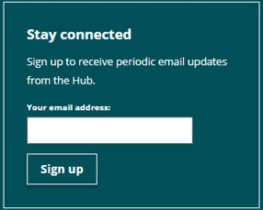
Disability Hub MN
Disability Hub MN Homepage

Slide 11
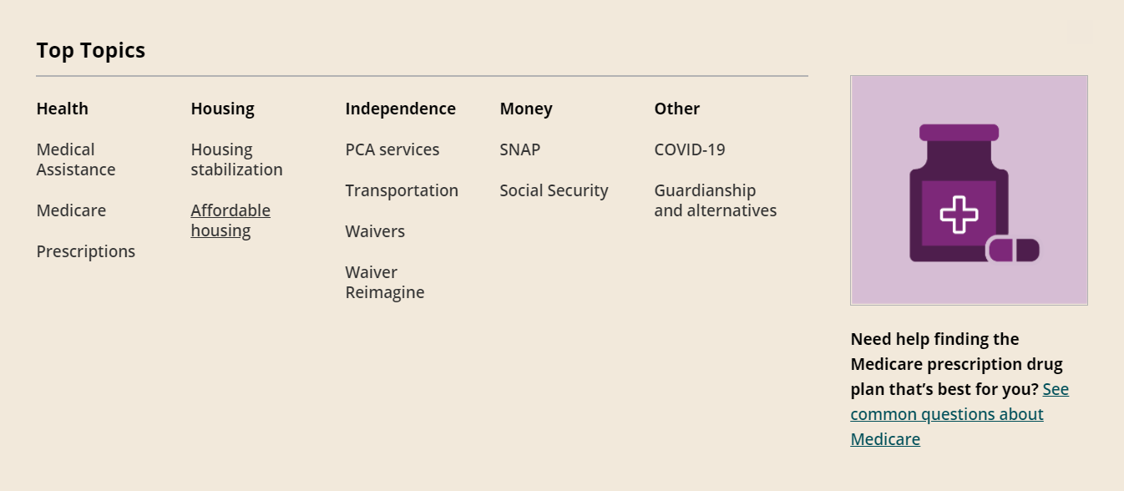
Top Topics
Disability Hub MN - Top Topics

Slide 12
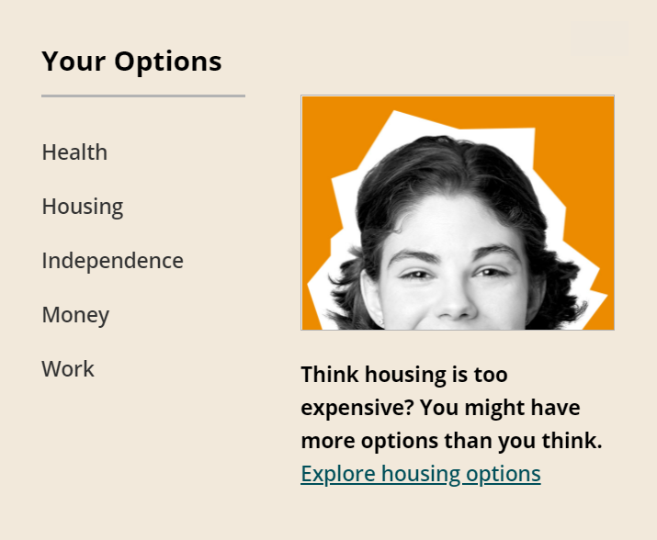
Your Options
Disability Hub MN - Your Options

Slide 13
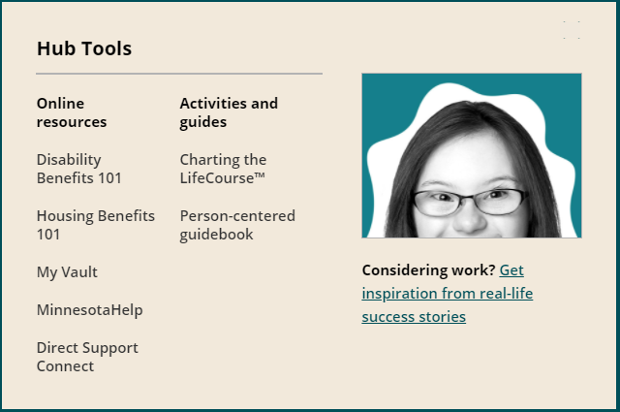
Hub Tools
Disability Hub MN - Hub Tools

Slide 14
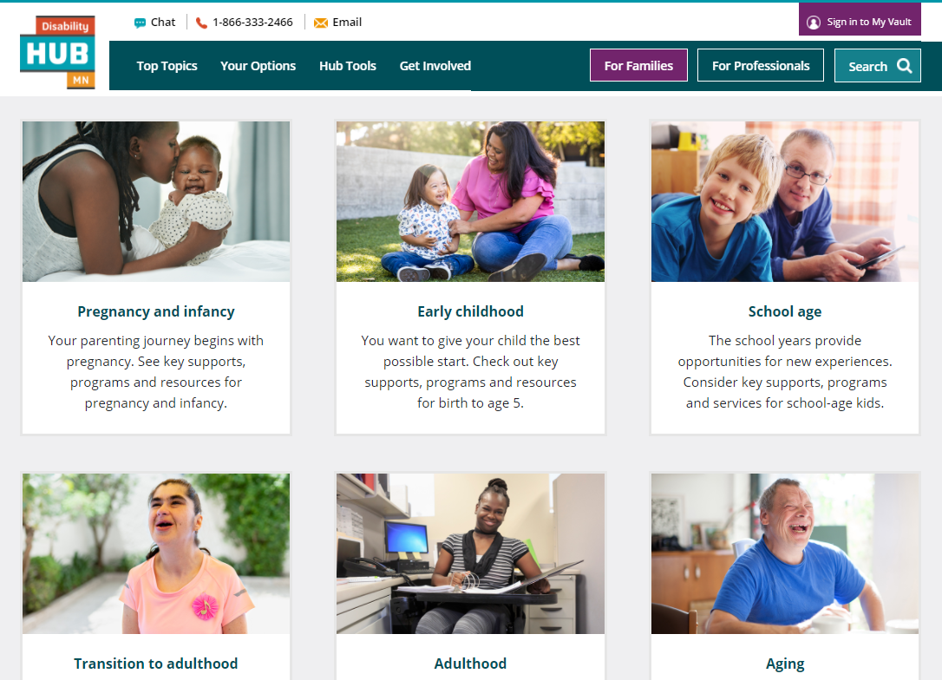
For Families
Disability Hub MN - For Families

Slide 15
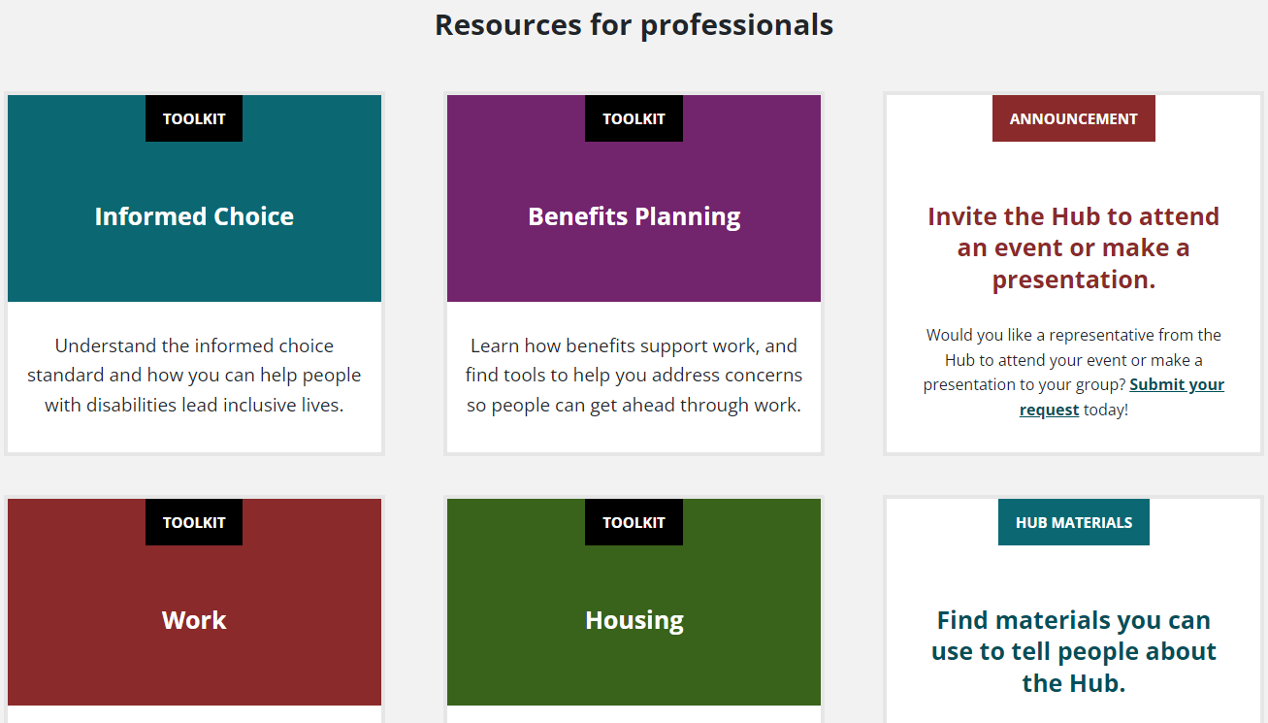
For Professionals
Disability Hub MN - For Professionals

Slide 16
Questions?

Slide 17
Anita & the Disability Hub MN

Slide 18
Anita Calls The Hub
Will graduate this spring!
Her and her family are concerned about how working will impact her benefits.
They reach out to the Hub to get started

Slide 19
Initial Call Discovery
Have you ever worked before?
Do you need support in finding work? Maintaining work?
What income and resources are currently available? Health Care coverage?
Are you getting any support now in your daily life? What type of supports do you need and want?

Slide 20
Initial Call Education
Social Security benefit differences.
Work incentives that allow a person to get ahead financially while working on benefits.
DB101:
My Vault
Articles

Slide 21
DB101 Articles for Anita & Family
Within the Youth Section:
Start Planning Now
Finding A Job
Parent Focus: Work is Possible
Within the Work & Benefits Section:
Going to Work Toolbox
Getting Past the Myths: The Truth About Working

Slide 22
Anita’s Vault
Save useful articles for her current situation
Complete activities in The Vault relative to current situations
Budget Tool
Build an Employment Team
Use the Contacts Section to add members of her support team who are assisting her with work and benefits
Share articles and other information with support team members

Slide 23
Anita Goes To Work

Slide 24
Anita Has Job Offer
Anita calls the Hub back when she has received an offer on a job
It is for part time work at a museum
Anita wants to know what impacts this employment is going to have on her benefits
They call back to the Hub for customized benefits planning information

Slide 25
Call Discovery
How much does the job pay and what are its hours?
Do you need any on the job supports or accommodations?
What income and resources are currently available? Health Care coverage?
Would you like assistance understanding reporting wages to the county and Social Security?

Slide 26
How Disability Hub MN Can Help Anita
Eligibility questions
Explain work rules for each benefit
Help to complete DB101 activities like the Estimator and Try Its
Provide individual benefit report for any complex situations
Help understand reporting to SSA and their county human services agency

Slide 27
Helpful DB101 Tools for Anita
Read articles about SSI and MA for details about work
Watch videos about benefits and work
Review the Going to Work Toolbox in the Work and Benefits Section
Register a My Vault account and complete activities including a Benefit Lookup, Estimator, Budget and more
Use the chat feature to reach out to Disability Hub MN with questions

Slide 28
Follow us on Facebook!

Slide 29
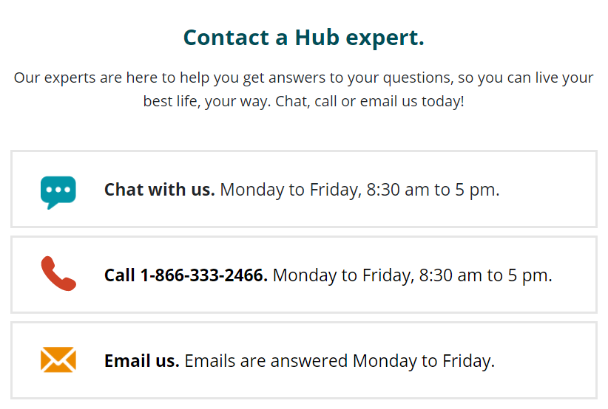
How to reach us?

Slide 30
Thank you!
Your best life, your way.
Disability Hub MN is a free statewide resource network that helps you solve problems, navigate the system, or plan for your future. Our team knows the ins and outs of community resources and government programs, and has years of experience helping people fit them all together

