Slide 1
Unlocking Math Mystery: From Befuddled to Confident!
Chelsea Paulson, MA
Minnesota State Academy for the Deaf, DHH Outreach Specialist

Slide 2
Agenda
The participants will come with resources from different entities of how to sign specific mathematical concepts in ASL and learn about student-centered resources for students using Math. This resource will be included within this workshop to bring to your workplace.
How to make math equitable for Deaf/Hard of Hearing learners?
Exploring National Council of Teachers of Mathematics
YouCubed - by Jo Boaler
Problem Solving activity

Slide 3
NCTM - National Council of Teachers of Mathematics, 2014
This came from Common Core Standards for Mathematics - 8 teaching practices:
Make sense of problems and persevere in solving them.
Reason abstractly and quantitatively.
Construct viable arguments and critique the reasoning of others.
Model with mathematics.
Use appropriate tools strategically.
Attend to precision.
Look for an make use of structure.
Look for and express regularity in repeated reasoning.

Slide 4
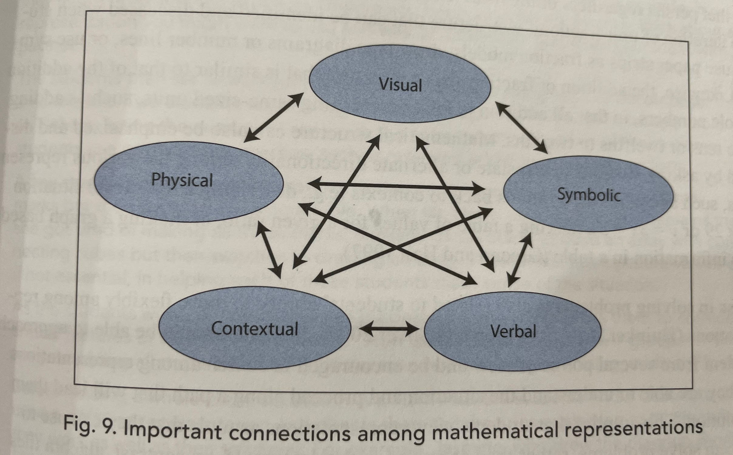
Connections with Mathematical Representations
Coming from procedural knowledge becoming conceptual knowledge.
Procedural knowledge is the math facts fluency, memorizing the formula, and regurgitation for tests.
Conceptual knowledge is the deep understanding of the content.
page 25 NCTM

Slide 5
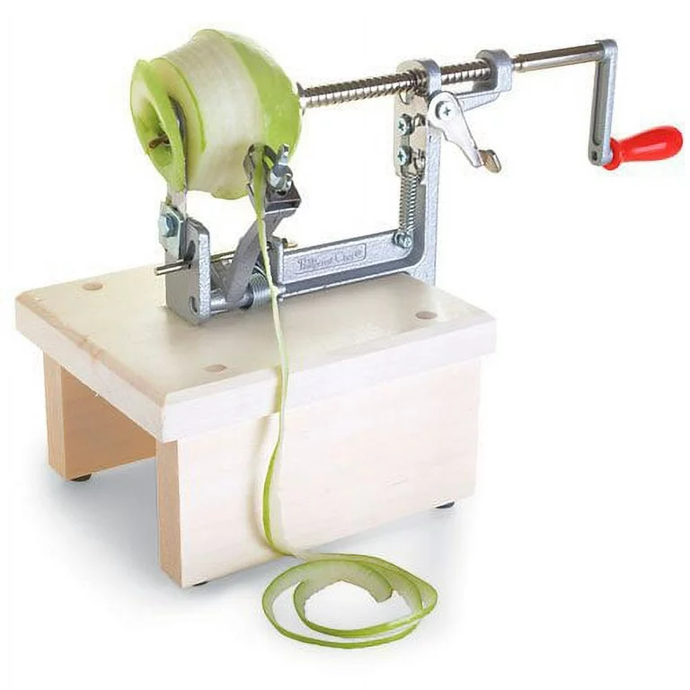
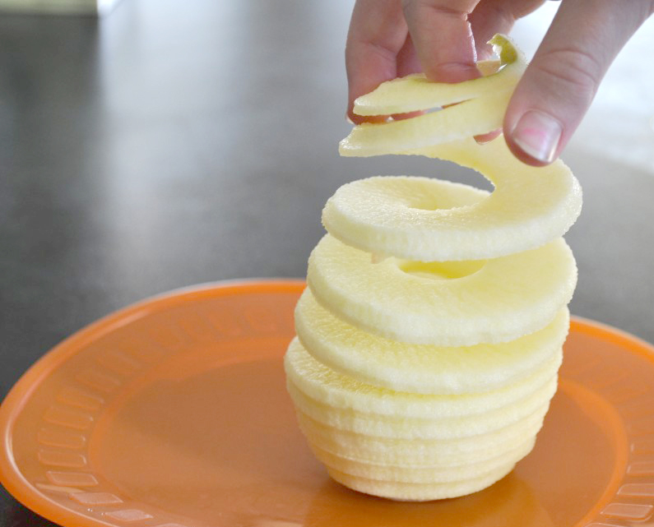
Timing for Math
Curriculum Pacing Guide
Curriculum is Spiraled…
Teachers who use pacing guide tend to feel rushed and as a result, they often omit rich and challenging problem-solving tasks that are essential for developing deeper mathematical understanding (David and Greene, 2007). [NTCM, 71]

Slide 6
Visuals - Frayer Model
Can be used for 1:1 to deepen the conceptual understanding.
Rule of Thumb:
To break away from “thinking in English”
use examples, and nonexamples
classifiers for characteristics
fingerspelling of term - and provide sign.

Slide 7
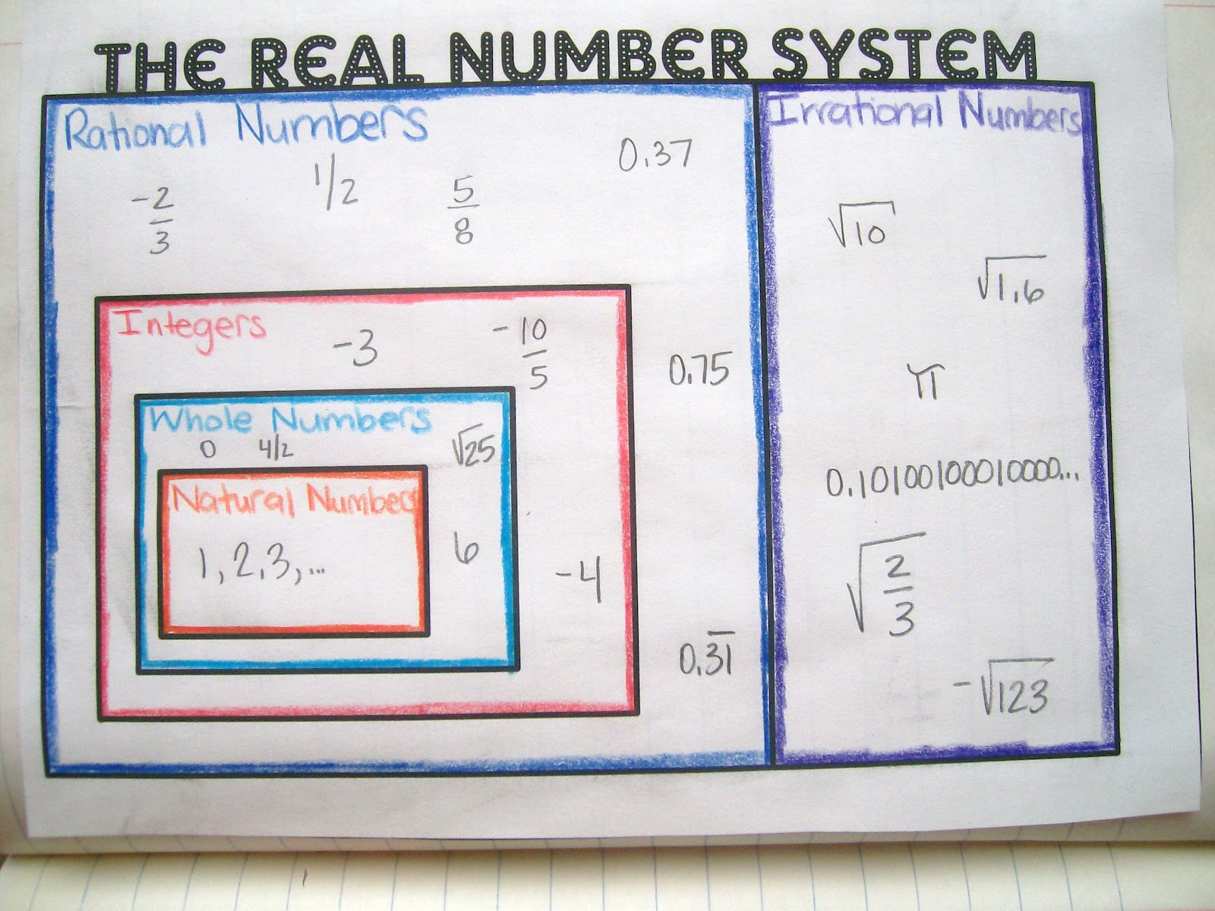
Visuals - The Real Number System - ASL from Paul Glaser
natural numbers - real number systems - whole concept - ALL NUMBERS - (not "real real") whole numbers (0:22) (YouTube)
integers - plus or negative
rational - CL:1 like a bar graph - 4/1
(with the image - WL - whole#)
irrational - IR numbers.
Imaginary - "i"

Slide 8
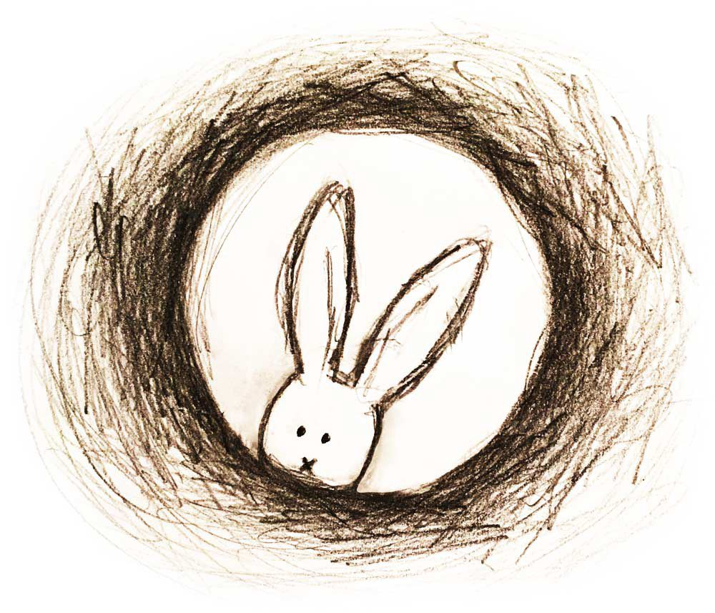
Math Rabbit Hole -
What is normed for able-bodied people, can be normed for Deaf population given right tools.
Math is no different. More resource are online for increased consistency in math terms in ASL.
Conceptual knowledge comes first, then procedural knowledge cements the knowledge.

Slide 9
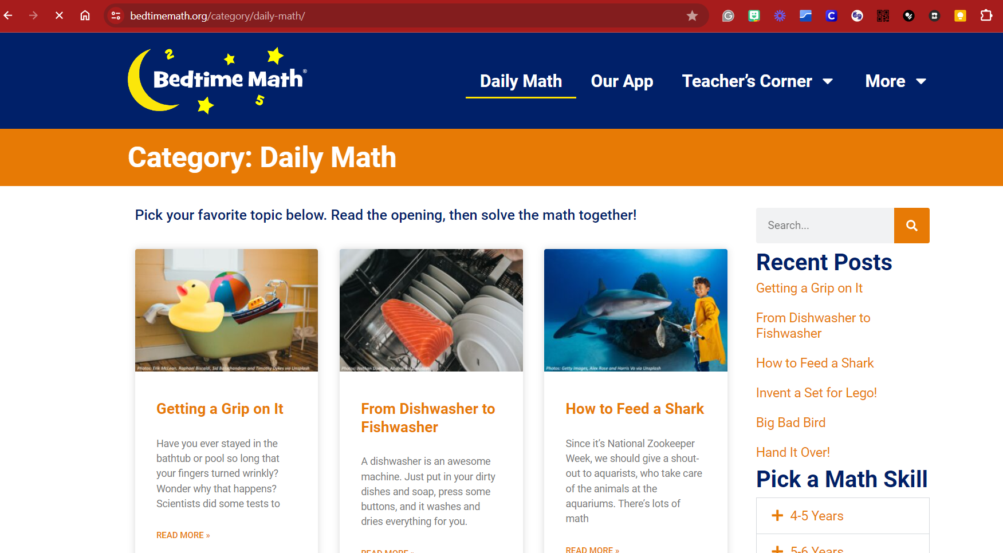
Resource: Bedtime App

Slide 10
Problem Solving Ideas

Slide 11
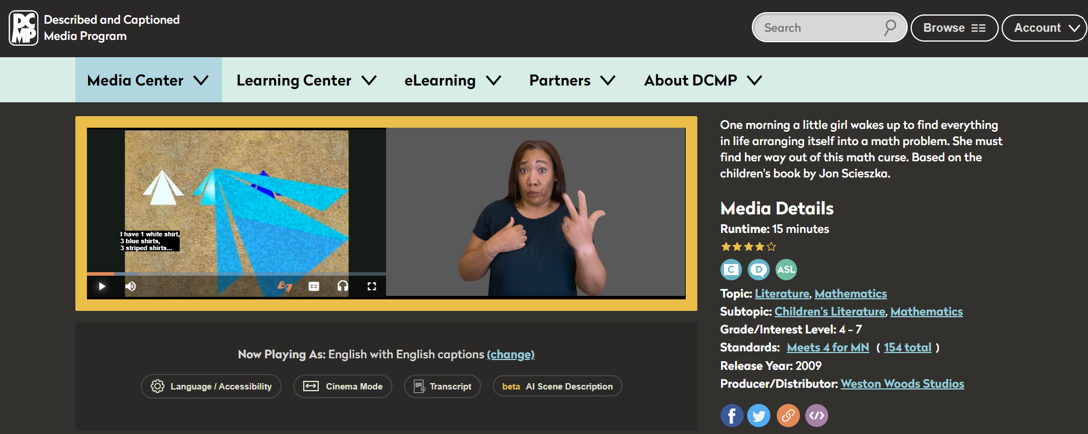
Resource: Described and Captioned Media Program

Slide 12
Bibliography – enjoy going down the rabbit holes!
Exploring National Council of Teachers of Mathematics - https://www.nctm.org/PtA/
YouCubed - by Jo Boaler - https://www.youcubed.org/
Problem Solving - Growth Mindset - Angela Duckworth, “Without deliberate practice, you can only maintain your current abilities.”
Math ASL Dictionaries:
https://signsci.terc.edu/index.html
https://aslclear.org/categories/math/topics/basic_math/lectures/fractions (use on Firefox)

Slide 13
Bibliography – enjoy going down the rabbit holes! More…
Math ASL Dictionaries: Math Concepts in ASL - YouTube
- Atlanta Area School for the Deaf ASL Math Playlist
Frayer Model: 6-12_L.VAU_Frayer_Model.pdf (wi.gov)
Subtopic: Mathematics - from Described and Captioned Media Program
XtraMath - Xtra Math online - ASLized!
Daily Math - Bedtime Math

Slide 14
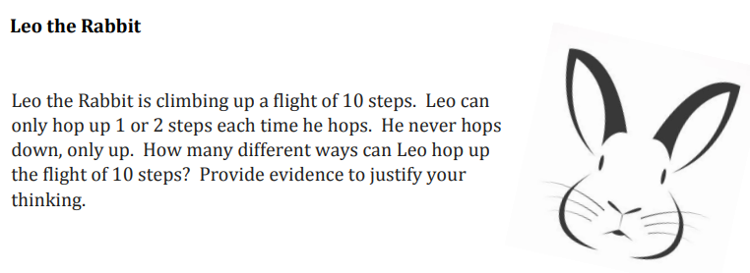
Activity
Pair up - think of your DHH student, describe the student to your partner: How can you make your thinking accessible for your DHH student?

Slide 15
Thank you!

