Slide 1
Making Your Mark!
Embracing Disability, Challenging Ableism, and Cultivating Impact
Provided by Brittanie Hernandez-Wilson, The Arc Minnesota

Slide 2
Centering Access
This is an invitation to show up as you are and to use the space you are in as you need or prefer.
Feel free to sit in chairs or on the floor, pace, lay down, rock, flap, spin..
(Modified from The Peoples Hub)

Slide 3
Agenda
Introduction
The Power of Belief
Understanding Ableism
Disability Justice
Making Your Mark
Closing
Q&A

Slide 4
Introduction

Slide 5
About The Arc Minnesota
Mission
The Arc Minnesota promotes and protects the human rights of people with intellectual and developmental disabilities (IDD), actively supporting them and their families in a lifetime of full inclusion and participation in their communities.

Slide 6
About Me
Journey
Born with a disability, low expectations by medical team
Mom and Grandma were foundational in encouraging me to dream
Family being forced to poverty so that I could get benefits and services

Slide 7
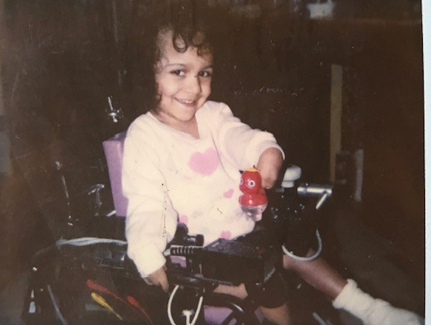
About Me, continued
Learnings
Understanding ableism at a young age even without knowing the language
Not seeing people around me who looked like me
We all have needs that need to be met. No one’s needs are more ‘special’ than the other, but often that’s not how it goes

Slide 8
About Me, continued 2
Successes
Teachers and social workers changed my life
Being the representation I needed
Being successfully employed for over a decade
The future is disabled!

Slide 9
Ableism

Slide 10
Defining Ableism
“Ableism is a system that places value on people’s bodies and minds based on societally constructed ideas” that “leads to people and society determining who is valuable and worthy”
Talila “TL” Lewis
“At its heart, ableism is rooted in the assumption that disabled people require ‘fixing’ and defines people by their disability”
Access Living

Slide 11
Ableism Shows up in Many Ways..
Structural > Physical and design barriers
Cultural > Lack of media representation, invisibility in culture and community, forced segregation
Medical > Medical Industrial Complex, institutionalization, forced sterilization, cure-focused treatment
Financial > Sub-minimum wage, high unemployment rates, forced poverty, Marriage inequality, carceral system, denial of due process
*This is not an exhaustive list

Slide 12
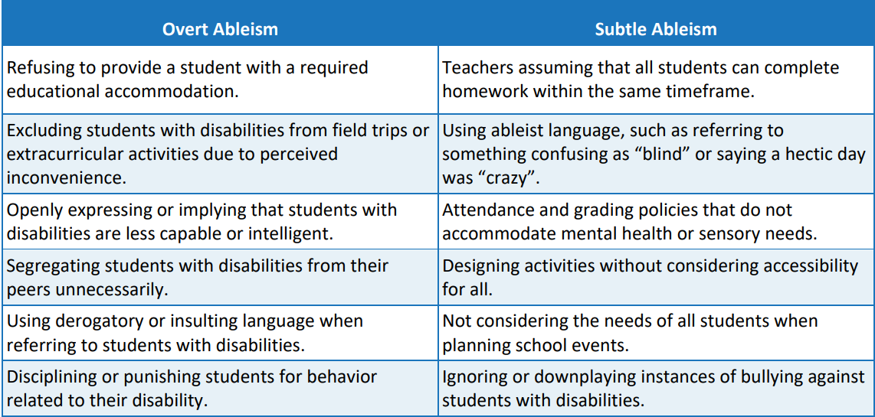
Ableism in Education
Oregon Department of Education

Slide 13
Models of Disability

Slide 14
Deficit-Based Language
Emphasizes what people with disabilities cannot do, rather than focusing on their abilities, strengths, or inherent value as individuals.
This type of language reinforces stereotypes and marginalizes people with disabilities by focusing on their "perceived" differences from what's considered "normal."

Slide 15
Ableism in Language
Casual Ableism: Ableist terms or phrases that are used in everyday conversation. The casual usage can "normalize" ableist ideas in our culture.
Examples:
Crazy
Psycho
Bipolar
Insane

Slide 16
Deficit-Based Language, continued
Emphasizes what people with disabilities cannot do, rather than focusing on their abilities, strengths, or inherent value as individuals.
This type of language reinforces stereotypes and marginalizes people with disabilities by focusing on their "perceived" differences from what's considered "normal."

Slide 17
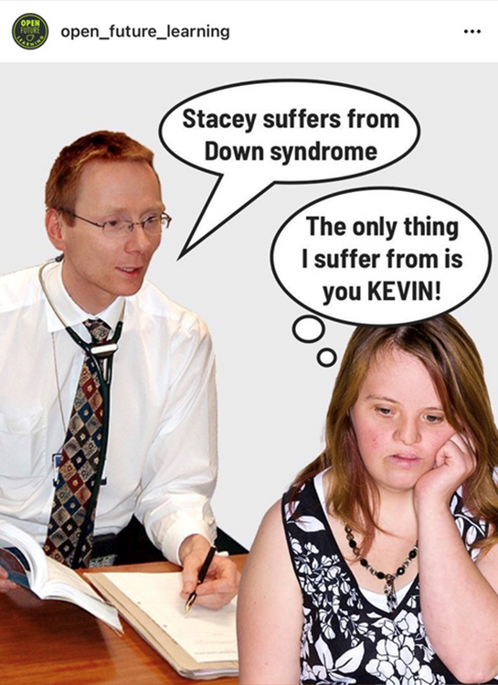
Deficit-Based Language, continued 2
Examples:
“Afflicted by” / “Suffers from”
High-functioning/low-functioning
Handicapped
Wheelchair-bound
Non-verbal

Slide 18
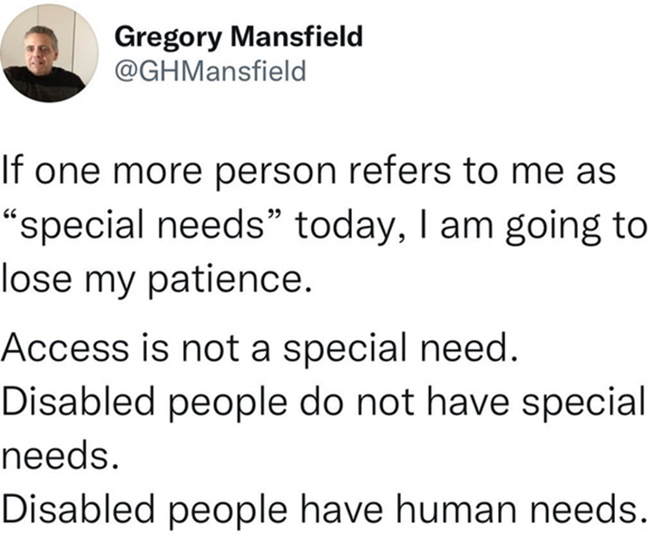
Euphemisms and "Special" Terminology
Examples:
Special needs
Differing abilities
Differently-abled
disABILITY

Slide 19
Language of Empowerment

Slide 20
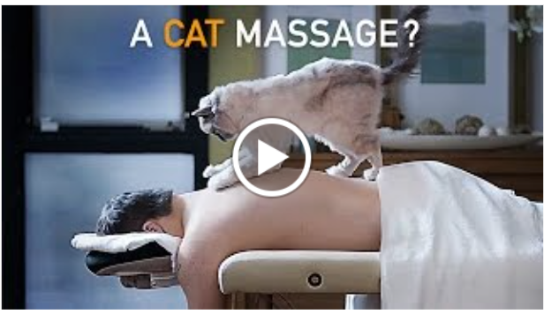
Not "Special Needs" Video
Assume That I Can | (2:00) (youtube.com)

Slide 21
Person-First Language
Person-first language puts the person before the disability as a way to reclaim personhood.
By placing the person first:
disability is not what defines the person
language reduces generalizations and stereotypes by focusing on the individual
language encourages mutual respect

Slide 22
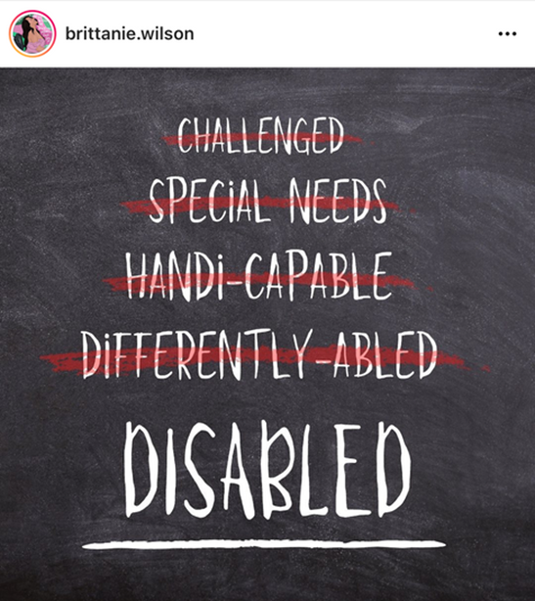
Identity-First Language
Identity-First Language puts the disability before the person.
By placing disabled identity first:
emphasizes that disability plays a role in who the person is
reinforces disability as a positive identity
allows the person to control how they are identified, by their own choice, rather than being told they are disabled by someone else who is usually not

Slide 23
Disability Justice

Slide 24
From The Disability Rights Movement to Disability Justice
The US Disability Rights Movement established a civil rights for people with disabilities
The ADA is the floor not the ceiling
Focus on the symptoms but not the root cause

Slide 25
Cliffhangers of The Disability Rights Movement
Disability rights is based in a single-issue identity. It focuses solely on disability at the expense of other intersections
Leadership of this movement has historically centered the experience of white folks.
Centers people with mobility disabilities, invisibilizing and marginalizing other types of lived experience and disability.

Slide 26
Disability Justice, continued
Recognizes that changing laws and policies does not address the way society is setup to treat disabled people as “bad”, “unproductive”, “disposable”
Acknowledges that each person experiences disability differently and how those differences shape our everyday relationships, health outcomes, and quality of life
Independence vs Interdependence
10 Principles

Slide 27
Disability Justice Understands
All bodies are unique and essential
All bodies have strengths and needs that must be met
We are all powerful, not despite the complexities of our body/minds, but because of them
All bodies are confined by ability, race, gender, sexuality, class, religion, etc - and we cannot separate them

Slide 28
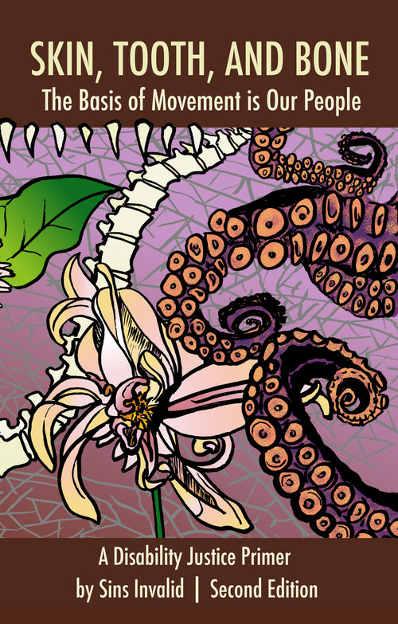
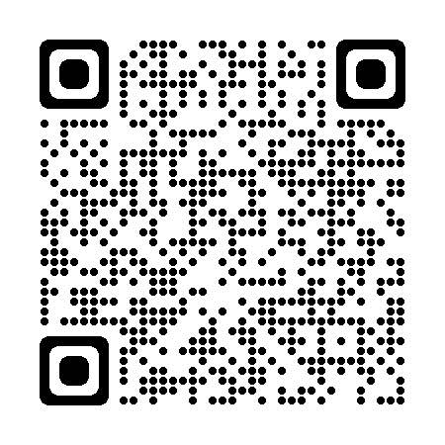
Disability Justice Primer
Skin, Tooth, and Bone: The Basis of Movement is Our People
A Disability Justice Primer by Sins Invalid

Slide 29
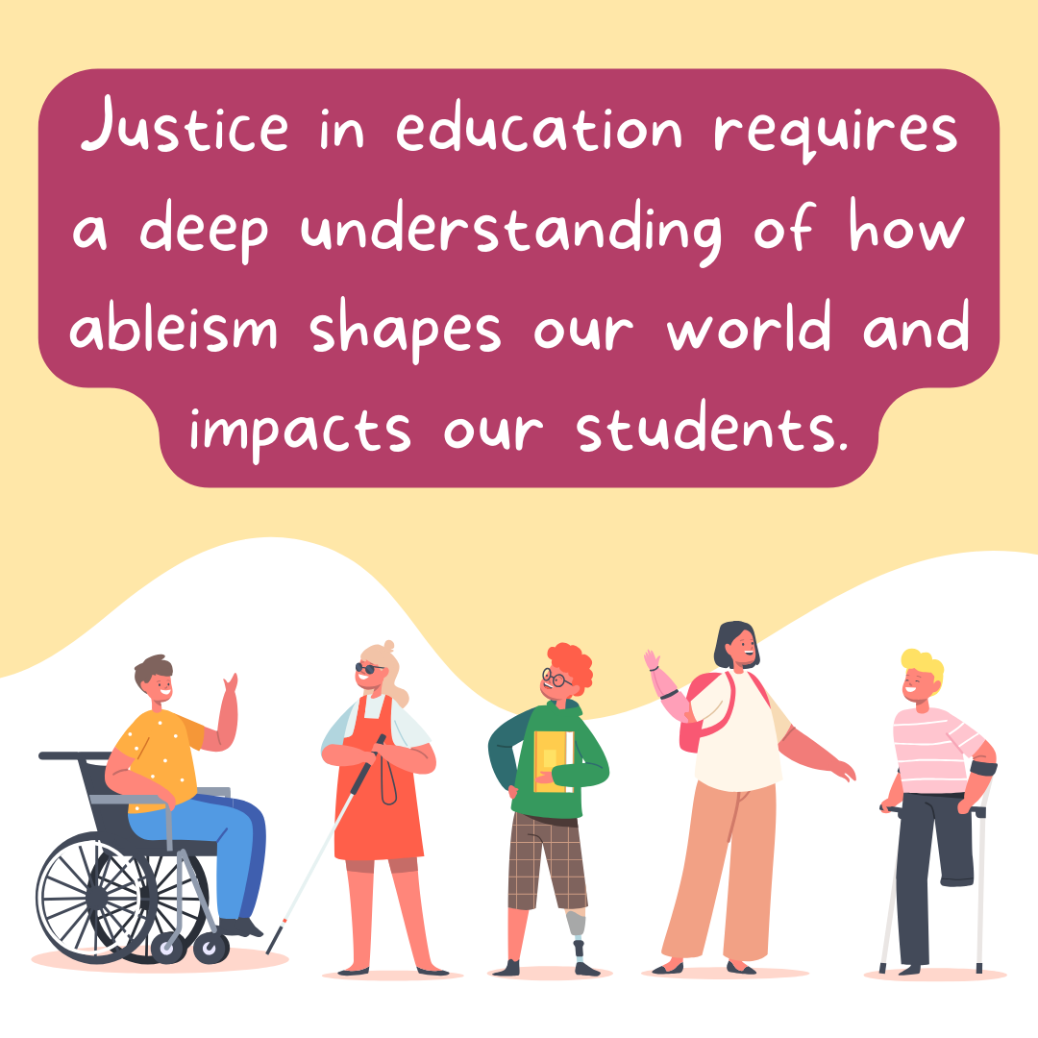
Justice in education

Slide 30
Making Your Mark!

Slide 31
Making Your Mark
Unpack and unlearn ableism
Recognize the power you have in shaping the lives of your students
Break down barriers
Challenge stereotypes
Advocate for inclusivity and justice in education and beyond
Advocate for representation in schools
Be patient with yourself, this is a lifelong journey!

Slide 32
Access is love!

Slide 33
Thank You!
Please feel free to reach out to me.
Email: BrittanieHernandezWilson@ArcMinnesota.Org

Slide 34
Q&A

