Slide 1
Active Engagement for Students Using Eye Gaze (or other SGD).
Julie Luedke ATP, P/HD, TBI, ASD, DCD, EBD, SLD
Mackenzie Keimig DCD, ASD, SLD

Slide 2
Background and Experience
Julie Luedke
Mackenzie Keimig
25 years in education
5 classroom multi-categorical
10 lead teacher in elementary schools
10 AT / Physically Impaired
DCD - MM/SP & Gen Ed K-6: UWEC
SLD / EBD : MA @ Bethel
ASD : Portfolio
P/HD : NDSU
ATP : RESNA certified
17 years in education
7 years transition program in IA
10 HS Multi: ASD/DCD-SP
DCD/SLD : UWEC
ASD : MA @ St. Thomas

Slide 3
What are barriers students might face “using” eye gaze?
How is using eye gaze for communication different from using direct select?
What are some nuances to keep in mind when teaching / using eyegaze vs. direct select?

Slide 4
What are barriers teachers need to keep in mind when teaching students who use eye gaze vs. direct select?
How do you currently engage / differentiate instruction to involve all students in activities?
What current barriers do you face?

Slide 5
Continued:
How do you currently create opportunities for peer engagement?
What current barriers do you face?

Slide 6
Parking lot:
Questions/concerns that you would like to discuss or address by the end of the presentation?

Slide 7
What are some easy ways to engage my students in my activities?
Program peers in for them to call on
Create a quick-fire button for “start” and have them call the start of a timer
Pre-plan a question and answer
Building opportunities around known routines
Following or providing opportunity to voice schedules

Slide 8
Specific to Math:
Consistently use the calculator to show numbers - works on motor planning.
Have the student roll the dice and tell the numbers to use in creating math problems.
Pair with a peer and have student spin the dice and partner say colors/numbers out loud.
Show where colors/shapes/skill words can be found - stay on the page and determine ways for student to respond with the words on the page.

Slide 9
Specific to Math, continued.
2 ____ 6 4 ____ 8 6 ____ 10 ____ 4 , 6 4 , 6, ____
$4.68 | $___.00
$5.27 | $___.00
$2.89 | $___.00
$8.56 | $___.00
$6.34 | $___.00

Slide 10
What are some easy ways to engage my students in my activities? Continued.
5, 10, 15, 20, ___
30, 35, 40, 45, ___
25, 30, 35, 40, ___
25 | 15 | 30
15 | 55 | 45
50 | 25 | 35

Slide 11
What are some easy ways to engage/ differentiate instruction to include students in activities?
Program peers in for them to call on
Create a quick-fire button for “start” and have them call the start of a timer
Pre-plan a question and answer

Slide 12
What are some easy ways to engage/ differentiate instruction to include students in activities? Continued.

Slide 13
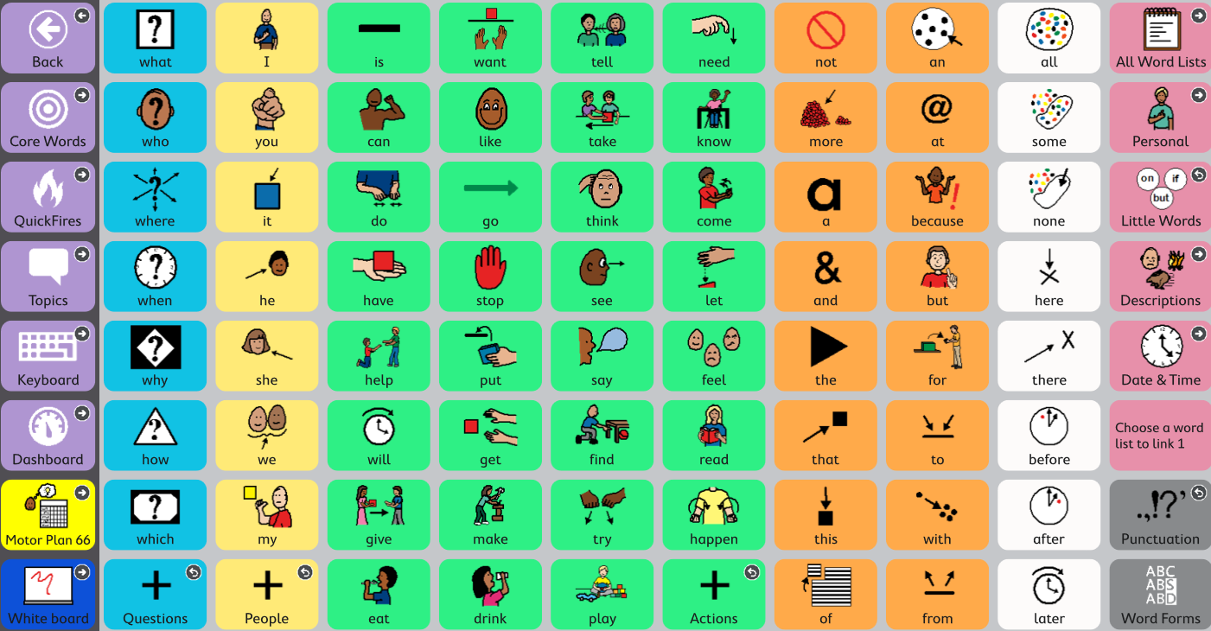
Core word lesson plan:
Example Lesson Plan

Slide 14
News2You:
Pick a word that student can “say” as the article is being read from the communication board.
Read the article.
Choose worksheets that are relevant and modify.

Slide 15
Written Language:
An area that we all continue to explore:
Student perspective:
Motor planning
Keyboard & word prediction
Getting from app to document to turn in

Slide 16
Template for paragraph

Slide 17
Parking lot, continued:
Questions/concerns that you would like to discuss or address by the end of the presentation?
Jump back to SLIDE *8*
Other questions or comments

Slide 18
Thank you!
651-621-6183
Julie.Luedke@mvpschools.org
651-621-7214
Mackenzie.Keimig@mvpschools.org

