Slide 1
Disability Hub MN™: A Resource Network
Provided by Marcy LaCroix
Community Capacity Builder
Disability Hub MNTM

Slide 2
What are Person-Centered Practices?
Continuum of strategies and activities that support the informed choice of students and families to make or have input into both
Major transitions, and
Everyday life decisions.
Focus on the interests and needs of the person receiving instruction or support.
Emphasize each person’s strengths and dreams rather than weaknesses or deficits.

Slide 3
Why use Person-Centered Practices?
Ensure that all students and their families have teams that use the most current information about their strengths, interests and needs
Make informed choices about learning, working, living and playing in the most integrated settings possible
Students can be even more active members of their
Home,
School, and
Local community

Slide 4
The Learning Community for Person Centered Practices
The Learning Community for Person Centered Practices envisions a world where all people have positive control over the lives they have chosen for themselves. Our efforts focus on people who have lost or may lose positive control because of society's response to the presence of a disability. We foster a global learning community that shares knowledge for that purpose.

Slide 5
How do we get to know students …
Evaluation Report (ER), sometimes called Evaluation Summary Report (ESR)
Functional Behavioral Assessment (FBA)
Individualized Family Service Plan (IFSP)

Slide 6
More of how do we get to know students…
Individualized Education Program (IEP)
Present levels of academic achievement and functional performance (PLAAFP)
Progress report (PR)
Limited English proficiency (LEP) impact on learning and progress
Assistive Technology (AT) devices and services considerations
Personal Learning Plan (PLP) process (grades 9–12)
Individual Service Plan (ISP)
Summary of Performance (SOP)

Slide 7
If technical information is our first introduction, it may look like the following …
‘Communication skills are significantly different from typically developing peers…’
‘Referred to public school by pediatrician…’
‘Presenting concern with delay of speech…’
‘Responds to the word ’stop’ and ’no’ and follows routine cues…’
‘Makes wants and needs known by pulling adult to items or pointing…’
‘Fine motor skills during functional activities observed to be discrepant from same-age peers…’
‘High level of distractibility…’

Slide 8
If technical information is our first introduction, it may look like the following … continued
‘Able to use a neat pincer grasp…’
‘Impairments in joint attention, reciprocal, social/emotional skills and limited peer interactions appropriate to age…’
‘Does not spontaneously respond to greeting/goodbye initiated by others…’
‘Safety concerns in the community…’
‘Delayed expressive/receptive communication and sensory processing skills…’
‘Hand-to-hand transfer…’

Slide 9
What do we know about Chandran?
How do we feel about this as an introduction to him?
Are we excited to meet him?
Are we excited to support him?
Is there another way?

Slide 10
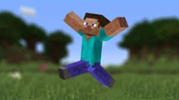
Chandran’s One-Page Description

Slide 11
Now—What do we know about Chandran?
How do we feel about this as an introduction to him?
Are we excited to meet him?
Are we excited to support him?

Slide 12
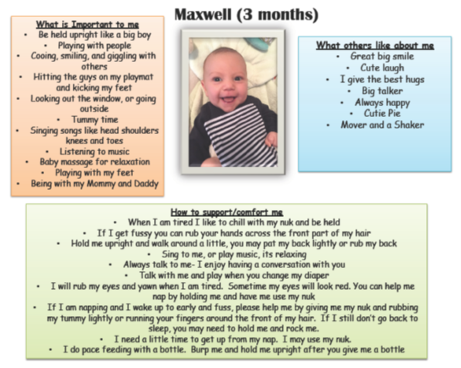
Objectives
To understand the purpose of a One-Page Description (OPD)
To understand the core headings always included in an OPD
To identify where you can use creativity and judgment in creating an OPD
To develop an OPD for yourself or a student
Hopefully, you have a student in mind
Important to practice with yourself
It’s not necessarily that easy to do for ourselves

Slide 13
Purpose of One-Page Description
Descriptions are used for a specific purpose to introduce someone (e.g., new job, at the front of personal records, orientation for new staff, etc.)
Know the purpose before you create one
They are an at-a-glance, positive source of information about the person

Slide 14
Purpose of One-Page Description (continued)
They can also be used:
As a way to introduce someone across different settings like school, home and community.
When moving to a new school.
When meeting new people, like a new Intervener.
At the front page of a student’s records to share when paperwork is transferred.
As the beginning of a more detailed Person Centered Description.
As the basis for action—going from an OPD to then asking what is working and not working from different perspectives and acting on this.
Or … They can be used throughout the lifespan and always support positive control for people

Slide 15
Maxwell 3 Months

Slide 16
Liam’s One Page Introduction
©TLCPCP 2016 www.tlcpcp.com

Slide 17
Elizabeth Kate’s One-Page Description
©TLCPCP 2016 www.tlcpcp.com

Slide 18
Conejo Team One-Page Description
©TLCPCP 2016 www.tlcpcp.com

Slide 19
One-Page Descriptions Must Include
What must be included:
What people like and admire
What is most important to
How to best support the person

Slide 20
What people like and admire
A proud list of people’s positive qualities, strengths, gifts and talents
What are the cool things about you or your student?
Be clear and avoid words like usually or sometimes
Do not use jargon words—socializes with peers well
What would you say about other people around this age?
Find out from the person the things they are proud of and ask their team members.
This is a positive list. What makes the person unique?

Slide 21
What is most important to me
This section should have enough information that someone that does not know you well would know what is important to you. If you took the names out, would people know it was you?
Include things about your life
Include enough detail, so people know who you are and what you value most

Slide 22
How to best support me
Include what is helpful and what is not
Be specific – What does support or help mean?
Think about environment
Learning vs. social environments
Classroom vs. non-classroom settings
Think about routine and comfort
How do we help the person be their best

Slide 23
One-Page Descriptions May Also Include
Hopes and dreams for the future
How I communicate with you
Characteristics of people who best support me
My story/history
Things I don’t like
What is important to my family
For some students, this may be a required element
Other

Slide 24
Who may have the best information for the description?
If you are looking for people who may be able to contribute, ask them:
What do you like about the person?
What do you admire about the person?
When was the last time that you had fun with the person?
Recommendation: If they can answer these three questions, and add even more details, then prioritize them for the person to consider reviewing their info to add/update their One-Page Description over time.

Slide 25
Thank you!
Your best life, your way.
Disability Hub MN is a free statewide resource network that helps you solve problems, navigate the system, or plan for your future. Our team knows the ins and outs of community resources and government programs, and has years of experience helping people fit them all together

