Slide 1
Sensory Supports For Autistic Students
Presented by Ellie Hamilton, Autism Specialist and Barb Niessink, Occupational Therapist
Notes:
Presentation Image Credits Google Images 2023

Slide 2
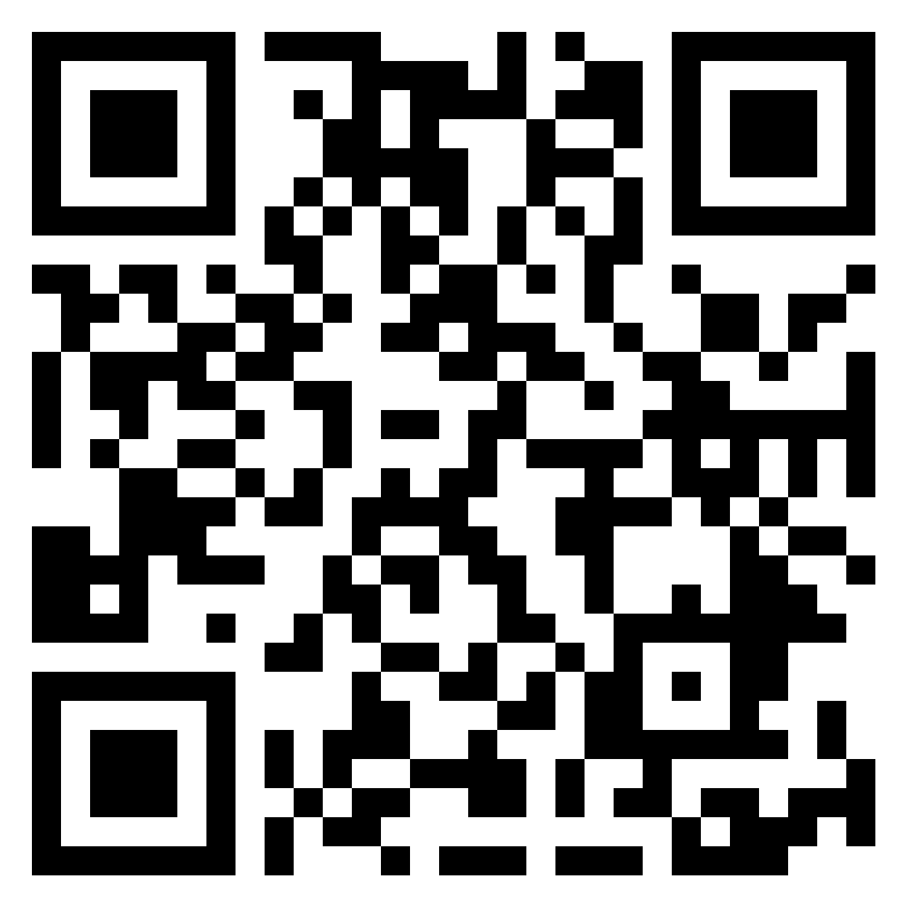
Tell us about you on Padlet.
tinyurl.com/y6f7m4e8
Share
Name
District
Why are you interested in Sensory?

Slide 3
Learning Outcomes
Participants will recognize the sensory needs of Autistic Students in PK-12 educational settings.
Participants will identify a collaborative team in their educational setting to support the sensory needs of Autistic students.
Participants will determine and reflect on the sensory supports available in their PK-12 education setting for supporting Autistic students.

Slide 4
Why sensory support for Autistic learners?
About 56% to 70% of learners with Autism are estimated to have sensory processing challenges (Baranek, David, Poe, Stone, & Watson, 2006; Ben-Sasson et al., 2007.
Notes:
UNC Frank Porter Graham Child Development Institute Autism Focused Intervention Resources & Modules Nowell, S., Sam, A., Waters, V., Dees, R., & AFIRM Team, 2021

Slide 5
Let us know about you on Padlet.
Padlet

Slide 6
New Smells and Overstimulated examples by Young Sheldon
Link to video 1:20 https://www.youtube.com/watch?v=o_Qwng_M07Q&t=80s
Link to video 1:55 https://www.youtube.com/watch?v=FMXRRKsg7jA&t=115s
Note: Please keep in mind each individual’s sensory experiences are unique and the media does not always portray how Autistic people think and feel accurately.
Notes:
Video 1 1:20 Start Video 2 1:55 Start

Slide 7
The Pyramid of Learning
Perkins.org
Notes:
Image credit Google images 2023 https://otplan.com/pyramid-of-learning/

Slide 8
Do not begin a sensory routine without consulting the support of an Occupational Therapist.
Follow district procedures for parent permission and implementation guidelines

Slide 9
Sensory Planning
Positive Partnerships:
Planning Tool
Diversity Wheel
Hands on as we grow Blog:
Sensory Planning
Sensory Activities. Sample week of activities
Water
Cardboard Tube Activities

Slide 10
Sensory Planning
Sensory World
Sensory Planning form

Slide 11
Sensory Sensitivity
Link (from South West Central Service Cooperative).
Page two has suggestions to try

Slide 12
Sensory Suggestions for the Classroom
Link (from South West Central Service Cooperative)

Slide 13
Lessonpix Sensory Visuals
Sandtable Topic Board
Bubbles Topic board
Blocks Topic Board
Offer choices and use a visual picture or choice board.
Choice Board Intervention Strategy by Ocali/ Ohio Center for Autism and Low Incidence

Slide 14
The Many Faces of Autism by Ocali Chapter 3 Sensory
Link to video 8 min autismcertificationcenter.org/course/1/chapter/146
Keep in mind that sensory experiences may impact other disability areas
Notes:
8 min video
Image credit Google images 2023 https://autismcertificationcenter.org/course/1/chapter/146

Slide 15
Connect and Redirect
Link to video 14:34
https://www.youtube.com/watch?v=fGseTSLY3cI
Notes:
14 min video

Slide 16
How can we do better for our kids?
Trigger warning this video discusses restraint and seclusion in the school setting.
Link to video https://www.youtube.com/watch?v=wsQ7XbKbpeY
7:50 and 11:34
Notes:
1 hour+video 7:50 “crunchy Jeans” 11:34 “5 senses”

Slide 17
Neurodiversity Affirming Sensory Integration
Link to video 1 - 23:41 https://www.youtube.com/watch?v=MV7klFMUHJU&t=1421s
Link to video 2 - 27:50 https://www.youtube.com/watch?v=MV7klFMUHJU&t=1670s
Notes:
Video one 23:41 video two 27:50

Slide 18
Brain Article
gregsantucci.com/infographic/upstairs-brain
Notes:
https://gregsantucci.com/

Slide 19
Upstairs Brain
We need to be able to monitor the sensory input coming from our environment, think and problem-solve. When our kids are having a hard time, they’re in their “downstairs” brain. They can’t access their “thinking” brain, and no amount of yelling, threatening, or punishment is going to get them there.
How do you help a child when they are in their downstairs brain?
First, lower expectations. Help them get regulated. This could be as simple as a hug or just being present. Once regulated only then can head upstairs.
Notes:
https://gregsantucci.com/

Slide 20
Brain Breaks and Sensory Breaks
Improvement was noted in these areas:
Social Participation/Social Skills
Visual and Auditory Processing
Planning and Ideas
Adaptability
Functional Communication Atypicality
Leadership
Attention Problems
Hyperactivity
Gwen Wild, MOT, OTR/L & Sherry Steeley, PhD developed a “Model for Classroom Based Intervention for Children with Sensory Processing Differences” and completed a research study in a rural school district in TX. They incorporated “Brain Breaks” and “Sensory Breaks” into the children’s daily routines.
Notes:
https://gregsantucci.com/

Slide 21
Brain Breaks
Brief (30-60 seconds) opportunity for whole body movement
Primary purpose is to get in touch with one’s body and where it is in space.
For Pre-K through 1st grade, “Brain Breaks” can easily be built into transitions
Recommended frequency:
Pre-K through 1st grade: every 15 minutes
2nd through 5th grade: every 30 minutes
5th grade to 6th grade: every 45 minutes
Notes:
https://gregsantucci.com/

Slide 22
Ideas for Brain Breaks
Hop on one foot
Row Boat
Finger pulls
“Make the room bigger” - Wall push-ups and wall sits
Yoga poses
Action songs
Belly breathing
Gallop
Isometrics (push hands together, pull apart, push legs against one another)
Desk stretches
Chair Push-ups
Cross Crawls
Coffee Grinder
Pressure push
Drink from water bottle
Animal Walks
Ear massage
Self-hug
Notes:
https://gregsantucci.com/

Slide 23
Tips for Brain Breaks
Allow the student to select and lead the “Brain Break”
Fill a poster board with “Brain Break” picture options and allow them to choose from them
Follow each “Brain Break” with two deep breaths of “belly breathing”
Notes:
https://gregsantucci.com/

Slide 24
Sensory Breaks
Goal of sensory breaks is to regulate the neurochemicals in the brain.
Optimal: at least 10 minutes of moderate to high intensity sensory input every 2 hours for ages 10 and up.
Pre-K to 1st grade = every hour
2nd to 4th grade = every 1 ½ hours
5th grade and up = every 2 hours
Recess, PE, art, music and lunch can usually count as sensory breaks
Need to be at least 10 minutes in length. Sensory seekers may need longer.
Stick with activities that are primarily proprioceptive or “just right” challenge
Notes:
https://gregsantucci.com/

Slide 25
Cari Bert Seminars
cariebertseminars.com

Slide 26
Re-thinking Classroom Expectations
What are the classroom expectations?
How can we adjust for students with sensory needs?

Slide 27
Try a chair or bilibo seat
moluk.com/bilibo.php

Slide 28
Cube Chair Options

Slide 29
Flexible Seating
Offer a Choice Board

Slide 30
Wiggle Seat
teacherdirect.com

Slide 31
What is the behavior really telling us?

Slide 32
Autistic Students may have heightened senses

Slide 33
Autistic Students may have heightened senses
A student may have hearing abilities that make lights, fans, or other items sound like a helicopter.
Close your eyes and see if you hear any sounds.
Check the room for smells. The lunchroom and essential oils are biggies! Perfume can be a trigger too.

Slide 34
Occupational Therapy association 2023
Notes:
Image Shared by Occupational Therapy Association Facebook Group 2023

Slide 35
Sensory Environment

Slide 36
Structured Breaks
headphones or earbuds
blankets
music
drawing paper and markers
puzzles
fidgets
magazines
waterbottle
Autism Internet Modules
A structured break may include, but its not limited to:

Slide 37
Structured Breaks
Autism Internet Modules
A structured break is NOT:
Time out
Seclusion
Punishment
Escape from work

Slide 38
Structured Breaks
Autism Internet Modules
Visual supports for structured breaks may include:
Breathing cards
Timer or countdown
Wait card
Stress Thermometer
Power card

Slide 39
Examples of Structured Break Areas

Slide 40
Examples of Structured Break Areas

Slide 41
Examples of Structured Break Areas

Slide 42
Structured Break Area in a job site location

Slide 43
Structured Break Area in a job site location
Private work space with dim calming lighting and music.

Slide 44
Visual Supports
Ocali Stress Thermometer Visual
Box Breathing
Breathing Cards
Power Cards

Slide 45
Sensory Differences
Most individuals with Autism do not experience sensory stimuli the same way as neurotypicals. Some are overly responsive whereas others are under-responsive to sensory experiences in the environment and within their bodies.
Individuals with sensory processing disorders benefit from services from and occupational therapist who can provide assessment and intervention strategies to help them manage their sensory differences and improve their access to successful home, school, social, and work experiences.
Autism Internet Modules

Slide 46
Cover Lights, turn off, or use lamps.

Slide 47
PVC DIY Bead Bar
Paths to Literacy

Slide 48
Star Autism Support & Ocali Visual Supports
Request Template. “I want” giving choices
Food Icons
Choice Board Sensory Activities
Choice Board Snack

Slide 49
LED Color Changing Glow Balls
enablingdevices.com

Slide 50
DIY/Do It Yourself Swing

Slide 51
Weighted Shopping Cart for Mobility and Sensory

Slide 52
Weighted Cart for Mobility and Sensory

Slide 53
Hallway Obstacle Courses
www.youtube.com/watch?v=P4q8dNwsR3E
Pair with goal content or core content.
Notes:
1:33 stop after full course

Slide 54
Obstacle Course Outline
Helicopter Spins x5 each direction
Alligator crawl across mat
Move across floor on ladder
Find 2 hidden items in the sensory bin
Blow 2 cotton balls across the table one end to the other.
Walk across the balance beam, stepping over small stickers or obstacles.
Place 3 beads onto a string or pipe-cleaner to copy pattern displayed
Listen and identify animal sound
REPEAT

Slide 55
Obstacles Course Ideas for Older Students
Forward and backward rolls (somersault)
Jump rope
Balance Beam
Jumping Jacks
Snow angels on the floor
Shooting baskets
Bean Bag toss
Lift a certain amount of weight for specific repetitions
Specify amount of time on treadmill or stationary bike
Repeat sequence work on memory, following directions, etc.
A learning or functional task such as an age appropriate puzzle, writing activity, or math skill can be incorporated and adjusted to the child’s age and developmental level.

Slide 56
BrainWorks by Sensational Brain LLC
Link to video 2:41 www.youtube.com/watch?v=uOnr_oBVUa0

Slide 57
50 Best Sensory Toys for Toddlers and Kids with Autism

Slide 58
Sensory Break Ideas
Playground play-gallop, skip, run, walk backwards: encourage a built in obstacle course using the playground equipment, encourage heavy work game with others.
Classroom or hallway obstacle course
Go Noodle www.gonoodle.com
Brain-breaks https://brain-breaks.com/
You Tube movement videos search “brain breaks” watch content and check district procedures before using with students.
Bouncy activities need to be followed by deep pressure or heavy work activities.
End with deep breathing

Slide 59
Sensory Break Ideas Continued
Sensory path in hallways https://thesensorypath.com/about-us/
Make your own sensory path https://www.pinkoatmeal.com/diy-sensory-path-and-motor-path/
Obstacle Course Video https://www.youtube.com/watch?v=AXb9zBs6OBk
Use materials and equipment available to you-look around your school for items.
Older students may be able to use equipment in the weight room, machines, lift weights, etc., with supervision and following district procedures.
Run errands, clean, and work on adaptive skills such as vacuuming, sweeping, dusting, etc. with supervision.
Talk to the occupational therapist at your district/building and ask for ideas for your specific student

Slide 60
Sensory Toys for Middle School High School Age Students
Find a space for the student
Body Sock

Slide 61
Sensory Toys for Middle School High School Age Students
Calm Strips

Slide 62
Build in sensory with play introduce sensory in daily routine
Gloves,socks, or latex gloves can be good protectors for sensitive hands.
Green Pea Sensory Squishy Bag happytoddlerplaytime.com

Slide 63
Low Cost Fidgets

Slide 64
Fun Fabrics and Pool Noodles
Notes:
Image credit Google Images 2023 Photo Credit Iowa Children’s Museum

Slide 65
Shaving Cream Writing

Slide 66
Sensory Routines or Breaks
Zones of regulation training calls it “sensory lifestyle” all day supports versus single break periods. Think about all day!

Slide 67
Simple Fidget Ideas

Slide 68
Heavy Work Task Examples
Early Childhood/ Elementary

Slide 69
Heavy Work Task Examples
Elementary/Middle School/ High School

Slide 70
Heavy Work Task Examples
Elementary Middle School High School

Slide 71
Jellyfish Live Video
Link to video
www.youtube.com/watch?v=OMlf71t2oV0

Slide 72
Eloping (running away) Sensory Connection
Scenario: Student elopes and runs off school grounds
Support Ideas:
Build a relationship
Give options where to run with visual pictures
Place visual signs go here or written plan where to go when running (track, hallway, gym)
Create a running plan before school or determine an area safe for running when needed. This could be a treadmill, hallway, or track.
Individualize based on student’s needs

Slide 73
Fake Jellyfish Aquarium
Calming
Battery operated or plug in options
Works as a nightlight or lamp for darkened room

Slide 74
Structured Breaks by Autism Internet Modules
Do It Yourself baggies with food coloring
Do It Yourself Hair Gel Sensory Baggies
Liquid Tile Set

Slide 75
Sensory Pans
pathstoliteracy.org

Slide 76
Food Support
Trying new foods choice wheel
Meal Time Rules Poster
Autism and Food Aversions 7 ways to Help a Picky Eater article by Autism Speaks

Slide 77
Treatment and Accommodation Ideas
Created by Barb Nessink Occupational Therapist
Barb.Niessink@swwc.org
Check with district procedures and Occupational Therapist before starting any sensory programming

Slide 78
Pressure Touch Model
If tactile defensiveness is severe contact your district Occupational Therapist about possibly utilizing the pressure touch model.
Check with district procedures and Occupational Therapist before starting any sensory programming.

Slide 79
Vestibular: “Seeker”
Move-N-Sit or Wiggle cushions, therapy ball or deflated beach ball at table
Cut slits in tennis balls and place on the end of opposite chair legs to allow “wobble”
Allow child movement breaks during class or homework time
Jump on trampoline
Playing on tummy with therapy ball
Swinging
Bike Riding

Slide 80
Vestibular: “Avoider”
Make sure feet can reach the ground or a surface when seated in chairs or allow standing
Provide proprioceptive or “heavy work” before and after vestibular activities
Go slow with introducing movement activities or allow compensatory technique
Allow child to choose and be involved in the activity to provide sense of control

Slide 81
Proprioceptive System (input into the joints)
This input helps “seekers” and “avoiders”
Heavy work system; Encourage any jobs around the classroom such as carrying milk crates, moving heavy books or furniture, erasing/washing chalkboard, stapling on bulletin boards, stocking pop machine, return library books, empty wastebaskets, water plants, sweep floors, sharpen pencils, etc.
Wearing weighted items, such as lap pad, backpack, hat, collar, blanket, heavy book on lap, etc.
Any jumping exercise such as jumping on trampoline, jumping jacks, running, jumping on bubble wrap packaging, etc.

Slide 82
Proprioceptive System (input into the joints) continued
Arm strengthening with wall push-ups, chair push-ups, scooter board, tug of war, “painting” with water on the fence or side of building, completing work on chalkboard, etc.
Complete activities on tummy when able in class or during homework or play time at home
At Home: Vacuuming, shoveling snow, moving furniture, carrying groceries, washing the car, etc.
Deep Massage, “squishing” in bean bag, rolling in mat.

Slide 83
Tactile System: “Seeker” or encourage “Avoider”
Host a “Messy” Day
Fingerpaints; shaving cream, foam soap, pudding, “slime,” play-doh, theraputty.
Hiding toys in buckets of rice, sand, wet or dry noodles, dry beans, styrofoam peanuts, etc.
Working with projects requiring gluing, sandpaper, fabric, wood, and other textures.
Provide basket of fidget toys or common objects (paper clip, eraser, etc.) for child to choose from to help maintain attention during classroom activities

Slide 84
Tactile “Avoider”
Place paint or gel inside a ziplock bag and allow child to “paint” without getting messy
Purchase tag-less clothing
Massage scalp before haircuts
Place x-ray vest over child during dentist visit (for proprioceptive input)
Soak nails and press on nail bed before cutting nails
Utilize t-shirt sheets

Slide 85
Visual System: “Seekers and Avoiders”
Evaluate classroom and reduce amount of visual distractions hanging from ceiling and walls (avoider)
Complete activities on a raised surface such as a easel or chalkboard
Provide outlines at a desk or letter/number lines taped to desk to decrease amount child has to copy from board
Color code notebooks and book covers to help with organization (i.e. green for math, blue for science)
Teach child to take a visual break (“avoider”
Ask parents if child has had a recent full visual assessment with eye doctor

Slide 86
Auditory System: “Seekers and Avoiders”
Warn children when able before fire drills, morning announcements and other loud noises in school
Close the door to your room to decrease hallway distractions
Allow headphones or earplugs if needed
Playing soft music in background during independent work may help with calming (but should be evaluated closely as it may also be too distracting)
Create a small area in the corner of the room where the child can go to take a sensory break
May need to position self in front of child and touch hand or arm to get attention when calling child’s name (“seeker”)

Slide 87
Oral “Seeker”
Proprioceptive input for the mouth
Chewy foods are “heavy work” for the mouth and are organizing (bubble gum, granola bars, dried fruit, bagels, jerky)
Crunchy foods are alerting (pretzels, baby carrots, crackers, crunchy cereal)
Sucking and blowing are also organizing (sucking yogurt or applesauce through a straw, blowing cotton balls on a table or blowing a whistle, blowing bubbles, etc.)
Battery operated or vibrating toothbrush may be helpful for “seeker” or “avoider”

Slide 88
Oral “Avoider”
Encourage age appropriate oral play (whistles, blowing, chewing, tasting/licking new foods)
May need to touch and play with food before they even consider tasting it
May be able to be encouraged to lick the new taste or put in mouth only briefly and then spit it out
If it is causing weight loss (failure to thrive) or other health concerns, may need to see a person specializing in treating oral aversions and/or nutritionist to ensure diet is adequate.

Slide 89
Treatment Activities Accommodations Interoception
Heavy work activities/input to the large joints of the body
Deep Diaphragmatic breathing
Identifying emotions
Meditation
Mindfulness programs
Yoga
Tai-Chi
Body scan to connect body signals to feelings
Biofeedback

Slide 90
Books + 12 Books to read if you teach Autistic Students Article
12 Books to read if you teach Autistic Students weareteachers.com

Slide 91
Support for Families
Support For Sensory Needs Facebook Group
Sensory Processing Disorder (SDP) Support Facebook Group
Project Sensory
Sensory Processing Parent Support Group
Sensory Processing Advocacy

Slide 92
References
Star Autism Support
MN Low Incidence Projects ASD
MN Low Incidence Projects OT
Afirm Module Sensory Integration
Autism Internet Modules
ASUM.org
Cari Bert Seminars
Perkins.org
Hands on We Grow
GregSantucci.com
Pathstoliteracy.org
Ocali.org
MDE Autism Spectrum Disorders
Autism Speaks
National Autism Resources
@Star Institute

Slide 93
Additional References
References Continued - Google Docs
Notes:
Image credit https://www.mnlowincidenceprojects.org/Projects/otpt/index.html

Slide 94
What questions do you have?
If you have concerns about a child’s development contact:
Help Me Grow Minnesota

Slide 95
Thank you!
Ellie Hamilton, Autism Specialist Ellie.Hamilton@swwc.org
Barb Niessink, Occupational Therapist Barb.Niessink@swsc.org

