Slide 1
ASL Activities: How to Implement Them in the Classroom as Part of the Individualized Education Program (IEP)
Provided by Lance Gonzalez
ASL specialist and Pre-Kindergarten Teacher
Statewide Professional Development to Support the Workforce and Low Incidence Disability Areas.

Slide 2
Expressive ASL Skills
This refers to the student's ability to effectively communicate using American Sign Language (ASL) by accurately producing a predetermined number of signs and sentences in daily interactions. This may involve practicing and refining their signing abilities to convey messages clearly and fluently.

Slide 3

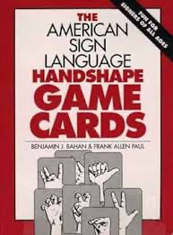
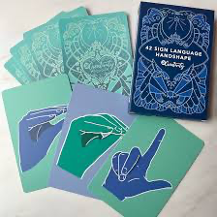
Expressive ASL Skills Activities
Rory’s Story Cubes (https://www.storycubes.com/en/)
Pick a picture based on student’s prior knowledge.
Description an object in the classroom and guess what object.
ASL Handshape Game Cards for multi-purpose

Slide 4
Receptive ASL Skills
This focuses on the student's ability to understand and comprehend ASL signs and sentences presented by others, such as teachers or peers, during classroom activities. The goal is for the student to accurately identify and interpret ASL communication in various contexts.

Slide 5
Receptive ASL Skills Activities
Read aloud a book**
ASL short story video** (youtube and in house ASL videos)
Train ASL short story (pair or small group)
Description an object or cartoon appearance and draw the picture match the description.
**Ask questions to check if students are following the video or story.

Slide 6
ASL Vocabulary Expansion
This involves actively learning new signs related to classroom content or everyday life and incorporating them into their communication. It's important for the student to continuously expand their ASL vocabulary to express a wider range of ideas and concepts effectively.

Slide 7
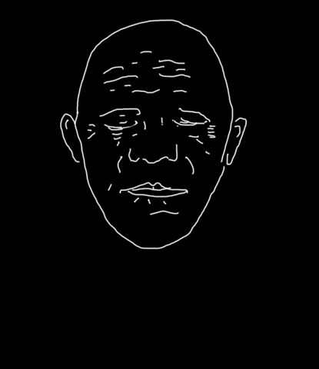
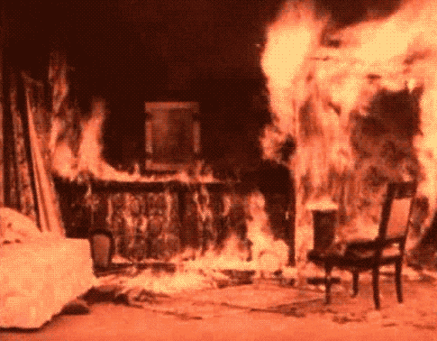

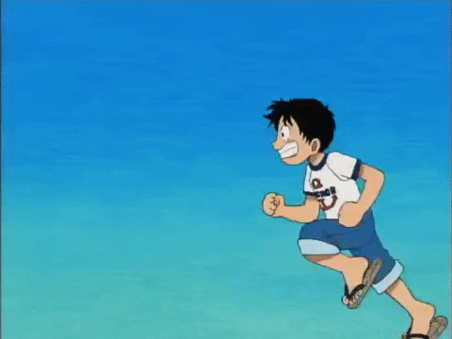

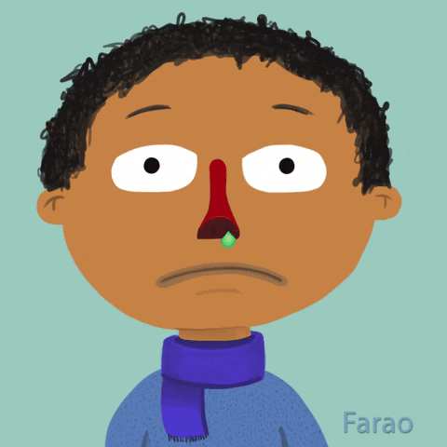
ASL Vocabulary Expansion Activities
Homonym (same word different sign)
Example- “GROW”
Example- “RUN”

Slide 8









ASL Vocabulary Expansion Activities, continued
Compound words

Slide 9
ASL Grammar and Syntax
This pertains to the student's understanding and application of the grammatical rules and sentence structure specific to ASL. Mastery of ASL grammar enables the student to construct sentences correctly and convey meaning accurately in their signed communication.

Slide 10
ASL Grammar and Syntax Activities
5 parameters
Handshape
Palm Orientation
Location
Movement
Non-manual signals

Slide 11
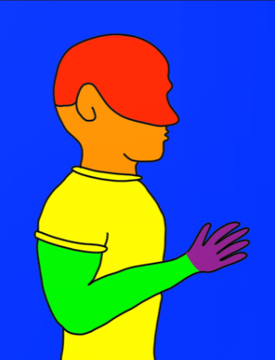
ASL Grammar and Syntax Activities, continued
Graphmes
Red-Signs are made on the forehead.
Orange-Signs are made at the chin, mouth, or nose.
Yellow- Signs are made at the chest
Green- Signs are made at the forearms and hands.
Blue- Signs are used to designate neutral parts of the body, not touching any body part.
Purple- Lexicalized fingerspelling

Slide 12
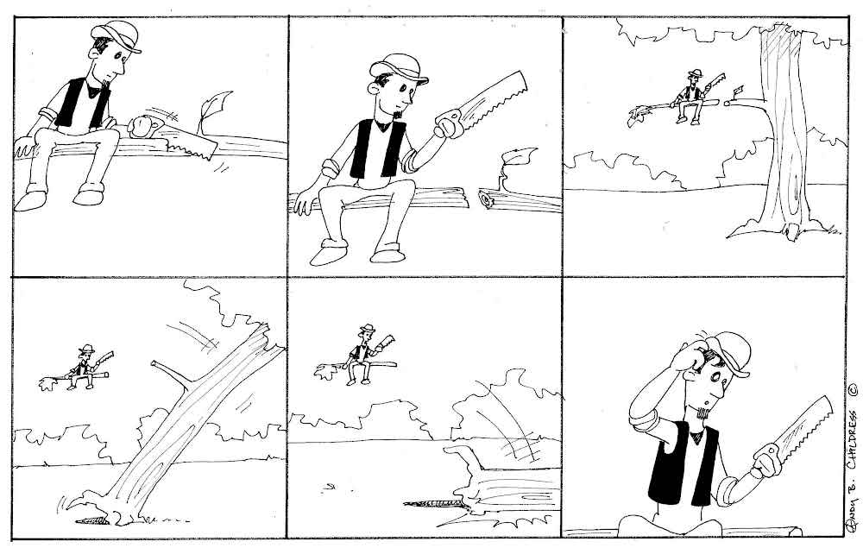
ASL Grammar and Syntax Activities, additional
Comic strip (wordless)

Slide 13
ASL Conversational Skills
This involves the student's ability to engage in meaningful exchanges using ASL, including initiating conversations, maintaining interaction, and appropriately responding to others. Developing conversational skills is crucial for effective communication and social interaction in various settings.

Slide 14
ASL Conversational Skills Activities
Generate a topic for students to engage in a conversation about.
Create an opportunity for students to initiate the conversation in order to gather data for their bar graph. (For example: "Which option would you prefer: pizza or chicken tenders?")
Create a video conversation between two characters, students viewing each other’s videos.

Slide 15
ASL Viewing Skills (reading)
This includes watching ASL videos, attending signed presentations or lectures, reading ASL literature, and interpreting visual texts presented in ASL. Strengthening ASL viewing skills involves improving one's ability to understand and interpret the language accurately, recognize different signing styles, comprehend linguistic nuances, and understand the cultural context of Deaf communication. These skills are essential for individuals learning ASL to effectively engage with the Deaf community, participate in ASL-based activities, and develop fluency in sign language.

Slide 16
ASL Viewing Skills (reading) Activities
Create several videos and/or find ASL videos on youtube
Plot hole
Identify incorrect animals, objects, or other elements in the video.
identify emotions in the video
Compare two same videos and look for the missing details.

Slide 17
ASL Viewing Skills (reading) Activities, continued
Questions:
Who is the main character of the video?
What is the setting of the video?
Can you describe the climax of the video?
What happens at the end of the video?
Can add other questions to match students’ IEP objectives/goals

Slide 18
Deaf Cultural Awareness
This focuses on the student's understanding and appreciation of Deaf culture, history, traditions, and current events. Participating in discussions, presentations, or projects related to Deaf culture helps the student develop cultural competence and a deeper connection to the Deaf community.

Slide 19
Deaf Cultural Awareness Activities
Deaf Culture Workshops
Students could learn about famous deaf individuals, watch deaf cinema, or explore deaf literature.
Simulation Activities
Students can try communicating with each other using only ASL and/or gestures or by wearing earplugs to simulate hearing loss. This can help Deaf students’ peers gain empathy and understanding of the challenges faced by deaf individuals.

Slide 20
Deaf Cultural Awareness Activities, continued
Deaf History Projects
Assign projects where students research and present on different aspects of deaf history, including key events, figures, and milestones in the deaf community's struggle for recognition and rights.
ASL Slangs

Slide 21
ASL (Deaf) Advocacy and Self-Advocacy
This involves empowering the student to advocate for their needs, preferences, and rights within the ASL community. It includes effectively communicating with peers, teachers, and other stakeholders about their ASL learning journey and accessibility requirements, fostering self-advocacy skills and promoting inclusivity.

Slide 22
ASL (Deaf) Advocacy and Self-Advocacy Activities
Learn how to effectively request accommodations to meet their needs in appointments, the workplace, and other settings to ensure accessibility.
Learn how to utilize communication tools such as VideoPhone, relay services, and enable closed captions.
Call a specific movie theatre or event organizer to request an interpreter for the Deaf community.
Interview Deaf adults for their advice on navigating the hearing world to become better self-advocates as Deaf individuals
Share your voice to get your needs related to accessing information at home or school.

Slide 23
Questions?
Thank you!
Lance Gonzalez
Lance.Gonzalez@msa.state.mn.us

